Slide 1
CHAPTER 9 GAS POWER CYCLES
Thermodynamics: An Engineering Approach
8th Edition Yunus A. Çengel, Michael A. Boles
McGraw-Hill, 2015
Adapted from the lecture slides by Mehmet Kanoglu Copyright © The McGraw-Hill Education.
Permission required for reproduction or display.

Slide 2
Objectives
Evaluate the performance of gas power cycles for which the working fluid remains a gas throughout the entire cycle.
Develop simplifying assumptions applicable to gas power cycles.
Review the operation of reciprocating engines.
Analyze both closed and open gas power cycles.
Solve problems based on the Otto, Diesel, Stirling, and Ericsson cycles.
Solve problems based on the Brayton cycle; the Brayton cycle with regeneration; and the Brayton cycle with intercooling, reheating, and regeneration.
Analyze jet-propulsion cycles.
Identify simplifying assumptions for second-law analysis of gas power cycles.
Perform second-law analysis of gas power cycles.

Slide 3
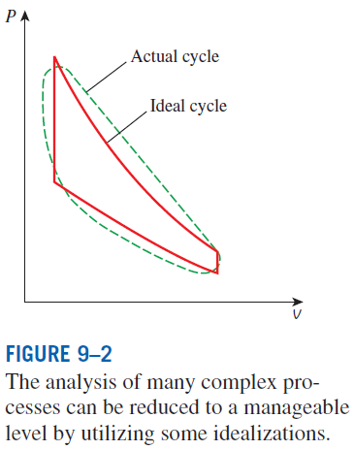
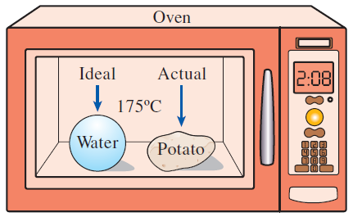
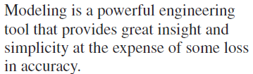
BASIC CONSIDERATIONS IN THE ANALYSIS OF POWER CYCLES
Thermal efficiency of heat engines:
Most power-producing devices operate on cycles.
Ideal cycle: A cycle that resembles the actual cycle closely but is made up totally of internally reversible processes is called an.
Reversible cycles such as Carnot cycle have the highest thermal efficiency of all heat engines operating between the same temperature levels. Unlike ideal cycles, they are totally reversible, and unsuitable as a realistic model.

Slide 4
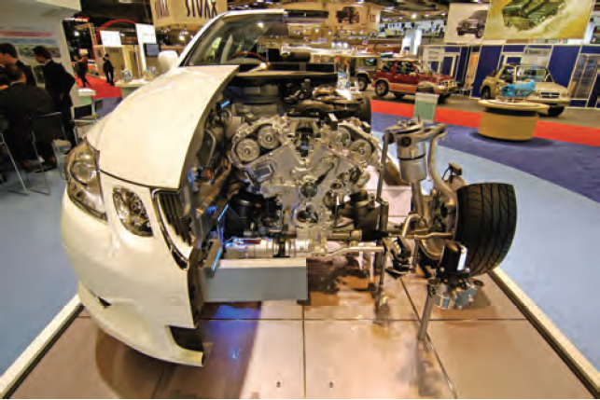
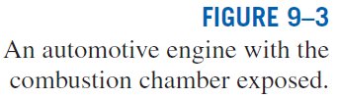
The ideal cycles are internally reversible, but, unlike the Carnot cycle, they are not necessarily externally reversible.
Therefore, the thermal efficiency of an ideal cycle, in general, is less than that of a totally reversible cycle operating between the same temperature limits.
However, it is still considerably higher than the thermal efficiency of an actual cycle because of the idealizations utilized.

Slide 5
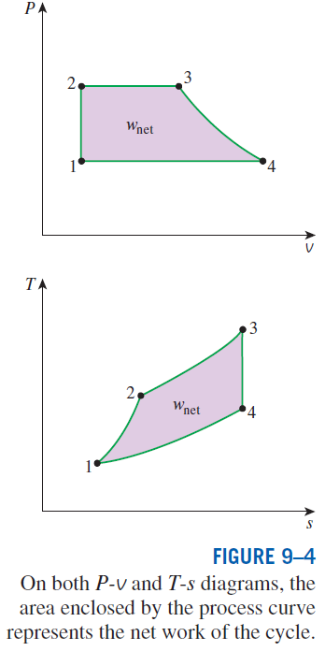
The idealizations and simplifications in the analysis of power cycles:
The cycle does not involve any friction. Therefore, the working fluid does not experience any pressure drop as it flows in pipes or devices such as heat exchangers.
All expansion and compression processes take place in a quasi-equilibrium manner.
The pipes connecting the various components of a system are well insulated, and heat transfer through them is negligible.
On a T-s diagram, the ratio of the area enclosed by the cyclic curve to the area under the heat-addition process curve represents the thermal efficiency of the cycle.
Any modification that increases the ratio of these two areas will also increase the thermal efficiency of the cycle.

Slide 6
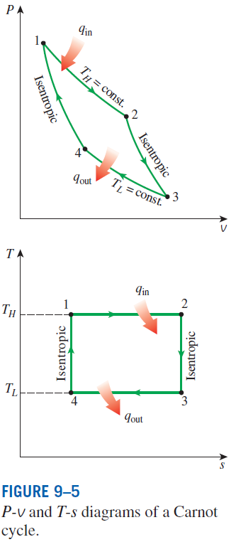

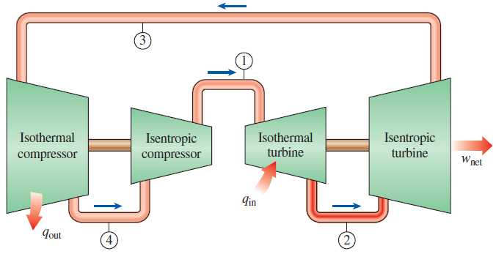
THE CARNOT CYCLE AND ITS VALUE IN ENGINEERING
The Carnot cycle is composed of four totally reversible processes: isothermal heat addition, isentropic expansion, isothermal heat rejection, and isentropic compression.
For both ideal and actual cycles: Thermal efficiency increases with an increase in the average temperature at which heat is supplied to the system or with a decrease in the average temperature at which heat is rejected from the system.
A steady-flow Carnot engine.

Slide 7
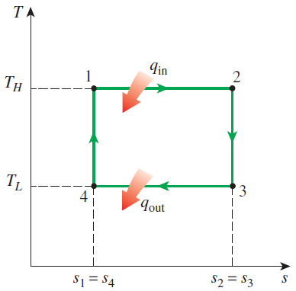



Derivation of the Efficiency of the Carnot Cycle

Slide 8
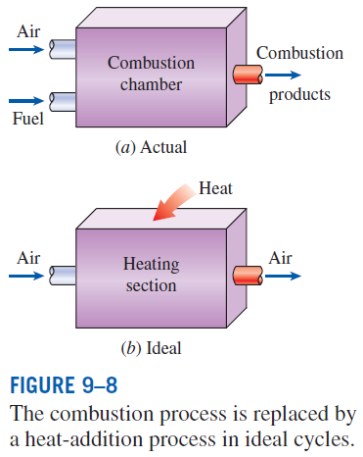
AIR-STANDARD ASSUMPTIONS
Air-standard assumptions:
The working fluid is air, which continuously circulates in a closed loop and always behaves as an ideal gas.
All the processes that make up the cycle are internally reversible.
The combustion process is replaced by a heat-addition process from an external source.
The exhaust process is replaced by a heat-rejection process that restores the working fluid to its initial state.
Cold-air-standard assumptions: When the working fluid is considered to be air with constant specific heats at room temperature (25°C).
Air-standard cycle: A cycle for which the air-standard assumptions are applicable.

Slide 9
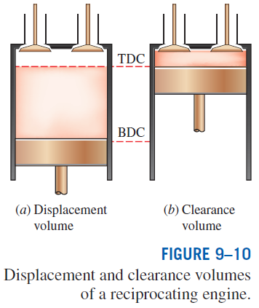
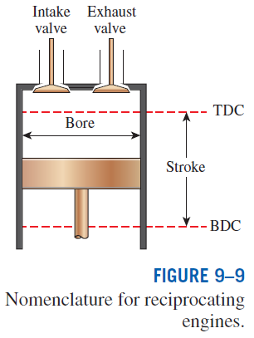
AN OVERVIEW OF RECIPROCATING ENGINES
Compression ratio
Spark-ignition (SI) engines
Compression-ignition (CI) engines

