Slide 1
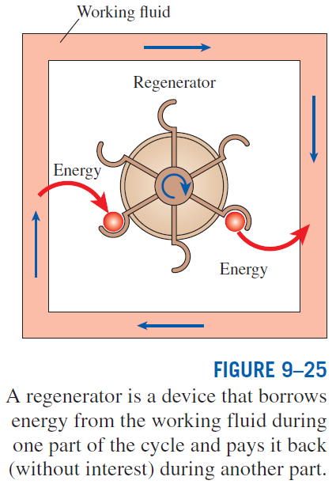
STIRLING AND ERICSSON CYCLES
Stirling cycle
1-2 T = constant expansion (heat addition from the external source)
2-3 v = constant regeneration (internal heat transfer from the working fluid to the regenerator)
3-4 T = constant compression (heat rejection to the external sink)
4-1 v = constant regeneration (internal heat transfer from the regenerator back to the working fluid)

Slide 2
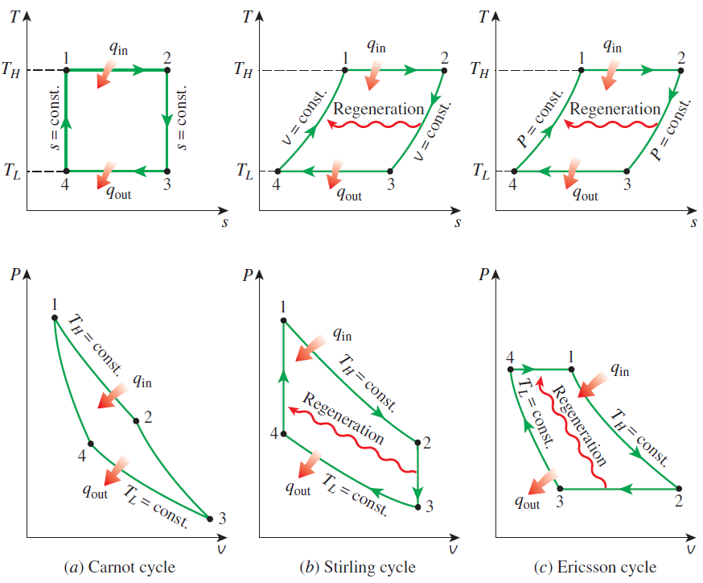
T-s and P-v diagrams of Carnot, Stirling, and Ericsson cycles.

Slide 3
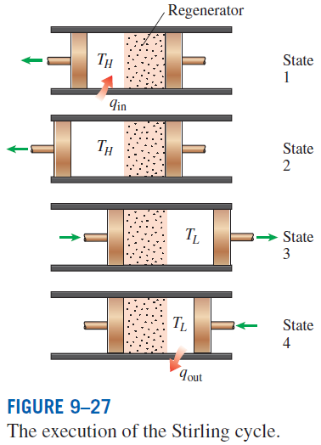
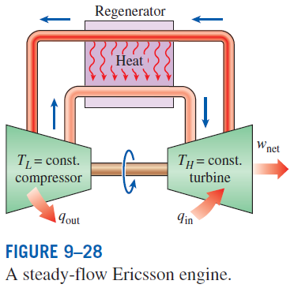
The Stirling and Ericsson cycles give a message: Regeneration can increase efficiency.
Both the Stirling and Ericsson cycles are totally reversible, as is the Carnot cycle, and thus:
The Ericsson cycle is very much like the Stirling cycle, except that the two constant-volume processes are replaced by two constant-pressure processes.

Slide 4
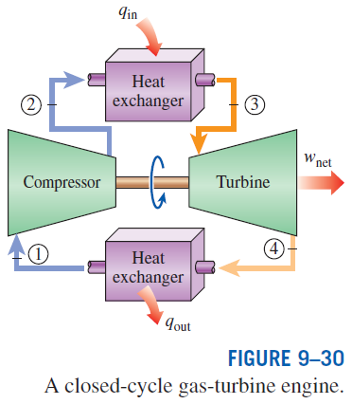
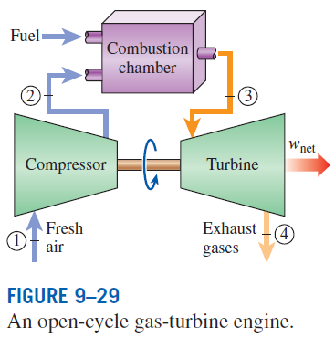
BRAYTON CYCLE: THE IDEAL CYCLE FOR GAS-TURBINE ENGINES
The combustion process is replaced by a constant-pressure heat-addition process from an external source, and the exhaust process is replaced by a constant-pressure heat-rejection process to the ambient air.
1-2 Isentropic compression (in a compressor)
2-3 Constant-pressure heat addition
3-4 Isentropic expansion (in a turbine)
4-1 Constant-pressure heat rejection

Slide 5
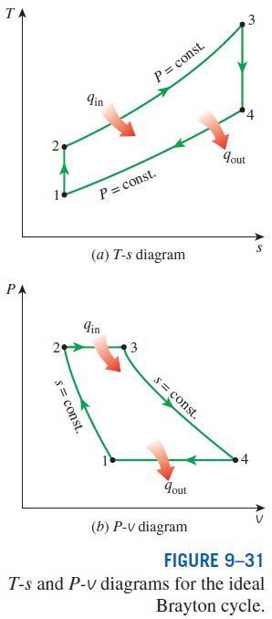

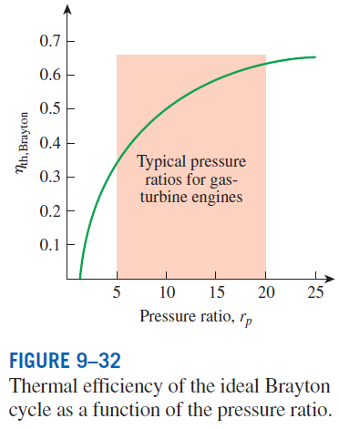

Pressure ratio

Slide 6
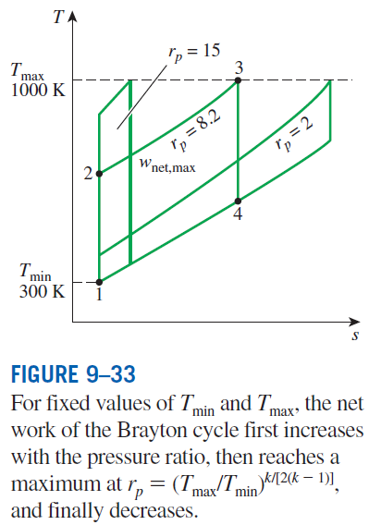
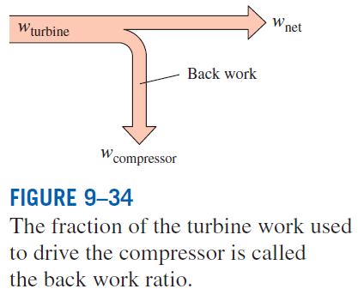
The two major application areas of gas-turbine engines are aircraft propulsion and electric power generation.
The highest temperature in the cycle is limited by the maximum temperature that the turbine blades can withstand. This also limits the pressure ratios that can be used in the cycle.
The air in gas turbines supplies the necessary oxidant for the combustion of the fuel, and it serves as a coolant to keep the temperature of various components within safe limits. An air–fuel ratio of 50 or above is not uncommon.

Slide 7
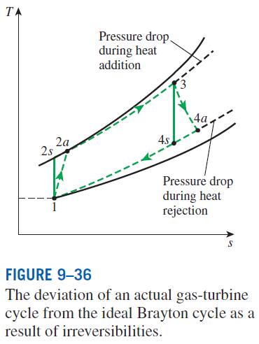
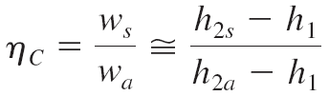
Development of Gas Turbines
Increasing the turbine inlet (or firing) temperatures
Increasing the efficiencies of turbomachinery components (turbines, compressors):
Adding modifications to the basic cycle (intercooling, regeneration or recuperation, and reheating).
Deviation of Actual Gas-Turbine Cycles from Idealized Ones
Reasons: Irreversibilities in turbine and compressors, pressure drops, heat losses
Isentropic efficiencies of the compressor and turbine

Slide 8
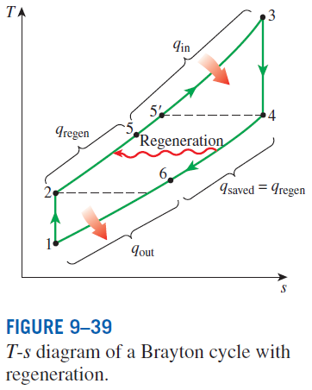
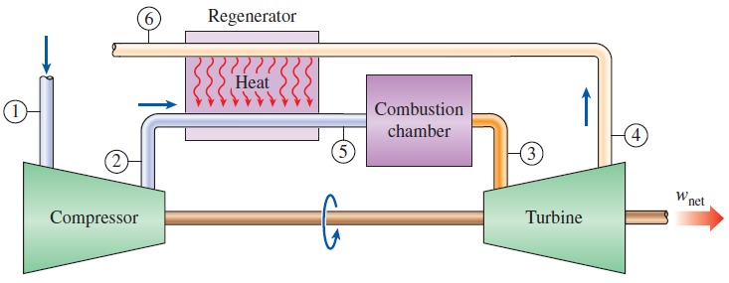
THE BRAYTON CYCLE WITH REGENERATION
In gas-turbine engines, the temperature of the exhaust gas leaving the turbine is often considerably higher than the temperature of the air leaving the compressor.
Therefore, the high-pressure air leaving the compressor can be heated by the hot exhaust gases in a counter-flow heat exchanger (a regenerator or a recuperator).
The thermal efficiency of the Brayton cycle increases as a result of regeneration since less fuel is used for the same work output.
A gas-turbine engine with regenerator.

Slide 9
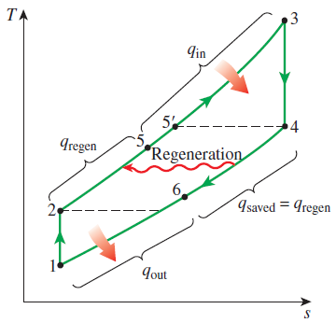
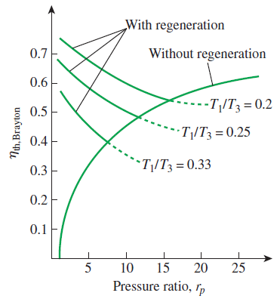
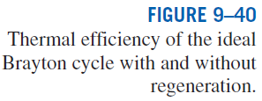
Effectiveness of regenerator
Effectiveness under cold-air standard assumptions
Under cold-air standard assumptions
The thermal efficiency depends on the ratio of the minimum to maximum temperatures as well as the pressure ratio.
Regeneration is most effective at lower pressure ratios and low minimum-to-maximum temperature ratios.
Can regeneration be used at high pressure ratios?

Slide 10
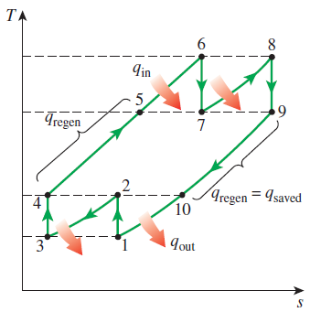
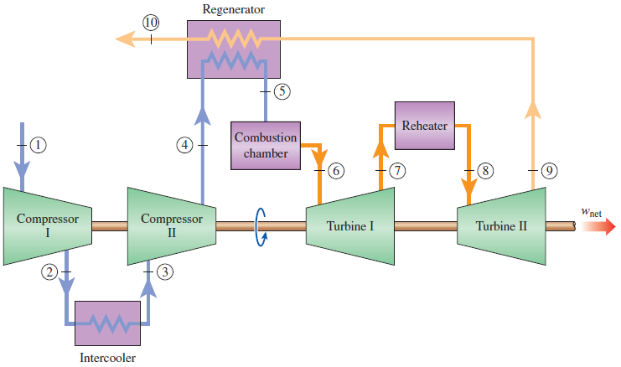

THE BRAYTON CYCLE WITH INTERCOOLING, REHEATING, AND REGENERATION
For minimizing work input to compressor and maximizing work output from turbine:
T-s diagram of an ideal gas-turbine cycle with intercooling, reheating, and regeneration.

Slide 11
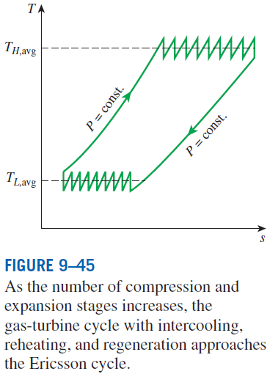
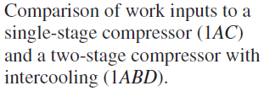
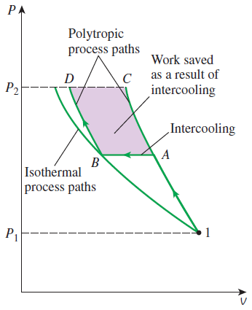
Multistage compression with intercooling: The work required to compress a gas between two specified pressures can be decreased by carrying out the compression process in stages and cooling the gas in between. This keeps the specific volume as low as possible.
Multistage expansion with reheating keeps the specific volume of the working fluid as high as possible during an expansion process, thus maximizing work output.
Intercooling and reheating always decreases the thermal efficiency unless they are accompanied by regeneration. Why?

Slide 12
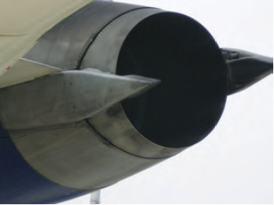
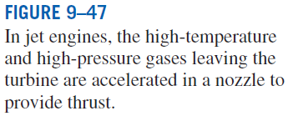
IDEAL JET-PROPULSION CYCLES
Gas-turbine engines are widely used to power aircraft because they are light and compact and have a high power-to-weight ratio.
Aircraft gas turbines operate on an open cycle called a jet-propulsion cycle.
The ideal jet-propulsion cycle differs from the simple ideal Brayton cycle in that the gases are not expanded to the ambient pressure in the turbine. Instead, they are expanded to a pressure such that the power produced by the turbine is just sufficient to drive the compressor and the auxiliary equipment.
The net work output of a jet-propulsion cycle is zero. The gases that exit the turbine at a relatively high pressure are subsequently accelerated in a nozzle to provide the thrust to propel the aircraft.
Aircraft are propelled by accelerating a fluid in the opposite direction to motion. This is accomplished by either slightly accelerating a large mass of fluid (propeller-driven engine) or greatly accelerating a small mass of fluid (jet or turbojet engine) or both (turboprop engine).

Slide 13
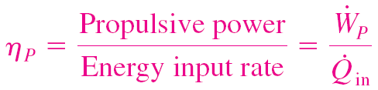
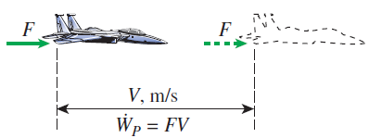
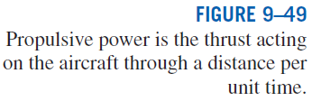
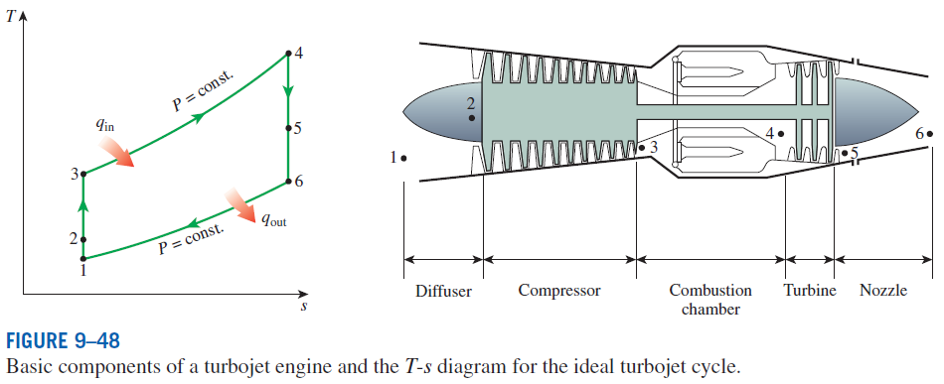
Thrust (propulsive force)
Propulsive efficiency
Propulsive power

Slide 14
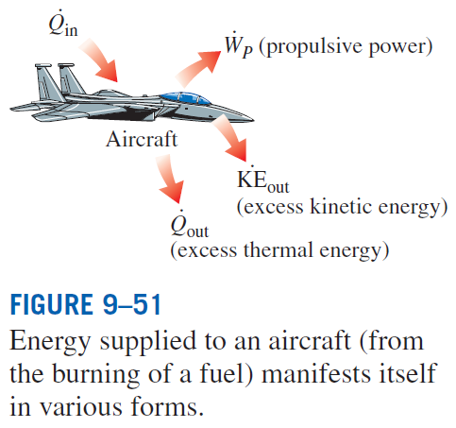

Slide 15
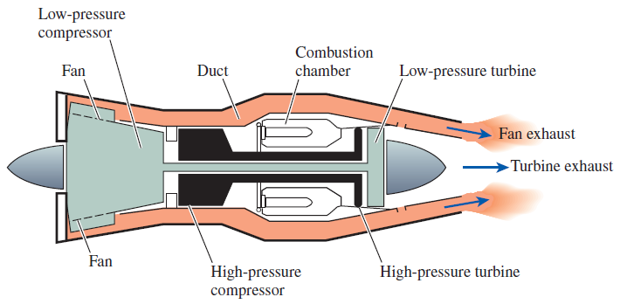

Modifications to Turbojet Engines
The first airplanes built were all propeller-driven, with propellers powered by engines essentially identical to automobile engines.
Both propeller-driven engines and jet-propulsion-driven engines have their own strengths and limitations, and several attempts have been made to combine the desirable characteristics of both in one engine.
Two such modifications are the propjet engine and the turbofan engine.
The most widely used engine in aircraft propulsion is the turbofan (or fanjet) engine wherein a large fan driven by the turbine forces a considerable amount of air through a duct (cowl) surrounding the engine.

Slide 16
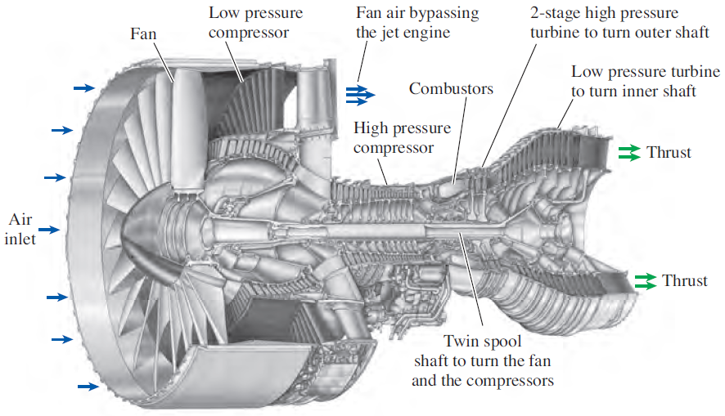
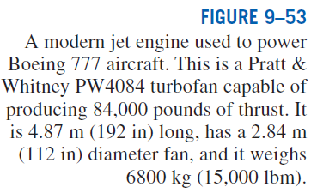

Slide 17
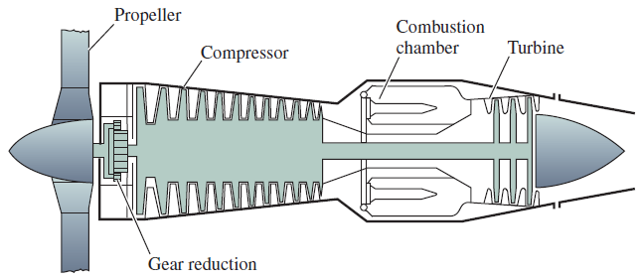

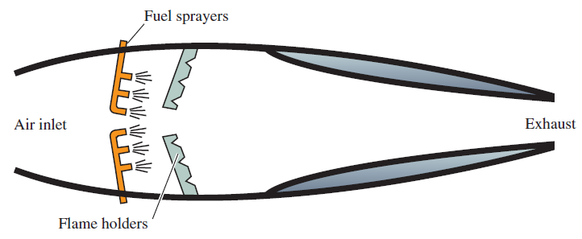

Various engine types:
Turbofan, Propjet, Ramjet, Sacramjet, Rocket

Slide 18
SECOND-LAW ANALYSIS OF GAS POWER CYCLES
Exergy destruction for a closed system
For a steady-flow system
Steady-flow, one-inlet, one-exit
Exergy destruction of a cycle
For a cycle with heat transfer only with a source and a sink
Closed system exergy
Stream exergy
A second-law analysis of these cycles reveals where the largest irreversibilities occur and where to start improvements.

Slide 19
Summary
Basic considerations in the analysis of power cycles
The Carnot cycle and its value in engineering
Air-standard sssumptions
An overview of reciprocating engines
Otto cycle: The ideal cycle for spark-ignition engines
Diesel cycle: The ideal cycle for compression-ignition engines
Stirling and Ericsson cycles
Brayton cycle: The ideal cycle for gas-turbine engines
The Brayton cycle with regeneration
The Brayton cycle with intercooling, reheating, and regeneration
Ideal jet-propulsion cycles
Second-law analysis of gas power cycles

