Slide 1
CHAPTER 10 VAPOR AND COMBINED POWER CYCLES
Thermodynamics: An Engineering Approach
8th Edition Yunus A. Çengel, Michael A. Boles
McGraw-Hill, 2015
Adapted from the lecture slides by Mehmet Kanoglu Copyright © The McGraw-Hill Education.
Permission required for reproduction or display.

Slide 2
Objectives
Evaluate the performance of gas power cycles for which the working fluid remains a gas throughout the entire cycle.
Analyze vapor power cycles in which the working fluid is alternately vaporized and condensed.
Analyze power generation coupled with process heating called cogeneration.
Investigate ways to modify the basic Rankine vapor power cycle to increase the cycle thermal efficiency.
Analyze the reheat and regenerative vapor power cycles.
Analyze power cycles that consist of two separate cycles known as combined cycles.

Slide 3

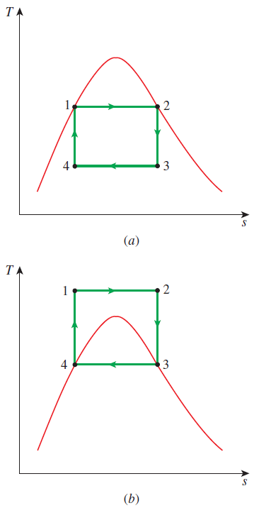
THE CARNOT VAPOR CYCLE
The Carnot cycle is the most efficient cycle operating between two specified temperature limits but it is not a suitable model for power cycles. Because:
Process 1-2 Limiting the heat transfer processes to two-phase systems severely limits the maximum temperature that can be used in the cycle (374°C for water)
Process 2-3 The turbine cannot handle steam with a high moisture content because of the impingement of liquid droplets on the turbine blades causing erosion and wear.
Process 4-1 It is not practical to design a compressor that handles two phases.
The cycle in (b) is not suitable since it requires isentropic compression to extremely high pressures and isothermal heat transfer at variable pressures.
1-2 isothermal heat addition in a boiler
2-3 isentropic expansion in a turbine
3-4 isothermal heat rejection in a condenser
4-1 isentropic compression in a compressor

Slide 4
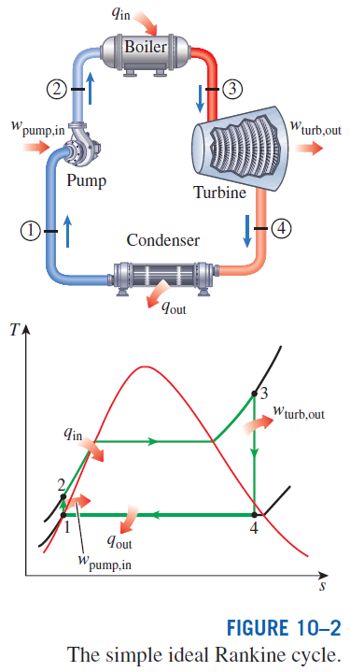
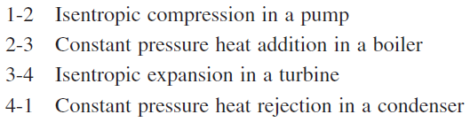
RANKINE CYCLE: THE IDEAL CYCLE FOR VAPOR POWER CYCLES
Many of the impracticalities associated with the Carnot cycle can be eliminated by superheating the steam in the boiler and condensing it completely in the condenser.
The cycle that results is the Rankine cycle, which is the ideal cycle for vapor power plants. The ideal Rankine cycle does not involve any internal irreversibilities.

Slide 5
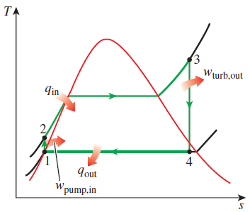


Energy Analysis of the Ideal Rankine Cycle
Steady-flow energy equation
The efficiency of power plants in the U.S. is often expressed in terms of heat rate, which is the amount of heat supplied, in Btu’s, to generate 1 kWh of electricity.
The thermal efficiency can be interpreted as the ratio of the area enclosed by the cycle on a T-s diagram to the area under the heat-addition process.

Slide 6
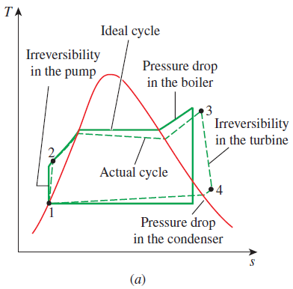
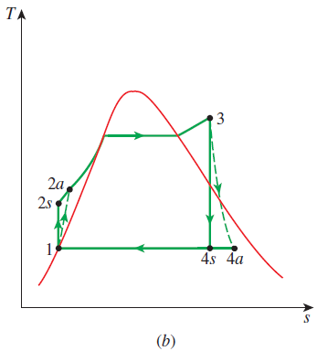
DEVIATION OF ACTUAL VAPOR POWER CYCLES FROM IDEALIZED ONES
The actual vapor power cycle differs from the ideal Rankine cycle as a result of irreversibilities in various components.
Fluid friction and heat loss to the surroundings are the two common sources of irreversibilities.
Isentropic efficiencies
(a) Deviation of actual vapor power cycle from the ideal Rankine cycle. (b) The effect of pump and turbine irreversibilities on the ideal Rankine cycle.

Slide 7
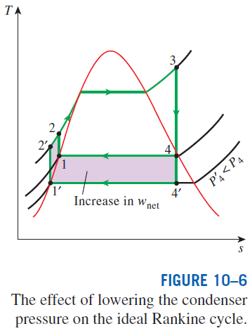
HOW CAN WE INCREASE THE EFFICIENCY OF THE RANKINE CYCLE?
The basic idea behind all the modifications to increase the thermal efficiency
of a power cycle is the same: Increase the average temperature at which heat is transferred to the working fluid in the boiler, or decrease the average temperature at which heat is rejected from the working fluid in the condenser.
Lowering the Condenser Pressure (Lowers T_{low,avg})
To take advantage of the increased efficiencies at low pressures, the condensers of steam power plants usually operate well below the atmospheric pressure. There is a lower limit to this pressure depending on the temperature of the cooling medium
Side effect: Lowering the condenser pressure increases the moisture content of the steam at the final stages of the turbine.

Slide 8
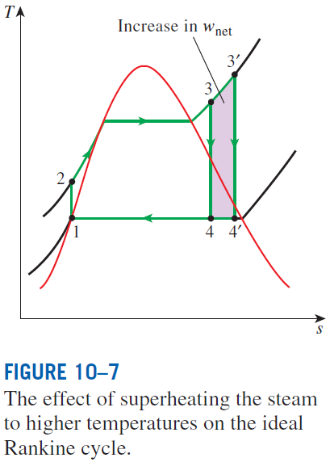
Superheating the Steam to High Temperatures (Increases T_{high,avg})
Both the net work and heat input increase as a result of superheating the steam to a higher temperature. The overall effect is an increase in thermal efficiency since the average temperature at which heat is added increases.
Superheating to higher temperatures decreases the moisture content of the steam at the turbine exit, which is desirable.
The temperature is limited by metallurgical considerations. Presently the highest steam temperature allowed at the turbine inlet is about 620°C.

Slide 9
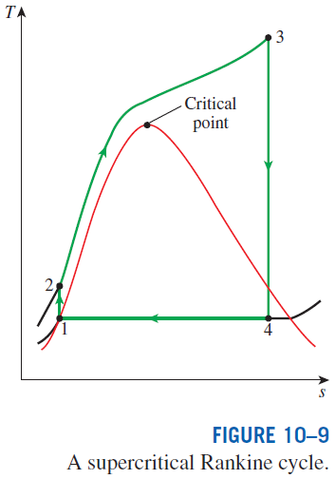
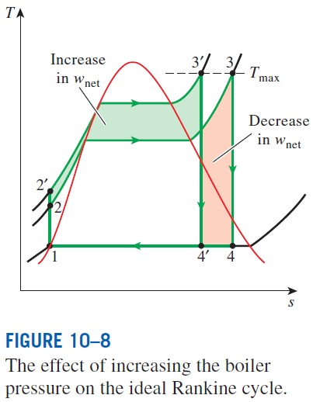
Increasing the Boiler Pressure (Increases T_{high,avg})
Today many modern steam power plants operate at supercritical pressures (P > 22.06 MPa) and have thermal efficiencies of about 40% for fossil-fuel plants and 34% for nuclear plants.
For a fixed turbine inlet temperature, the cycle shifts to the left and the moisture content of steam at the turbine exit increases. This side effect can be corrected by reheating the steam.

Slide 10

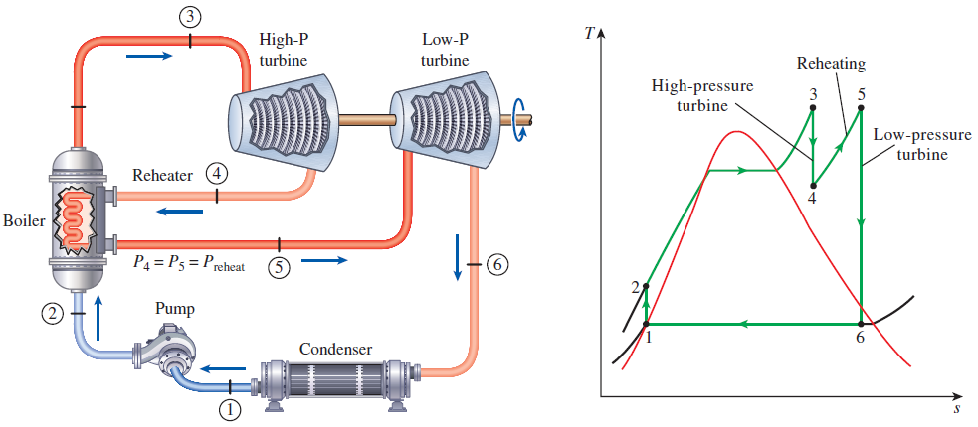
THE IDEAL REHEAT RANKINE CYCLE
How can we take advantage of the increased efficiencies at higher boiler pressures without facing the problem of excessive moisture at the final stages of the turbine?
1. Superheat the steam to very high temperatures. It is limited metallurgically.
2. Expand the steam in the turbine in two stages, and reheat it in between (reheat)

Slide 11
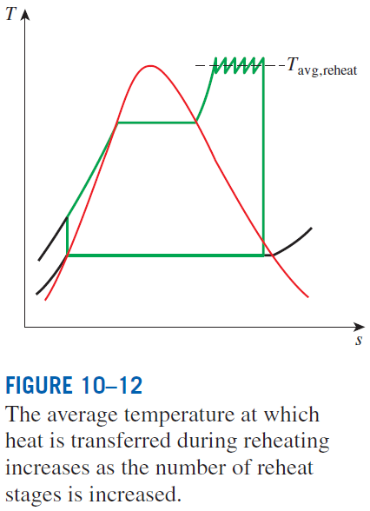
The single reheat in a modern power plant improves the cycle efficiency by 4 to 5% by increasing the average temperature at which heat is transferred to the steam.
The average temperature during the reheat process can be increased by increasing the number of expansion and reheat stages. As the number of stages is increased, the expansion and reheat processes approach an isothermal process at the maximum temperature. The use of more than two reheat stages is not practical. The theoretical improvement in efficiency from the second reheat is about half of that which results from a single reheat.
The reheat temperatures are very close or equal to the turbine inlet temperature.
The optimum reheat pressure is about one-fourth of the maximum cycle pressure.

Slide 12
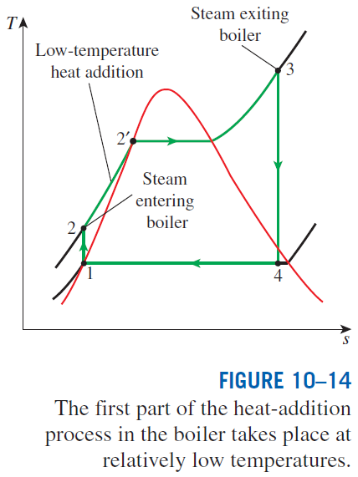
THE IDEAL REGENERATIVE RANKINE CYCLE
Heat is transferred to the working fluid during process 2-2’ at a relatively low temperature. This increases the average (outside) heat-addition temperature and thus the cycle efficiency.
In steam power plants, steam is extracted from the turbine at various points. This steam, which could have produced more work by expanding further in the turbine, is used to heat the feedwater instead. The device where the feedwater is heated by regeneration is called a regenerator, or a feedwater heater (FWH).
A feedwater heater is basically a heat exchanger where heat is transferred from the steam to the feedwater either by mixing the two fluid streams (open feedwater heaters) or without mixing them (closed feedwater heaters).

Slide 13
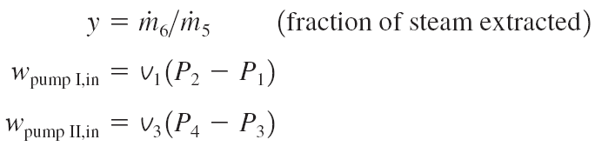
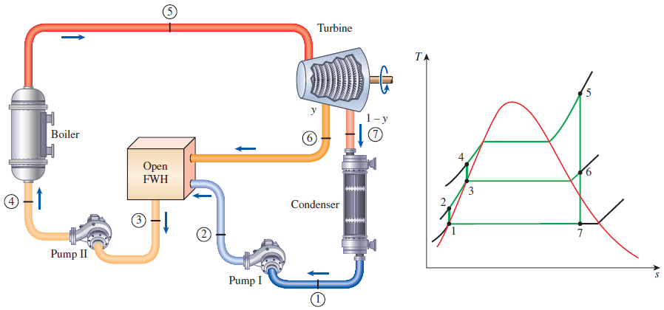
Open Feedwater Heaters
An open (or direct-contact) feedwater heater is basically a mixing chamber, where the steam extracted from the turbine mixes with the feedwater exiting the pump. Ideally, the mixture leaves the heater as a saturated liquid at the heater pressure.
The ideal regenerative Rankine cycle with an open feedwater heater.

