Slide 1
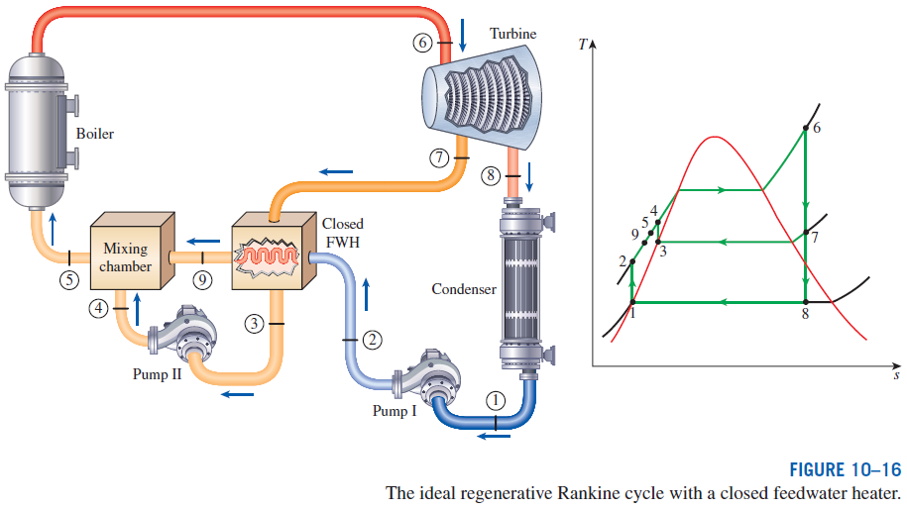
Closed Feedwater Heaters
Another type of feedwater heater frequently used in steam power plants is
the closed feedwater heater, in which heat is transferred from the extracted steam to the feedwater without any mixing taking place. The two streams now can be at different pressures, since they do not mix.

Slide 2
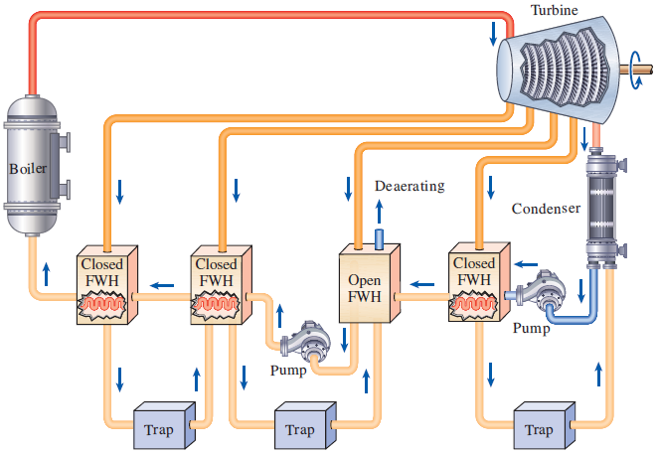
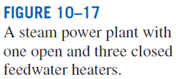
The closed feedwater heaters are more complex because of the internal tubing network, and thus they are more expensive. Heat transfer in closed feedwater heaters is less effective since the two streams are not allowed to be in direct contact. However, closed feedwater heaters do not require a separate pump for each heater since the extracted steam and the feedwater can be at different pressures.
Open feedwater heaters are simple and inexpensive and have good heat transfer characteristics. For each heater, however, a pump is required to handle the feedwater.
Most steam power plants use a combination of open and closed feedwater heaters.

Slide 3
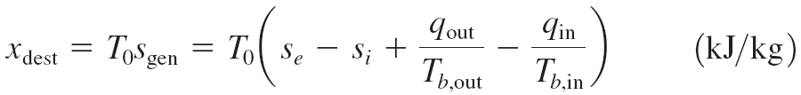
SECOND-LAW ANALYSIS OF VAPOR POWER CYCLES
Exergy destruction for a steady-flow system
Steady-flow, one-inlet, one-exit
Exergy destruction of a cycle
For a cycle with heat transfer only with a source and a sink
Stream exergy
A second-law analysis of vaporpower cycles reveals where the largest irreversibilities occur and where to start improvements.

Slide 4
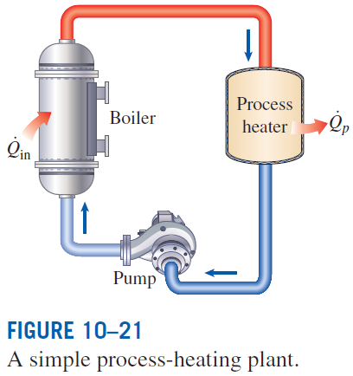
COGENERATION
Many industries require energy input in the form of heat, called process heat. Process heat in these industries is usually supplied by steam at 5 to 7 atm and 150 to 200°C. Energy is usually transferred to the steam by burning coal, oil, natural gas, or another fuel in a furnace.
Industries that use large amounts of process heat also consume a large amount of electric power.
It makes sense to use the already-existing work potential to produce power instead of letting it go to waste.
The result is a plant that produces electricity while meeting the process-heat requirements of certain industrial processes (cogeneration plant)
Cogeneration: The production of more than one useful form of energy (such as process heat and electric power) from the same energy source.

Slide 5

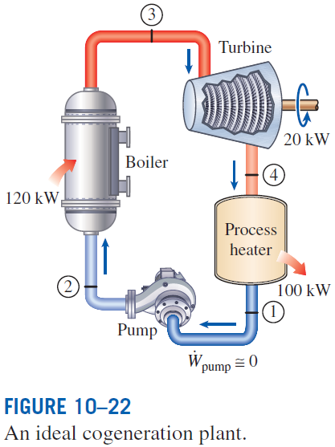

Utilization factor
The utilization factor of the ideal steam-turbine cogeneration plant is 100%.
Actual cogeneration plants have utilization factors as high as 80%.
Some recent cogeneration plants have even higher utilization factors.

Slide 6
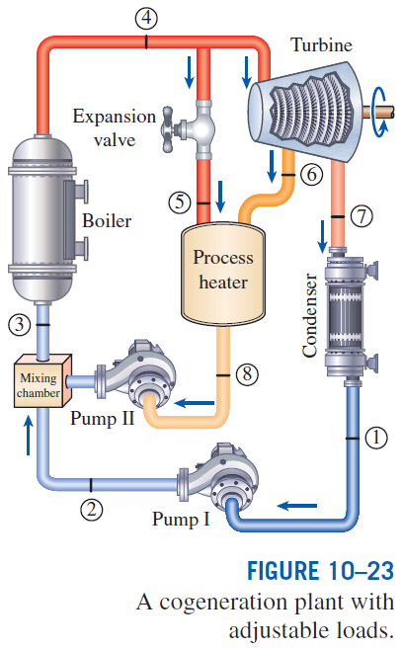
At times of high demand for process heat, all the steam is routed to the process-heating units and none to the condenser (m₇= 0). The waste heat is zero in this mode.
If this is not sufficient, some steam leaving the boiler is throttled by an expansion or pressure-reducing valve to the extraction pressure P₆ and is directed to the process-heating unit.
Maximum process heating is realized when all the steam leaving the boiler passes through the PRV (m₅= m₄). No power is produced in this mode.
When there is no demand for process heat, all the steam passes through the turbine and the condenser (m₅=m₆=0), and the cogeneration plant operates as an ordinary steam power plant.

Slide 7
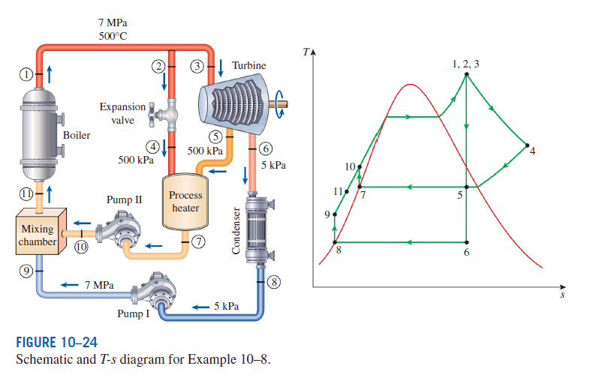
COGENERATION – Process Diagram

Slide 8
COMBINED GAS–VAPOR POWER CYCLES
The continued quest for higher thermal efficiencies has resulted in rather innovative modifications to conventional power plants.
A popular modification involves a gas power cycle topping a vapor power cycle, which is called the combined gas–vapor cycle, or just the combined cycle.
The combined cycle of greatest interest is the gas-turbine (Brayton) cycle topping a steam-turbine (Rankine) cycle, which has a higher thermal efficiency than either of the cycles executed individually.
It makes engineering sense to take advantage of the very desirable characteristics of the gas-turbine cycle at high temperatures and to use the high-temperature exhaust gases as the energy source for the bottoming cycle such as a steam power cycle. The result is a combined gas–steam cycle.
Recent developments in gas-turbine technology have made the combined gas–steam cycle economically very attractive.
The combined cycle increases the efficiency without increasing the initial cost greatly. Consequently, many new power plants operate on combined cycles, and many more existing steam- or gas-turbine plants are being converted to combined-cycle power plants.
Thermal efficiencies over 50% are reported.

Slide 9
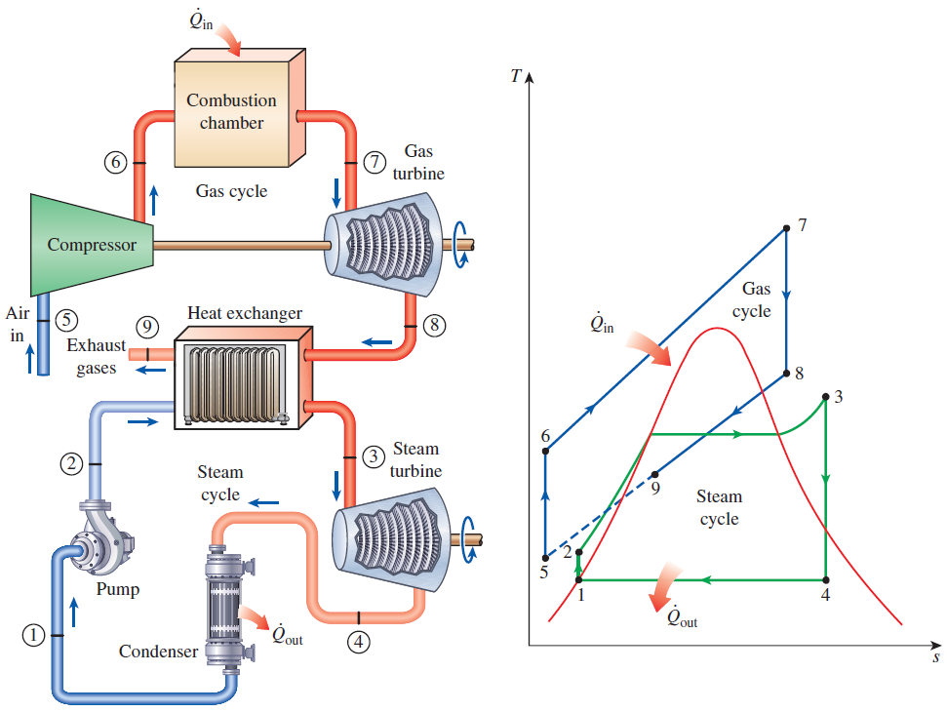


Slide 10
Summary
The Carnot vapor cycle
Rankine cycle: The ideal cycle for vapor power cycles
Energy analysis of the ideal Rankine cycle
Deviation of actual vapor power cycles from idealized ones
How can we increase the efficiency of the Rankine cycle?
Lowering the condenser pressure (Lowers T_{low,avg})
Superheating the steam to high temperatures (Increases T_{high,avg})
Increasing the boiler pressure (Increases T_{high,avg})
The ideal reheat Rankine cycle
The ideal regenerative Rankine cycle
Open feedwater heaters
Closed feedwater heaters
Second-law analysis of vapor power cycles
Cogeneration
Combined gas–vapor power cycles

