Slide 1
CHAPTER 11 REFRIGERATION CYCLES
Thermodynamics: An Engineering Approach
8th Edition Yunus A. Çengel, Michael A. Boles
McGraw-Hill, 2015
Adapted from the lecture slides by Mehmet Kanoglu Copyright © The McGraw-Hill Education.
Permission required for reproduction or display.

Slide 2
Objectives
Introduce the concepts of refrigerators and heat pumps and the measure of their performance.
Analyze the ideal vapor-compression refrigeration cycle.
Analyze the actual vapor-compression refrigeration cycle.
Review the factors involved in selecting the right refrigerant for an application.
Discuss the operation of refrigeration and heat pump systems.
Evaluate the performance of innovative vapor-compression refrigeration systems.
Analyze gas refrigeration systems.
Introduce the concepts of absorption-refrigeration systems.

Slide 3
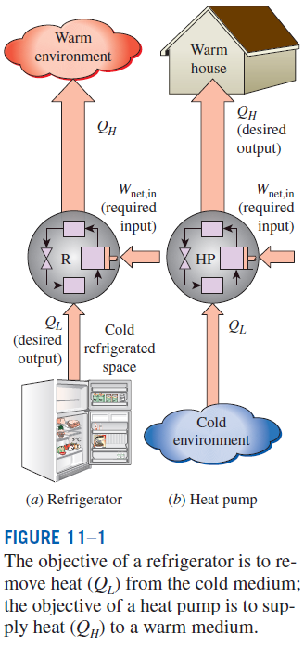
REFRIGERATORS AND HEAT PUMPS
The transfer of heat from a low-temperature region to a high-temperature one requires special devices called refrigerators.
Another device that transfers heat from a low-temperature medium to a high-temperature one is the heat pump.
Refrigerators and heat pumps are essentially the same devices; they differ in their objectives only.
for fixed values of Q_{L} and Q_{H}

Slide 4
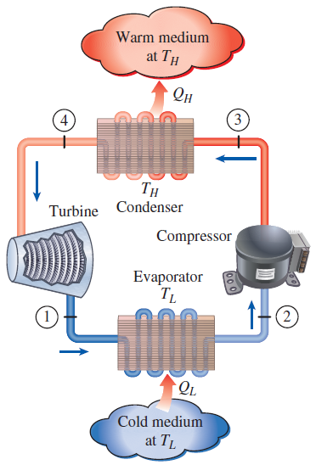

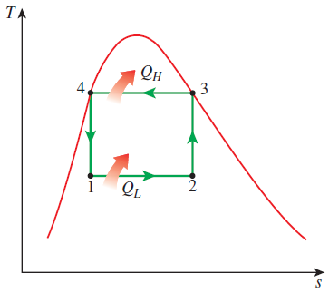
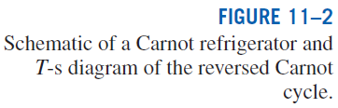
THE REVERSED CARNOT CYCLE
The reversed Carnot cycle is the most efficient refrig. cycle operating between T_{L} and T_{H}.
It is not a suitable model for refrigeration cycles since processes 2-3 and 4-1 are not practical because Process 2-3 involves the compression of a liquid–vapor mixture, which requires a compressor that will handle two phases, and process 4-1 involves the expansion of high-moisture-content refrigerant in a turbine.
Both COPs increase as the difference between the two temperatures decreases, that is, as T_{L} rises or T_{H} falls.

Slide 5
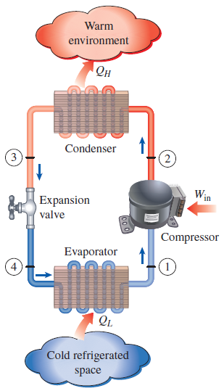
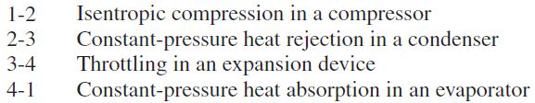
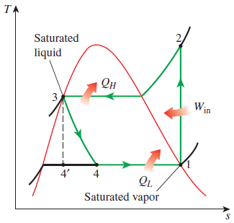
THE IDEAL VAPOR-COMPRESSION REFRIGERATION CYCLE
The vapor-compression refrigeration cycle is the ideal model for refrigeration systems. Unlike the reversed Carnot cycle, the refrigerant is vaporized completely before it is compressed and the turbine is replaced with a throttling device.
This is the most widely used cycle for refrigerators, A-C systems, and heat pumps.
Schematic and T-s diagram for the ideal vapor-compression refrigeration cycle.

Slide 6
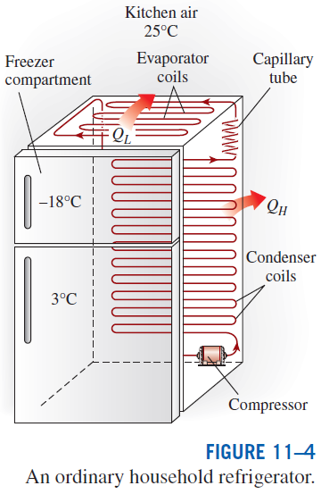
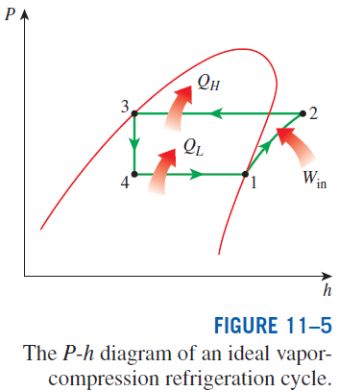
The ideal vapor-compression refrigeration cycle involves an irreversible (throttling) process to make it a more realistic model for the actual systems.
Replacing the expansion valve by a turbine is not practical since the added benefits cannot justify the added cost and complexity.
Steady-flow energy balance

Slide 7
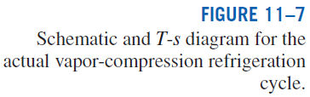
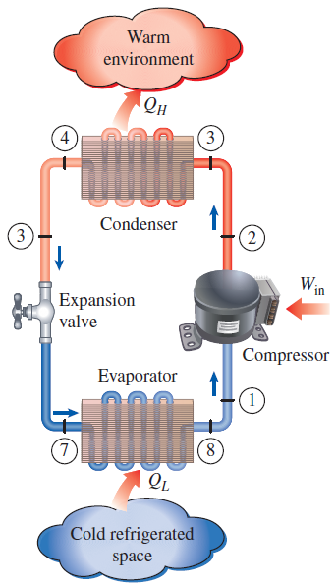
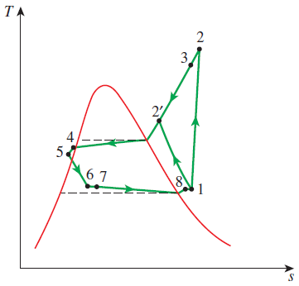
ACTUAL VAPOR-COMPRESSION REFRIGERATION CYCLE
An actual vapor-compression refrigeration cycle differs from the ideal one owing mostly to the irreversibilities that occur in various components, mainly due to fluid friction (causes pressure drops) and heat transfer to or from the surroundings.
DIFFERENCES
Non-isentropic compression
Superheated vapor at evaporator exit
Subcooled liquid at condenser exit
Pressure drops in condenser and evaporator
The COP decreases as a result of irreversibilities.

Slide 8


SECOND-LAW ANALYSIS OF VAPOR-COMPRESSION REFRIGERATION CYCLE
The maximum COP of a refrigeration cycle operating between temperature limits of T_{L} and T_{H}
Actual refrigeration cycles are not as efficient as ideal ones like the Carnot cycle because of the irreversibilities involved. But the conclusion we can draw from Eq. 11–9 that the COP is inversely proportional to the temperature difference T_{H} - T_{L} is equally valid for actual refrigeration cycles.
The goal of a second-law or exergy analysis of a refrigeration system is to determine the components that can benefit the most by improvements.
This is done identifying the locations of greatest exergy destruction and the components with the lowest exergy or second-law efficiency.
Exergy destruction in a component can be determined directly from an exergy balance or by using

Slide 9
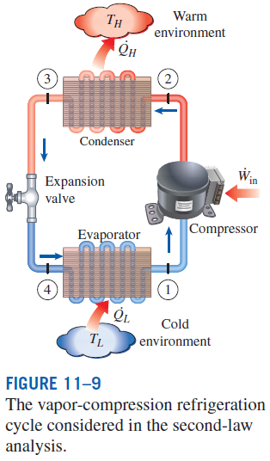
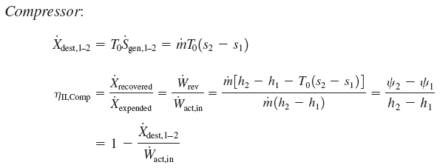
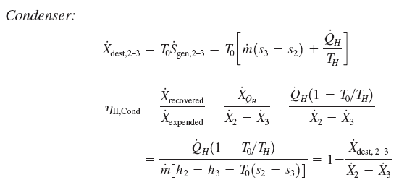
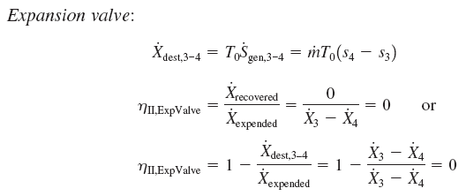
Note that when T_{H} = T₀, which is often the case for refrigerators, η_{II,cond} = 0 since there is no recoverable exergy in this case.

Slide 10
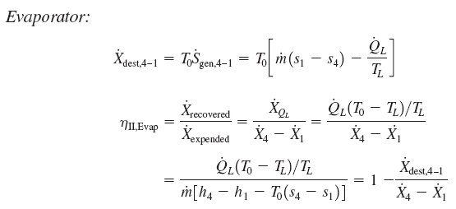


The exergy rate associated with the withdrawal of heat from the low-temperature medium at T_{L} at a rate of Q_{L}
This is equivalent to the power that can be produced by a Carnot heat engine receiving heat from the environment at T₀ and rejecting heat to the low temperature medium at T_{L} at a rate of Q_{L}.
Note that when T_{L} = T₀, which is often the case for heat pumps, η_{II,evap} = 0 since there is no recoverable exergy in this case.

Slide 11





Total exergy destruction
Second-law (exergy) efficiency
T₀ = T_{H} for a refrigeration cycle
This second-law efficiency definition accounts for all irreversibilities associated within the refrigerator, including the heat transfers with the refrigerated space and the environment.

Slide 12
SELECTING THE RIGHT REFRIGERANT
Several refrigerants may be used in refrigeration systems such as chlorofluorocarbons (CFCs), ammonia, hydrocarbons (propane, ethane, ethylene, etc.), carbon dioxide, air (in the air-conditioning of aircraft), and even water (in applications above the freezing point).
R-11, R-12, R-22, R-134a, and R-502 account for over 90 percent of the market.
The industrial and heavy-commercial sectors use ammonia (it is toxic).
R-11 is used in large-capacity water chillers serving A-C systems in buildings.
R-134a (replaced R-12, which damages ozone layer) is used in domestic refrigerators and freezers, as well as automotive air conditioners.
R-22 is used in window air conditioners, heat pumps, air conditioners of commercial buildings, and large industrial refrigeration systems, and offers strong competition to ammonia.
R-502 (a blend of R-115 and R-22) is the dominant refrigerant used in commercial refrigeration systems such as those in supermarkets.
CFCs allow more ultraviolet radiation into the earth’s atmosphere by destroying the protective ozone layer and thus contributing to the greenhouse effect that causes global warming. Fully halogenated CFCs (such as R-11, R-12, and R-115) do the most damage to the ozone layer. Refrigerants that are friendly to the ozone layer have been developed.
Two important parameters that need to be considered in the selection of a refrigerant are the temperatures of the two media (the refrigerated space and the environment) with which the refrigerant exchanges heat.

