Slide 1
SELECTING THE RIGHT REFRIGERANT
Several refrigerants may be used in refrigeration systems such as chlorofluorocarbons (CFCs), ammonia, hydrocarbons (propane, ethane, ethylene, etc.), carbon dioxide, air (in the air-conditioning of aircraft), and even water (in applications above the freezing point).
R-11, R-12, R-22, R-134a, and R-502 account for over 90 percent of the market.
The industrial and heavy-commercial sectors use ammonia (it is toxic).
R-11 is used in large-capacity water chillers serving A-C systems in buildings.
R-134a (replaced R-12, which damages ozone layer) is used in domestic refrigerators and freezers, as well as automotive air conditioners.
R-22 is used in window air conditioners, heat pumps, air conditioners of commercial buildings, and large industrial refrigeration systems, and offers strong competition to ammonia.
R-502 (a blend of R-115 and R-22) is the dominant refrigerant used in commercial refrigeration systems such as those in supermarkets.
CFCs allow more ultraviolet radiation into the earth’s atmosphere by destroying the protective ozone layer and thus contributing to the greenhouse effect that causes global warming. Fully halogenated CFCs (such as R-11, R-12, and R-115) do the most damage to the ozone layer. Refrigerants that are friendly to the ozone layer have been developed.
Two important parameters that need to be considered in the selection of a refrigerant are the temperatures of the two media (the refrigerated space and the environment) with which the refrigerant exchanges heat.

Slide 2
HEAT PUMP SYSTEMS
The most common energy source for heat pumps is atmospheric air (air-to- air systems).
Water-source systems usually use well water and ground-source (geothermal) heat pumps use earth as the energy source. They typically have higher COPs but are more complex and more expensive to install.
Both the capacity and the efficiency of a heat pump fall significantly at low temperatures. Therefore, most air-source heat pumps require a supplementary heating system such as electric resistance heaters or a gas furnace.
Heat pumps are most competitive in areas that have a large cooling load during the cooling season and a relatively small heating load during the heating season. In these areas, the heat pump can meet the entire cooling and heating needs of residential or commercial buildings.

Slide 3
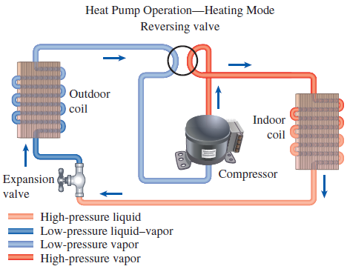
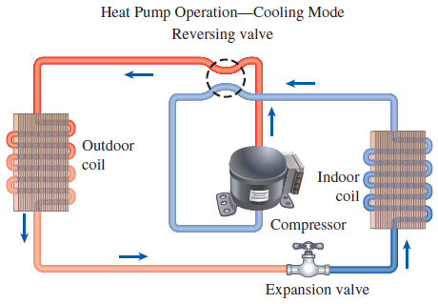

Slide 4
INNOVATIVE VAPOR-COMPRESSION REFRIGERATION SYSTEMS
The simple vapor-compression refrigeration cycle is the most widely used refrigeration cycle, and it is adequate for most refrigeration applications.
The ordinary vapor-compression refrigeration systems are simple, inexpensive, reliable, and practically maintenance-free.
However, for large industrial applications efficiency, not simplicity, is the major concern.
Also, for some applications the simple vapor-compression refrigeration cycle is inadequate and needs to be modified.
For moderately and very low temperature applications some innovative refrigeration systems are used. The following cycles will be discussed:
Cascade refrigeration systems
Multistage compression refrigeration systems
Multipurpose refrigeration systems with a single compressor
Liquefaction of gases

Slide 5
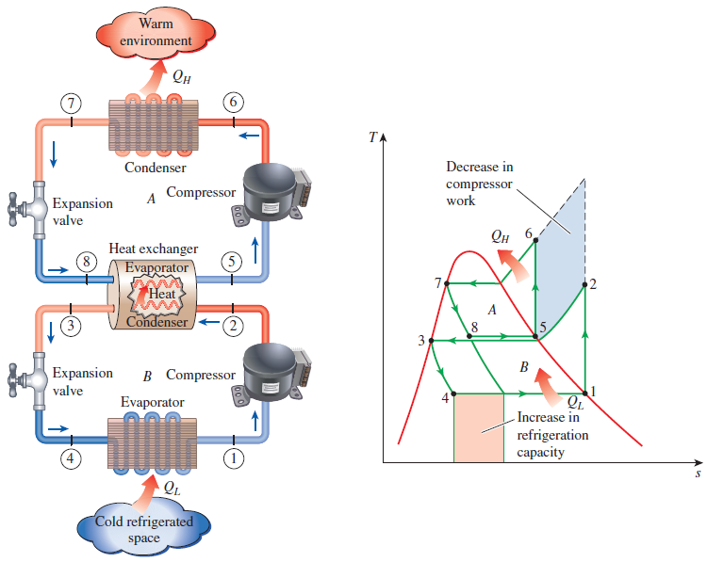

Cascade Refrigeration Systems
Some industrial applications require moderately low temperatures, and the temperature range they involve may be too large for a single vapor-compression refrigeration cycle to be practical. The solution is cascading.
Cascading improves the COP of a refrigeration system.
Some systems use three or four stages of cascading.

Slide 6
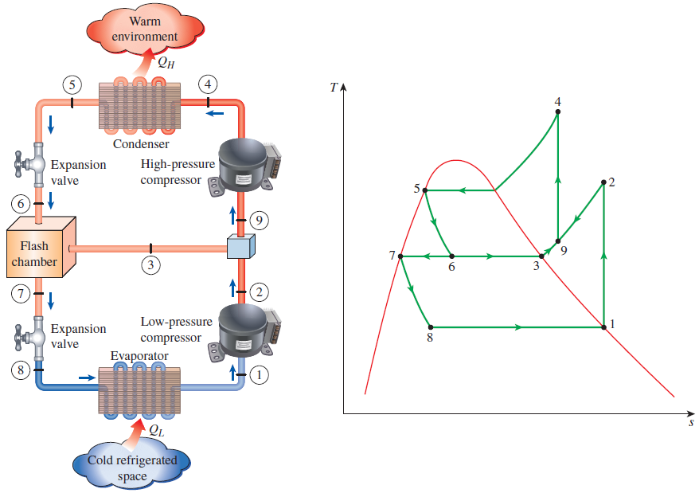
Multistage Compression Refrigeration Systems
When the fluid used throughout the cascade refrigeration system is the same, the heat exchanger between the stages can be replaced by a mixing chamber (called a flash chamber) since it has better heat transfer characteristics.

Slide 7
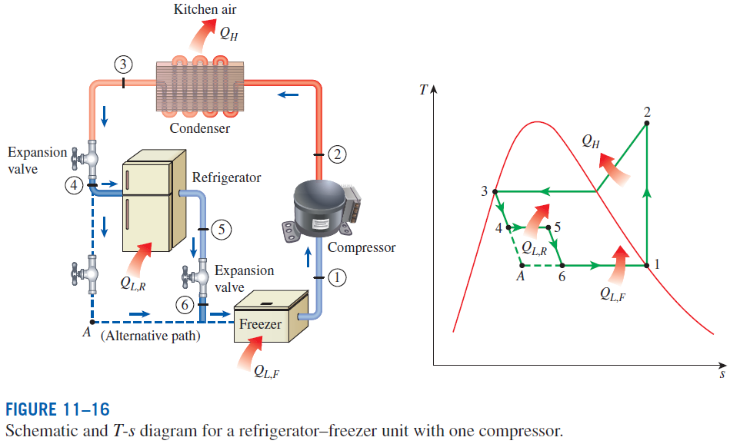
Multipurpose Refrigeration Systems with a Single Compressor
Some applications require refrigeration at more than one temperature. A practical and economical approach is to route all the exit streams from the evaporators to a single compressor and let it handle the compression process for the entire system.

Slide 8

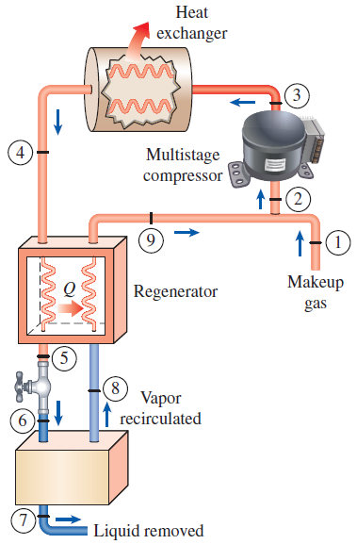
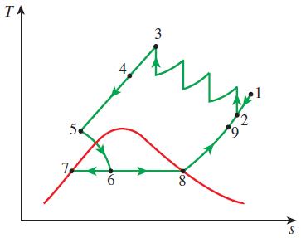
Liquefaction of Gases
Many important scientific and engineering processes at cryogenic temperatures (below about 100°C) depend on liquefied gases including the separation of oxygen and nitrogen from air, preparation of liquid propellants for rockets, the study of material properties at low temperatures, and the study of superconductivity.
The storage (i.e., hydrogen) and transportation of some gases (i.e., natural gas) are done after they are liquefied at very low temperatures. Several innovative cycles are used for the liquefaction of gases.

Slide 9
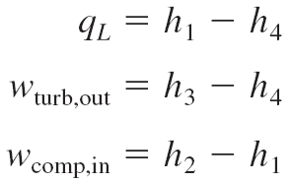

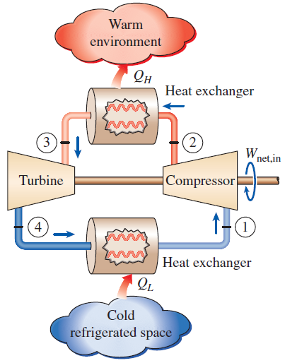
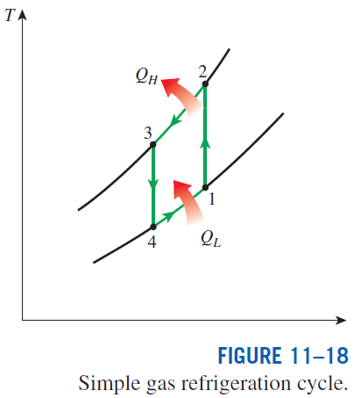
GAS REFRIGERATION CYCLES
The reversed Brayton cycle (the gas refrigeration cycle) can be used for refrigeration.

Slide 10
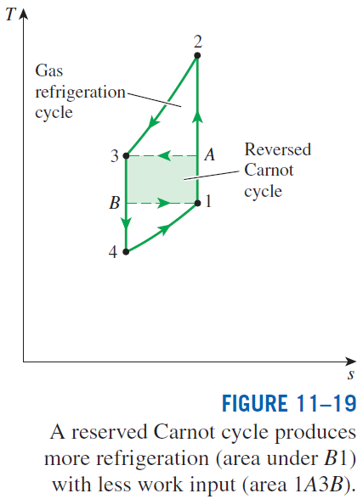
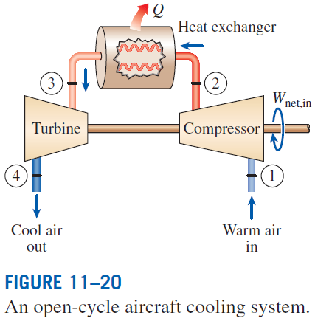
The gas refrigeration cycles have lower COPs relative to the vapor-compression refrigeration cycles or the reversed Carnot cycle.
The reversed Carnot cycle consumes a fraction of the net work (area 1A3B) but produces a greater amount of refrigeration (triangular area under B1).
Despite their relatively low COPs, the gas refrigeration cycles involve simple, lighter components, which make them suitable for aircraft cooling, and they can incorporate regeneration

Slide 11
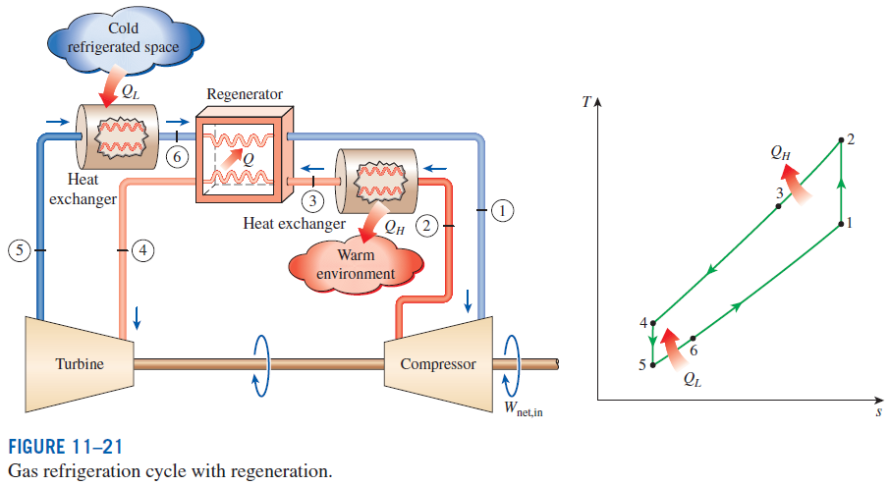
Without regeneration, the lowest turbine inlet temperature is T₀, the temperature of the surroundings or any other cooling medium.
With regeneration, the high-pressure gas is further cooled to T₄ before expanding in the turbine.
Lowering the turbine inlet temperature automatically lowers the turbine exit temperature, which is the minimum temperature in the cycle.
Extremely low temperatures can be achieved by repeating regeneration process.

Slide 12
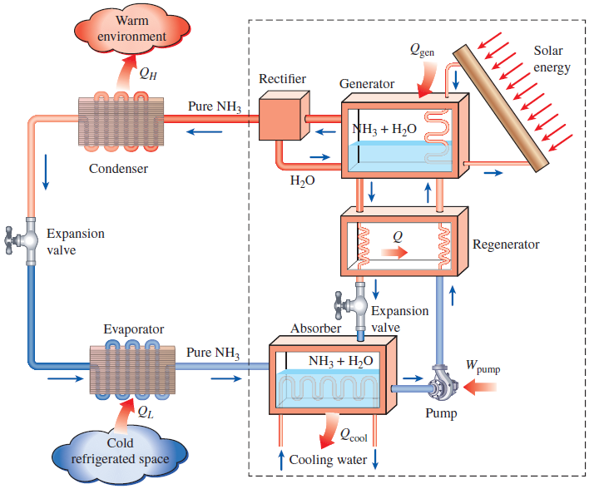

ABSORPTION REFRIGERATION SYSTEMS
Absorption refrigeration is economic when there is a source of inexpensive thermal energy at a temperature of 100 to 200°C.
Some examples include geothermal energy, solar energy, and waste heat from cogeneration or process steam plants, and even natural gas when it is at a relatively low price.

Slide 13
Absorption refrigeration systems (ARS) involve the absorption of a refrigerant by a transport medium.
The most widely used system is the ammonia–water system, where ammonia (NH₃) serves as the refrigerant and water (H₂O) as the transport medium.
Other systems include water–lithium bromide and water–lithium chloride systems, where water serves as the refrigerant. These systems are limited to applications such as A-C where the minimum temperature is above the freezing point of water.
Compared with vapor-compression systems, ARS have one major advantage: A liquid is compressed instead of a vapor and as a result the work input is very small (on the order of one percent of the heat supplied to the generator) and often neglected in the cycle analysis.
ARS are often classified as heat-driven systems.
ARS are much more expensive than the vapor-compression refrigeration systems. They are more complex and occupy more space, they are much less efficient thus requiring much larger cooling towers to reject the waste heat, and they are more difficult to service since they are less common.
Therefore, ARS should be considered only when the unit cost of thermal energy is low and is projected to remain low relative to electricity.
ARS are primarily used in large commercial and industrial installations.

Slide 14
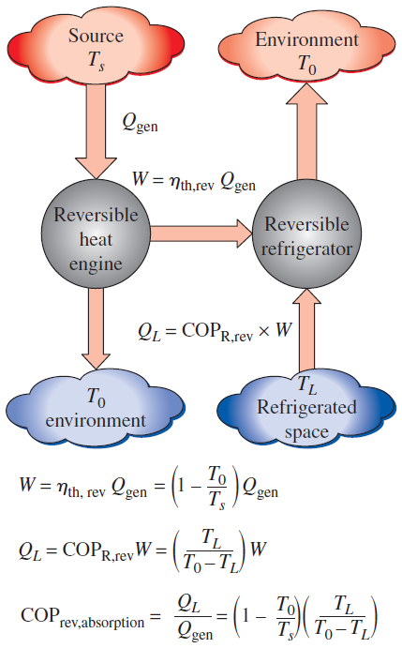


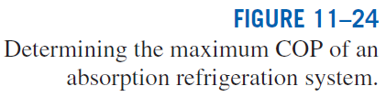
The COP of actual absorption refrigeration systems is usually less than 1.
Air-conditioning systems based on absorption refrigeration, called absorption chillers, perform best when the heat source can supply heat at a high temperature with little temperature drop.

Slide 15
Summary
Refrigerators and Heat Pumps
The Reversed Carnot Cycle
The Ideal Vapor-Compression Refrigeration Cycle
Actual Vapor-Compression Refrigeration Cycle
Second-law Analysis of Vapor-Compression Refrigeration Cycle
Selecting the Right Refrigerant
Heat Pump Systems
Innovative Vapor-Compression Refrigeration Systems
Gas Refrigeration Cycles
Absorption Refrigeration Systems

