Slide 1
CHAPTER 12 THERMODYNAMIC PROPERTY RELATIONS
Thermodynamics: An Engineering Approach
8th Edition Yunus A. Çengel, Michael A. Boles
McGraw-Hill, 2015
Adapted from the lecture slides by Mehmet Kanoglu Copyright © The McGraw-Hill Education.
Permission required for reproduction or display.

Slide 2
Objectives
Develop fundamental relations between commonly encountered thermodynamic properties and express the properties that cannot be measured directly in terms of easily measurable properties.
Develop the Maxwell relations, which form the basis for many thermodynamic relations.
Develop the Clapeyron equation and determine the enthalpy of vaporization from P, v, and T measurements alone.
Develop general relations for c_{v}, c_{p}, du, dh, and ds that are valid for all pure substances.
Discuss the Joule-Thomson coefficient.
Develop a method of evaluating the ∆h, ∆u, and ∆s of real gases through the use of generalized enthalpy and entropy departure charts.

Slide 3
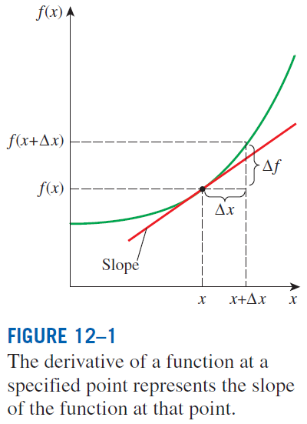

A LITTLE MATH—PARTIAL DERIVATIVES AND ASSOCIATED RELATIONS
The state postulate: The state of a simple, compressible substance is completely specified by any two independent, intensive properties. All other properties at that state can be expressed in terms of those two properties.
The derivative of a function f(x) with respect to x represents the
rate of change of f with x.

Slide 4
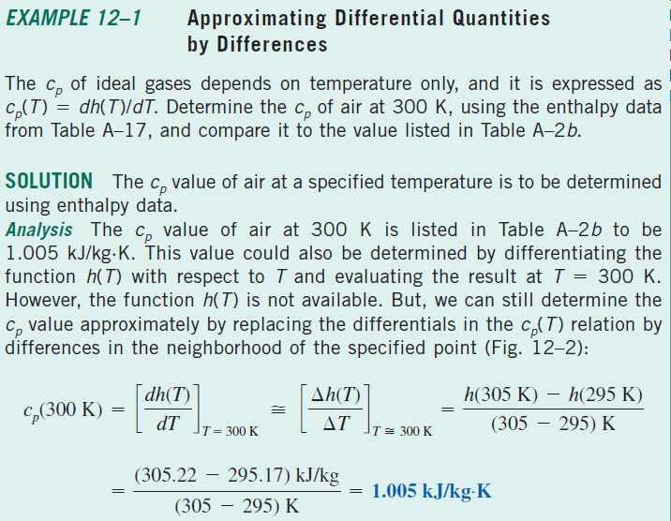
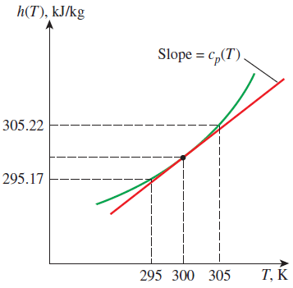

Slide 5
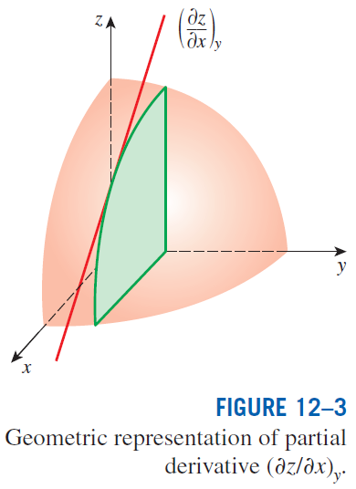
Partial Differentials
The variation of z(x, y) with x when y is held constant is called the partial derivative of z with respect to x, and it is expressed as
The symbol ∂ represents differential changes, just like the symbol d. They differ in that the symbol d represents the total differential change of a function and reflects the influence of all variables, whereas ∂ represents the partial differential change due to the variation of a single variable.
The changes indicated by d and ∂ are identical for independent variables, but not for dependent variables.

Slide 6
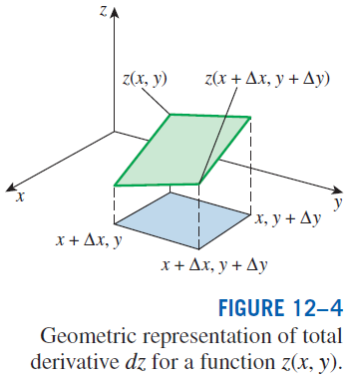
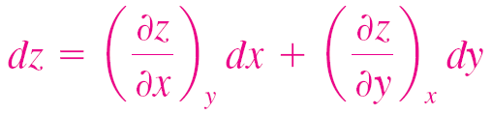
This is the fundamental relation for the total differential of a dependent variable in terms of its partial derivatives with respect to the independent variables.

Slide 7
Partial Differential Relations
The order of differentiation is immaterial for properties since they are continuous point functions and have exact differentials. Thus,

Slide 8







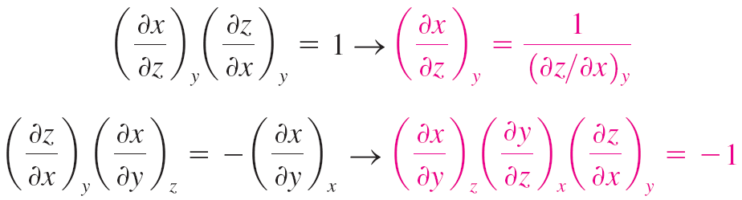
Partial Differential Relations
z dependent on x, y
x dependent on z, y
y is independent of z.
Therefore the equation is satisfied for all y and z, when terms inside brackets vanish
Reciprocity relation
Cyclic relation

Slide 9
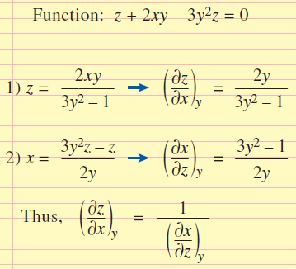
Demonstration of Reciprocity Relations
Demonstration of the reciprocity relation for the function z + 2xy − 3y²z = 0.

Slide 10
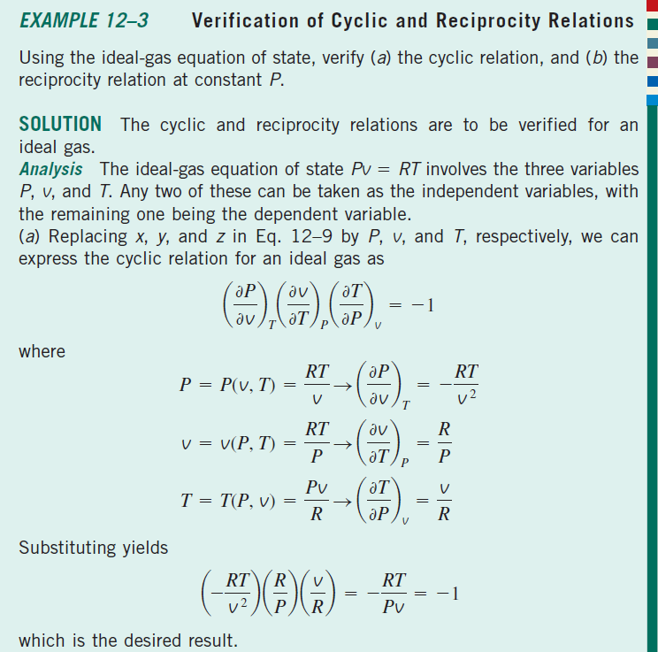

Slide 11
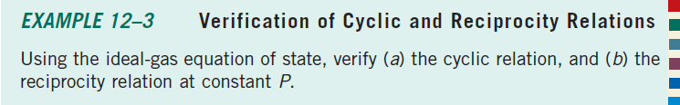
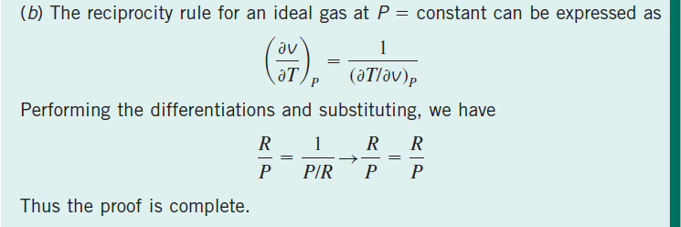

Slide 12
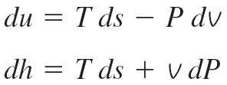
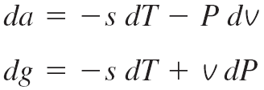

THE MAXWELL RELATIONS
The equations that relate the partial derivatives of properties P, v, T, and s
of a simple compressible system to each other are called the Maxwell relations. They are obtained from the four Gibbs equations by exploiting the
exactness of the differentials of thermodynamic properties.
Helmholtz function
Gibbs function
Maxwell relations are extremely valuable in thermodynamics because they provide a means of determining the change in entropy, which cannot be measured directly, by simply measuring the changes in properties P, v, and T.
These Maxwell relations are limited to simple compressible systems.
Maxwell relations

Slide 13
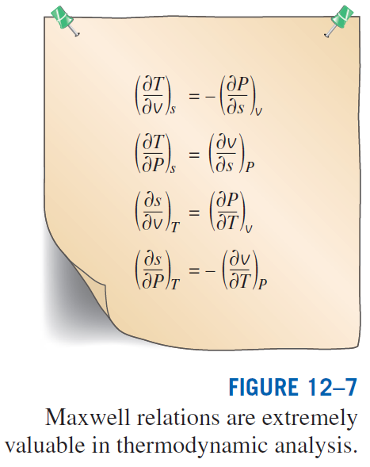

Slide 14
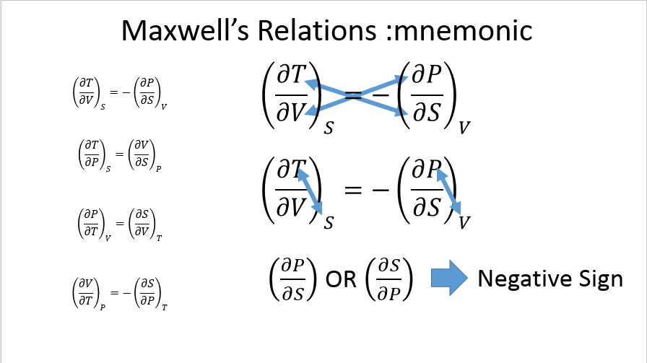

Slide 15




$${\left(\frac{∂T}{∂V}\right)}_{S}={−\left(\frac{∂P}{∂S}\right)}_{V}$$
$$dU=TdS−PdV$$
$${\left(\frac{∂T}{∂P}\right)}_{S}={\left(\frac{∂V}{∂S}\right)}_{P}$$
$$dH=TdS+VdP$$
$${\left(\frac{∂P}{∂T}\right)}_{V}={\left(\frac{∂S}{∂V}\right)}_{T}$$
$$dA=−PdV−SdT$$
$${\left(\frac{∂V}{∂T}\right)}_{P}={−\left(\frac{∂S}{∂P}\right)}_{T}$$
$$dG=VdP−SdT$$
Maxwell’s Relations

Slide 16
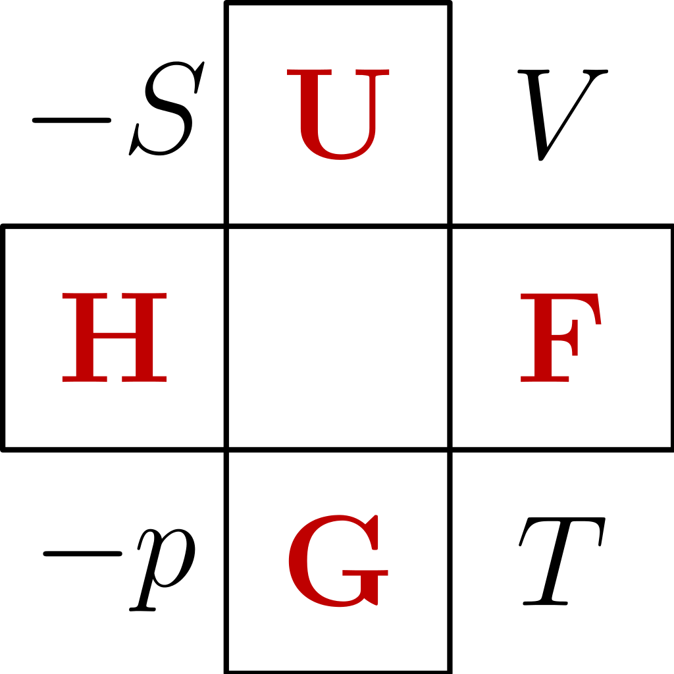
Differential Relations :mnemonic
$$dU=TdS−PdV$$
$$dH=TdS+VdP$$
$$dA=−PdV−SdT$$
$$dG=VdP−SdT$$
Good Physicists have Studied Under Very Fine Teachers
Thermodynamic Square

Slide 17
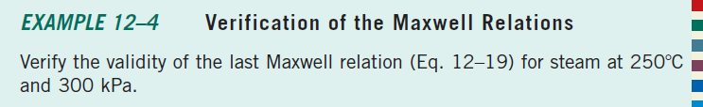
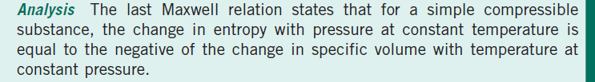
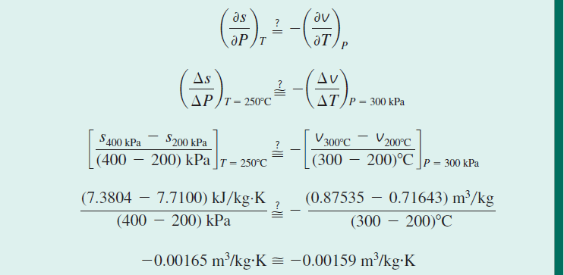

Slide 18
THE CLAPEYRON EQUATION

Slide 19
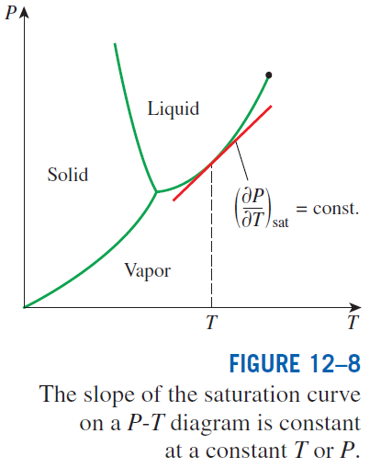
Clapeyron equation
The Clapeyron equation enables us to determine the enthalpy of vaporization h_{fg} at a given temperature by simply measuring the slope of the saturation curve on a P-T diagram and the specific volume of saturated liquid and saturated vapor at the given temperature.
General form of the Clapeyron equation when the subscripts 1 and 2 indicate the two phases.

Slide 20
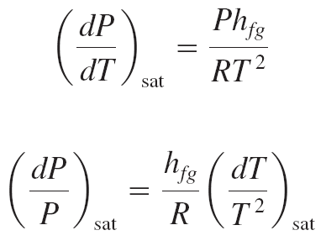
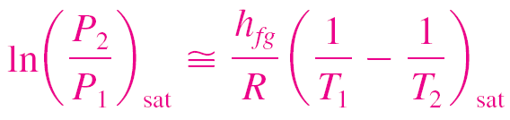
The Clapeyron equation can be simplified for liquid–vapor and solid–vapor phase changes by utilizing some approximations.
At low pressures
Treating vapor as an ideal gas
The Clapeyron–Clausius equation can be used to determine the variation of saturation pressure with temperature.
It can also be used in the solid–vapor region by replacing h_{fg} by h_{ig} (the enthalpy of sublimation) of the substance.
Substituting these equations into the Clapeyron equation
Integrating between two saturation states. Further assuming for small temperature intervals, h_{fg} is constant at some average value
Clapeyron–Clausius equation

Slide 21
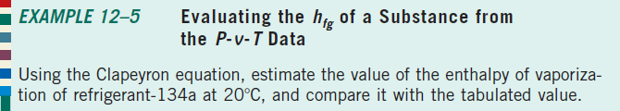
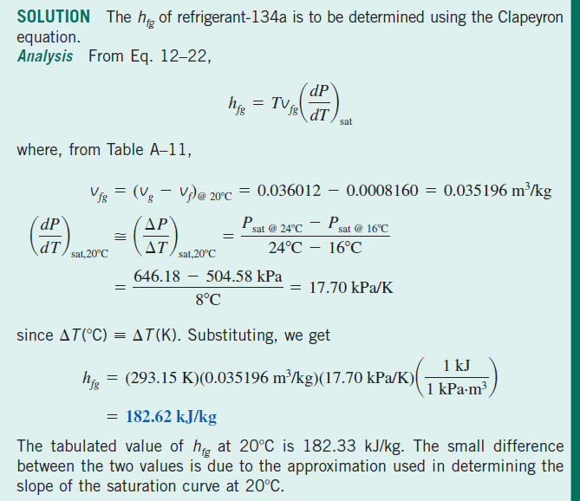

Slide 22
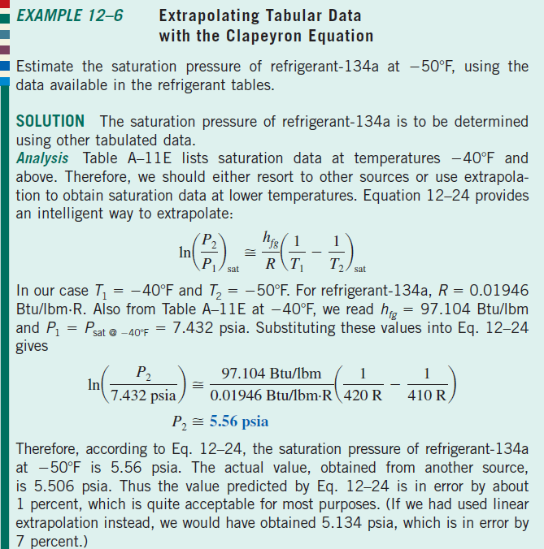

Slide 23
GENERAL RELATIONS FOR du, dh, ds, c_{v}, AND c_{p}
The state postulate established that the state of a simple compressible system is completely specified by two independent, intensive properties.
Therefore, we should be able to calculate all the properties of a system such as internal energy, enthalpy, and entropy at any state once two independent, intensive properties are available.
The calculation of these properties from measurable ones depends on the availability of simple and accurate relations between the two groups.
In this section we develop general relations for changes in internal energy, enthalpy, and entropy in terms of pressure, specific volume, temperature, and specific heats alone.
We also develop some general relations involving specific heats.
The relations developed will enable us to determine the changes in these properties.
The property values at specified states can be determined only after the selection of a reference state, the choice of which is quite arbitrary.

Slide 24
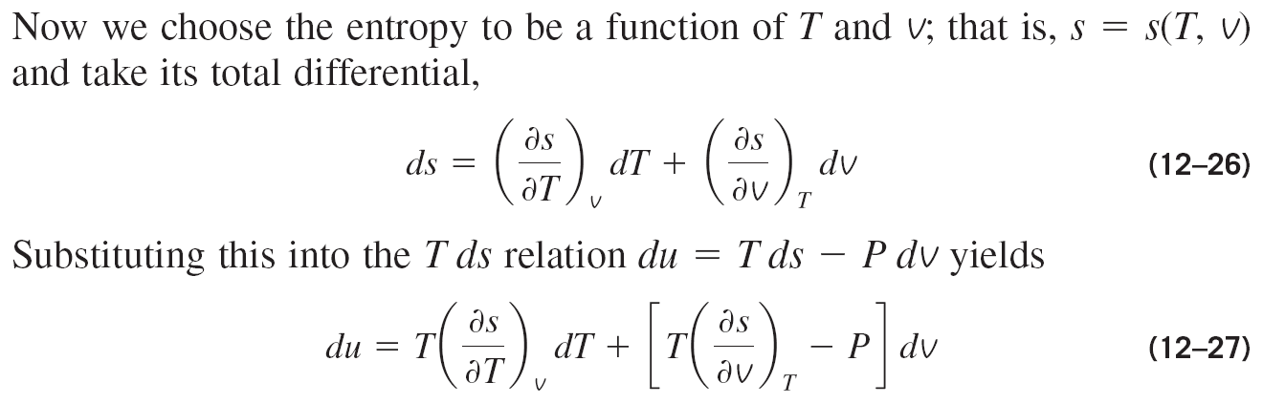
Internal Energy Changes

Slide 25
