Slide 1
Enthalpy Changes

Slide 3

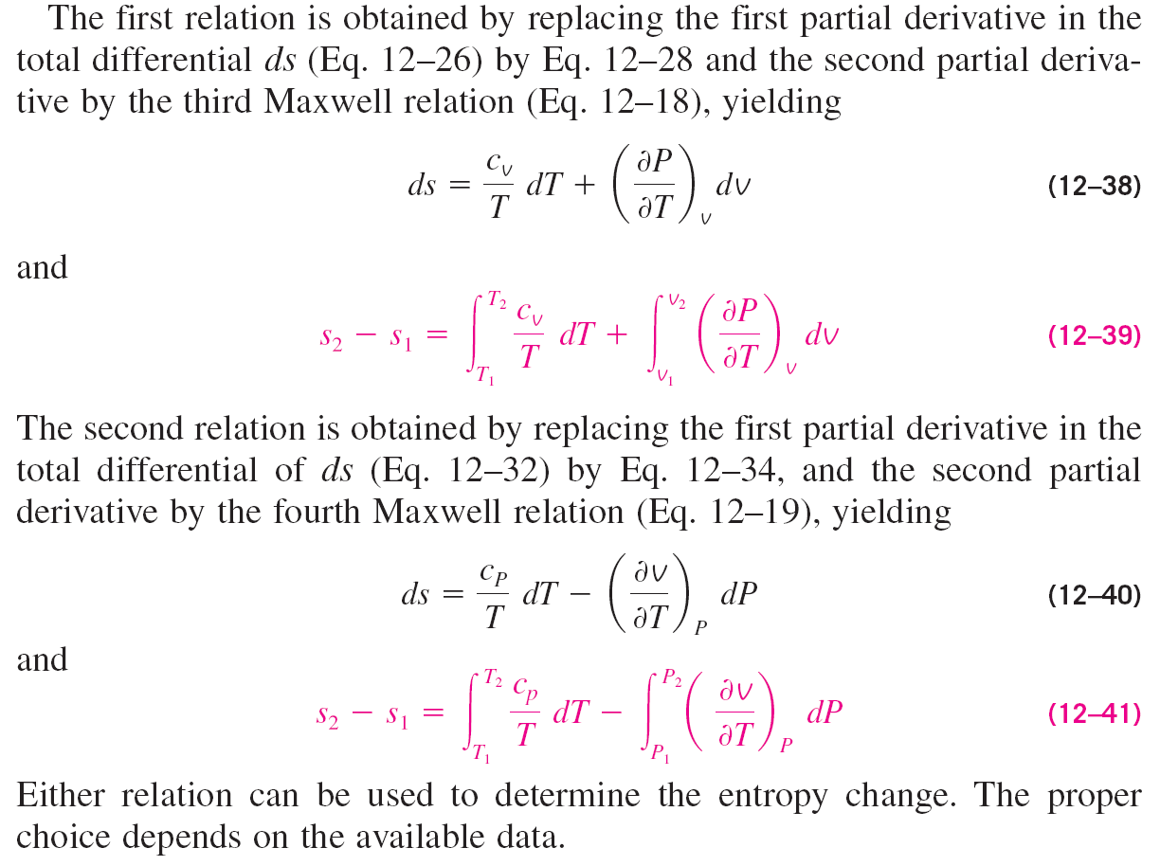





Entropy Changes

Slide 4
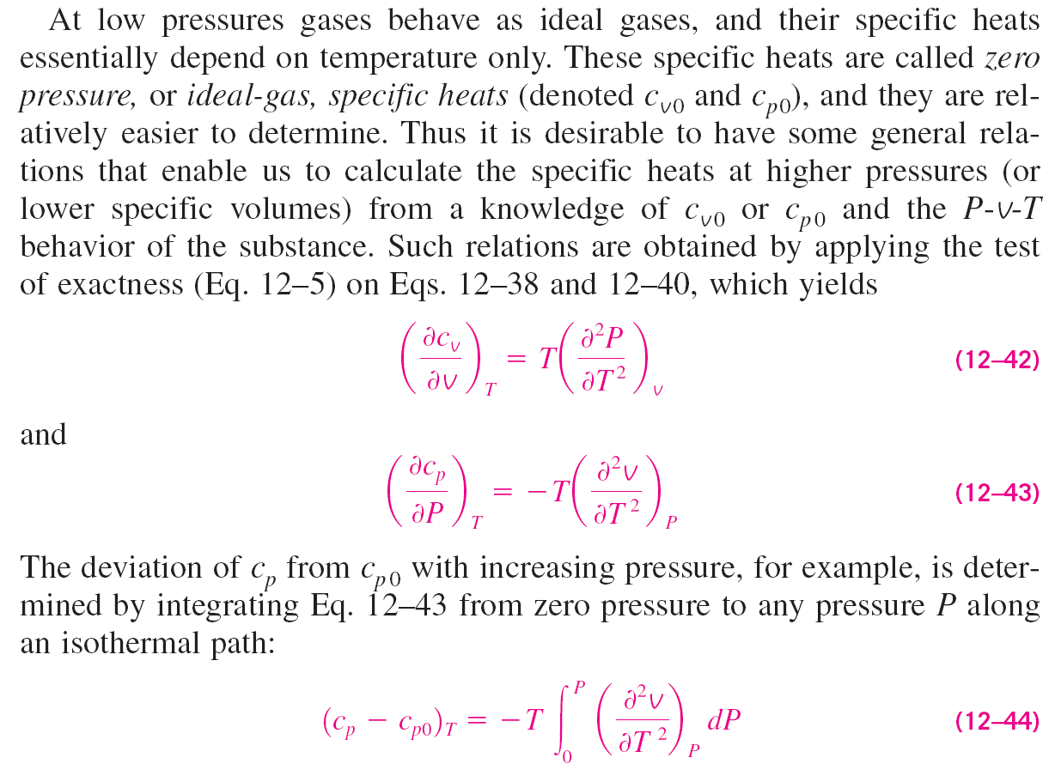



Specific Heats c_{v} and c_{p}

Slide 5

Specific Heats c_{v} and c_{p}

Slide 6


Difference between Specific Heats (c_{P} – c_{V})

Slide 7
Mayer relation

Slide 8
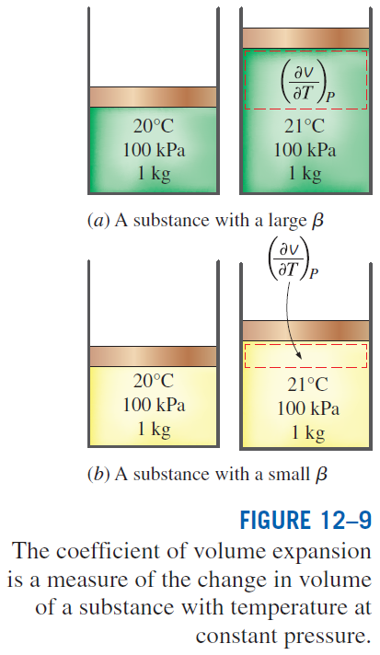
Mayer relation
Conclusions from Mayer relation:
1. The right hand side of the equation is always greater than or equal to zero. Therefore, we conclude that
2. The difference between c_{p} and c_{v} approaches zero as the absolute temperature approaches zero.
3. The two specific heats are identical for truly incompressible substances since v constant. The difference between the two specific heats is very small and is usually disregarded for substances that are nearly incompressible, such as liquids and solids.

Slide 9
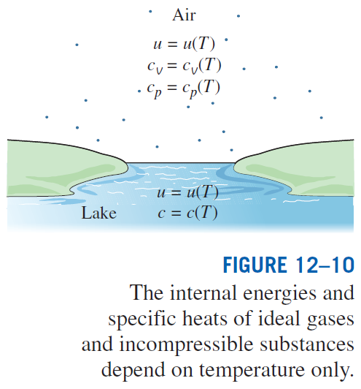

Slide 10
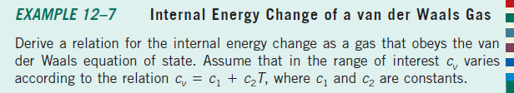
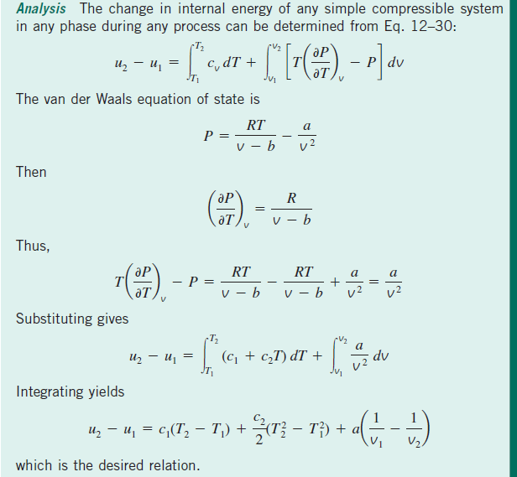

Slide 11
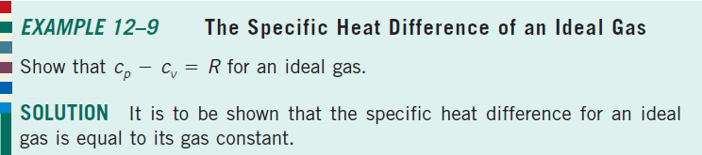
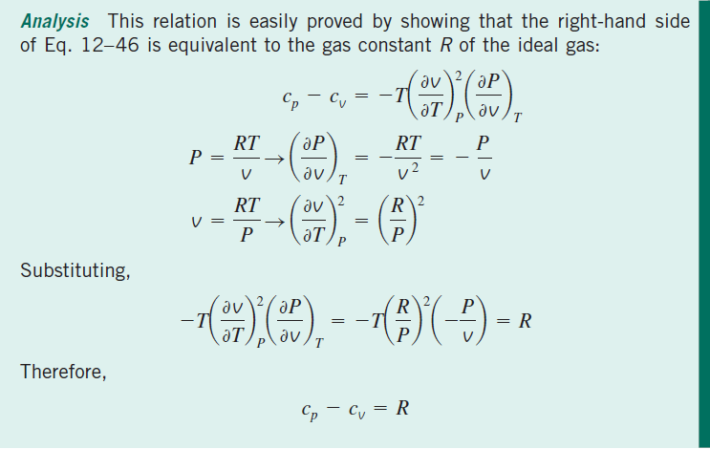

Slide 12
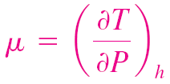
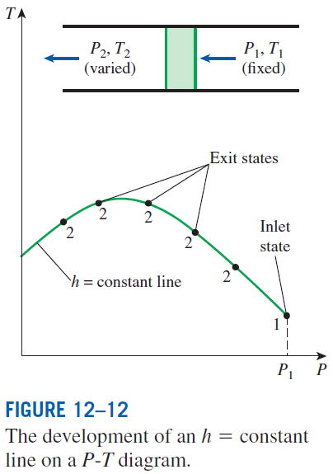
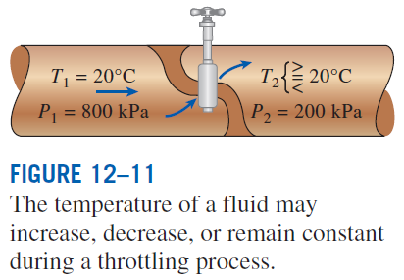
THE JOULE-THOMSON COEFFICIENT
The temperature behavior of a fluid during a throttling (h = constant) process is described by the Joule-Thomson coefficient
The Joule-Thomson coefficient represents the slope of h = constant lines on a T-P diagram.

Slide 13
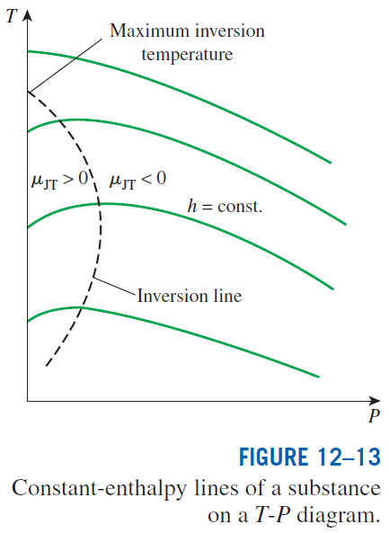
A throttling process proceeds along a constant-enthalpy line in the direction of decreasing pressure, that is, from right to left.
Therefore, the temperature of a fluid increases during a throttling process that takes place on the right-hand side of the inversion line.
However, the fluid temperature decreases during a throttling process that takes place on the left-hand side of the inversion line.
It is clear from this diagram that a cooling effect cannot be achieved by throttling unless the fluid is below its maximum inversion temperature.
This presents a problem for substances whose maximum inversion temperature is well below room temperature.

Slide 14
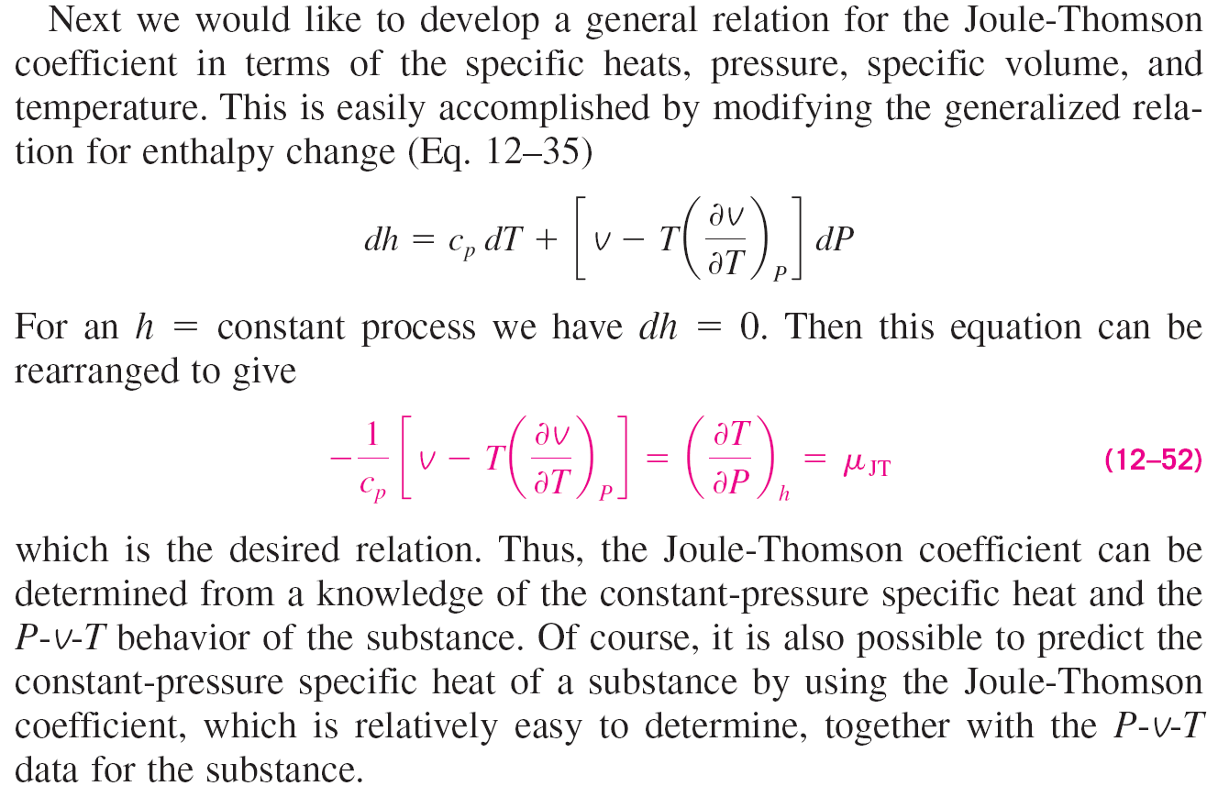

Slide 15
