Slide 1
THE ∆h, ∆u, AND ∆s OF REAL GASES
Gases at low pressures behave as ideal gases and obey the relation Pv = RT. The properties of ideal gases are relatively easy to evaluate since the properties u, h, c_{v}, and c_{p} depend on temperature only.
At high pressures, however, gases deviate considerably from ideal-gas behavior, and it becomes necessary to account for this deviation.
In Chap. 3 we accounted for the deviation in properties P, v, and T by either using more complex equations of state or evaluating the compressibility factor Z from the compressibility charts.
Now we extend the analysis to evaluate the changes in the enthalpy, internal energy, and entropy of nonideal (real) gases, using the general relations for du, dh, and ds developed earlier.

Slide 2
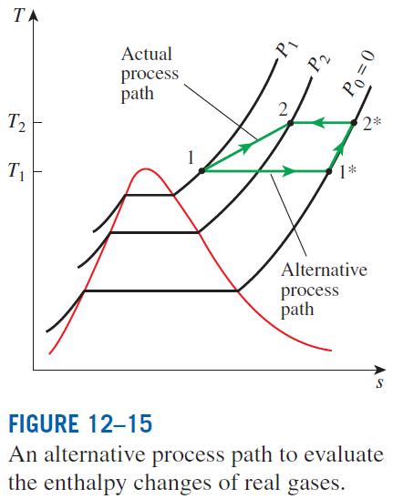
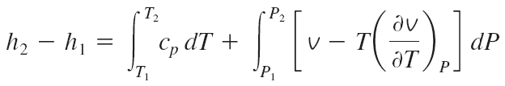
Enthalpy Changes of Real Gases
The enthalpy of a real gas, in general, depends on the pressure as well as on the temperature. Thus the enthalpy change of a real gas during a process can be evaluated from the general relation for dh
For an isothermal process dT = 0, and the first term vanishes. For a constant-pressure process, dP = 0, and the second term vanishes.

Slide 3
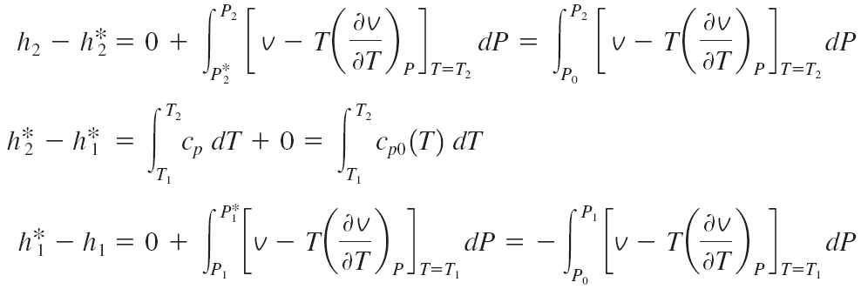
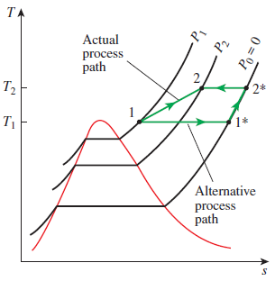
Using a superscript asterisk (*) to denote an ideal-gas state, we can express
the enthalpy change of a real gas during process 1-2 as
The difference between h and h* is called the enthalpy departure, and it represents the variation of the enthalpy of a gas with pressure at a fixed temperature. The calculation of enthalpy departure requires a knowledge of the P-v-T behavior of the gas. In the absence of such data, we can use the relation Pv = ZRT, where Z is the compressibility factor. Substituting,

Slide 4

Enthalpy departure factor
The values of Z_{h} are presented in graphical form as a function of P_{R} (reduced pressure) and T_{R} (reduced temperature) in the generalized enthalpy departure chart.
Z_{h} is used to determine the deviation of the enthalpy of a gas at a given P and T from the enthalpy of an ideal gas at the same T.
For a real gas during a process 1-2
from ideal gas tables
Internal Energy Changes of Real Gases
Using the definition

Slide 5
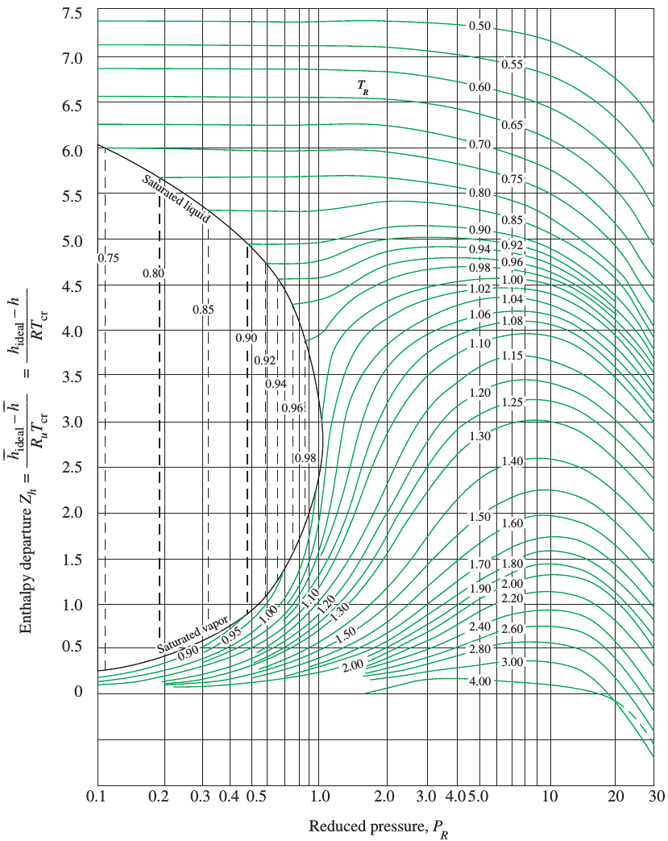
Enthalpy departure chart

Slide 6
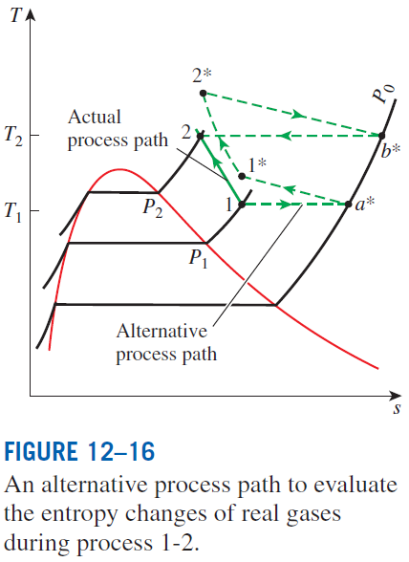
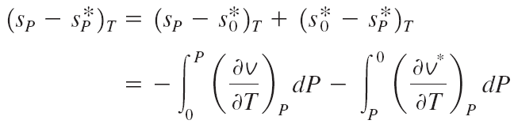

Entropy Changes of Real Gases
General relation for ds
Using the approach in the figure
During isothermal process

Slide 7


Entropy departure factor
Entropy departure
The values of Z_{s} are presented in graphical form as a function of P_{R} (reduced pressure) and T_{R} (reduced temperature) in the generalized entropy departure chart.
Z_{s} is used to determine the deviation of the entropy of a gas at a given P and T from the entropy of an ideal gas at the same P and T.
For a real gas during a process 1-2
from the ideal gas relations

Slide 8
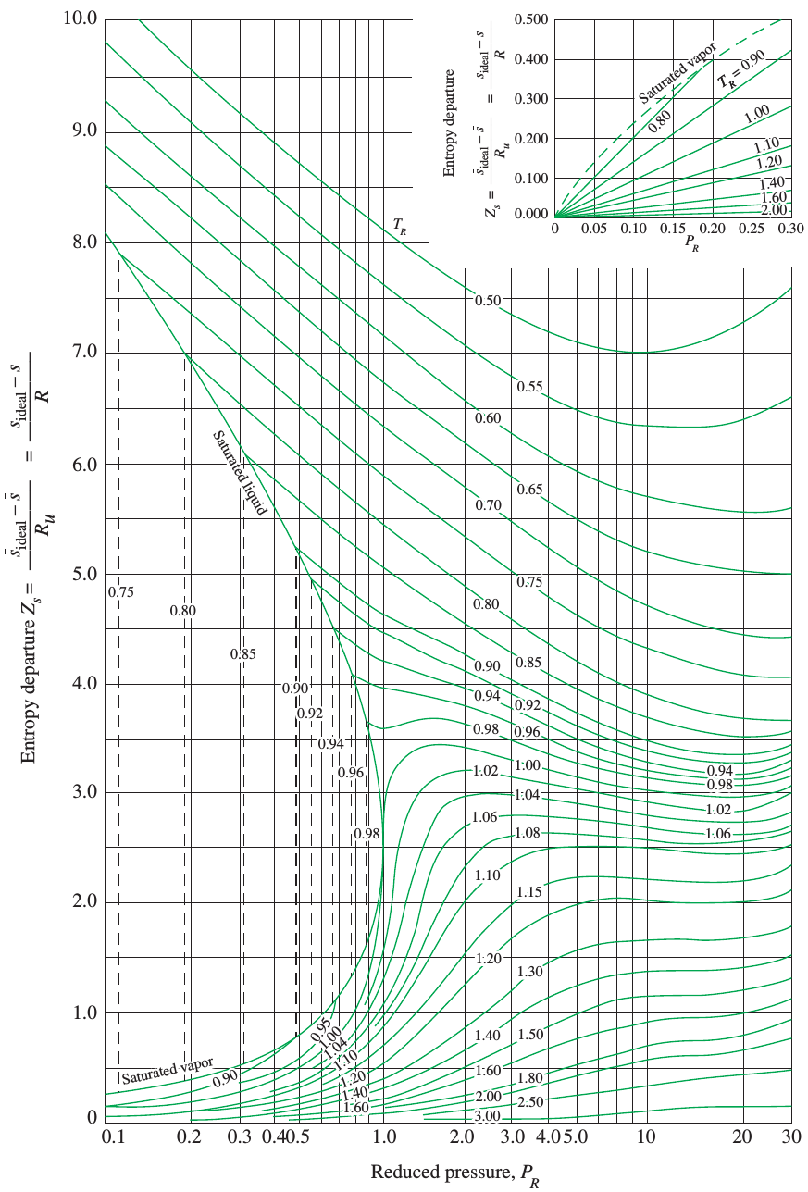
Entropy departure chart

Slide 9
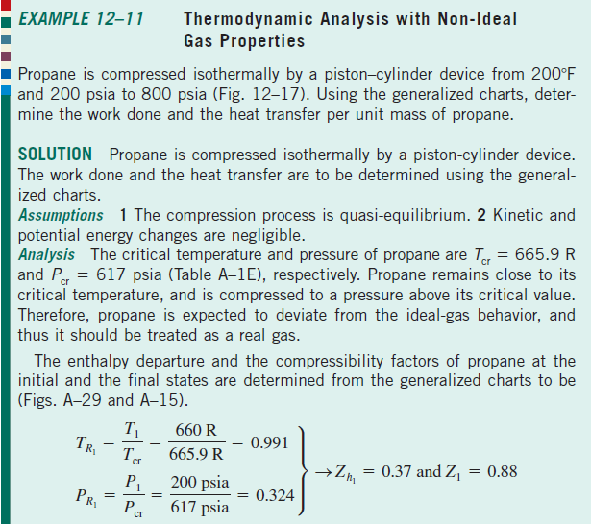
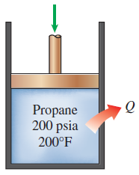
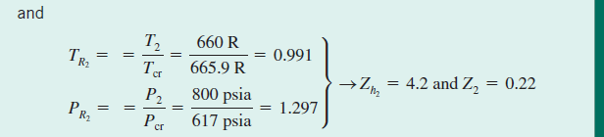

Slide 10
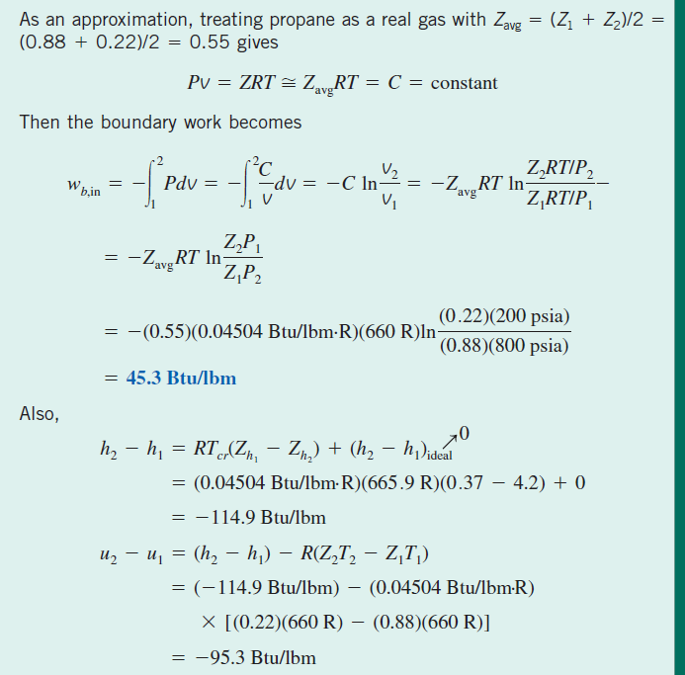

Slide 11
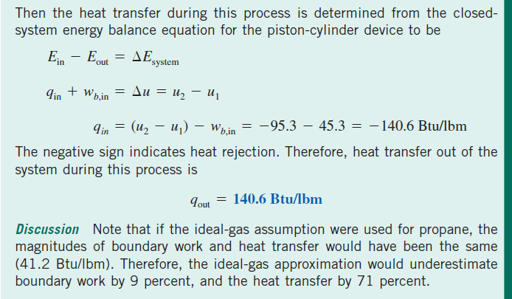

Slide 12
Summary
A little math—Partial derivatives and associated relations
Partial differentials
Partial differential relations
The Maxwell relations
The Clapeyron equation
General relations for du, dh, ds, c_{v},and c_{p}
Internal energy changes
Enthalpy changes
Entropy changes
Specific heats c_{v} and c_{p}
The Joule-Thomson coefficient
The ∆h, ∆ u, and ∆ s of real gases
Enthalpy changes of real gases
Internal energy changes of real gases
Entropy changes of real gases

Slide 13
CHAPTER 15 CHEMICAL REACTIONS
Thermodynamics: An Engineering Approach
8th Edition Yunus A. Çengel, Michael A. Boles
McGraw-Hill, 2015
Adapted from the lecture slides by Mehmet Kanoglu Copyright © The McGraw-Hill Education.
Permission required for reproduction or display.

Slide 14
Objectives
Give an overview of fuels and combustion.
Apply the conservation of mass to reacting systems to determine balanced reaction equations.
Define the parameters used in combustion analysis, such as air–fuel ratio, percent theoretical air, and dew-point temperature.
Apply energy balances to reacting systems for both steady-flow control volumes and fixed mass systems.
Calculate the enthalpy of reaction, enthalpy of combustion, and the heating values of fuels.
Determine the adiabatic flame temperature for reacting mixtures.
Evaluate the entropy change of reacting systems.
Analyze reacting systems from the second-law perspective.

Slide 15
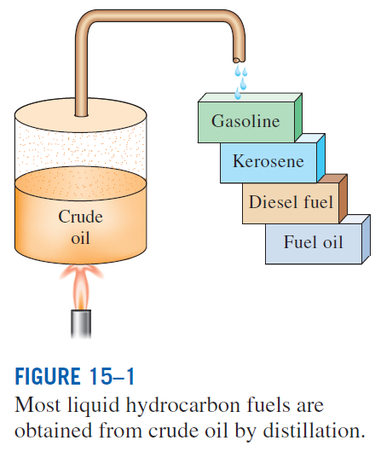
FUELS AND COMBUSTION
Fuel: Any material that can be burned to release thermal energy.
Most familiar fuels consist primarily of hydrogen and carbon.
They are called hydrocarbon fuels and are denoted by the general formula C_{n}H_{m}.
Hydrocarbon fuels exist in all phases, some examples being coal, gasoline (usually treated as octane C₈H₁₈), and natural gas.

Slide 16
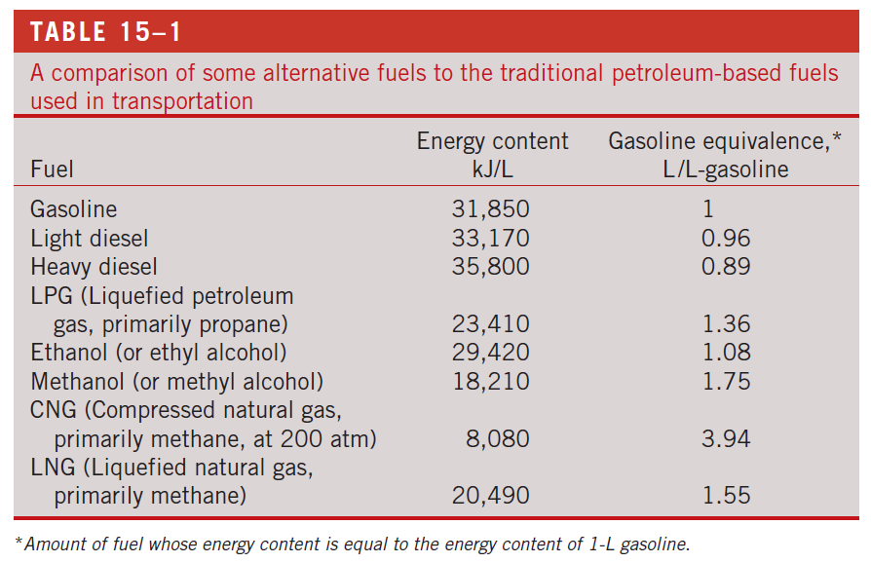

Slide 17
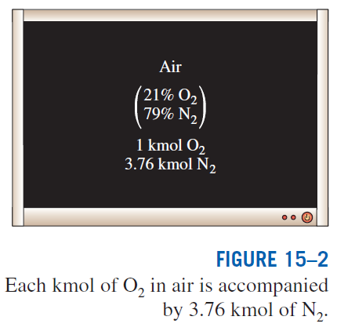
The oxidizer most often used in combustion processes is air. Why?
On a mole or a volume basis, dry air is composed of 20.9% O₂, 78.1% N₂, 0.9% Ar, and small amounts of CO₂, He, Ne, H₂.
In the analysis of combustion processes, dry air is approximated as 21% O₂ and 79% N₂ by mole numbers.
Combustion: A chemical reaction during which a fuel is oxidized and a large quantity of energy is released.

Slide 18
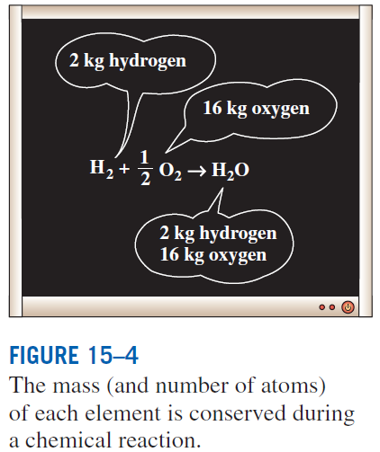
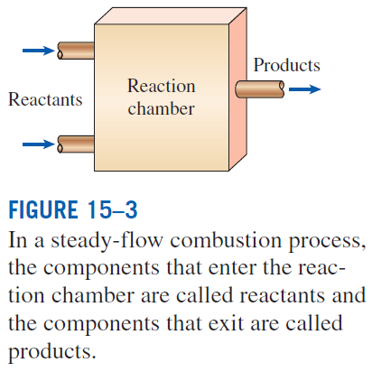
The fuel must be brought above its ignition temperature to start the combustion. The minimum ignition temperatures in atmospheric air are approximately 260°C for gasoline, 400°C for carbon, 580°C for hydrogen, 610°C for carbon monoxide, and 630°C for methane.
Proportions of the fuel and air must be in the proper range for combustion to begin. For example, natural gas does not burn in air in concentrations less than 5% or greater than about 15%.
The total number of moles is not conserved during a chemical reaction.

Slide 19

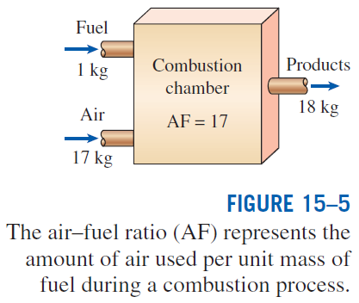
Air-fuel ratio (AF) is usually expressed on a mass basis and is defined as the ratio of the mass of air to the mass of fuel for a combustion process
m mass
N number of moles
M molar mass
Fuel–air ratio (FA): The reciprocal of air–fuel ratio.

Slide 20
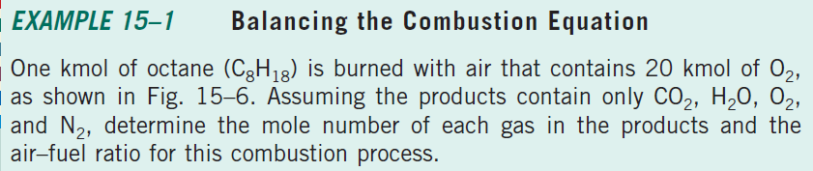
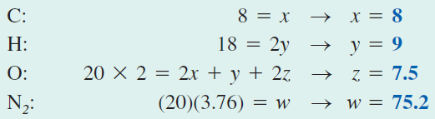
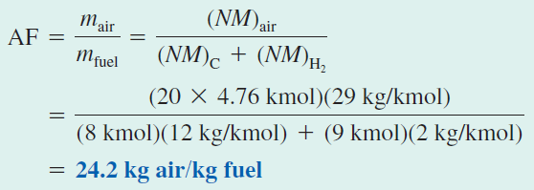

Slide 21
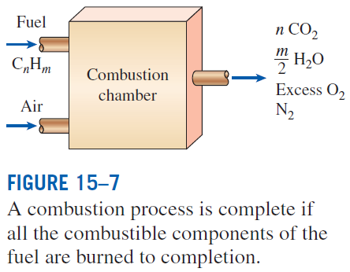
THEORETICAL AND ACTUAL COMBUSTION PROCESSES
Complete combustion: If all the carbon in the fuel burns to CO₂, all the hydrogen burns to H₂O, and all the sulfur (if any) burns to SO₂.
Incomplete combustion: If the combustion products contain any unburned fuel or components such as C, H₂, CO, or OH.
Reasons for incomplete combustion: 1 Insufficient oxygen, 2 insufficient mixing in the combustion chamber during the limited time that the fuel and the oxygen are in contact, and 3 dissociation (at high temperatures).
Oxygen has a much greater tendency to combine with hydrogen than it does with carbon. Therefore, the hydrogen in the fuel normally burns to completion, forming H₂O.

Slide 22
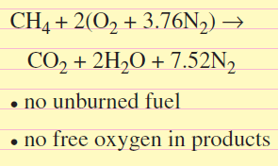
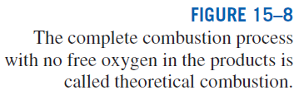
Stoichiometric or theoretical air: The minimum amount of air needed for the complete combustion of a fuel. Also referred to as the chemically correct amount of air, or 100% theoretical air.
Stoichiometric or theoretical combustion: The ideal combustion process during which a fuel is burned completely with theoretical air.
Excess air: The amount of air in excess of the stoichiometric amount. Usually expressed in terms of the stoichiometric air as percent excess air or percent theoretical air.
Deficiency of air: Amounts of air less than the stoichiometric amount. Often expressed as percent deficiency of air.
Equivalence ratio: The ratio of the actual fuel–air ratio to the stoichiometric fuel–air ratio.
50% excess air = 150% theoretical air
200% excess air = 300% theoretical air.
90% theoretical air = 10% deficiency of air

Slide 23
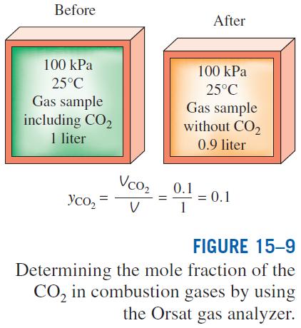
Predicting the composition of the products is relatively easy when the combustion process is assumed to be complete.
With actual combustion processes, it is impossible to predict the composition of the products on the basis of the mass balance alone.
Then the only alternative we have is to measure the amount of each component in the products directly.
A commonly used device to analyze the composition of combustion gases is the Orsat gas analyzer.
The results are reported on a dry basis.

Slide 24
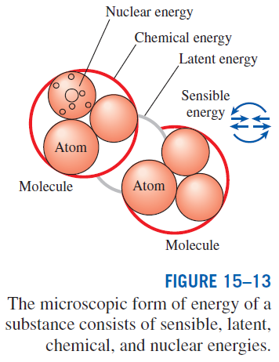
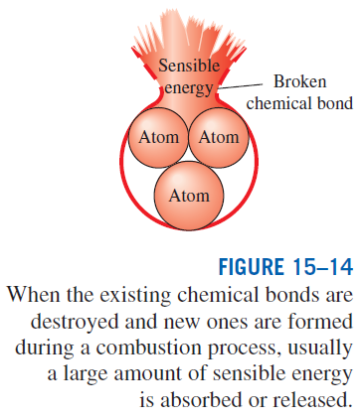
ENTHALPY OF FORMATION AND ENTHALPY OF COMBUSTION
Disregarding any changes in kinetic and potential energies, the energy change of a system during a chemical reaction is due to a change in state and a change in chemical composition:

