Slide 1
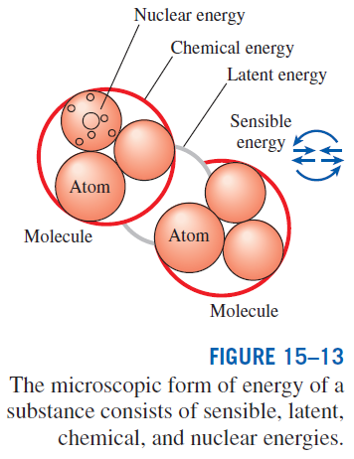
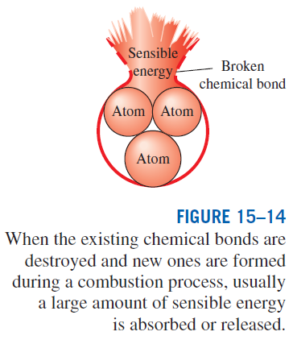
ENTHALPY OF FORMATION AND ENTHALPY OF COMBUSTION
Disregarding any changes in kinetic and potential energies, the energy change of a system during a chemical reaction is due to a change in state and a change in chemical composition:

Slide 2

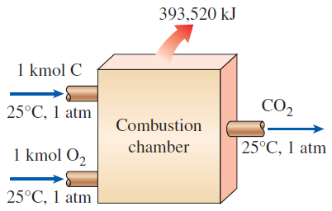

Enthalpy of reaction h_{R} : The difference between the enthalpy of the products at a specified state and the enthalpy of the reactants at the same state for a complete reaction.
Enthalpy of combustion h_{C} : It is the enthalpy of reaction for combustion processes. It represents the amount of heat released during a steady-flow combustion process when 1 kmol (or 1 kg) of fuel is burned completely at a specified temperature and pressure.
Enthalpy of formation h_{f} : The amount of energy absorbed or released as the component is formed from its stable elements during a steady-flow process at a specified state.
To establish a starting point, we assign the enthalpy of formation of all stable elements (such as O₂, N₂, H₂, and C) a value of zero at the standard reference state of 25°C and 1 atm.

Slide 3

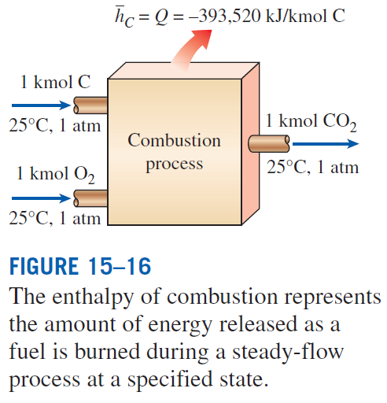

Slide 4
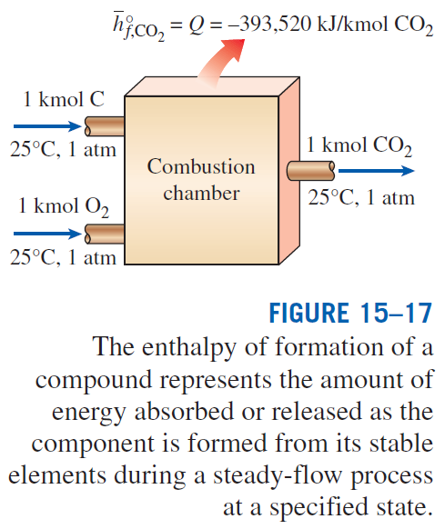
Enthalpy of formation: The enthalpy of a
substance at a specified state due to its chemical composition.

Slide 5
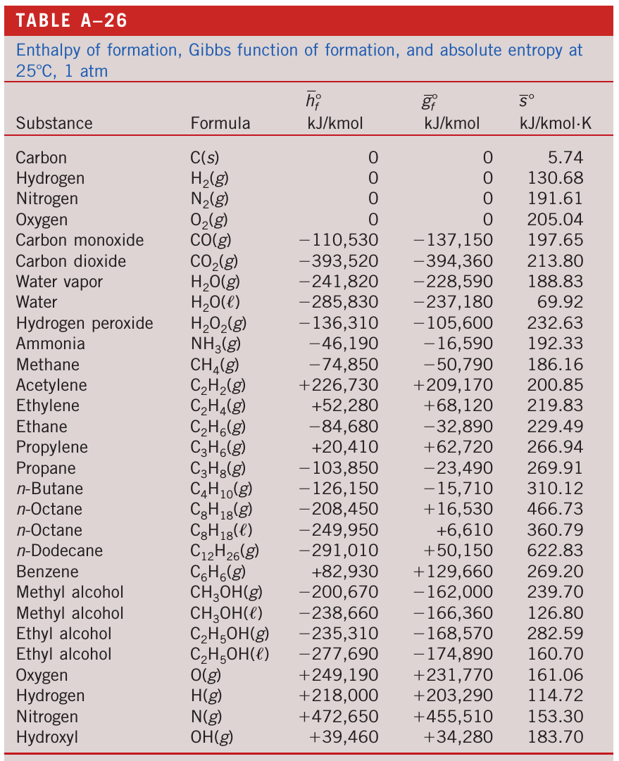
ENTHALPY OF FORMATION: Table

Slide 6
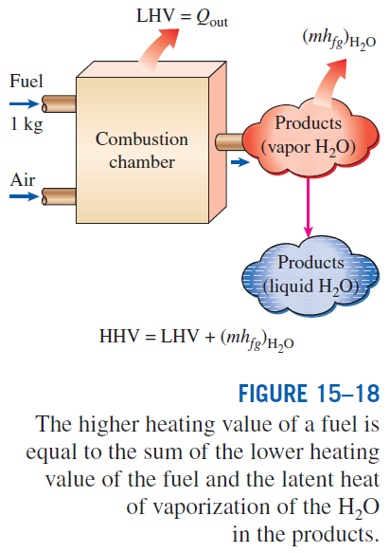
Heating value: The amount of heat released when a fuel is burned completely in a steady-flow process and the products are returned to the state of the reactants. The heating value of a fuel is equal to the absolute value of the enthalpy of combustion of the fuel.
Higher heating value (HHV): When the H₂O in the products is in the liquid form.
Lower heating value (LHV): When the H₂O in the products is in the vapor form.
For the fuels with variable composition (i.e., coal, natural gas, fuel oil), the heating value may be determined by burning them directly in a bomb calorimeter.

Slide 7
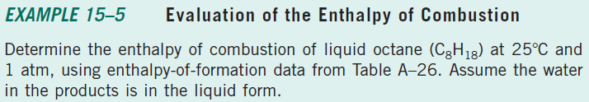
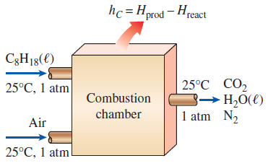

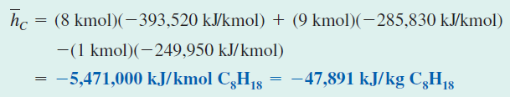

Slide 8
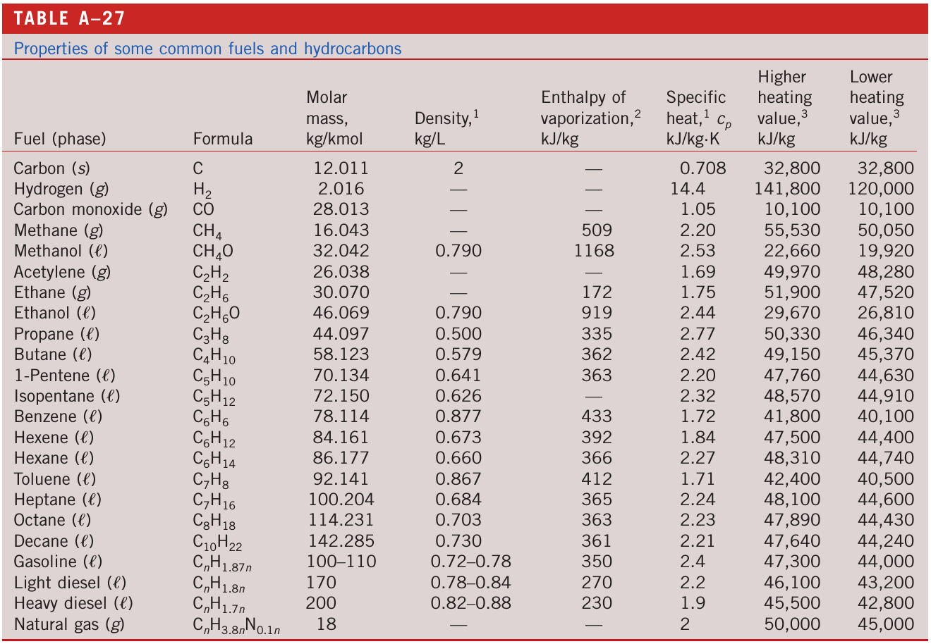
HEATING VALUE OF FUELS: Table

Slide 9

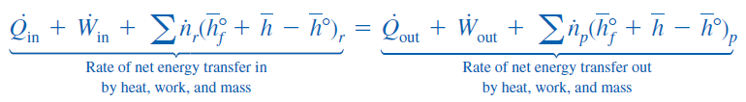
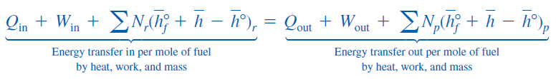
FIRST-LAW ANALYSIS OF REACTING SYSTEMS
The energy balance (the first-law) relations developed in Chaps. 4 and 5 are applicable to both reacting and nonreacting systems. We rewrite the energy balance relations including the changes in chemical energies.
Steady-Flow Systems
Table A26
Table A17-A25
When the changes in kinetic and potential energies are negligible, the steady-flow energy balance for a chemically reacting steady-flow system:

Slide 10
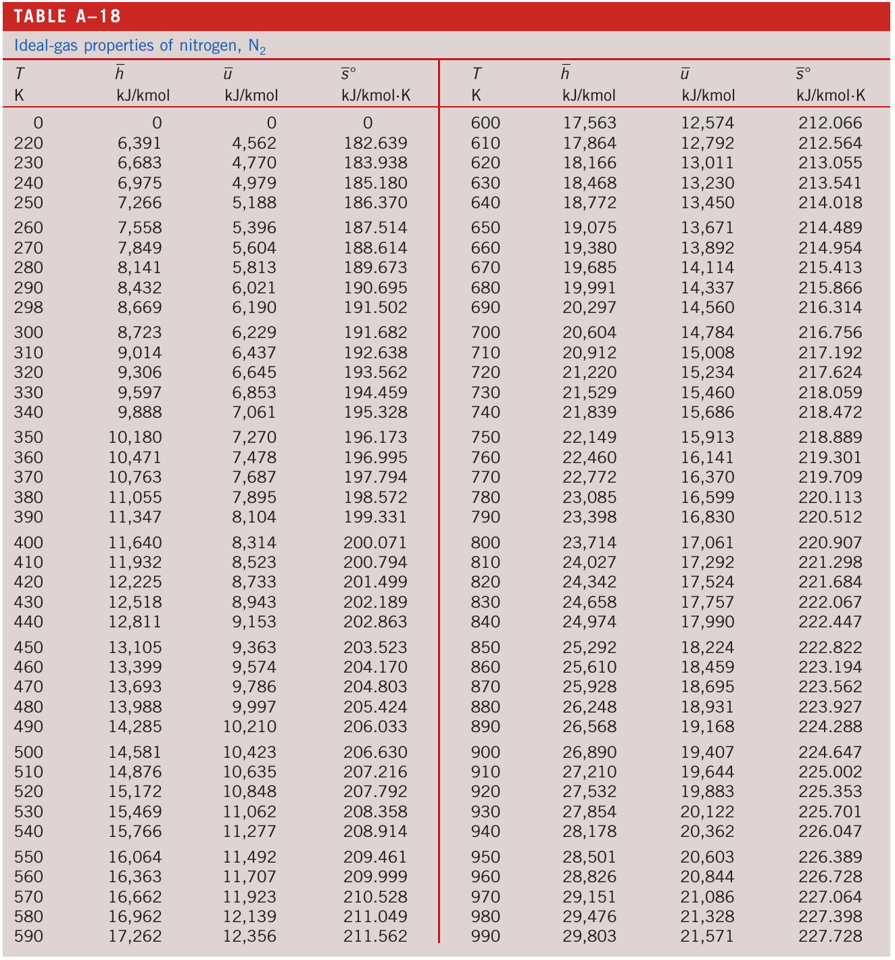
Nitrogen: Table

Slide 11
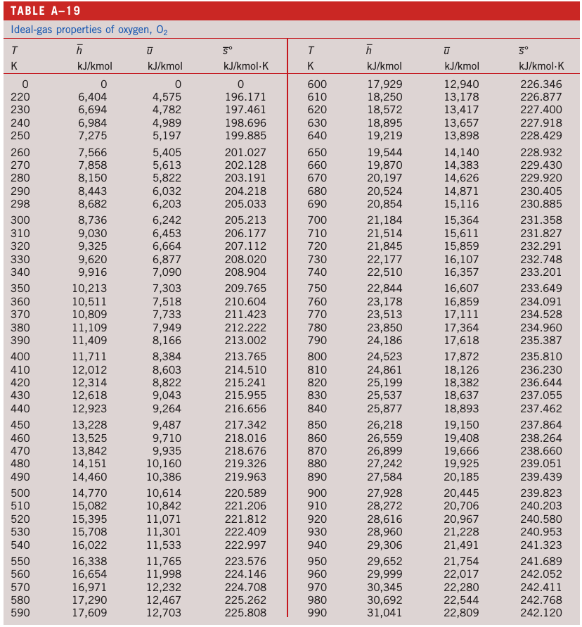
Oxygen: Table

Slide 12
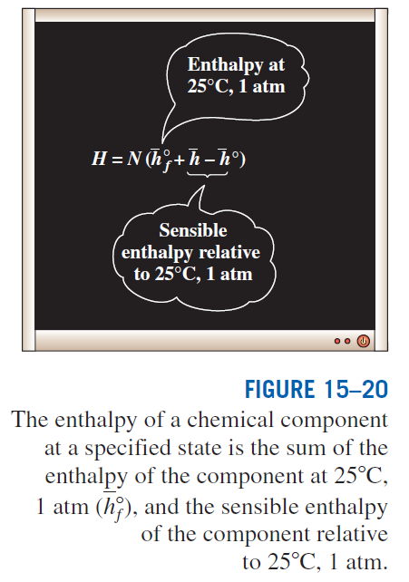

Slide 13
Taking heat transfer to the system and work done by the system to be positive quantities, the energy balance relation is
If the enthalpy of combustion for a particular reaction is available:
Most steady-flow combustion processes do not involve any work interactions. Also, combustion chamber normally involves heat output but no heat input:

Slide 14
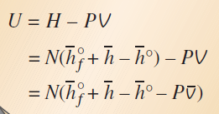
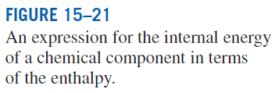


Closed Systems
Taking heat transfer to the system and work done by the system to be positive quantities, the general closed-system energy balance relation can be expressed for a stationary chemically reacting closed system as
Utilizing the definition of enthalpy:
The Pv terms are negligible for solids and liquids, and can be replaced by R_{u}T for gases that behave as an ideal gas.

Slide 15
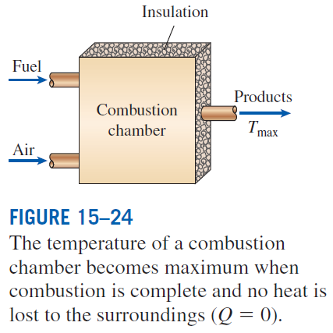
ADIABATIC FLAME TEMPERATURE
In the limiting case of no heat loss to the surroundings (Q = 0), the temperature of the products reaches a maximum, which is called the adiabatic flame or adiabatic combustion temperature.
since
The determination of the adiabatic flame temperature by hand requires the use of an iterative technique.

Slide 16
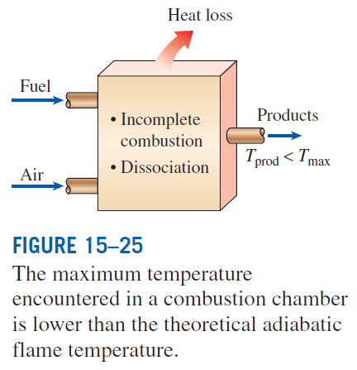
The adiabatic flame temperature of a fuel depends on
the state of the reactants
the degree of completion of the reaction
the amount of air used
For a specified fuel at a specified state burned with air at a specified state,
the adiabatic flame temperature attains its maximum value when complete combustion occurs with the theoretical amount of air.

Slide 17
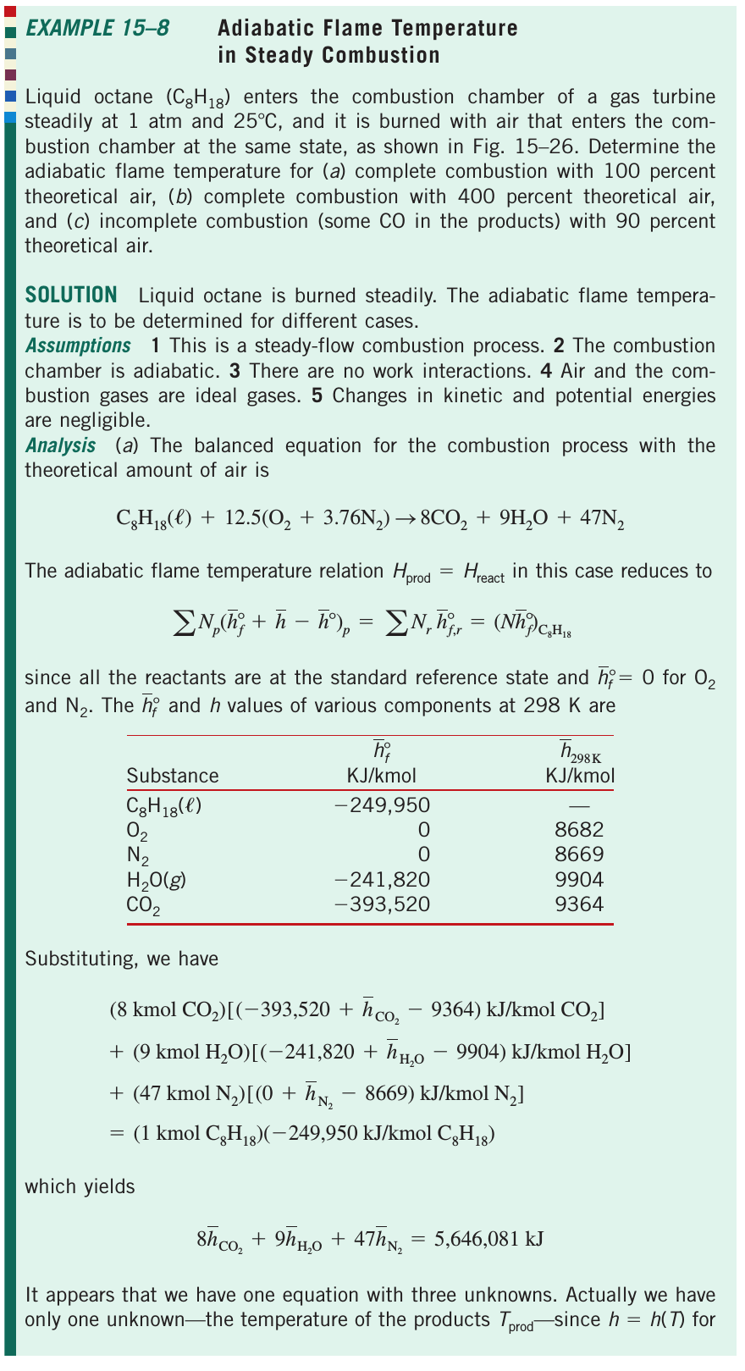
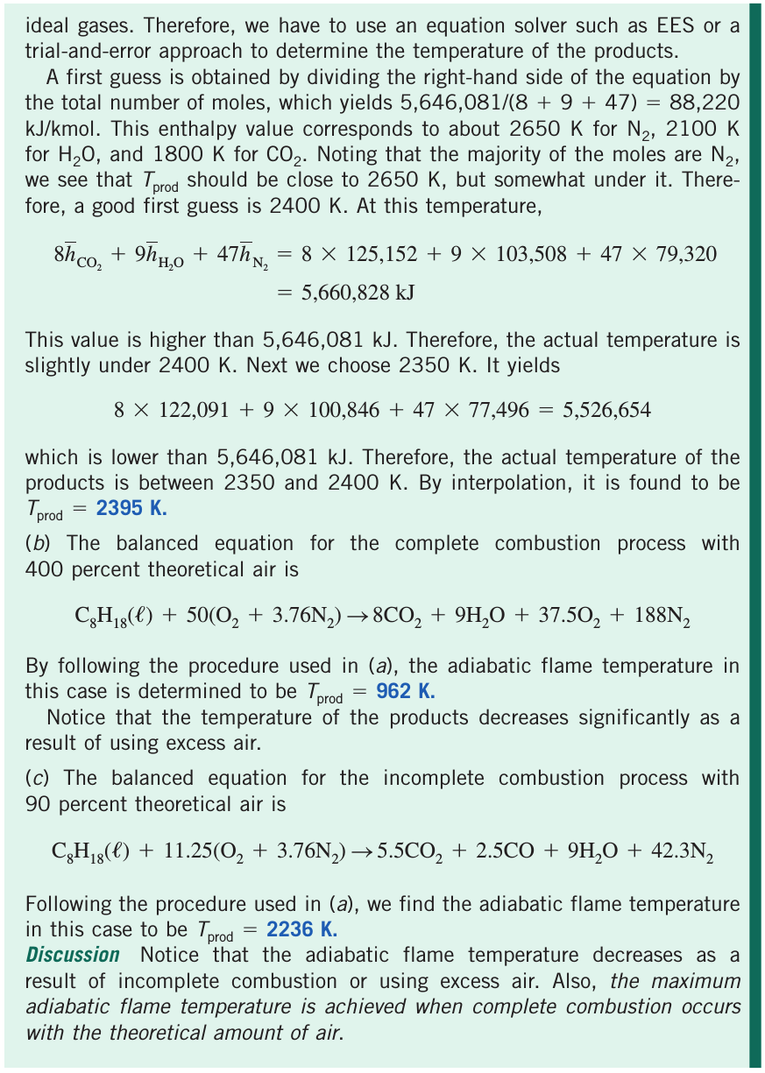
Adiabatic flame temperature: example

