Slide 1

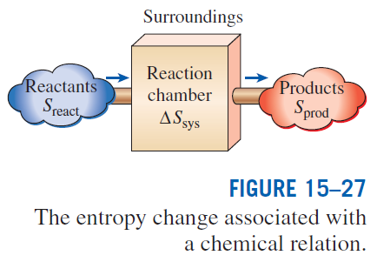
ENTROPY CHANGE OF REACTING SYSTEMS
entropy balance for any system (including reacting systems) undergoing any process
for a closed or steady-flow reacting system
for an adiabatic process (Q = 0)

Slide 2
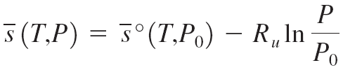
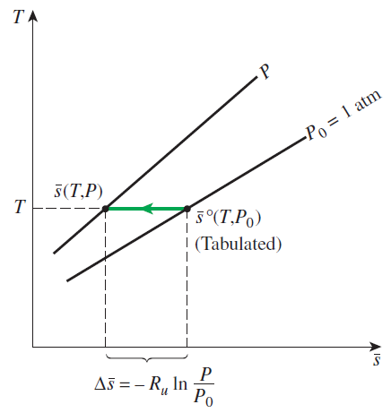
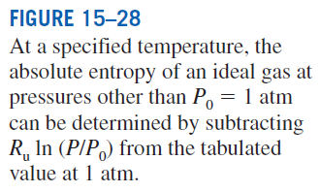
Entropy of a component
P₀ = 1 atm
P_{i} partial pressure
y_{i} mole fraction
P_{m} total pressure of mixture.
When evaluating the entropy of a component of an ideal-gas mixture, we should use the temperature and the partial pressure of the component.
The absolute entropy values are listed in Tables A–18 through A–25 for various ideal gases at the specified temperature and at a pressure of 1 atm. The absolute entropy values for various fuels are listed in Table A–26 at the standard reference state of 25°C and 1 atm.

Slide 3

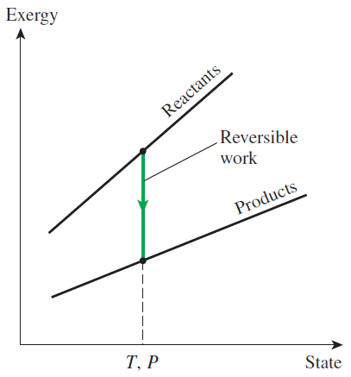


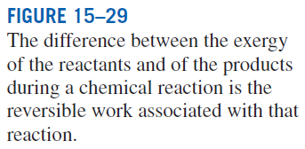
SECOND-LAW ANALYSIS OF REACTING SYSTEMS
Exergy destruction
The reversible work for a steady-flow combustion process that involves heat transfer with only the surroundings at T₀
When both the reactants and the products are at T₀
Gibbs function

Slide 4
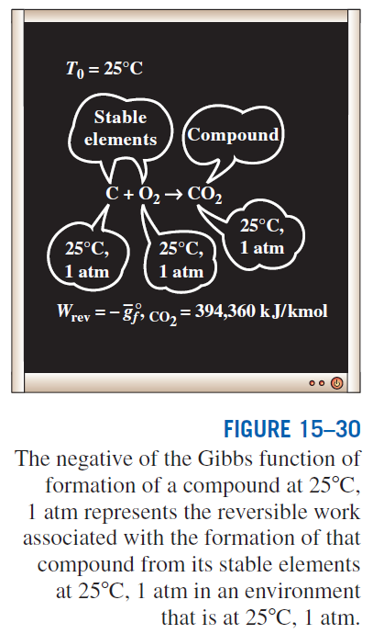

For the very special case of
T_{react} = T_{prod} = T₀ = 25°C
We can conclude from the above equation that the value (the negative of the Gibbs function of formation at 25°C and 1 atm) of a compound represents the reversible work associated with the formation of that compound from its stable elements at 25°C and 1 atm in an environment at 25°C and 1 atm.

Slide 5
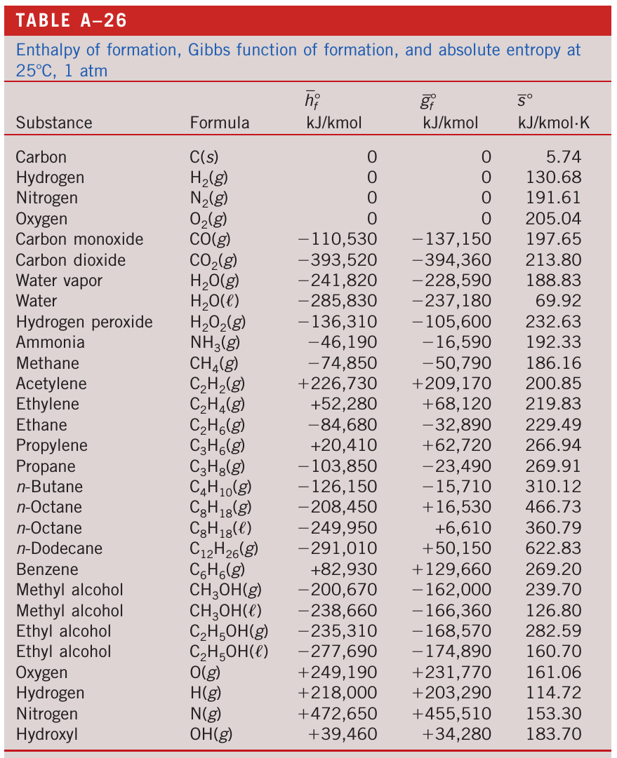
GIBBS FUNCTION: Table

Slide 6
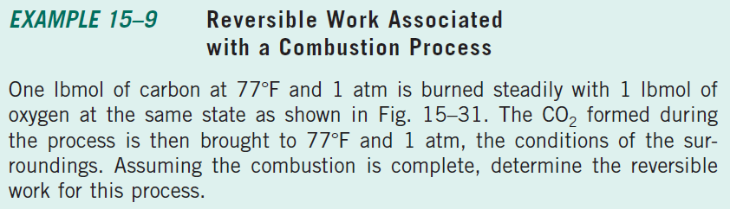
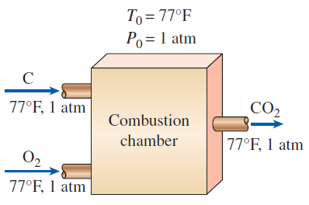

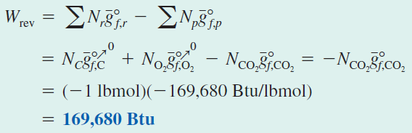

Slide 7
Summary
Fuels and combustion
Theoretical and actual combustion processes
Enthalpy of formation and enthalpy of combustion
First-law analysis of reacting systems
Steady-flow systems
Closed systems
Adiabatic flame temperature
Entropy change of reacting systems
Second-law analysis of reacting systems

Slide 8
CHAPTERS 11-15 Few Examples
Thermodynamics: An Engineering Approach
8th Edition Yunus A. Çengel, Michael A. Boles
McGraw-Hill, 2015
Adapted from the lecture slides by Mehmet Kanoglu Copyright © The McGraw-Hill Education.
Permission required for reproduction or display.

Slide 9
Chapter 11
Refrigeration Cycles

Slide 10
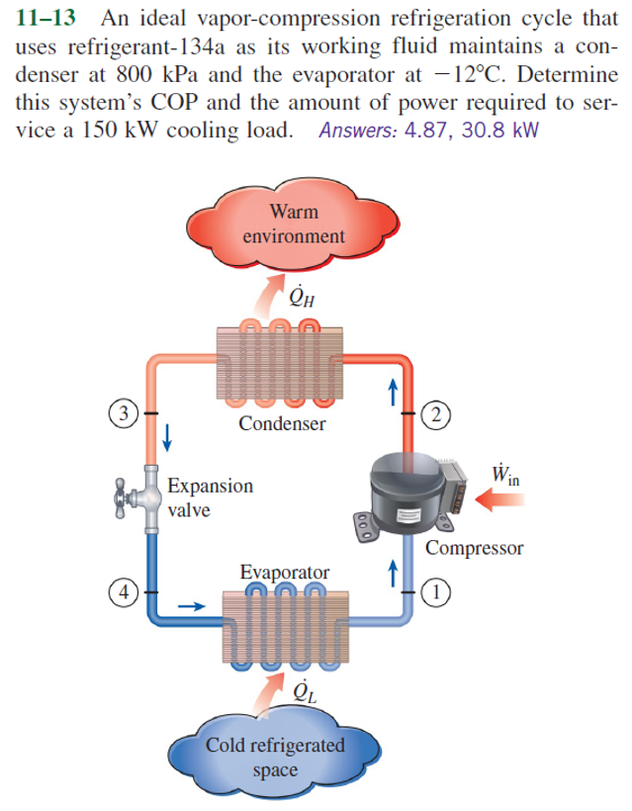

Slide 11
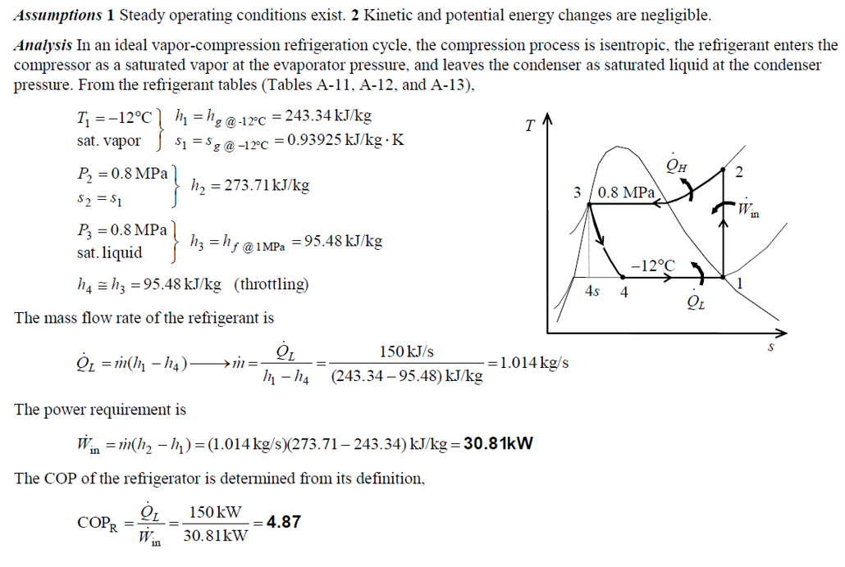

Slide 12
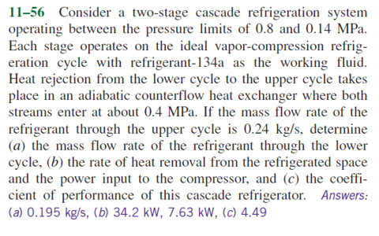

Slide 13
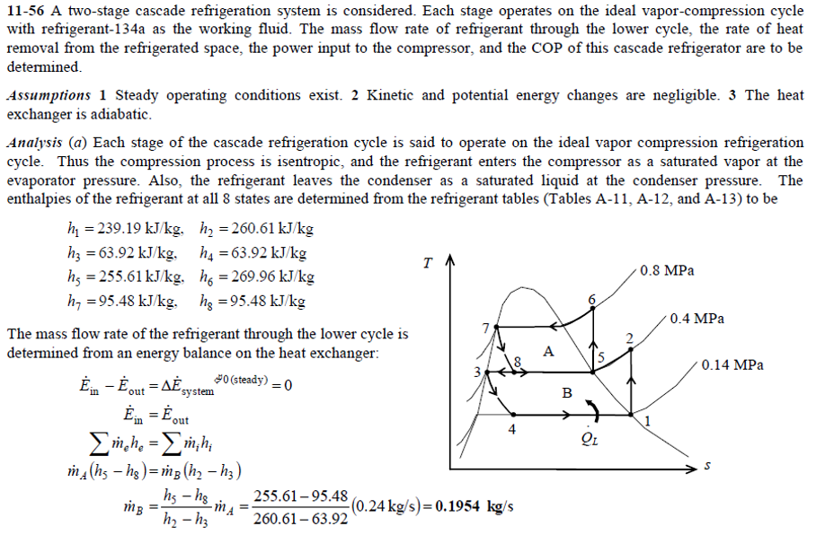

Slide 14
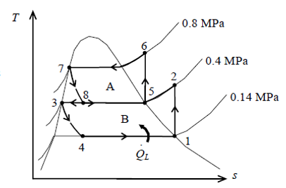
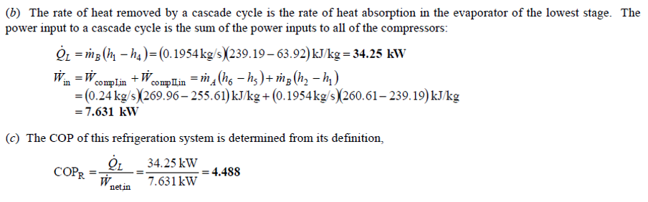

Slide 15
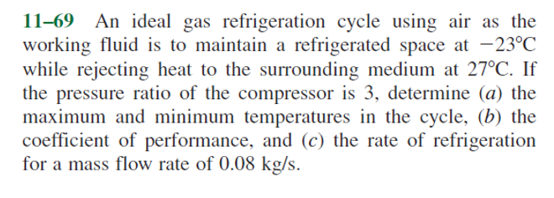

Slide 16
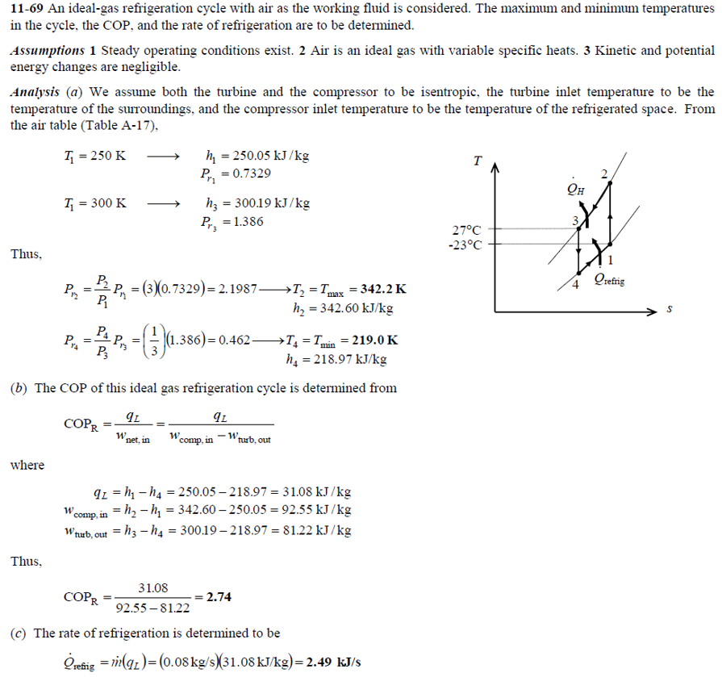

Slide 17
Chapter 12
Thermodynamic Property Relations

Slide 18
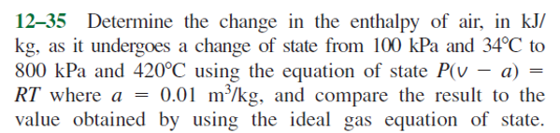

Slide 19
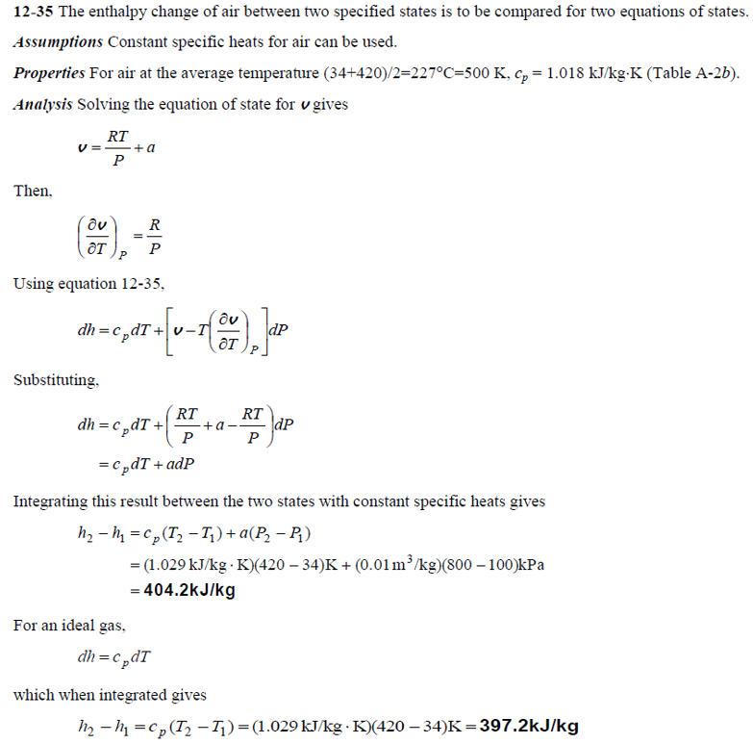

Slide 20
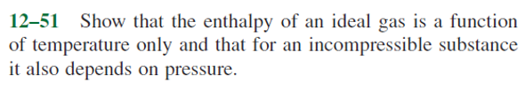

Slide 21
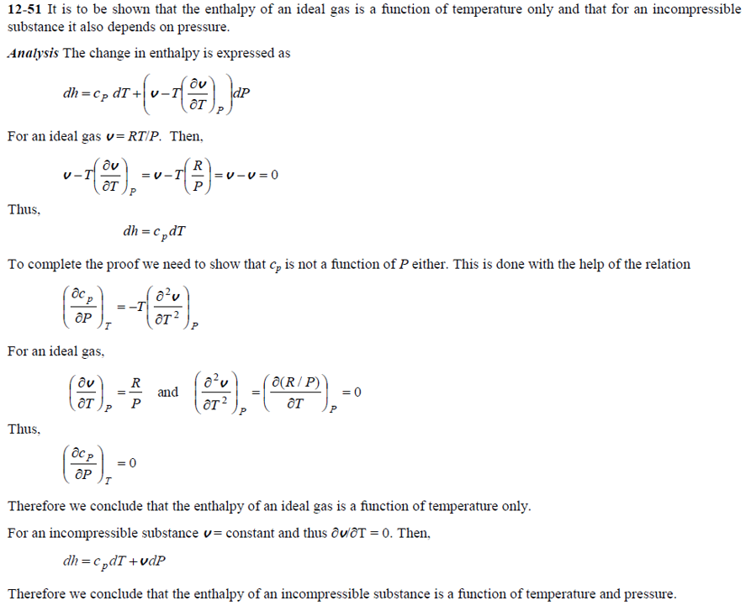

Slide 22
Chapter 15
Chemical Reactions

Slide 23


Slide 24
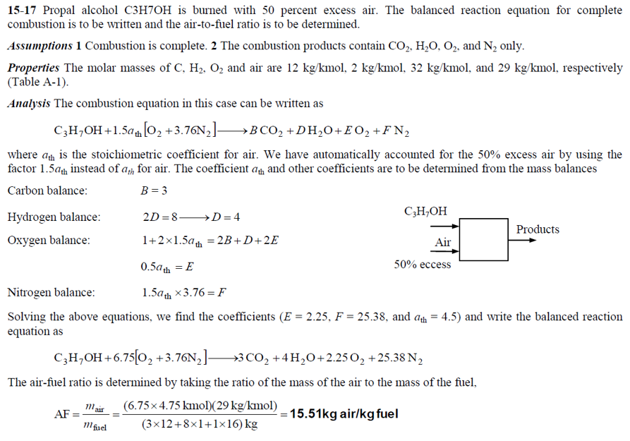

Slide 25
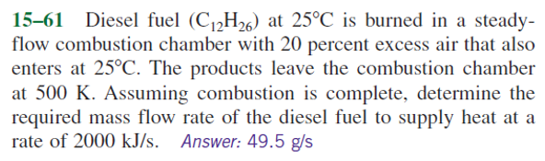

Slide 26
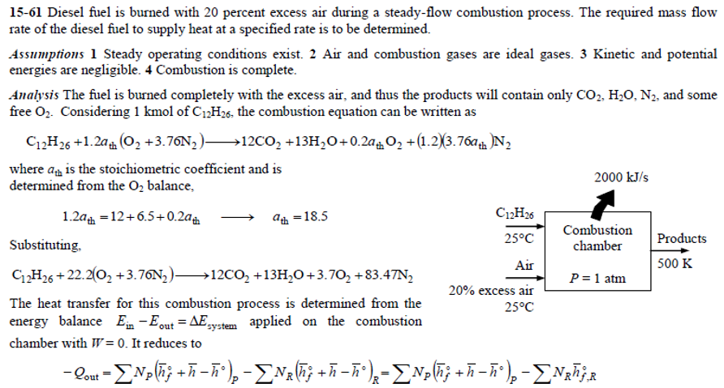

Slide 27
