Slide 1
CHAPTER 7 ENTROPY
Thermodynamics: An Engineering Approach
8th Edition Yunus A. Çengel, Michael A. Boles
McGraw-Hill, 2015
Adapted from the lecture slides by Mehmet Kanoglu Copyright © The McGraw-Hill Education.
Permission required for reproduction or display.

Slide 2
Objectives
Apply the second law of thermodynamics to processes.
Define a new property called entropy to quantify the second-law effects.
Establish the increase of entropy principle.
Calculate the entropy changes that take place during processes for pure substances, incompressible substances, and ideal gases.
Examine a special class of idealized processes, called isentropic processes, and develop the property relations for these processes.
Derive the reversible steady-flow work relations.
Develop the isentropic efficiencies for various steady-flow devices.
Introduce and apply the entropy balance to various systems.

Slide 3
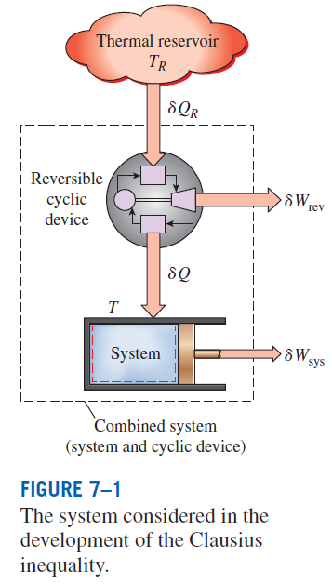



ENTROPY
Clasius inequality
The equality in the Clausius inequality holds for totally or just internally reversible cycles and the inequality for the irreversible ones.

Slide 4
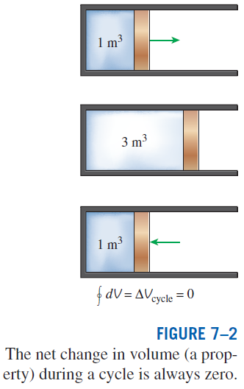
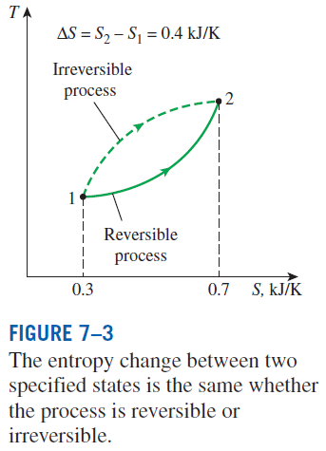
A quantity whose cyclic integral is zero (i.e., a property like volume)
Entropy is an extensive property of a system.
A Special Case: Internally Reversible
Isothermal Heat Transfer Processes
This equation is particularly useful for determining the entropy changes of thermal energy reservoirs.

Slide 5
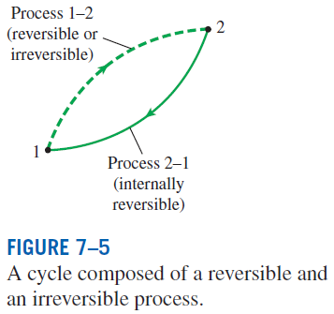



THE INCREASE OF ENTROPY PRINCIPLE
The equality holds for an internally reversible process and the inequality for an irreversible process.
Some entropy is generated or created during an irreversible process, and this generation is due entirely to the presence of irreversibilities.
The entropy generation S_{gen} is always a positive quantity or zero.
Can the entropy of a system during a process decrease?

Slide 6
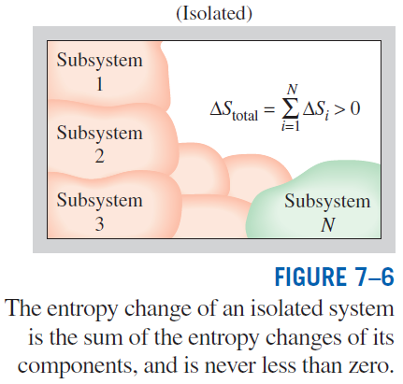
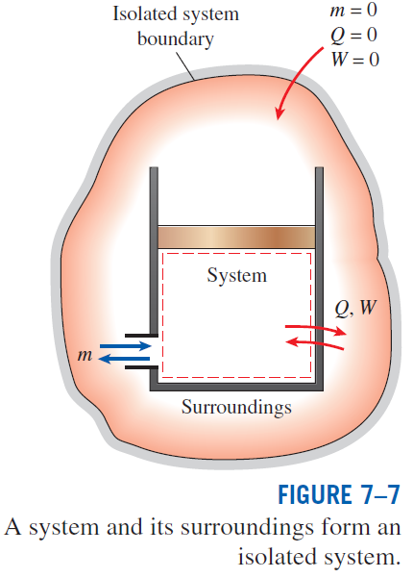
The increase of entropy principle

Slide 7
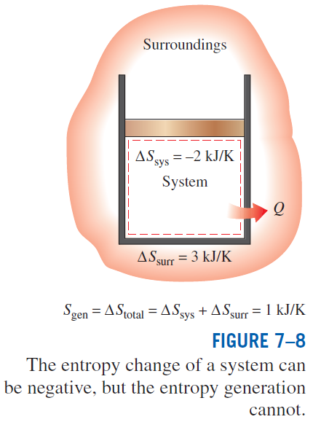
Some Remarks about Entropy
Processes can occur in a certain direction only, not in any direction. A process must proceed in the direction that complies with the increase of entropy principle, that is, S_{gen} ≥ 0. A process that violates this principle is impossible.
Entropy is a nonconserved property, and there is no such thing as the conservation of entropy principle. Entropy is conserved during the idealized reversible processes only and increases during all actual processes.
The performance of engineering systems is degraded by the presence of irreversibilities, and entropy generation is a measure of the magnitudes of the irreversibilities during that process. It is also used to establish criteria for the performance of engineering devices.

