Slide 1
Application of a temporal orientation classifier in opioid addiction study
FINAL
Gian Carlo L. Baldonado
December 8, 2022
Notes:
Time is perceived by us through our senses and internal biological clock which are intrinsically connected to our lifespans. It has a physiological aspect that could not possibly be affected by learning an incredibly different language.

Slide 2
Agenda
Introduction
Related Work
Purpose
Project Timeline
Data Collection and Annotation
Data Preprocessing and Feature Engineering
Building Models
Evaluation
Conclusion

Slide 3

Introduction
Time Perspective (TP) is the manner in which individuals divide the flow of their human experience into different time frames or time zones (i.e. past, present, future) – automatically and non-consciously.
Social science and psychology studies show that a person’s time perspective orientation has a profound impact on different aspects of their personhood, including their health[1].
Using social media posts, can we create a decent temporal orientation classifier that can resolve syntactic tense to semantic time?
Can we use temporal orientation to predict a person’s state of opioid drug addiction (using, withdrawal, recovery)?
In 2019, an estimated 10.1 million people aged 12 or older misused opioids in the past year.[1]
9.7 million people misused prescription pain relievers
745,000 people used heroin
Opioid addiction continues to be a contemporary health crisis.
How can we use time perspective, the manner in which individuals divide the flow of their human experience into different time zones, help in modelling the epidemic?
Notes:
According to a 2019 study by the US Department of Health’s Substance Abuse and Mental Health Services Administration
On this note…
Time Perspective (TP) is the manner in which individuals divide the flow of their human experience into different time frames or time zones (i.e. past, present, future) – automatically and non-consciously.
In the paper “Resolution of grammatical tense into actual time, and its application in Time Perspective study in the tweet space”
we’ve learned that a person’s temporal orientation or time perspective has profound impact on their behavior, attitudes, emotions, educational achievements, and health.
For example, the analysis of thatt paper show that people who are

Slide 4
Related Work
Modeling opioid epidemiology addiction
Identifying and Characterizing Opioid Addiction States Using Social Media Posts (D. Jha, et. al.)
Extracted Reddit posts to use for identifying the progression of individuals through stages of opioid addiction.
Resolution of grammatical tense into actual time, and its application in Time Perspective study in the tweet spac (Sabyasachi Kamila et. al.)
Used Twitter data and built temporal orientation classifiers that can resolve syntactic tense to semantic time.
An application study of temporal orientation classifiers onto the opioid addiction study has yet to be done.

Slide 5
Purpose
Using social media posts, can we create a temporal orientation classifier that can resolve syntactic tense to semantic time relevant to the opioid user’s addiction state.
Notes:
In the paper “Resolution of grammatical tense into actual time, and its application in Time Perspective study in the tweet space”
we’ve learned that a person’s temporal orientation or time perspective has profound impact on their behavior, attitudes, emotions, educational achievements, and health.
For example, the analysis of thatt paper show that people who are

Slide 6
Updates from Phase II
No longer conducting a correlation study.
The scope of work is focused on building the temporal orientation classifier.
Notes:
Correlation study moot because there is a dependent and independent variable. and correlations

Slide 7
Project Timeline
Data collection and annotation
Building Models
Data preprocessing and feature engineering
Evaluation
Figure 1: The timeline of building a temporal orientation classifier.
Notes:
Gather and manually annotate data (tweets)
Build a temporal classifier based on the annotated data
After Phase II presentation (after 11/17)
Obtain a dataset that contains Twitter/Reddit users with sample tweets and their opioid state.
Use temporal classifier on obtained dataset and measure user-level TP.
Perform an association/correlation study between user TP and opioid states.

Slide 8
Data Collection & Annotation
Twitter API via tweepy: narrowed results through opioid-related keywords obtained through multiple sources.
eg, codeine, morphine, hydrocodone, pills, syrup, oxycodone, oxycontin, percocet, etc.
Reddit via PushiftAPI: collected data from r/Opiates and r/OpiatesRecovery[4] and favored tweets with less than or equal to 280 characters.
TP Orientation | Sample Post
Future | I’m like 20-ish days clean and the Brain zaps finally stopped.. my goal is to not use any hard drugs all of 2021 let’s make it happen 🙏🏽
Past | I was on 170mg and had been for two years. The physical withdrawals lasted a little over a month, the mental stuff went away after about 3.
Present | I am on day 8 as well and the mood swings are insane. I thought I was going crazy.
Table 1: Samples of data collected from Twitter and Reddit.
Notes:
In the paper “Resolution of grammatical tense into actual time, and its application in Time Perspective study in the tweet space”
we’ve learned that a person’s temporal orientation or time perspective has profound impact on their behavior, attitudes, emotions, educational achievements, and health.
For example, the analysis of thatt paper show that people who are

Slide 9
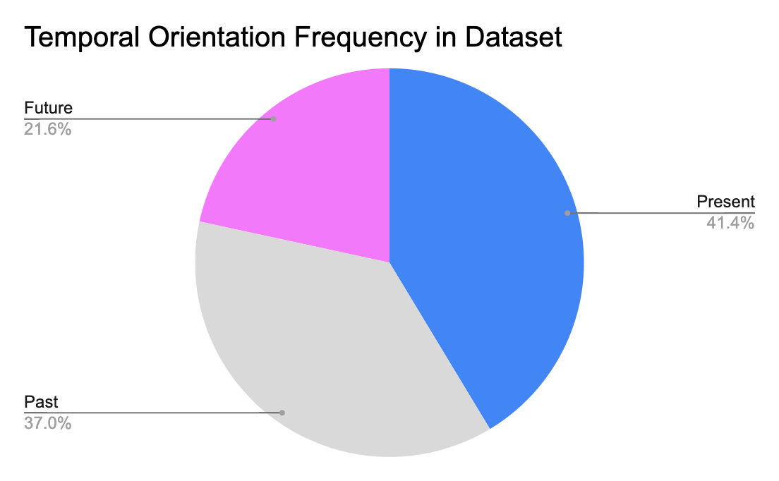
Data Collection & Annotation
Updated dataset now has a total of 648 annotated social media posts
140 future-oriented posts
240 past-oriented posts
268 present-oriented posts
Figure 2: Frequency of TP orientation out of the 648 annotated social media posts.
Notes:
In the paper “Resolution of grammatical tense into actual time, and its application in Time Perspective study in the tweet space”
we’ve learned that a person’s temporal orientation or time perspective has profound impact on their behavior, attitudes, emotions, educational achievements, and health.
For example, the analysis of thatt paper show that people who are

Slide 10
Data Preprocessing
Split the dataset into training and test sets.
 | Training set (n=434) |  | Testing set (n = 214)
TP Orientation | Count | Percent | Count | Percent
Future | 90 | 20.74% | 50 | 23.36%
Past | 163 | 37.56% | 77 | 35.98%
Present | 181 | 41.71% | 87 | 40.65%
Total | 434 |  | 214
Table 2: TP orientation count and frequencies in the training and test sets.
Notes:
In the paper “Resolution of grammatical tense into actual time, and its application in Time Perspective study in the tweet space”
we’ve learned that a person’s temporal orientation or time perspective has profound impact on their behavior, attitudes, emotions, educational achievements, and health.
For example, the analysis of thatt paper show that people who are

Slide 11
Data Preprocessing
Enhanced preprocessing
Basic cleaning: convert \n to ‘_’, lower case, remove punctuations, strip, remove hyperlinks
Deconstruction of contractions, e.g.. ‘ll to will
Modified stop word: removed verbs and common contractions from stopwords, e.g. the word won’t is not in stopwords
Notes:
The skipgram model learns to predict a target word thanks to a nearby word. On the other hand, the cbow model predicts the target word according to its context.

Slide 12
Feature Engineering
Overview
Polarity and Subjectivity scores
Count time expressions
Count temporal modifiers (adj. and adv.)
Count part of speech tags
Word2Vec matrix, TF-IDF matrix
A feature-engineered dataset that includes all features has a total of 366 features.
Notes:
The skipgram model learns to predict a target word thanks to a nearby word. On the other hand, the cbow model predicts the target word according to its context.

Slide 13
Feature Engineering
Polarity and Subjectivity scores
Polarity score
NLTK Vader
Output structure: [negative score, neutral score, positive score, compound score], each score scale [0,1]
Subjectivity score
Textblob
scale [0,1]
Count time expressions
Counts instances of time expressions using Stanford CoreNLP SUTime
 | Example
Input (cleaned, tokenized) | 'find helps change everything new friends new hobbies new routines get healthy lifestyle exercise work mental health stuff personally therapy ppl self help groups'
Output, polarity and subjectivity score | (0.0, 0.643, 0.357, 0.8779, 0.39)
Output, count time expressions | 0
Table 3: Sample input and outputs for feature engineering polarity and subjectivity scores and count time expressions.
Notes:
The compound score is the sum of positive, negative & neutral scores which is then normalized between -1(most extreme negative) and +1 (most extreme positive).
The skipgram model learns to predict a target word thanks to a nearby word. On the other hand, the cbow model predicts the target word according to its context.

Slide 14
Feature Engineering
Temporal Type | Adverbs and Adjectives
Futuristic | ['finally', 'later', 'next', 'soon', 'yet', 'forward']
Past | ['then', 'before', 'formerly', 'last', 'late', 'previously', 'past', 'former']
Past-present | ['yesterday', 'already', 'early', 'earlier', 'since', 'earlier']
Present | ['now', 'today', 'just', 'lately', 'recently']
Present-futuristic | ["tomorrow", "tonight", "later"]
Undetermined | ['daily', 'fortnightly', 'hourly', 'monthly', 'nightly']
Count temporal modifiers (adj. and adv.)
Consulted articles online for linguistic domain knowledge.
Built lists of temporal adjectives and adverbs according to their type
Types determined: futuristic, past, past present, present, present futuristic, undetermined
Count part of speech tags
NLTK
Count of nouns, verbs, interjections, adverbs, determiners, prepositions, etc.
Table 4: Some of the temporal adverbs and adjectives used in feature engineering.
Notes:
The compound score is the sum of positive, negative & neutral scores which is then normalized between -1(most extreme negative) and +1 (most extreme positive).
The skipgram model learns to predict a target word thanks to a nearby word. On the other hand, the cbow model predicts the target word according to its context.

Slide 15
Feature Engineering
Word2Vec and TF-IDF
Word2Vec
Accounted for bigrams and trigrams
Created a w2v model with 300 dimensions
TF-IDF
max_features 10,000
ngram range (1,2)
Decreased the dimensionality of the sparse matrix using feature selection chi-squared with p-value limit of 0.80.
From 10,000 features to 46 most relevant features.
Feature selection for TF-IDF
['future', 'year sober', 'plan', 'hopefully', 'forward', 'want', 'live', 'mind', 'keep', 'use kratom', 'relapsing', 'thank', 'time im', 'look', 'excited', 'im excited', 'sober fentanyl', 'thank thank', 'puts', 'tapering', 'feel normal', 'way live', 'ahead', 'withdrawals im', 'hoping', 'jump', 'path', 'social', 'deep', 'maybe use', 'sleep maybe', 'use tramadol', 'ill keep', 'month use', 'life', 'think hell', 'used', 'loved', 'im', 'times', 'made', 'lost', 'years', 'percs', 'itching', 'pupils']
Table 5: Forty-six most relevant features according to a chi-squared test of the TF-IDF matrix.
Notes:
The compound score is the sum of positive, negative & neutral scores which is then normalized between -1(most extreme negative) and +1 (most extreme positive).
The skipgram model learns to predict a target word thanks to a nearby word. On the other hand, the cbow model predicts the target word according to its context.

Slide 16
Feature Importance
Chi-squared test
 | Top features by class
Future | thank,future,jump,puts,forward,live,plan,tapering,hoping,path
Past | times,used,made,years,loved,lost,keep,mind,im
Present | made,used,pupils,futuristic,percs,times,years,im,tapering
Table 6: Top features by class according to chi-square test with p_value limit 0.90
Notes:
The compound score is the sum of positive, negative & neutral scores which is then normalized between -1(most extreme negative) and +1 (most extreme positive).
The skipgram model learns to predict a target word thanks to a nearby word. On the other hand, the cbow model predicts the target word according to its context.

Slide 17
Models
Overview
First iteration (Phase II)
Second iteration (Final)
Random Forest
Logistic Regression
Naive Bayes
SVM
Notes:
The compound score is the sum of positive, negative & neutral scores which is then normalized between -1(most extreme negative) and +1 (most extreme positive).
The skipgram model learns to predict a target word thanks to a nearby word. On the other hand, the cbow model predicts the target word according to its context.

Slide 18
Models
First Iteration (Phase 2): features used include count of part of speech tags, polarity and subjectivity scores from Textblob, word2vec (100 size)
Random Forest
Optimal hyperparameters: n_estimators: 1000, max_features 20
accuracy: [0.41, 0.45]
Second Iteration (Final): features used include polarity and subjectivity scores, count time expressions, count temporal modifiers (adj. and adv.), count part of speech tags, Word2Vec matrix, (300 size) and reduced TF-IDF matrix
Random Forest
Performed grid-search cross validation (5-fold)
'n_estimators' : [100,200,500,1000],
'max_features' : [9, 19, 38]
Notes:
Random forest takes random subsets of features and tries to find the best split. max_features helps to find the number of features to take into account in order to make the best split.

Slide 19
Models
Second Iteration (Final): features used include polarity and subjectivity scores, count time expressions, count temporal modifiers (adj. and adv.), count part of speech tags, Word2Vec matrix, (300 size) and reduced TF-IDF matrix
Logistic Regression
multi_class = 'auto'
'C' : [0.1, 1, 10, 100],
'solver' : ['lbfgs', 'liblinear']
Multinomial Naive Bayes
'alpha' : np.linspace(0.5, 1.5, 6),
'fit_prior' : [True, False]
Notes:
Logistic Regression
penalty{‘l1’, ‘l2’, ‘elasticnet’, None}, default=’l2’
Specify the norm of the penalty:
None: no penalty is added;
'l2': add a L2 penalty term and it is the default choice;
'l1': add a L1 penalty term;
'elasticnet': both L1 and L2 penalty terms are added.
From a practical standpoint, L1 tends to shrink coefficients to zero whereas L2 tends to shrink coefficients evenly. L1 is therefore useful for feature selection, as we can drop any variables associated with coefficients that go to zero. L2, on the other hand, is useful when you have collinear/codependent features.
Cfloat, default=1.0
Inverse of regularization strength; must be a positive float. Like in support vector machines, smaller values specify stronger regularization.
solver{‘lbfgs’, ‘liblinear’, ‘newton-cg’, ‘newton-cholesky’, ‘sag’, ‘saga’}, default=’lbfgs’
Algorithm to use in the optimization problem. Default is ‘lbfgs’. To choose a solver, you might want to consider the following aspects:
Naive bayes
alphafloat or array-like of shape (n_features,), default=1.0
Additive (Laplace/Lidstone) smoothing parameter (set alpha=0 and force_alpha=True, for no smoothing).
fit_priorbool, default=True
Whether to learn class prior probabilities or not. If false, a uniform prior will be used.

Slide 20
Models
Second Iteration (Final): features used include polarity and subjectivity scores, count time expressions, count temporal modifiers (adj. and adv.), count part of speech tags, Word2Vec matrix, (300 size) and reduced TF-IDF matrix
SVM
{'kernel': ['rbf'], 'gamma': [1e-3, 1e-4], 'C': [1, 10, 100, 1000]},
{'kernel': ['linear'], 'C': [1, 10, 100, 1000]}
Notes:
Cfloat, default=1.0
Regularization parameter. The strength of the regularization is inversely proportional to C. Must be strictly positive. The penalty is a squared l2 penalty.
kernel{‘linear’, ‘poly’, ‘rbf’, ‘sigmoid’, ‘precomputed’} or callable, default=’rbf’
Specifies the kernel type to be used in the algorithm. If none is given, ‘rbf’ will be used. If a callable is given it is used to pre-compute the kernel matrix from data matrices; that matrix should be an array of shape (n_samples, n_samples).
gamma{‘scale’, ‘auto’} or float, default=’scale’
Kernel coefficient for ‘rbf’, ‘poly’ and ‘sigmoid’.
if gamma='scale' (default) is passed then it uses 1 / (n_features * X.var()) as value of gamma,
if ‘auto’, uses 1 / n_features
if float, must be non-negative.

Slide 21
Evaluation
Model | Accuracy | Optimal Parameters
Random Forest (1st iteration) | 0.45 | n_estimators: 1000, max_features: 28
Random Forest (2nd iteration) | 0.52 | n_estimators: 500, max_features: 38
Logistic Regression | 0.54 | C: 1, solver: lbfgs
Naive Bayes | 0.58 | alpha: 0.5, fit_prior: True
SVM | 0.57 | C: 100, kernel: linear, gamma: scale
Table 6: Model comparisons, with naive bayes highlighted as the highest performing algorithm for the final phase.
Notes:
SVM It tries to find an optimal boundary (known as hyperplane) between different classes. In simple words, SVM does complex data transformations depending on the selected kernel function, and based on those transformations, it aims to maximize the separation boundaries between your data points.
Naive bayes: Because of the class independence assumption, naive Bayes classifiers can quickly learn to use high dimensional features with limited training data compared to more sophisticated methods. This can be useful in situations where the dataset is small compared to the number of features, such as images or texts.

Slide 22
Conclusion
Naive bayes and SVM are promising algorithms to be used for temporal orientation classification with a relatively small dataset.
TF-IDF features and count of temporal modifiers among top features according to chi-squared test.
Next steps
Feature: count of verb phrasals
Use spacy
Consult linguistic references for morphological patterns that determine future, past, and present-oriented sentences
Perform classification reports for all models (include F1, Precision, Recall scores)
Notes:
Because of the class independence assumption, naive Bayes classifiers can quickly learn to use high dimensional features with limited training data compared to more sophisticated methods. This can be useful in situations where the dataset is small compared to the number of features, such as images or texts

