Slide 1
Applications of a temporal orientation classifier in opioid addiction study
Gian Carlo L. Baldonado
November 17, 2022
Notes:
Time is perceived by us through our senses and internal biological clock which are intrinsically connected to our lifespans. It has a physiological aspect that could not possibly be affected by learning an incredibly different language.

Slide 2
Agenda
Introduction
Purpose
Goals
Project Timeline
Data Collection and Annotation
Data Preprocessing and Feature Engineering
Building Models
Evaluation
Conclusion

Slide 3
Introduction > Purpose
Social science and psychology studies show that a person’s time perspective orientation has a profound impact on different aspects of their personhood, including their health[1].
Using social media posts, can we create a decent temporal orientation classifier that can resolve syntactic tense to semantic time?
Can we use temporal orientation to predict a person’s state of opioid drug addiction (using, withdrawal, recovery)?
Notes:
In the paper “Resolution of grammatical tense into actual time, and its application in Time Perspective study in the tweet space”
we’ve learned that a person’s temporal orientation or time perspective has profound impact on their behavior, attitudes, emotions, educational achievements, and health.
For example, the analysis of thatt paper show that people who are

Slide 4
Introduction > Goals
Use Twitter and Reddit API and manually annotate dataset.
Leverage Random Forest Classifier and Bi-LSTM to create a temporal classifier.
Conduct a correlation study between user-level temporal orientation with user’s opioid addiction state.
Notes:
In the paper “Resolution of grammatical tense into actual time, and its application in Time Perspective study in the tweet space”
we’ve learned that a person’s temporal orientation or time perspective has profound impact on their behavior, attitudes, emotions, educational achievements, and health.
For example, the analysis of thatt paper show that people who are

Slide 5
Project Timeline
Part I
Part II*
Data collection and annotation
Building models
Measuring user-level TP
Data preprocessing and feature engineering
Evaluating models
Conducting correlation Study
Figure 1: The timeline is separated into two parts. Part II can be done separately given a pre-trained temporal orientation classifier.
Notes:
Gather and manually annotate data (tweets)
Build a temporal classifier based on the annotated data
After Phase II presentation (after 11/17)
Obtain a dataset that contains Twitter/Reddit users with sample tweets and their opioid state.
Use temporal classifier on obtained dataset and measure user-level TP.
Perform an association/correlation study between user TP and opioid states.

Slide 6
Data Collection & Annotation
TP Orientation | Sample Post
Future | now to wait for the oxycodone to kick in. if there's anything i have to look forward to in life, it's definitely painkillers. that, and alcohol.
Past | Being clean and sober is lovely but sometimes I wonder if the last 6 years of stress is more harmful than heroin. 🤔
Present | guys to be honest I’m on dilaudid and I can’t keep my eyes open or at least both of them at a time
Mixed | I see what you're saying but I know myself pretty well and I have more self control than that. I've quit other drugs before and tapering works for me, kinda suck that nobody gave any advice on how to do it.
Twitter API via tweepy: narrowed results through opioid-related keywords obtained through multiple sources.[2, 3]
eg, codeine, morphine, hydrocodone, pills, syrup, oxycodone, oxycontin, percocet, etc.
Reddit via PushiftAPI: collected data from r/Opiates and r/OpiatesRecovery[4] and favored tweets with less than or equal to 280 characters.
Table 1: Samples of data collected from Twitter and Reddit.
Notes:
In the paper “Resolution of grammatical tense into actual time, and its application in Time Perspective study in the tweet space”
we’ve learned that a person’s temporal orientation or time perspective has profound impact on their behavior, attitudes, emotions, educational achievements, and health.
For example, the analysis of thatt paper show that people who are

Slide 7
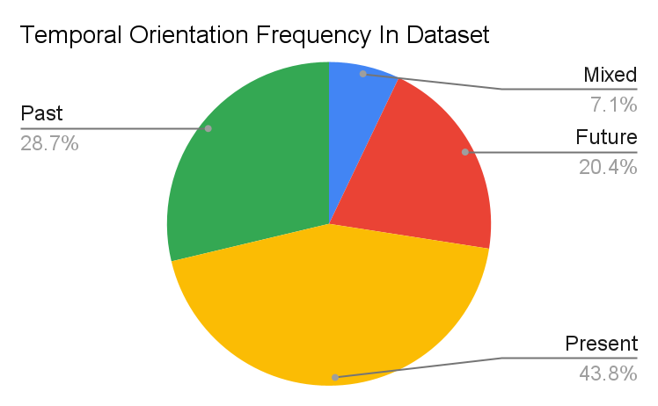
Data Collection & Annotation
N total 550 annotated social media posts
Past: 158, 28.7%
Mixed: 39, 7.1%
Future: 112, 20.4%
Present: 241, 43.8%
Figure 2: Frequency of TP orientation out of the 550 annotated social media posts.
Notes:
In the paper “Resolution of grammatical tense into actual time, and its application in Time Perspective study in the tweet space”
we’ve learned that a person’s temporal orientation or time perspective has profound impact on their behavior, attitudes, emotions, educational achievements, and health.
For example, the analysis of thatt paper show that people who are

Slide 8
Data Preprocessing and Feature Engineering
Split the dataset into training and test sets.
TP Orientation | Training set (n = 368) | Testing set (n = 182)
Future | 66, 17.93% | 46, 25.27%
Past | 113, 30.71% | 45, 24.73%
Present | 168, 45.65% | 73, 40.11%
Mixed | 21, 5.71% | 18, 9.89%
Table 2: TP orientation count and frequencies in the training and test sets.
Preferably each label should comprise more than 10%. A solution is to add more data for the minority class.
Notes:
In the paper “Resolution of grammatical tense into actual time, and its application in Time Perspective study in the tweet space”
we’ve learned that a person’s temporal orientation or time perspective has profound impact on their behavior, attitudes, emotions, educational achievements, and health.
For example, the analysis of thatt paper show that people who are

Slide 9
Data Preprocessing and Feature Engineering
Cleaning
Removed links, punctuations, white spaces, lowercase, tokenize
Features
Part of speech tagging using NLTK
count of nouns, verbs, interjections, adverbs, determiners, prepositions, etc.
Sentiment polarity and subjectivity using TextBlob
polarity score [-1,1], where -1 is a negative sentiment
subjectivity score [0,1], where 1 infers high subjectivity (opinion)
Word embeddings using Gensim with vector size 100, skip-gram
Notes:
The skipgram model learns to predict a target word thanks to a nearby word. On the other hand, the cbow model predicts the target word according to its context.

Slide 10
Building Models
Random Forest Classifier
Hyperparameters
ntree = 100, 500, 1000, 2000
max features = 5, 10, 20
Optimal model out of optimal hyper-parameter search:
ntree = 1000, max features = 20
RF score 0.45
Out of bag accuracy score 0.49
All models, including the optimal model, performed poorly, yet an evaluation of the optimal model gives an insight to future work and adjustments to the current model.
Notes:
The skipgram model learns to predict a target word thanks to a nearby word. On the other hand, the cbow model predicts the target word according to its context.

Slide 11
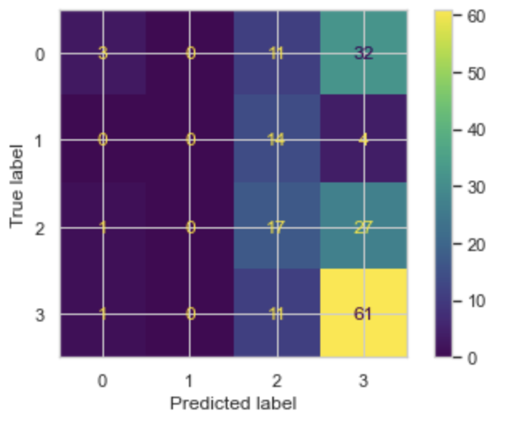
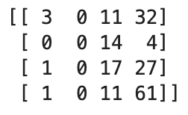
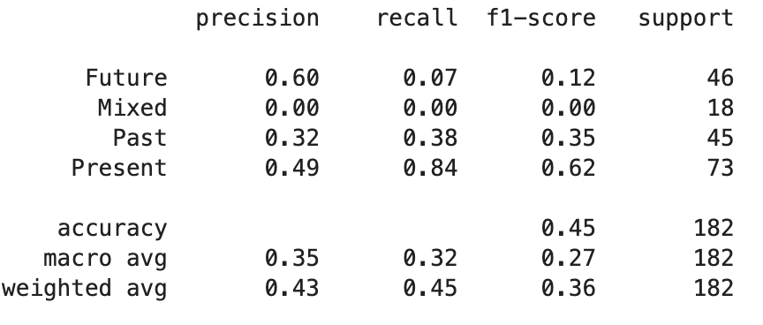
Evaluation
Random Forest Classifier
ntree = 1000, max features = 20
Observations
Performed worst on Mixed labels
Performed best on Present labels
Drastic difference between Future label precision and recall scores
Class 0: Future, Class 1: Mixed Class 2: Past, Class 3: Present
Figure 3: Confusion matrix table and classification report of the RF classifier.
Notes:
Insights
model performed as expected.
future - High false negatives and few false positives
A highly sensitive test means that there are few false negative results, and thus fewer cases of disease are missed. The specificity of a test is its ability to designate an individual who does not have a disease as negative.

Slide 12
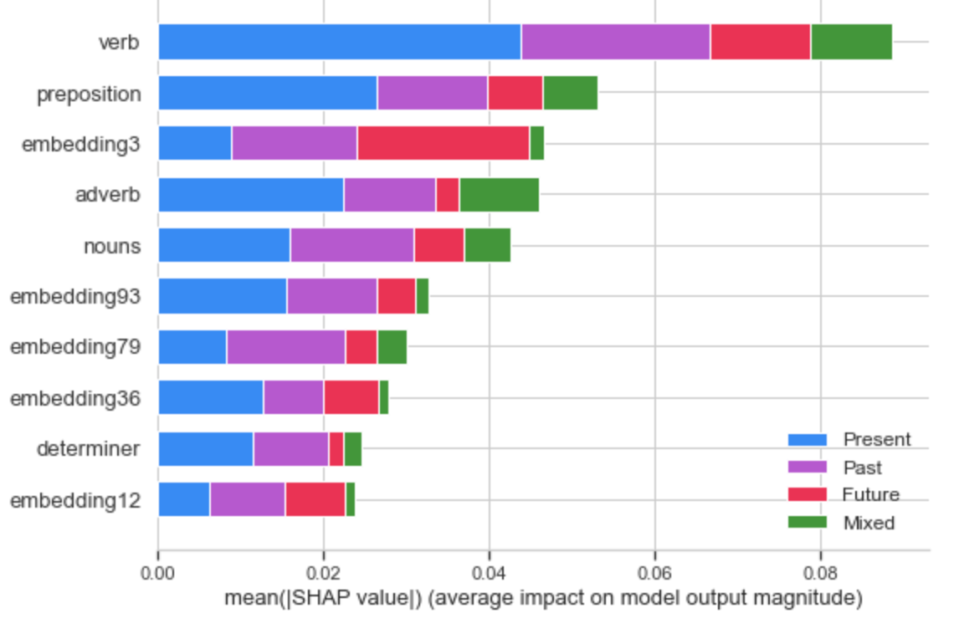
Evaluation
Random Forest Classifier
ntree = 1000, max features = 20
Feature importance
Observations
Presence of verb and prepositions dominate top feature ranking
Figure 4: Features are ranked based on average impact on model output via SHAP importance..
Notes:
The skipgram model learns to predict a target word thanks to a nearby word. On the other hand, the cbow model predicts the target word according to its context.

Slide 13
Conclusion
Future work informed by Phase II:
Review collected data
Collect more data?
Mixed labels
Perform sentence-level analysis instead of post level?
Feature engineering
Verb phrasal chunking with NLTK
Build a Bi-LSTM classifier
Discussion
What algorithms are robust to larger number of features compared to number of samples?

Slide 14
Citations
Kamila, S., Hasanuzzaman, M., Ekbal, A., & Bhattacharyya, P. (2018). Resolution of grammatical tense into actual time, and its application in Time Perspective study in the tweet space. PLoS ONE, 14(2). https://doi.org/10.1371/journal.pone.0211872
Anwar, M., Khoury, D., Aldridge, A. P., Parker, S. J., & Conway, K. P. (2020). Using Twitter to Surveil the Opioid Epidemic in North Carolina: An Exploratory Study. JMIR Public Health and Surveillance, 6(2). https://doi.org/10.2196/17574
Lossio-Ventura, Juan Antonio & Bian, Jiang. (2018). An inside look at the Opioid Crisis over Twitter. 1496-1499. 10.1109/BIBM.2018.8621101.
R. Eshleman, D. Jha and R. Singh, "Identifying individuals amenable to drug recovery interventions through computational analysis of addiction content in social media," 2017 IEEE International Conference on Bioinformatics and Biomedicine (BIBM), 2017, pp. 849-854, doi: 10.1109/BIBM.2017.8217766.

