Slide 1
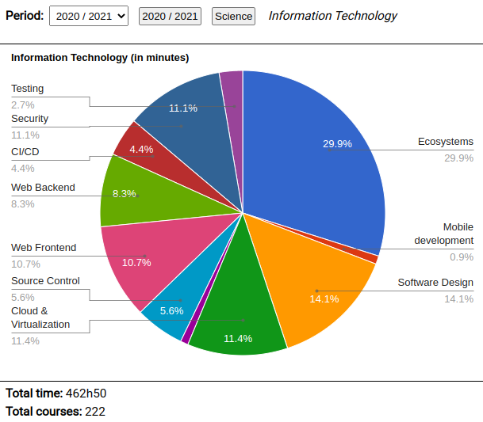
Gianluca Costa – https://gianlucacosta.info/
Work experience
(most relevant positions)
Software Engineer
YOOX NET-A-PORTER GROUP
2019 – Present
Main technologies: C#, NUnit, SpecFlow, Jenkins CI, Groovy, TypeScript, NodeJS, Scala, AWS, Docker, Windows, Linux
Software Engineer
Dedalus S.p.A.
2018
Main technologies: Java 7, Java EE 7, EJB, AngularJS, Lodash, CSS 3, Docker, Kubernetes, Jenkins CI, Ant, Ivy, Linux
Software Engineer
Gruppo Euris Spa, in the context of YOOX
2013-2014
Main technologies: C#, Castle Windsor, MongoDB, Solr, Microsoft SQL Server, NUnit, TeamCity.
Passionate about agile development, I also devoted time to holding brown-bag seminars and code katas.
Software Engineer
Sitech Srl
2009-2013
Development of ASP.NET MVC 2 web applications and Silverlight 4 clients.
Main technologies: C# (3, 4), ASP.NET MVC 2, WCF web services, Silverlight 4, SQL Server, Oracle 10g.
I was also dedicated to mentoring new colleagues in C# and OOP.
For further details about my work experience, please visit my LinkedIn profile: https://www.linkedin.com/in/giancosta86/
Science
Passionate software craftsman since 1999
More than 7 years of experience in the IT industry
MSc and BSc in Computer Engineering - 110 cum laude
One of the 30 best Engineering students in Bologna, in 2016
More than 80 open source projects on GitHub: https://github.com/giancosta86
Linux user since 2004
Presentations on SpeakerDeck: https://speakerdeck.com/giancosta86
Humanism
Curious learner, passionate teacher
C1 level in English (CAE, BEC Higher)
C1 level in French (DALF)
B1 level in German (Goethe Zertifikat)
Poet, mainly in ancient Italian
Proudly supporting LGBT+ rights and equality
Award in national competition of Latin translation, in 2003
https://gianlucacosta.info/#learning

