Slide 1
GENRE PREDICTION & PLAYLIST GENERATION
Stephen Gianfortoni, Scott Shepard, Anna Whelan
31008/1: Data Mining

Slide 2
Outline
Problem Statement
Data Exploration
Genre Prediction
Playlist Generation
Prediction Validation
Discussion & Conclusion

Slide 3
1.
PROBLEM STATEMENT
What are we trying to do?

Slide 4
Client: Music Streaming Company
Desired Solution
Launch auto-generated playlist feature
Users select genre/mood and playlist will auto-generate
Problem
Many songs missing genre
How can we fill this in?
Once filled in, how can we generate playlists?

Slide 5
2.
DATA EXPLORATION
What does the data look like?

Slide 6
Echonest Data
Source
Free Music Archive with Echonest features
Echonest is a data mining music company
Sold to Spotify in 2014
Variable Audio Features
Accousticness
Danceability
Energy
Instrumentalness
Liveness
Speechiness
Tempo*
Valence
Genres
Classical
Electronic
Blues
Folk
Hip-Hop
International
Jazz
Instrumental
Experimental
Old-Time/Historic
Pop
Rock

Slide 7
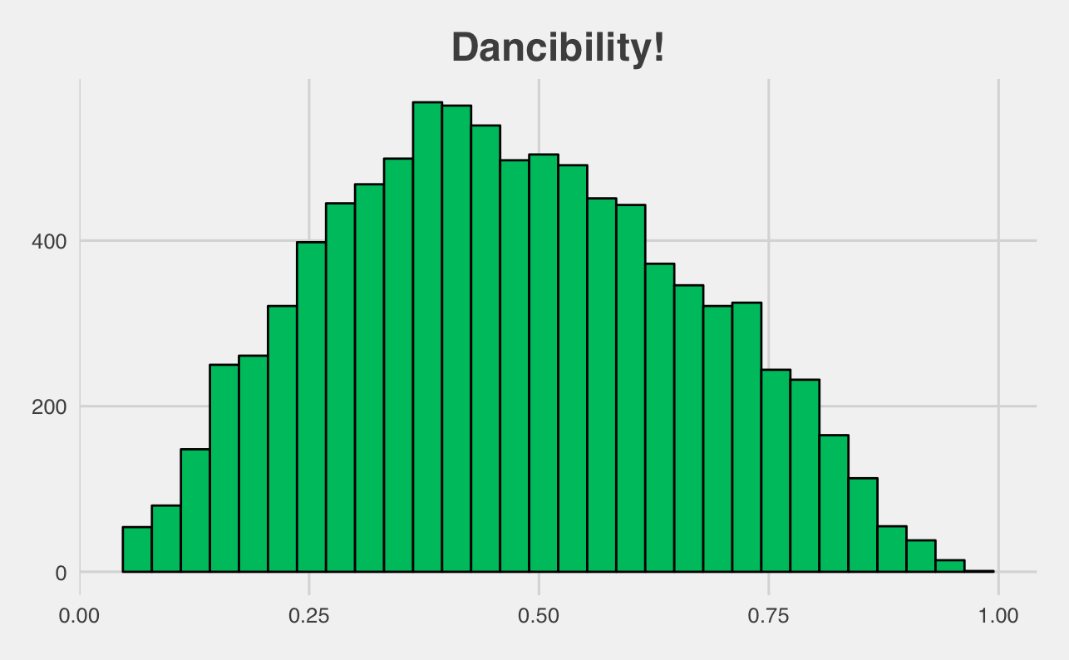
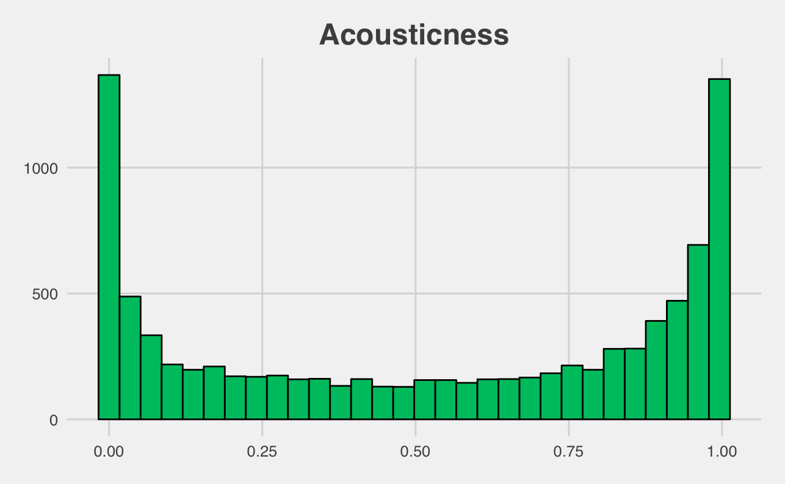
Danceability

Slide 8
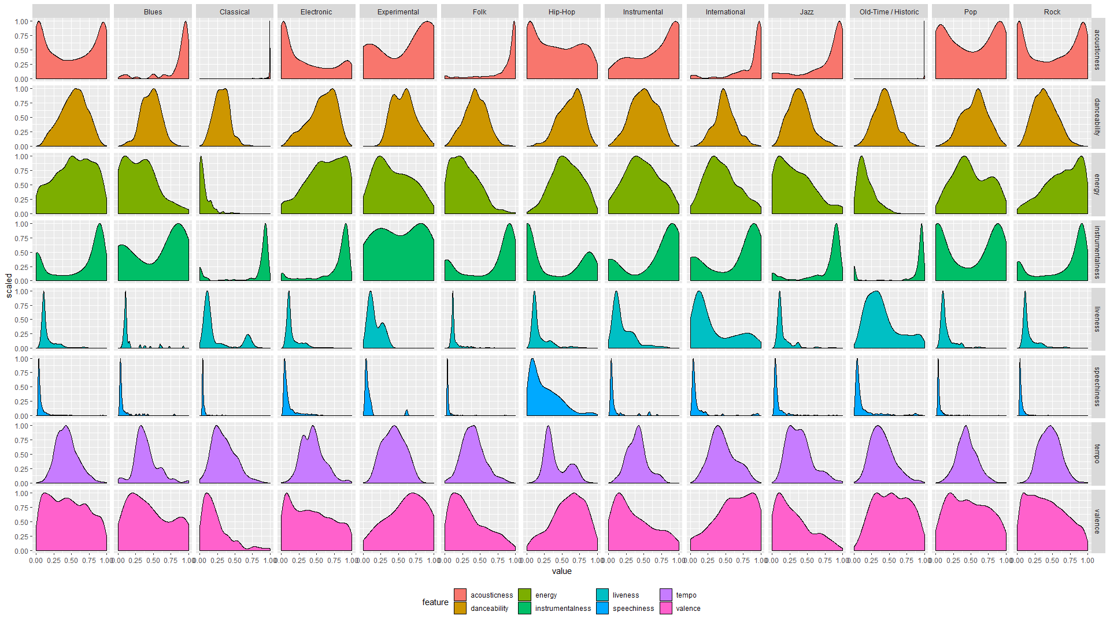

Slide 9
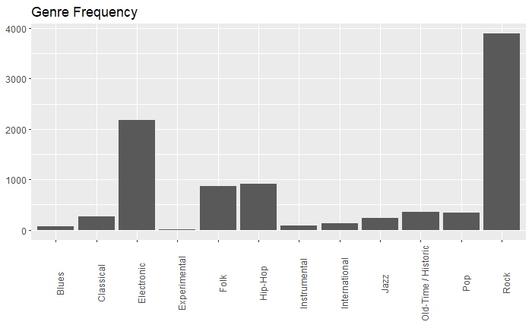
Some genres were not prevalent

Slide 10
Data Cleaning
Remove International and Experimental
Low interpretability, features indistinguishable
N=133 and N=17
1
Combine Folk and Blues
Similar Echonest features
N=874 and N=66
2

Slide 11
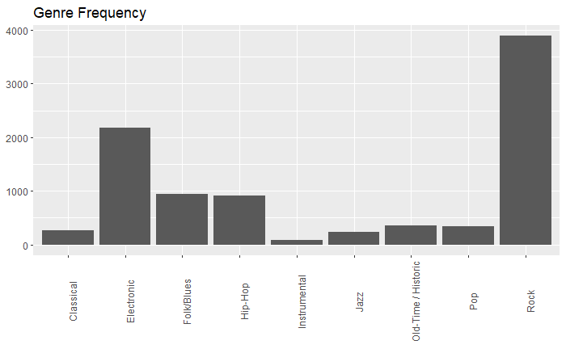
Data Cleaning

Slide 12
3.
GENRE PREDICTION
How do we predict a song’s genre?

Slide 13
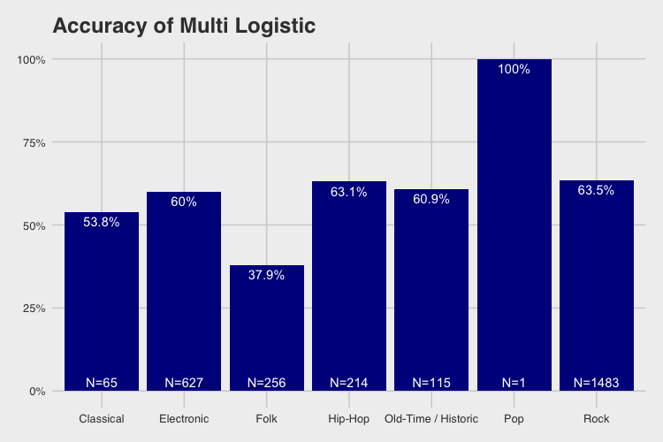
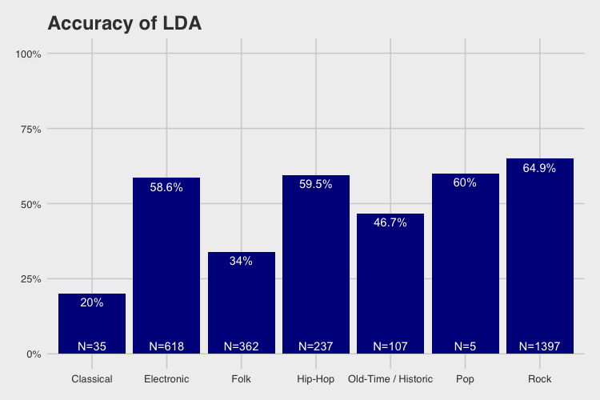
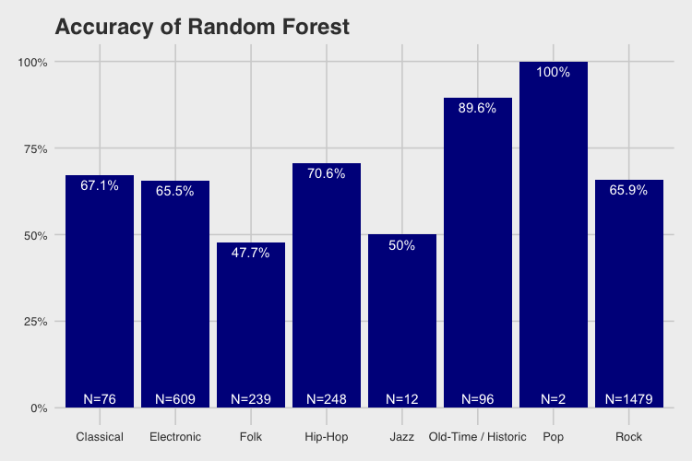
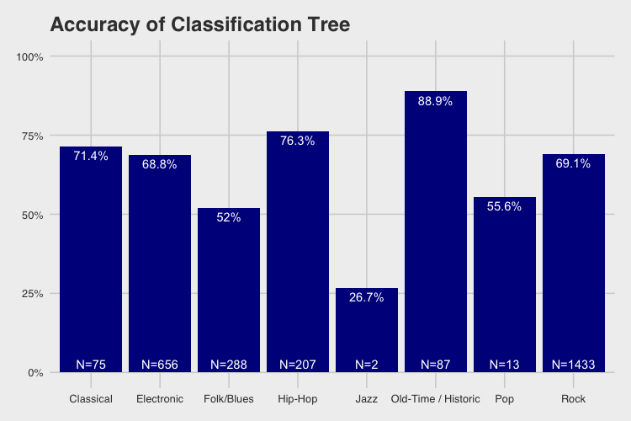

Slide 14
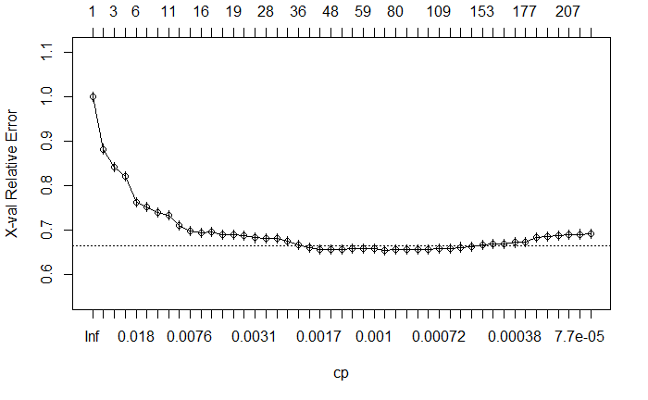
Classification Tree: Setup
Echonest variables
Minsplit: 25
Cross validations: 20
Notes:
Complex property had nsplit of 72

Slide 15
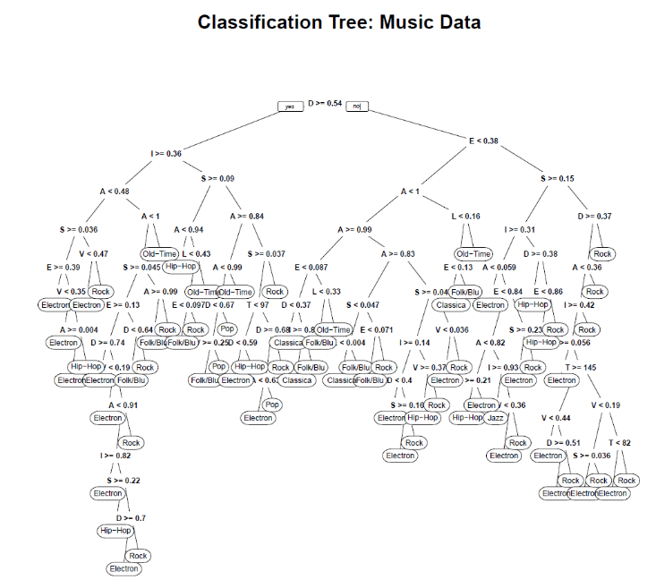
Accousticness
Danceability
Energy
Instrumentalness
Liveness
Speechiness
Tempo*
Valence

Slide 16
Train Validation Correlation Matrix
 | C | E | F/B | H | I | J | O-T/H | P | R
C | 0.67 | 0.01 | 0.22 | 0 | 0 | 0 | 0.04 | 0 | 0.06
E | 0.01 | 0.68 | 0.03 | 0.03 | 0 | 0 | 0 | 0 | 0.25
F/B | 0.02 | 0.04 | 0.50 | 0.02 | 0 | 0 | 0.02 | 0 | 0.4
H | 0 | 0.22 | 0.01 | 0.59 | 0 | 0 | 0 | 0 | 0.18
I | 0.03 | 0.3 | 0.11 | 0.03 | 0 | 0.02 | 0.02 | 0.02 | 0.48
J | 0.05 | 0.11 | 0.23 | 0.04 | 0 | 0.02 | 0.01 | 0.01 | 0.53
O-T/H | 0.06 | 0.01 | 0.03 | 0 | 0 | 0.01 | 0.84 | 0 | 0.05
P | 0 | 0.21 | 0.07 | 0.06 | 0 | 0 | 0 | 0.07 | 0.58
R | 0 | 0.07 | 0.05 | 0.02 | 0 | 0 | 0 | 0 | 0.85

Slide 17
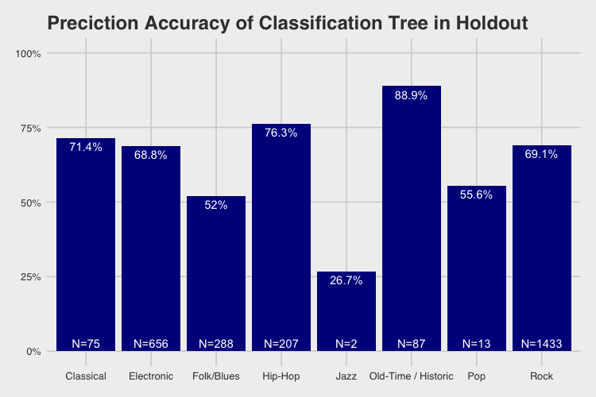
Holdout Validation Accuracy

Slide 18
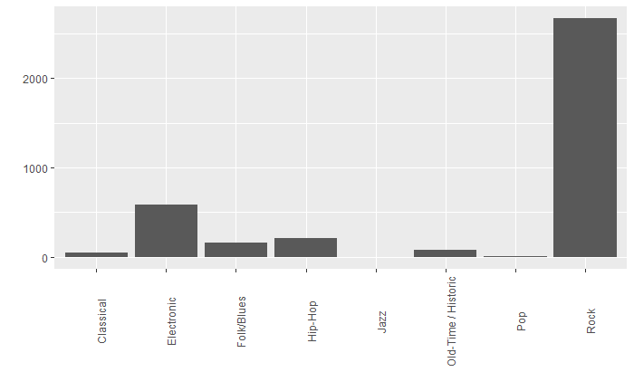
Classification Tree: New Genres
Genre | Count (N=3775)
Classical | 50
Electronic | 584
Folk/Blues | 163
Hip-Hop | 212
Instrumental | 0
Jazz | 2
Old-Time/Historic | 80
Pop | 11
Rock | 2673

Slide 19
4.
PLAYLIST GENERATION
How do we auto-generate playlists?

Slide 20
3 Tested Methods to Group by Similarity
1. K-means clustering on all songs
2. Split songs by genre and then K-means cluster
3. Latent Profile Analysis

Slide 21
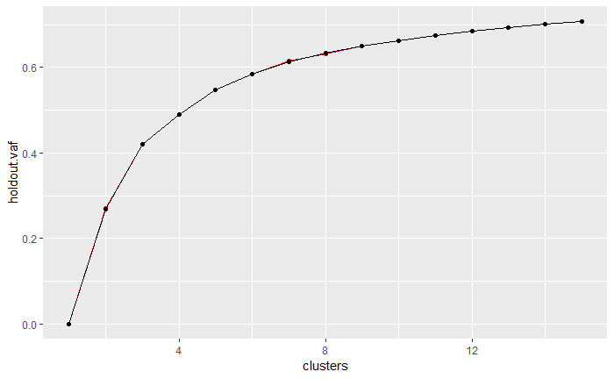
K-means clustering on all songs
1.
Idea is to create mood based playlists
Based on the scree plot, six clusters were chosen
Listening to the songs showed a clear differentiation between clusters

Slide 22
Split songs by genre and then K-means cluster
2.
People may expect a consistent genre when listening to playlists
First created subsets of the largest genres (Rock, Electronic, Hip Hop, and Folk)
Then performed K-means clustering
Created 5 clusters for each genre

Slide 23
Latent Profile Analysis
3.
Uses numerical data
Several packages: OpenMx, MCLUST, or newly created tidyLPA*
MCLUST algorithm used
4 methods of covariance structures tested:
Spherical, equal volume
Diagonal, varying volume and shape
Ellipsoidal, equal volume, shape, and orientation
Ellipsoidal, varying volume, shape, and orientation
*https://jrosen48.github.io/blog/lpa-in-r-using-mclust/

Slide 24
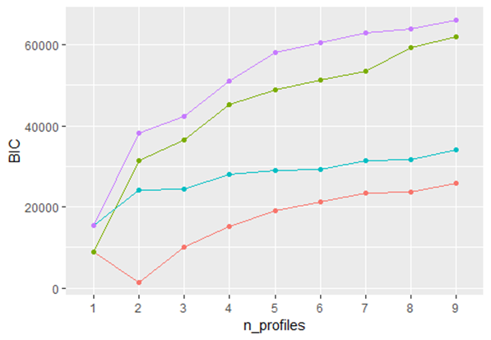
Latent Profile Analysis
3.
First method had the lowest BIC with two groups, but 6 were ultimately used in order to compare with the K-means cluster results
Profiles very similar to K-means result

Slide 25
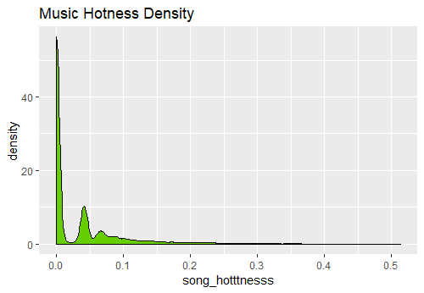
Playlist Generation
Sampled 25 songs weighted by song ‘hotness’ attribute
Song Hotness was chosen to weight more popular songs, but also pick new ones

Slide 26
5.
PREDICTION VALIDATION
What does it look like put together?

Slide 27
Validation
Tested classification results by comparing with intra-genre clusters
Idea is that results should hold if classification accurate
Rock and electronic matched well
For Hip Hop, two out of five clusters did not match
Blues/Folk music did not perform well
Inspection of the Folk cluster shows that all had high values for acousticness
This was likely a key factor for the tree to assign to Folk

Slide 28
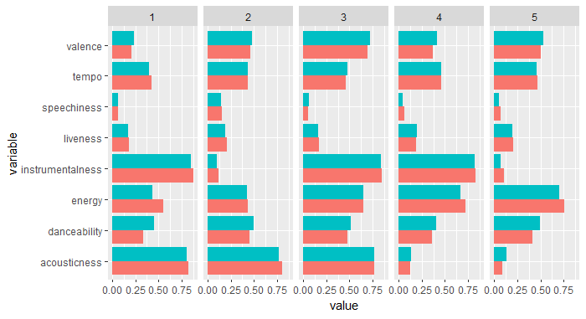
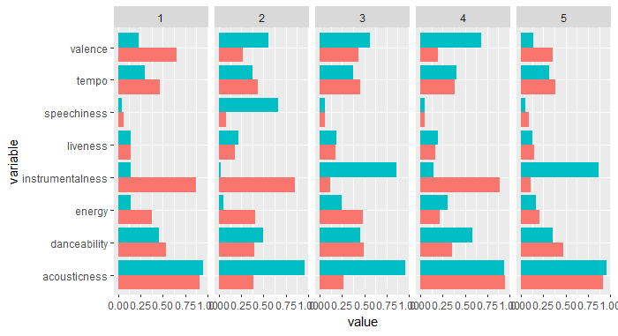
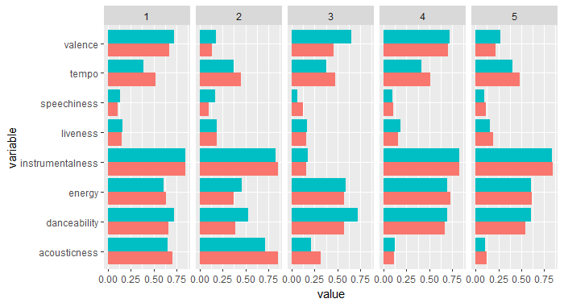
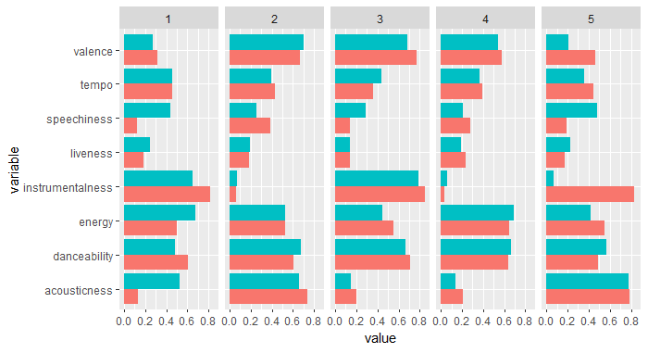
Unknown Genre Cluster Comparison
Rock Folk/Blues
Train
Unknown
Electronic Hip-Hop

Slide 29
6.
DISCUSSION & CONCLUSION
How did we do?

Slide 30
Conclusion & Limitations
Mediocre data quality
Model selection
Classification and clustering can validate each other
Audio features can define genre and mood
Notes:
Limited information about data collection techniques
Models only as good as its data
Simple decision tree model performed better than other complex algorithms in terms of accuracy

Slide 31
Future Enhancement: Song Recommendation
Song Recommendation
Make recommendations based off playlists that have same songs
Use Apriori or Eclat if we had large number of pre-existing playlists
Recommend songs based on Echonest clusters for which a playlist has a distinct mood

Slide 32
THANK YOU!
Any questions?

