Slide 1

Multimodal Chain-of-Thought reasoning:
A Case Study on the Fakeddit Dataset (MM-COT)
Semantics in Intelligent Information Access a.y. 2022/2023
Francesco Ranieri, Gianfranco Demarco (with the guide of prof. Marco Polignano)

Slide 2



Chain-of-thought reasoning refers to the ability of a language model to follow a sequence of logical steps to arrive at a conclusion.
One of the key benefits of chain-of-thought reasoning is that it allows language models to perform inference over long sequences of text, without losing the context or making erroneous assumptions. This is because the model is trained to reason about the relationships between concepts and ideas, rather than simply memorizing patterns in the input data.
Tell me about Chain-of-Thought Reasoning in Language Models
Notes:
In today’s information age, the proliferation of fake news and misinformation is a pressing concern.
Detecting and combating such misinformation requires sophisticated techniques that can analyze data from multiple modalities, including language, vision, and audio.
One of this tecnology is the chain-of-thought reasoning model. The cot models overcome the limitaion of conventional language models that, despite their impressive performance, are still limited in their ability to perform complex reasoning tasks.

Slide 3
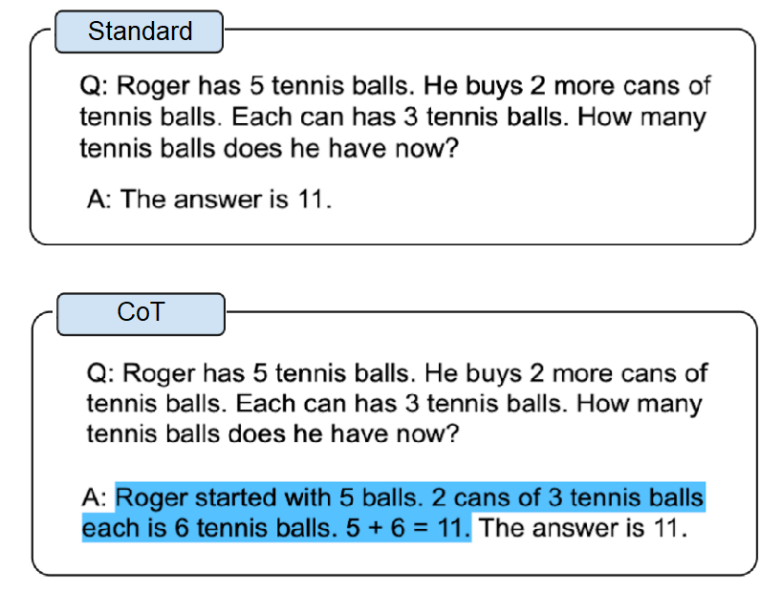
Give me an example of CoT models output

Slide 4

Multimodal Chain-of-Thought (MM-CoT) reasoning is a type of reasoning that combines different types of information, such as text, images, and knowledge graphs, to reason about a given task or problem.
A detailed research of the MM-CoT models was conducted by Zhang et al. in the "Multimodal Chain-of-Thought Reasoning in Language Models"
Tell me about Multimodal Chain-of-Thought Reasoning in Language Models
Notes:
In the context of language models, it refers to the ability of a model to understand and reason about language in a way that takes into account not just the words themselves, but also the context in which they appear, as well as any accompanying images or other forms of data.
The goal of MM-CoT reasoning is to enable language models to better understand and generate text that is more coherent and contextually relevant. By incorporating information from multiple modalities, the model can build a more complete understanding of the

Slide 5
Zhang and colleagues tackled the challenge of multimodal CoT and proposed the Multimodal-CoT framework on SCIENCEQA dataset, which integrates language and vision modalities and splits the task into two stages: rationale generation and answer inference. By doing so, the approach enables answer inference to benefit from more effective rationale generation based on the combination of different modalities.
Can you provide more info about this PAPER?

Slide 6
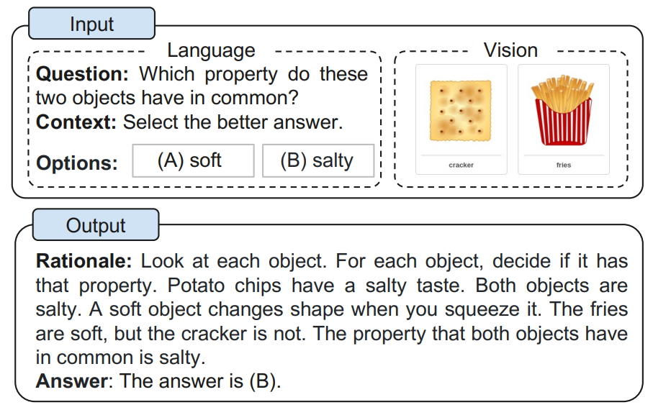
Give me an example of two stages MM-CoT model

Slide 7





Reproducibility by memory usage optimization
Zero-shot abilities test of MM-CoT pre-trained model on the Fakeddit Dataset
Engineering of the codebase to speed up integration of new datasets and models
What are the objectives and contributions of this project?

Slide 8

Fakeddit is one of the first multimodal datasets, consisting of over 1 million samples of Reddit posts, labelled to enable the Fake news detection task.
In this work, the 2-way classification is considered. (Real news or Fake news)
Image | Title | Ground truth
 | Moonlight sonata by ludwig van barktoven | Fake news
Give me more information about Fakeddit Dataset

Slide 9

Baseline experiments
Trained custom models using various input combinations to assess their contribution to the output.
Experiments with pre-trained models
Tested zero-shot capabilities of models provided by the authors of the original work.
Tell me about the Project Experimental Design

Slide 10

Baseline models trained with different combinations of input data:​
only textual data ​
textual data + rationale ​
textual data + rationale + vision features​
​
Vision features extracted with 3 different models:​
DETR model​
CLIP model​
VIT-based model
Can you tell more details about the Baseline experiments?

Slide 11




Vision features type | Use rationale | Accuracy
CLIP | Yes | 71.17
CLIP | No | 68.80
ViT | Yes | 62.00
ViT | No | 55.20
DETR | Yes | 65.33
DETR | No | 68.67
None | Yes | 64.00
None | No | 66.50
Image Features improve models performances
Rationales sometimes improve the predictions
CLIP + rationales is the best! ...but the authors only shared models trained with DETR
Continue

Slide 12
The experiments with pretrained models regard:​
​
Rational generation: a process that involves generating a textual explanation for a given decision. In the field of machine learning, this process is used to explain the reasoning behind a classification output​
Classification: decide if a Reddit post is a "fake news" (misinformation, manipulated content...)
Can you tell more details about the experiments with pre-trained models?

Slide 13
Efforts on fine-tuning the prompt to produce more effective rationales​
Under basic configuration:​
Repetitive and unrelated output​
Using the repetition_penalty parameter for generation:​
more diverse and relevant output​
still mostly unconclusive and meaningless
Tell me about Rationale Generation

Slide 14
Many knobs to turn:​
Prompt​
Input combinations​
Rationale generated with same prompt of the classification vs rationale generated with different prompt
Tell me about classification

Slide 15
Prompt | Vision Feature | Use Rationale | Accuracy
Question: Is this news fake or not? Context: 〈TEXT〉 Options: 〈OPTIONS〉 | No | No | 41.8
 | DETR | No | 41.8
 | DETR | RATIONALE-1 | 44.6
Question: Is the statement in this post (A) True or (B) False? Context: This post features a piece of text that makes a specific statement or claim about a topic. The statement may be related to politics, science, health, or any other field. The post has been shared widely on social media. 〈TEXT〉 Options: 〈OPTIONS〉 | No | No | 61.1
 | DETR | No | 61.3
 | DETR | RATIONALE-1 | 49.6
(more experiments in the report)
Tell me about Results

Slide 16

Highest accuracy: 61.3%​
Prompt is very important​
Vision features have small (positive impact)​
Rationale worsens the results
Tell me some insights

Slide 17

Task difficulty​
Text input: short, sarcastic, web language​
Vison input: poor quality, digitally altered, highly detailed​
Prompt shared by every example​
Overall differences with the training dataset
What limitations affected the results?

Slide 18
Code engineering is extremely important in AI research: faster development, easier extensibility, peer review​
Resources are limited and must be managed with care, to achieve better training times and enable other to reproduce the experiments​
Chain-of-thought is hard – some capabilities can be carried over into different domains, but generally it is difficult with small models​
Community is strong! - we shared with the community our insights and suggestions to expand the knowledge on this research​
The original work – our fork
What Conclusions can be drawn?

Slide 19

Thank you for your time!
And a huge thanks to prof. Marco Polignano

