Slide 1
Rap Battle it Out !
A guide by Gian Villafañe, Taisgaly Vélez Rodríguez, Rosemary Medina-Casanova, Maya Wilson-Fernandez

Slide 2
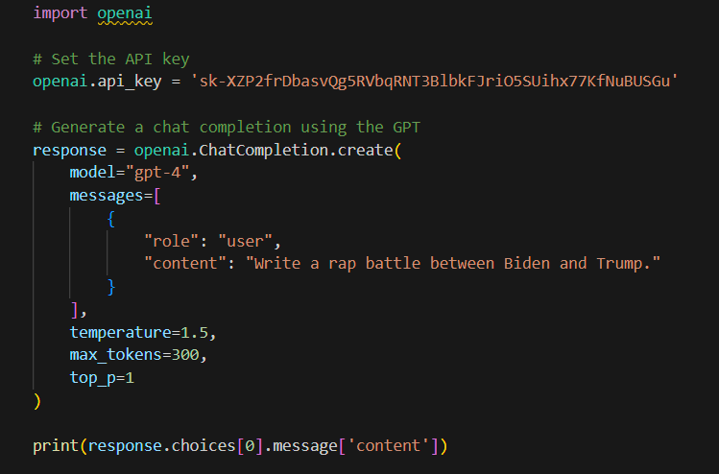
Creating a Rap Battle Poet
We wanted to create a rap battle GPT. It only works for notable people who have some sort of information online about them, but perhaps with further exploration, it can take inputs about people in your surroundings and make raps about them.

Slide 3
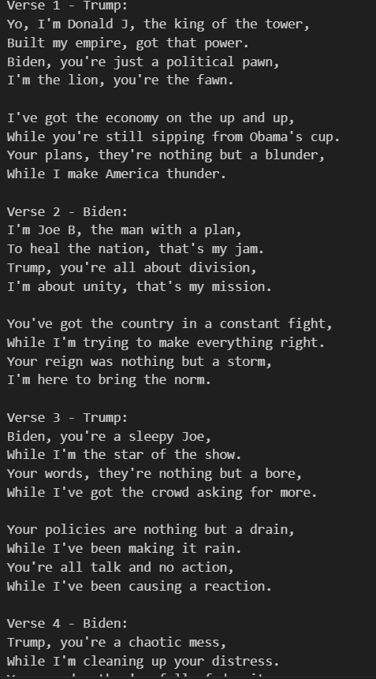
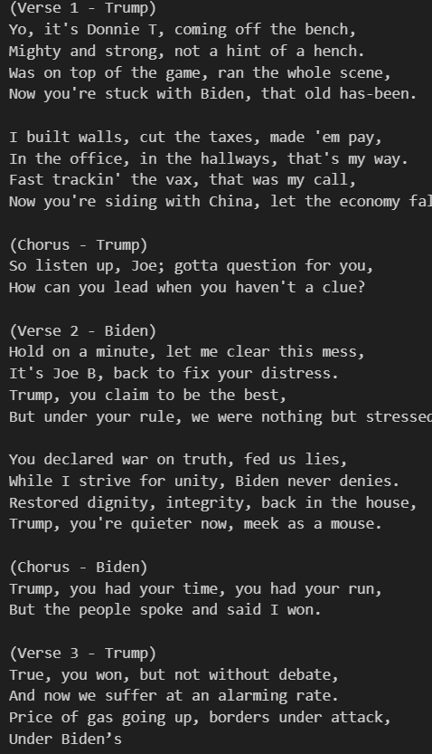
What the poets are saying
We set the temperature to 1.0 and 0.5, respectively, but the outcomes appeared similar. This could be because, given the creative nature of the task, it defaults to a setting of ‘1.0’.
Temperatures:
Left - 1.0
Right - 0.5

Slide 4
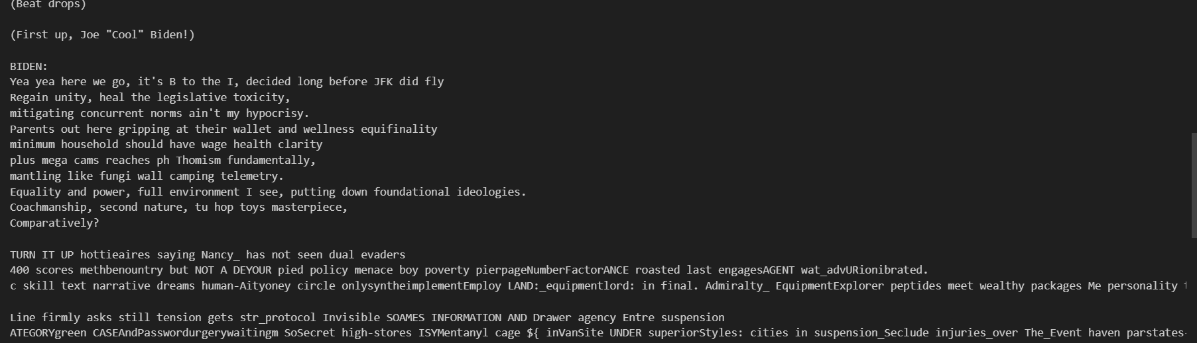
Setting the temperature to 1.5 in a language model like GPT significantly increases creativity, often at the expense of accuracy. This heightened creativity can result in the model generating imaginative and unconventional text, which might include fictional or unexpected elements—referred to as "hallucinations." It starts as a normal rap, but as more one reads, the less comprehensible it becomes.

Slide 5
Lessons Learned
The temperature setting controls the creativity and directness of ChatGPT's responses. It ranges from 0.0 to 2.0, with values above 1.0 potentially leading to responses that are difficult to understand.
The number of tokens correlates with the amount of content the AI can generate, as tokens represent the words and phrases it produces. Higher token counts allow for more extensive responses.
The top_p parameter regulates the randomness of text generation. In our experience, increasing it resulted in an error, while decreasing it did not produce a noticeable change in the output.

Slide 6


Thank you!
Gian F. Villafañe
Taisgaly Vélez Rodríguez
Rosemary Medina-Casanova
Maya Wilson-Fernandez

