Slide 1

Electronic Piano
Group 3

Slide 2
Team member & Assignments
Nguyen Truong Giang:
Design Class Diagram, structure of application
Design GUI: aboutUs.fxml ,instruction.fxml, piano.fxml
Write package:
+ Keyboard: LoadGuitarKeyborad, LoadKeyborad, LoadPianoKeyborad, LoadTromboneKeyborad, LoadViolinKeyborad, Note, Playable(interface).
+ screen: MidiApp, MidiAppController.
Write report
Nguyen Ba Hai:
Design Class Diagram, the structure of application, design GUI (piano.fxml)
Write package:
+ record: Record, RecordList.
+ screen: RecordScreen, RecordItemScreen.
Vu Thanh Hai:
Writing report.
Making Demo video.
- Test the application.

Slide 3
Problem Statement
User can play the piano by interacting with GUI
(Vitual keyboard)
Help menu shows the basic usage and aim of the program
A button for increasing/decreasing volume
A record button to record the play
A button for changing music style

Slide 4
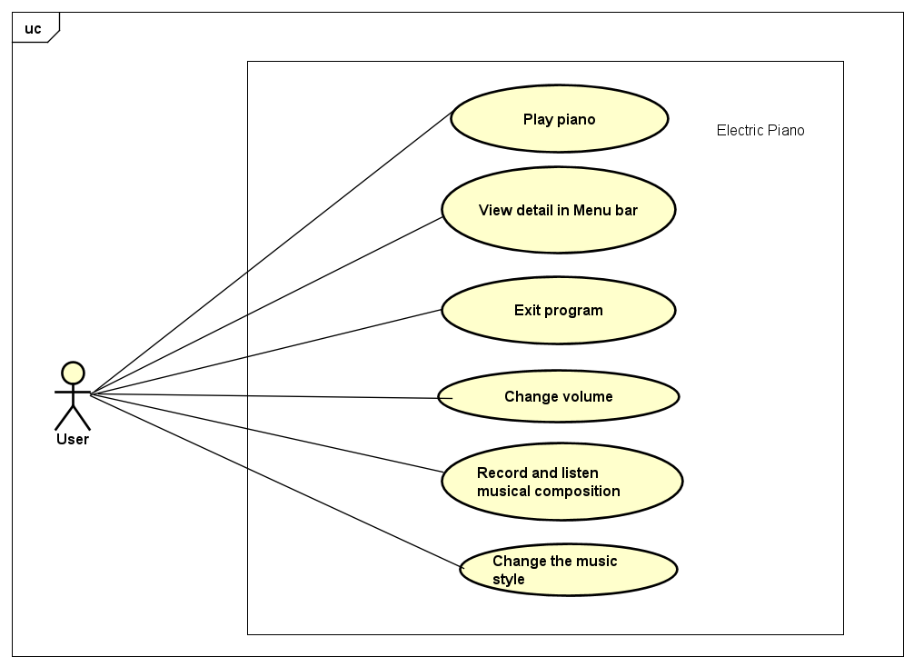
Use Case Diagram

Slide 5
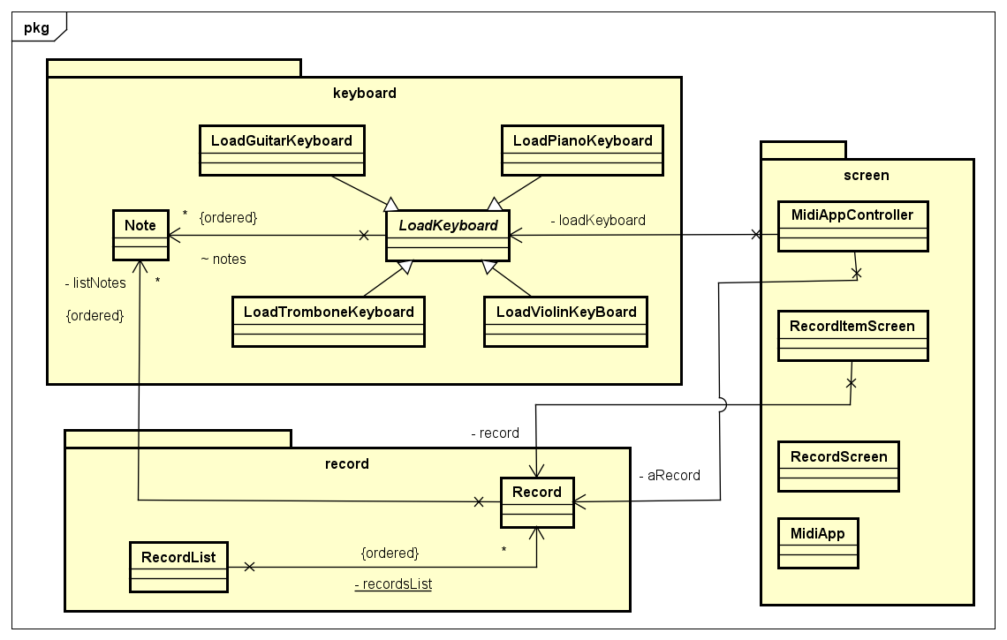
General Class Diagram
The application is
divide into
3 packages:
+ keyboard
+ screen
+ record
Each package has a specific role in the system.

Slide 6
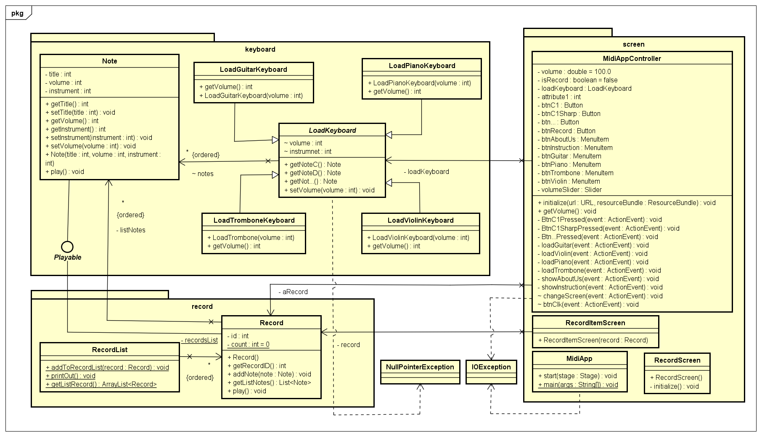
Detail Class Diagram

Slide 7
Encapsulation
The encapsulation is represented in the design of the program. In this app, we divide the program into 3 main packages: keyboard, screen, and record.

Slide 8
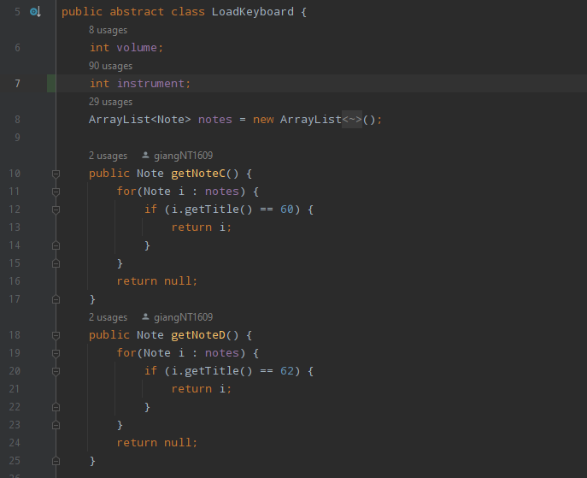
Abstraction
Abstract class LoadKeyboard
Abstract classes serve as templates for their subclasses.
- Abstract classes require subclasses to further define attributes necessary for individual instantiation

Slide 9
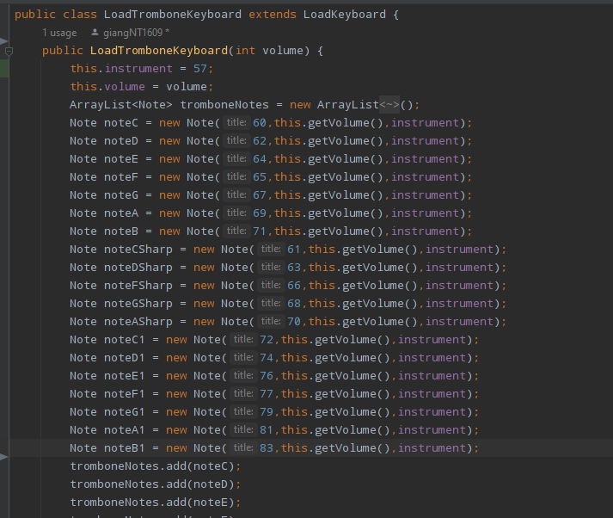
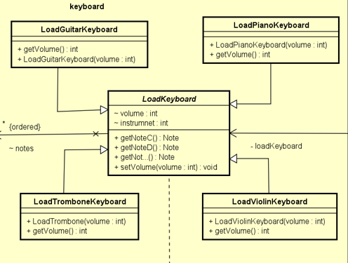
Inheritance
LoadPianoKeyboard, LoadGuitarKeyboard, LoadViolinKeyboard, and LoadTromboneKeyboard classes have inherited LoadKeyboard class.

Slide 10
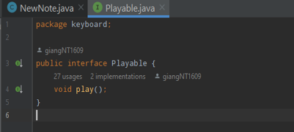
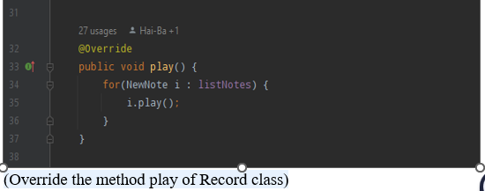
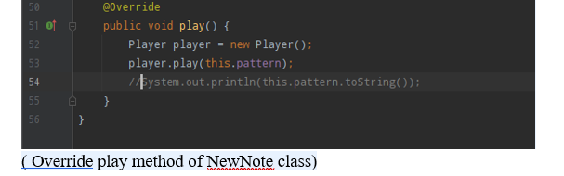
Polymorphism
The program having polymorphism is shown when we use the interface Playable. And Override the method play() for different object

Slide 11
Link video Demo
https://drive.google.com/drive/folders/1TFkOjVpH8tt_QFoTXQyaMbbIgBfutfoF

