Slide 1

Electronic Piano
Group 3

Slide 2
Team member & Assignments
Nguyen Truong Giang:
Design Class Diagram, structure of application
Design GUI: aboutUs.fxml ,instruction.fxml, piano.fxml
Write package:
+ Keyboard: LoadGuitarNote, LoadNote, LoadPianoNote, LoadTrombone, LoadViolinNote, NewNote, Playable(interface).
+ screen: MidiApp, MidiAppController.
Write report
Nguyen Ba Hai:
Design Class Diagram, structure of application
Write package:
+ record: Record, RecordList.
+ screen: RecordScreen, RecordItemScreen.
Vu Thanh Hai:
Writing report.

Slide 3
Problem Statement
User can play the piano by interacting with GUI
(Vitual keyboard)
Help menu shows the basic usage and aim of the program
A button for increasing/decreasing volume
A record button to record the play
A button for changing music style

Slide 4
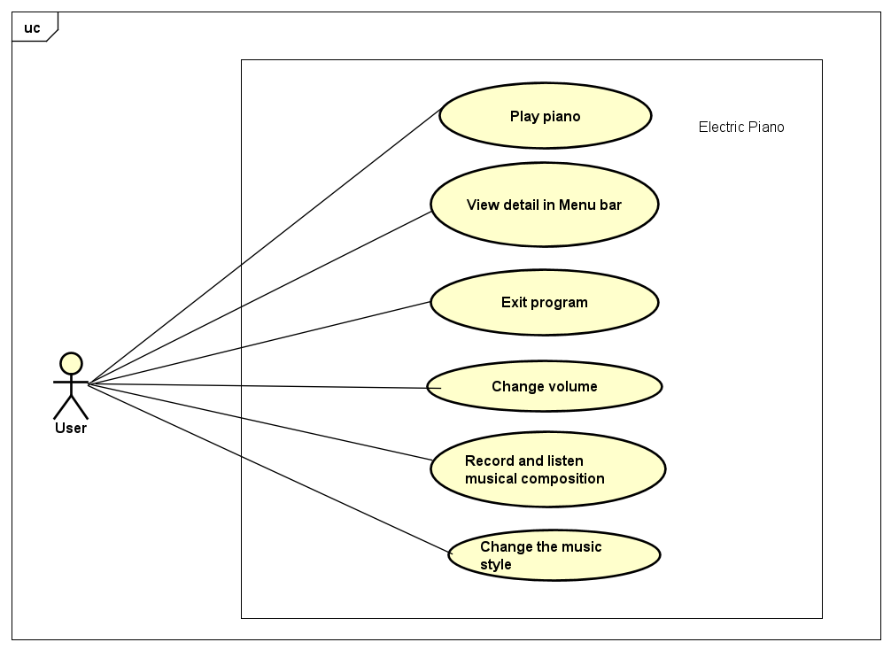
Use Case Diagram

Slide 5
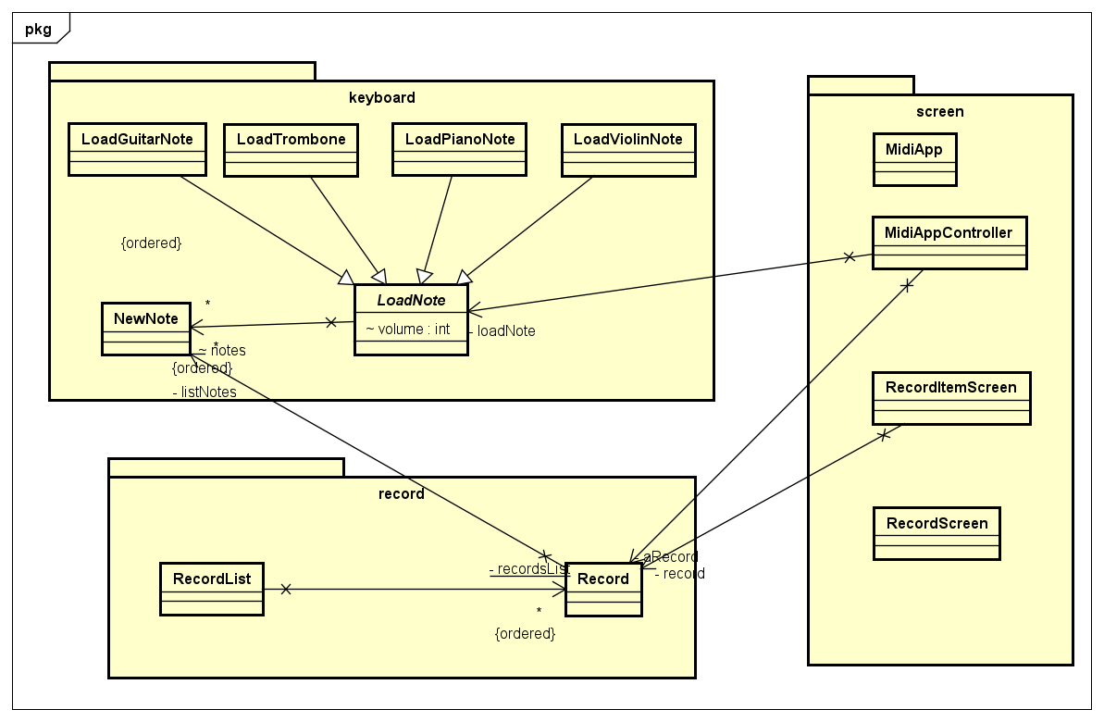
General Class Diagram

Slide 6
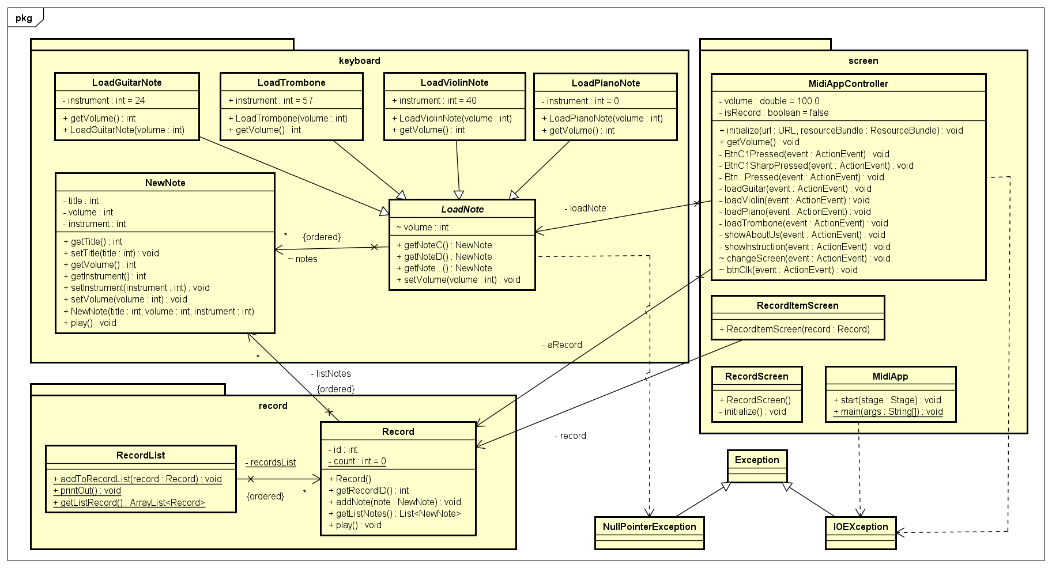
Detail Class Diagram

Slide 7
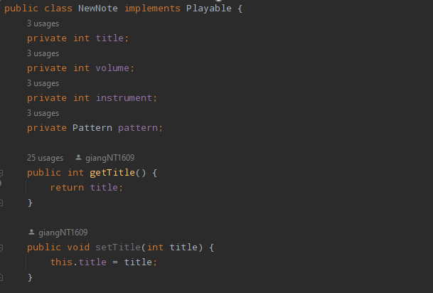
Encapsulation
The object’s information is hidden, and communication with the object is just using methods.

Slide 8
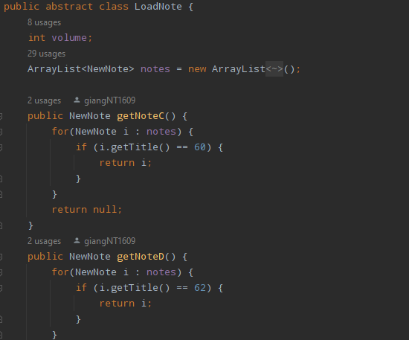
Abstraction
Making abstract class : LoadNote

Slide 9
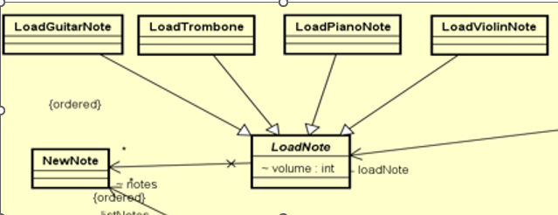
Inheritance
LoadPianoNote, LoadGuitarNote, LoadViolinNote, and LoadTrombone classes have inherited LoadNote class.

Slide 10
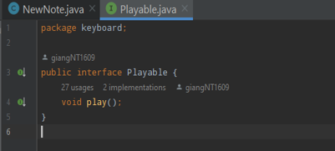
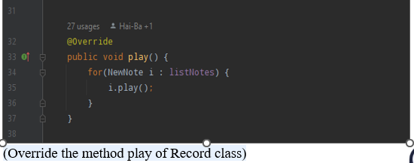
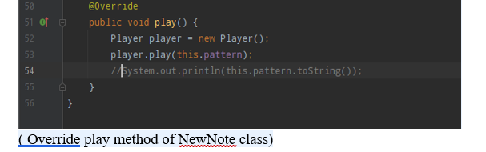
Polymorphism
The program having polymorphism is shown when we use the interface Playable. And Override the method play() for different object

Slide 11
Link video Demo
https://drive.google.com/drive/folders/1TFkOjVpH8tt_QFoTXQyaMbbIgBfutfoF

