Slide 1

Concussion Management
Concussion, the most common type of traumatic brain injury, is an emergent public health issue.
Recent studies suggest links between concussions and long-term consequences such as cognitive impairment and neurodegenerative disease.
By combining predictive modeling and data-driven stochastic optimization methods, we develop novel methods to better identify concussion and optimize post-injury management.

Slide 2

Concussion Management
Concussion, the most common type of traumatic brain injury, is an emergent public health issue.
Recent studies suggest links between concussions and long-term consequences such as cognitive impairment and neurodegenerative disease.
By combining predictive modeling and data-driven stochastic optimization methods, we develop novel methods to better identify concussion and optimize post-injury management.

Slide 3

Opioid Overdose Crisis
In the United States, opioid overdose is a leading cause of accidental death each year, with over 100,000 overdose deaths in 2020 alone.
Real-time monitoring and surveillance of the opioid crisis is critical to enabling timely policy response. Yet, existing data reporting infrastructure is wrought with a lack of real-time and sufficiently granular data.
In response to these data challenges, we aim to develop novel statistical and machine learning methods to facilitate the near real-time spatio-temporal monitoring and surveillance of opioid overdose deaths.

Slide 4
Concussion Management
Concussion, the most common type of traumatic brain injury, is an emergent public health issue.
Recent studies suggest links between concussions and long-term consequences such as cognitive impairment and neurodegenerative disease.
By combining predictive modeling and data-driven stochastic optimization methods, we develop novel methods to better identify concussion and optimize post-injury management.

Slide 5
Opioid Crisis
In the United States, opioid overdose is a leading cause of accidental death each year, with over 100,000 overdose deaths in 2020 alone.
Real-time surveillance of the opioid crisis is critical to enabling timely policy response. Yet, existing infrastructure lacks real-time and sufficiently granular data.
We aim to develop novel statistical and machine learning methods to facilitate the near real-time spatio-temporal monitoring and surveillance of opioid overdose deaths.

Slide 6

Personalized Maternal Health
The United States has one of the highest rates of maternal mortality amongst high-income nations.
While prenatal care is critical to reducing maternal mortality rates, existing guidelines recommend a one-size-fits-all approach.
We combine predictive modeling, discrete optimization, and stochastic dynamic programming to generate personalized and interpretable prenatal care guidelines that are amenable for clinical implementation.

Slide 7
Personalized Maternal Health
The United States has one of the highest rates of maternal mortality amongst high-income nations.
While prenatal care is critical to reducing maternal mortality rates and detecting potential adverse outcomes, existing guidelines recommend a one-size-fits-all approach.
Our goal is to combine predictive modeling, discrete optimization, and stochastic dynamic programming to generate personalized, technology-enabled, and interpretable prenatal care guidelines that are amenable for clinical implementation.

Slide 8

Opioid Overdose Crisis
In the United States, opioid overdose is a leading cause of accidental death each year, with over 100,000 overdose deaths in 2020 alone.
Real-time monitoring and surveillance of the opioid crisis is critical to enabling timely policy response. Yet, existing data reporting infrastructure is wrought with a lack of real-time and sufficiently granular data.
In response to these data challenges, we aim to develop novel statistical and machine learning methods to facilitate the near real-time spatio-temporal monitoring and surveillance of opioid overdose deaths.

Slide 9
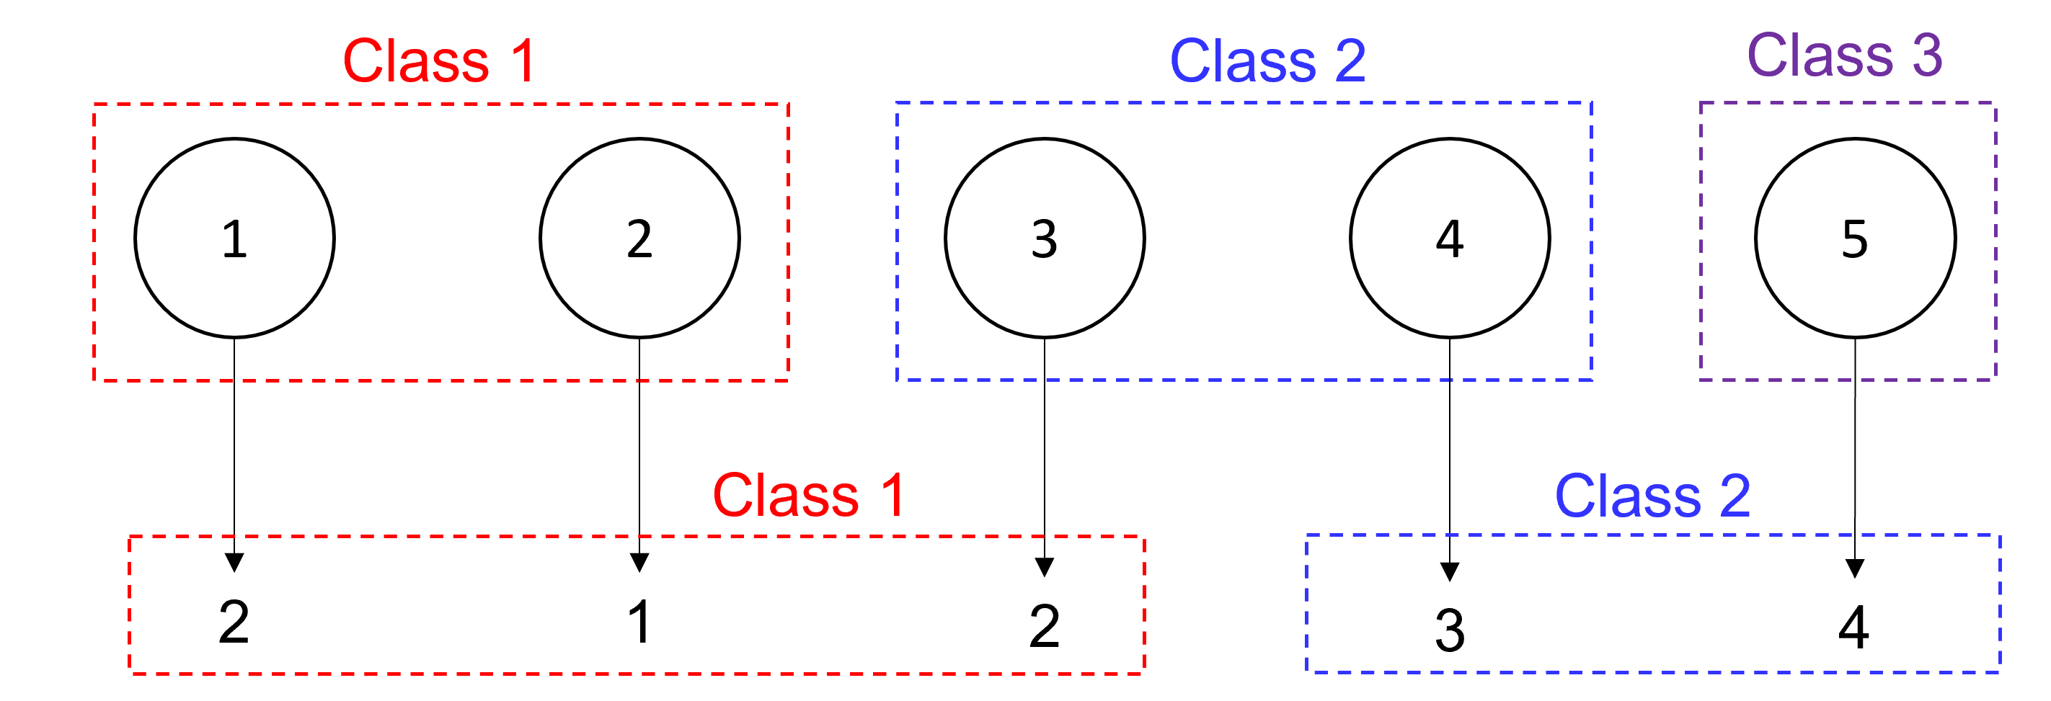
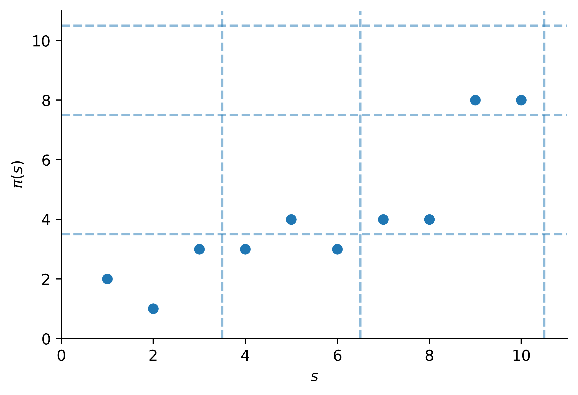
Interpretability in Health Care
The advent of artificial intelligence in medicine has been met with resistance to the proliferation of black box models for high-stakes decisions.
We aim to leverage recent advances in machine learning and optimization to generate efficient methods for the interpretable design and analysis of interpretable models for diagnosis, personalized treatment planning, and population-wide treatment guidelines.

Slide 10
Health Equity
Something about health equity
Something something about methods

