Slide 1
Clinic booking platform
Target architecture for online booking
Solution architect
2026-10-16
Notes:
Good morning. Today I will present the target architecture for the clinic booking platform. We will go from the problems of today's system to the domain design, the main flows and the deployment on the cloud.

Slide 2
Agenda
From today's problems to the target architecture, following the 4+1 views
1
Introduction
3–4
6
Core patterns
15–17
2
Domain design
5–7
7
High-level and physical view
18–19
3
Use case view
8–10
8
Development view
20–21
4
Logical view
11
9
Q&A
22
5
Process view
12–14
Notes:
First the problems and the proposed solution. Then the domain design and the use cases. Then the logical and process views with the booking saga, the core patterns, the deployment, and finally the technology and the key decisions.

Slide 3
Proposed solution
Five pain points, each answered by a subdomain, a pattern or a decision
Problem today | Answer in the target architecture
Schedules live in per-clinic spreadsheets, so double bookings happen weekly | Scheduling is the only owner of slots; a slot is held for 10 minutes, then committed
Patients can only book by phone during opening hours | Online booking on web and mobile through one API gateway with web and mobile routes
One deployable and one database; every change needs a full regression | One service per subdomain, each with its own database, released on its own
When the card-payment integration hangs, nobody can book in any clinic | Isolated partner calls (timeouts, retries, circuit breakers), with an outbox and idempotency keys
Reminders are sent by hand, so no-shows are high | Event-driven reminders from the notification service
Notes:
Today's system has five problems. Double bookings, because schedules live in spreadsheets: in the new design, the scheduling service is the only owner of slots. Booking by phone only: patients will book on web and mobile. One deployable and one database: we split the platform into one service per subdomain. A hanging payment partner blocks everyone: partner calls are isolated, and the outbox keeps every step safe to retry. And reminders by hand: the notification service sends them from appointment events.

Slide 4
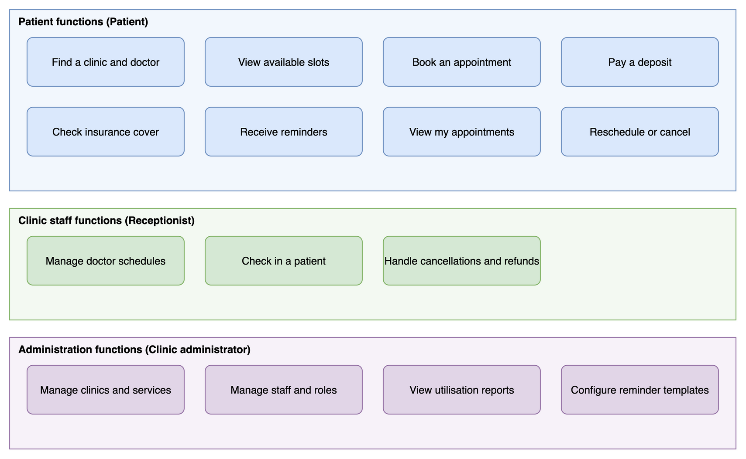
Main business functions
Fifteen functions for patients, clinic staff and administrators
Patient functions
Clinic staff functions
Administration functions
Notes:
Three groups of users. Patients find a doctor, book, pay a deposit, check insurance cover, get reminders and manage their appointments. Clinic staff manage schedules, check patients in and handle cancellations. Administrators manage clinics, staff, reports and reminder templates.

Slide 5
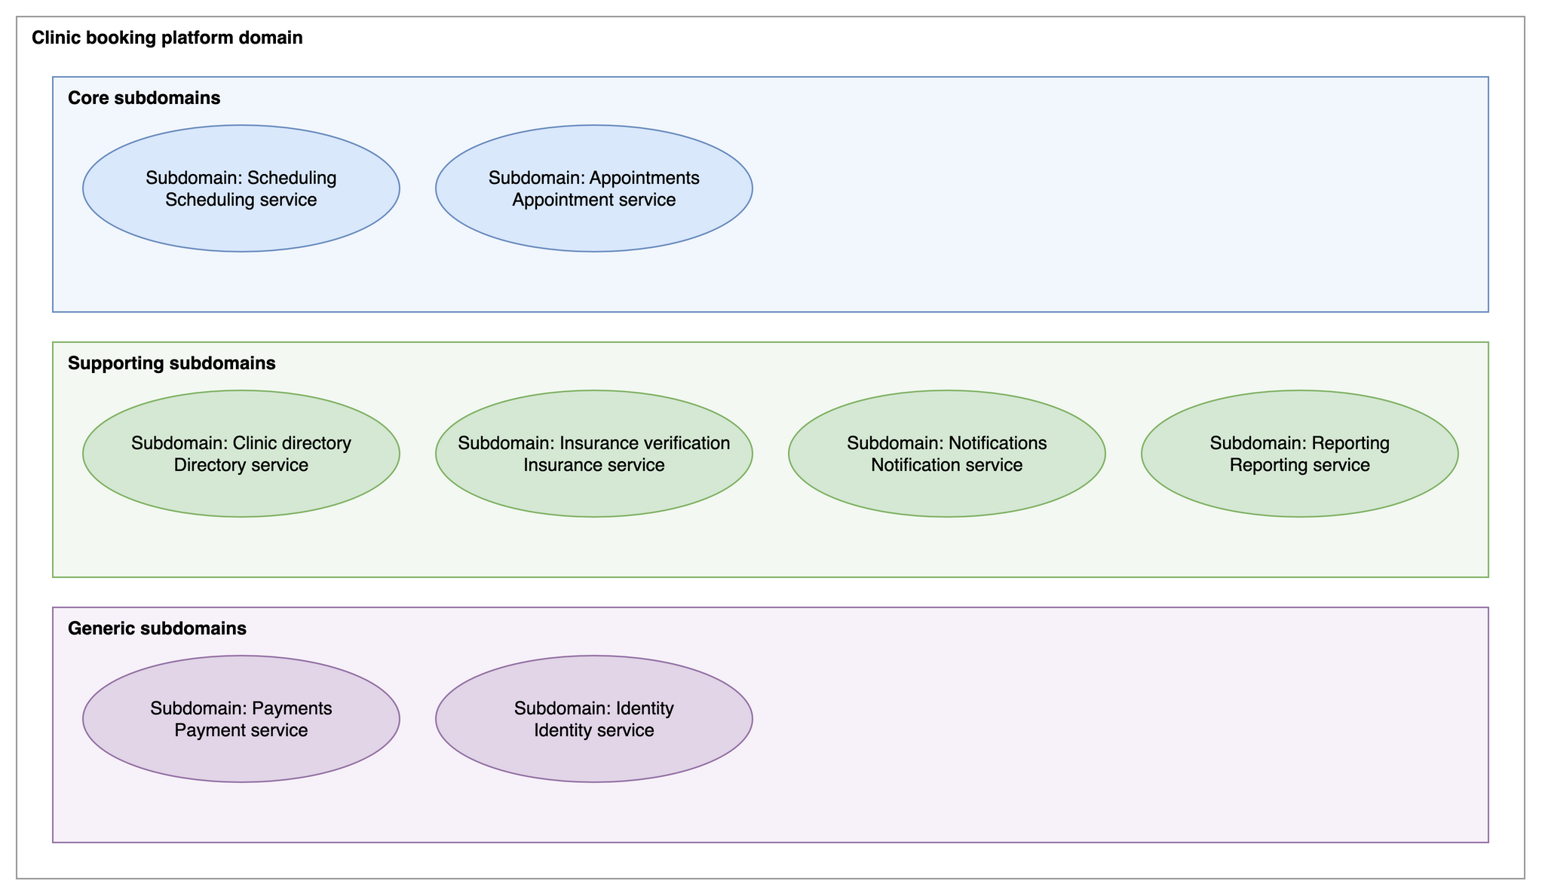
Subdomains
Scheduling and appointments are the core; each of the 8 subdomains is owned by one service
Core subdomain
Supporting subdomain
Generic subdomain
Notes:
We split the domain into eight subdomains. Scheduling and appointments are the core: they hold the slots and the booking flow, which is where the business wins or loses. Clinic directory, insurance verification, notifications and reporting support them. Payments and identity are generic, so we use managed services behind our own small services. Each subdomain has exactly one service.

Slide 6
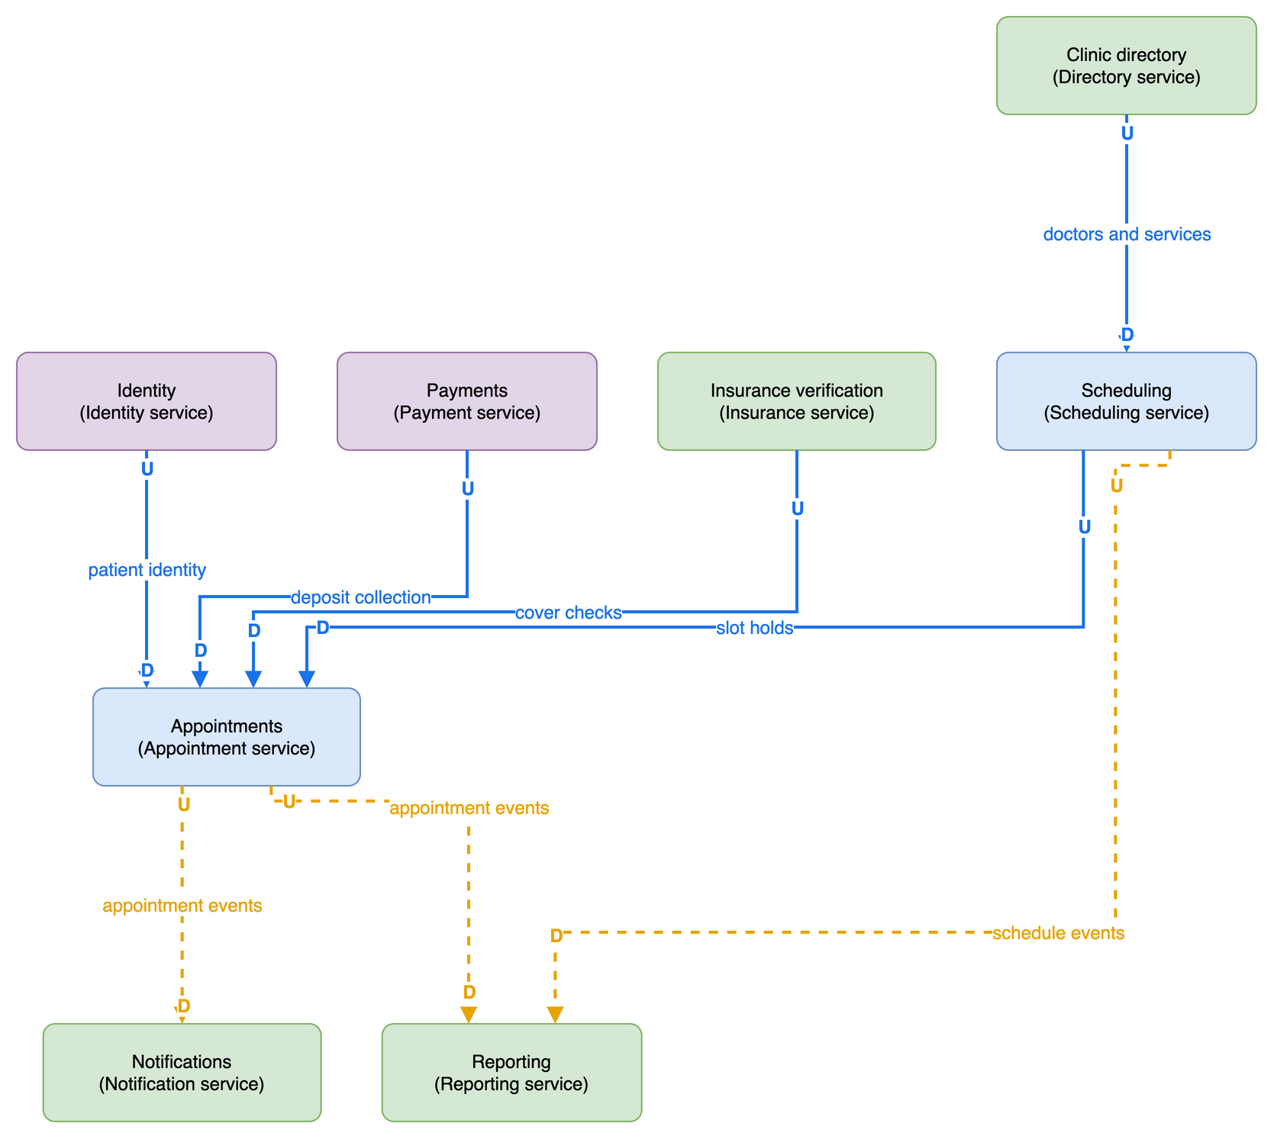
Context map
Appointments depends on four upstream contexts and feeds notifications and reporting with events
Core subdomain
Supporting subdomain
Generic subdomain
Sync call
Async event
Notes:
The context map shows who depends on whom. Appointments is downstream of scheduling for slot holds, of payments for the deposit, of insurance verification for cover checks, and of identity for the patient. Appointments is upstream of notifications and reporting, and it talks to them only through domain events. Scheduling depends on the clinic directory for doctors and services.

Slide 7
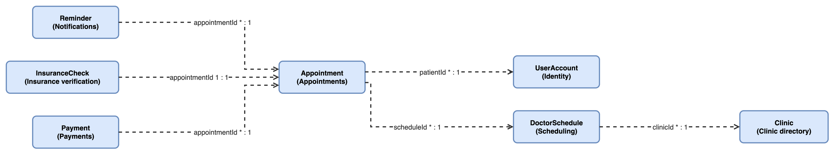
Aggregate roots
Seven aggregates refer to each other by ID only; the appointment is at the centre
Aggregate root
ID reference
Notes:
Each subdomain protects its rules in an aggregate. The appointment is at the centre. Reminders, insurance checks and payments refer to it by appointment ID. The appointment refers to the patient account and the doctor schedule by ID, never by a shared table. Reporting has no aggregate: it only builds read models from events.

Slide 8
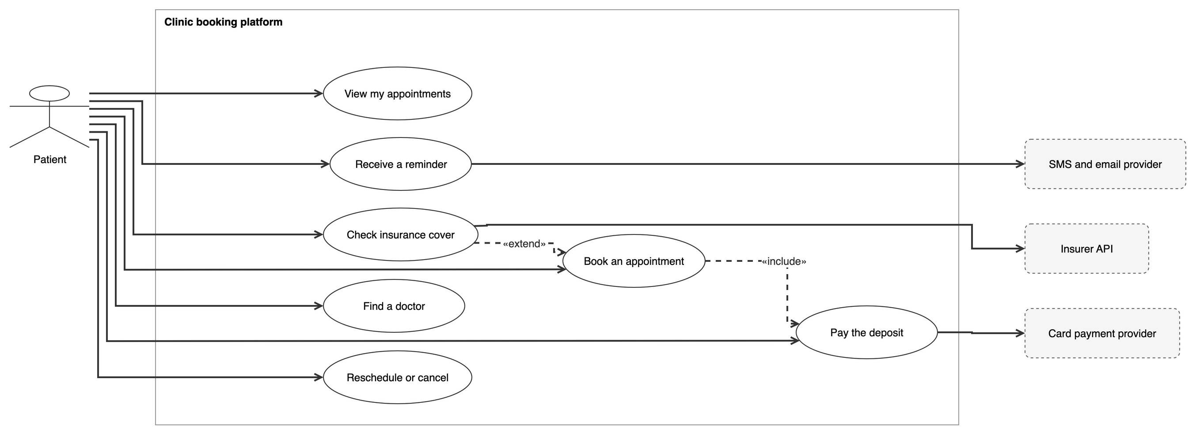
Use cases: Patient functions
Patients book online; booking includes the deposit and may extend into an insurance check
Use case
Actor
External system
Uses
Includes / extends
Notes:
For patients, the main use case is booking an appointment. It always includes paying the deposit, through the card payment provider, and it can be extended by an insurance check with the insurer. Patients also find doctors, view and reschedule appointments and receive reminders.

Slide 9
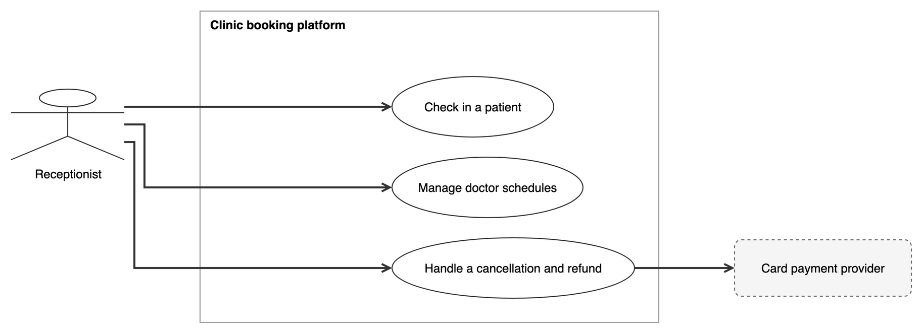
Use cases: Clinic staff functions
Receptionists run schedules, check-in and refunds
Use case
Actor
External system
Uses
Notes:
Receptionists manage doctor schedules, check patients in, and handle cancellations, which may refund the deposit through the payment provider.

Slide 10
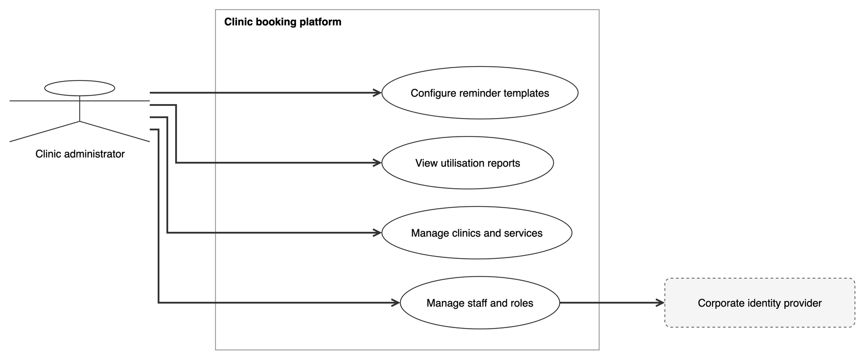
Use cases: Administration functions
Administrators manage clinics, staff and roles, reports and reminder templates
Use case
Actor
External system
Uses
Notes:
Administrators manage clinics and services, staff and roles through the corporate identity provider, utilisation reports and reminder templates.

Slide 11
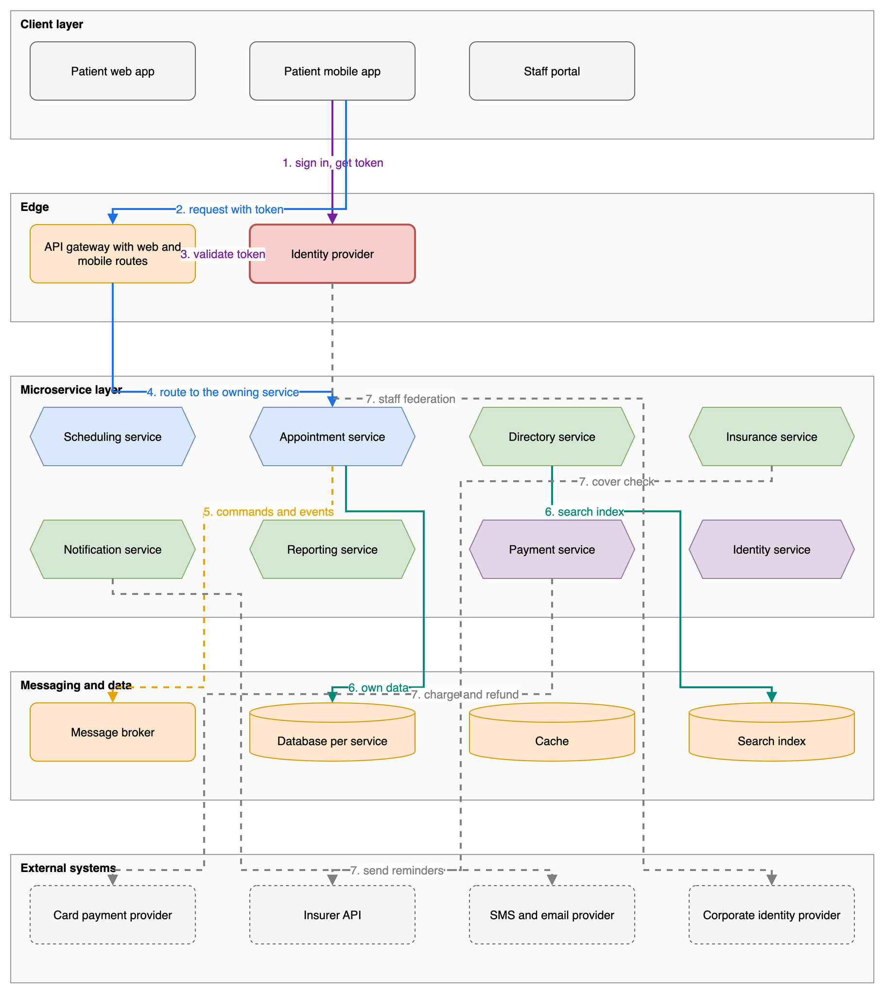
Logical view
Every request passes one gateway and the identity provider; every service owns its data
Client
API gateway
Identity provider
Core subdomain
Supporting subdomain
Generic subdomain
Message broker
Data store
External system
Authentication
Sync call
Async event
Data access
External call
Notes:
Follow the numbers. The patient app signs in with the identity provider and gets a token. Every request goes through the API gateway, which checks the token and routes to the owning service. Services send commands and events through the message broker, and each service owns its own database. Calls to partners, for payment, insurance and messages, always leave from one service, and staff sign in through the corporate identity provider.

Slide 12
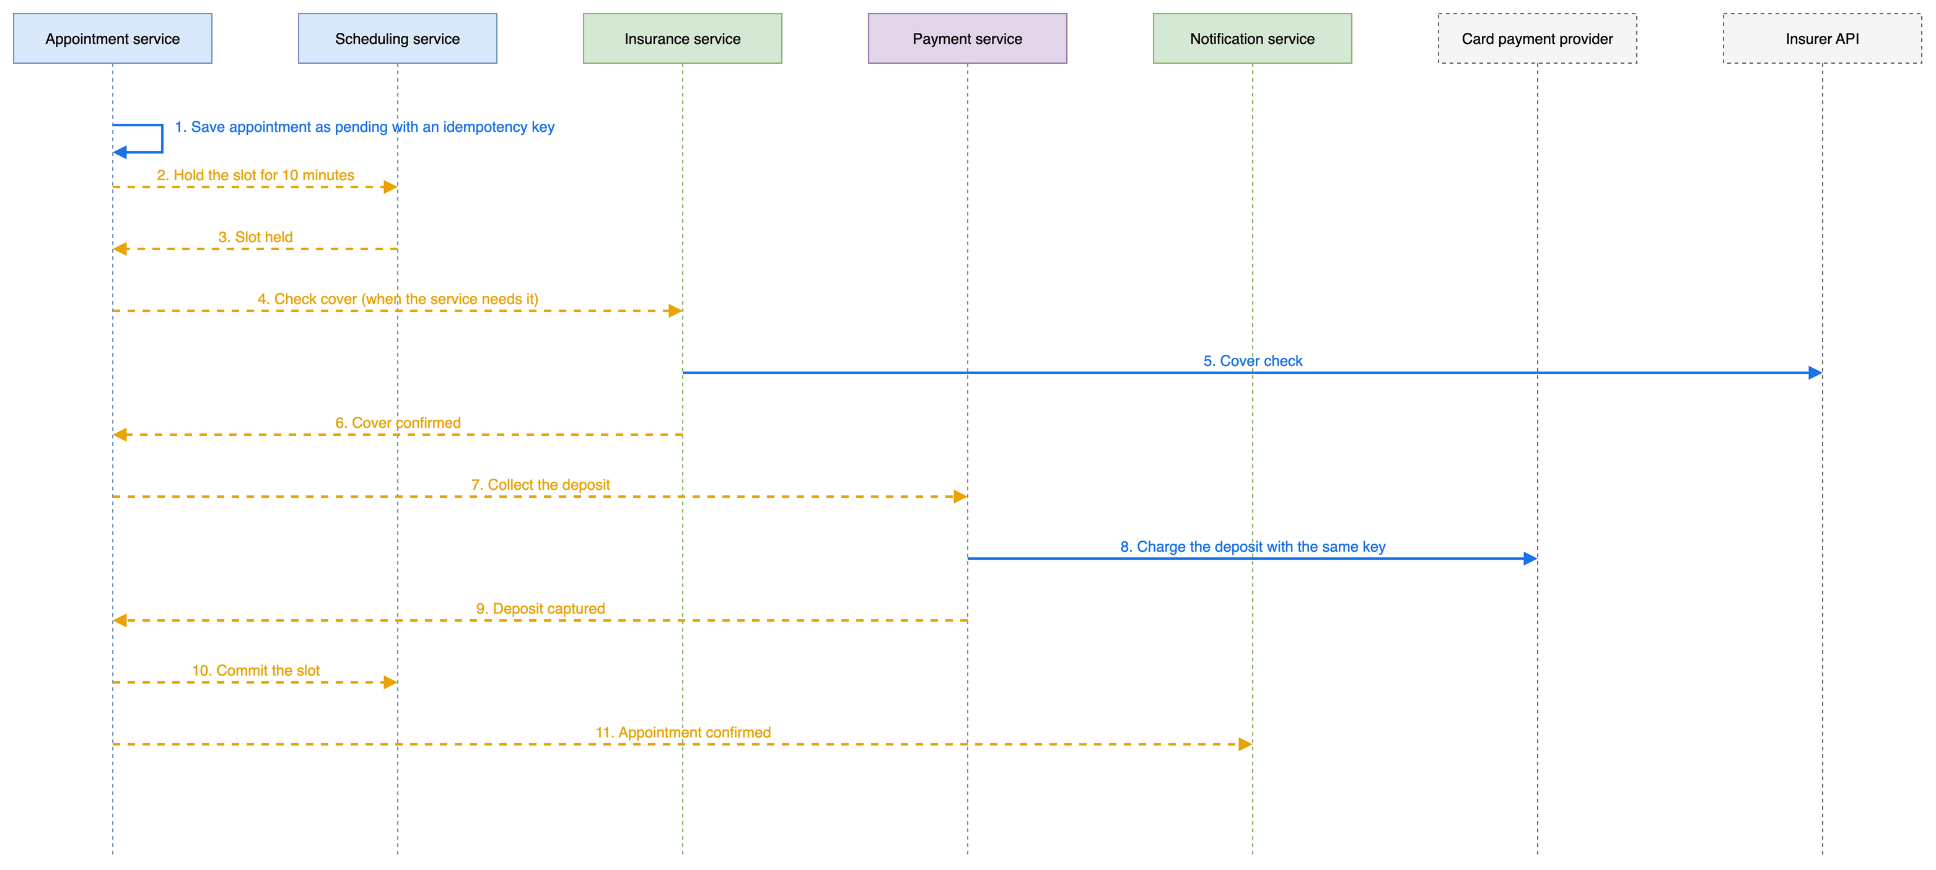
Saga: Book an appointment: Happy path
The appointment service orchestrates the booking as a saga of eleven steps
Core subdomain
Supporting subdomain
Generic subdomain
External system
Sync call
Async event
Notes:
This is the core flow. The appointment service saves the booking as pending, with an idempotency key. It asks scheduling to hold the slot for ten minutes. It checks insurance cover when the service needs it, then asks payments to collect the deposit with the same key. When the deposit is captured, it commits the slot and tells notifications that the appointment is confirmed. Every step is a message through the outbox, so a retry never books twice.

Slide 13
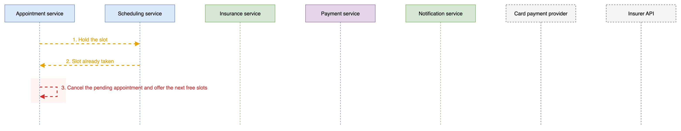
Saga: Book an appointment: Slot already taken
When the slot is gone, the booking is cancelled and the next free slots are offered
Core subdomain
Supporting subdomain
Generic subdomain
External system
Async event
Compensation
Notes:
First failure: the slot is already taken. Scheduling answers that the hold failed. The appointment service compensates: it cancels the pending appointment and offers the patient the next free slots.

Slide 14
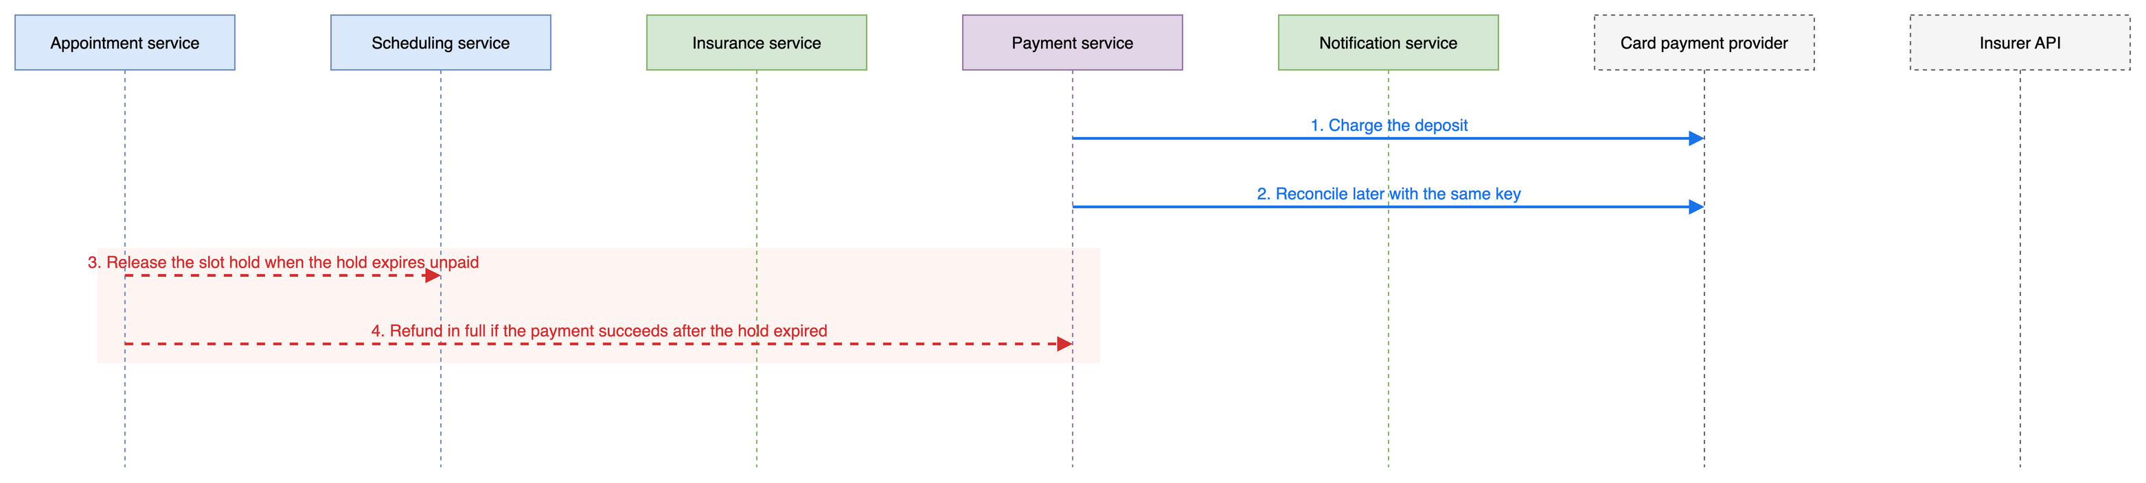
Saga: Book an appointment: Deposit payment times out
A payment timeout never leaves a slot held or money taken without an appointment
Core subdomain
Supporting subdomain
Generic subdomain
External system
Sync call
Compensation
Notes:
Second failure: the payment provider times out. Payments reconciles later with the same key. If the hold expires unpaid, the slot is released. If the payment succeeds after the hold expired, the deposit is refunded in full.

Slide 15
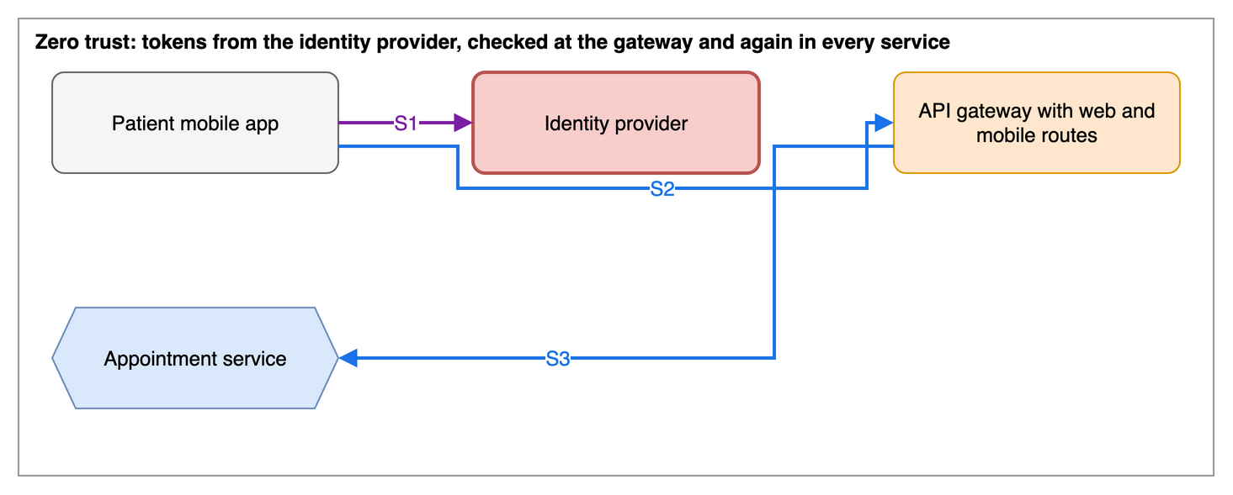
Security pattern
Zero trust: tokens from the identity provider, checked at the gateway and again in every service
Client
Identity provider
API gateway
Core subdomain
Authentication
Sync call
Notes:
Security follows zero trust. Patients sign in and get a token, and staff federate through the corporate identity provider. Every call carries the token. The gateway validates it, and each service checks roles and resources again.

Slide 16
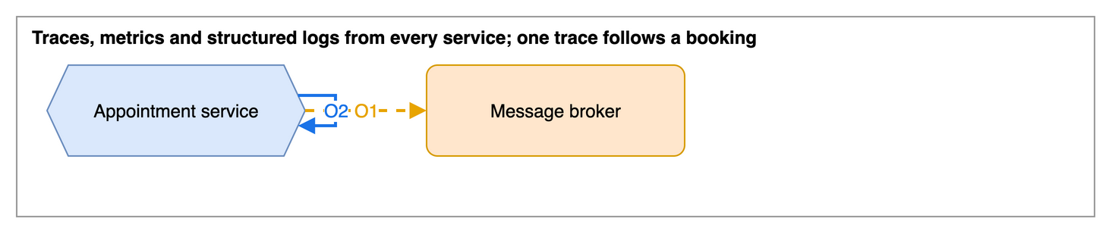
Observability pattern
One trace follows a booking through every service and message
Core subdomain
Message broker
Async event
Sync call
Notes:
Every service emits traces, metrics and structured logs. The trace context travels with commands and events through the outbox, so one trace follows a booking end to end, and alarms notify the on-call team.

Slide 17
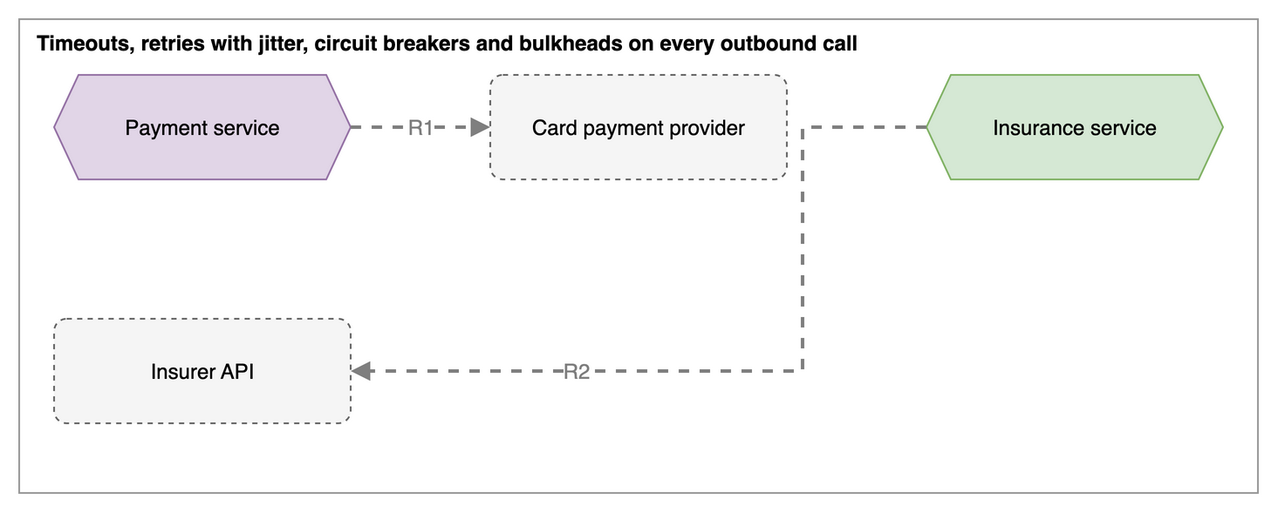
Resilience pattern
Timeouts, retries, circuit breakers and fallbacks on every partner call
Generic subdomain
External system
Supporting subdomain
External call
Notes:
Every outbound call has a timeout, retries with backoff and jitter, and a circuit breaker. When the insurer is down and the circuit is open, we book without the check and verify later, so a partner problem no longer stops booking.

Slide 18
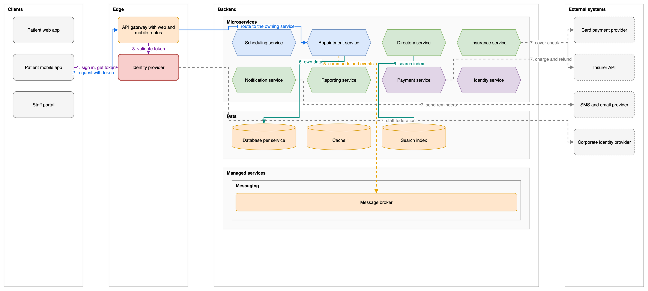
High-level architecture
Clients reach 8 services through one gateway; data and messaging are managed services
Core subdomain
Supporting subdomain
Generic subdomain
Client
API gateway
Identity provider
Data store
Message broker
External system
Authentication
Sync call
Async event
Data access
External call
Notes:
Here is the whole system from left to right. Three clients, the gateway and identity provider at the edge, the eight services in the middle, each with its own data, the message broker as a managed service, and the four external partners on the right. The physical view uses exactly the same layout.

Slide 19
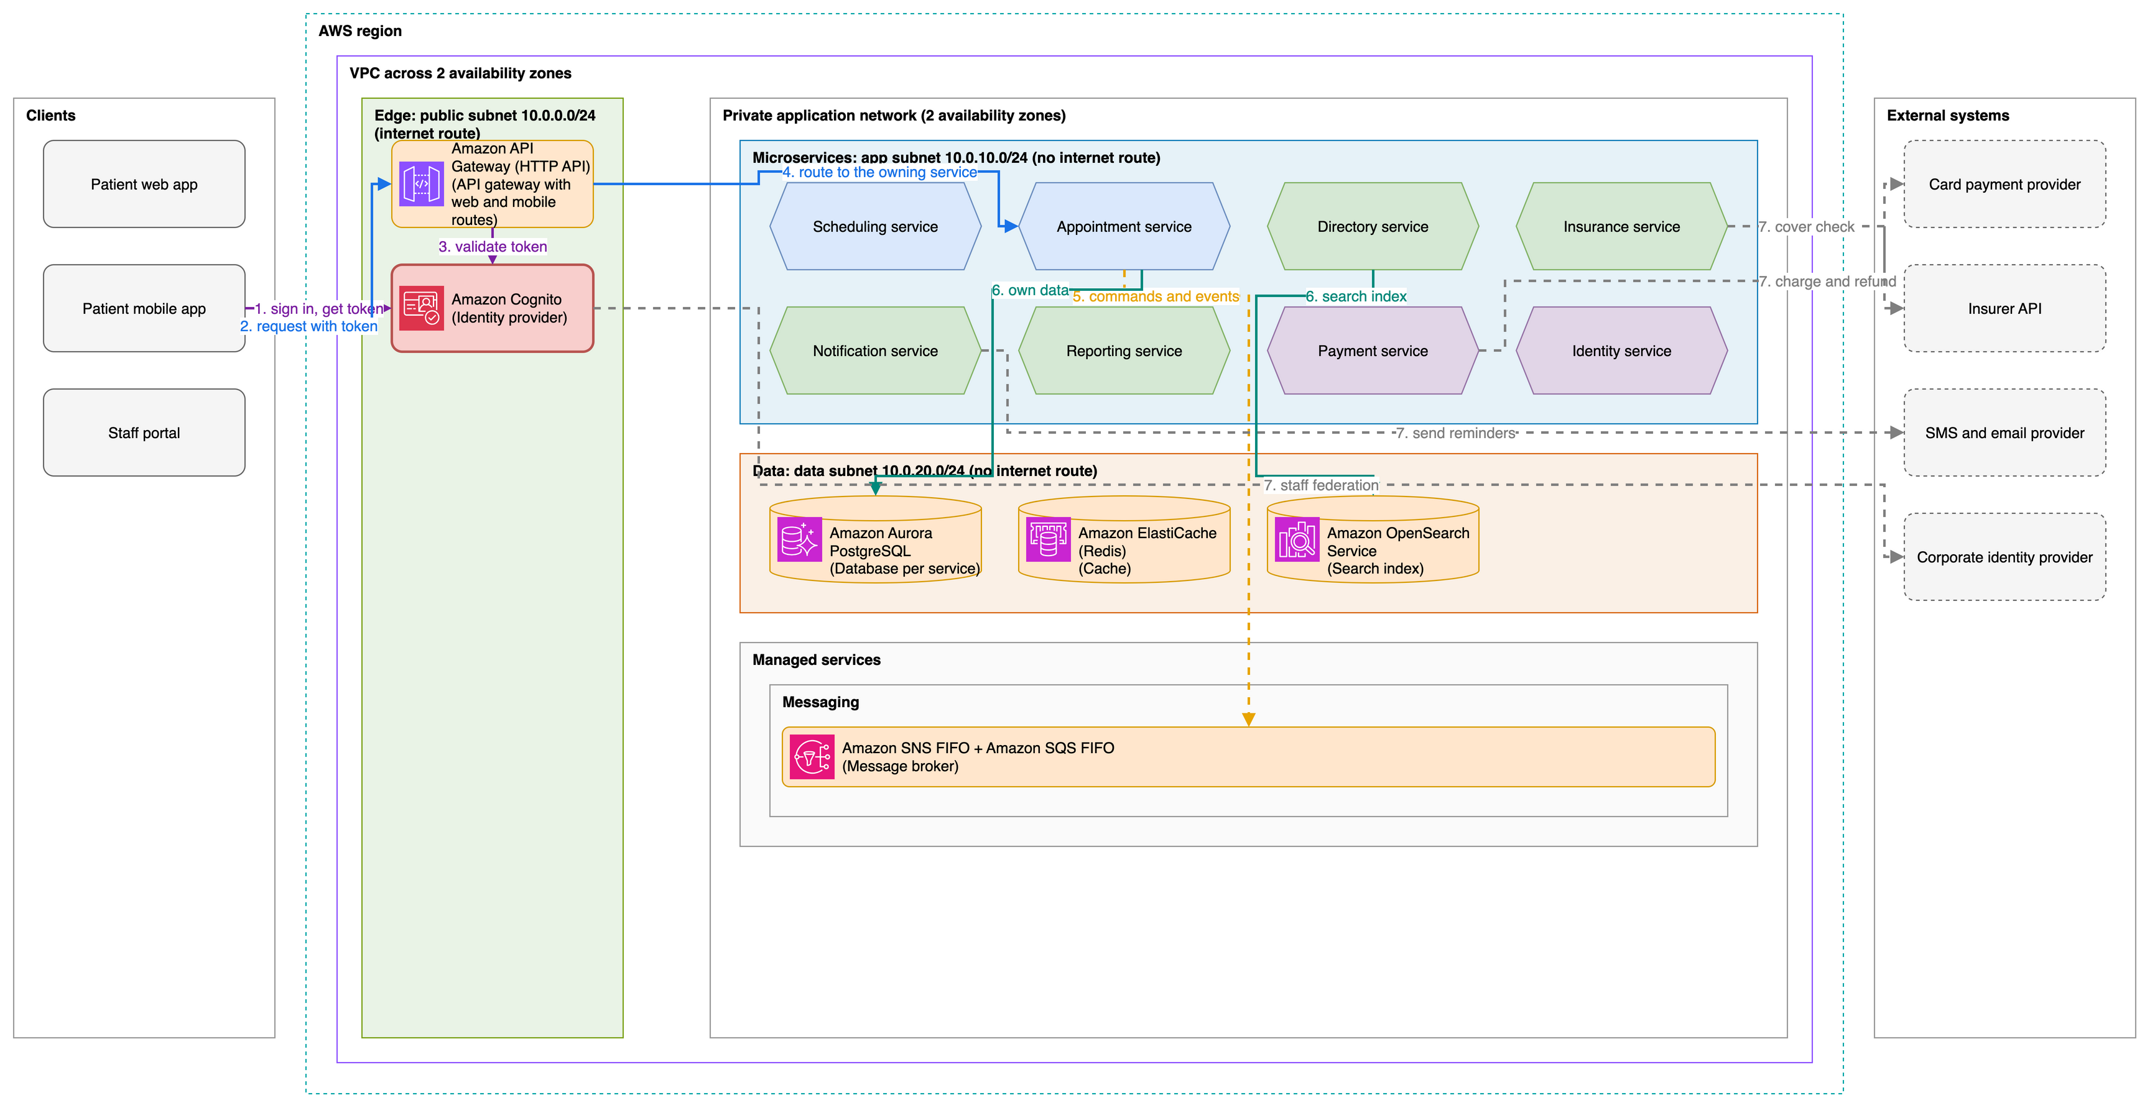
Physical view and network
One AWS region, two availability zones, and three subnet tiers
Core subdomain
Supporting subdomain
Generic subdomain
Client
API gateway
Identity provider
Data store
Message broker
External system
Authentication
Sync call
Async event
Data access
External call
Notes:
On AWS, everything runs in one region across two availability zones. The edge sits in a public subnet behind API Gateway and Cognito. Services run on Fargate in a private app subnet. Aurora, ElastiCache and OpenSearch sit in a data subnet with no internet route. Databases accept only the service tasks, and AWS services are reached through VPC endpoints.

Slide 20
Technology stack
Managed AWS services and one main language, chosen for the saga, the outbox and the Monday peak
Layer | Choice | Why
Clients | React and React Native with TypeScript | One team owns patient web, mobile and the staff portal
Edge | Route 53, CloudFront, WAF and API Gateway | Managed entry point with web and mobile routes
Services and API | Java and Spring Boot; REST with OpenAPI | Libraries for transactions, resilience and tracing; contract-first
Messaging | SNS FIFO and SQS FIFO with dead-letter queues | Ordered per appointment; no brokers to run
Data | Aurora PostgreSQL per service, ElastiCache, OpenSearch, S3 | Transactions, cache, search and documents, all managed
Compute | ECS on Fargate with auto scaling | No cluster to operate; scales for the Monday peak
Observability | OpenTelemetry, X-Ray and CloudWatch | Managed tracing, metrics, logs and alarms
Security | Cognito, corporate identity federation, Secrets Manager | Zero trust with managed identity and secrets
Notes:
The stack follows the design. React for all three clients. A managed edge with API Gateway. Java and Spring Boot for the services, because the saga and the outbox need solid transaction, resilience and tracing libraries. FIFO queues keep messages in order per appointment. Every data store is managed, and Fargate scales out for the Monday morning peak without a cluster to run.

Slide 21
Architecture decisions
Seven decisions shape the design; each one has a trade-off we accept
Decision | Alternatives | Trade-off
One service per subdomain | One modular deployable; a service per aggregate | More services to run, deploy and monitor
Slots held and committed by the scheduling service | Lock rows in a shared database; optimistic booking | A hold can expire while the patient pays
Orchestrated booking saga | Choreography with events only | The appointment service becomes a central component
Outbox and idempotency keys | Two-phase commit; dual writes | Eventual consistency; consumers must deduplicate
One API gateway with web and mobile routes | Clients calling services directly; a GraphQL layer | No response composition at the edge
Isolate partner calls | Synchronous calls without protection | More code paths and tuning per partner
Event-driven reminders | Reminders sent by staff; a nightly batch export | Another service to run
Notes:
Seven decisions shape the design. The two most important: one service per subdomain, which costs us more services to run but lets each area release on its own; and the orchestrated saga with outbox and idempotency keys, which accepts eventual consistency in exchange for no double bookings and safe retries. Every decision lists the alternatives we rejected and the trade-off we accept.

Slide 22
Questions
Thank you
Notes:
Thank you. I am happy to take your questions.

