Slide 1
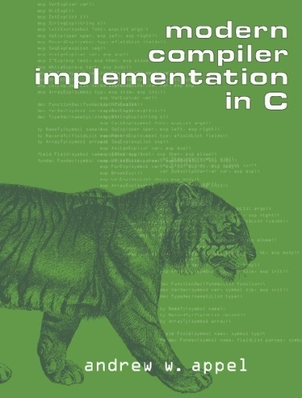
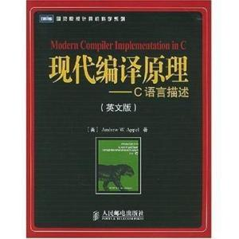
Teaching Staffs
Instructor
  臧斌宇
  Email: byzang@sjtu.edu.cn
  Office phone: 13917124245
Teaching Assistants
  李鼎基、李浩宇
Website
  ipads.se.sjtu.edu.cn/courses/compilers
Text book
  Modern Compiler Implementation in C
  Andrew W. Appel

Slide 2
What are Compilers

Slide 3
Outline
The basic structure of compilers
The input of compilers
The output of compilers
A variety of compiler structures
How a compiler is developed

Slide 4
The basic structure of compilers
Source Program
Target Program
compiler
Error message

Slide 5
Sources languages
Usually, high level programming languages
  Fortran, Algo, Pascal, C
  Lisp
  Prolog
  Java
Sometimes, others
  Verilog, lex languages, …

Slide 6
Target languages
Usually, machine languages
  Assembly languages
  Binary languages
Sometimes, others
  High level programming languages

Slide 7
A Variety of Compiler structures
There are many source and target languages
There are several kinds of compiler structures
  Single pass, multi-pass, load-and-go,
  debugging,
  optimizing
The basic tasks are essentially the same
The basic techniques are the same

Slide 8
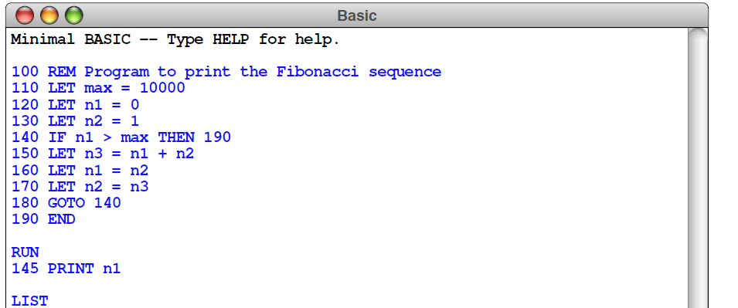
Mini-Basic Interpreter
Build a minimal BASIC interpreter, starting with the code for the integer expression evaluator

Slide 9

History of Compilers
The first compiler was initiated by John Backus in 1953(Speedcoding), and completed in 1957(Fortran)
Since then, a bunch of theories were developed. And a lot of tools were developed according to these theories
In the early 1980s, theories and implementations about traditional compilers got to mature
In the middle 1980s, compiler designers turned to optimization techniques and how to compile modern programming languages
1977 ACM Turing Award

Slide 10
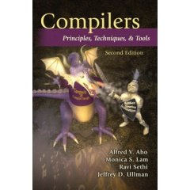
About the text book
There two parts in this book
  We study the first part
  And part of the second
There is another famous text book
  Compilers: Principles, Techniques, and Tools(2nd Ed.)
  By Alfred V. Aho, Ravi Sethi, Jeffrey D. Ullman and Monica S. Lam
  2006, the "Purple Dragon Book"

Slide 11
A journey to the internal compiler world

Slide 12
Outline
How to define source languages?
How to represent programs internally?
How to translate sources to internals?
How to translate internals to targets?
Tiger langague

Slide 13
A simple language
Straight line
  Assign statements
  Print statements
  Sequence of statements
Form of expressions
  Identifies, numbers
  Expressions connected by operators such as
    +, -, *, /
  Expression sequence
    (statement, expression)

Slide 14
Example
a := 5 + 3 ; b := (print(a, a-1), 10*a); print (b)
Output
8, 7
80

Slide 15
Syntax Definition for the Source
Regular expression
  Used to define alphabet and vocabulary
  Will be explained in chapter 2
Context free grammar
  Used to define statements and expressions
  Will be explained in chapter 3

Slide 16
Syntax Definition for the Source
Alphabet
  letter → A | B | … | Z | a | b | … | z
  digit → 0 | 1 | … | 9
Vocabulary
  id → letter ( letter | digit )*
  num → digit digit*
Delimiter
  White space, newline, tab

Slide 17
Syntax Definition for the Source
Statement
  Stm → Stm; Stm (CompoundStm)
  Stm → id := Exp (AssignStm)
  Stm → print(ExpList) (PrintStm)
Exp
  Exp → id (IdExp)
  Exp → num (NumExp)
  Exp → Exp Binop Exp (OpExp)
  Exp → (Stm, Exp) (EseqExp)

Slide 18
Syntax Definition for the Source
ExpList
  ExpList → Exp, ExpList (PairExpList)
  ExpList → Exp (LastExp)
Binop
  Binop → + (Plus)
  Binop → - (Minus)
  Binop → * (Times)
  Binop → / (Div)

Slide 19
Context-free Grammar
A set of tokens
  terminal symbol
A set of nonterminals
A set of productions, where each production consists of
  a nonterminal
    the left side of the production
  an arrow
  a sequence of tokens and/or nonterminals
    the right side of the production

Slide 20
Context-free Grammar
A designation of one of the nonterminals as the start symbol
Example
  stm → id := expr
Right side
Left side
token
nonterminal

Slide 21
Context-free Grammar
Group the productions
  Productions with the same nonterminal on the left
  Their right sides can be grouped
    with the alternative right sides separated by the symbol “|”
    read “or”

Slide 22
Syntax Definition for the Source
Statement
  Stm → Stm; Stm (CompoundStm)
  | id := Exp (AssignStm)
  | print(ExpList) (PrintStm)
Exp
  Exp → id (IdExp)
  | num (NumExp)
  | Exp Binop Exp (OpExp)
  | (Stm, Exp) (EseqExp)

Slide 23
Syntax Definition for the Source
ExpList
  ExpList → Exp, ExpList (PairExpList)
  | Exp (LastExp)
Binop
  Binop → + (Plus)
  | - (Minus)
  | * (Times)
  | / (Div)

Slide 24
Outline
How to define source languages?
  Regular Expressions and Context free grammars
How to represent programs internally?
How to translate sources to internals?
How to translate internals to targets?
Tiger language

Slide 25
Basic Structures of Compilers
Analysis
  From source programs to intermediate representations
Synthesis
  From intermediate representations to target programs
Analysis
Synthesis
source
IR
target

Slide 26
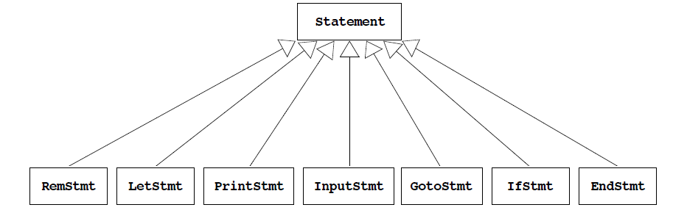
Mini-Basic Interpreter

Slide 27
a := 5 + 3 ; b := (print(a, a-1), 10*a); print (b)
CompoundStm
AssignStm
CompoundStm
a
OpExp
AssignStm
PrintStm
b
LastExpList
EseqExp
NumExp
plus
NumExp
printStm
IdExp
OpExp
5
3
PairExpList
b
NumExp
Times
NumExp
a
LastExpList
10
a
OpExp
IdExp
Minus
NumExp
a
1

Slide 28
Tree Languages
Statement
  Stm → Stm; Stm (CompoundStm)
  | id := Exp (AssignStm)
  | print(ExpList) (PrintStm)
Exp
  Exp → id (IdExp)
  | num (NumExp)
  | Exp Binop Exp (OpExp)
  | (Stm, Exp) (EseqExp)
ExpList
  ExpList → Exp, ExpList (PairExpList)
  | Exp (LastExp)

Slide 29
Tree Languages
Binop
  Binop → + (Plus)
  | - (Minus)
  | * (Times)
  | / (Div)

Slide 30
Tree Data Structures
typedef struct A_stm_ *A_stm ;
typedef struct A_exp_ *A_exp ;
typedef struct A_expList_ *A_expList ;
typedef enum {
A_plus, A_minus, A_times, A_div
} A_binop ;

Slide 31
Tree Data Structures
struct A_stm_ {
enum { A_CompoundStm, A_assignStm, A_printStm } kind;
union {
struct {A_stm stm1; A_stm stm2; } compound ;
struct {string id; A_exp exp; } assign ;
struct {A_expList exps; } print ;
} u ;
} ;
A_stm A_CompoundStm (A_stm, A_stm) ;
A_stm A_AssignStm (string, A_exp);
A_stm A_PrintStmt (A_expList) ;

Slide 32
Tree Data Structures
struct A_exp_ {
enum { A_idExp, A_numExp, A_opExp, A_eseqExp } kind;
union {
string id ;
int num ;
struct {A_exp left; A_binop oper; A_exp right;} op ;
struct {A_stm stm; A_exp exp; } eseq ;
} u ;
} ;
A_exp A_IdExp (A_stm, A_stm) ;
A_exp A_NumExp (string, A_exp);
A_exp A_OpExp (A_expList);
A_exp A_EseqExp (A_stm, A_exp);

Slide 33
Tree Data Structures
struct A_expList_ {
enum { A_pairExpList, A_lastExp} kind;
union {
struct {A_exp head; A_expList tail; } pair ;
A_exp last ;
} u ;
} ;
A_stm A_CompoundStm (A_stm stm1, A_stm stm2) {
A_stm s = checked_malloc(sizeof(*s)) ;
s->kind = A_compoundStm ;
s->u.compound.stm1=stm1; s->u.compound.stm2=stm2;
return s ;
}

Slide 34
Assignment
1. Write a function int maxargs(A_stm)
  Tells the maximum number of arguments of any print statement within any subexpression of a given statement
  Remember print statements can contain expressions that contain other statements
2. Write a function void interp(A_stm)
  Interprets a program in this language
  Make two mutually recursive functions interpStm and interpExp

Slide 35
Environments (symbol tables)
Represent a “table” as a list of id × int pairs
  mapping identifiers to the integer values
typedef struct table *Table_;
struct table { string id; int value; Table_ tail};
Table_ Table(string id, int value,, struct table *tail) {
Table_ t = malloc(sizeof(*t));
t->id=id; t->value=value; t->tail=tail;
return t;
}
Table_ update(Table_ t, string id, int value);
int lookup(Table_ t, string key);

Slide 36
Straight-line program interpreter
Input
  Write hardcoded programs by directly invoking constructors
No side effect
  Denotational semantics, attribute grammar
  {a |-> 3, c|->4},
  Changing c to 7
  {a|->3, c|->7}
a | 3
c | 4
c | 7
a | 3
c | 4

Slide 37
Straight-line program interpreter
Execution
  Traverse the tree
  evaluate each subtrees and then the tree itself
Table_ interpStm(A_stm s, Table_ t)
  The result is a table
    final values of each identifier
struct IntAndTable {int i; Table_ t};
struct IntAndTable interpExp(A_exp e, Table_ t);
  The result is a table
    For side effects
  and the value of the expression itself

Slide 38
Naming Rules and Modularity Principles
A_stm
A_CompoundStm (A_stm stm1, A_stm stm2)
Each module (header file) shall have a prefix unique to that module
lowercase
uppercase

Slide 39
Outline
How to define source languages?
How to represent programs internally?
  Abstract syntax tree and environment (tables)
How to translate sources to internals?
How to translate internals to targets?
Tiger language

Slide 40
Front end
scanner
parser
source
token
IR
errors

Slide 41
Front end
Responsibilities:
  recognize legal procedure
  report errors
  produce IR
  preliminary storage map
  shape the code for the back end
Much of front end construction can be automated

Slide 42
Scanner
Maps characters into tokens
  the basic unit of syntax
  a := a - 1 becomes
    <id, a>; <:=, >; <id, a>; <-, >; <num, 1>
  A lexeme is
    a value for a token : character string, integer
  typical tokens: numb, id, +, -, ……
Eliminates white space (tabs, blanks, comments)
  Simplify the parser
A key issue is speed
  use specialized recognizer (as opposed to lex)

Slide 43
Parser
Parser
  recognize context-free syntax
  guide context-sensitive analysis
  construct IR
  produce meaningful error messages
  attempt error correction
Parser generators mechanize much of the work

Slide 44
Outline
How to define source languages?
How to represent programs internally?
How to translate sources to internals?
  Scanner and parser
How to translate internals to targets?
Tiger language

Slide 45
Back End
Responsibilities
  translate IR into target machine code
  choose instructions for each IR operation
  decide what to keep in registers at each point
  ensure conformance with system interfaces
Automation has been less successful here

Slide 46
Three pass compilers
target
source
Analysis
HIR
Synthesis
LIR
Code Gen
errors
Analyzes and generates HIR close to source
translates HIR to LIR close to target
Emits target from LIR

Slide 47
Optimizer
Token
Lexical
analysis
Source
Analyzes and changes IR
The goal is to reduce runtime
Optimizer must preserve values
Parsing
IR
Code
Gen.
Optimization
target

Slide 48
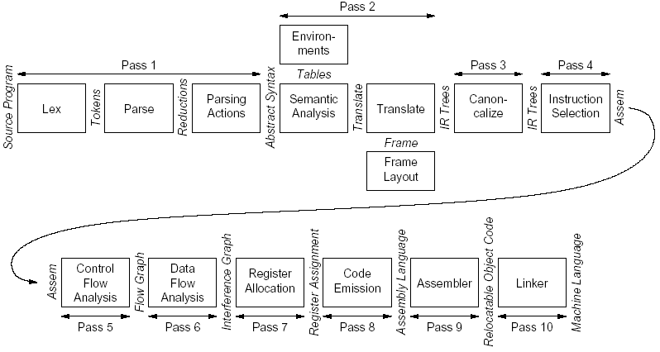

Slide 49
Outline
How to define source languages?
How to represent programs internally?
How to translate sources to internals?
How to translate internals to targets?
  Multiple passes (translations)
Tiger language
  Appendix (Tiger language reference manual)
  P518-527

Slide 50
Tiger Language(Merge.tig)
let
type any = {any : int} /*type declaration */
var buffer := getchar() /*variable declaration */
function readint(any: any) : int = /*function declaration */
let
var i := 0
function isdigit(s: string) : int =
ord(buffer)>=ord(“0”) & ord(buffer)<=ord(“9”)
in
while buffer=“ “ | buffer=“\n” do buffer := getchar()
any.any := isdigit(buffer);
while isdigit(buffer)
do ( i := i*10+ord(buffer)-ord(“0”); buffer := getchar() )
i
end
Buiding type
Standard library

Slide 51
Tiger Language(Merge.tig)
type list = {first: int, rest: list}
……
function printint(i: int) =
let function f(i: int) = =if i > 0
then (f(i/10); print(chr(i - i/10*10+ord(“0”))))
in if i < 0 then (print(“-”); f(-i))
else if ( i > 0 ) then f(i)
else print(“0”)
end
record
Nested function

Slide 52
Tiger Language(Merge.tig)
function printlist(l: list) =
if l=nil then print(“\n”)
else (pintint((l.first); print(“ “); printlist(l.rest))
/* BODY OF MAIN PROGRAM */
in
printlist(merge(readlist(), readlist()))
end
var N := 8
type intArray = array of int
var row := intArray [N] of 0
array

Slide 53
Tiger Language
Mutually recursive types
declared by a consecutive sequence of type declarations. Each recursion cycle must pass through a record or array type.
type tree = {key: int, chidren: treelist}
type treelist = {hd: tree, tl: treelist}
Mutually recursive functions
declared by a sequence of consecutive function declarations
function treeLeaves(t ：tree) : int =
if t = nil then 1
else treelistLeaves(t.children)
function treelistLeaves(L : treelist) : int =
if L = nil then 0
else treeLeaves(L.hd) + treelistLeaves(L.tl)

