Slide 1
Introduction to Parsing

Slide 2
Outline
Parser overview
Context-free grammars (CFG’s)
Derivations
Ambiguities

Slide 3
Outline
Parser overview
Context-free grammars (CFG’s)
Derivations
Ambiguities

Slide 4
Languages and Automata
Formal languages are very important in CS
  Especially in programming languages
Regular languages
  The weakest formal languages widely used
  Many applications
We will also study context-free languages

Slide 5
Limitations of Regular Languages
Intuition: A finite automaton that runs long enough must repeat states
Finite automaton can’t remember # of times it has visited a particular state
Finite automaton has finite memory
  Only enough to store in which state it is
  Cannot count, except up to a finite limit
E.g., language of balanced parentheses is not regular: { (^{i} )^{i} | i ≥ 0}

Slide 6
The Functionality of the Parser
Input: sequence of tokens from lexer
Output: parse tree of the program

Slide 7
Example
  if x = y then 1 else 2 fi
Parser input
  IF ID = ID THEN INT ELSE INT FI
Parser output
IF-THEN-ELSE
=
INT
INT
ID
ID

Slide 8
Comparison with Lexical Analysis
Phase | Input | Output
Lexer | Sequence of characters | Sequence of tokens
Parser | Sequence of tokens | Parse tree

Slide 9
The Role of the Parser
Not all sequences of tokens are programs . . .
. . . Parser must distinguish between valid and invalid sequences of tokens
We need
  A language for describing valid sequences of tokens
  A method for distinguishing valid from invalid sequences of tokens

Slide 10
Outline
Parser overview
Context-free grammars (CFG’s)
Derivations
Ambiguities

Slide 11
Context-Free Grammars
Programming language constructs have recursive structure
An EXPR is
  Exp → Exp Binop Exp (OpExp) or
  Exp → (Stm, Exp) (EseqExp)
  …
Context-free grammars are a natural notation for this recursive structure

Slide 12
CFGs (Cont.)
A CFG consists of
  A set of terminals T
  A set of non-terminals N
  A start symbol S (a non-terminal)
  A set of productions
  Assuming X ∈ N, a production has the following forms
  X → ε , or
  X → Y₁ Y₂ ... Y_{n} where Y_{i} ⊆ N ∪ T

Slide 13
Notational Conventions
In these lecture notes
  Non-terminals are written upper-case
  Terminals are written lower-case
  The start symbol is the left-hand side of the first production
Productions
  X → α, A left side, α right side
  A set of production X → α₁, X → α₂, … , X → α _{k},
  with the same left hand side can be written as
  X → α₁ | α₂ | … | α _{k},

Slide 14
Examples of CFGs
Exp → id (IdExp)
| num (NumExp)
| Exp Binop Exp (OpExp)
| (Stm, Exp) (EseqExp)

Slide 15
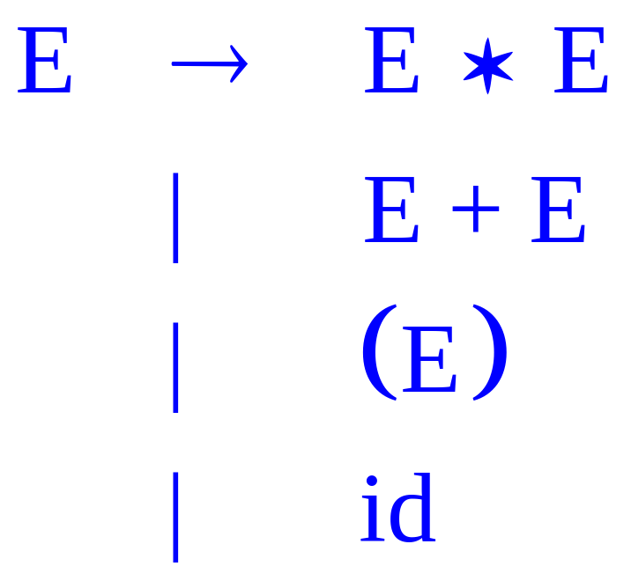
Examples of CFGs (cont.)
Simple arithmetic expressions:

Slide 16
The Language of a CFG
Read productions as replacement rules:
X → Y₁ ... Y_{n}
  Means X can be replaced by Y₁ ... Y_{n}
X → ε
  Means X can be erased (replaced with empty string)

Slide 17
Key Ideas
Begin with a string consisting of the start symbol “S”
Replace any non-terminal X in the string by a right-hand side of some production
X → Y₁ … Y_{n}
Repeat (2) until there are no non-terminals in the string

Slide 18
The Language of a CFG (Cont.)
More formally, write
X₁ … X_{i} … X_{n} → X₁ … X_{i-1} Y₁ … Y_{m} X_{i+1} … X_{n}
if there is a production
X_{i} → Y₁ … Y_{m}

Slide 19
The Language of a CFG (Cont.)
Write
X₁ … X_{n} → * Y₁ … Y_{m}
if
X₁ … X_{n} → … → … → Y₁ … Y_{m}
in 0 or more steps

Slide 20
The Language of a CFG
Let G be a context-free grammar with start symbol S. Then the language of G is:
{ a₁ … a_{n} | S → * a₁ … a_{n} and every a_{i} is a terminal }

Slide 21
Terminals
Terminals are called because there are no rules for replacing them
Once generated, terminals are permanent
Terminals ought to be tokens of the language

Slide 22
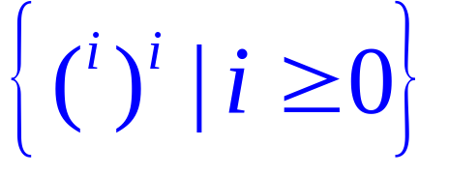
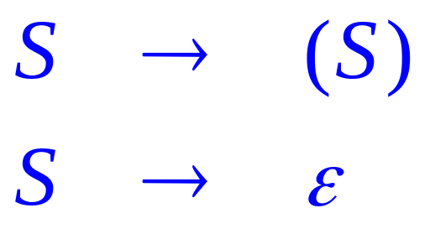
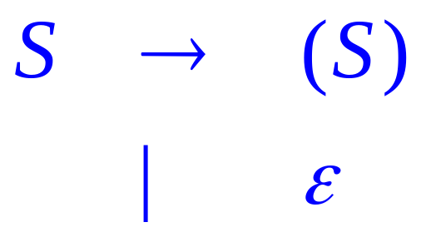
Examples
L(G) is the language of CFG G
Strings of balanced parentheses
Two grammars:
OR

Slide 23
Example
Exp → id (IdExp)
| num (NumExp)
| Exp Binop Exp (OpExp)
| (Stm, Exp) (EseqExp)

Slide 24
Example (Cont.)
Some elements of the language
id
id + num
id * id + num
(id:=num, id)

Slide 25
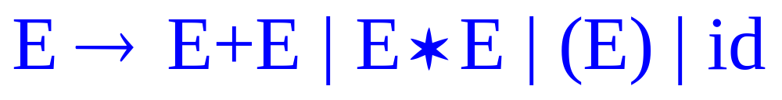
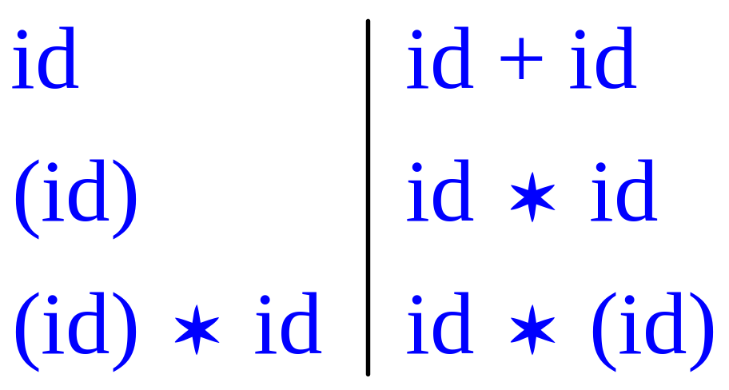
Arithmetic Example
Simple arithmetic expressions:
Some elements of the language:

Slide 26
Notes
The idea of a CFG is a big step. But:
Membership in a language is “yes” or “no”
  we also need parse tree of the input
Must handle errors gracefully
Need an implementation of CFG’s (e.g., bison)

Slide 27
More Notes
Form of the grammar is important
  Many grammars generate the same language
  Tools are sensitive to the grammar
  Note: Tools for regular languages (e.g., flex) are also sensitive to the form of the regular expression, but this is rarely a problem in practice

Slide 28
Outline
Parser overview
Context-free grammars (CFG’s)
Derivations
Ambiguities

Slide 29
Derivations and Parse Trees
A derivation is a sequence of productions
S → … → …
A derivation can be drawn as a tree
  Start symbol is the tree’s root
  For a production X → Y₁ … Y_{n} add children Y₁, …, Y_{n} to node X

Slide 30

Derivation Example
Grammar
String

Slide 31
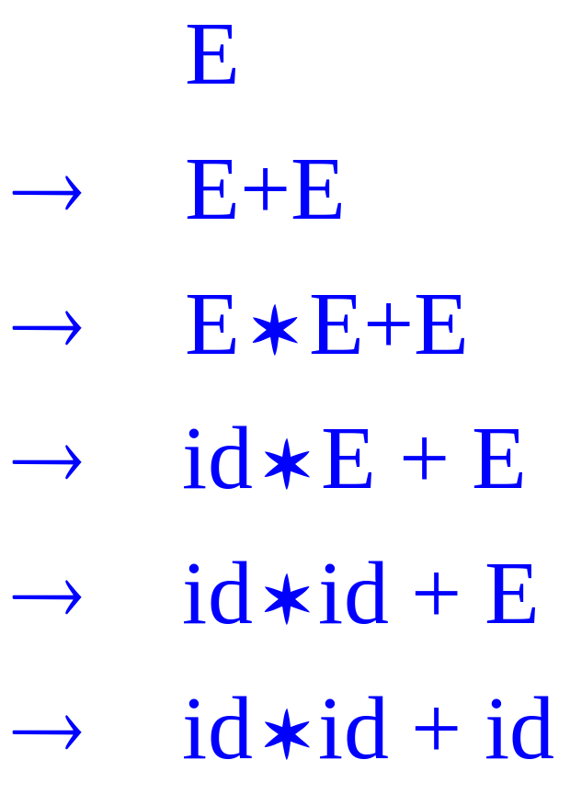
Derivation Example (Cont.)
E
E
+
E
E
*
E
id
id
id

Slide 32

Derivation in Detail (1)
E

Slide 33
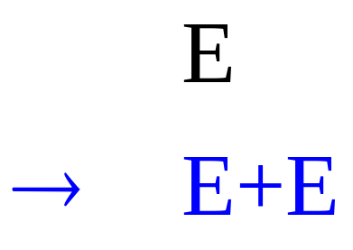
Derivation in Detail (2)
E
E
+
E

Slide 34
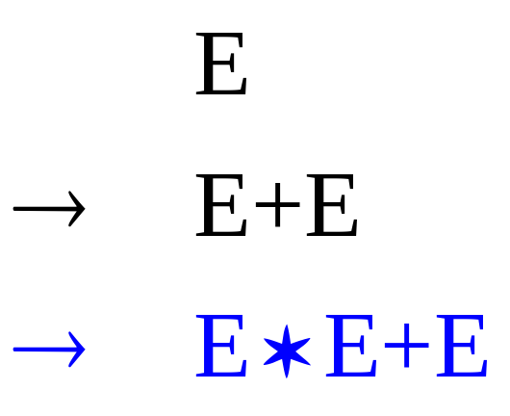
Derivation in Detail (3)
E
E
+
E
E
*
E

Slide 35
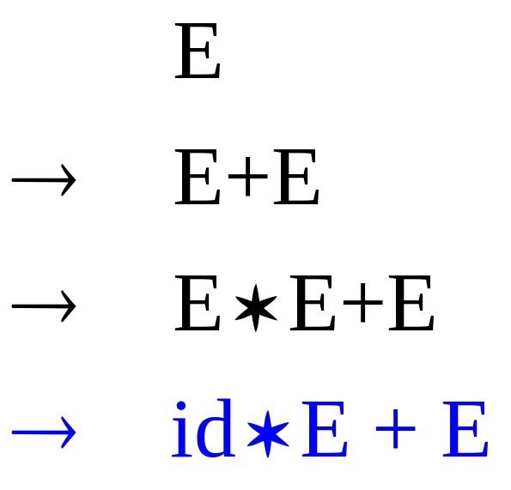
Derivation in Detail (4)
E
E
+
E
E
*
E
id

Slide 36
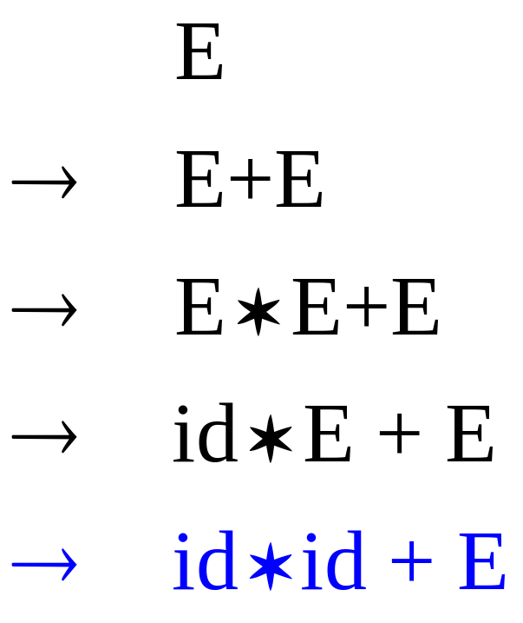
Derivation in Detail (5)
E
E
+
E
E
*
E
id
id

Slide 37
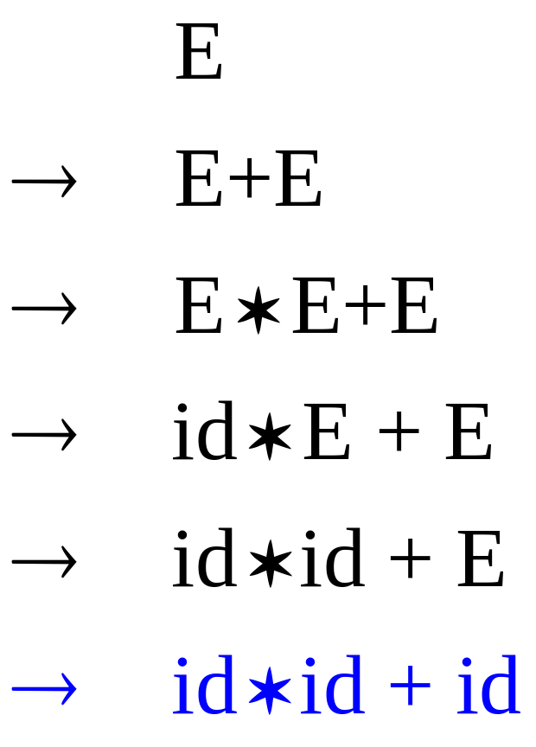
Derivation in Detail (6)
E
E
+
E
E
*
E
id
id
id

Slide 38
Notes on Derivations
A parse tree has
  Terminals at the leaves
  Non-terminals at the interior nodes
An in-order traversal of the leaves is the original input
The parse tree shows the association of operations, the input string does not

Slide 39
Left-most and Right-most Derivations
Two choices to be made in each step in a derivation
  Which nonterminal to replace
  Which alternative to use for that nonterminal

Slide 40
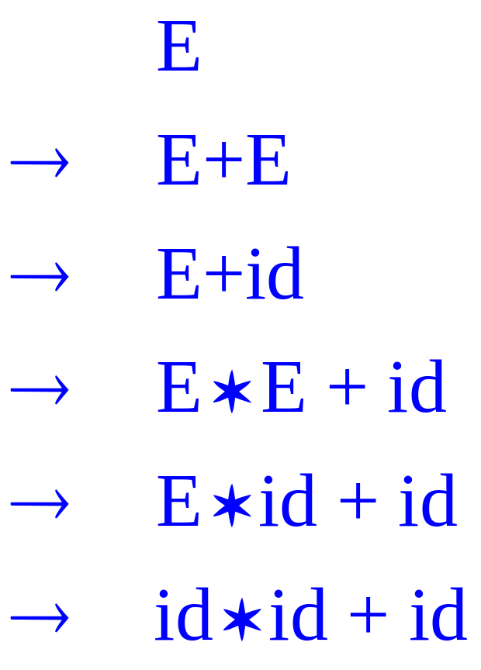
Left-most and Right-most Derivations
The example is a left-most derivation
  At each step, replace the left-most non-terminal
There is an equivalent notion of a right-most derivation

Slide 41
Right-most Derivation in Detail (1)
E

Slide 42
Right-most Derivation in Detail (2)
E
E
+
E

Slide 43
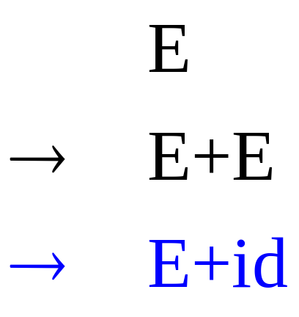
Right-most Derivation in Detail (3)
E
E
+
E
id

Slide 44
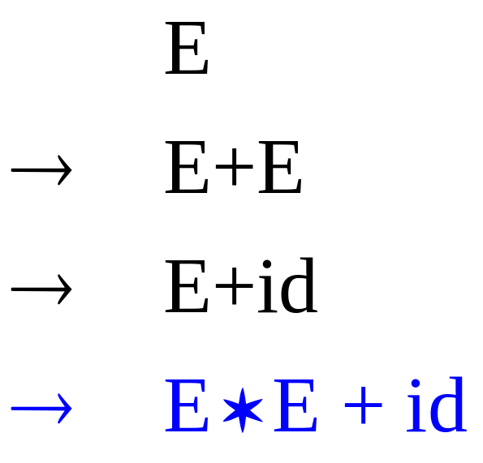
Right-most Derivation in Detail (4)
E
E
+
E
E
*
E
id

Slide 45
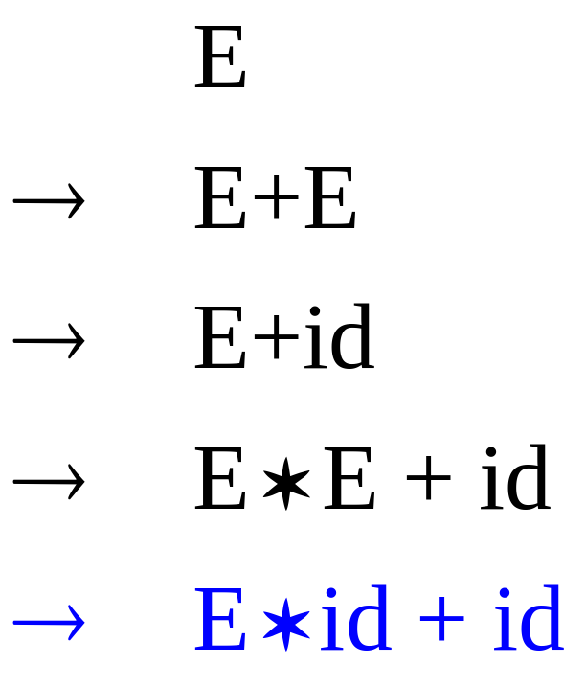
Right-most Derivation in Detail (5)
E
E
+
E
E
*
E
id
id

Slide 46
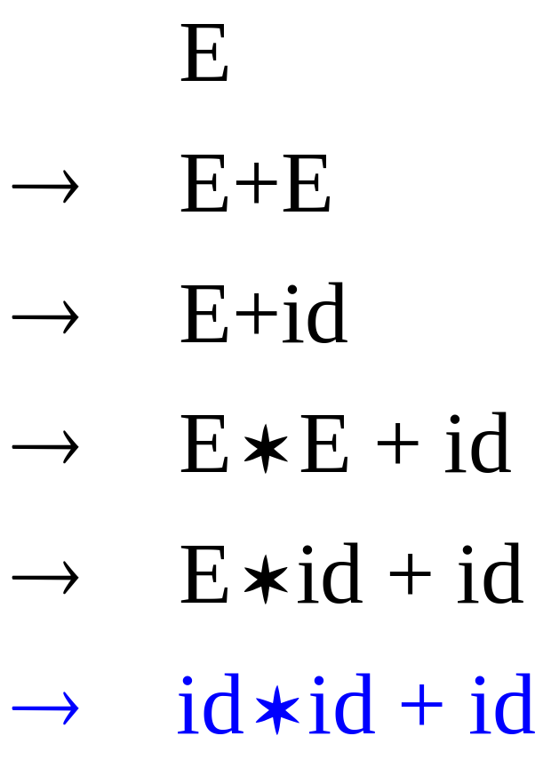
Right-most Derivation in Detail (6)
E
E
+
E
E
*
E
id
id
id

Slide 47
Derivations and Parse Trees
Note that right-most and left-most derivations have the same parse tree
The difference is the order in which branches are added

Slide 48
Outline
Parser overview
Context-free grammars (CFG’s)
Derivations
Ambiguities

Slide 49
Ambiguity
Grammar
  E → E + E | E * E | ( E ) | int
Strings
  int + int + int
  int * int + int

Slide 50
Ambiguity. Example
This string has two parse trees
E
E
E
+
E
E
+
E
E
+
E
int
int
E
+
E
int
int
int
int
+ is left-associative

Slide 51
Ambiguity. Example
This string has two parse trees
E
E
E
+
E
E
*
E
E
*
E
int
int
E
+
E
int
int
int
int
* has higher precedence than +

Slide 52
Ambiguity (Cont.)
A grammar is ambiguous if it has more than one parse tree for some string
  Equivalently, there is more than one right-most or left-most derivation for some string

Slide 53
Ambiguity (Cont.)
Ambiguity is bad
  Leaves meaning of some programs ill-defined
Ambiguity is common in programming languages
  Arithmetic expressions
  IF-THEN-ELSE

Slide 54
Dealing with Ambiguity
There are several ways to handle ambiguity
Most direct method is to rewrite the grammar unambiguously
  E → E + T | T
  T → T * int | int | ( E )
Enforces precedence of * over +
Enforces left-associativity of + and *

Slide 55
Ambiguity. Example
The int * int + int has ony one parse tree now
E
E
E
+
T
E
*
E
T
int
int
E
+
E
T
int
int
*
int
int

Slide 56
Ambiguity: The Dangling Else
Consider the grammar
  E → if E then E
  | if E then E else E
  | OTHER
This grammar is also ambiguous

Slide 57
The Dangling Else: Example
The expression
  if E₁ then if E₂ then E₃ else E₄
  has two parse trees
if
if
E₁
if
E₄
E₁
if
E₂
E₃
E₂
E₃
E₄
Typically we want the second form

Slide 58
The Dangling Else: A Fix
else matches the closest unmatched then
We can describe this in the grammar (distinguish between matched and unmatched “then”)
E → MIF /* all then are matched */
  | UIF /* some then are unmatched */
  MIF → if E then MIF else MIF
  | OTHER
  UIF → if E then E
  | if E then MIF else UIF
Describes the same set of strings

Slide 59
The Dangling Else: Example Revisited
The expression if E₁ then if E₂ then E₃ else E₄
if
if
E₁
if
E₁
if
E₄
E₂
E₃
E₄
E₂
E₃
A valid parse tree (for a UIF)
Not valid because the then expression is not a MIF

Slide 60
Ambiguity
No general techniques for handling ambiguity
Impossible to convert automatically an ambiguous grammar to an unambiguous one
Used with care, ambiguity can simplify the grammar
  Sometimes allows more natural definitions
  We need disambiguation mechanisms

Slide 61
Precedence and Associativity Declarations
Instead of rewriting the grammar
  Use the more natural (ambiguous) grammar
  Along with disambiguating declarations
Most tools allow precedence and associativity declarations to disambiguate grammars
Examples …

Slide 62
Associativity Declarations
Consider the grammar E → E + E | int
Ambiguous: two parse trees of int + int + int
E
E
E
+
E
E
+
E
E
+
E
int
int
E
+
E
int
int
int
int
Left-associativity declaration: %left +

Slide 63
Precedence Declarations
Consider the grammar E → E + E | E * E | int
  And the string int + int * int
E
E
E
*
E
E
+
E
E
+
E
int
int
E
*
E
int
int
int
int
Precedence declarations: %left +
%left *

Slide 64
Review
We can specify language syntax using CFG
A parser will answer whether s ∈ L(G)
… and will build a parse tree
… and pass on to the rest of the compiler
Next:
  How do we answer s ∈ L(G) and build a parse tree?

