Slide 1
Constructing LR Parsing Generators

Slide 2
Key Issue: How is the DFA Constructed?
The stack describes the context of the parse
  What non-terminal we are looking for
  What production rhs we are looking for
  What we have seen so far from the rhs
Each DFA state describes several such contexts
  E.g., when we are looking for non-terminal E, we might be looking either for an int or a E + (E) rhs

Slide 3
LR(1) Items
An LR(1) item is a pair:
  X → α•β, a
  X → αβ is a production
  a is a terminal (the lookahead terminal)
  LR(1) means 1 lookahead terminal
[X → α•β, a] describes a context of the parser
  We are trying to find an X followed by an a, and
  We have α already on top of the stack
  Thus we need to see next a prefix derived from βa

Slide 4
Note
The symbol I was used before to separate the stack from the rest of input
  α I γ, where α is the stack and γ is the remaining string of terminals
In items • is used to mark a prefix of a production rhs:
  X → α•β, a
  Here β might contain non-terminals as well
In both case the stack is on the left

Slide 5
Convention
We add to our grammar a fresh new start symbol S and a production S → E
  Where E is the old start symbol
The initial parsing context contains:
  S → •E, $
  Trying to find an S as a string derived from E$
  The stack is empty

Slide 6
LR(1) Items (Cont.)
In context containing
  E → E + • ( E ), +
  If ( follows then we can perform a shift to context containing
  E → E + (• E ), +
In context containing
  E → E + ( E ) •, +
  We can perform a reduction with E → E + ( E )
  But only if a + follows

Slide 7
LR(1) Items (Cont.)
Consider the item
  E → E + (• E ) , +
We expect a string derived from E ) +
There are two productions for E
    E → int and E → E + ( E)
We describe this by extending the context with two more items:
  E → • int, )
  E → • E + ( E ) , )

Slide 8
The Closure Operation
The operation of extending the context with items is called the closure operation
Closure(Items) =
repeat
for each [X → α•Yβ, a] in Items
for each production Y → γ
for each b ∈ First(βa)
add [Y → •γ, b] to Items
until Items is unchanged

Slide 9
Constructing the Parsing DFA (1)
Construct the start context: Closure({S → •E, $})
S → •E, $
E → • E+(E), $
E → • int, $
E → • E+(E), +
E → • int, +
We abbreviate as:
S → • E, $
E → • E+(E), $/+
E → • int, $/+

Slide 10
Constructing the Parsing DFA (2)
A DFA state is a closed set of LR(1) items
The start state contains [S → •E, $]
A state that contains [X → α•, b] is labeled with “reduce with X → α on b”
And now the transitions …

Slide 11
The DFA Transitions
A state “State” that contains [X → α•yβ, b] has a transition labeled y to a state that contains the items “Transition(State, y)”
  y can be a terminal or a non-terminal
Transition(State, y)
Items = ∅
for each [X → α•yβ, b] ∈ State
add [X → αy•β, b] to Items
return Closure(Items)

Slide 12
Constructing the Parsing DFA. Example.
0
1
S → •E, $
E → •E+(E), $/+
E → •int, $/+
E → int
on $, +
E → int •, $/+
int
E → E+ • (E), $/+
3
E
+
2
S → E•, $
E → E•+(E), $/+
(
E → E+(• E), $/+
E → • E+(E), )/+
E → • int, )/+
4
accept
on $
E
E → E+(E •), $/+
E → E • +(E), )/+
int
5
6
E → int •, )/+
E → int
on ), +
and so on…

Slide 13
LR Parsing Tables. Notes
Parsing tables (i.e. the DFA) can be constructed automatically for a CFG
But we still need to understand the construction to work with parser generators
  E.g., they report errors in terms of sets of items
What kind of errors can we expect?

Slide 14
Shift/Reduce Conflicts
If a DFA state contains both
  [X → α•aβ, b] and [Y → γ•, a]
Then on input “a” we could either
  Shift into state [X → αa•β, b], or
  Reduce with Y → γ
This is called a shift-reduce conflict

Slide 15
Shift/Reduce Conflicts
Typically due to ambiguities in the grammar
Classic example: the dangling else
S → if E then S | if E then S else S | OTHER
Will have DFA state containing
[S → if E then S •, else]
[S → if E then S • else S, x]
If else follows then we can shift or reduce
Default (bison) is to shift
  Default behavior is as needed in this case

Slide 16
More Shift/Reduce Conflicts
Consider the ambiguous grammar
E → E + E | E * E | int
We will have the states containing
[E → E * E •, +]
[E → E • + E, +]
Again we have a shift/reduce on input +
  We need to reduce (* binds more tightly than +)
  Recall solution: declare the precedence of * and +

Slide 17
More Shift/Reduce Conflicts
In bison declare precedence and associativity:
%left +
%left *
The precedence of the rule is determined by the last token in its rhs
Resolve shift/reduce conflict with a shift if:
  no precedence declared for either rule or terminal
  input terminal has higher precedence than the rule
  the precedences are the same and right associative

Slide 18
Using Precedence to Solve S/R Conflicts
Back to our example:
[E → E * E •, +]
[E → E • + E, +]
Will choose reduce because precedence of rule E → E * E is higher than of terminal +

Slide 19
Using Precedence to Solve S/R Conflicts
Same grammar as before
E → E + E | E * E | int
We will also have the states
[E → E + E •, +]
[E → E • + E, +]
Now we also have a shift/reduce on input +
  We choose reduce because E → E + E and + have the same precedence and + is left-associative

Slide 20
Using Precedence to Solve S/R Conflicts
Back to our dangling else example
[S → if E then S •, else]
[S → if E then S • else S, x]
Can eliminate conflict by declaring else with higher precedence than then
  Or just rely on the default shift action
But this starts to look like “hacking the parser”
Best to avoid overuse of precedence declarations or you’ll end with unexpected parse trees

Slide 21
Reduce/Reduce Conflicts
If a DFA state contains both
  [X → α •, a] and [Y → β •, a]
  Then on input “a” we don’t know which production to reduce
This is called a reduce/reduce conflict

Slide 22
Reduce/Reduce Conflicts
Usually due to gross ambiguity in the grammar
Example: a sequence of identifiers
  S → ε | id | id S
There are two parse trees for the string id
S → id
S → id S → id
How does this confuse the parser?

Slide 23
More on Reduce/Reduce Conflicts
Consider the states [S → id •, $]
[S’ → • S, $] [S → id • S, $]
[S → •, $] ⇒^{id} [S → •, $]
[S → • id, $] [S → • id, $]
[S → • id S, $] [S → • id S, $]
Reduce/reduce conflict on input $
S’ → S → id
S’ → S → id S → id
Better rewrite the grammar: S → ε | id S

Slide 24
Using Parser Generators
Parser generators construct the parsing DFA given a CFG
  Use precedence declarations and default conventions to resolve conflicts
  The parser algorithm is the same for all grammars (and is provided as a library function)
But most parser generators do not construct the DFA as described before
  Because the LR(1) parsing DFA has 1000s of states even for a simple language

Slide 25
LR(1) Parsing Tables are Big
But many states are similar, e.g.
and
Idea: merge the DFA states whose items differ only in the lookahead tokens
  We say that such states have the same core
We obtain
1
5
E → int•, $/+
E → int
on $, +
E → int
on ), +
E → int•, )/+
1’
E → int•, $/+/)
E → int
on $, +, )

Slide 26
The Core of a Set of LR Items
Definition: The core of a set of LR items is the set of first components
  Without the lookahead terminals
Example: the core of
{ [X → α•β, b], [Y → γ•δ, d]}
is
{X → α•β, Y → γ•δ}

Slide 27
LALR States
Consider for example the LR(1) states
{[X → α•, a], [Y → β•, c]}
{[X → α•, b], [Y → β•, d]}
They have the same core and can be merged
And the merged state contains:
{[X → α•, a/b], [Y → β•, c/d]}
These are called LALR(1) states
  Stands for LookAhead LR
  Typically 10 times fewer LALR(1) states than LR(1)

Slide 28
A LALR(1) DFA
Repeat until all states have distinct core
  Choose two distinct states with same core
  Merge the states by creating a new one with the union of all the items
  Point edges from predecessors to new state
  New state points to all the previous successors
A
B
C
A
C
BE
D
E
F
D
F

Slide 29
Conversion LR(1) to LALR(1). Example.
int
int
0
1
0
1,5
E
E → int
on $, +, )
E → int
on $, +
E
+
(
int
2
3
4
accept
on $
E
int
+
(
2
3,8
4,9
)
E → int
on ), +
accept
on $
7
6
5
+
E
E → E + (E)
on $, +
+
int
)
(
7,11
6,10
8
9
E → E + (E)
on $, +, )
E
+
10
11
E → E + (E)
on ), +
)

Slide 30
The LALR Parser Can Have Conflicts
Consider for example the LR(1) states
{[X → α•, a], [Y → β•, b]}
{[X → α•, b], [Y → β•, a]}
And the merged LALR(1) state
{[X → α•, a/b], [Y → β•, a/b]}
Has a new reduce-reduce conflict
In practice such cases are rare

Slide 31
LALR vs. LR Parsing
LALR languages are not natural
  They are an efficiency hack on LR languages
Any reasonable programming language has a LALR(1) grammar
LALR(1) has become a standard for programming languages and for parser generators

Slide 32
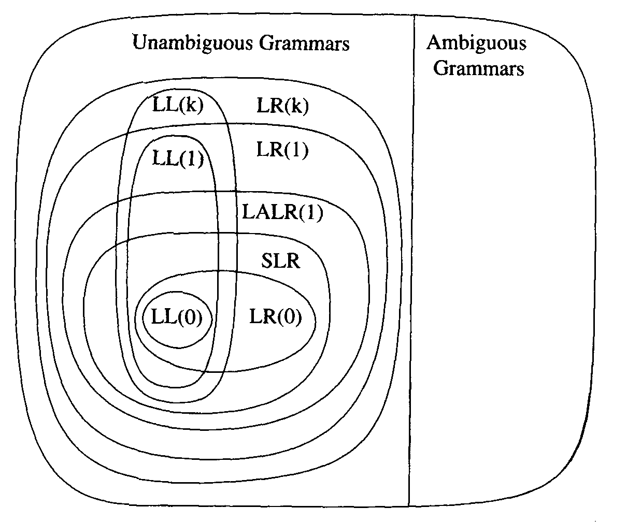
A Hierarchy of Grammar Classes

Slide 33
Notes on Parsing
Parsing
  A solid foundation: context-free grammars
  A simple parser: LL(1)
  A more powerful parser: LR(1)
  An efficiency hack: LALR(1)
  LALR(1) parser generators
Still we have to do error handling

Slide 34
LR Parsing Error Recovery

Slide 35
Error Recovery
What should happen when your parser finds an error in the user’s input?
  stop immediately and signal an error
  record the error but try to continue
In the first case, the user must recompile from scratch after possibly a trivial fix
In the second case, the user might be overwhelmed by a whole series of error messages, all caused by essentially the same problem
We will talk about how to do error recovery in a principled way

Slide 36
Error Recovery
Error recovery:
  process of adjusting input stream so that the parser can continue after unexpected input
Possible adjustments:
  delete tokens
  insert tokens
  substitute tokens
Classes of recovery:
  local recovery: adjust input at the point where error was detected (and also possibly immediately after)
  global recovery: adjust input before point where error was detected.
Error recovery is possible in both top-down and bottom-up parsers

Slide 37
Local Bottom-up Error Recovery
exp→NUM
| exp PLUS exp
| ( exp )
exps → exp
| exps ; exp
General strategy for both bottom-up and top-down:
  look for a synchronizing token
Accomplished in bottom-up parsers by adding error rules to grammar:
exp → ( error )
exps → exp
| error ; exp

Slide 38
Local Bottom-up Error Recovery
In general, follow error with a synchronizing token. Recovery steps:
  Pop stack (if necessary) until a state is reached in which the action for the error token is shift
  Shift the error token
  Discard input symbols (if necessary) until a state is reached that has a non-error action
  Resume normal parsing

Slide 39
Local Bottom-up Error Recovery
exp → NUM
| exp PLUS exp
| ( exp )
exps → exp
| exps ; exp
exp → ( error )
exps → exp
| error ; exp
yet to read
input:
NUM PLUS ( NUM PLUS @#$ PLUS NUM ) PLUS NUM
stack:
exp PLUS ( exp PLUS
@#$ is an unexpected token!

Slide 40
Local Bottom-up Error Recovery
exp → NUM
| exp PLUS exp
| ( exp )
exps → exp
| exps ; exp
exp → ( error )
exps → exp
| error ; exp
yet to read
input:
NUM PLUS ( NUM PLUS @#$ PLUS NUM ) PLUS NUM
stack:
exp PLUS (
pop stack until shifting “error” can result in correct parse

Slide 41
Local Bottom-up Error Recovery
exp → NUM
| exp PLUS exp
| ( exp )
exps → exp
| exps ; exp
exp → ( error )
exps → exp
| error ; exp
yet to read
input:
NUM PLUS ( NUM PLUS @#$ PLUS NUM ) PLUS NUM
stack:
exp PLUS (error
shift “error”

Slide 42
Local Bottom-up Error Recovery
exp → NUM
| exp PLUS exp
| ( exp )
exps → exp
| exps ; exp
exp → ( error )
exps → exp
| error ; exp
yet to read
input:
NUM PLUS ( NUM PLUS @#$ PLUS NUM ) PLUS NUM
stack:
exp PLUS (error
discard input until we can legally shift or reduce

Slide 43
Local Bottom-up Error Recovery
exp → NUM
| exp PLUS exp
| ( exp )
exps → exp
| exps ; exp
exp → ( error )
exps → exp
| error ; exp
yet to read
input:
NUM PLUS ( NUM PLUS @#$ PLUS NUM ) PLUS NUM
stack:
exp PLUS (error)
SHIFT )

Slide 44
Local Bottom-up Error Recovery
exp → NUM
| exp PLUS exp
| ( exp )
exps → exp
| exps ; exp
exp → ( error )
exps → exp
| error ; exp
yet to read
input:
NUM PLUS ( NUM PLUS @#$ PLUS NUM ) PLUS NUM
stack:
exp PLUS exp
REDUCE using exp ::= ( error )

Slide 45
Local Bottom-up Error Recovery
exp → NUM
| exp PLUS exp
| ( exp )
exps → exp
| exps ; exp
exp → ( error )
exps → exp
| error ; exp
yet to read
input:
NUM PLUS ( NUM PLUS @#$ PLUS NUM ) PLUS NUM
stack:
exp PLUS exp
continue parsing...

Slide 46
global error recovery
Global error recovery
  determines the smallest set of insertions, deletions or replacements that will allow a correct parse
  even if those operations occur before an error would have been detected

Slide 47
Burke-Fisher error recovery
Global error recovery
  determines the smallest set of insertions, deletions or replacements that will allow a correct parse,
  even if those operations occur before an error would have been detected
Burke-Fisher error repair
  tries every possible single-token insertion, deletion or replacement at every point in the input up to K tokens before the error is detected
    eg: K = 20; parser gets stuck at token 500; all possible repairs between token 480-500 tried
    best repair = longest successful parse

Slide 48
global error recovery
Consider Burke-Fisher with
  K-token window
  N different token types
Total number of repairs = N + 2K*N
    deletions (K) +
    insertions (K + 1)*N +
    replacements (K)(N-1)
Affordable in the uncommon case when there is an error

Slide 49
global error recovery
Parser must be able to back up K tokens and reparse
Mechanics:
  parser maintains old stack and new stack
K-token window maintained in queue by parser
K-token window
yet to read
input:
ID := NUM ; ID := ID + ( ID := NUM + ...
new stack:
S ; ID := ID + (
old stack:
ID := NUM

Slide 50
global error recovery
Parser must be able to back up K tokens and reparse
Mechanics:
  parser maintains old stack and new stack
K-token window maintained in queue by parser
K-token window
yet to read
input:
ID := NUM ; ID := ID + ( ID := NUM + ...
new stack:
S ; ID := ID + (
old stack:
ID := NUM
old stack lags the new stack by K=6 tokens
Reduction (E → NUM and S → ID := E) has applied to new stack already

Slide 51
global error recovery
Parser must be able to back up K tokens and reparse
Mechanics:
  parser maintains old stack and new stack
K-token window maintained in queue by parser
K-token window
yet to read
input:
ID := NUM ; ID := ID + ( ID := NUM + ...
new stack:
S ; ID := ID + (
old stack:
ID := E
Reduction (E → NUM) applies to old stack now

Slide 52
Parser Generator

Slide 53
YACC Source Format
%{Supplementary Code%}
%definition
……
%definition
%%
Rules

Slide 54
Definitions’ Norm
%{ … }%
%union
%token
%type
%start
%nonassoc %right %left

Slide 55
Yacc (example 1)
%{
int yylex(void);
void yyerror(char *s) { EM_error(EM_tokPos, “%s”, s)}
%}
%token ID WHILE BEGIN END DO IF THEN ELSE ESMI ASSIGN
%start prog
Terminal
Nonterminal

Slide 56
Yacc (example 1)
%%
prog: stmlist
stm : ID ASSIGN ID
| WHILE ID DO stm
| BEGIN stmlist END
| IF ID THEN stm
| IF ID THEN stm ELSE stm
stmlis : stm
| stmlist SEMI stm

Slide 57
Yacc (example 2)
%{ declarations for yylex and yyerror %}
%token INT PLUS MINUS TIMES UMINS
%start exp
%left PLUS MINUS
%left TIMES
%left UMINUS
%%
exp : INT
exp : exp PLUS exp
exp : exp MINUS exp
exp : exp TIMES exp
exp : MINUS exp %prec UMINU

Slide 58
Yacc (example 3)
%{ declarations for yylex and yyerror %}
%token ID ASSIGN PLUS AND EQUAL
%start stm
%lef OR
%left AND
%left PLUS

Slide 59
Yacc (example 3)
%%
stm: ID ASSIGN ae
| ID ASSIGN be
be: be OR be
| be AND be
| ae EQUAL ae
| ID
ae: ae PLUS ae
| ID
reduce/reduce conflict for ID to ae or ID to be

Slide 60
Yacc (example 3)
%%
stm: ID ASSIGN e
e : ID
| e OR e
| e AND e
| e EQUAL e
| e PLUS e
Defer the error report for expression “a + b&c” to semantic phase

Slide 61
Burke-Fisher in ML-Yacc
ML-Yacc provides additional support for Burke-Fisher
  to continue parsing, we need semantics values for inserted tokens
  some multiple-token insertions & deletions are common, but it is too expensive for ML-Yacc to try every 2,3,4- token insertion, deletion
%value ID {make_id “bogus”}
%value INT {0}
%value STRING {“”}
%change EQ -> ASSIGN
| SEMI ELSE -> ELSE
| -> IN INT END
ML-Yacc would do this
anyway but by specifying,
it tries it first

