Slide 1
Actions Class in Selenium

Slide 2
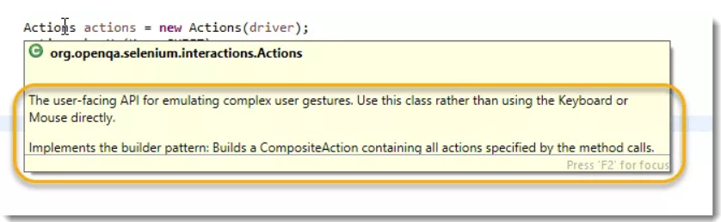
What is Actions class in Selenium?

Slide 3
Actions class
Actions class is a collection of individual Action that you want to perform. For e.g. we may want to perform a mouse click on an element. In this case we are looking at two different Action
Moving the mouse pointer to the element
Clicking on the element
Individual action mentioned above are represented by a class called Action, we will talk about it later. Collection of such Action is represented by the Actions class.

Slide 4

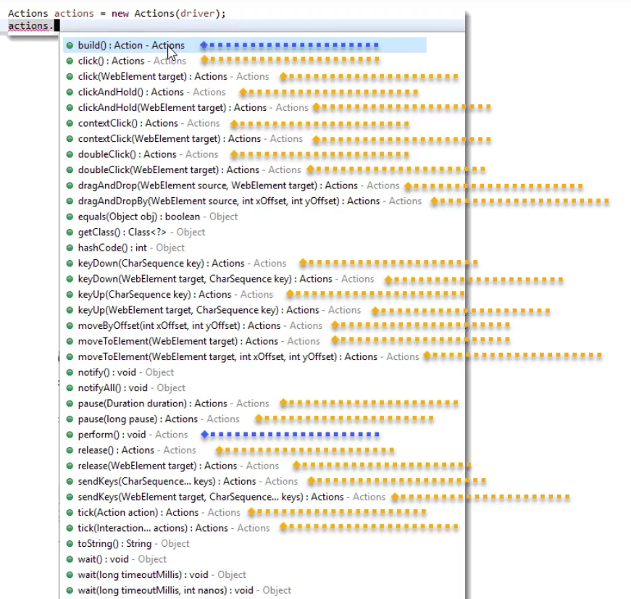

Actions class

Slide 5
What is Action Class?
Actually it is not a class but an Interface.
It is only used to represent the single user interaction to perform the series of action items build by Actions class.

Slide 6
What is the difference between Actions Class and Action Class in Selenium?
Actions is a class that is based on a builder design pattern. This is a user-facing API for emulating complex user gestures.
Whereas Action is an Interface which represents a single user-interaction action. It contains one of the most widely used methods perform().

Slide 7
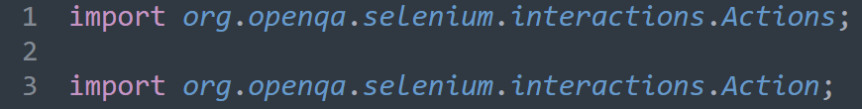
How to Use Actions class in Selenium?
Import package

Slide 8
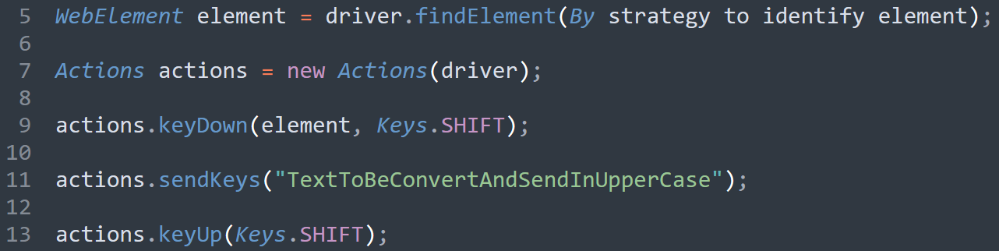
How to Use Actions class in Selenium?
Instantiate Actions class and generate action sequence

Slide 9

How to Use Actions class in Selenium?
Build the actions sequence
Perform actions sequence

