Slide 1
Lecture 3. Socket API Introduction
Tran Quang Duc, SoICT, HUST

Slide 2
Content
Socket
Stream Socket
Datagram Socket
APIs for managing names and IP addresses
Socket Address Structures

Slide 3
Socket
What is a socket ?
Sockets (in plural) are an application programming interface (API) application program and the TCP/IP stack
A socket is an abstraction through which an application may send and receive data
A socket allows an application to plug in to the network and communicate with other applications that are plugged in to the same network.

Slide 4
Socket (cont)
The main types of sockets in TCP/IP are
stream sockets : use TCP as the end-to-end protocol (with IP underneath) and thus provide a reliable byte-stream service
datagram sockets : use UDP (again, with IP underneath) and thus provide a best-effort datagram service
Socket Address : include host name and port

Slide 5
Stream sockets (TCP)‏
TCP provides connections between clients and servers
TCP also provides reliability : When TCP sends data to the other end, it requires an acknowledgment in return
TCP provides flow control
TCP connection is full-duplex

Slide 6
Stream sockets(TCP)‏
Server
socket()‏
bind()‏
Client
listen()‏
socket()‏
accept()‏
Block until
connect
Connection Establishmt.
connect()‏
bind()‏
Data (request)‏
send()‏
recv()‏
Process
request
Data (reply)‏
send()‏
recv()‏

Slide 7
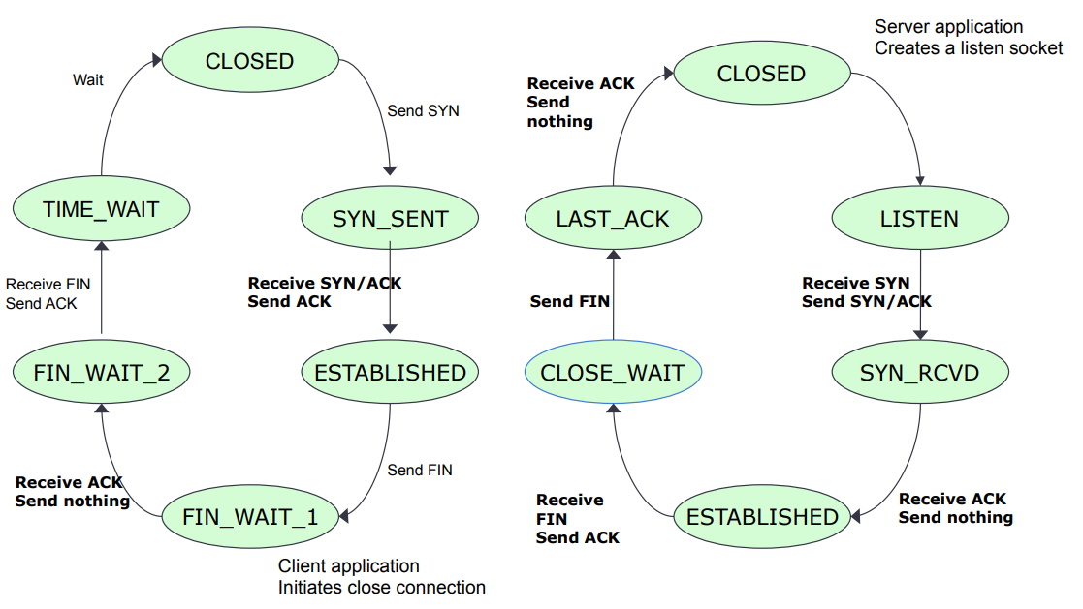
Life cycle of a TCP connection

Slide 8
Stream Socket APIs
socket()
creates a socket of a given domain, type, protocol (buy a phone)
Returns a file descriptor (called a socket ID)
bind()
Assigns a name to the socket (get a telephone number)
Associate a socket with an IP address and port number (Eg : 192.168.1.1:80)
connect()
Client requests a connection request to a server
This is the first of the client calls

Slide 9
Stream Socket APIs (cont)
accept() :
Server accept an incoming connection on a listening socket (request from a client)
There are basically three styles of using accept:
Iterating server: Only one socket is opened at a time.
Forking server: After an accept, a child process is forked off to handle the connection.
Concurrent single server: use select to simultaneously wait on all open socketIds, and waking up the process only when new data arrives

Slide 10
Stream Socket APIs (cont)
listen()
Specifies the number of pending connections that can be queued for a server socket. (call waiting allowance)
send()
Write to connection (speak)
Send a message
recv()
read from connection (listen)
Receive data on a socket
close()
close a socket (end the call)

Slide 11
Datagram Socket (UDP)‏
UDP is a simple transport-layer protocol
If a datagram is errored or lost, it won’t be automatically retransmitted (can process in application)
UDP provides a connectionless service, as there need not be any long-term relationship between a UDP client and server

Slide 12
Datagram Socket (UDP)‏
Server
socket()‏
Client
bind()‏
socket()‏
recvfrom()‏
bind()‏
Block until
Data from
client
Data (request)‏
sendto()‏
Process
request
Data (reply)‏
sendto()‏
recvfrom()‏

Slide 13
APIs for managing names and IP addresses
gethostname(): Returns the name of the system
gethostbyname() : Get an IP address for a hostname, or vice-versa
htons(), htonl(), ntohs(), ntohl(): byte ordering
inet_ntoa(), inet_aton() : Convert IPv4 addresses from a dots-and-number string (eg : 192.168.1.1) to a struct in_addr and back
inet_pton(), inet_ntop(): conversion of IPv4 or IPv6 numbers between presentation and strings

Slide 14
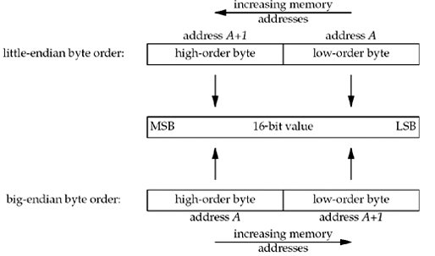
Byte Ordering
There are two ways to store the two bytes in memory
little-endian byte order
big-endian byte order

Slide 15
Byte Ordering (cont)
There is no standard between these two byte orderings
A variety of systems that can change between little-endian and big-endian byte ordering
Problem : Converting between
host byte order
network byte order (The Internet protocols use big-endian byte ordering)
Four functions to convert between these two byte orders.

Slide 16
htons(), htonl(), ntohs(), ntohl()
Convert multi-byte integer types from host byte order to network byte order
Each function returns the converted value.
#include <netinet/in.h>
uint32_t htonl(u_long hostlong); // host to network long
uint16_t htons(u_short hostshort);// host to network short
uint32_t ntohl(u_long netlong); // network to host long
uint16_t ntohs(u_short netshort); // network to host short

Slide 17
IP Number translation
IP address strings to 32 bit number
Hence, these routines translate between the address as a string and the address as the number.
Hence, we have 4 representations:
IP number in host order
IP number in network order
Presentation (eg. dotted decimal)
Fully qualified domain name

Slide 18
Socket Address Structures
Most socket functions require a pointer to a socket address structure as an argument.
Each supported protocol suite defines its own socket address structure.
A Socket Address Structure is a structure which has information of a socket to create or connect with it
There are three types of socket address structures
IPv4
IPv6

Slide 19
IPv4 socket address structure
#include <netinet/in.h>
struct in_addr {
in_addr_t s_addr; // 32-bit IPv4 address
// network byte ordered
};
struct sockaddr_in {
uint8_t sin_len; // length of structure
sa_family_t sin_family; // AF_INET
in_port_t sin_port; // 16-bit TCP or UDP port number
// network byte ordered
struct in_addr sin_addr; // 32-bit IPv4 address
// network byte ordered
char sin_zero[8]; // unused
};

Slide 20
IPv6 socket address structure
#include <netinet/in.h>
struct in6_addr {
uint8_t s6_addr[16]; // 128-bit IPv6 address
// network byte ordered
};
#define SIN6_LEN // required for compile-time tests
struct sockaddr_in6 {
uint8_t sin6_len; // length of this struct
sa_family_t sin6_family; // AF_INET6
in_port_t sin6_port; // transport layer port#
// network byte ordered
uint32_t sin6_flowinfo; // flow information, undefined
struct in6_addr sin6_addr; // IPv6 address
// network byte ordered
uint32_t sin6_scope_id; // set of interfaces for a scope
};

Slide 21
inet_aton()
#include <arpa/inet.h>
int inet_aton(const char *cp, struct in_addr *inp)
Convert IP addresses from a dots-and-number string to a struct in_addr
Return:
The value non-zero if the address is valid
The value 0 if the address is invalid
struct in_addr someAddr;
if(inet_aton("10.0.0.1", &someAddr))
printf("The address is valid");
else printf ("The address is invalid");

Slide 22
inet_ntoa()
#include <arpa/inet.h>
char *inet_ntoa(struct in_addr in);
Convert IP addresses from a struct in_addr to a dots-and-number string
Return: the dots-and-numbers string
struct in_addr someAddr;
if(inet_aton("10.0.0.1", someAddr))
printf("The address is valid");
else printf ("The address is invalid");
char *addrStr;
addrStr = inet_ntoa(someAddr);

Slide 23
inet_addr()
#include <arpa/inet.h>
in_addr_t inet_addr(const char *cp);
Convert IP addresses from a dots-and-number string to a struct in_addr_t
Return:
The value -1 if there’s an error
The address as an in_addr_t
struct in_addr someAddr;
someAddr.s_addr = inet_addr("10.0.0.1");

Slide 24
inet_pton()
#include <arpa/inet.h>
int inet_pton(in family, const char *cp, void *addr)
Convert IP addresses from a dots-and-number string to a struct in_addr or in6_addr
family is AF_INET or AF_INET6
Return:
The value non-zero if the address is valid
The value 0 if the address is invalid

Slide 25
inet_ntop()
#include <arpa/inet.h>
const char *inet_ntop(int family, const void *addr,
char *cp, size_t len);
Convert IP addresses from a struct in_addr to a dots-and-number string
Return: the dots-and-numbers string
struct sockaddr_in sa;
char str[INET_ADDRSTRLEN];
// store this IP address in sa:
inet_pton(AF_INET, "192.0.2.33", &(sa.sin_addr));
// now get it back and print it
inet_ntop(AF_INET, &(sa.sin_addr), str, INET_ADDRSTRLEN);
printf("%s\n", str);

Slide 26
Address Resolution

Slide 27
Content
IPv4 and IPv6
DNS
Address and Name APIs

Slide 28
IPv4
Developed in APRANET (1960s)
32-bit number
Divided into classes that describe the portion of the address assigned to the network (netID) and the portion assigned to endpoints (hosten)
A : netID – 8 bit
B : netID – 16 bit
C : netID – 24 bit
D : use for multicast
E : use for experiments

Slide 29
IPv4 problem
IPv4 addresses is being exhausted
Have to map multiple private addresses to a single public IP addresses (NATs)
Connect 2 PCs use private address space ?
NAT must be aware of the underlying protocols
IPv4 addressing is not entirely hierarchical → router must maintain routing table to deliver packets to right locations
→ Develope a new version of IP Address : IPv6

Slide 30
IPv6
IPv6 address is 128 bits
To subdivide the available addresses into a hierarchy of routing domains that reflect the Internet's topology
IPv6 address is typically expressed in 16-bit chunks displayed as hexadecimal numbers separated by colons
Example : 21DA:00D3:0000:2F3B:02AA:00FF:FE28:9C5A
or : 21DA:D3:0:2F3B:2AA:FF:FE28:9C5A

Slide 31
DNS (Domain Name System)
Computers use IP Addresses to connect hosts
What about humans ? – IP Addresses are very complex and hard to remember (for people)
Use name instead of IP Address → Domain Name System
Problem of DNS
People use names, Computers use IP Addresses → translate between two spaces
Domain name system must be hierarchical (for management and maintain)
Domain name space : divide to zones

Slide 32
DNS (cont)
How to translate between domain name-IP Address and reverse ?
DNS Resolver
DNS Server
A DNS query
A non-recursive query : DNS server provides a record for a domain for which it is authoritative itself, or it provides a partial result without querying other servers
A recursive query : DNS server will fully answer the query by querying other name servers
DNS primarily uses User Datagram Protocol (UDP) on port number 53 to serve requests

Slide 33
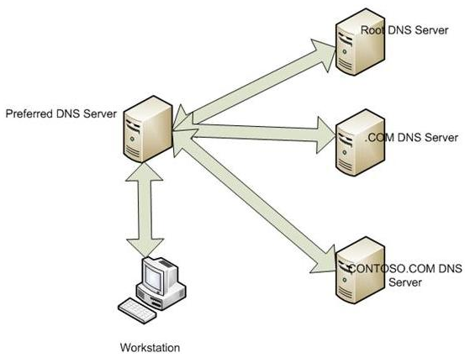
DNS (cont)
Address resolution mechanism
Local system is pre-configured with the known addresses of the root server in a file of root hints
Query one of the root servers to find the server authoritative for the next level down
Querying level down server for the address of a DNS server with detailed knowledge of the lower level domain until reach the DNS Server return final address

Slide 34
DNS (cont)
A Resource Record (RR) is the basic data element in the domain name system
All records use the common format specified in RFC 1035 (in IP networks)
RR (Resource record) fields
NAME (variable)
Name of the node to which this record pertains.
TYPE (2)
Type of RR. For example, MX is type 15
CLASS (2)
Class code
TTL (4)
Unsigned time in seconds that RR stays valid
RDLENGTH (2)
Length of RDATA field
RDATA (variable)
Additional RR-specific data

Slide 35
List of Address and Name APIs
#include <sys/socket.h>
gethostbyaddr()
Retrieve the name(s) and address corresponding to a network address.
gethostname()
Retrieve the name of the local host.
gethostbyname()
Retrieve the name(s) and address corresponding to a host name.
getprotobyname()
Retrieve the protocol name and number corresponding to a protocol name.
getprotobynumber()
Retrieve the protocol name and number corresponding to a protocol number.
getservbyname()
Retrieve the service name and port corresponding to a service name.
getservbyport()
Retrieve the service name and port corresponding to a port.

Slide 36
New APIs for IPv6
Those APIs only supports IPv4 but IPv6 will be replace IPv4 in the future, so we need APIs support IPv6
They are
getaddrinfo
getnameinfo
These APIs have replaced the IPv4 specific routines

Slide 37
gethostbyaddr()
#include <netdb.h>
#include <sys/socket.h>
struct hostent *gethostbyaddr (in_addr *addr, socklen_t len, int family);
Get host information corresponding to an address.
Parameters:
[IN] addr: A pointer to an address in network byte order.
[IN] len: The length of the address, which must be 4 for AF_INET addresses.
[IN] family: The type of the address, which must be AF_INET.
Return value
If no error occurs, returns a pointer to the hostent structure
Otherwise it returns a NULL pointer and a specific error number

Slide 38
struct hostent
struct hostent {
char *h_name; // official (canonical) name of host
char **h_aliases; // pointer to array of pointers to alias names
int h_addrtype; // host address type: AF_INET
int h_length; // length of address: 4
char **h_addr_list; // ptr to array of ptrs with IPv4 addrs
};
what is this struct hostent that gets returned?
It has a number of fields that contain information about the host in question.

Slide 39
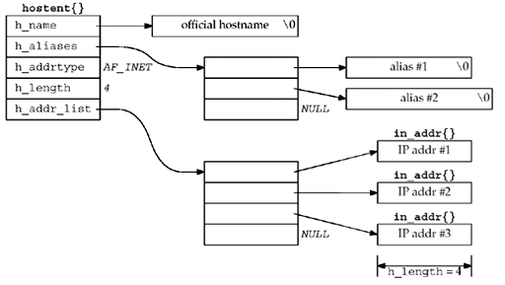
struct hostent

Slide 40
gethostname()
#include <sys/unistd.h>
#include <sys/socket.h>
int gethostname(char *name, size_t len);
Return the standard host name for the local machine.
Parameters:
[OUT] name: points to a buffer that will receive the host name.
[IN] len: the length of the buffer
Return value
If no error occurs, returns 0
Otherwise it returns SOCKET_ERROR and a specific error code

Slide 41
gethostbyname()
#include <netdb.h>
#include <sys/socket.h>
struct hostent *gethostbyname (const char *hostname);
Get host information corresponding to a hostname.
[IN] name: Points to the name of the host
Returns a pointer to a hostent structure
Return value
If no error occurs, returns a pointer to the hostent structure described above.
Otherwise it returns a NULL pointer and a specific error number

Slide 42
getservbyname()
#include <netdb.h>
#include <sys/socket.h>
struct servent *getservbyname (const char *servname,
const char *protoname);
Get service information corresponding to a service name and protocol.
Parameters:
[IN] servname: A pointer to a service name.
[IN] protoname: An optional pointer to a protocol name.
If this is NULL, getservbyname() returns the first service entry for which the name matches the s_name or one of the s_aliases.
Otherwise getservbyname() matches both the name and the proto.
Returns
non-null pointer if OK
NULL on error
struct servent *sptr;
sptr = getservbyname("ftp", "tcp");

Slide 43
struct servent
struct servent {
char *s_name;
char **s_aliases;
int s_port;
char *s_proto;
};
s_name
Official name of the service.
s_aliases
A NULL-terminated array of alternate names.
s_port
The port number at which the service may be contacted. Port numbers are returned in network byte order.
s_proto
The name of the protocol to use when contacting the service.

Slide 44
getpeername ()
#include <sys/socket.h>
int getpeername(int sockfd, struct sockaddr *addr, socklen_t *addr_len);
Retrieve the address associated with the remote socket
Parameters:
[IN] sockfd: the local socket connecting to remote socket
[OUT] addr: points to the sockaddr struct
[IN, OUT] addr_len: points to the socklen_t value initiated to indicate the amount of space pointed to by addr.
Return:
On success, returns 0
On error, return -1 and errno set to indicate the error

Slide 45
getservbyport()
#include <netdb.h>
#include <sys/socket.h>
struct servent *getservbyport (int port, const char *protoname);
Get service information corresponding to a port and protocol.
Parameters:
[IN] port: The port for a service, in network byte order.
[IN] protoname: An optional pointer to a protocol name.
If this is NULL, returns the first service entry for which the port matches the s_port.
Otherwise getservbyport() matches both the port and the proto.
Return
non-null pointer if OK
NULL on error
struct servent *sptr;
sptr = getservbyport (htons (53), "udp");

