Slide 1
elementary sockets
Tran Quang Duc, SoICT, HUST

Slide 2
Content
socket()
UDP Socket APIs
TCP Socket APIs
Iterative TCP Server
Design application protocol

Slide 3
socket()
#include <sys/types.h>
#include <sys/socket.h>
int socket(int domain, int type, int protocol);
Creates an endpoint for communication
[IN] domain: AF_INET, AF_INET6, or AF_UNSPEC, …
[IN] type argument can be:
SOCK_STREAM: Provides sequenced, reliable, two-way, connection- based byte streams
SOCK_DGRAM: Supports datagrams
SOCK_RAW: Provides raw network protocol access
[IN] protocol is usually 0
Returns value
A new socket descriptor that you can use to do sockety things with
If error occurs, return -1 (remember errno)
Notes:
The protocol specifies a particular protocol to be used with the socket. Normally only a single protocol exists to support a particular socket type within a given protocol family, in which case protocol can be specified as 0

Slide 4
bind()
#include <sys/types.h>
#include <sys/socket.h>
int bind(int sockfd, const struct sockaddr *addr, socklen_t addrlen);
Associate a socket with an IP address and port number
where
[IN] sockfd : socket descriptor
[IN] addr : pointer to a sockaddr structure assigned to sockfd
[IN] addrlen : specifies the size, in bytes of address structure pointed to by addr
Return value
Returns 0 if no error occurs.
Otherwise, return -1 (and errno will be set accordingly)

Slide 5
shutdown()
#include <sys/socket.h>
int shutdown(int socket, int how);
Shut down socket send and receive operations
where
[IN] sockfd: a descriptor identifying a socket.
[IN] how: SHUT_RD, SHUT_WR, SHUT_RDWR
Return value
Returns 0 if no error occurs.
Otherwise, return -1 (and errno will be set accordingly)
Notes:
SHUT_RD: further receptions will be disallowed.
SHUT_WR: further transmissions will be disallowed.
SHUT_RDWR: further receptions and transmissions will be disallowed.

Slide 6
close()
#include <unistd.h>
int close(int sockfd);
Close a socket descriptor
[IN] sockfd: a descriptor identifying a socket.
Return value
Returns 0 if no error occurs.
Otherwise, return -1 (and errno will be set accordingly)
close() vs shutdown()
close() tries to complete this transmission before closing, frees the socket descriptor
shutdown(): immediately stops receiving and transmitting data, don’t releases the socket descriptor

Slide 7
Socket options
#include <sys/socket.h>
int setsockopt (int sockfd, int level, int optname,
void *optval, int optlen);
Set the options that control the transfering data on a socket
Parameters:
[IN] sockfd: refer to an open socket descriptor
[IN] level: specifies the protocol level at which the option resides
[IN] optname: specifies a single option to set
[IN] optval: points to the setted option value
[IN] optlen: the size of option value pointed by optval
Return:
Returns 0 if no error occurs.
Otherwise, return -1 (and errno will be set accordingly)
Notes:
getsockopt, setsockopt - get and set options on sockets
The level argument specifies the protocol level at which the option resides. To set options at the socket level, specify the level argument as SOL_SOCKET

Slide 8
Socket options(cont)
#include <sys/socket.h>
int getsockopt (int sockfd, int level, int optname,
void *optval, int *optlen);
Set the options that control the transfering data on a socket
Parameters:
[IN] sockfd: refer to an open socket descriptor
[IN] level: specifies the protocol level at which the option resides
[IN] optname: specifies a single option to set
[OUT] optval: points to the setted option value
[IN, OUT] optlen: the size of option value pointed by optval
Return:
Returns 0 if no error occurs.
Otherwise, return -1 (and errno will be set accordingly)

Slide 9
level = SOL_SOCKET
Value name | Type | Description
SO_BROADCAST | int | Configures a socket for sending broadcast data.(Only UDP socket)
SO_DONTROUTE | int | Sets whether outgoing data should be sent on interface the socket is bound to and not a routed on some other interface
SO_KEEPALIVE | int | TCP automatically sends a keep-alive probe to the peer
SO_LINGER | linger | specifies how the close function operates for a connection-oriented protocol
SO_REUSEADDR | int | Allows the socket to be bound to an address that is already in use
SO_RCVTIMEO | timeval | Sets the timeout for blocking receive calls
SO_SNDTIMEO | timeval | Sets the timeout for blocking send calls

Slide 10
UDP socket

Slide 11
UDP (User Datagram Protocol)
No reliable
No flow control
Familiar example
DNS
Streaming
Image
Postcard exchange
server
client
data
data
data
data
data

Slide 12
UDP client/server
Server
socket()‏
Client
bind()‏
socket()‏
recvfrom()‏
bind()‏
Block until data from client
Data (request)‏
sendto()‏
Block until data send to server
Process
request
Data (reply)‏
sendto()‏
recvfrom()‏

Slide 13
recvfrom()
ssize_t recvfrom(int sockfd, void *buf, size_t len,
int flags, struct sockaddr *from, socklen_t *fromlen );
Received data from a socket
Parameters:
[IN] sockfd: the socket file descriptor
[OUT] buf: the buffer where the message should be stored
[IN] len: the size of the buffer
[IN] flags: how to control recvfrom function work
[OUT] from: the address of the sender
[OUT] fromlen: the size of sender’s address
Return:
Success: return the length of the received data in bytes. If the incoming message is too long to fit in the supplied buffer, the excess bytes shall be discarded.
Error: −1 and set errno to indicate the error.

Slide 14
recvfrom()- Flags
MSG_PEEK: Peeks at an incoming message. The data is treated as unread and the next recvfrom() or similar function shall still return this data.
MSG_OOB: Requests out-of-band data. The significance and semantics of out-of-band data are protocol-specific.
MSG_WAITALL: On SOCK_STREAM sockets this requests that the function block until the full amount of data can be returned, excepting:
the connection is terminated
MSG_PEEK was specified
an error is pending for the socket
a signal is caught
Use bitwise OR operator (|) to combine more than one flag
Notes:
MSG_PEEK: This flag causes the receive operation to return data from the beginning of the receive queue without removing that data from the queue. Thus, a subsequent receive call will return the same data.
MSG_OOB: This flag requests receipt of out-of-band data that would not be received in the normal data stream.
MSG_WAITALL (since Linux 2.2): This flag requests that the operation block until the full request is satisfied.

Slide 15
sendto()
ssize_t sendto(int sockfd, void *buf, size_t len, int flags, struct sockaddr *to, socklen_t *tolen );
Received data from a socket
Parameters:
[IN] sockfd: the socket file descriptor
[IN] buf: points to a buffer containing the message to be sent
[IN] len: the size of the message
[IN] flags: how to control sendto function work
[IN] to: the address of the receiver
[IN] tolen: the length of the sockaddr structure pointed to by the to argument
Return:
Success: shall return the length of the sent message in bytes
Error: −1 and set errno to indicate the error.

Slide 16
sendto()- Flags
MSG_OOB: Sends out-of-band data on sockets that support out-of-band data.
MSG_DONTROUTE: Don't use a gateway to send out the packet, only send to hosts on directly connected networks
Use bitwise OR operator (|) to combine more than one flag

Slide 17
sendto()
UDP socket buffer doesn't really exist
UDP socket buffer has a send buffer size
If an application writes a datagram larger than the socket send buffer size, EMSGSIZE is returned
application
application buffer
sendto()
user process
kernel
UDP
socket send buffer
UDP datagram
IP
IP packets
output queue
datalink

Slide 18

Example
A simple UDP client and server
Server receives data from client
Server sends back data to client
It present in udpserv01.c and dg_echo.c

Slide 19
Example – UDP Echo Server
int sockfd, rcvBytes, sendBytes;
socklen_t len;
char buff[BUFF_SIZE+1];
struct sockaddr_in servaddr, cliaddr;
//Step 1: Construct socket
if((sockfd = socket(AF_INET, SOCK_DGRAM, 0)) < 0){
perror("Error: ");
return 0;
}
//Step 2: Bind address to socket
bzero(&servaddr, sizeof(servaddr));
servaddr.sin_family = AF_INET;
servaddr.sin_addr.s_addr = htonl(INADDR_ANY);
servaddr.sin_port = htons(SERV_PORT);
if(bind(sockfd, (struct sockaddr *) &servaddr, sizeof(servaddr))){
perror("Error: ");
return 0;
}
printf("Server started.");

Slide 20
Example – UDP Echo Server(cont)
//Step 3: Communicate with client
for ( ; ; ) {
len = sizeof(cliaddr);
rcvBytes = recvfrom(sockfd, buff, BUFF_SIZE, 0,
(struct sockaddr *) &cliaddr, &len);
if(rcvBytes < 0){
perror("Error: ");
return 0;
}
buff[recvBytes] = '\0';
printf("[%s:%d]: %s", inet_ntoa(cliaddr.sin_addr), ntohs(cliaddr.sin_port), mesg);
sendBytes = sendto(sockfd, buff, rcvBytes, 0,
(struct sockaddr *) &cliaddr, len);
if(sendBytes < 0){
perror("Error: ");
return 0;
}
}

Slide 21
Example – UDP Echo Client
int sockfd, rcvBytes, sendBytes;
socklen_t len;
char buff[BUFF_SIZE+1];
struct sockaddr_in servaddr;
//Step 1: Construct socket
if((sockfd = socket(AF_INET, SOCK_DGRAM, 0)) < 0){
perror("Error: ");
return 0;
}
//Step 2: Define the address of the server
bzero(&servaddr, sizeof(servaddr));
servaddr.sin_family = AF_INET;
servaddr.sin_addr = inet_aton(SERV_ADDR, &servaddr.sin_addr);
servaddr.sin_port = htons(SERV_PORT);

Slide 22
Example – UDP Echo Client(cont)
//Step 3: Communicate with server
printf("Send to server: ");
gets_s(buff, BUFF_SIZE);
len = sizeof(servaddr);
sendBytes = sendto(sockfd, buff, strlen(buff), 0,
(struct sockaddr *) &seraddr, len);
if(sendBytes < 0){
perror("Error: ");
return 0;
}
rcvBytes = recvfrom(sockfd, buff, BUFF_SIZE, 0,
(struct sockaddr *) &seraddr, &len);
if(rcvBytes < 0){
perror("Error: ");
return 0;
}
buff[recvBytes] = '\0';
printf("Reply from server: %s", buff);

Slide 23
TCP socket

Slide 24
TCP (Transmission Control Protocol)
Provide reliable communication
Data rate control
Example
Mail
WEB
Image
client
server
SYN
SYN+ACK
ACK
Data

Slide 25
TCP Server
TCP Server
socket()‏
bind()‏
TCP client
listen()‏
socket()‏
accept()‏
connect()‏
establish
Block until connection from client
send()‏
data
recv()‏
data
send()‏
recv()‏
close()‏
close()‏

Slide 26
TCP server side
Create a socket – socket().
Bind the socket – bind().
Listen on the socket – listen().
Accept a connection – accept().
Send and receive data – recv(), send().
Disconnect connection– close()
Close LISTENING socket
repeatedly

Slide 27
listen()
#include <sys/socket.h>
int listen(int sockfd, int backlog);
Establish a socket to LISTENING for incoming connection.
Parameters:
[IN] sockfd: a descriptor identifying a bound, unconnected socket
[IN] backlog:the queue length for completely established sockets waiting to be accepted
Return value
On success, 0 is returned
On error, -1 is returned, and errno is set appropriately

Slide 28
accept()
#include <sys/types.h>
#include <sys/socket.h>
int accept(int sockfd, struct sockaddr *addr,socklen_t *addrlen);
Accept an incoming connection on a LISTENING socket
Parameters:
[IN] sockfd: A descriptor identifying a socket which is listening for connections after a listen().
[OUT] addr: pointer to a sockaddr structure filled in with the address of the peer socket
[IN, OUT] addrlen: the caller must initialize it to contain the size (in bytes) of the structure pointed to by addr; on return it will contain the actual size of the peer address.
Return value
Newly connected socket descriptor if no errors
-1 if has errors

Slide 29
Process connections
client
server
listen() called
LISTENING
connect() called
SYN
SYN_RECEIVED
SYN/ACK
connect() returns
ACK
ESTABLISHED
New connection queues
accept() called
Head connection is hold

Slide 30
Socket Mode
Types of server sockets
Iterating server: Only one socket is opened at a time.
Concurent server: After an accept, a child process/thread is spawned to handle the connection.
Multiplexing server: use select to simultaneously wait on all open socketIds, and waking up the process only when new data arrives

Slide 31
TCP Client
TCP Server
socket()‏
bind()‏
TCP client
listen()‏
socket()‏
accept()‏
connect()‏
establish
Block until connection from client
send()‏
data
recv()‏
Process request
send()‏
data
recv()‏
end
close()‏
close()‏

Slide 32
TCP client side
The typical TCP client’s communication involves four basic steps:
Create a TCP socket using socket().
Establish a connection to the server using connect().
Communicate using send() and recv().
Close the connection with close().
Why “clients” doesn’t need bind() ?

Slide 33
connect()
#include <sys/types.h>
#include <sys/socket.h>
int connect(int sockfd, const struct sockaddr *serv_addr, socklen_t addrlen);
Connect a socket to a server
Parameters:
[IN] sockfd: A descriptor identifying an unconnected socket.
[IN] serv_addr: The address of the server to which the socket is to be connected.
[IN] addrlen: The length of the name.
Return value
If no error occurs, returns 0.
Otherwise, it returns -1

Slide 34
send()
#include <sys/types.h>
#include <sys/socket.h>
ssize_t send(int sockfd, const void *buf, size_t len,
int flags);
Send data on a connected socket
Parameter:
[IN] sockfd: a descriptor identifying a connected socket.
[IN] buf: points to the buffer containing the message to send.
[IN] len: specifies the length of the message
[IN] flags: specifies the type of message transmission, usually 0
Return value:
If no error occurs, send() returns the total number of characters sent
Otherwise, return -1

Slide 35
send() - Flags
MSG_OOB: Send as “out of band” data. The receiver will receive the signal SIGURG and it can then receive this data without first receiving all the rest of the normal data in the queue.
MSG_DONTROUTE :Don't send this data over a router, just keep it local.
MSG_DONTWAIT: If send() would block because outbound traffic is clogged, have it return EAGAIN. This is like a “enable non-blocking just for this send.”
MSG_NOSIGNAL: If you send() to a remote host which is no longer recv(), you'll typically get the signal SIGPIPE. Adding this flag prevents that signal from being raised.

Slide 36
send() – Data size is greater buffer’s
char sendBuff[2048];
int dataLength, nLeft, idx;
// Fill sendbuff with 2048 bytes of data
nLeft = dataLength;
idx = 0;
while (nLeft > 0){
// Assume s is a valid, connected stream socket
ret = send(s, &sendBuff[idx], nLeft, 0);
if (ret == -1)
{
// Error handler
}
nLeft -= ret;
idx += ret;
}

Slide 37
recv()
#include <sys/types.h>
#include <sys/socket.h>
ssize_t recv(int sockfd, void *buf, size_t len, int flags);
Receive data on a socket
Parameter:
[IN] sockfd: a descriptor identifying a connected socket.
[IN, OUT] buf: points to a buffer where the message should be stored
[IN] len: specifies the length in bytes of the buffer
[IN] flags: specifies the type of message reception, usually 0
Return value:
If no error occurs, returns the length of received message in bytes
If peer has performed an orderly shutdown, return 0
Otherwise, return -1

Slide 38
recv() - Flags
MSG_PEEK: Peeks at an incoming message. The data is treated as unread and the next recvfrom() or similar function shall still return this data.
MSG_OOB: Requests out-of-band data. The significance and semantics of out-of-band data are protocol-specific.
MSG_WAITALL: On SOCK_STREAM sockets this requests that the function block until the full amount of data can be returned, excepting:
the connection is terminated
MSG_PEEK was specified
an error is pending for the socket
a signal is caught
Use bitwise OR operator (|) to combine more than one flag

Slide 39
Example – TCP Echo Server
int listenfd, connfd;
char buff[BUFF_SIZE+1];
struct sockaddr_in servAddr;
//Step 1: Construct socket
listenfd = socket(AF_INET, SOCK_STREAM, 0);
//Step 2: Bind address to socket
bzero(&servaddr, sizeof(servaddr));
servaddr.sin_family = AF_INET;
servaddr.sin_addr.s_addr = htonl(INADDR_ANY);
servaddr.sin_port = htons(SERV_PORT);
if(bind(listenfd, (struct sockaddr *) &servAddr, sizeof(servAddr))){
perror("Error: ");
return 0;
}

Slide 40
Example – TCP Echo Server(cont)
//Step 3: Listen request from client
if(listen(listenfd, 10)){
perror("Error! Cannot listen.");
return 0;
}
printf("Server started!");
//Step 4: Communicate with client
sockaddr_in clientAddr;
int rcvBytes, sendBytes, clientAddrLen = sizeof(clientAddr);
while(1){
//accept request
connfd = accept(listenfd, (sockaddr *) & clientAddr,
&clientAddrLen);

Slide 41
Example – TCP Echo Server(cont)
//receive message from client
rcvBytes = recv(connfd, buff, BUFF_SIZE, 0);
if(rcvBytes < 0){
perror("Error :");
}
else{
buff[rcvBytes] = ‘\0’;
printf("Receive from client[%s:%d] %s\n",
inet_ntoa(clientAddr.sin_addr), ntohs(clientAddr.sin_port), buff);
//Echo to client
sendBytes = send(connfd, buff, strlen(buff), 0);
if(sendBytes < 0)
perror("Error: ",);
}
closesocket(connfd);
} //end while

Slide 42
Example – TCP Echo Client
int clientfd;
char buff[BUFF_SIZE+1];
struct sockaddr_in servaddr;
//Step 1: Construct socket
clientfd = socket(AF_INET, SOCK_STREAM, 0);
//Step 2: Specify server’s address
bzero(&servaddr, sizeof(servaddr));
servaddr.sin_family = AF_INET;
servaddr.sin_addr.s_addr = htonl(SERV_ADDR);
servaddr.sin_port = htons(SERV_PORT);
//Step 4: Connect server
if(connect(clientfd, (sockaddr *) &serverAddr, sizeof(serverAddr))){
perror("Error: ");
return 0;
}

Slide 43
Example – TCP Echo Client(cont)
//Step 5: Communicate with server
char buff[BUFF_SIZE];
int ret;
//Send message
printf("Send to server: ");
gets_s(buff, BUFF_SIZE);
ret = send(clientfd, buff, strlen(buff), 0);
if(ret < 0){
perror("Error: ");
return 0;
}
//Receive echo message
ret = recv(clientfd, buff, BUFF_SIZE, 0);
if(ret < 0){
perror("Error: ");
return 0;
}
printf("Receive from server: %s\n", buff);
close(clientfd);
return 0;

Slide 44
Byte stream problem
TCP does not operate on packets of data.
TCP operates on streams of data.
Sender
Receiver
send(msg1)
send “bull”
bull
socket buff
bull
send(msg2)
dog
send “dog”
receiver is busy…
bulldog
recv()
process “bulldog”
Oops! Something went wrong.

Slide 45
Byte stream problem(cont)
TCP does not operate on packets of data.
TCP operates on streams of data.
Sender
Receiver
I have a LARGE data
send(part1)
xxxxxxxxxxx
send part1
socket buff
xxxxxxxxxxxx
send(part2)
send part2
recv()
yyyyyyyyyyy
process part1
Oops! Something went wrong.

Slide 46
Byte stream problem(cont)
TCP does not operate on packets of data.
TCP operates on streams of data.
Sender
Receiver
send(msg)
xxxxxxxyyyy
send msg
socket buff
xxxxxxxyyyy
recv()
app. buff size: 7
xxxxxxx
process xxxxxxx
Oops! Something went wrong.

Slide 47
Byte stream problem(cont)
TCP does not operate on packets of data.
TCP operates on streams of data.
Sender
Receiver
send(msg1)
bulldog
Send window: 4
send “bull”
socket buff
dog
bull
send “dog”
recv()
process “bull”
Oops! Something went wrong.

Slide 48
Byte stream problem(cont)
Receiver doesn’t know the size of message that sender has sent
Solution 1: Fixed-length message
What length? How to pad?
Solution 2: Delimiters
But message also can contain delimiters
Complex!
Solution 3: Length prefixing
Send message with its length
Receiver:
recv(…,n, MSG_WAITALL) returns the length of the message
Receives data (next slide)
Message 1 |  | Message 2
Length - n bytes | Message

Slide 49
Byte stream problem(cont)
char recvBuff[BUFF_SIZE], *data;
int ret, nLeft;
nLeft = msgLength; //length of the data needs to be received
data = (char *) malloc(msgLength);
memset(data, 0, msgLength)
idx = 0;
while (nLeft > 0)
{
ret = recv(s, &recvBuff, BUFF_SIZE, 0);
if (ret == -1){
// Error handler
break;
}
idx += ret;
memcpy(data + idx, recvBuff, ret)
nLeft -= ret;
}

Slide 50
connect() with UDP
If server isn’t running, the client blocks forever in the call to recvfrom() → asynchronous error
Use connect() for a UDP socket
But it’s different from calling connect() on a TCP socket
Calling connect() on a UDP socket doesn’t create a connection
The kernel just checks for any immediate errors and returns immediately to the calling process
We do not use sendto(), but write() or send() instead
We do not need to use recvfrom() to learn the sender of a datagram, but read(), recv() instead
Asynchronous errors are returned to the process for connected UDP sockets
recvfrom

Slide 51
Example
int n;
char sendline[MAXLINE], recvline[MAXLINE + 1];
struct sockaddr_in servaddr;
connect(sockfd, (struct sockaddr *) &servaddr, servlen);
while (fgets(sendline, MAXLINE, fp) != NULL) {
send(sockfd, sendline, strlen(sendline));
n = recv(sockfd, recvline, MAXLINE);
recvline[n] = 0; /* null terminate */
printf(“%s”, recvline);
}

Slide 52
Application Protocol Design

Slide 53
Protocol
Set of rules:
Message format
Message sequence
Process message
Goals
Everyone must know
Everyone must agree
Unambiguous
Complete

Slide 54
Example: POP session
C: <client connects to service port 110>
S: +OK POP3 server ready <1896.6971@mailgate.dobbs.org>
C: USER bob
S: +OK bob
C: PASS redqueen
S: +OK bob's maildrop has 2 messages (320 octets)
C: LIST
S: +OK 2 messages (320 octets)
S: 1 120
S: 2 200
S: .
C: QUIT
S: +OK dewey POP3 server signing off (maildrop empty)
C: <client hangs u>

Slide 55
Example: FTP authentication
> ftp 202.191.56.65
C: Connected to 202.91.56.65
S: 220 Servers identifying string
User: ngoctn (C: USER ngoctn)
S: 331 Password required for tungbt
Password:(C: PASS)
S: 530 Login incorrect
C: ls
S: 530 Please login with USER and PASS
C: USER ngoctn
S: 331 Password required for tungbt
Password:(C: PASS)
S: 230 User tungbt logged in

Slide 56
Steps in design
Define services
Choose application model(client/server, P2P,…)
Establish the design goals
Design the message structure: format, fields, types of messages, encoding, …
Protocol processing
Interaction with environment (DNS, DHCP…)

Slide 57
Design Goals
Do we need reliable exchanges?
How many types of parties are involved? Can they all communicate to each other?
Is the authentication of parties needed
How important is the authentication of parties?
Is the transferred data confidential? What degree of authorization is needed?
Do we need complex error handling?

Slide 58
Design Issues
Is it to be stateful vs stateless?
Is the transport protocol reliable or unreliable?
Are replies needed?
How to respond to lose replies?
Is it to be broadcast, multicast or unicast?
Boadrcast, multicast: must use UDP Socket
Are there multiple connections?
How to synchronize?
How many types of parties are involved? Can they all communicate to each other?
Session management
Security: authentication, authorization, confidential…

Slide 59
Designing the Message
Header: contains structured fields describing the actual data in the message, such as
message type
command
body size
recipient information
sequence information
retransmission count…
Body: the actual data to be transmitted:
the command parameters
the data payload
Header
Body
The simplest formats:
Type – Length – Value(TLV)
Type – Value

Slide 60
Control Messages
Define the stages of the dialogue between the parties
Control the dialogue between the parties Address various communication aspects:
communication initiation or ending
describe the communication stage (e.g. authentication, status request, data transfer)
coordination (e.g. receipt confirmation, retry requests)
resource changes (e.g. requests for new communication channels)
Usual format:
Command: SHOULD has fix length or use delimiter
Example: USER, PASS, PWD (FTP),
Command | Parameter

Slide 61
Data transfer
Messages that carry data over the network
They are usually sent as a responses to specific commands
Data is usually fragmented in multiple messages
Header describe:
the type of the binary data format
clues for the layout of the structured data (when the structure is flexible/dynamic)
data size, offset or sequence information
type of the data block: last / intermediary

Slide 62
Message Format
Byte oriented
The first part of the message is typically a byte to distinguish between message types.
Further bytes in the message would contain message content according to a pre-defined format
Advantages: compactness
Disadvantages: harder to process, debug or test
Example: DHCP, DNS

Slide 63
Data Format
Text-oriented
A message is a sequence of one or more lines
The start of the first line of the message is typically a word that represents the message type.
The rest of the first line and successive lines contain the data.
Advantage:
easy to understand, monitor
flexible
easy to test
Example: HTTP, FTP, email protocols
Disadvantage
may make the messages unjustifiably large
may become complex

Slide 64
Protocol Processing
Describe the sequences of messages, at each and all the stages in the of each communication scenario, for all parties in the system
Finite State Machine is mandatory:
State:
Transaction:
Choose:
And/ Or use state Table
Trigger[Guard]/[Effect]
Current state | Transcation |  | Next state
 | Receive | Send

Slide 65
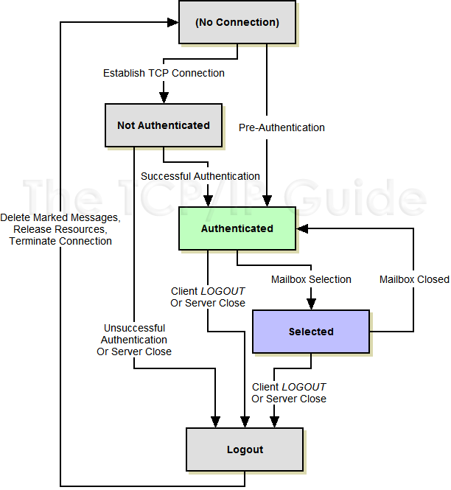
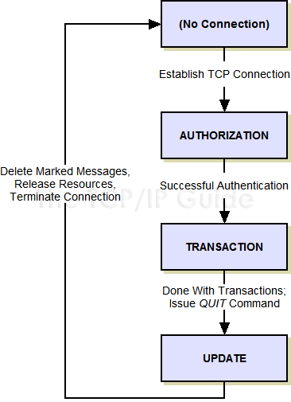
Example: POP3 and IMAP4 session

Slide 66
Example: TCP connection
Server application
Creates a listen socket
CLOSED
CLOSED
Wait
Receive ACK
Send nothing
Send SYN
TIME_WAIT
SYN_SENT
LAST_ACK
LISTEN
Receive FIN
Send ACK
Receive SYN/ACK
Send ACK
Receive SYN
Send SYN/ACK
Send FIN
FIN_WAIT_2
ESTABLISHED
CLOSE_WAIT
SYN_RCVD
Receive ACK
Send nothing
Send FIN
FIN_WAIT_1
Receive FIN
Send ACK
ESTABLISHED
Receive ACK
Send nothing
Client application
Initiates close connection

Slide 67
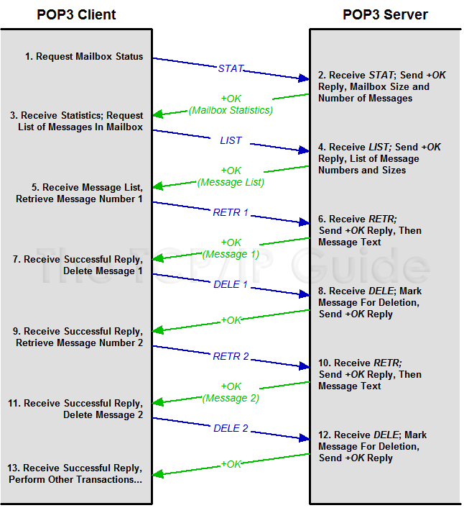
Message Transaction Diagram
Represents the sequence of message transaction
Example: POP3

Slide 68
Implementing an Application Protocol
Message handler(pseudo code)
//handle message
switch (msg_type){
case MSG_TYPE1:
{
//...
}
case MGS_TYPE2:
{
//...
if(data_type == DATA_TYPE1)
//...
}
//...
}

Slide 69
Implementing an Application Protocol
Type of message
Use integer: enum msg_type {…}
Use string
Data structure
Use struct. Example:
Use string or byte array
struct message{
msg_type type;
struct msg_payload payload;
};
struct message{
char msg_type[4];
char data_type[8];
int value;
}
struct msg_payload{
int id;
char fullname[30];
int age;
//...
}
or
of
of
msg_type | data_type | length | value | data_type | length | value | …
fixed length

