Slide 1
Concurrent TCP Server
Tran Quang Duc, SoICT, HUST

Slide 2
Content
I/O Models
Concurrent TCP server: one child per client
Concurrent TCP server: one thread per client

Slide 3
I/o models

Slide 4
I/O Models
blocking I/O
nonblocking I/O
I/O multiplexing (select and poll)
signal driven I/O (SIGIO)
asynchronous I/O (the POSIX aio_functions)

Slide 5
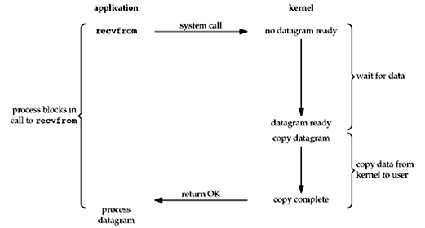
Blocking I/O Model
Blocking I/O model: I/O function block process/thread until returning.
accept(), connect(), send(), recv(),…

Slide 6
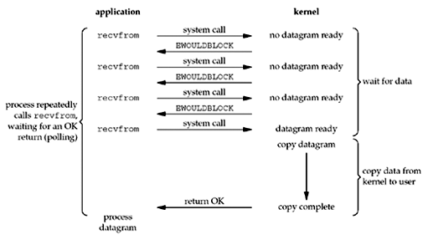
Non-blocking I/O Model
Non-blocking I/O model: I/O function returns immediately
If there is no data to return, so the kernel immediately returns an error of EWOULDBLOCK instead

Slide 7
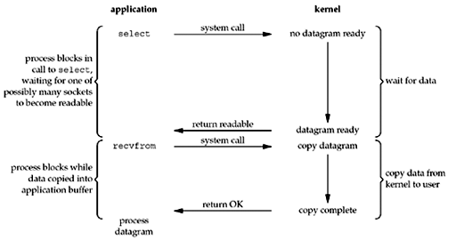
I/O Multiplexing Model
With I/O multiplexing, we call select or poll and block in one of these two system calls, instead of blocking in the actual I/O system call

Slide 8
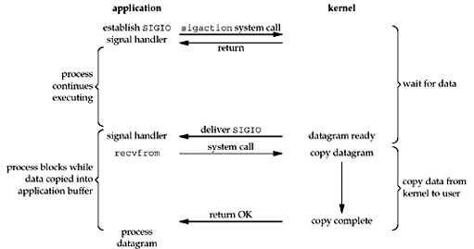
Signal-Driven I/O Model
Use signals, telling the kernel to notify app with the SIGIO signal when the descriptor is ready

Slide 9
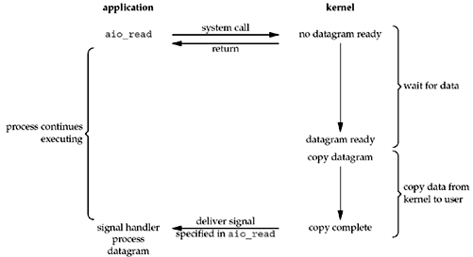
Asynchronous I/O Model

Slide 10
Asynchronous I/O Model (2)
App calls aio_read (the POSIX asynchronous I/O functions begin with aio_)
Pass the kernel
the descriptor
buffer pointer
buffer size (the same three arguments for read)
buffer offset (similar to lseek)
how to notify us when the entire operation is complete
This system call returns immediately and our process is not blocked while waiting for the I/O to complete.

Slide 11
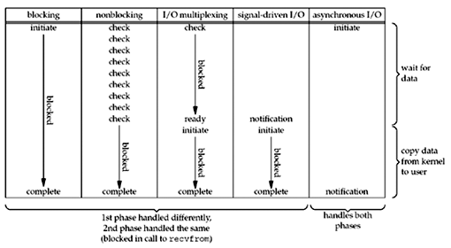
Comparison of the I/O Models

Slide 12
Review TCP Echo Server
while(1){
//accept request
connfd = accept(listenfd, (sockaddr *) & clientAddr,
&clientAddrLen);
//receive message from client
rcvBytes = recv(connfd, buff, BUFF_SIZE, 0);
if(rcvBytes < 0){
perror("Error :");
}
else{
buff[rcvBytes] = ‘\0’;
printf("Receive from client: %s\n",buff);
//Echo to client
sendBytes = send(connfd, buff, strlen(buff), 0);
if(sendBytes < 0)
perror("Error: ",);
}
closesocket(connfd);
} //end while

Slide 13
Blocking I/O Model and TCP server
socket()‏
TCP Server
TCP client
bind()‏
socket()‏
listen()‏
establish
connect()‏
accept()‏
send()‏
data
Cannot accept new connection until the current connection closes.
recv()‏
Block until data from client
recv()‏
data
send()‏
close()‏
close()‏

Slide 14
Iterating server
Simple server
But when a client request can take longer to service, we can’t handle other clients
Use a concurrent server
One child per client: fork() a child process to handle each client
One thread per client: create a thread to handle each client by using pthread_create()

Slide 15
Multi-process server

Slide 16
fork()
#include <unistd.h>
pid_t fork(void);
Create a new process by copying itself.
Returns twice:
Once in the calling process (called the parent) with a return value that is the process ID of the newly created process (the child).
Once in the child, with a return value of 0
All descriptors open in the parent before the call to fork are shared with the child after fork returns

Slide 17
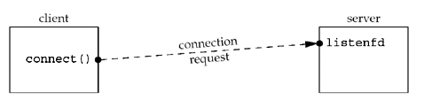
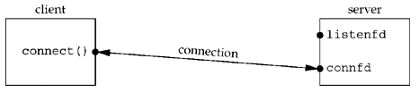
One child per client

Slide 18
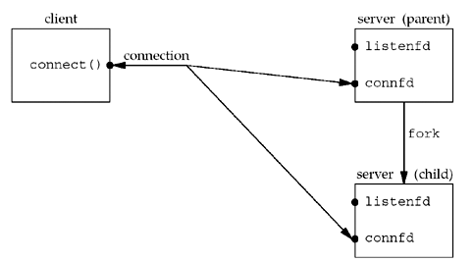
One child per client
X

Slide 19
Use fork()
pid_t pid;
int listenfd, connfd;
//Step 1: Construct socket
//Step 2: Bind address to socket
//Step 3: Listen request from client
//Step 4: Communicate with client
while (1) {
connfd = accept (listenfd, ... );
if( (pid = fork()) == 0) {// process in child
close(listenfd); // child closes listening socket
doit(connfd); // process the request
close(connfd); // done with this client
exit(0); // child terminates
}
close(connfd); // parent closes connected socket
}

Slide 20
Handling SIGCHLD Signals
When a child process ends, it sends the SIGCHLD signal to the parent
Information about the child process is still maintained in “process table” in order to allow its parent to read the child exit status afterward.
If we ignore the SIGCHLD, the child process will enter the zombie state
We need to wait and handle SIGCHLD signal

Slide 21
Signaling
A signal is a notification to a process that an event has occurred.
Signals are sometimes called software interrupts.
Signals usually occur asynchronously. By this we mean that a process doesn't know ahead of time exactly when a signal will occur.
Signals can be sent
By one process to another process (or to itself)
By the kernel to a process

Slide 22
Signal (cont.)
Typing certain key combinations at the controlling terminal of a running process causes the system to send it certain signals:
Ctrl-C sends an INT signal ("interrupt", SIGINT)
Ctrl-Z sends a TSTP signal ("terminal stop", SIGTSTP)
Ctrl-\ sends a QUIT signal (SIGQUIT)
SIGHUP is sent to a process when its controlling terminal is closed (a hangup)
SIGTERM is sent to a process to request its termination.
Unlike the SIGKILL signal, it can be caught and interpreted or ignored by the process.

Slide 23
Handling SIGCHLD Signals
The purpose of the zombie state is to maintain information about the child for the parent to fetch at some later time.
They take up space in the kernel and eventually we can run out of processes
Whenever we fork children, we must wait for them to prevent them from becoming zombies → establish a signal handler to catch SIGCHLD, and within the handler, we call wait
Establish the signal handler by adding the function call : signal (SIGCHLD, handler);

Slide 24
wait() and waitpid()
#include <sys/wait.h>
pid_t wait (int *statloc);
pid_t waitpid (pid_t pid, int *statloc, int options);
Wait for the status change of a process.
Use to handle the terminated child
Both return two values:
The return value of the function:
the process ID of the terminated child
0 or -1 if error
The termination status of the child (an integer) is returned through the statloc pointer.

Slide 25
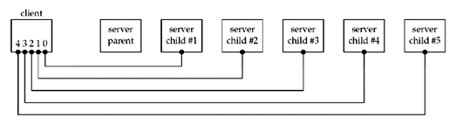
wait()
Create 5 connections from a client to a forking server
When the client terminates, all open descriptors are closed automatically by the kernel → five connections ended simultaneous

Slide 26
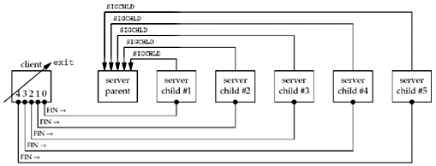
waitpid()
Client terminates, closing all five connections, terminating all five children → four children are zombies
It can happen when many users connect to a server
→ we have to use waitpid()

Slide 27
waitpid()
pid_t waitpid (pid_t pid, int *statloc, int options);
pid < 0: wait for any child process whose process group ID is equal to the absolute value of pid.
pid = -1: wait for any child process.
pid = 0: wait for any child process whose process group ID is equal to that of the calling process
pid > 0: wait for the child whose process ID is equal to the value of pid
Without option WNOHANG, waitpid blocks until the status change
With option WNOHANG, waitpid returns immediately
Return
Pid of the child whose state has changed
with option WNOHANG, return 0 if the specified process has not changed status.

Slide 28
void sig_chld(int signo)
void sig_chld(int signo)
{
pid_t pid;
int stat;
pid = waitpid(-1, &stat, WNOHANG );
printf("child %d terminated\", pid);
}
WNOHANG: waitpid() does not block
while loop: waitpid() repeatedly until there is no child process change status, i.e until waitpid returns 0.

Slide 29
Forking server
pid_t pid;
int listenfd, connfd;
//Step 1: Construct socket
//Step 2: Bind address to socket
//Step 3: Listen request from client
// wait for a child process to stop
signal(SIGCHLD, sig_chld);
//Step 4: Communicate with client
while (1) {
connfd = accept (listenfd, ... );
if( (pid = fork()) == 0) {// process in child
close(listenfd); // child closes listening socket
doit(connfd); // process the request
close(connfd); // done with this client
exit(0); // child terminates
}
close(connfd); // parent closes connected socket
}

Slide 30
Handling EINTR Errors
When a process is blocked in a slow system call and the process catches a signal and the signal handler returns, the system call can return an error of EINTR.
Slow system call: connect, accept, send, recv…
Not all kernels automatically restart some interrupted system calls
We must rewrite function to handle EINTR error
while(1)
if ((connfd = accept (listenfd...) < 0) {
if (errno == EINTR)
continue; /* back to for () */
else
perror ("Error: ");
}

Slide 31
Other problems
Connection abort before accept return
Termination of server process
Crashing of sever host
Crashing and Reboot of server host

Slide 32
Multi-thread server

Slide 33
pthread_create()
#include <pthread.h>
int pthread_create(pthread_t *tid, const pthread_attr_t *attr, void *(*routine) (void *), void *arg);
Create a new thread
Parameters:
[OUT] tid:points to ID of the new thread
[IN] attr : points to structure whose contents are used to determine attributes for the new thread
[IN] routine: the new thread starts execution by invoking routine()
[IN] arg: points to the argument is passed as the sole argument of routine()
Return:
On success, returns 0
On error, returns an error number
Compile and link with -pthread

Slide 34
pthread_create()
By default, the new thread is joinable:
Not automatically cleaned up by GNU/Linux when it terminates
the thread’s exit state hangs around in the system until another thread calls pthread_join() to obtain its return value
Detached thread is cleaned up automatically when it terminates
Another thread may not obtain its return value
Detach a thread: int pthread_detach(pthread_t tid)
On success, returns 0
On error, returns an error number

Slide 35
Synchronize threads
Since multiple threads can be running concurrently, accessing the shared variables:
The order of the accessing shared memory is unpredictable, so
The processing flow of the thread may be incontrollable, and/or
The process crash
Synchronize threads so that only one thread can access shared meory:
Inter-lock
Semaphore
Mutex

Slide 36
Mutex
#include <pthread.h>
int pthread_mutex_lock(pthread_mutex_t * mptr);
int pthread_mutex_unlock(pthread_mutex_t * mptr);
The thread can access the shared variable only when it hold the mutex
pthread_mutex_lock(): lock a mutex
pthread_mutex_unlock(): unlock a mutex
If the thread try to lock a mutex that is already locked by some other thread, it is blocked until the mutex is unlocked.
void *routine(void *arg){
//...
pthread_mutex_lock(mptr);
// access shared memory
pthread_mutex_unlock(mptr);
//...
}

Slide 37
fork() vs pthread_create()
fork()
pthread_create()
Heavy-weight
Passing information from the parent to the child before the fork is easy
Returning information from the child to the parent takes more work
Needn’t synchronize processes
Greater isolation between the parent and the child
Light-weight
Passing information from a thread to the others is easy
Don’t need signal-driven processing when the threads ends.
May synchronize threads
If a thread crashes, process may crash

