Slide 1
ADVANCED IO
Tran Quang Duc, SoICT, HUST

Slide 2
Content
Non-blocking IO
Signal-driven I/O
Some advanced I/O functions

Slide 3
Blocking I/O
By default, sockets are blocking: when a socket call cannot be completed immediately, the process is put to sleep, waiting for the condition to be true
Input functions: recv(), recvfrom(), etc • Blocks until some data arrives
Output function: send(), sendto(), etc • TCP: blocks until there is free space in sending buffer • UDP: block on some systems due to the buffering and flow control
Accepting incoming connections: accept() • Blocks until a new connection is available
Initiating outgoing connections: connect() • Blocks until the client receives the ACK of its SYN

Slide 4
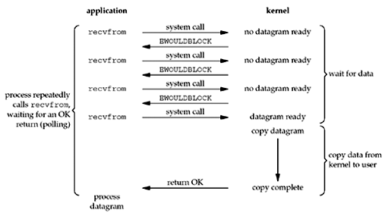
Non-blocking I/O Model
Non-blocking I/O model: I/O function returns immediately
If there is no data to return, so the kernel immediately returns an error of EWOULDBLOCK instead

Slide 5
Non-blocking I/O: use fcntl()
Perform the file control operations described below on open files
Parameter:
[IN]fd: the file descriptor
[IN]cmd: the control operation
The 3rd argument according to cmd
Return:
Return -1 on error
Otherwise, return others depending on cmd
#include <fcntl.h>
int fcntl(int fd, int cmd, ... /* int arg */ );

Slide 6
Non-blocking I/O: use ioctl()
Manipulates the underlying device parameters of special files and control operating characteristics of files
Parameters
[IN]fd: the file descriptor
[IN]request: device-dependent request code
The 3rd argument according to request
Return:
0 if succeed
-1 if error
#include <sys/ioctl.h> int ioctl(int fd, int request, ... /* void arg */ );
int on = 1; /* Set a socket as nonblocking */ ioctl(fd, FIONBIO, (char *)&on); on = 0; /* Turn off non-blocking mode on socket */ ioctl(fd, FIONBIO, (char *)&on);

Slide 7
Non-blocking I/O: use fcntl()
Set non-blocking mode
Turn off non-blocking mode
int flags;
/* Get the file status flags and file access modes */
if ((flags = fcntl(fd, F_GETFL, 0)) < 0)
perror("F_GETFL error");
/* Set a socket as nonblocking */
if (fcntl(fd, F_SETFL, flags | O_NONBLOCK) < 0)
perror("F_SETFL error");
int flags; /* Get the file status flags and file access modes */ if ((flags = fcntl(fd, F_GETFL, 0)) < 0) perror("F_GETFL error"); /* Turn off non-blocking mode on socket */ if (fcntl(fd, F_SETFL, flags & ~O_NONBLOCK) < 0) perror("F_SETFL error");

Slide 8
Non-blocking I/O: process return value
//call I/O functions if(ret < 0){ //Error on I/O operation if (errno != EWOULDBLOCK) } else if(ret == 0){ //Connection terminated normally } else if{ //I/O operation is successful }

Slide 9
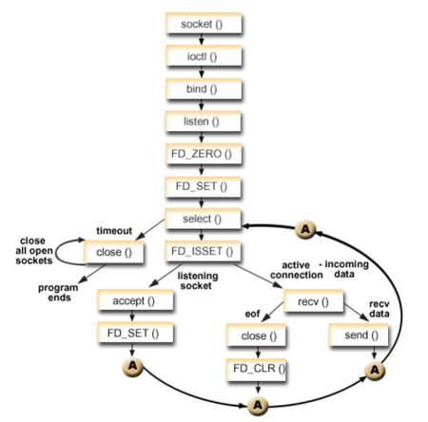
Non-blocking I/O:Example

Slide 10
SIGNAL-DRIVEN I/O
Tran Quang Đuc, SoICT, HUST

Slide 11
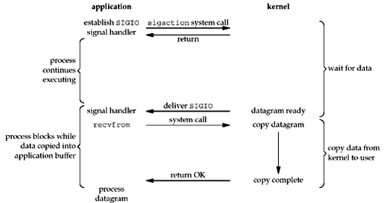
Signal-driven I/O
Use signals, telling the kernel to notify app with the SIGIO signal when the descriptor is ready

Slide 12
Signal-driven I/O: 3 steps
A signal handler must be established for the SIGIO signal.
Assign a process to receive the SIGIO signal fcntl(fd, F_SETOWN, process_id)
Enable signal-driven I/O on socket
Turn on asynchronous mode
Turn on non-blocking mode
The importance is determining what conditions cause SIGIO to be generated for the socket owner

Slide 13
Signal-driven I/O: use fcntl()
Enable signal-driven I/O on socket
Turn off asynchronous I/O mode
int flags; /* Get the file status flags and file access modes */ if ( (flags = fcntl (fd, F_GETFL, 0)) < 0) err_sys("F_GETFL error"); /* Set a socket as nonblocking */ if (fcntl(fd, F_SETFL, flags | O_ASYNC | O_NONBLOCK) < 0) err_sys("F_SETFL error");
int flags; /* Get the file status flags and file access modes */ if ( (flags = fcntl (fd, F_GETFL, 0)) < 0) err_sys("F_GETFL error"); /* Turn off non-blocking mode on socket */ if (fcntl(fd, F_SETFL, flags & ~O_ASYNC & ~O_NONBLOCK) < 0) err_sys("F_SETFL error");

Slide 14
Signal-driven I/O: use ioctl()
int on = 1; /* Set a socket as nonblocking */ ioctl(fd, FIOASYNC, (char *)&on); ioctl(fd, FIONBIO, (char *)&on) on = 0; /* Turn off non-blocking mode on socket */ ioctl(fd, FIOASYNC, (char *)&on); ioctl(fd, FIONBIO, (char *)&on)

Slide 15
SIGIO on sockets
UDP socket: The signal SIGIO is generated whenever
A datagram arrives for the socket
An asynchronous error occurs on the socket
TCP socket: the following conditions all cause SIGIO to
be generated(very complex)
A connection request has completed on a listening socket
A disconnect request has been initiated
A disconnect request has completed
Half of a connection has been shut down
Data has arrived on a socket
Data has been sent from a socket (i.e., the output buffer has free
space)
An asynchronous error occurred

Slide 16
Example: signal-driven I/O on UDP socket
See source code

