Slide 1

iOS Extensions
Nguyen Ha Giang
iOS Developer

Slide 2
Content
What are app Extensions
Types
How app Extensions work
Demo

Slide 3
Extensions
Introduced in iOS 8.0 and OS X v10.10
Is not an app
Extends functionality beyond your app
App Extensions Increase Your Impact

Slide 4
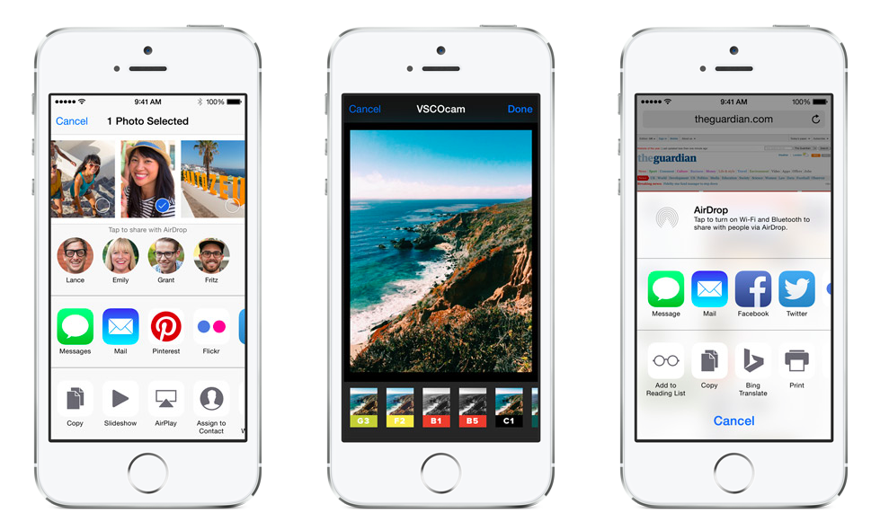
Extensions

Slide 5
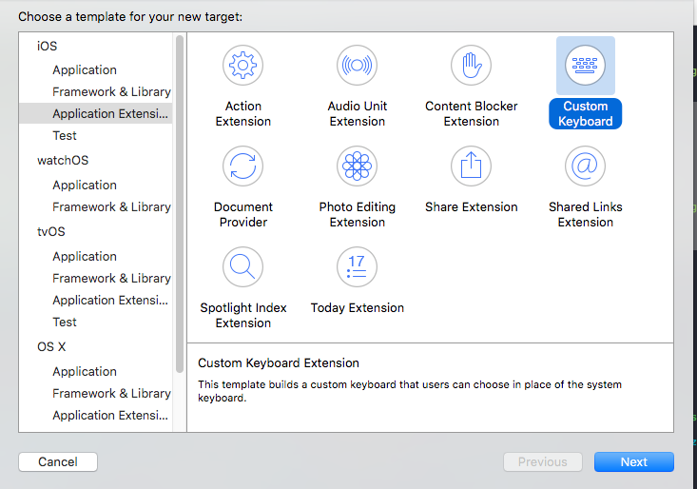
Types of App Extensions

Slide 6
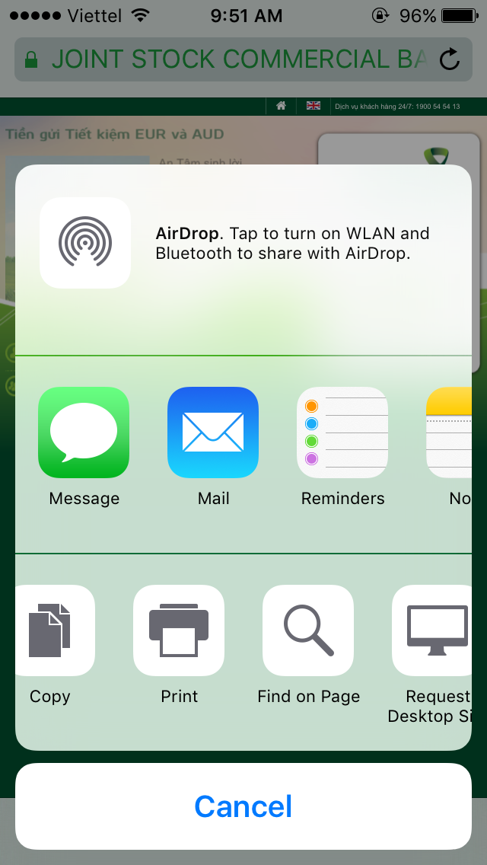
Action Extension
Small Utilities
Manipulate or view content originating in a host app.
UI or non-UI

Slide 7
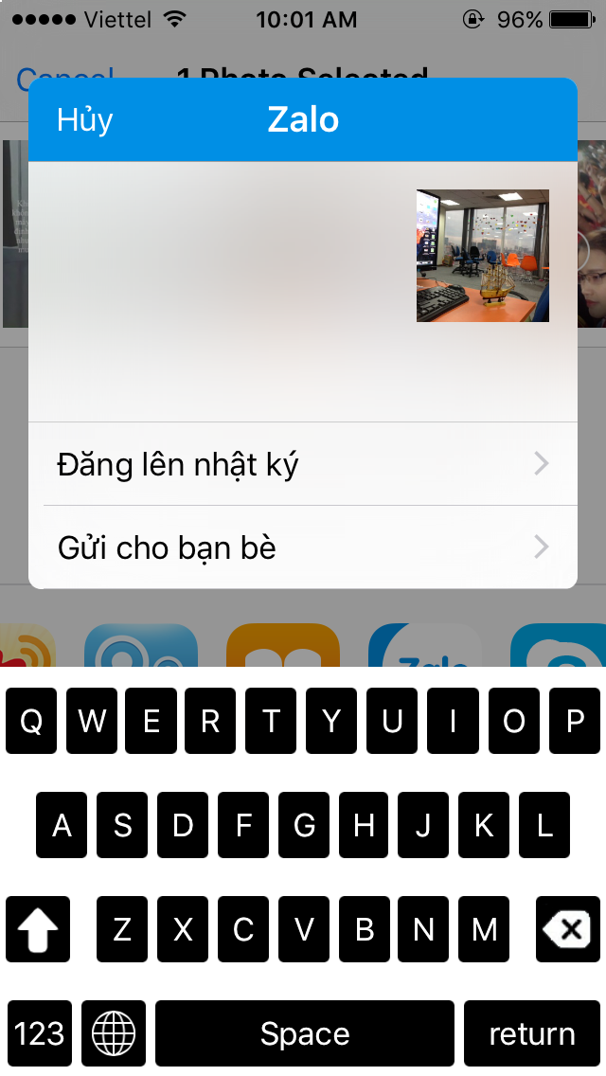
Share Extension
Share contents with others
Subclass of SLComposeServiceViewController

Slide 8
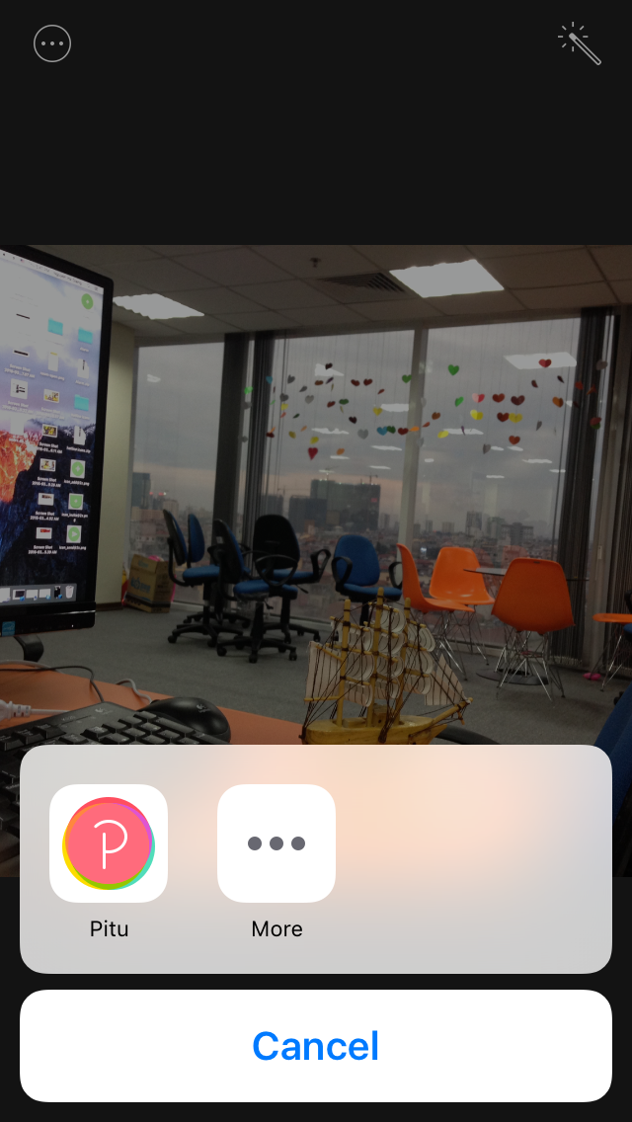
Photo Editing Extensions
Extends photo editing capacity by providing new filters and image manipulations.

Slide 9
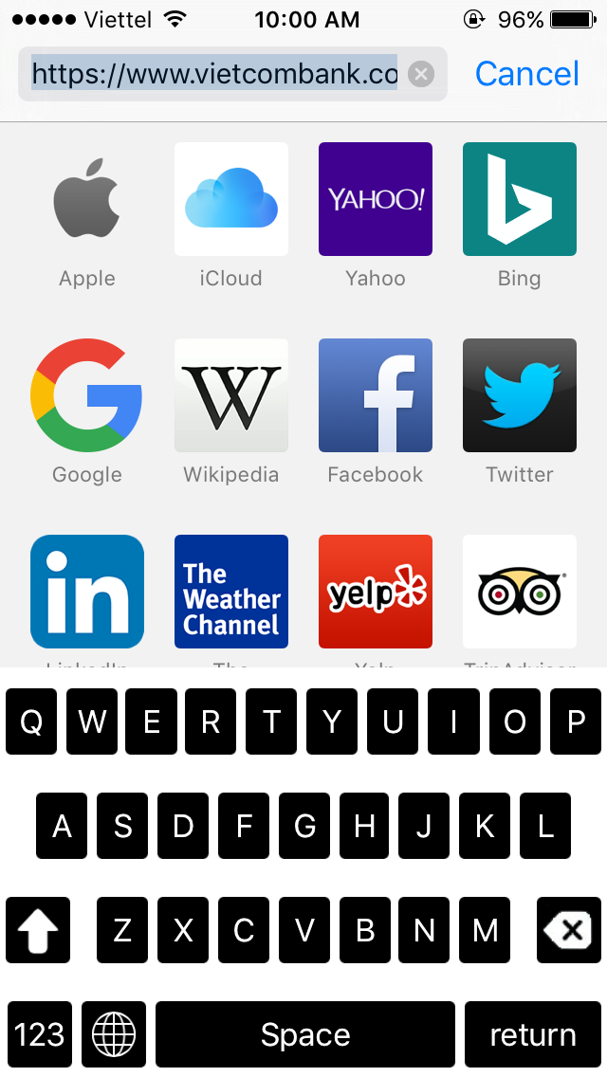
Custom Keyboard
Allows to write your own keyboard with whatever layout and designed you want.
Animated GIF keyboard : http://popkey.co/

Slide 10
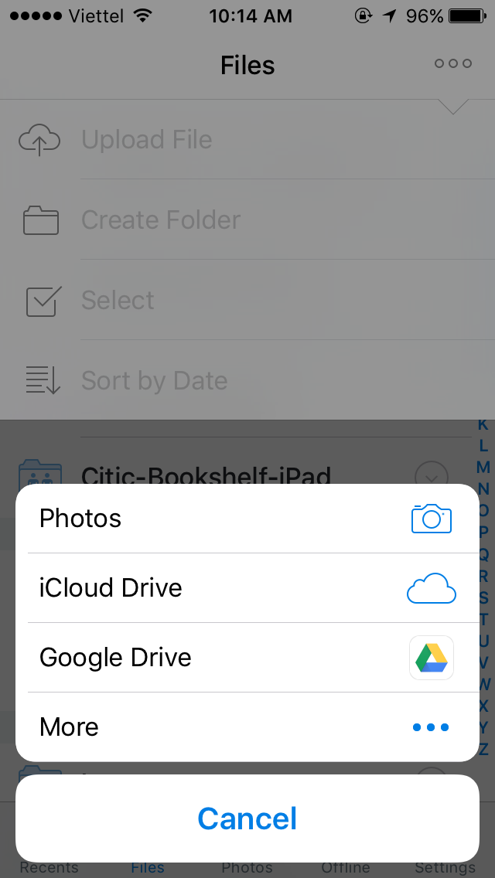
Document Provider
Access documents from one app within another
File management interface

Slide 11
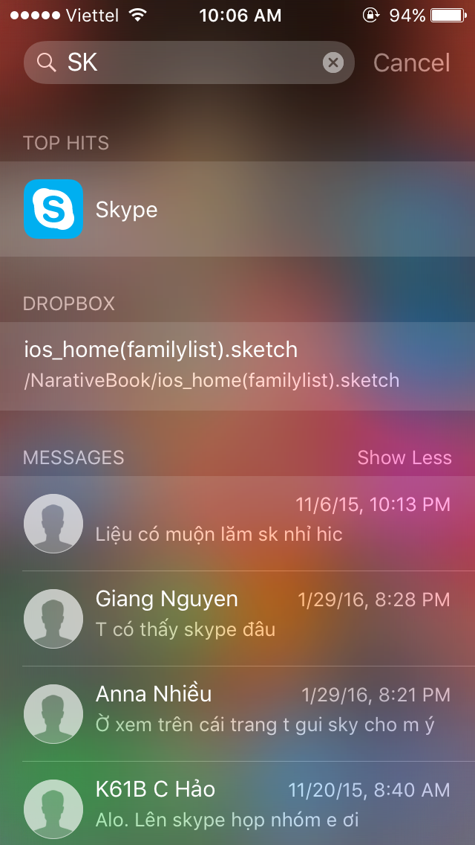
Spotlight Index Extension
Use CoreSpotlight framework

Slide 12
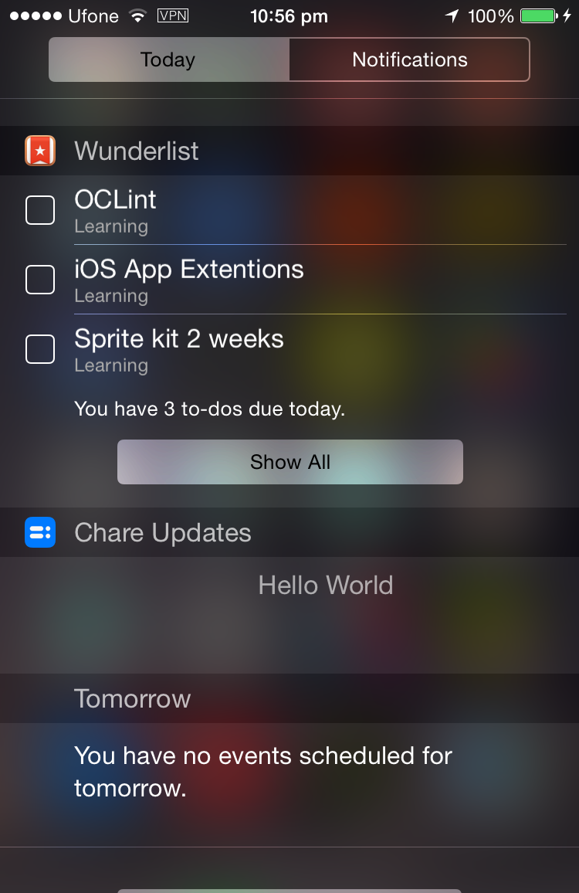
Today Extension
Notification Center Widgets
Display quick updates from your app

Slide 13
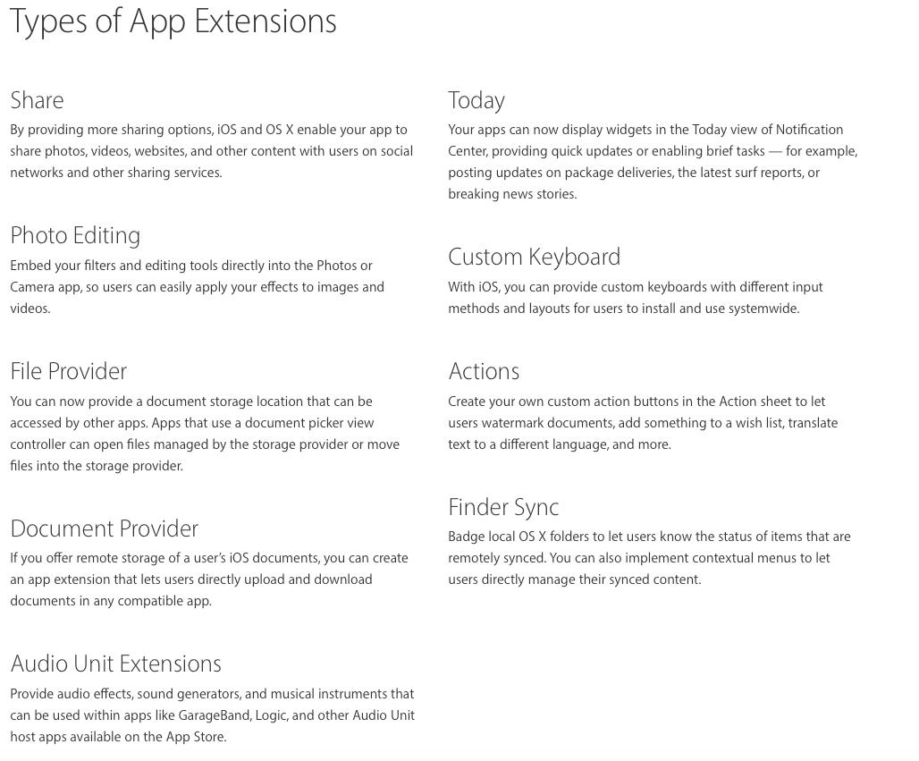

Slide 14
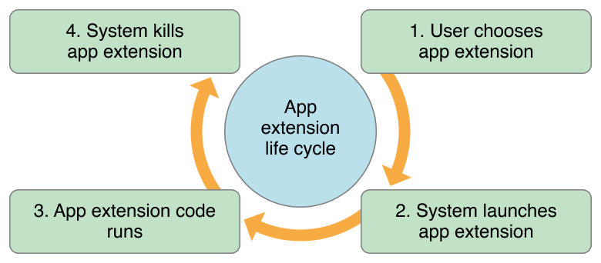
Extension Life Cycle

Slide 15
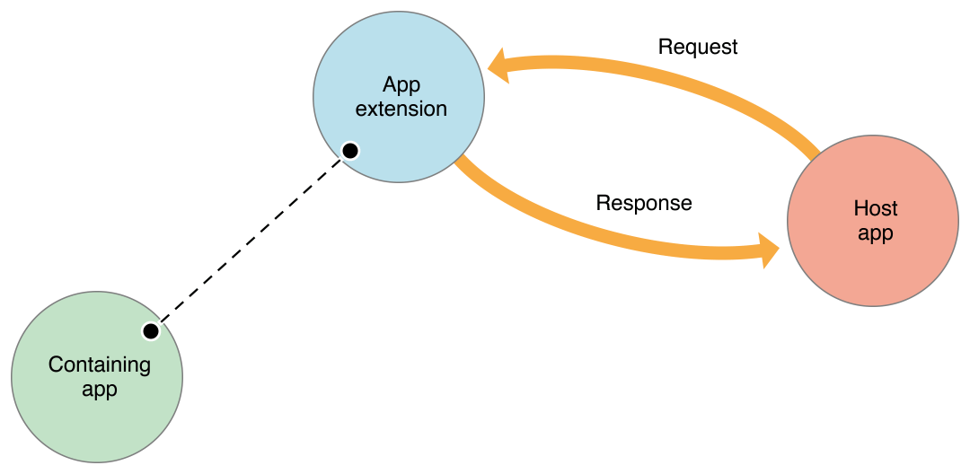
How an App Extension Communicates

Slide 16
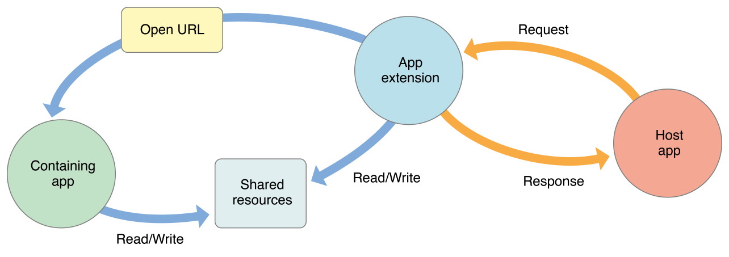
How an App Extension Communicates

Slide 17
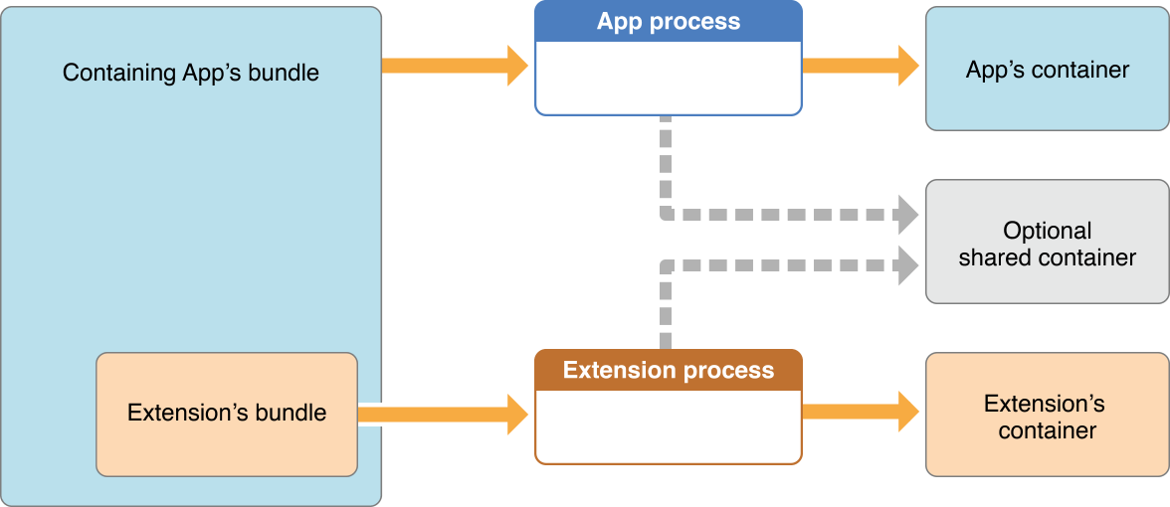
How an App Extension Communicates

Slide 18
Demo
Make a simple keyboard extension

Slide 19
Distribute the extension
You can’t submit an app extension to the App Store unless it’s inside a containing app, and you can’t transfer an extension from one app to another.
https://developer.apple.com/app-store/review/guidelines/#extensions

Slide 20
References
https://developer.apple.com/app-extensions/
http://code.tutsplus.com/tutorials/ios-8-how-to-build-a-simple-action-extension--cms-22794
https://developer.apple.com/library/ios/documentation/General/Conceptual/ExtensibilityPG/
http://www.theappguruz.com/blog/share-extension-in-ios-8

Slide 21
Thanks for listening!
Nguyen Ha Giang
Twitter: @hagianghnue
Facebook: @hagianghnue
Email: giangnh2@ominext.com

