Slide 1
MVVM
What? and Why ?

Slide 2
Agenda
Intro : Traditional UI development.
MVVM in Deep :
What is MVVM?
Model / View Model /View.
Classes interaction .
MVVM and other patterns.
MVVM Advantages /Disadvantages.
MVVM in Android.
Conclusion & Recommendations.

Slide 3
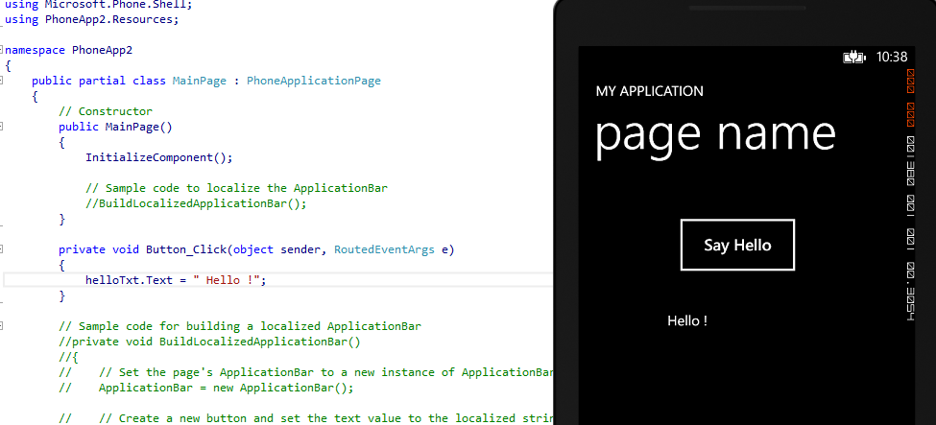
Traditional UI Development
Simple , no problem

Slide 4
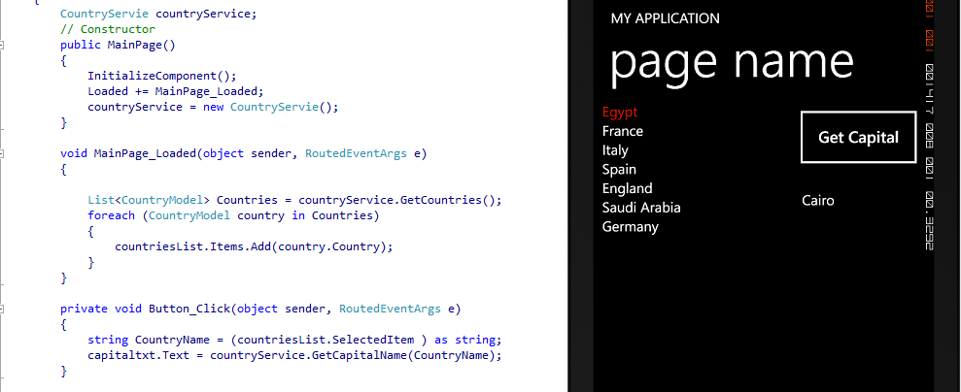
Traditional UI Development
More work , more problems

Slide 5
Traditional UI Development
Model
View
UI Layout
Domain objects
Update and get data
Code behind

Slide 6

Traditional UI Development
Constraints:
Difficult to Test
Encourages using UI as data storage
Complex classes and a huge mount of code.
No code sharing .
very strong dependency between UI & logic.
What if you need to redesign UI?

Slide 7
MVVM in Deep
What ? And How?

Slide 8
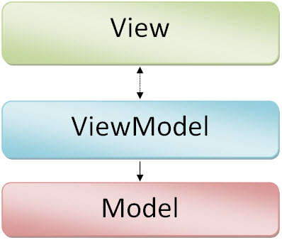
What is MVVM?
The Model View ViewModel.
Introduced by Microsoft in 2006.
Not a design pattern it is an architectural pattern.
It is a specialization of the presentation model pattern.

Slide 9
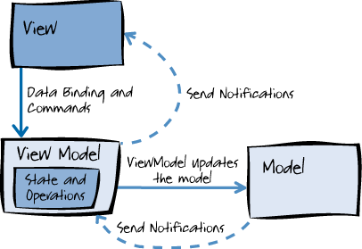
MVVM In Deep
Components to be swapped
Internal implementation to be changed without affecting the others
Components to be worked on independently
Isolated unit testing

Slide 10
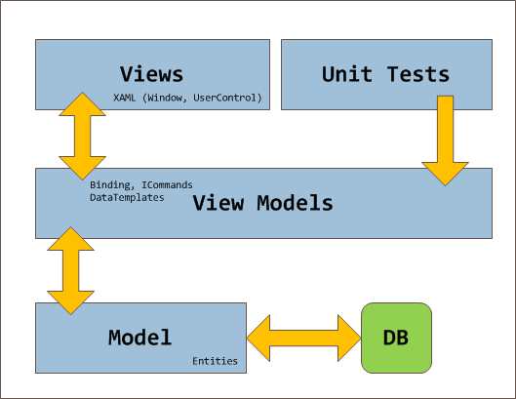
MVVM In Deep

Slide 11

Model
Non-visual classes that encapsulate the application's data and business logic.
Can’t See View Model or View.
Should not contain any use case–specific or user task–specific behavior or application logic.
Notifies other components of any state changes.
May provide data validation and error reporting

Slide 12
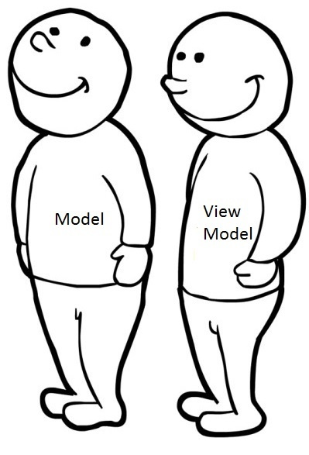
View Model
Non-visual class encapsulates the presentation logic required.
Can’t See View (no direct Reference).
Coordinates the view's interaction with the model.
May provide data validation and error reporting.
Notifies the view of any state changes.

Slide 13
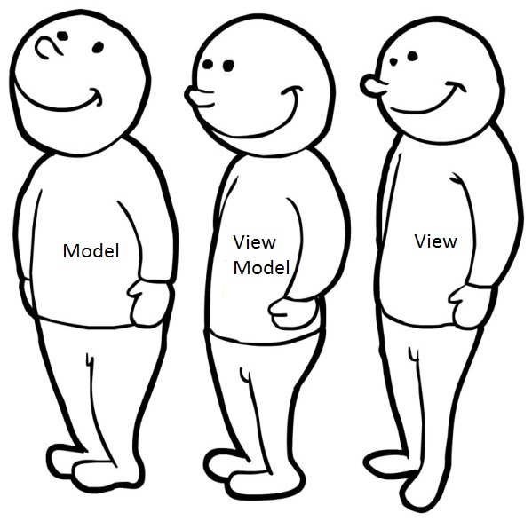
View
Visual element defines the controls and their visual layout and styling.
Can see all others components.
Defines and handles UI visual behavior, such as animations or transitions.
Code behind may contain code that requires direct references to the specific UI controls.

Slide 14
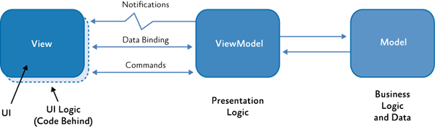
Classes Interaction
Interaction Ways
Data Binding
Commands
Notifications

Slide 15
MVVM and other patterns
What about MVP & MVC ?

Slide 16
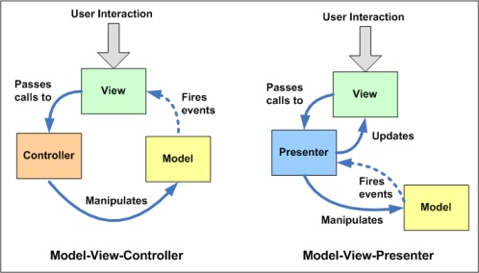
MVP vs. MVC vs. MVVM

Slide 17
MVP vs. MVC vs. MVVM
MVP (Presenter) | MVC (Controller) | MVVM (View Model)
view communicates with the presenter by directly calling functions on an instance of the presenter. | view sends input events to the controller via a callback or registered handler | View binds directly to the View Model.
The presenter communicates with the view by talking to an interface implemented by the view | View receives updates directly from the model without having to go through the controller | changes in view are automatically reflected in View Model and changes and Vice versa.
Use where binding via a data context is not possible | Use where the connection between view and the rest of the program is not always available | Use where binding via a data context is possible

Slide 18
MVVM Advantages & Disadvantags
Why ? And Why not?

Slide 19

MVVM Advantages
Separation of concerns.
Can use unit tests.
Designers and developers can work synchronously.
Easy to redesign the UI .
Can share code easily.

Slide 20
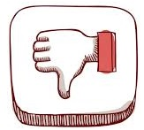
MVVM Disadvantages
Harder to debug.
May affect performance.
More files to serve the architecture.

Slide 21
MVVM in Android
MVVMCross for Xamarin.Android.
Dot42 Framework. (C# for android).
Android-binding.
Robo Binding

Slide 22
Conclusion & Recommendations
MVVM is a suitable architectural pattern for business apps.
Use MVVM only when you need it.
Using MVVM is highly recommended in Cross-Platform development.
MVVM is a tool not a purpose.

Slide 23
References
http://www.codeproject.com/Articles/100175/Model-View-ViewModel-MVVM-Explained
http://blogs.adobe.com/paulw/archives/2007/10/presentation_pa_3.html
http://en.wikipedia.org/wiki/Model_View_ViewModel
http://aspnet.blogershub.com/Archive/2013/12/what-is-difference-Application-Architecture-and-Design-Patterns
http://msdn.microsoft.com/en-us/library/hh848246.aspx
http://msdn.microsoft.com/en-us/library/ms752347(v=vs.110).aspx
http://msdn.microsoft.com/en-us/library/windows/apps/xaml/hh758320.aspx
http://msdn.microsoft.com/en-us/library/gg405484(v=pandp.40).aspx
http://joel.inpointform.net/software-development/mvvm-vs-mvp-vs-mvc-the-differences-explained/

Slide 24
Design Patterns VS. Architectural Patterns
Design Patterns
Architectural Patterns
Guidelines to avoid/solve common problems in application development.
Tell us how we can achieve a solution in terms of implementation.
Implementation Level.
Guidelines to construct the structure and behavior of applications.
Tell us how to arrange the interaction between application packages, databases, and middleware systems .
Abstract Level.

Slide 25
Presentation Model Pattern
Introduce by Martin Fowler in 2004.
An abstract of the view that is not dependent on a specific GUI framework.
State is in the presentation model.
Logic is in the presentation model.
View observes the model and updates accordingly.
The view “knows” about the presentation model.
The presentation model does not “know” about the view.
presentation model Also Known as application model, view state or logical View.

Slide 26
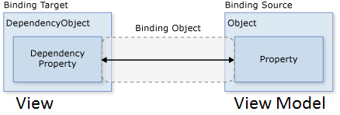
Data Binding (State)
Process that establishes a connection between the application UI and application logic.
When the data changes its value, the elements that are bound to the data reflect changes automatically.

Slide 27
Data Binding (State)
Direction of the data flow:
One Time bindings update the target with the source data when the binding is created.
One Way bindings update the target with the source data when the binding is created, and any time the data changes. This is the default mode.
Two Way bindings update both the target and the source when either changes.

Slide 28
Commands (Behavior)
Provide a way to represent actions or operations that can be easily bound to controls in the UI.
Encapsulate the actual code that implements the action or operation .
Examples : Button Click , List selection changed.

Slide 29
Notifications
Implementing INotifyPropertyChanged and INotifyCollectionChanged interface.
OnPropertyChanged method is required to notify binding target properties with change in source.
Observable Collection needed for binding lists source.

