Slide 1
Company Turnover Rate Analysis
Gia Blum

Slide 2
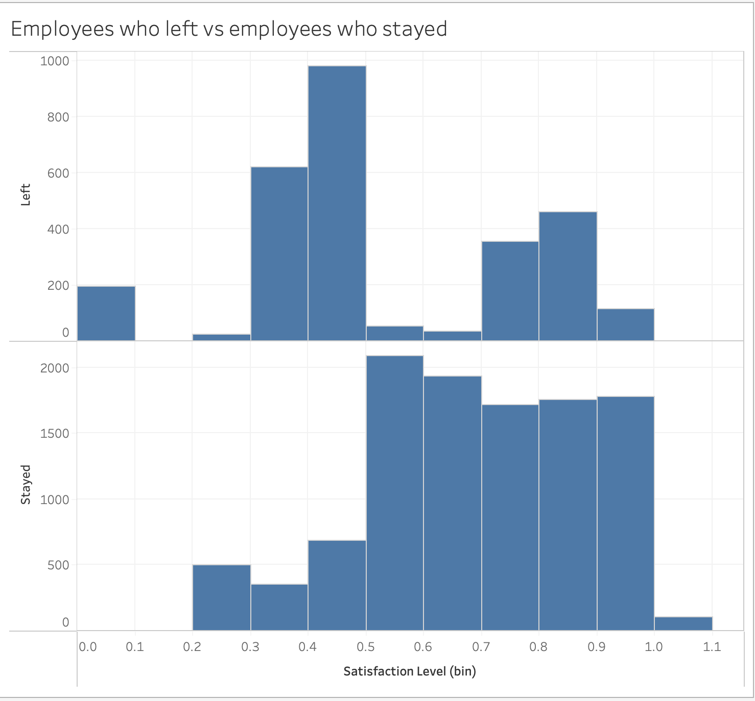
Satisfaction ratings
When analyzing retention rates, a common way to gain insight is through customer satisfaction. The bar chart to the left displays the amount of employees who have left and the amount of employees who have stayed in comparison to their satisfaction rating. This shows us that employees who leave tend to have a satisfaction rating of < 0.5. Since there are a signification number of employees with higher than average satisfaction rating that still left, this tells us that there must be other contributing factors to retention rate.

Slide 3
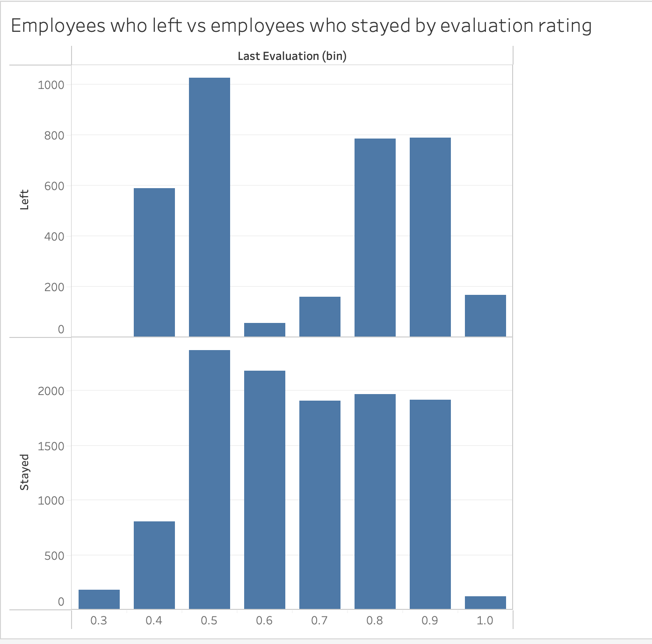
Evaluation rating
Most employees that left had a most recent evaluation between 0.4 and 0.6.
However, over 1500 employees with a rating over 0.8 still left the company.
This suggest other features are likely more important when analyzing/predicting retention rates
Moving forward I will analyze evaluation and satisfaction together
since they are both continuous features

Slide 4
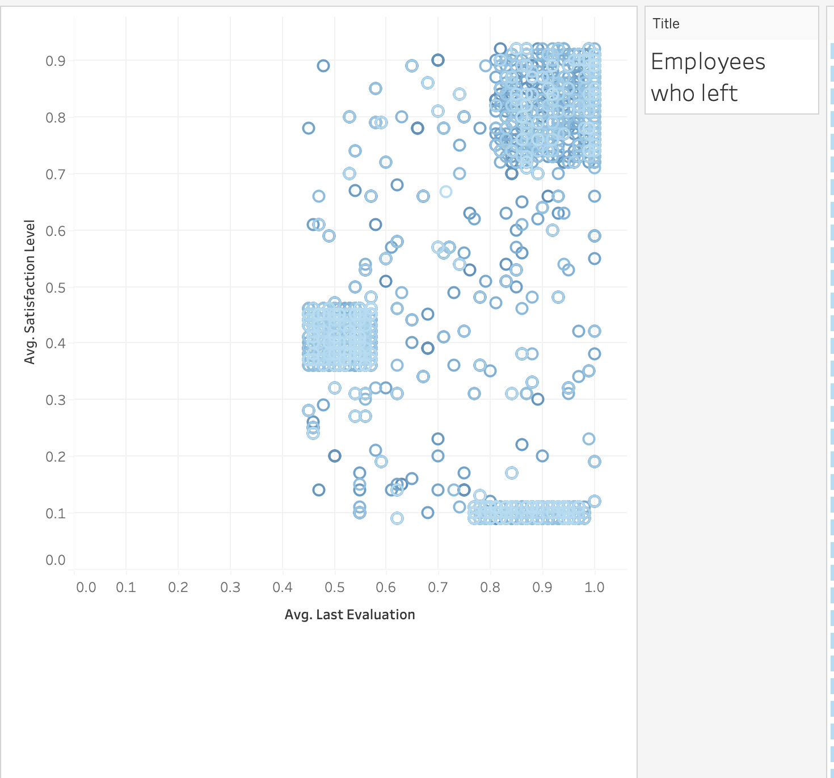
Here we see a scatterplot of all employees who have left the company. It’s immediately apparent that the majority of employees who have left fall into one of three clusters.
The top right cluster relates to employees with a high satisfaction and high evaluation rating.
The top left relates to high performance but low satisfaction. This suggest that it’s possible these employees left due to feeling undervalues or undercompensated.
The bottom cluster relates to poor performance and low satisfaction. No further analysis needed for this cluster.

Slide 5
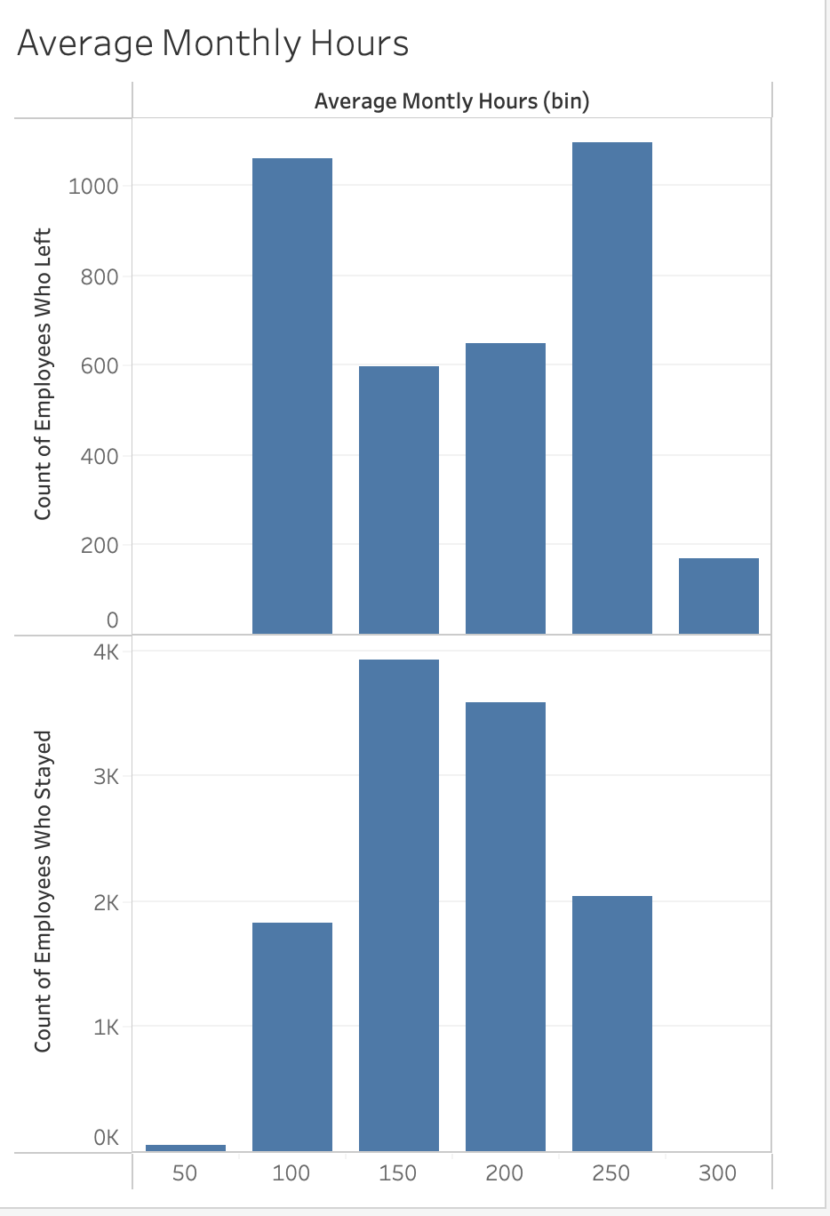
These histograms indicate the average working hours for both groups are around 200 hours.
Most employees that departed worked an average if 100-150 hours per month, indicating that part time employees have a higher turnover rate.
However there was also a high turnover rate for workers working more than 250 hours.
Workers most likely to remain in the company worked around 150-200 hours a month.

Slide 6
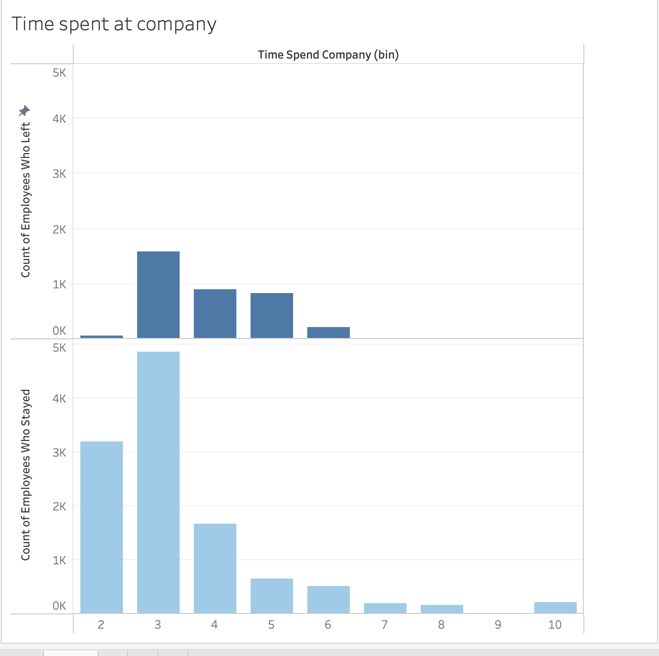
Most employees who leave have completed 3 years at the job. The majority of other employees who left, left after 4,5, or 6 years. The lowest turnover rates are at <2 years and >6 years.
Lower turnover rate at <2 years likely correlates with the employee seeking promotion at the company. It’s likely that employees tend to leave after 3 years if they haven’t received a promotion.

Slide 7
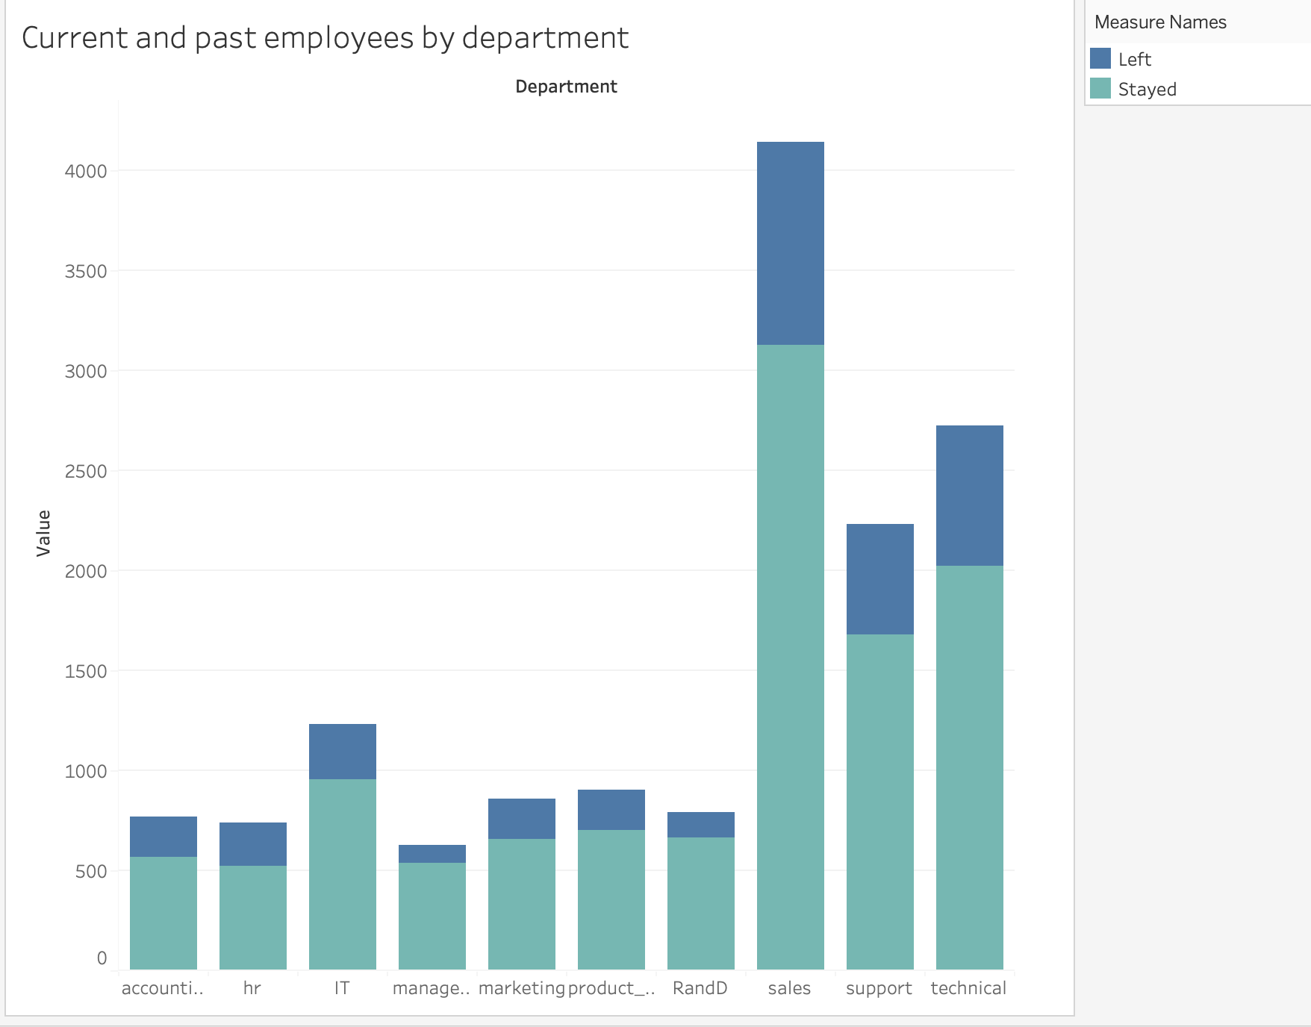
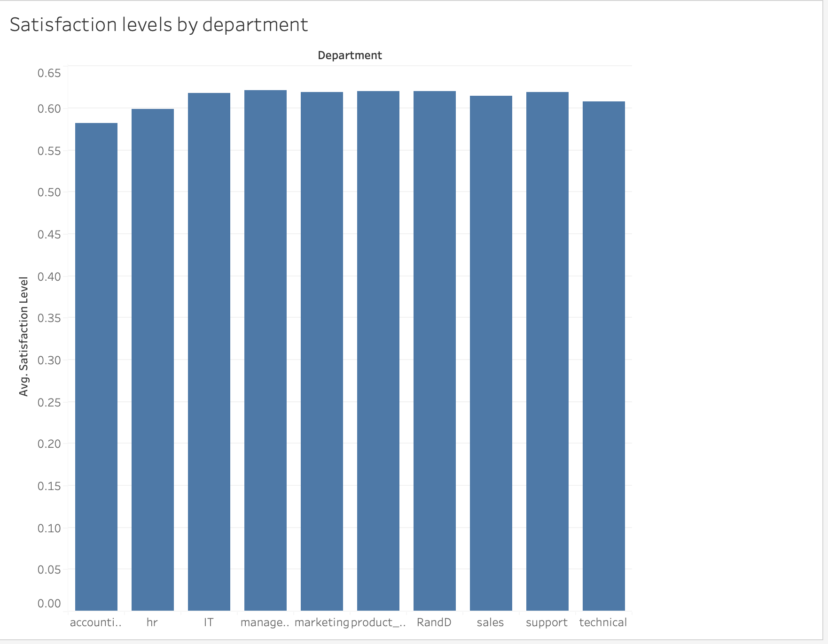
HR has the highest turnover rate at 29.0% while management had the lowest turnover rate at 14.44%.
The departments with the highest rates of turnover also have the lowest mean rates of satisfaction.

Slide 8
Conclusion
The most important numerical features when analyzing employee retention rate at this company is satisfaction level, average monthly hours, and promotion. Employees who leave on average have a lower satisfaction rating, and work longer hours on average. Employees who achieve promotion are the employees least likely to leave the company.

