Slide 1
Authentic Execution in Smart Farming
Second Thesis presentation
Student: Gianluca Scopelliti
Promotor: Frank Piessens
Supervisors: Jan Tobias Mühlberg, Fritz Alder

Slide 2
Recap

Slide 3
Recap: what is this thesis about?
Goal: provide a secure implementation of a distributed, event-driven application
In practice: extend the concept of «Authentic Execution» with new features
Support for Intel SGX
Integration with Sancus
Application: Smart Farming

Slide 4
Authentic Execution between SGX enclaves

Slide 5
Introduction
Goal: keep the same structure and philosophy of the Sancus implementation
The developer defines
The main logic of the modules (with some annotations in the code)
A description of the system to be built (descriptor file)
All the rest is added at compile time
Authentic Execution, Enclaved Execution

Slide 6


Platform
The applications are written in Rust
Modern, efficient
Safe
Fortanix EDP is the framework used to write SGX applications
Full abstraction over the SGX layer
Allows to write a SGX module as a normal, native application

Slide 7
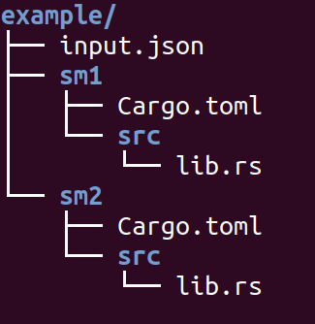
Input: from the developer to the framework
The developer passes as input a folder, containing:
Description of the system
Specified in a configuration file
Description of the single modules
Each module is a separate Rust project

Slide 8
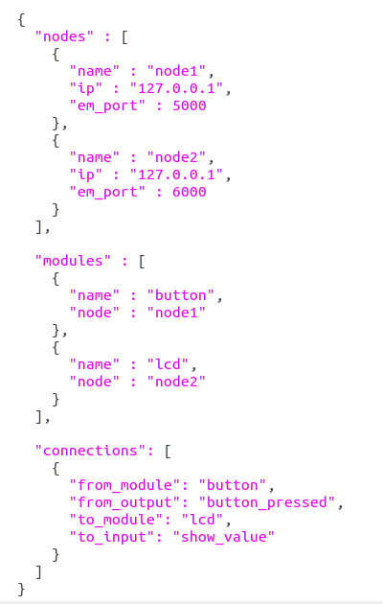
Defining the system
The input JSON file contains a full description of the system
Nodes
Subsystems
Each node has an Event Manager
Modules
Each module belongs to a node
Except for Remote Attestation, a module directly communicates only with the EM
Connections
Trusted path between the output of a module and the input of another

Slide 9
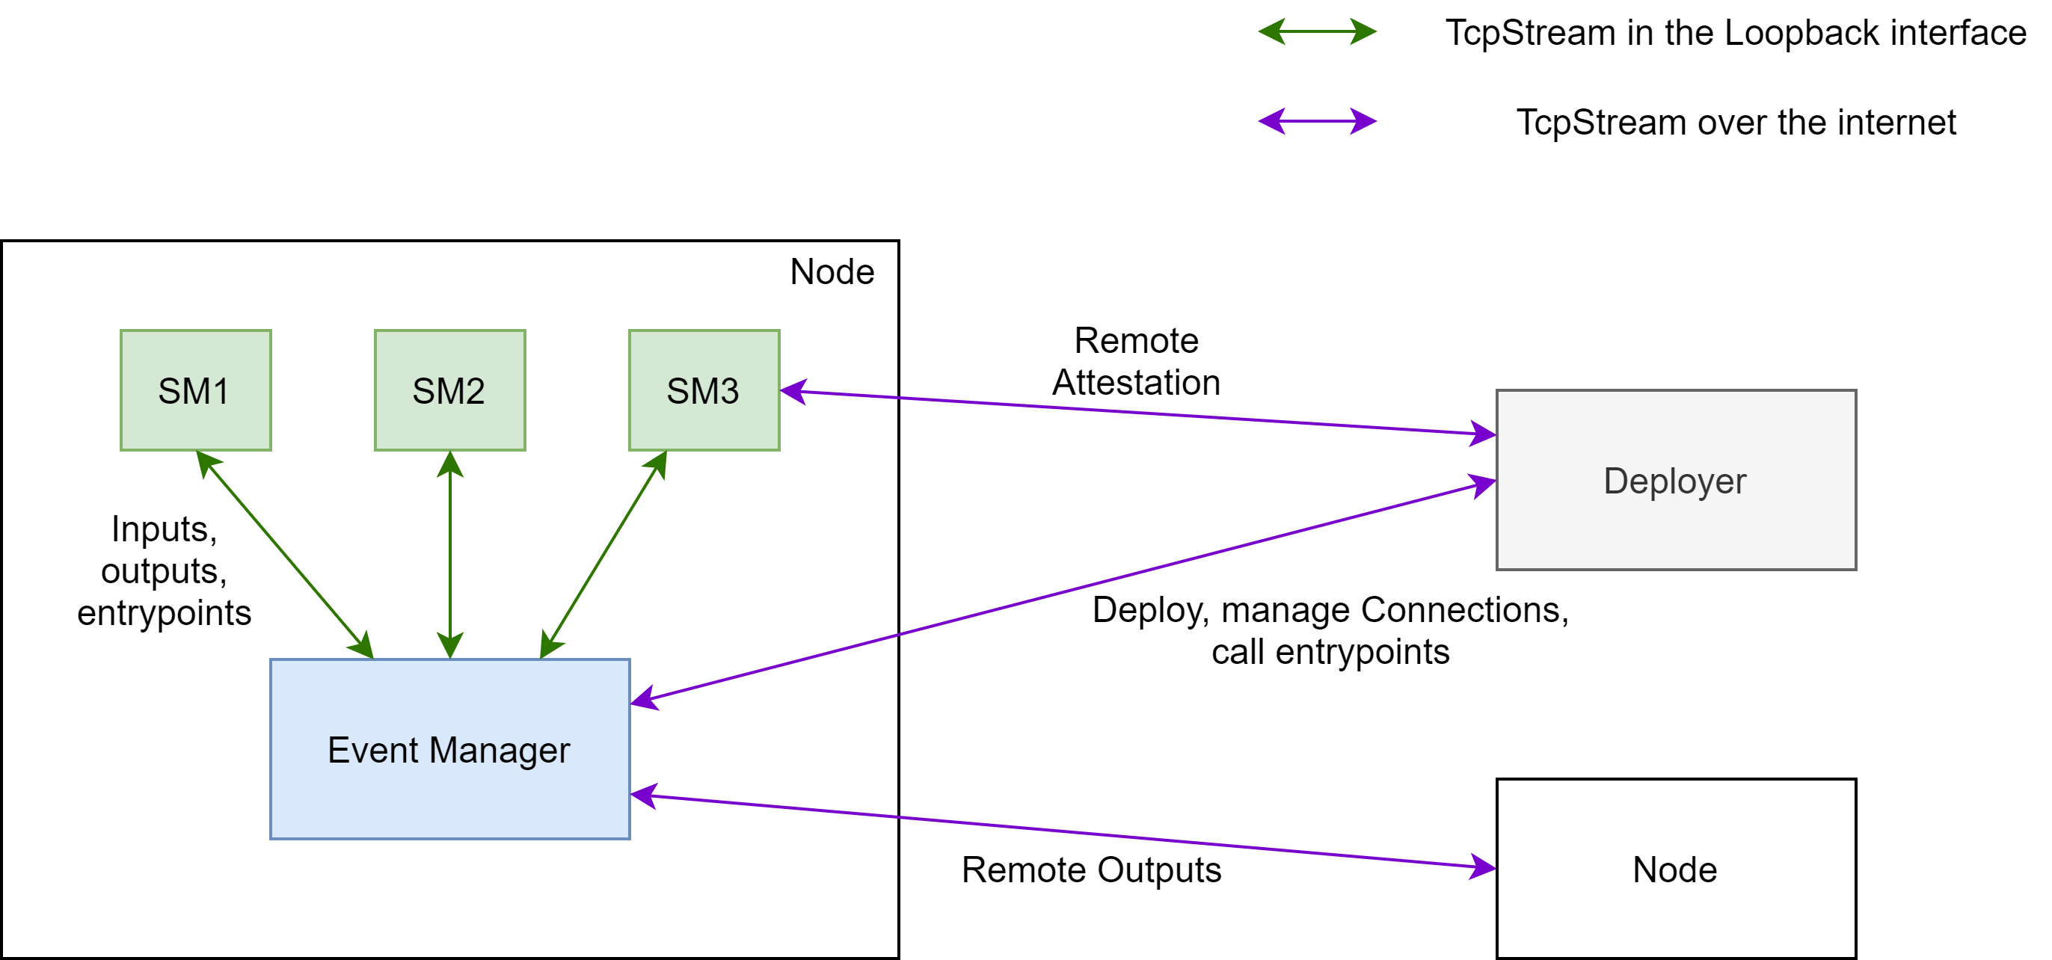
The complete scheme

Slide 10
Security concerns
Only SMs and Deployer are considered trusted
Event managers, nodes and network are not.
The same principles described in the «Authentic Execution» paper have been implemented
Remote Attestation: ensures that a module is correctly loaded into a node
A Master Key is established during the process
Each connection between modules is protected with a Connection Key

Slide 11
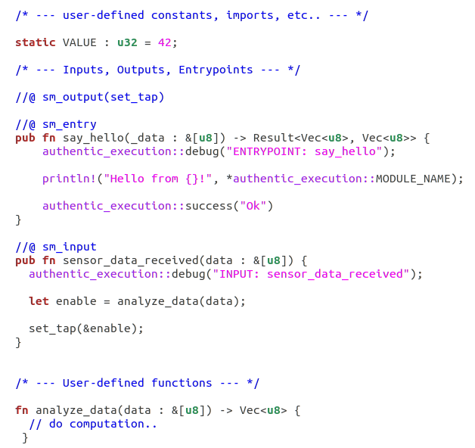
Defining a Module
The developer creates a Rust Cargo library
Logic of the module
Inputs, Outputs, Entrypoints
Automatic generation of the missing code
main function
Code for Authentic Execution
Code for Remote Attestation
Dependencies for Enclaved Execution

Slide 12
Details
After performing Remote Attestation, the module will listen for messages (events) sent by the Event Manager
Message: [<Entrypoint ID> <data>]
EID 0: set_key
EID 1: handle_input
The other entrypoints are defined by the developer

Slide 13
Future extensions
Store the Master Key using SGX data sealing
Perform RA only the first time the module is executed
Only the module can retrieve the key
N:N relationships between inputs and outputs
Currently only 1:1 relationships allowed (for simplicity)
Multiple connections would be useful
e.g. a sensor output connected to both a «database» and a «computation» enclave

Slide 14
Conclusions
The framework provides a very easy way for developers to write distributed SGX applications
Trusted paths between modules, in terms of confidentiality, integrity and authenticity of the data
Availability is out-of-scope (e.g. EM might not deliver messages)
The source of the path cannot be trusted
No secure I/O in SGX
Need to use SGX enclaves in combination to other ones (-> Sancus)

Slide 15
Next steps

Slide 16
Integration with Sancus
Sancus: Trusted Execution Environment for embedded devices
Important feature: Secure I/O
Combination of Sancus and SGX enclaves: full trusted paths
From an input (e.g. sensor) to an output (e.g. actuator)
Authentic Execution for Sancus devices already implemented
Goal: «merge» the two frameworks into a single one

Slide 17
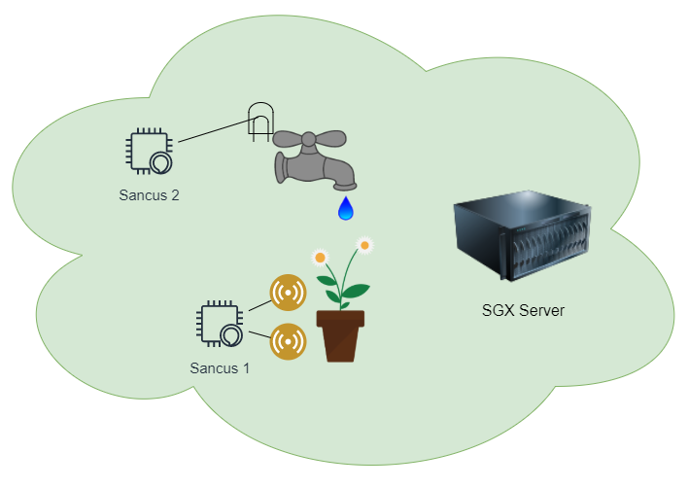
Prototype for Smart Farming
Simple application, illustrated in the first presentation
Automatic water supply of a flowerpot
Sancus 1: retrieve data using sensors
SGX server: execute some logic and make decisions
Sancus 2: enable/disable the water tap

Slide 18
Other ideas
Availability concerns: implement some «backup» logic to be executed when availability is not guaranteed (e.g. the network goes down)
General network API: Communication between Event Managers in different nodes can also be performed using different mediums
End-user application: a dashboard for the end-user (i.e. the farmer) used to monitor the system and send commands

Slide 19
Related work

Slide 20
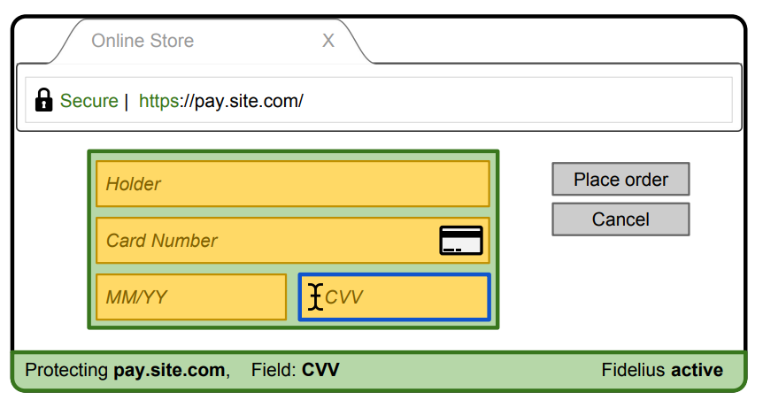
Fidelius: Protecting User Secrets from Compromised Browsers
Developed by researchers from the Stanford University
Goal: secure sensitive form fields of a web page
Establishment of a trusted path from end-user to remote server
Main concern is confidentiality of data (e.g. credit card info)
Different from ours (integrity)

Slide 21
Conclusions

Slide 22
Conclusions
The SGX implementation brings the Authentic Execution framework to the next level
We can now define modules to perform some expensive computation..
..or to store data into a central database
Microcontrollers alone cannot perform these operations
The framework can be easily extended in future work
New features
Support for other architectures
Support for other comm. mediums

Slide 23
References
Authentic Execution
Rust programming language
Fortanix EDP
Remote Attestation Rust code
Fidelius

