Slide 1
Authentic Execution in Smart Farming
Second Thesis presentation
Student: Gianluca Scopelliti
Promotor: Frank Piessens
Supervisors: Jan Tobias Mühlberg, Fritz Alder

Slide 2
Recap

Slide 3
Recap: what is this thesis about?
The main purpose of my thesis is to provide a secure implementation of a distributed, event-driven application, composed by modules developed for different architectures.
In practice, i extend the concept of «Authentic Execution», providing new features to the current implementation, such as the support of the Intel SGX architecture, and the integration with Sancus.
The work is then applied to Smart Farming, which is an interesting use-case where security is an huge concern.

Slide 4
Authentic Execution between SGX enclaves

Slide 5
Introduction
The first step of my work was to implement an Authentic Execution framework for applications (enclaves) written using Intel SGX.
The main idea was to keep the same philosophy and structure used for the Sancus implementation
The framework provides to the developer an abstraction where all the main functionalities are provided automatically.
The developer only needs to write the core logic of the module, defining also how the modules are connected each other, using a descriptor file and annotations in the code.
All the rest (i.e. the code for Enclaved Execution and Authentic Execution) is added at compile time.

Slide 6


Platform
The applications are written in Rust
Efficient, modern programming language
It is a safe language: thanks to the powerful Rust compiler, many memory management vulnerabilities are prevented at compile time; for other ones, runtime controls are introduced (e.g. checking bounds of an array)
Fortanix EDP is the framework used to write SGX applications
The platform provides a full abstraction over the SGX layer, where the developer can write his own application like a normal, native one

Slide 7
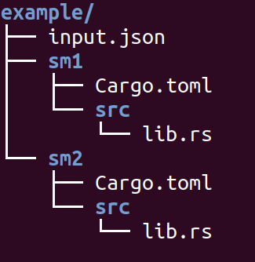
Input: from the developer to the framework
The developer passes as input a folder, containing:
Description of the system:
The developer specifies a configuration file, containing information about the modules, nodes, connections and so on
Description of the single modules:
Each module is a separate Rust project; the developer only has to write the core logic of the module

Slide 8
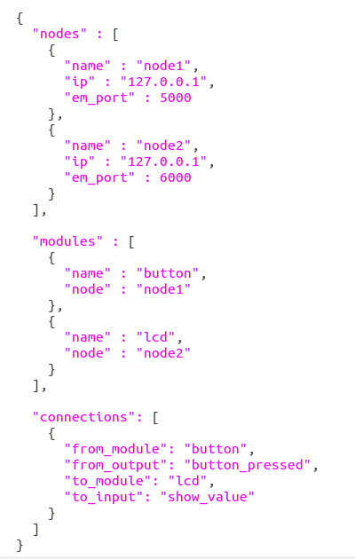
Defining the system
The input JSON file contains a full description of the system
Nodes
A subsystem that contains modules
Each node has an Event Manager, which handles the events to/from the node
Modules
Each module belongs to a node
Except for Remote Attestation, a module directly communicates only with the EM
Connections
A connection establishes a trusted path between the output of a module and the input of another

Slide 9
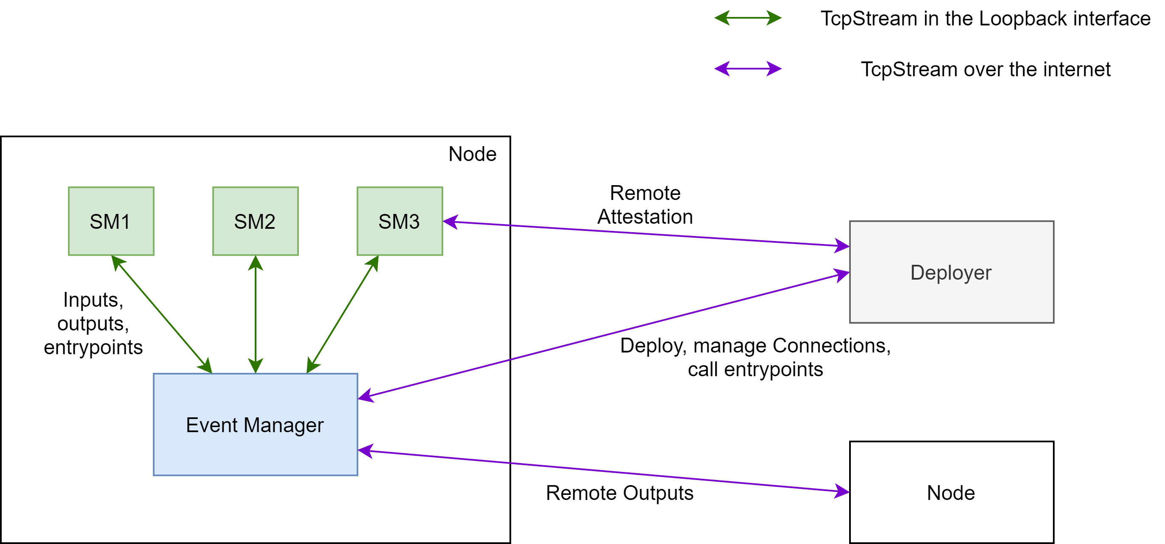
The complete scheme

Slide 10
Security concerns
Only the SMs and the Deployer are considered trusted, whereas the event managers, the nodes and the communication network are not.
To guarantee strong security properties in this scenario (in terms of Confidentiality, Integrity and Authenticity of the data), the same principles as described in the «Authentic Execution» paper have been implemented.
Remote Attestation ensures that a module is correctly loaded inside a node (and not tampered with). Moreover, a Master Key is established during the process, known only by the deployer and the module itself.
Each connection between modules is protected with a Connection Key, generated by the deployer and sent to the two modules involved (encrypted with the modules’ Master Key).

Slide 11
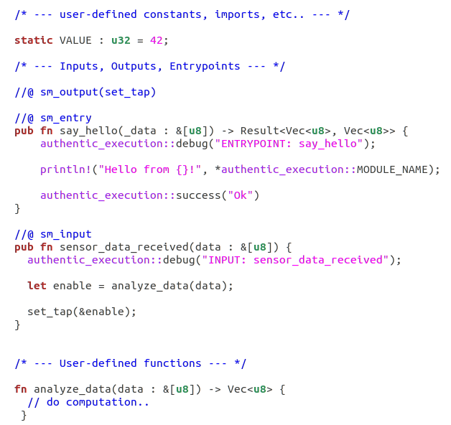
Defining a Module
The developer creates a Rust Cargo library and writes all the logic of the module, as well as defining inputs, outputs and entrypoints
An external script takes the module as input and generate the missing code.
This includes a main function and all the data structures and functions needed for Authentic Execution to work, as well as the code for Remote Attestation and Enclaved Execution

Slide 12
Details
The module, after performing Remote Attestation with the deployer, will listen for messages (events) sent by the Event Manager
A message contains an Entrypoint ID and data. Based on the EID, the corresponding function is executed
EID 0: set_key
EID 1: handle_input
The other entrypoints are defined by the developer.

Slide 13
Future extensions
Store the Master Key on disk using the SGX data sealing feature
Useful if the module crashes or it is stopped and runned again
Thanks to the SGX hardware, we have strong guarantees that only the module would be able to read its own sealed data
N:N relationships between inputs and outputs
Current implementation: An output can only be connected to a single input and vice-versa
This is a limitation introduced for simplicity. However, multiple connections would be useful (e.g. a sensor output connected to both a «database» and a «computation» enclave).

Slide 14
Conclusions
The framework provides a very easy way for developers to write distributed SGX applications
The Authentic Execution environment provides a «trusted path» between modules, in terms of confidentiality, integrity and authenticity of the data
Since the EM, nodes and the network are not trusted, availability is out-of-scope (we cannot, for example, guarantee that the EM will deliver an event to a module)
Unfortunately, the source of the path cannot be trusted
SGX does not provide support for secure I/O: in this scenario, the source can only be an entrypoint defined by the developer (but everyone can call module’s entrypoints!)
To take full advantages from this framework, SGX modules need to be connected to modules whose architecture can perform secure I/O (-> Sancus)

Slide 15
Next steps

Slide 16
Integration with Sancus
Sancus is a Trusted Execution Environment for embedded devices; it also provides Secure I/O
Developing Sancus modules, we can establish a full trusted path from an input source to an output
Use case (applied to Smart Farming):
Sensor: collect data from the environment (Sancus) ->
Stats: compute statistics given the data collected (SGX) ->
Actuator: perform operations on the environment (Sancus)
The code for creating an Authentic Execution environment for Sancus devices has already been implemented
The next step of my work is to «merge» the two frameworks into a single one, while at the same time leaving some space for the support of other architectures.

Slide 17
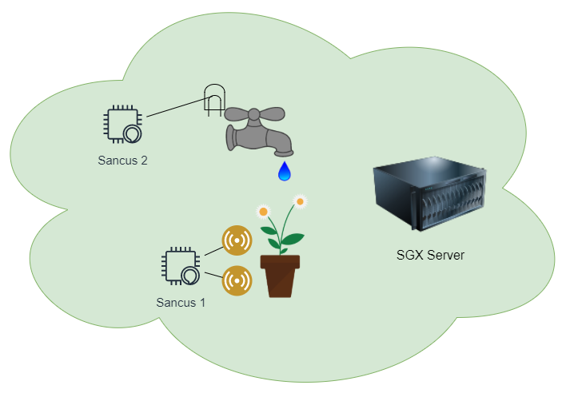
Prototype for Smart Farming
In the first presentation i illustrated a prototype for a possible application of my work applied to the Smart Farming field.
The prototype consisted of a simple application for automatic water supply of a flowerpot, where:
An input node (Sancus 1), retrieves data from a flowerpot using sensors
A computation node (SGX server) executes some logic given the data received and makes decisions
An output node (Sancus 2) receives commands from the SGX server to enable/disable the water tap

Slide 18
Other ideas
Availability concerns: implement some «backup» logic to be executed when availability is not guaranteed (e.g. the network goes down)
General network API: Communication between Event Managers in different nodes can also be performed using different mediums
End-user application: a dashboard for the end-user (i.e. the farmer) used to monitor the system and send commands

Slide 19
Related work

Slide 20
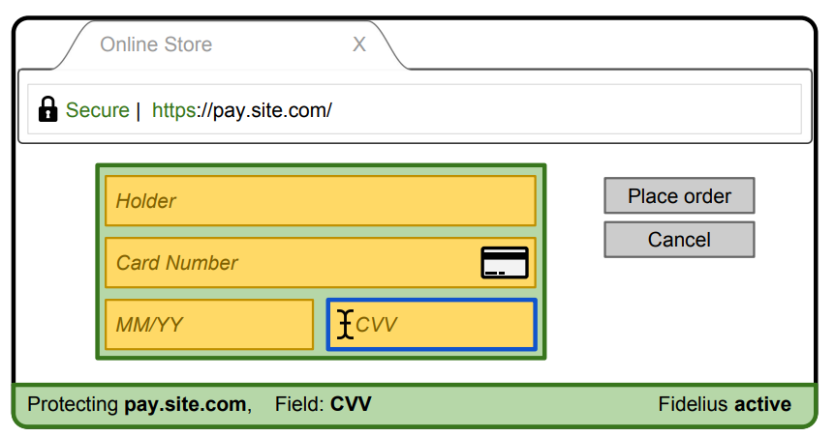
Fidelius: Protecting User Secrets from Compromised Browsers
An interesting project developed by researchers from the Stanford University.
Goal is to secure some sensitive form fields of a web page (e.g. credit card info), protecting the data inserted by the user from the keyboard to the remote server.
The concept is to establish a «trusted path», where all the system is untrusted (OS, browser, etc..)
As a comparison with our work, we can say that Fidelius’ main concern is confidentiality of data. Our approach, instead, aims primarily on integrity.

Slide 21
Conclusions

Slide 22
Conclusions
Over the past 6-8 weeks, i developed a framework for performing Authentic Execution between SGX enclaves
Next steps: integrate SGX and Sancus enclaves
At the same time: improve code, provide new features
Demo for Smart Farming

Slide 23
References
Authentic Execution
Rust programming language
Fortanix EDP
Remote Attestation Rust code
Fidelius

