Slide 1
Channel Coding Project - IEEE 802.22-2011
Gianluca Guerra
gianluca.guerra@studenti.unipd.it

Slide 2
Outline
Standard IEEE 802.22-2011 overview
The binary Convolutional Turbo Code (CTC) encoding
The binary CTC decoding
Bit Interleaved Coded Modulation (BCIM)
Performance evaluation in AWGN channel

Slide 3
1. IEEE 802.22-2011 overview

Slide 4
IEEE 802.22-2011
Published in July 2011 but development started in 2004
Standard for wireless regional area network (WRAN) exploiting white spaces in the television frequency spectrum through cognitive radio (CR)
PHY layer
ODFM modulation assures fast jumping adaptation between free channel
Channel bonding allows multiple channel transmission
Channel coding
MAC layer implements CR technology exploiting spectrum sensing
Worldwide applicability

Slide 5
PHY layer channel coding
Binary interleaved coded modulation (BICM)
Supported binary codes
Binary Convolutional Code (BCC) (mandatory)
Duo-binary Convolutional Turbo Code (CTC) (optional)
Low-Density Parity check codes (LDPC) (optional)
Shortened Block Turbo Codes (SBTC) (optional)
Puncturing
Bit interleaving
Constellation mapping

Slide 6
2. Duo-binary Convolutional Turbo Code encoding

Slide 7
The duo-binary convolutional turbo code
Parallel concatenation of two equal component codes C1 and C2, respectively with non-interleaved and interleaved uncoded input stream
The component code is a Circular Recursive Systematic Convolutional (CRSC) code
The interleaver assures pseudo-random permutation of the original input stream
Basic rate of 1/2

Slide 8
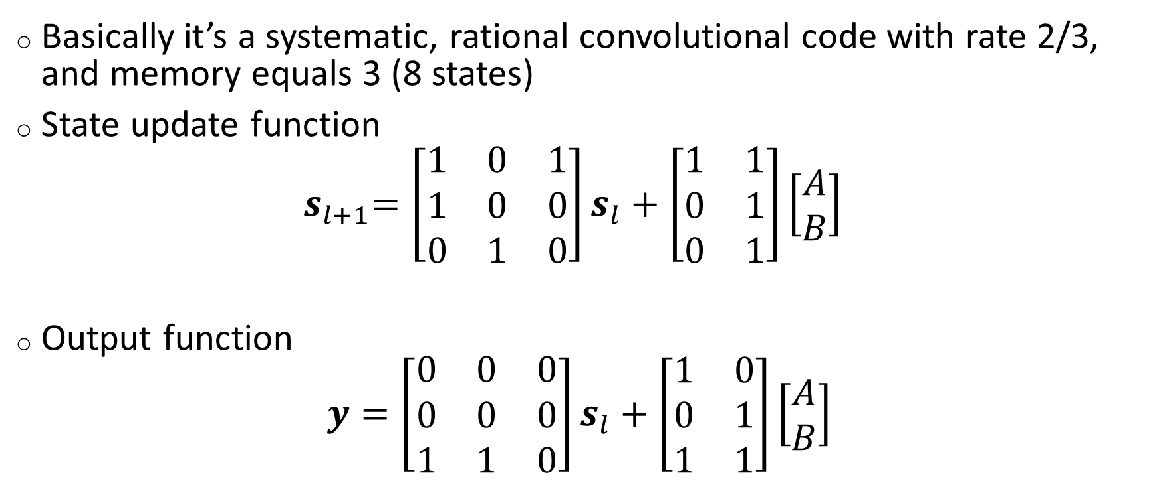
The CRSC component code
Basically it’s a systematic, rational convolutional code with rate 2/3, and memory equals 3 (8 states)
State update function
${ s}_{l+1}=\left[\begin{matrix}1 & 0 & 1 \\ 1 & 0 & 0 \\ 0 & 1 & 0\end{matrix}\right]s_{l}+\left[\begin{matrix}1 & 1 \\ 0 & 1 \\ 0 & 1\end{matrix}\right]\left[\begin{matrix}A \\ B\end{matrix}\right]$
Output function
$$y=\left[\begin{matrix}0 & 0 & 0 \\ 0 & 0 & 0 \\ 1 & 1 & 0\end{matrix}\right]s_{l}+\left[\begin{matrix}1 & 0 \\ 0 & 1 \\ 1 & 1\end{matrix}\right]\left[\begin{matrix}A \\ B\end{matrix}\right]$$

Slide 9
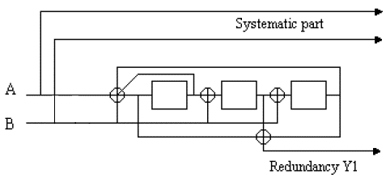
The CRSC encoder block diagram

Slide 10
The circulation states (1)
CRSC codes allows tail-biting through the determination of the circulation states
Tail biting allows the decoder to start and end in the same state without a zero tail code block termination
The circulation states are unknown at the decoder
Algorithm for the circulation state determination
Initialize the encoder with 0 state.
Encode the input sequence without producing redundancy
Determine the circulation state according with the final state, and the length N of the input couples (A,B) (see next table)

Slide 11
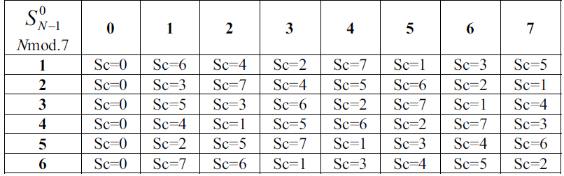
The circulation states (2)

Slide 12
The interleaver
The interleaver permutes the input stream on two levels
Inside the input couples (intra-couples interleaving)
Between couples (inter-couples interleaving)
Interleaving algorithm
If (j mod 2) = 0, then (A,B) = (B,A), where j = 0 … N-1
If (j mod 4) = 0, then P = 0;
If (j mod 4) = 1, then P = N/2 + P1;
If (j mod 4) = 2, then P = P2;
If (j mod 4) = 3, then P = N/2 + P3;
i = (P0*j + P + 1) mod N,
where j = 0 … N-1 and P0, P1, P2, P3 parameters depending on N

Slide 13
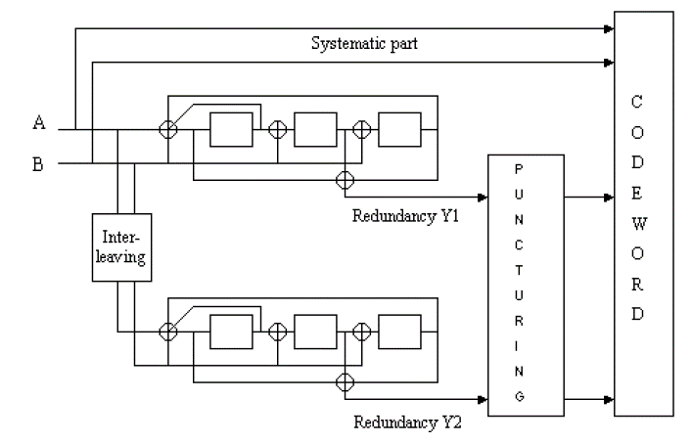
The encoder block diagram

Slide 14
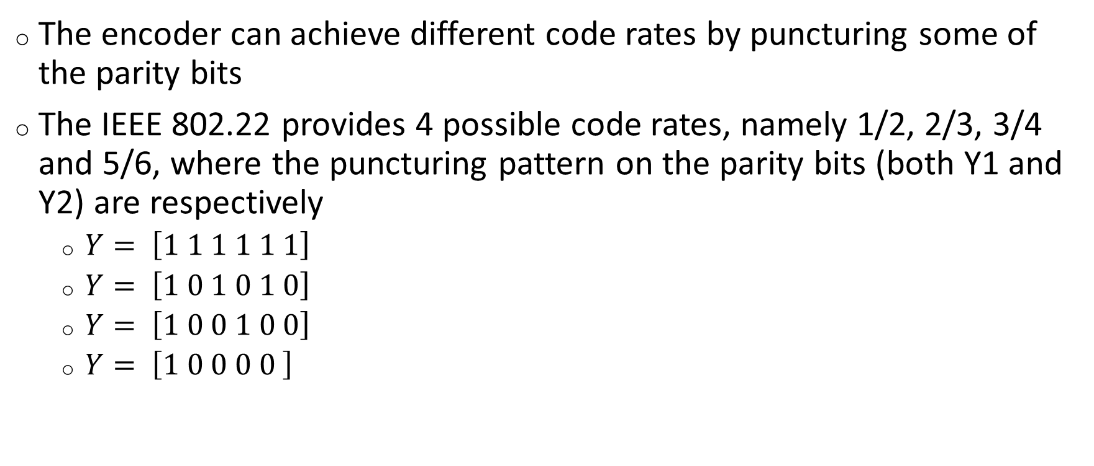
The puncturing
The encoder can achieve different code rates by puncturing some of the parity bits
The IEEE 802.22 provides 4 possible code rates, namely 1/2, 2/3, 3/4 and 5/6, where the puncturing pattern on the parity bits (both Y1 and Y2) are respectively
$Y= \left[1 1 1 1 1 1\right]$
$Y= \left[1 0 1 0 1 0\right]$
$Y= \left[1 0 0 1 0 0\right]$
$Y= \left[1 0 0 0 0 \right]$

Slide 15
3. Duo-binary Convolutional Turbo Code decoding

Slide 16
Dual-binary CTC decoding
Two main approches
Decoding through Soft Output Viterbi Algorithm (SOVA)
Decoding through message passing algorithms
Sum-product (“almost” MAP symbols decoding)
Min-sum (“almost” MAP sequence decoding)
Message passing is not a MAP approach when there are cycles in the Forney style Factor Graph (FFG) representation of the code. However reliable results in CTC decoding are possible providing a decoding schedule and an initialization

Slide 17
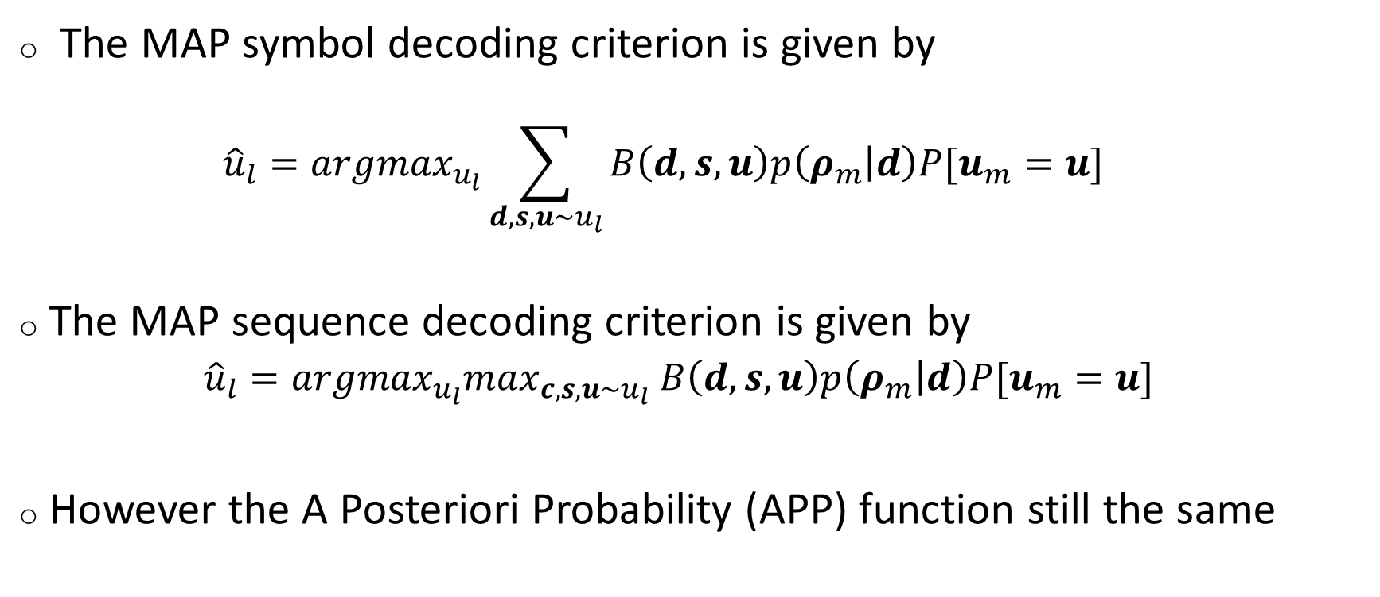
The message passing decoding
The MAP symbol decoding criterion is given by
$${\hat{u}}_{l}={argmax}_{u_{l}}\sum_{d,s,u\sim u_{l}}{B\left(d,s,u\right)p\left(ρ_{m} | d\right)P[u_{m}=u]}$$
The MAP sequence decoding criterion is given by
${\hat{u}}_{l}={argmax}_{u_{l}}\max_{c,s,u\sim u_{l}}$ $B\left(d,s,u\right)p\left(ρ_{m} | d\right)P[u_{m}=u]$
However the A Posteriori Probability (APP) function still the same

Slide 18
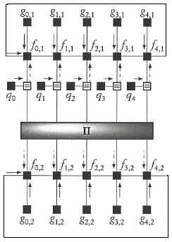
The FFG of the APP function

Slide 19
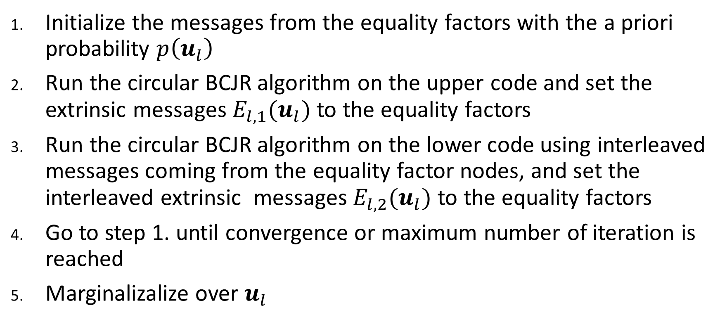
Message passing initialization and schedule
Initialize the messages from the equality factors with the a priori probability $p\left(u_{l}\right)$
Run the circular BCJR algorithm on the upper code and set the extrinsic messages $E_{l,1}(u_{l})$ to the equality factors
Run the circular BCJR algorithm on the lower code using interleaved messages coming from the equality factor nodes, and set the interleaved extrinsic messages $E_{l,2}(u_{l})$ to the equality factors
Go to step 1. until convergence or maximum number of iteration is reached
Marginalizalize over $u_{l}$

Slide 20
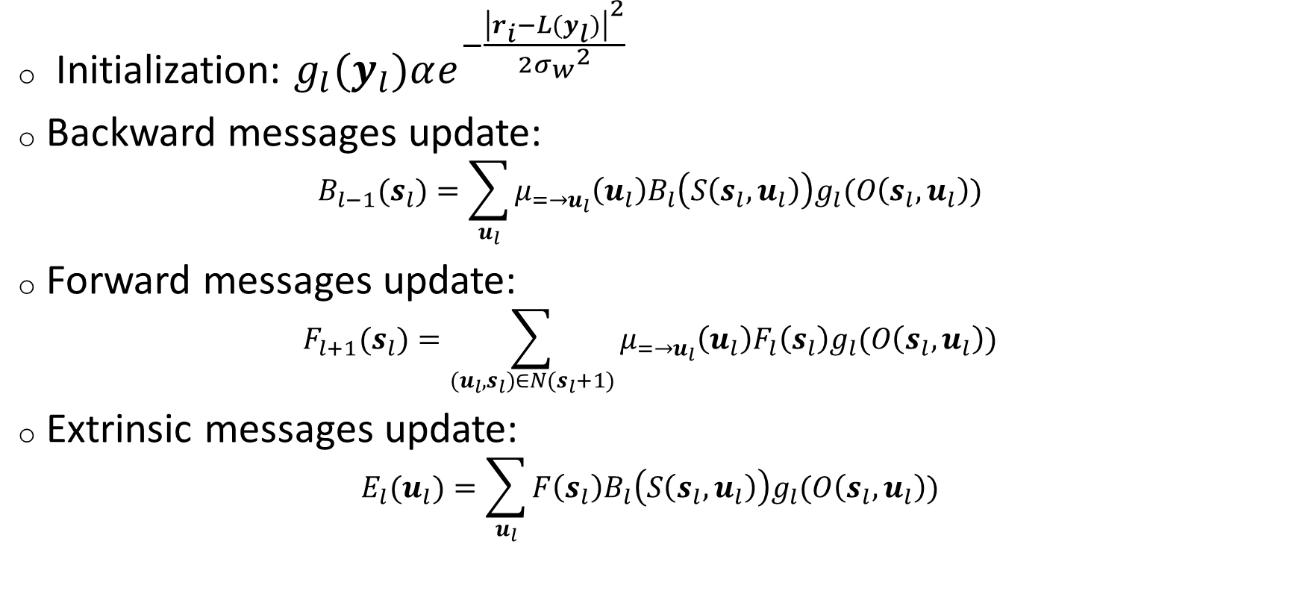
The circular BCJR on the CRSC component code
Initialization: $g_{l}(y_{l})αe^{−\frac{{\left|r_{i}−L(y_{l})\right|}^{2}}{2{σ_{w}}^{2}}}$
Backward messages update:
$$B_{l−1}(s_{l})=\sum_{u_{l}}{μ_{=→u_{l}}\left(u_{l}\right)B_{l}\left(S\left(s_{l},u_{l}\right)\right)g_{l}(O\left(s_{l},u_{l}\right))}$$
Forward messages update:
$$F_{l+1}(s_{l})=\sum_{(u_{l},s_{l})∈N(s_{l}+1)}{μ_{=→u_{l}}\left(u_{l}\right)F_{l}\left(s_{l}\right)g_{l}(O\left(s_{l},u_{l}\right))}$$
Extrinsic messages update:
$$E_{l}(u_{l})=\sum_{u_{l}}{F\left(s_{l}\right)B_{l}\left(S\left(s_{l},u_{l}\right)\right)g_{l}(O\left(s_{l},u_{l}\right))}$$

Slide 21
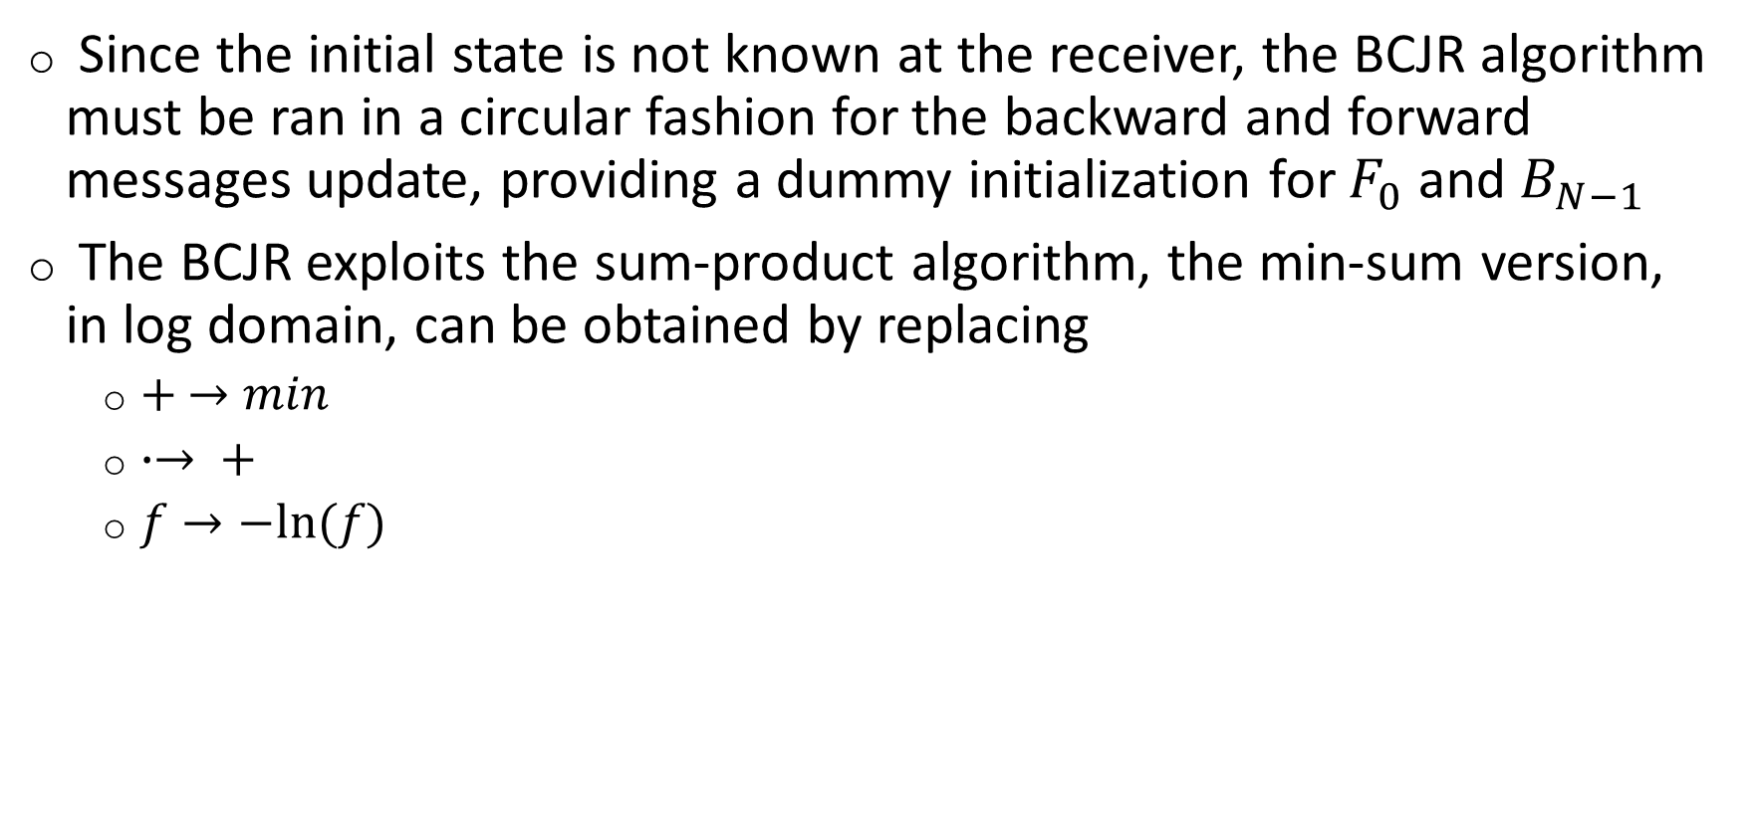
The BCJR on the CRSC component code (2)
Since the initial state is not known at the receiver, the BCJR algorithm must be ran in a circular fashion for the backward and forward messages update, providing a dummy initialization for $F_{0}$ and $B_{N−1}$
The BCJR exploits the sum-product algorithm, the min-sum version, in log domain, can be obtained by replacing
$+ →min$
$∙→ +$
$f→−ln⁡(f)$

Slide 22
4. Bit Interleaved Code Modulation

Slide 23

The BICM
Exploits the binary CTC encoder and a conform map (usually Gray) to have an M-ary modulation format.
A bit interleaver is introduced in order to remove correlation betweeen neighbors bits in the codeword

Slide 24
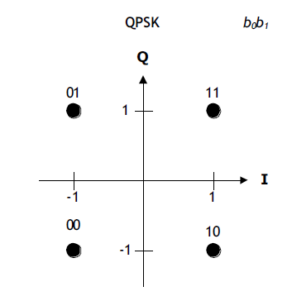
Constellation mapping and modulation (1)
The standard provides Gray constellation mapping for three types modulation, namely, QPSK, 16-QAM, 64-QAM
QPSK Gray coding constellation mapping

Slide 25
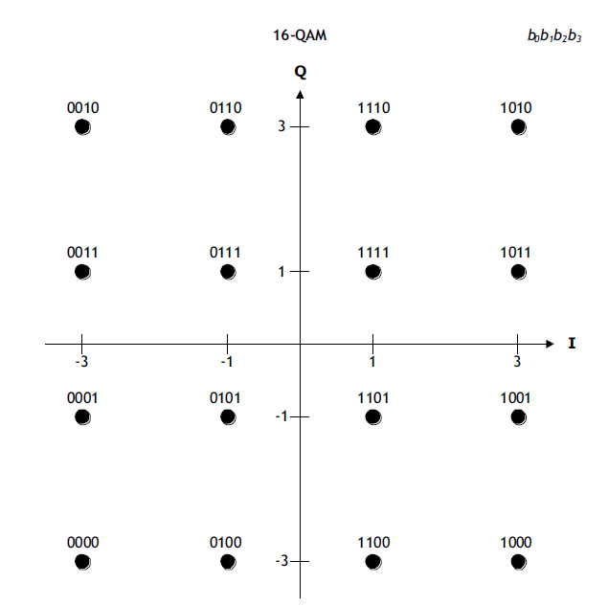
Constellation mapping and modulation (2)
16-QAM Gray coding constellation mapping

Slide 26
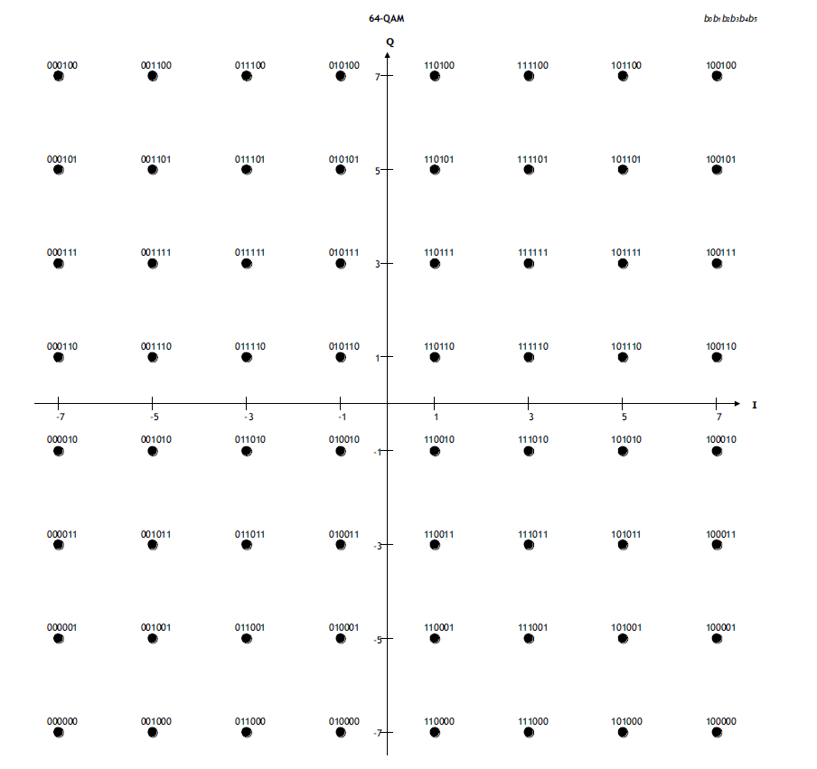
Constellation mapping and modulation (3)
64-QAM Gray coding constellation mapping

Slide 27
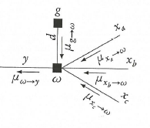
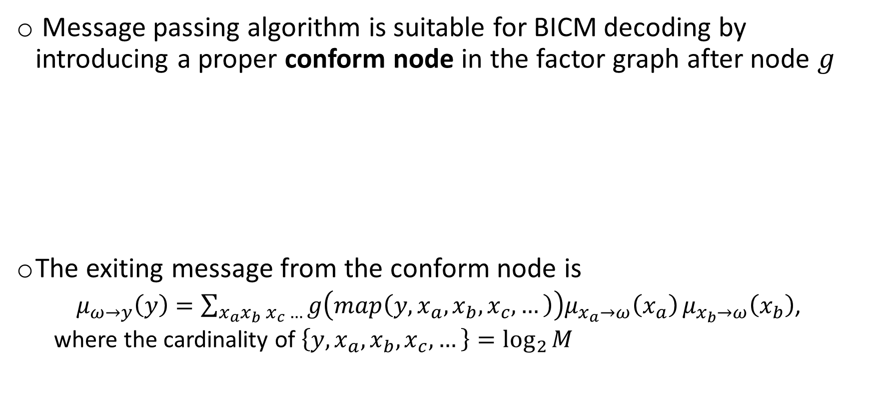
The BICM decoding
Message passing algorithm is suitable for BICM decoding by introducing a proper conform node in the factor graph after node $g$
The exiting message from the conform node is
$μ_{ω→y}\left(y\right)=\sum_{x_{a}x_{b} x_{c} …}{g\left(map\left(y,x_{a},x_{b},x_{c},…\right)\right)μ_{x_{a}→ω}\left(x_{a}\right)}μ_{x_{b}→ω}\left(x_{b}\right)$,
where the cardinality of $\left\{y,x_{a},x_{b},x_{c},…\right\}=\log_{2}{M}$

Slide 28
The BICM decoding schedule (1)
BICM
The conform nodes are updated the first iteration and soft information sent to the CTC decoder
The message passing decoding is performed on the CTC without re-evaluate the conform nodes
BICM-ID (Iterative demapping)
The conform nodes are updated and soft information sent to the CTC decoder
One iteration of the CTC decoding is performed and then conform nodes are re-evaluated
Go to step 1 until convergence or the maximum number of iteration is reached

Slide 29
The BICM decoding schedule (2)
In turbo coding contex the BCIM-ID schedule is not use due to the low coding gain with respect to the BICM decoding
A much more used variant of BCIM-ID is BCIM-ID-SSD that involves constellation rotation

Slide 30
5. Performance evaluation

Slide 31
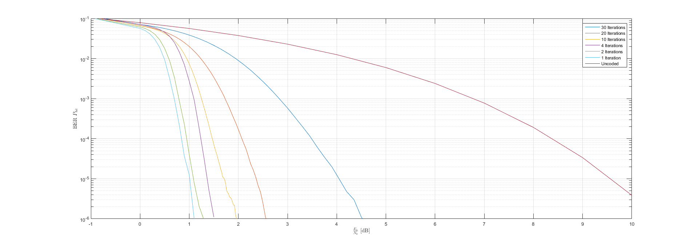
Binary CTC: BER vs Eb/N0 and number of iterations

Slide 32
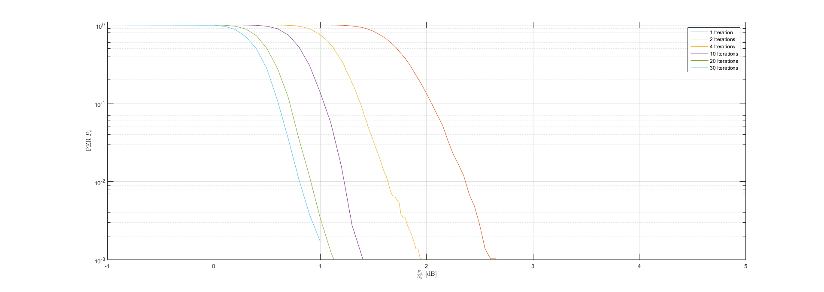
Binary CTC: PER vs Eb/N0 and number of iterations

Slide 33
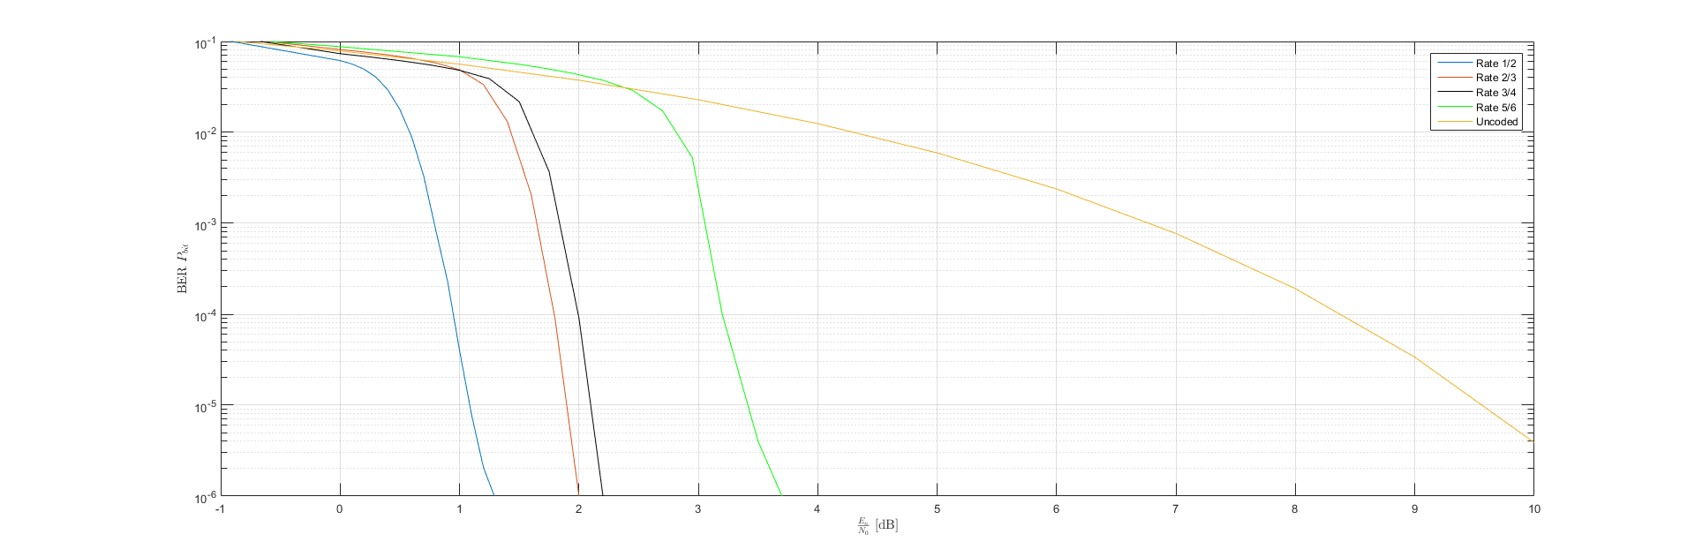
Binary CTC: BER vs Eb/N0 at different rates

Slide 34
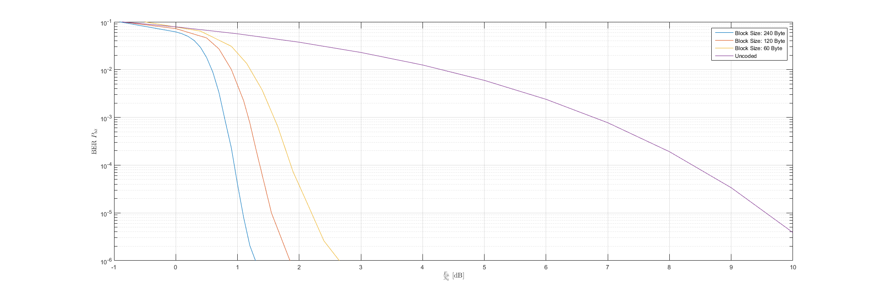
Binary CTC: BER vs Eb/N0 at different block sizes

Slide 35
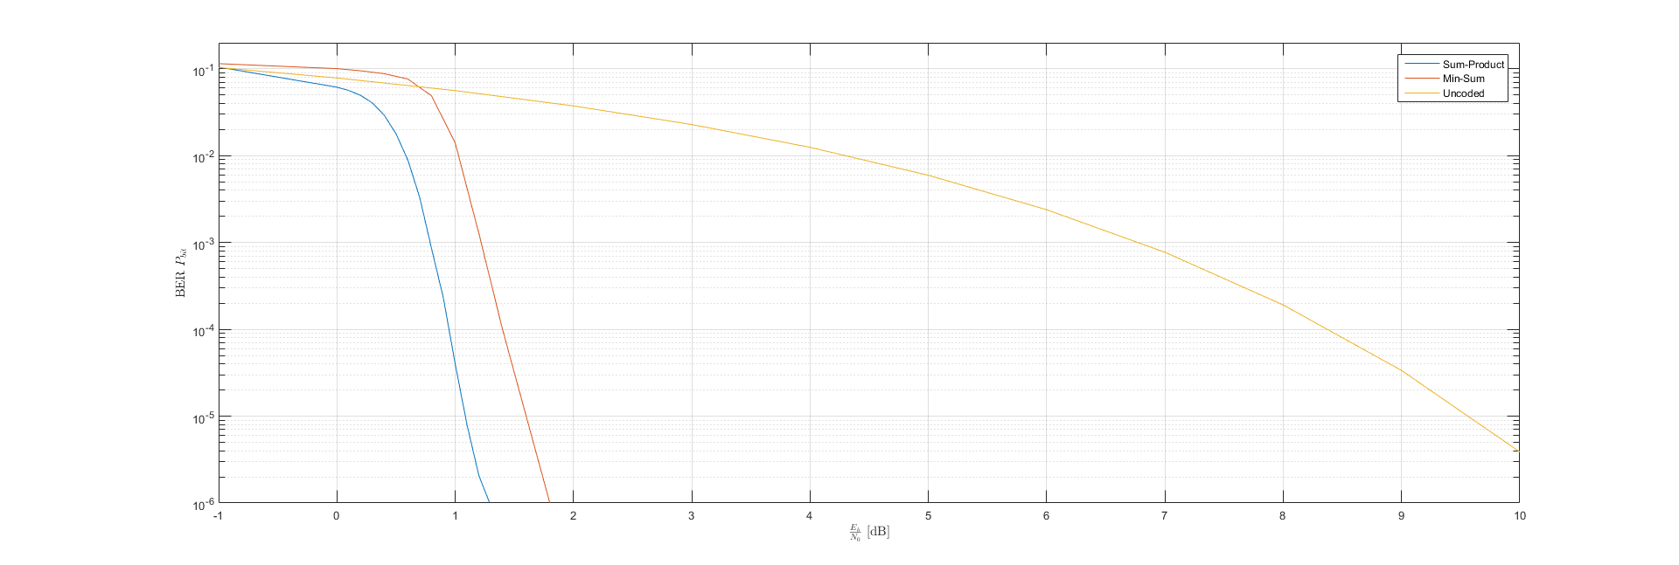
Binary CTC: Sum-product vs Min-sum

Slide 36
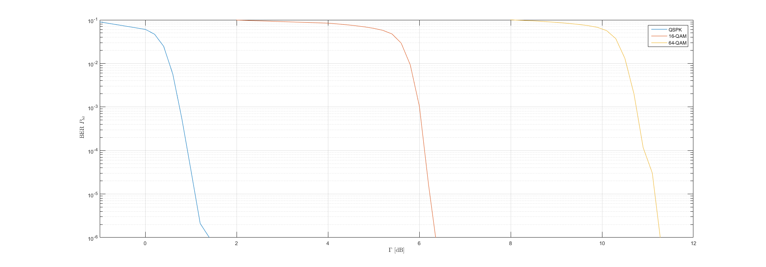
BICM: BER vs SNR with different modulation

Slide 37
The end.

