Slide 1

Sveltos in Pull Mode Manage Any Cluster, Anywhere

Slide 2

👋 Meet Gianluca Mardente
Name: Gianluca Mardente
Role: Creator and Lead Maintainer of Project Sveltos
GitHub: github.com/gianlucam76
LinkedIn: linkedin.com/in/gianlucamardente/
About Me:
🔧 Experienced open-source contributor with a focus on Kubernetes and cloud-native tools.
🚀 Passionate about building scalable infrastructure solutions and day-2 ops
📦 Actively maintaining and evolving Project Sveltos to improve cluster management workflows.

Slide 3

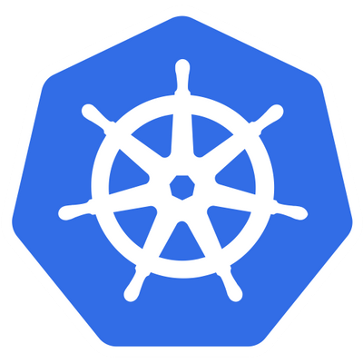




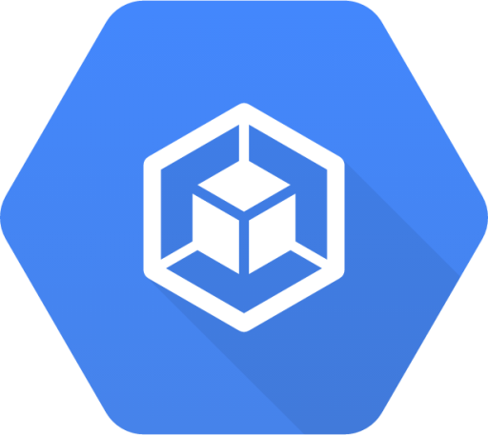

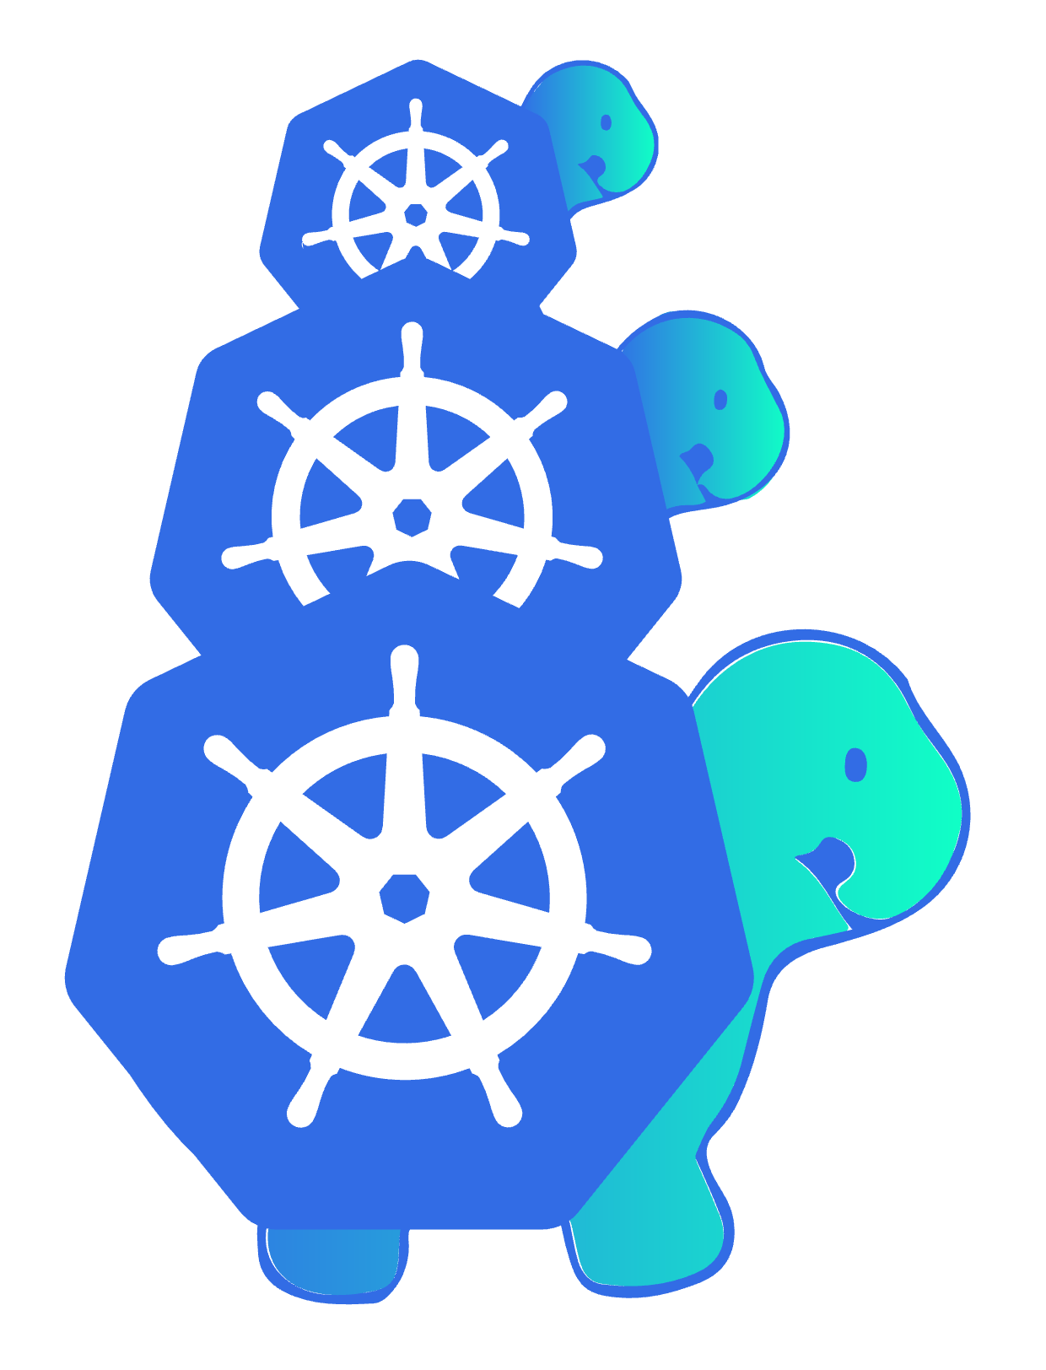
Push-Only Management Mode
Before pull mode, Sveltos needed direct access to managed cluster API servers.
Declarative configuration (which addons to deploy and where)
ClusterProfile
definition
Management Cluster
Sveltos discovers clusters and
creates, updates, upgrades,
deletes addons
Hetzener
clusters
Rancher
RKE2 clusters
Civo
clusters
GKE
clusters
EKS
clusters
Other clusters can be easily registered with Sveltos
Built in support for ClusterAPI

Slide 4
Push Only Limitations
Before pull mode, Sveltos could not manage clusters that:
❌ Were in private networks or behind restrictive firewalls: If the management cluster couldn't directly reach the managed cluster's API server due to network segmentation or security rules, it was unmanageable.
❌ Operated in disconnected or air-gapped environments: Clusters without external network ingress or internet access were beyond Sveltos's reach.
❌ Exposed only private API endpoints: Cloud clusters configured with private API access (e.g., in their own VPC/VNet, without peering or private links to the management cluster) were inaccessible.

Slide 5
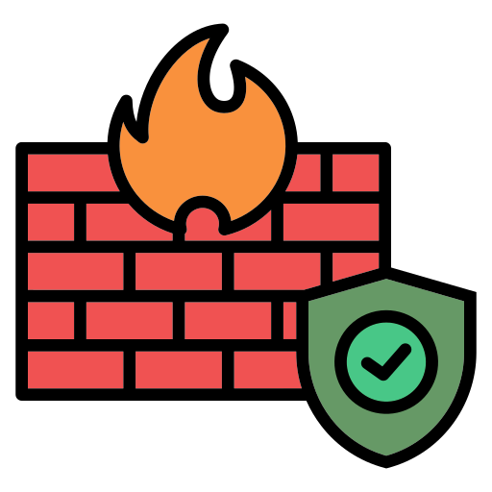
Project Sveltos: Pull Mode
Declarative configuration (which addons to deploy and where)
With pull mode, Sveltos now manages clusters regardless of their API server's direct reachability from the management cluster.
ClusterProfile
definition
Management Cluster
However, managed clusters in pull mode
do need to be able to reach the management
cluster's API server.
Sveltos discovers clusters and
creates, updates, upgrades,
deletes addons
Hetzener
clusters
Rancher
RKE2 clusters
Civo
clusters
ClusterAPI Powered
Workload clusters
Behind Firewall

Slide 6


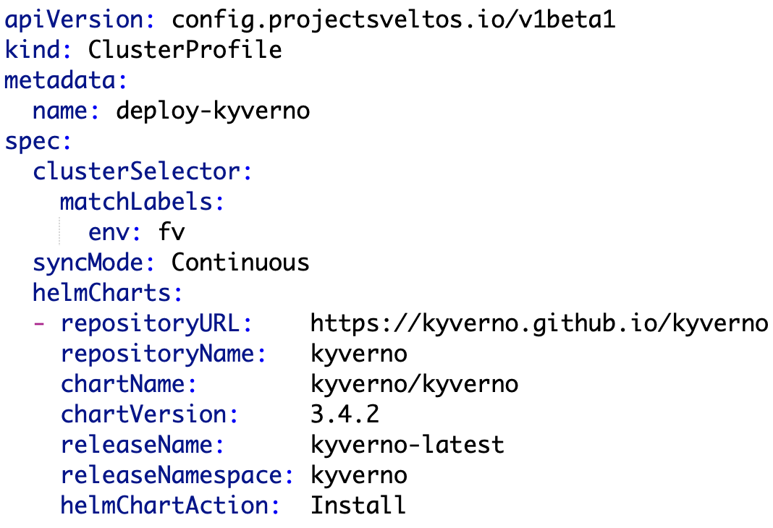

Push Mode: Server-Triggered Updates
Cluster API
Mgmt Cluster
Watch Loop
kubectl apply -f …
Provision
Push
Provision
Push
env=fv
env=fv
Workload Cluster
Workload Cluster

Slide 7

Pull Mode: Autonomous Agent-Triggered Fetch & Apply
Cluster API
Mgmt Cluster
Watch Loop
kubectl apply -f …
Provision
Pull
Provision
Pull
env=fv
env=fv
sveltos agent
sveltos agent
Workload Cluster
Pull Mode
Workload Cluster Pull Mode

Slide 8
Dual Mode: Orchestrated Push Meets Autonomous Pull
Cluster API
Mgmt Cluster
Watch Loop
kubectl apply -f …
Provision
Pull
Provision
Push
env=fv
env=fv
sveltos agent
Workload Cluster
Pull Mode
Workload Cluster

Slide 9
Push Communication Flow
When a cluster is registered in push mode:
SveltosCluster instance: a SveltosCluster instance is created in the management cluster and labeled to match profile selectors.
Secret with Kubeconfig: the managed cluster kubeconfig is stored in a Secret in the management cluster.
Deployment Flow: anytime Sveltos needs to deploy something to that managed cluster, it fetches this kubeconfig Secret, creates a Kubernetes client using it to access the managed cluster's API server, and then directly deploys the necessary resources.

Slide 10
Pull Communication Flow: Agent-Initiated, Autonomous Sync
When a cluster is registered in pull mode:
SveltosCluster instance: A SveltosCluster instance is created in the management cluster, labeled, and explicitly marked for pull mode.
Agent ServiceAccount: A highly-permissioned (strict permissions) ServiceAccount is created within the management cluster for the agent that will operate on the managed cluster.
Deployment Flow: When something needs to be deployed, Sveltos prepares the resources and stores them in the management cluster. The agent, deployed in the managed cluster, will then fetch these resources and apply them to its cluster.

