Slide 1
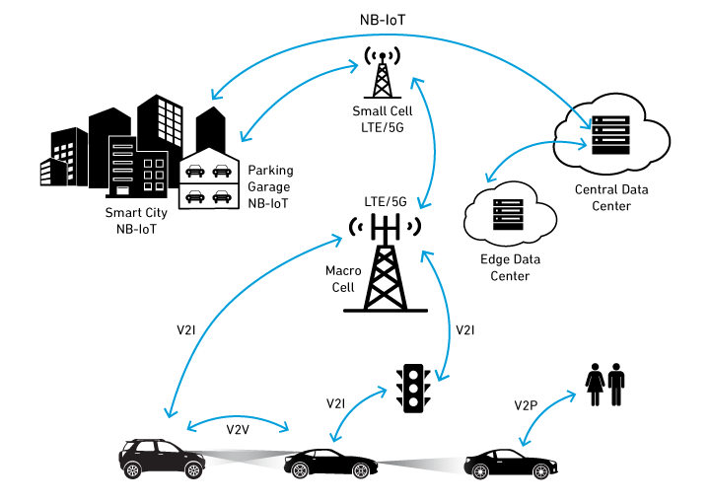










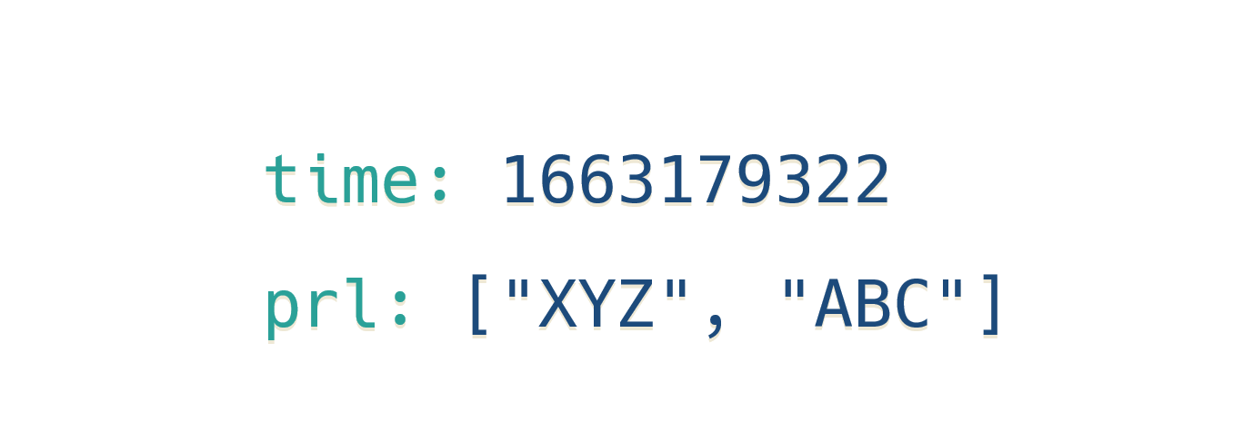



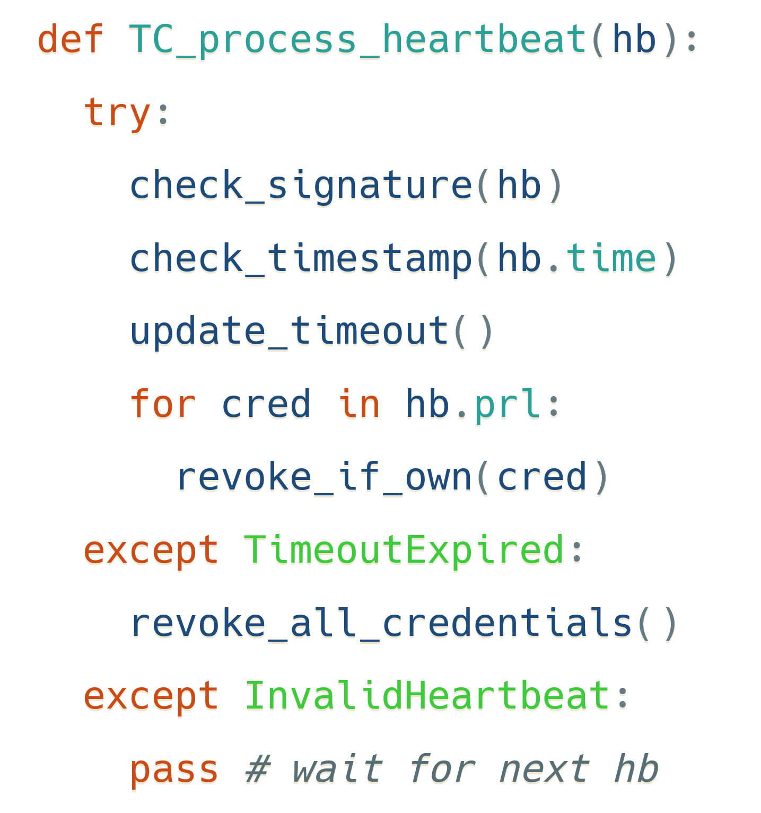





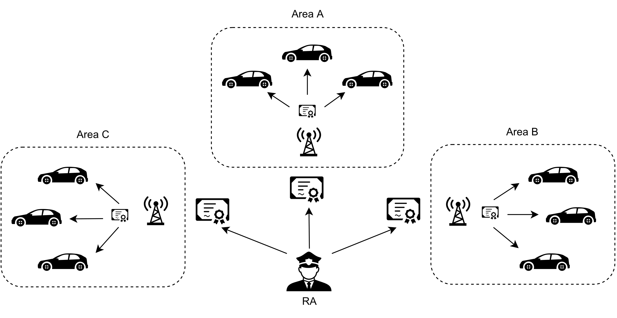
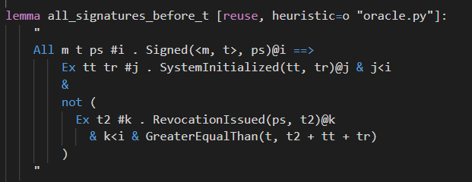





Scalable and Provably Secure Self-Revocation Protocols for V2X Gianluca Scopelliti¹², Christoph Baumann¹, Fritz Alder², Eddy Truyen², Jan Tobias Mühlberg²
¹Ericsson Security Research, Sweden, ²KU Leuven, Belgium
 gianluca.scopelliti@ericsson.com
V2X: Vehicle-to-Everything
Self-Revocation of V2X credentials
Hey, please revoke certificate XYZ, thank you!
Revocation Authority
(RA)
Of course. Have a nice day!
Vehicle
OBU: On-Board Unit
Central processing
Networking: V2V, V2I, V2P
Can be compromised
TC: Trusted Component
Remote attestation
Credential management
OBU
TC
TPM 2.0
[1]
[2,3]
Examples of TCs:
Revocation message: Heartbeat
Revocation in practice
Scenario 1: Honest vehicle
OBU
TC
Process heartbeat
RA
RA
1
2
3
Revoked
Broadcast
Vehicle
No trusted time? → Logical clock
(“Epochs”)
TC
Scenario 2: Malicious vehicle
Trusted time source
TC
Timeout
RA
1
2
3
Revoked
Vehicle
Formal verification
End-to-End Evaluation
Formal verification: Tamarin prover
Property | Description
A | Revocation is deterministic and completes within a fixed time
B | The revoked credential can be removed from the heartbeat after a fixed time
C | After a fixed time, other vehicles discard any messages signed with the revoked credential
Scalable: the number of heartbeats does not depend on the number of vehicles
References
Example: Property A with trusted time in TC
[1] https://www.qorvo.com/design-hub/blog/v2x-in-the-connected-car-of-the-future
[2] Förster, D., Löhr, H., Zibuschka, J., & Kargl, F. (2015). REWIRE – Revocation Without Resolution: A Privacy-Friendly Revocation Mechanism for Vehicular Ad-Hoc Networks. In M. Conti, M. Schunter, & I. Askoxylakis (Eds.), Trust and Trustworthy Computing (pp. 193–208). Springer International Publishing.
[3] Whitefield, J., Chen, L., Giannetsos, T., Schneider, S., & Treharne, H. (2017). Privacy-enhanced capabilities for VANETs using direct anonymous attestation. 2017 IEEE Vehicular Networking Conference (VNC), 123–130.

