Slide 1
1
Project-Work
Team 14 I-Z
3rd sprint release + total sprint process
Mariniello Alessandro, Rabasca Dario, Spinelli Gianluigi, Zito Adamo

Slide 2
Contents
2
finish
What we’re covering
3rd sprint release
Updated product backlog
Sprint review report
UML
1
3
5
7
2
4
6
8
Sprint
backlog
Project burndown chart
Sprint retrospective report
Scrum Process
start

Slide 3
3rd sprint release
3
Demo live!

Slide 4
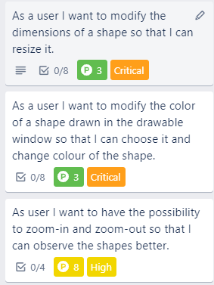
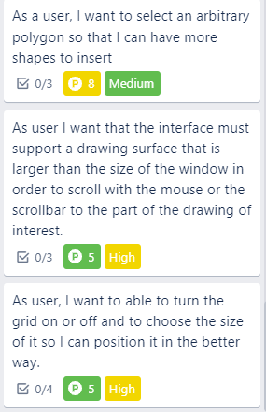
Sprint backlog
4
Available on Trello.com
Actual velocity: 32
Estimated velocity:
27

Slide 5
Updated Product backlog
5
We paid off technical debts
We fixed last sprint bugs
Grooming

Slide 6
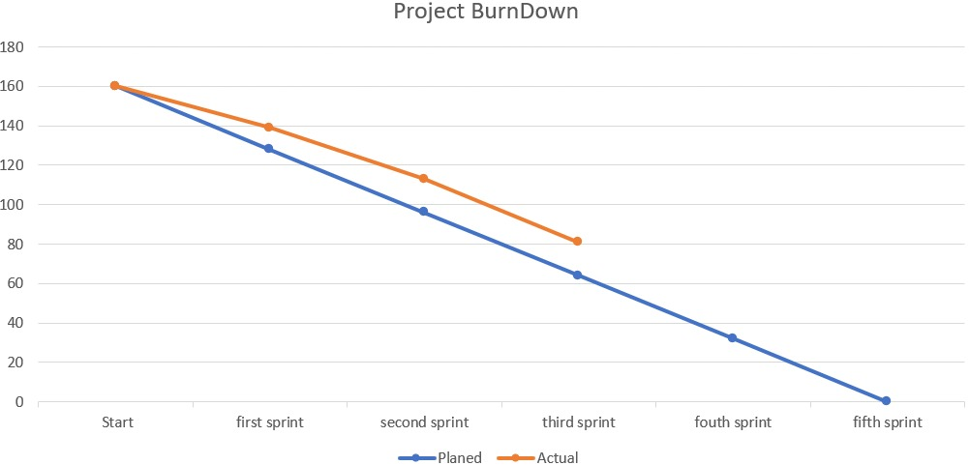
Project Burndown Chart
6

Slide 7
Sprint review report
7
Available on our git repository
01
Issues discovered implementing/examining the release
02
Issues with the Product Backlog
03
Technical Debt:
Factory not implemented
In the model only one shape at a time is selected

Slide 8
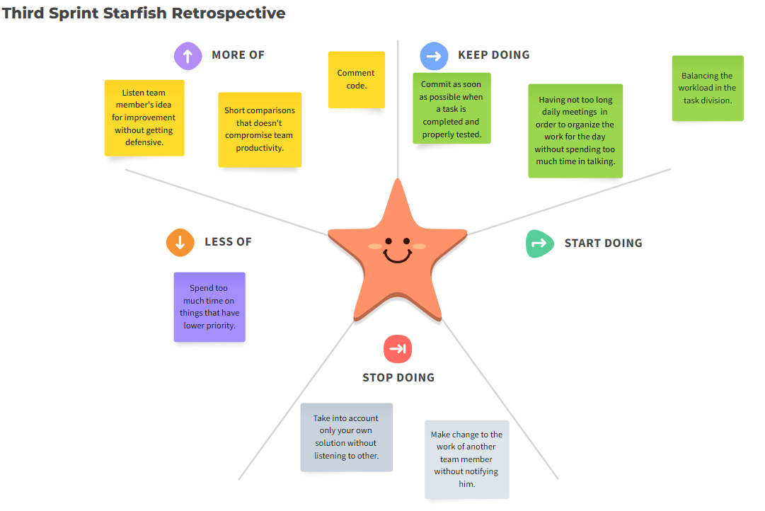
Sprint retrospective
8

Slide 9
Architecture & UML
9
Let’s have a look of how we designed our software…

Slide 10
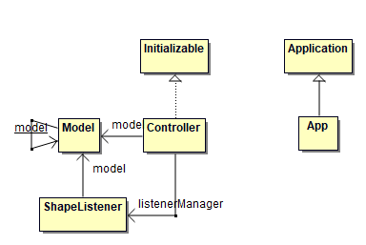
MVC (Model singleton)
10

Slide 11
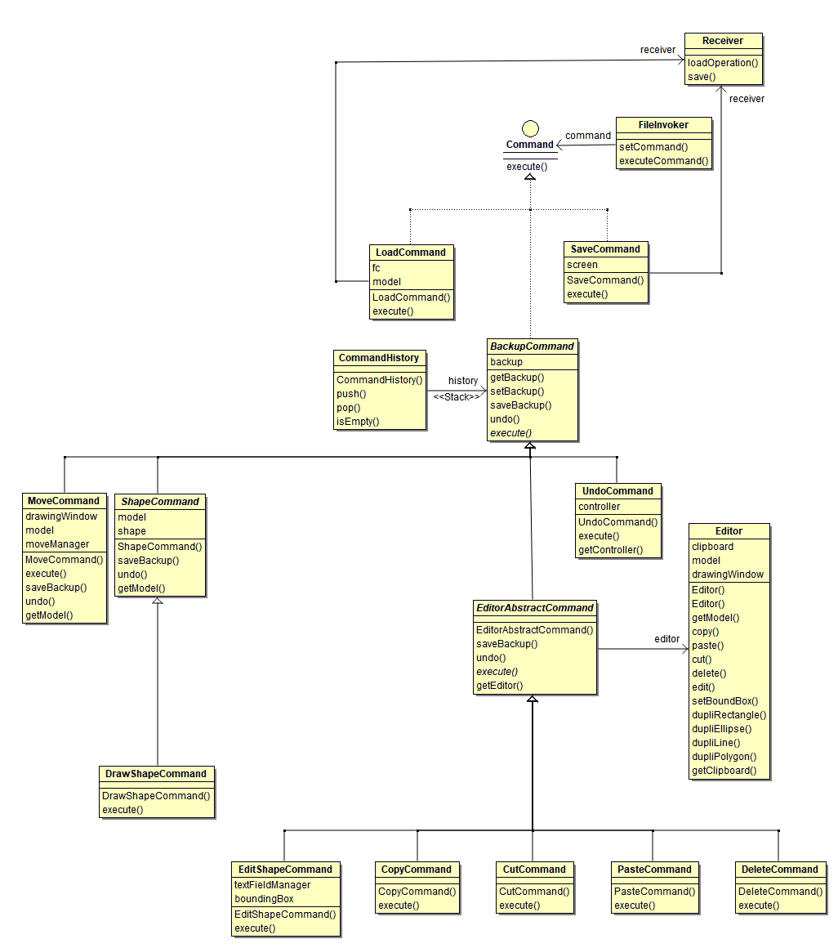
Command
11

Slide 12
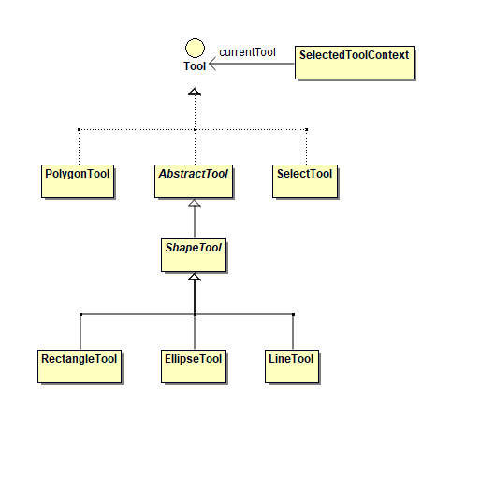
Tool (State)
12

Slide 13
Pre game phase
Game phase
13
1st sprint
Sprint review report
Daily
Sprint meeting
Effort [estimated=21, done=26]
Bugs: No bugs
Technical Debt: need to implement a Model class
(improving MVC)
Planning
1 week Sprint
Sprint goal
Basic functionalities
High level design architecture
1st sprint backlog
Product backlog
1st Sprint Retrospective
Sprint review report
1st Sprint Review

Slide 14
Scrum process
14
Game phase
2nd sprint
Daily
Sprint meeting
Sprint review report
Project velocity
Estimated: 29
Done: 26
Bugs:
undo with drawing Window
Binding stroke and fill color of the select shape
Techincal Debts:
Drag and drop event conflict
All commands implement the Command interface
All tools implement the Tool interface
Sprint goal
1 week Sprint
Moving a shape, deleting, copy, cut, paste, undo, overlapping
2nd sprint backlog
Product backlog
2nd Sprint Retrospective
Sprint review report
2nd Sprint Review

Slide 15
Scrum process
15
Game phase
3rd sprint
Daily
Sprint meeting
Sprint review report
Project velocity
Estimated: 27
Done: 32
Bugs:
Grid disappearing
Increasing bounding box on every click
Drawing window being selected
Moving and drawing conflicts
MoveCommand doesn’t save a backup
Still drawing a polygon and showing a
context menu after right click
Techincal Debts:
Factory
In the Model only one shape
at a time is selected
Sprint goal
1 week Sprint
Adding polygons, zoom, modify color and shape, grid
3rd sprint backlog
Product backlog
3rd Sprint Retrospective
Sprint review report
3rd Sprint Review

Slide 16
16
Thank you!
Any questions?

