Slide 1
TypeScript

Slide 2
Slides and Samples https://github.com/AGiorgetti/TechBar_2017_02_16_TypeScript.git

Slide 3
JavaScript: you know it...
It's powerfull.
It's flexible.
But...

Slide 4
JavaScript: 'the not so good parts'
Global namespace pollution.

Slide 5
JavaScript: 'the not so good parts'
It does not have a 'true' type system:
how do you check the proper parameters are passed to a function?
Implicit conversion can cause confusion and bugs:
== != ===
(or maybe: == !== === ?)

Slide 6
JavaScript: 'the not so good parts'
It can be 'troublesome' for devs used to OO paradigms:
Lack of class based programming techniques*.
'New / Unusual' design patterns (prototypical inheritance, revealing module pattern, etc...).
You need to define and enforce a coding style guide: it needs discipline!
* Not true anymore in ES2015!

Slide 7
JavaScript: 'the not so good parts'
It's not well suited for large projects:
It used to lacks in code structuring* (no classes, no modules, …).
It lacks in maintainability (code analysis, refactoring).
Tooling isn’t good enough!
* Not true anymore in ES2015!

Slide 8
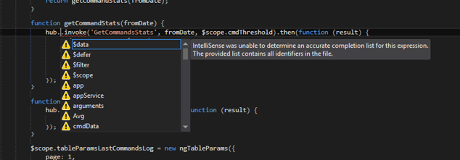
I bet you saw this so many times...
JavaScript Tooling is not that good :(

Slide 9
Introducing TypeScript www.typescriptlang.org
It's an Open Source project from Microsoft Technologies (code on GitHub).
It’s a Superset of JavaScript => JavaScript + Static Types + Code Structuring.
TypeScript is a Source to Source compiler: a transpiler.
It uses ES2015 syntax with Type Annotation and compiles to plain JavaScript (targets: ES3, ES5, ES6).
Any valid JavaScript application is also a TypeScript application.

Slide 10
TypeScript
Helps us to:
Structure our code (types, interfaces, classes, namespaces and modules).
Use object-oriented programming paradigms and techniques.
Enforce coding guidelines.
Extend the language beyond the standard (decorators, async/await).
Delivers a better Coding Experience:
Intellisense.
Syntax checking.
Code Analysis & Navigation.
Refactoring.
The best part of it: It's all a development time illusion!

Slide 11
Environment & Tools

Slide 12
Environment Setup
A Source Control System (ex: Git)
NodeJs
TypeScript
A Code Editor – Visual Studio Code, Visual Studio 2015+, your editor of choice*
* it should have support for TypeScript for a better coding experience

Slide 13
A version control system: GIT
Git is a free and open source distributed version control system.
https://git-scm.com/

Slide 14
A JavaScript runtime: NodeJs / NPM
https://nodejs.org
It’s always a good idea to keep npm updated:
npm install npm -g

Slide 15
TypeScript
https://www.typescriptlang.org/
npm install typescript -g

Slide 16
An editor: Visual Studio Code
https://code.visualstudio.com/
Add some 'suggested' extensions:
TypeScript Hero - https://marketplace.visualstudio.com/items?itemName=rbbit.typescript-hero
Npm - https://marketplace.visualstudio.com/items?itemName=eg2.vscode-npm-script
Git History - https://marketplace.visualstudio.com/items?itemName=donjayamanne.githistory
TsLint - https://marketplace.visualstudio.com/items?itemName=eg2.tslint
Debugger for Chrome - https://marketplace.visualstudio.com/items?itemName=msjsdiag.debugger-for-chrome

Slide 17
TypeScript – what is it?

Slide 18
TSC - TypeScript Compiler
TSC is a source-to-source compiler (a transpiler).
There are lots of options that allow you to:
generate sourcemaps.
generate ambient definition files (for libraries).
generate module loading code (node.js or require.js).
Compiler options: http://www.typescriptlang.org/docs/handbook/compiler-options.html
app.js.map
app.ts
tsc app.ts
app.js
app.d.ts

Slide 19
Ambient Declaration Files (.d.ts)
TypeScript Definition File (ambient declaration file):
.d.ts extension.
Allows the definition of strong types.
Provide type definition for external JavaScript libraries.
A community driven project on GitHub that tracks all of them: DefinitelyTyped (http://definitelytyped.org/)
In the beginning it had a specialized package manager: TSD... now it's all about NPM:
npm install @types/LIBRARYNAME --save / --save-dev

Slide 20
TypeScript Project Structure & Setup

Slide 21
TypeScript Project Structure
We just need:
An empty directory.
A tsconfig.json file that will hold the compiler configuration options, it defines the root of a TypeScript project:
http://www.typescriptlang.org/docs/handbook/tsconfig-json.html
http://www.typescriptlang.org/docs/handbook/compiler-options.html
A package.json file to instruct npm which libraries (and @types) download; it also provide basic support for scripting some actions.
Notes:
Git checkout empty project
Illustiamo solo i file necessari

Slide 22
TypeScript Project Structure
Optionally:
Configure our Editor / IDE.
We can configure Visual Studio Code using:
settings.json to configure the editor itself.
tasks.json to interact with task runners.
launch.json to configure the debugger.
More advanced scenarios involving task runners and complex build pipelines (that allows for minification and code concatenation) can be found in the TypeScript documentation:
http://www.typescriptlang.org/docs/handbook/integrating-with-build-tools.html
Notes:
Git checkout empty project
Illustiamo solo i file necessari

Slide 23
tsconfig.json – compiler options
target: “es3”, “es5”, “es2015”, … the standard JavaScript to emit.
sourcemap: true / false, do you like debugging?
include: an array of strings, specifies files or folders to include, supports wildcards and file glob, ex: "include": [ "src/**/* " ]
exclude: an array of strings, specifies files or folders to exclude, supports wildcards and file glob, ex: "exclude": [ "node_modules" ]
Notes:
Esegui:
tsc --init

Slide 24
tsconfig.json – compiler options
And some more, like:
outDir: specifies a folder that will contain the compilation artifacts.
experimentalDecorators: true / false, allow the usage of decorators (language extension).
emitDecoratorMetadata: true / false

Slide 25
tsconfig.json – compiler options
lib: this is used to provide a list of libraries that should be included in the compilation process. It is especially usefull for the new TypeScript 2.1 Downlevel Async/Await functions
(you will probably need a polyfil for Promise and you need to make sure TypeScript knows they exists setting –lib to: ["dom", "es2015"] or ["dom", "es2015.promise", "es5"]).
noImplicitAny: raise error on expressions and declarations with an implied any type.
strictNullChecks: if set the null and undefined values are not in the domain of every type and are only assignable to themselves and any (the one exception being that undefined is also assignable to void).

Slide 26
tsconfig.json - @types discovery
By default all visible "@types" packages are included in your compilation. Packages in node_modules/@types of any enclosing folder are considered visible; specifically, that means packages within ./node_modules/@types/, ../node_modules/@types/, ../../node_modules/@types/, and so on.
Automatic inclusion is only important if you're using files with global declarations.
If typesRoots is specified, only packages under typeRoots will be included.
If types is specified, only packages listed will be included.
Notes:
TypeScript needs to know the TYPES!

Slide 27
tsconfig.json – configuration inheritance
A tsconfig.json file can inherit configurations from another file using the extends property.
extends value is a string containing a path to another configuration file to inherit from.
configs/base.json:
{
"compilerOptions": { "noImplicitAny": true, "strictNullChecks": true }
}
tsconfig.json:
{
"extends": "./configs/base",
"files": [ "main.ts", "supplemental.ts" ]
}

Slide 28
TypeScript: a build using Gulp
A more complex build pipeline might involve using Gulp as a task runner:
npm install –g gulp-cli
The gulp tasks defined in the gulpfile.js can be invoked by Visual Studio Code if we remap them in the tasks.json file.
Visual Studio Code integrated debugger can be configured to attach itself on executing instances of the program configuring the actions in the launch.json file.
More information on the Visual Studio Code configuration files can be found at: http://code.visualstudio.com
Notes:
Magari mostrare un esempio di task gulp e file di progetto completi che possono essere utilizzati per compilare il progetto.
Descrivere i files direttamente sul progetto.
Far vedere tutti i configuration file necessari.

Slide 29
TypeScript – Hands on

Slide 30
Types
number, string, etc... all the primitive JavaScript Types.
null / undefined: have their own type, they also are subtypes of any other type (maybe :D).
any: I can be any type, disable the type checking!
void: I have no type at all (function return value)!
never: the type of values that never occur (like the return value of a function that throws an exception)
enum / const enum: define enumerated values.
<T>: casting! Type Assertions! This is not a type conversion!

Slide 31
Types
Array: defines a collection of elements ( number[] ).
Tuple: fixed size array of elements of different types ( [number, string] ).
Generics: great for code reuse! We can specify constraints if we want.
Indexable types: to express concepts like dictionaries of elements with a numeric or string key.
Intersection types (&): combine multiple types in a single type.
Union types (|): when something can be one of a pool of multiple types.
Notes:
esempio :
00-types
types.ts,
types-generics.ts

Slide 32
Arrow functions
ES2015 introduces a new syntax to define functions on the fly: the Arrow Syntax:
(arg1: number, arg2: string) => string
let addFn = (left: number, right: number): number => {
return left + right;
}
If the function is just 1 line of code:
let addFn = (left: number, right: number) => left + right;
Notes:
esempio :
00-types
arrow-functions.ts

Slide 33
Type Checking, Interfaces, Classes
Interfaces are used to define the SHAPE (a Code Contract) of our objects.
Classes implement the behavior of an entity, they are one of the basic building blocks of ES2015.
Interfaces and Classes are used to define new Types!

Slide 34
Type Checking
The type checking is based on a concept called Structural Typing (or Duck Typing), which means the object shape / structure is the most important thing!
"Two types are compatible if their members are compatible."

Slide 35
Interface
Interface can describe:
Objects / Entities
Functions
Indexable Types: Arrays / Dictionaries
Hybrid Types ('things' that are both objects and functions)
Interface support:
Inheritance
Can be qualified with generic types
Readonly properties
Optional properties
They do not support accessors (get / set): you need to convert the 'property' to a 'getProperty()' function if you wanna give that readonly behavior.
Notes:
Esempio:
01-interfaces
interfaces.ts,
interfaces-generic.ts

Slide 36
Optional properties and type checking…
prop?: T != prop: T | undefined
The Shape matters, and the ‘?’ qualifies the property itself, not its type!
Beware! It can lead to runtime errors under normal type checking rules
(see ‘classes-strictNullChecks.ts’)
Notes:
Example:
01-Interfaces
interfaces.ts
02-Classes
classes-strictNullChecks.ts

Slide 37
Class
Class implements the behaviors of an entity.
They have support for:
accessors (get, set) [ES5+]
modifiers: public, private, protected
constructor
inheritable
static properties
abstract (class & methods)
interface implementation
can be qualified with generic types
Readonly properties
Optional properties
Classes also define Types, they have two sides:
instance side (the properties involved in structural type checking)
static side (constructor and static properties, not involved in the type checking)
Notes:
Aspetta la prossima slide per gli esempi

Slide 38
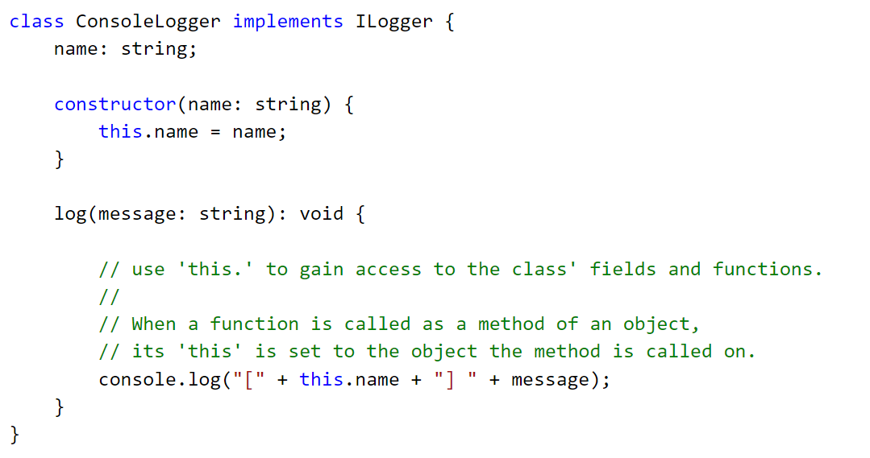
Class

Slide 39
Is This important ?!
Inside a class the 'this': it always (well… most of the times) represents the instance of the class itself (like in C# or Java).
The 'this' has a different meaning in function expression and when using the 'arrow syntax':
function() { … }: this act exactly as expected in JavaScript Strict Mode (it can be undefined or whatever it was when entering the function execution context).
() => { … }: this always refers to the class instance.
Pay attention to: Composition / Encapsulation patterns: don't mess up with the this! Always delegate the function call properly, that is: call the function on its original object rather than assigning function pointer to another variable!
Notes:
Esempio: 02-classes
Classes.ts
Classes-this-arrow-function.ts
Classes-composition.ts

Slide 40
Null Check – strict or not ?
Default Null Checking mode
The null and undefined values are in the domain of every type.
So T and T | undefined are considered synonymous in regular type checking mode (because undefined is considered a subtype of any T).
Strict Null Checking mode
The null and undefined values are not in the domain of every type and are only assignable to themselves and any (the one exception being that undefined is also assignable to void).
So T and T | undefined are different types in strict type checking mode, and only T | undefined permits undefined values. The same is true for the relationship of T to T | null.
Notes:
Esempio:
00-Types
types-strictNullChecks.ts

Slide 41
Takeaways
Structural Typing/Duck Typing: the shape matters!
Always use the 'arroy syntax' when defining functions / callbacks on the fly!
Beware of the this: composition pattern (the same in JavaScript): always call the function on its original object instance, never assign the pointer to another variable!
Configure the compile for the ‘level’ of type checking and null checking you desire (noImplicitAny, strictNullCheck)!
Notes:
Come esempio possiamo iniziare a creare una ToDo list app.
Classe (ToDo service)
Servizio di gestione dello stato (ToDo service)
Eventualmente poi interazione con servizio esterno (Express ? As an exercise)

Slide 42
Namespaces & Modules
Namespaces and Modules are used to add more structuring to your code.
Group and Organize objects based on their behavior or because they are related to each other in some way (i.e.: all the classes of a specific feature, a library, etc...). It’s a way to group up a set of entities that share the same purpose.
Allow to split your code in multiple files.

Slide 43
Namespace (a.k.a. Internal Module)
defined by the keyword: namespace.
export: decide what to expose to the outside world.
can be split in multiple files.
When to use them:
it’s not meant to be used with dynamic module loading (Node.js / Require.js).
reference the files using <script> tags in the correct order.
Notes:
an ambient namespace is used to provide a typed interface to JavaScript libraries.
Esempio: 03-namespace

Slide 44
Module (a.k.a. External Module)
A Module in TypeScript follows the ES2015 standard module specification.
Every file containing a top-level import or export directive is a different module.
To make things visible outside of a module you need to export them.
To gain access to the things exported by a module you need to import the module itself (or the single entities you want to use).
How to use them:
You need to use a module loader: Node.js / Require.js or another dynamic module loader.
You must use the '--module' compiler switch to specify the format to use [commonjs, amd, system, ...].
Reference them using the import keyword and assign a name alias or decide which exported types to use.
Notes:
Esempio: 04-modules
(l’esempio può essere eseguito in node col debugger (modifica il launch task))

Slide 45
TypeScript supports ES2015 features
let / const declarations
Destructuring declarations
for..of
Template strings
Generators
Class expressions
Notes:
Esempio:
06-ES2015-features

Slide 46
And some custom language extensions
Tuple types.
Union types.
Intersection types.
Lookup Types / Mapped Types (transformation types).
Decorators (ES7 proposal).
Async / Await (since TypeScript 2.1 available for ES3 / ES5 / ES6).
Notes:
Esempio:
06-ES2015-features
types-1… .ts
..
types-5… .ts

Slide 47
@Decorator()
Decorators make it possible to annotate and modify classes and properties behavior at design time.
A decorator is:
an expression that evaluates to a function
that takes the target, name, and property descriptor as arguments
and optionally returns a property descriptor to install on the target object
In TypeScript we have 4 types of decorators:
ClassDecorator
MethodDecorator
PropertyDecorator
ParameterDecorator
Notes:
Esempio:
05-decorators

Slide 48
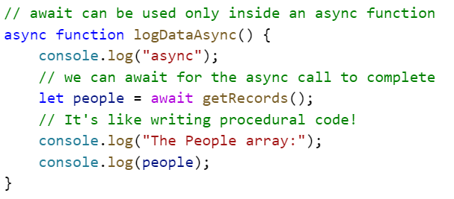
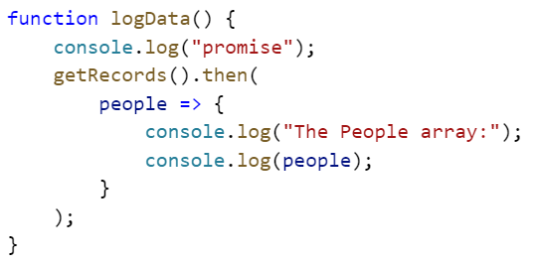
Async / Await – for ES3 / ES5 / ES6
Notes:
Esempio:
07-async-await

Slide 49
TypeScript evolves…
It’s highly (and I mean HIGHLY) recommended to keep an eye on:
What’s New
https://github.com/Microsoft/TypeScript/wiki/What%27s-new-in-TypeScript
Breaking Changes
https://github.com/Microsoft/TypeScript/wiki/Breaking-Changes

Slide 50
That's it! Thanks all!

Slide 51
By the way… Who am I ?
Dott.ing. Alessandro Giorgetti
Facebook: https://www.facebook.com/giorgetti.alessandro
Twitter: @a_giorgetti
LinkedIn: https://it.linkedin.com/in/giorgettialessandro
E-mail: alessandro.giorgetti@live.com
Blog: www.primordialcode.com

Slide 52
Reference
TypeScript: http://www.typescriptlang.org/
TypeScript Handbook: http://www.typescriptlang.org/docs/handbook/basic-types.html
TypeScript Language Specification: https://github.com/Microsoft/TypeScript/blob/master/doc/spec.md
Visual Studio Code: http://code.visualstudio.com/docs

