Slide 1
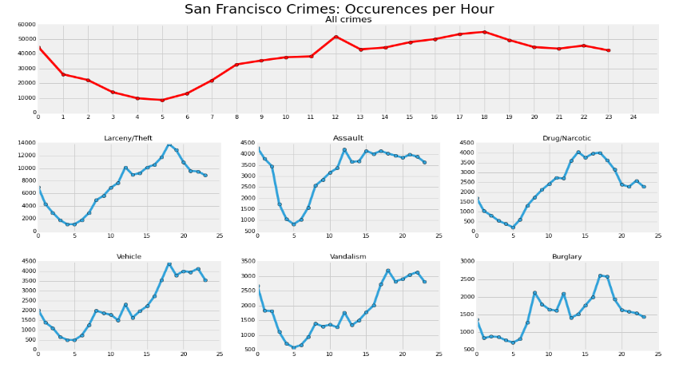
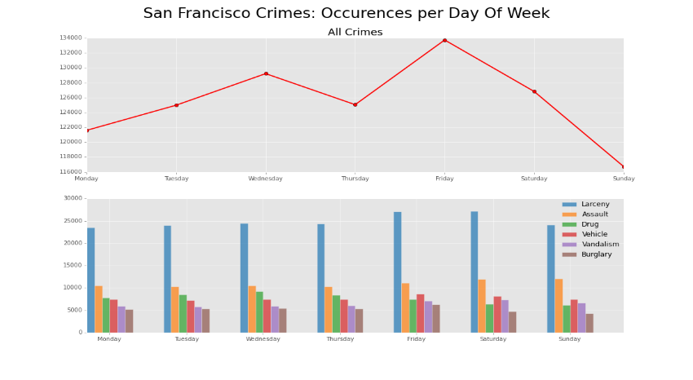
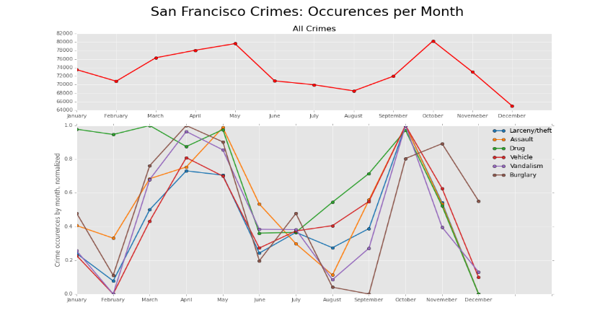
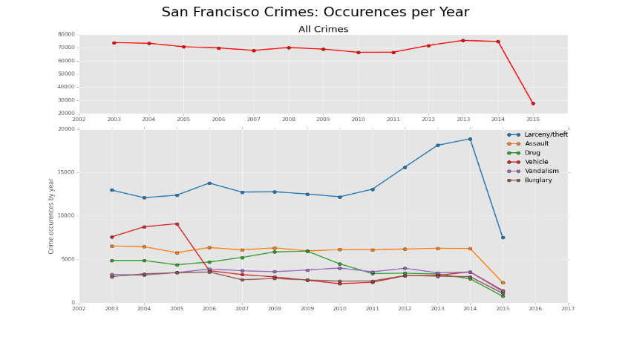
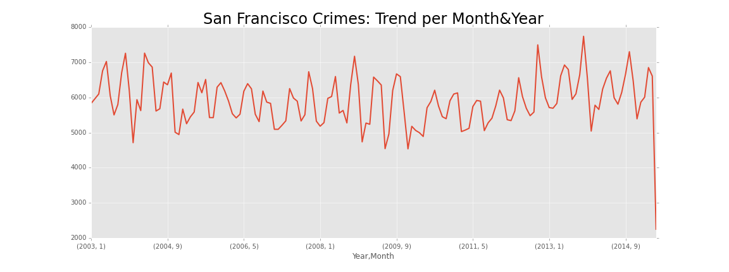
(a) Crime occurrences grouped by hour
(b) Crime occurrences grouped by day of the week
(c) Crime occurrences grouped by month
(d) Crime occurrences grouped by year
(e) Crime occurrences grouped by year and month

