Slide 1
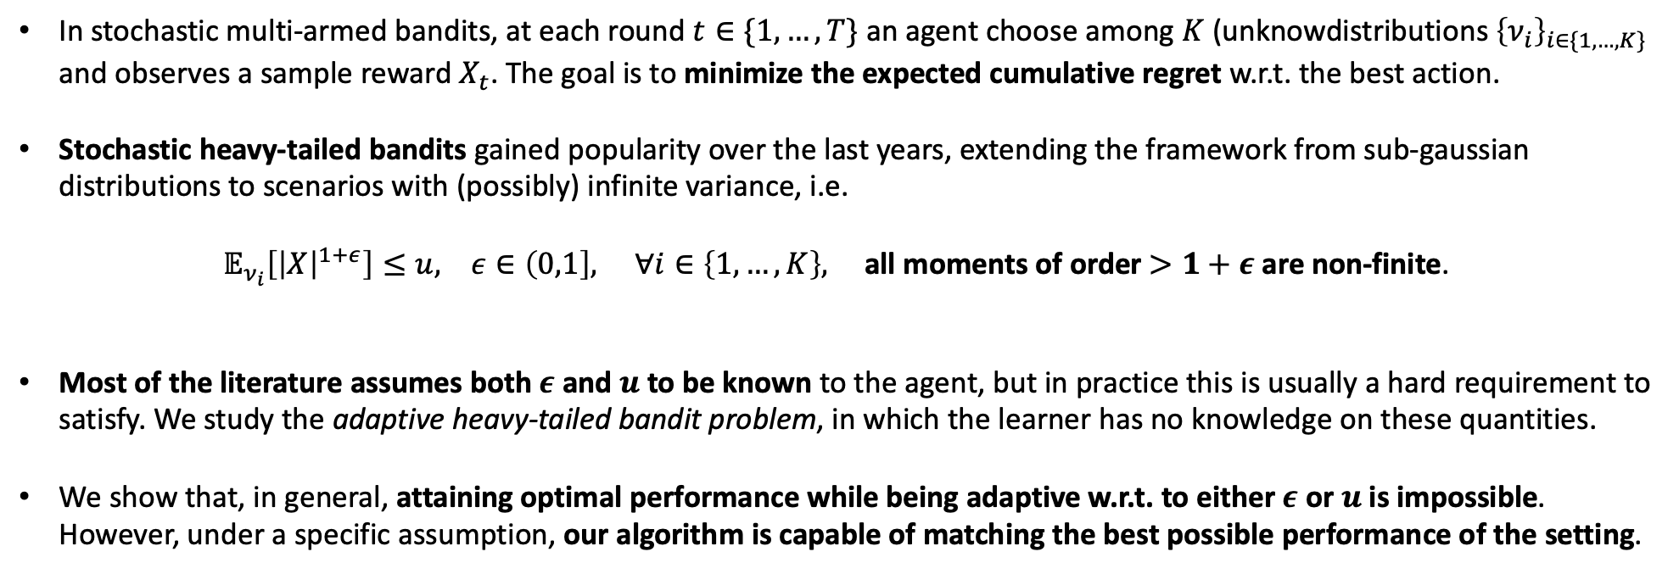
In stochastic multi-armed bandits, at each round $t∈\{1,…,T\}$ an agent choose among $K$ (unknowdistributions ${\left\{ν_{i}\right\}}_{i∈\{1,…,K\}}$ and observes a sample reward $X_{t}$. The goal is to minimize the expected cumulative regret w.r.t. the best action.
Stochastic heavy-tailed bandits gained popularity over the last years, extending the framework from sub-gaussian distributions to scenarios with (possibly) infinite variance, i.e.
$𝔼_{ν_{i}}\left[{\left|X\right|}^{1+ε}\right]≤u, ε∈\left(0,1\right], ∀i∈\left\{1,…, K\right\},$ all moments of order $>1+ε$ are non-finite.
Most of the literature assumes both $ε$ and $u$ to be known to the agent, but in practice this is usually a hard requirement to satisfy. We study the adaptive heavy-tailed bandit problem, in which the learner has no knowledge on these quantities.
We show that, in general, attaining optimal performance while being adaptive w.r.t. to either $ε$ or $u$ is impossible. However, under a specific assumption, our algorithm is capable of matching the best possible performance of the setting.

