Slide 1
imdb-data2_pres
GMD

Slide 2
Deskripsi Dataset
Dataset yang kami ambil memiliki nama IMDB-Movie-Data.csv yang berisikan database film bedasarkan situs laman IMDb. IMDb itu tersendiri adalah situs yang menampilkan deskripsi film, rating film, dan para aktor juga. Dataset ini memiliki 12 kolom atribut yang terdiri dari Rank, Title, Description, Director, Year, Runtime, Rating, Votes, Revenue, dan Metascore. Dataset ini juga memiliki jumlah baris sebanyak 1000 baris dan memiliki ukuran file sebesar 303 kb. Dataset ini belumlah bersih karena terdapat nilai NA yang dapat mempengarhi kesimpulan dalam menarik kesimpulan bisnis.
Berikut penjelasan singkat tiap kolom dalam dataset IMDB-Movie-Data.csv:
Rank : Urutan data yang bersifat numerik
Title : Judul film
Genre : Jenis film
Description : Sinopsis film
Director : Sutradara film
Actors : Pemeran film yang dapat lebih dari 1 pemeran
Year : Tahun rilis film
Runtime : Durasi lamanya film dalam satuan menit
Rating : Penilaian yang diberikan oleh user IMDB dengan skala 1 – 10
Votes : Jumlah user IMDB yang memberikan rating suatu film
Revenue : Penghasilan yang dihasilkan dari film dalam satuan juta Dollar Amerika
Metascore : Penilaian dari kritikus dengan skala 0 – 100

Slide 3
Berapa jumlah Genre yang dihasilkan per tahunnya?
Akan dicari jumlah Genre yang dihasilkan per tahunnya, dan rata-rata Revenue untuk tiap kategori. Dan selanjutnya kan dilihat hubungan antar keduanya.
Diperlukan Tabel seperti berikut:
DataGenreYear(Year, Genre, Count, MeanRev)
DataGenreTotal(Genre, Count, MeanRev)
Keterangan:
Year : Merupakan tahun rilis dari sebuah film. Range yang digunakan adalah tahun 2006 – 2016
Genre : Merupakan jenis/kategori film
Count : Jumlah Film per Genre
MeanRev : Merupakan rata-rata penghasilan film yang dihasilkan per genre dalam satuan juta dolar USD

Slide 4
Persiapan awal
#Import library yang diperlukan library(ggplot2) library(dplyr) library(tidyr) #Import dataset yang digunakan data <- read.csv("IMDB-Movie-Data.csv") head(data)
## Rank Title Genre ## 1 1 Guardians of the Galaxy Action,Adventure,Sci-Fi ## 2 2 Prometheus Adventure,Mystery,Sci-Fi ## 3 3 Split Horror,Thriller ## 4 4 Sing Animation,Comedy,Family ## 5 5 Suicide Squad Action,Adventure,Fantasy ## 6 6 The Great Wall Action,Adventure,Fantasy ## Description ## 1 A group of intergalactic criminals are forced to work together to stop a fanatical warrior from taking control of the universe. ## 2 Following clues to the origin of mankind, a team finds a structure on a distant moon, but they soon realize they are not alone. ## 3 Three girls are kidnapped by a man with a diagnosed 23 distinct personalities. They must try to escape before the apparent emergence of a frightful new 24th. ## 4 In a city of humanoid animals, a hustling theater impresario's attempt to save his theater with a singing competition becomes grander than he anticipates even as its finalists' find that their lives will never be the same. ## 5 A secret government agency recruits some of the most dangerous incarcerated super-villains to form a defensive task force. Their first mission: save the world from the apocalypse. ## 6 European mercenaries searching for black powder become embroiled in the defense of the Great Wall of China against a horde of monstrous creatures. ## Director ## 1 James Gunn ## 2 Ridley Scott ## 3 M. Night Shyamalan ## 4 Christophe Lourdelet ## 5 David Ayer ## 6 Yimou Zhang ## Actors ## 1 Chris Pratt, Vin Diesel, Bradley Cooper, Zoe Saldana ## 2 Noomi Rapace, Logan Marshall-Green, Michael Fassbender, Charlize Theron ## 3 James McAvoy, Anya Taylor-Joy, Haley Lu Richardson, Jessica Sula ## 4 Matthew McConaughey,Reese Witherspoon, Seth MacFarlane, Scarlett Johansson ## 5 Will Smith, Jared Leto, Margot Robbie, Viola Davis ## 6 Matt Damon, Tian Jing, Willem Dafoe, Andy Lau ## Year Runtime..Minutes. Rating Votes Revenue..Millions. Metascore ## 1 2014 121 8.1 757074 333.13 76 ## 2 2012 124 7.0 485820 126.46 65 ## 3 2016 117 7.3 157606 138.12 62 ## 4 2016 108 7.2 60545 270.32 59 ## 5 2016 123 6.2 393727 325.02 40 ## 6 2016 103 6.1 56036 45.13 42

Slide 5
Penyiapan Data
Buat 3 kolom baru untuk hasil pemisahan Genre
i <- 1 while (i <= nrow(data)) { genres <- unlist(strsplit(data$Genre[i], ",", fixed = TRUE)) data$Genre1[i] <- genres[1] data$Genre2[i] <- genres[2] data$Genre3[i] <- genres[3] i <- i + 1 } head(data)
## Rank Title Genre ## 1 1 Guardians of the Galaxy Action,Adventure,Sci-Fi ## 2 2 Prometheus Adventure,Mystery,Sci-Fi ## 3 3 Split Horror,Thriller ## 4 4 Sing Animation,Comedy,Family ## 5 5 Suicide Squad Action,Adventure,Fantasy ## 6 6 The Great Wall Action,Adventure,Fantasy ## Description ## 1 A group of intergalactic criminals are forced to work together to stop a fanatical warrior from taking control of the universe. ## 2 Following clues to the origin of mankind, a team finds a structure on a distant moon, but they soon realize they are not alone. ## 3 Three girls are kidnapped by a man with a diagnosed 23 distinct personalities. They must try to escape before the apparent emergence of a frightful new 24th. ## 4 In a city of humanoid animals, a hustling theater impresario's attempt to save his theater with a singing competition becomes grander than he anticipates even as its finalists' find that their lives will never be the same. ## 5 A secret government agency recruits some of the most dangerous incarcerated super-villains to form a defensive task force. Their first mission: save the world from the apocalypse. ## 6 European mercenaries searching for black powder become embroiled in the defense of the Great Wall of China against a horde of monstrous creatures. ## Director ## 1 James Gunn ## 2 Ridley Scott ## 3 M. Night Shyamalan ## 4 Christophe Lourdelet ## 5 David Ayer ## 6 Yimou Zhang ## Actors ## 1 Chris Pratt, Vin Diesel, Bradley Cooper, Zoe Saldana ## 2 Noomi Rapace, Logan Marshall-Green, Michael Fassbender, Charlize Theron ## 3 James McAvoy, Anya Taylor-Joy, Haley Lu Richardson, Jessica Sula ## 4 Matthew McConaughey,Reese Witherspoon, Seth MacFarlane, Scarlett Johansson ## 5 Will Smith, Jared Leto, Margot Robbie, Viola Davis ## 6 Matt Damon, Tian Jing, Willem Dafoe, Andy Lau ## Year Runtime..Minutes. Rating Votes Revenue..Millions. Metascore Genre1 ## 1 2014 121 8.1 757074 333.13 76 Action ## 2 2012 124 7.0 485820 126.46 65 Adventure ## 3 2016 117 7.3 157606 138.12 62 Horror ## 4 2016 108 7.2 60545 270.32 59 Animation ## 5 2016 123 6.2 393727 325.02 40 Action ## 6 2016 103 6.1 56036 45.13 42 Action ## Genre2 Genre3 ## 1 Adventure Sci-Fi ## 2 Mystery Sci-Fi ## 3 Thriller <NA> ## 4 Comedy Family ## 5 Adventure Fantasy ## 6 Adventure Fantasy

Slide 6
Penyiapan Data (2)
Buat dataframe baru dengan menggabungkan Genre dari 3 kolom ke satu kolom dengan menambahkan 1 baris untuk tiap Genre
dataGenre1 <- data.frame(data$Title, data$Year, data$Genre1, data$Revenue..Millions.) colnames(dataGenre1) <- c("Title", "Year", "Genre", "Revenue") dataGenre2 <- data.frame(data$Title, data$Year, data$Genre2, data$Revenue..Millions.) colnames(dataGenre2) <- c("Title", "Year", "Genre", "Revenue") dataGenre2 <- dataGenre2 %>% drop_na(Genre) dataGenre3 <- data.frame(data$Title, data$Year, data$Genre3, data$Revenue..Millions.) colnames(dataGenre3) <- c("Title", "Year", "Genre", "Revenue") dataGenre3 <- dataGenre3 %>% drop_na(Genre) dataGenre <- bind_rows(dataGenre1, dataGenre2, dataGenre3) dataGenre
## Title Year ## 1 Guardians of the Galaxy 2014 ## 2 Prometheus 2012 ## 3 Split 2016 ## 4 Sing 2016 ## 5 Suicide Squad 2016 ## 6 The Great Wall 2016 ## 7 La La Land 2016 ## 8 Mindhorn 2016 ## 9 The Lost City of Z 2016 ## 10 Passengers 2016 ## 11 Fantastic Beasts and Where to Find Them 2016 ## 12 Hidden Figures 2016 ## 13 Rogue One 2016 ## 14 Moana 2016 ## 15 Colossal 2016 ## 16 The Secret Life of Pets 2016 ## 17 Hacksaw Ridge 2016 ## 18 Jason Bourne 2016 ## 19 Lion 2016 ## 20 Arrival 2016 ## 21 Gold 2016 ## 22 Manchester by the Sea 2016 ## 23 Hounds of Love 2016 ## 24 Trolls 2016 ## 25 Independence Day: Resurgence 2016 ## 26 Paris pieds nus 2016 ## 27 Bahubali: The Beginning 2015 ## 28 Dead Awake 2016 ## 29 Bad Moms 2016 ## 30 Assassin's Creed 2016 ## 31 Why Him? 2016 ## 32 Nocturnal Animals 2016 ## 33 X-Men: Apocalypse 2016 ## 34 Deadpool 2016 ## 35 Resident Evil: The Final Chapter 2016 ## 36 Captain America: Civil War 2016 ## 37 Interstellar 2014 ## 38 Doctor Strange 2016 ## 39 The Magnificent Seven 2016 ## 40 5- 25- 77 2007 ## 41 Sausage Party 2016 ## 42 Moonlight 2016 ## 43 Don't Fuck in the Woods 2016 ## 44 The Founder 2016 ## 45 Lowriders 2016 ## 46 Pirates of the Caribbean: On Stranger Tides 2011 ## 47 Miss Sloane 2016 ## 48 Fallen 2016 ## 49 Star Trek Beyond 2016 ## 50 The Last Face 2016 ## 51 Star Wars: Episode VII - The Force Awakens 2015 ## 52 Underworld: Blood Wars 2016 ## 53 Mother's Day 2016 ## 54 John Wick 2014 ## 55 The Dark Knight 2008 ## 56 Silence 2016 ## 57 Don't Breathe 2016 ## 58 Me Before You 2016 ## 59 Their Finest 2016 ## 60 Sully 2016 ## 61 Batman v Superman: Dawn of Justice 2016 ## 62 The Autopsy of Jane Doe 2016 ## 63 The Girl on the Train 2016 ## 64 Fifty Shades of Grey 2015 ## 65 The Prestige 2006 ## 66 Kingsman: The Secret Service 2014 ## 67 Patriots Day 2016 ## 68 Mad Max: Fury Road 2015 ## 69 Wakefield 2016 ## 70 Deepwater Horizon 2016 ## 71 The Promise 2016 ## 72 Allied 2016 ## 73 A Monster Calls 2016 ## 74 Collateral Beauty 2016 ## 75 Zootopia 2016 ## 76 Pirates of the Caribbean: At World's End 2007 ## 77 The Avengers 2012 ## 78 Inglourious Basterds 2009 ## 79 Pirates of the Caribbean: Dead Man's Chest 2006 ## 80 Ghostbusters 2016 ## 81 Inception 2010 ## 82 Captain Fantastic 2016 ## 83 The Wolf of Wall Street 2013 ## 84 Gone Girl 2014 ## 85 Furious Seven 2015 ## 86 Jurassic World 2015 ## 87 Live by Night 2016 ## 88 Avatar 2009 ## 89 The Hateful Eight 2015 ## 90 The Accountant 2016 ## 91 Prisoners 2013 ## 92 Warcraft 2016 ## 93 The Help 2011 ## 94 War Dogs 2016 ## 95 Avengers: Age of Ultron 2015 ## 96 The Nice Guys 2016 ## 97 Kimi no na wa 2016 ## 98 The Void 2016 ## 99 Personal Shopper 2016 ## 100 The Departed 2006 ## 101 Legend 2015 ## 102 Thor 2011 ## 103 The Martian 2015 ## 104 Contratiempo 2016 ## 105 The Man from U.N.C.L.E. 2015 ## 106 Hell or High Water 2016 ## 107 The Comedian 2016 ## 108 The Legend of Tarzan 2016 ## 109 All We Had 2016 ## 110 Ex Machina 2014 ## 111 The Belko Experiment 2016 ## 112 12 Years a Slave 2013 ## 113 The Bad Batch 2016 ## 114 300 2006 ## 115 Harry Potter and the Deathly Hallows: Part 2 2011 ## 116 Office Christmas Party 2016 ## 117 The Neon Demon 2016 ## 118 Dangal 2016 ## 119 10 Cloverfield Lane 2016 ## 120 Finding Dory 2016 ## 121 Miss Peregrine's Home for Peculiar Children 2016 ## 122 Divergent 2014 ## 123 Mike and Dave Need Wedding Dates 2016 ## 124 Boyka: Undisputed IV 2016 ## 125 The Dark Knight Rises 2012 ## 126 The Jungle Book 2016 ## 127 Transformers: Age of Extinction 2014 ## 128 Nerve 2016 ## 129 Mamma Mia! 2008 ## 130 The Revenant 2015 ## 131 Fences 2016 ## 132 Into the Woods 2014 ## 133 The Shallows 2016 ## 134 Whiplash 2014 ## 135 Furious 6 2013 ## 136 The Place Beyond the Pines 2012 ## 137 No Country for Old Men 2007 ## 138 The Great Gatsby 2013 ## 139 Shutter Island 2010 ## 140 Brimstone 2016 ## 141 Star Trek 2009 ## 142 Diary of a Wimpy Kid 2010 ## 143 The Big Short 2015 ## 144 Room 2015 ## 145 Django Unchained 2012 ## 146 Ah-ga-ssi 2016 ## 147 The Edge of Seventeen 2016 ## 148 Watchmen 2009 ## 149 Superbad 2007 ## 150 Inferno 2016 ## 151 The BFG 2016 ## 152 The Hunger Games 2012 ## 153 White Girl 2016 ## 154 Sicario 2015 ## 155 Twin Peaks: The Missing Pieces 2014 ## 156 Aliens vs Predator - Requiem 2007 ## 157 Pacific Rim 2013 ## 158 Crazy, Stupid, Love. 2011 ## 159 Scott Pilgrim vs. the World 2010 ## 160 Hot Fuzz 2007 ## 161 Mine 2016 ## 162 Free Fire 2016 ## 163 X-Men: Days of Future Past 2014 ## 164 Jack Reacher: Never Go Back 2016 ## 165 Casino Royale 2006 ## 166 Twilight 2008 ## 167 Now You See Me 2 2016 ## 168 Woman in Gold 2015 ## 169 13 Hours 2016 ## 170 Spectre 2015 ## 171 Nightcrawler 2014 ## 172 Kubo and the Two Strings 2016 ## 173 Beyond the Gates 2016 ## 174 Her 2013 ## 175 Frozen 2013 ## 176 Tomorrowland 2015 ## 177 Dawn of the Planet of the Apes 2014 ## 178 Tropic Thunder 2008 ## 179 The Conjuring 2 2016 ## 180 Ant-Man 2015 ## 181 Bridget Jones's Baby 2016 ## 182 The VVitch: A New-England Folktale 2015 ## 183 Cinderella 2015 ## 184 Realive 2016 ## 185 Forushande 2016 ## 186 Love 2015 ## 187 Billy Lynn's Long Halftime Walk 2016 ## 188 Crimson Peak 2015 ## 189 Drive 2011 ## 190 Trainwreck 2015 ## 191 The Light Between Oceans 2016 ## 192 Below Her Mouth 2016 ## 193 Spotlight 2015 ## 194 Morgan 2016 ## 195 Warrior 2011 ## 196 Captain America: The First Avenger 2011 ## 197 Hacker 2016 ## 198 Into the Wild 2007 ## 199 The Imitation Game 2014 ## 200 Central Intelligence 2016 ## 201 Edge of Tomorrow 2014 ## 202 A Cure for Wellness 2016 ## 203 Snowden 2016 ## 204 Iron Man 2008 ## 205 Allegiant 2016 ## 206 X: First Class 2011 ## 207 Raw (II) 2016 ## 208 Paterson 2016 ## 209 Bridesmaids 2011 ## 210 The Girl with All the Gifts 2016 ## 211 San Andreas 2015 ## 212 Spring Breakers 2012 ## 213 Transformers 2007 ## 214 Old Boy 2013 ## 215 Thor: The Dark World 2013 ## 216 Gods of Egypt 2016 ## 217 Captain America: The Winter Soldier 2014 ## 218 Monster Trucks 2016 ## 219 A Dark Song 2016 ## 220 Kick-Ass 2010 ## 221 Hardcore Henry 2015 ## 222 Cars 2006 ## 223 It Follows 2014 ## 224 The Girl with the Dragon Tattoo 2011 ## 225 We're the Millers 2013 ## 226 American Honey 2016 ## 227 The Lobster 2015 ## 228 Predators 2010 ## 229 Maleficent 2014 ## 230 Rupture 2016 ## 231 Pan's Labyrinth 2006 ## 232 A Kind of Murder 2016 ## 233 Apocalypto 2006 ## 234 Mission: Impossible - Rogue Nation 2015 ## 235 The Huntsman: Winter's War 2016 ## 236 The Perks of Being a Wallflower 2012 ## 237 Jackie 2016 ## 238 The Disappointments Room 2016 ## 239 The Grand Budapest Hotel 2014 ## 240 The Host 2013 ## 241 Fury 2014 ## 242 Inside Out 2015 ## 243 Rock Dog 2016 ## 244 Terminator Genisys 2015 ## 245 Percy Jackson & the Olympians: The Lightning Thief 2010 ## 246 Les MisÃ©rables 2012 ## 247 Children of Men 2006 ## 248 20th Century Women 2016 ## 249 Spy 2015 ## 250 The Intouchables 2011 ## 251 Bonjour Anne 2016 ## 252 Kynodontas 2009 ## 253 Straight Outta Compton 2015 ## 254 The Amazing Spider-Man 2 2014 ## 255 The Conjuring 2013 ## 256 The Hangover 2009 ## 257 Battleship 2012 ## 258 Rise of the Planet of the Apes 2011 ## 259 Lights Out 2016 ## 260 Norman: The Moderate Rise and Tragic Fall of a New York Fixer 2016 ## 261 Birdman or (The Unexpected Virtue of Ignorance) 2014 ## 262 Black Swan 2010 ## 263 Dear White People 2014 ## 264 Nymphomaniac: Vol. I 2013 ## 265 Teenage Mutant Ninja Turtles: Out of the Shadows 2016 ## 266 Knock Knock 2015 ## 267 Dirty Grandpa 2016 ## 268 Cloud Atlas 2012 ## 269 X-Men Origins: Wolverine 2009 ## 270 Satanic 2016 ## 271 Skyfall 2012 ## 272 The Hobbit: An Unexpected Journey 2012 ## 273 21 Jump Street 2012 ## 274 Sing Street 2016 ## 275 Ballerina 2016 ## 276 Oblivion 2013 ## 277 22 Jump Street 2014 ## 278 Zodiac 2007 ## 279 Everybody Wants Some!! 2016 ## 280 Iron Man Three 2013 ## 281 Now You See Me 2013 ## 282 Sherlock Holmes 2009 ## 283 Death Proof 2007 ## 284 The Danish Girl 2015 ## 285 Hercules 2014 ## 286 Sucker Punch 2011 ## 287 Keeping Up with the Joneses 2016 ## 288 Jupiter Ascending 2015 ## 289 Masterminds 2016 ## 290 Iris 2016 ## 291 Busanhaeng 2016 ## 292 Pitch Perfect 2012 ## 293 Neighbors 2: Sorority Rising 2016 ## 294 The Exception 2016 ## 295 Man of Steel 2013 ## 296 The Choice 2016 ## 297 Ice Age: Collision Course 2016 ## 298 The Devil Wears Prada 2006 ## 299 The Infiltrator 2016 ## 300 There Will Be Blood 2007 ## 301 The Equalizer 2014 ## 302 Lone Survivor 2013 ## 303 The Cabin in the Woods 2012 ## 304 The House Bunny 2008 ## 305 She's Out of My League 2010 ## 306 Inherent Vice 2014 ## 307 Alice Through the Looking Glass 2016 ## 308 Vincent N Roxxy 2016 ## 309 The Fast and the Furious: Tokyo Drift 2006 ## 310 How to Be Single 2016 ## 311 The Blind Side 2009 ## 312 La vie d'AdÃ¨le 2013 ## 313 The Babadook 2014 ## 314 The Hobbit: The Battle of the Five Armies 2014 ## 315 Harry Potter and the Order of the Phoenix 2007 ## 316 Snowpiercer 2013 ## 317 The 5th Wave 2016 ## 318 The Stakelander 2016 ## 319 The Visit 2015 ## 320 Fast Five 2011 ## 321 Step Up 2006 ## 322 Lovesong 2016 ## 323 RocknRolla 2008 ## 324 In Time 2011 ## 325 The Social Network 2010 ## 326 The Last Witch Hunter 2015 ## 327 Victor Frankenstein 2015 ## 328 A Street Cat Named Bob 2016 ## 329 Green Room 2015 ## 330 Blackhat 2015 ## 331 Storks 2016 ## 332 American Sniper 2014 ## 333 Dallas Buyers Club 2013 ## 334 Lincoln 2012 ## 335 Rush 2013 ## 336 Before I Wake 2016 ## 337 Silver Linings Playbook 2012 ## 338 Tracktown 2016 ## 339 The Fault in Our Stars 2014 ## 340 Blended 2014 ## 341 Fast & Furious 2009 ## 342 Looper 2012 ## 343 White House Down 2013 ## 344 Pete's Dragon 2016 ## 345 Spider-Man 3 2007 ## 346 The Three Musketeers 2011 ## 347 Stardust 2007 ## 348 American Hustle 2013 ## 349 Jennifer's Body 2009 ## 350 Midnight in Paris 2011 ## 351 Lady Macbeth 2016 ## 352 Joy 2015 ## 353 The Dressmaker 2015 ## 354 CafÃ© Society 2016 ## 355 Insurgent 2015 ## 356 Seventh Son 2014 ## 357 Demain tout commence 2016 ## 358 The Theory of Everything 2014 ## 359 This Is the End 2013 ## 360 About Time 2013 ## 361 Step Brothers 2008 ## 362 Clown 2014 ## 363 Star Trek Into Darkness 2013 ## 364 Zombieland 2009 ## 365 Hail, Caesar! 2016 ## 366 Slumdog Millionaire 2008 ## 367 The Twilight Saga: Breaking Dawn - Part 2 2012 ## 368 American Wrestler: The Wizard 2016 ## 369 The Amazing Spider-Man 2012 ## 370 Ben-Hur 2016 ## 371 Sleight 2016 ## 372 The Maze Runner 2014 ## 373 Criminal 2016 ## 374 Wanted 2008 ## 375 Florence Foster Jenkins 2016 ## 376 Collide 2016 ## 377 Black Mass 2015 ## 378 Creed 2015 ## 379 Swiss Army Man 2016 ## 380 The Expendables 3 2014 ## 381 What We Do in the Shadows 2014 ## 382 Southpaw 2015 ## 383 Hush 2016 ## 384 Bridge of Spies 2015 ## 385 The Lego Movie 2014 ## 386 Everest 2015 ## 387 Pixels 2015 ## 388 Robin Hood 2010 ## 389 The Wolverine 2013 ## 390 John Carter 2012 ## 391 Keanu 2016 ## 392 The Gunman 2015 ## 393 Steve Jobs 2015 ## 394 Whisky Galore 2016 ## 395 Grown Ups 2 2013 ## 396 The Age of Adaline 2015 ## 397 The Incredible Hulk 2008 ## 398 Couples Retreat 2009 ## 399 Absolutely Anything 2015 ## 400 Magic Mike 2012 ## 401 Minions 2015 ## 402 The Black Room 2016 ## 403 Bronson 2008 ## 404 Despicable Me 2010 ## 405 The Best of Me 2014 ## 406 The Invitation 2015 ## 407 Zero Dark Thirty 2012 ## 408 Tangled 2010 ## 409 The Hunger Games: Mockingjay - Part 2 2015 ## 410 Vacation 2015 ## 411 Taken 2008 ## 412 Pitch Perfect 2 2015 ## 413 Monsters University 2013 ## 414 Elle 2016 ## 415 Mechanic: Resurrection 2016 ## 416 Tusk 2014 ## 417 The Headhunter's Calling 2016 ## 418 Atonement 2007 ## 419 Harry Potter and the Deathly Hallows: Part 1 2010 ## 420 Shame 2011 ## 421 Hanna 2011 ## 422 The Babysitters 2007 ## 423 Pride and Prejudice and Zombies 2016 ## 424 300: Rise of an Empire 2014 ## 425 London Has Fallen 2016 ## 426 The Curious Case of Benjamin Button 2008 ## 427 Sin City: A Dame to Kill For 2014 ## 428 The Bourne Ultimatum 2007 ## 429 Srpski film 2010 ## 430 The Purge: Election Year 2016 ## 431 3 Idiots 2009 ## 432 Zoolander 2 2016 ## 433 World War Z 2013 ## 434 Mission: Impossible - Ghost Protocol 2011 ## 435 Let Me Make You a Martyr 2016 ## 436 Filth 2013 ## 437 The Longest Ride 2015 ## 438 The imposible 2012 ## 439 Kick-Ass 2 2013 ## 440 Folk Hero & Funny Guy 2016 ## 441 Oz the Great and Powerful 2013 ## 442 Brooklyn 2015 ## 443 Coraline 2009 ## 444 Blue Valentine 2010 ## 445 The Thinning 2016 ## 446 Silent Hill 2006 ## 447 Dredd 2012 ## 448 Hunt for the Wilderpeople 2016 ## 449 Big Hero 6 2014 ## 450 Carrie 2013 ## 451 Iron Man 2 2010 ## 452 Demolition 2015 ## 453 Pandorum 2009 ## 454 Olympus Has Fallen 2013 ## 455 I Am Number Four 2011 ## 456 Jagten 2012 ## 457 The Proposal 2009 ## 458 Get Hard 2015 ## 459 Just Go with It 2011 ## 460 Revolutionary Road 2008 ## 461 The Town 2010 ## 462 The Boy 2016 ## 463 Denial 2016 ## 464 Predestination 2014 ## 465 Goosebumps 2015 ## 466 Sherlock Holmes: A Game of Shadows 2011 ## 467 Salt 2010 ## 468 Enemy 2013 ## 469 District 9 2009 ## 470 The Other Guys 2010 ## 471 American Gangster 2007 ## 472 Marie Antoinette 2006 ## 473 2012 2009 ## 474 Harry Potter and the Half-Blood Prince 2009 ## 475 Argo 2012 ## 476 Eddie the Eagle 2016 ## 477 The Lives of Others 2006 ## 478 Pet 2016 ## 479 Paint It Black 2016 ## 480 Macbeth 2015 ## 481 Forgetting Sarah Marshall 2008 ## 482 The Giver 2014 ## 483 Triple 9 2016 ## 484 Perfetti sconosciuti 2016 ## 485 Angry Birds 2016 ## 486 Moonrise Kingdom 2012 ## 487 Hairspray 2007 ## 488 Safe Haven 2013 ## 489 Focus 2015 ## 490 Ratatouille 2007 ## 491 Stake Land 2010 ## 492 The Book of Eli 2010 ## 493 Cloverfield 2008 ## 494 Point Break 2015 ## 495 Under the Skin 2013 ## 496 I Am Legend 2007 ## 497 Men in Black 3 2012 ## 498 Super 8 2011 ## 499 Law Abiding Citizen 2009 ## 500 Up 2009 ## 501 Maze Runner: The Scorch Trials 2015 ## 502 Carol 2015 ## 503 Imperium 2016 ## 504 Youth 2015 ## 505 Mr. Nobody 2009 ## 506 City of Tiny Lights 2016 ## 507 Savages 2012 ## 508 (500) Days of Summer 2009 ## 509 Movie 43 2013 ## 510 Gravity 2013 ## 511 The Boy in the Striped Pyjamas 2008 ## 512 Shooter 2007 ## 513 The Happening 2008 ## 514 Bone Tomahawk 2015 ## 515 Magic Mike XXL 2015 ## 516 Easy A 2010 ## 517 Exodus: Gods and Kings 2014 ## 518 Chappie 2015 ## 519 The Hobbit: The Desolation of Smaug 2013 ## 520 Half of a Yellow Sun 2013 ## 521 Anthropoid 2016 ## 522 The Counselor 2013 ## 523 Viking 2016 ## 524 Whiskey Tango Foxtrot 2016 ## 525 Trust 2010 ## 526 Birth of the Dragon 2016 ## 527 Elysium 2013 ## 528 The Green Inferno 2013 ## 529 Godzilla 2014 ## 530 The Bourne Legacy 2012 ## 531 A Good Year 2006 ## 532 Friend Request 2016 ## 533 Deja Vu 2006 ## 534 Lucy 2014 ## 535 A Quiet Passion 2016 ## 536 Need for Speed 2014 ## 537 Jack Reacher 2012 ## 538 The Do-Over 2016 ## 539 True Crimes 2016 ## 540 American Pastoral 2016 ## 541 The Ghost Writer 2010 ## 542 Limitless 2011 ## 543 Spectral 2016 ## 544 P.S. I Love You 2007 ## 545 Zipper 2015 ## 546 Midnight Special 2016 ## 547 Don't Think Twice 2016 ## 548 Alice in Wonderland 2010 ## 549 Chuck 2016 ## 550 I, Daniel Blake 2016 ## 551 The Break-Up 2006 ## 552 Loving 2016 ## 553 Fantastic Four 2015 ## 554 The Survivalist 2015 ## 555 Colonia 2015 ## 556 The Boy Next Door 2015 ## 557 The Gift 2015 ## 558 Dracula Untold 2014 ## 559 In the Heart of the Sea 2015 ## 560 Idiocracy 2006 ## 561 The Expendables 2010 ## 562 Evil Dead 2013 ## 563 Sinister 2012 ## 564 Wreck-It Ralph 2012 ## 565 Snow White and the Huntsman 2012 ## 566 Pan 2015 ## 567 Transformers: Dark of the Moon 2011 ## 568 Juno 2007 ## 569 A Hologram for the King 2016 ## 570 Money Monster 2016 ## 571 The Other Woman 2014 ## 572 Enchanted 2007 ## 573 The Intern 2015 ## 574 Little Miss Sunshine 2006 ## 575 Bleed for This 2016 ## 576 Clash of the Titans 2010 ## 577 The Finest Hours 2016 ## 578 Tron 2010 ## 579 The Hunger Games: Catching Fire 2013 ## 580 All Good Things 2010 ## 581 Kickboxer: Vengeance 2016 ## 582 The Last Airbender 2010 ## 583 Sex Tape 2014 ## 584 What to Expect When You're Expecting 2012 ## 585 Moneyball 2011 ## 586 Ghost Rider 2007 ## 587 Unbroken 2014 ## 588 Immortals 2011 ## 589 Sunshine 2007 ## 590 Brave 2012 ## 591 MÃ¤n som hatar kvinnor 2009 ## 592 Adoration 2013 ## 593 The Drop 2014 ## 594 She's the Man 2006 ## 595 Daddy's Home 2015 ## 596 Let Me In 2010 ## 597 Never Back Down 2008 ## 598 Grimsby 2016 ## 599 Moon 2009 ## 600 Megamind 2010 ## 601 Gangster Squad 2013 ## 602 Blood Father 2016 ## 603 He's Just Not That Into You 2009 ## 604 Kung Fu Panda 3 2016 ## 605 The Rise of the Krays 2015 ## 606 Handsome Devil 2016 ## 607 Winter's Bone 2010 ## 608 Horrible Bosses 2011 ## 609 Mommy 2014 ## 610 Hellboy II: The Golden Army 2008 ## 611 Beautiful Creatures 2013 ## 612 Toni Erdmann 2016 ## 613 The Lovely Bones 2009 ## 614 The Assassination of Jesse James by the Coward Robert Ford 2007 ## 615 Don Jon 2013 ## 616 Bastille Day 2016 ## 617 2307: Winter's Dream 2016 ## 618 Free State of Jones 2016 ## 619 Mr. Right 2015 ## 620 The Secret Life of Walter Mitty 2013 ## 621 Dope 2015 ## 622 Underworld Awakening 2012 ## 623 Antichrist 2009 ## 624 Friday the 13th 2009 ## 625 Taken 3 2014 ## 626 Total Recall 2012 ## 627 X-Men: The Last Stand 2006 ## 628 The Escort 2016 ## 629 The Whole Truth 2016 ## 630 Night at the Museum: Secret of the Tomb 2014 ## 631 Love & Other Drugs 2010 ## 632 The Interview 2014 ## 633 The Host 2006 ## 634 Megan Is Missing 2011 ## 635 WALLÂ·E 2008 ## 636 Knocked Up 2007 ## 637 Source Code 2011 ## 638 Lawless 2012 ## 639 Unfriended 2014 ## 640 American Reunion 2012 ## 641 The Pursuit of Happyness 2006 ## 642 Relatos salvajes 2014 ## 643 The Ridiculous 6 2015 ## 644 Frantz 2016 ## 645 Viral 2016 ## 646 Gran Torino 2008 ## 647 Burnt 2015 ## 648 Tall Men 2016 ## 649 Sleeping Beauty 2011 ## 650 Vampire Academy 2014 ## 651 Sweeney Todd: The Demon Barber of Fleet Street 2007 ## 652 Solace 2015 ## 653 Insidious 2010 ## 654 Popstar: Never Stop Never Stopping 2016 ## 655 The Levelling 2016 ## 656 Public Enemies 2009 ## 657 Boyhood 2014 ## 658 Teenage Mutant Ninja Turtles 2014 ## 659 Eastern Promises 2007 ## 660 The Daughter 2015 ## 661 Pineapple Express 2008 ## 662 The First Time 2012 ## 663 Gone Baby Gone 2007 ## 664 The Heat 2013 ## 665 L'avenir 2016 ## 666

Slide 7
Penyiapan Data (3)
Kelompokkan data berdasarkan Tahun dan Genre, lalu hitung jumlah film yang dihasilkan dan rata-rata Revenue-nya
dataGenreYear <- dataGenre %>% group_by(Year, Genre) %>% summarise(Count = n(), MeanRev = mean(Revenue, na.rm = TRUE)) #Untuk kolom bernilai NaN akan diubah nilainya menjadi 0 dataGenreYear$MeanRev[is.nan(dataGenreYear$MeanRev)] <- 0 dataGenreYear
## # A tibble: 195 x 4 ## # Groups: Year [11] ## Year Genre Count MeanRev ## <int> <chr> <int> <dbl> ## 1 2006 Action 11 166. ## 2 2006 Adventure 13 123. ## 3 2006 Animation 2 221. ## 4 2006 Biography 3 61.3 ## 5 2006 Comedy 12 76.3 ## 6 2006 Crime 7 58.2 ## 7 2006 Drama 26 50.1 ## 8 2006 Family 1 198. ## 9 2006 Fantasy 6 158. ## 10 2006 History 1 16.0 ## # ... with 185 more rows

Slide 8
Analisis Data
Gambarkan plot yang membandingkan Revenue dengan jumlah film untuk masing-masing Genre
allGenre <- unique(dataGenreYear$Genre) for(genre_ in allGenre){ dataOneGenre <- dataGenreYear %>% filter(Genre == sprintf("%s", genre_)) print(ggplot(dataOneGenre)+ geom_col(aes(x = as.factor(Year), y = Count * (max(dataOneGenre$MeanRev, na.rm = TRUE)/max(dataOneGenre$Count, na.rm = TRUE))), fill="cadetblue1")+ geom_line(aes(x = as.factor(Year), y = MeanRev, group = Genre), size = 1.5)+ geom_text(aes(label=as.integer(MeanRev), x = as.factor(Year), y = MeanRev))+ geom_text(aes(label=as.integer(Count), x = as.factor(Year), y = Count * (max(dataOneGenre$MeanRev, na.rm = TRUE)/max(dataOneGenre$Count, na.rm = TRUE))))+ scale_y_continuous(sec.axis = sec_axis(~ . / (max(dataOneGenre$MeanRev, na.rm = TRUE)/max(dataOneGenre$Count, na.rm = TRUE)), name = "Count"))+ theme(axis.text=element_text(size=14), axis.title=element_text(size=24), plot.title = element_text(size = 36, face = "bold"))+ ggtitle(sprintf("Genre: %s", genre_))+ xlab("Year")+ ylab("Revenue (in million dollars)")) }

Slide 9
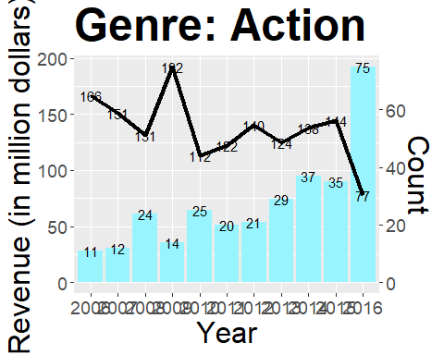

Slide 10
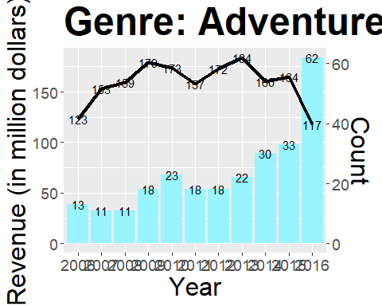

Slide 11
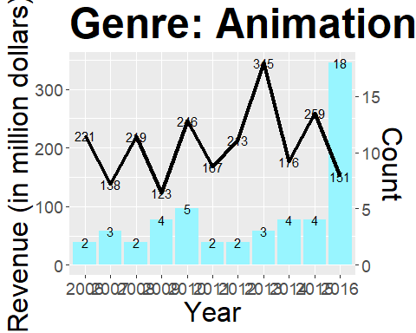

Slide 12
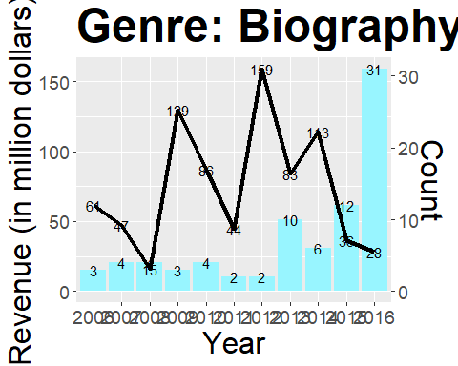

Slide 13
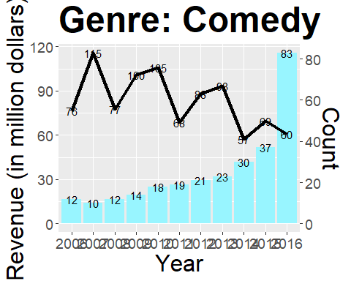

Slide 14
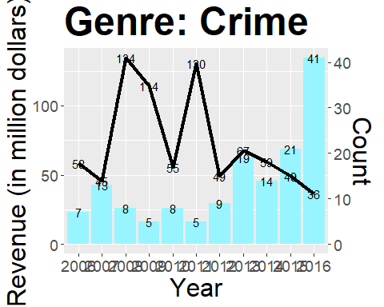

Slide 15
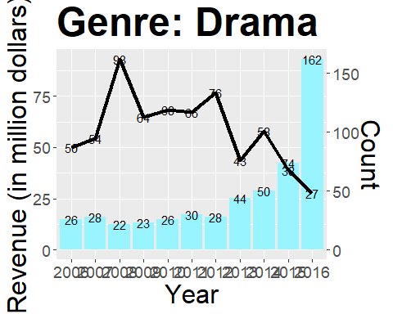

Slide 16
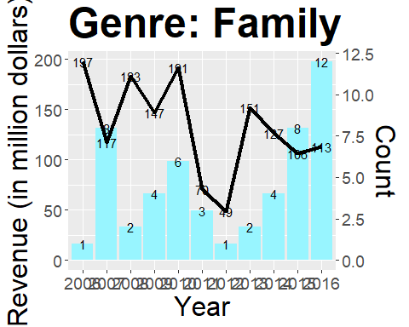

Slide 17
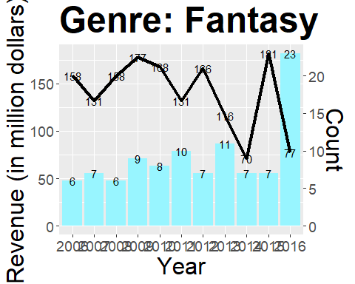

Slide 18
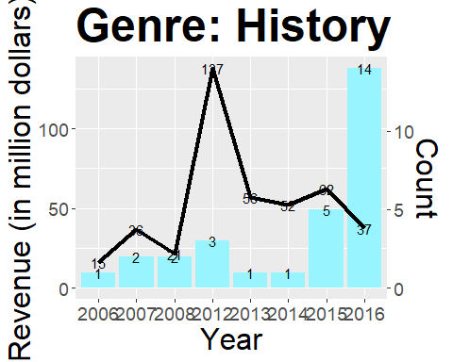

Slide 19
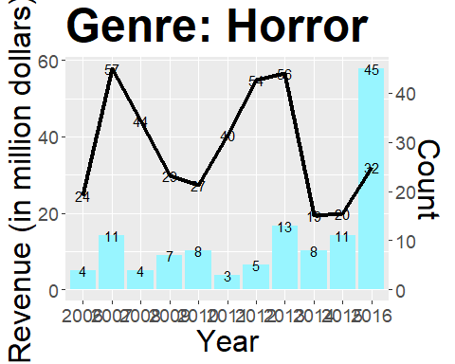

Slide 20
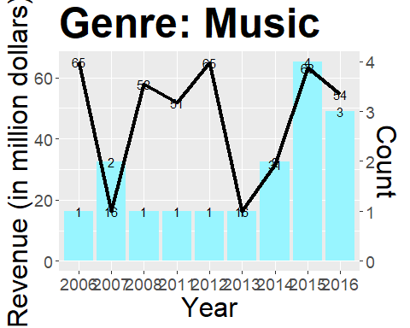

Slide 21
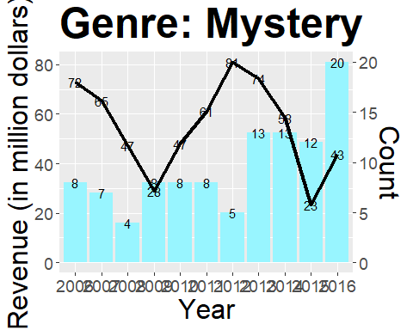

Slide 22
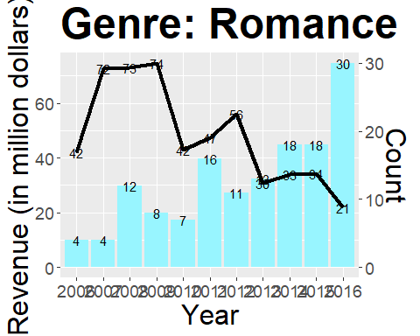

Slide 23
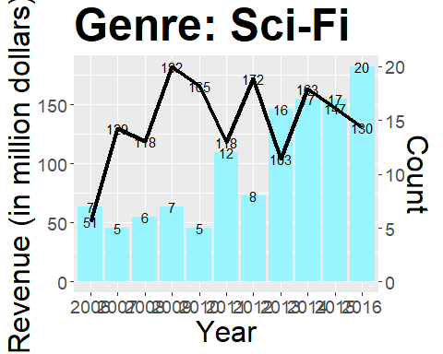

Slide 24
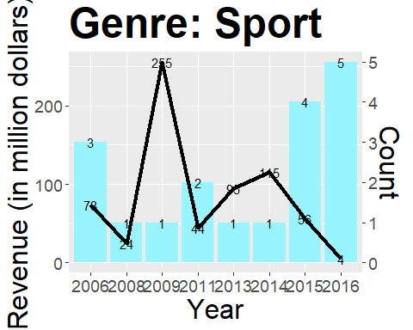

Slide 25
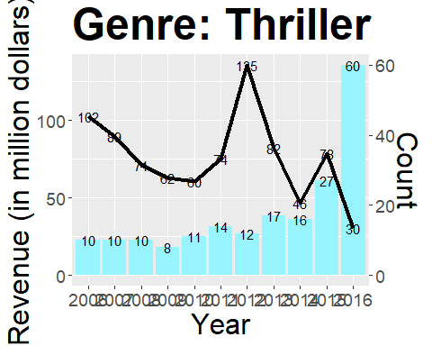

Slide 26
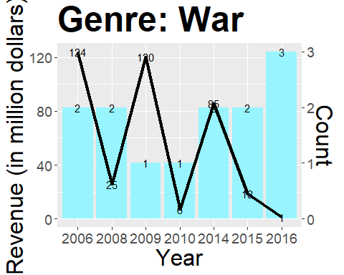

Slide 27
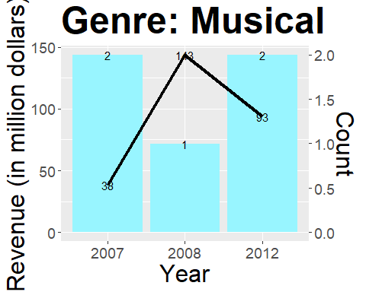

Slide 28
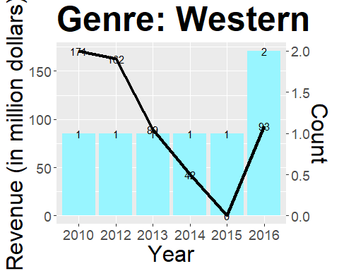

Slide 29
Analisis Data (2)

Slide 33
Analisis Data (3)
Selain itu juga, kami membuat barplot horizontal yang menunjukkan total jumlah film bedasarkan genre. Untuk y-label adalah genre film. Untuk x-label menggunakan count yang merupakan banyaknya jumlah film. Berikut barplot yang kami buat:
dataGenreTotal <- dataGenreYear %>% group_by(Genre) %>% summarise(Count = sum(Count), MeanRev = mean(MeanRev)) dataGenreTotal
## # A tibble: 20 x 3 ## Genre Count MeanRev ## <chr> <int> <dbl> ## 1 Action 303 137. ## 2 Adventure 259 159. ## 3 Animation 49 206. ## 4 Biography 81 73.3 ## 5 Comedy 279 83.1 ## 6 Crime 150 72.8 ## 7 Drama 513 58.4 ## 8 Family 51 132. ## 9 Fantasy 101 140. ## 10 History 29 52.5 ## 11 Horror 119 37.0 ## 12 Music 16 46.9 ## 13 Musical 5 92.0 ## 14 Mystery 106 55.0 ## 15 Romance 141 48.1 ## 16 Sci-Fi 120 135. ## 17 Sport 18 83.8 ## 18 Thriller 195 75.9 ## 19 War 13 54.7 ## 20 Western 7 93.2
ggplot(dataGenreTotal, aes(x = reorder(Genre, Count), y = Count))+ geom_bar(stat = 'identity')+ coord_flip()+ xlab("Genre")+ ylab("Count")+ ggtitle("Jumlah Seluruh Film Bedasarkan Genre")

Slide 34
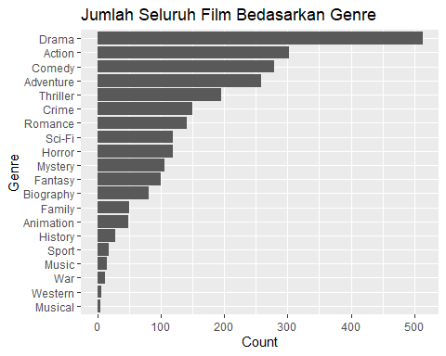

Slide 35
Analisis Data (4)
Selain itu juga, kami membuat barplot horizontal yang menunjukkan total jumlah film bedasarkan genre. Untuk y-label adalah genre film. Untuk x-label menggunakan count yang merupakan banyaknya jumlah film. Berikut barplot yang kami buat:
ggplot(dataGenreTotal, aes(x = reorder(Genre, MeanRev), y = MeanRev))+ geom_bar(stat = 'identity')+ coord_flip()+ xlab("Genre")+ ylab("Revenue in Million Dollar")+ ggtitle("Rata-rata Revenue Film Bedasarkan Genre")

Slide 36
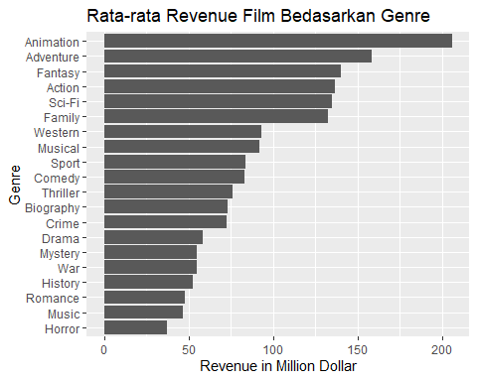

Slide 37
Insight dan Manfaat
Dari Visualisasi plot-plot yang kami sudah buat didapatkan beberapa insight:
Drama menjadi genre yang paling banyak dipilh sebagai genre untuk sebuah film, disusul Action dan Comedy. Genre Musical dan Western jarang dibuat sebagai film.
Film animasi lebih banyak menghasilkan uang ( dilihat dari pehitungan rata-rata revenue ) dari genre manapun. Film Adventure juga menjadi film kedua dengan rata-rata revenue yang tinggi. Film Horror memiliki rata-rata revenue yang paling rendah dari seluruh genre.
Produksi film pada tahun 2016 meroket daripada tahun-tahun sebelumnya. Hal ini juga menandakan rumah produksi film sudah melihat film menjadi penghasil uang yang cukup besar.
Film Action, Drama, Adventure, Animation, Biography, Comedy, Drime, Horror, History mengalami kelonjakan yang sangat tinggi pada tahun 2016
Di beberapa kasus, semakin banyak film yang diproduksi rata-rata pendapatan yang diperoleh semakin kecil.
Ada beberapa genre yang tidak tercatat—atau bisa saja tidak ada film di tahun itu diproduksi. Berikut Rinciannya:
2006: Western, Musical
2007: Western, War, Sport
2008: Western
2009: Western, Musical, Music, History
2010: Musical, Sport, Music, History
2011: Western, Musical, War, History
2012: War, Sport
2013: Musical, War
2014: Musical
2015: Musical
2016: Musical

Slide 38
Insight dan Manfaat (2)
Dari insight-insight yang kami dapatkan, keputusan bisnis yang dapat dilakukan:
Pihak manajemen bioskop dapat membuka slot kuota penayangan lebih banyak lagi untuk film yang bergenre Drama, Action, dan juga Comedy dibandingkan film-film Musical, Western, maupun War. Hal ini akan membuat bioskop lebih ramai dan menggaet lebih banyak penonton.
Pihak produksi film dapat lebih memilih Animation, Adventure ataupn Sci-Fi untuk mendapatkan pendapatan yang tinggi dibandingkan film genre yang lain seperti Horror, Romance, dan Music.
Pihak produksi film yang baru-baru dibuat seperti A24 bisa lebih memilih genre Drama maupun Action untuk meningkatkan popularitas rumah produksi mereka
Pihak produksi dapat untuk menghindari merilis film di tahun itu, jika pada tahun tersebut terdapat banyak film lain dengan Genre yang sama. Akan lebih baik untuk menggeser jadwal tayangnya karena memungkinkan untuk lebih menguntungkan dari segi pendapatan.

Slide 39
-
Terima Kasih

