Slide 1
EC601 Project 2 – Social Media Analyzer
Gianna Iafrate
10/10/21

Slide 2
Project Goal
Gather MLB data for each team and see which teams have the best feedback
See if the feedback lines up to the current MLB rankings
  i.e. best feedback = highest ranked team in standings

Slide 3
User Stories
As an MLB fan, I want to see what people are saying about each team.
I want to use a combination of Twitter and Google to see how people and fans are feeling about the various teams’ performance.
Given the sentiment analysis, I want to see which fan base has the best things to say about their team, and if there is any correlation to the current standings.
I want to see what emotions the happiest and least happy fan base are feeling.
I want to gather a large amount of data from Twitter and analyze it.

Slide 4
Method to Analyze
Train a Google sentiment model on data from Google Quickstart Tutorial
Use Twitter API to pull recent MLB tweets using the following method:
  Search recent 100 tweets and remove any retweets or replies for each team using the keyword of the name (i.e. “red sox”)
  Perform same method but using the MLB 2021 team hashtags (i.e. #DirtyWater)
  Repeat this pull method again at another date to get different data
Perform Google sentiment analysis on each tweet
Average the sentiment results

Slide 5
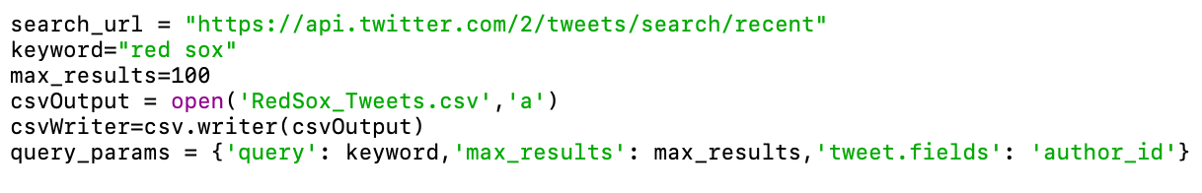
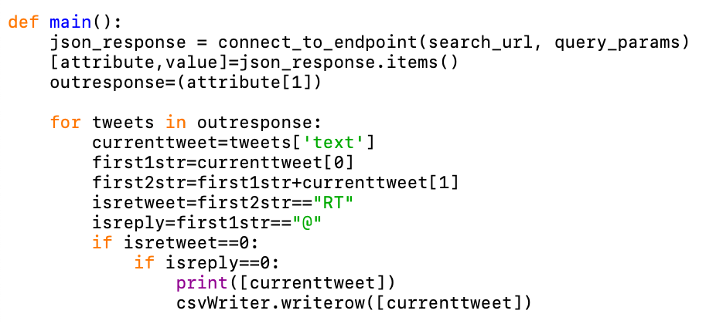
Twitter Code
Keyword and csv output name changed for each team
Index into the .json output to get each tweet retrieved
If not a retweet or reply, write the tweet to the .csv file

Slide 6
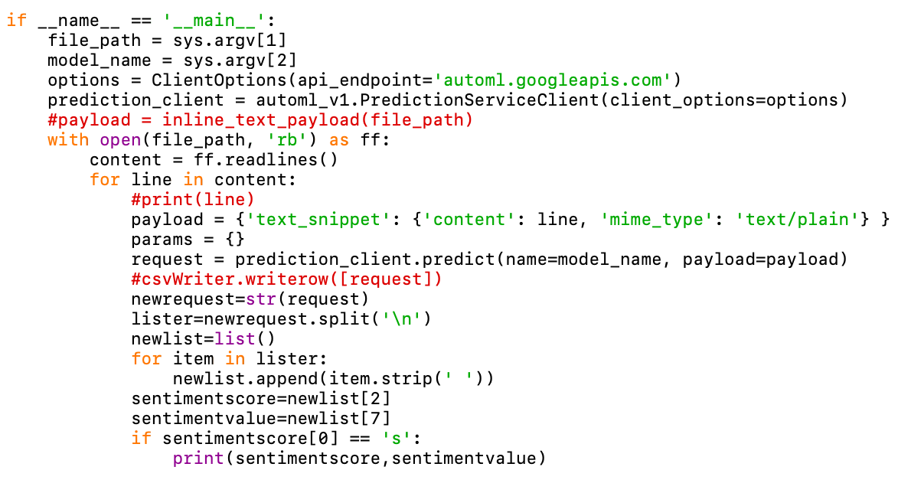
Google Code
First argument when running code is path to .csv file with teams’ tweets
Send output to a csv file through terminal
Index through the output to only print the sentiment score and value to each line per tweet

Slide 7
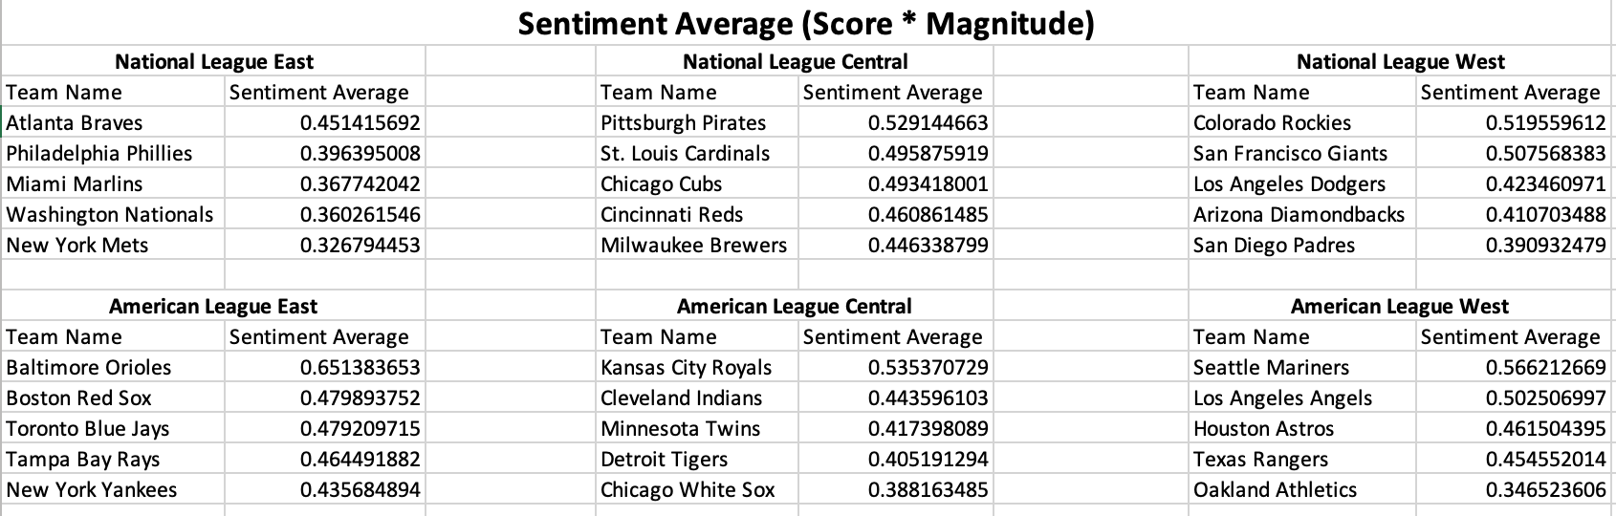
Results
Sentiment Average: Score (ranked 1-4 of how positive/negative it is) * magnitude (or value, % of how emotional the tweet is)
Ranked each team by Division (above) and overall

Slide 8
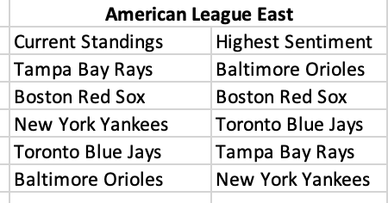
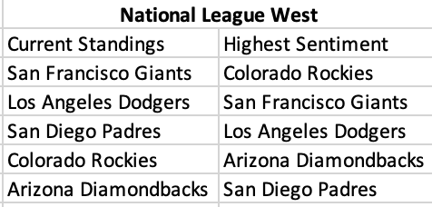
Comparison to Standings - Example
Some leagues were not too far off, others were extremely different
Overall rankings had no trend or correlation to the standings

Slide 9
Conclusions
The results can be taken one of two ways:
The fan base happiness does not always equate to how well the team is performing
The Google sentiment model was not trained well enough and should have been trained on data more closely related to sports analytics
If this were to be performed in the future, I would recommend gathering tweets first, ranking their sentiment based on reading them, and training a Google model off of that.

Slide 10
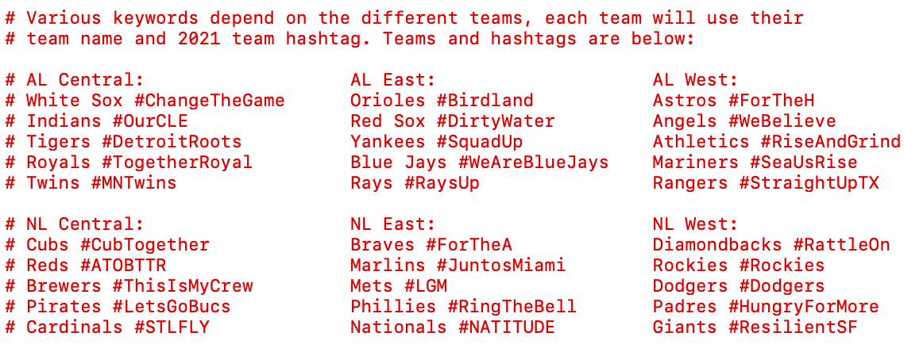
Appendix: Names and Hashtags

