Slide 1
Finding Inclusion Rules
Flagging SNAP cases for review: INCL_ scripts
https://github.com/giannella/snap_qc
Version 2: rules found by machine learning, kept only when we can be confident in their accuracy, then tuned for each state
Inclusion rules · INCL_ scripts
1

Slide 2
The problem
Review capacity is limited; only a small fraction of cases can be examined.
We want to flag the cases most likely to have large, correctable payment errors.
An “inclusion” rule marks a case as more likely to have one of these errors.
Designed to focus on high precision (maximize average yield per reviewed case) while still catching a predefined level of errors (recall).
Inclusion rules · INCL_ scripts
2

Slide 3
Key ideas
Precision : share of flagged cases that are true errors.
Recall : share of all errors (or error dollars) that get flagged.
Finding rules: two standard machine-learning methods (xgboost and ranger) grow thousands of decision trees on the data; every branch becomes a candidate if-then rule. The two methods find different rules, so we use both.
Keeping rules: a rule tested on only a handful of cases can look great by luck. Before keeping a rule, we shrink its measured precision to what we can be statistically confident of, given how many cases it was tested on. Without this step, a rule list promising 20% precision delivered about 10% on new data.
By household size: cases are split into sizes 1, 2-3, and 4+ and modeled separately, since benefits and error amounts scale with household size.
Counting every error: when a flagged case turns out to have a different kind of error than the rule was built for, the review still succeeded. Counting only the original error type understates real-world accuracy by about half.
Inclusion rules · INCL_ scripts
3

Slide 4
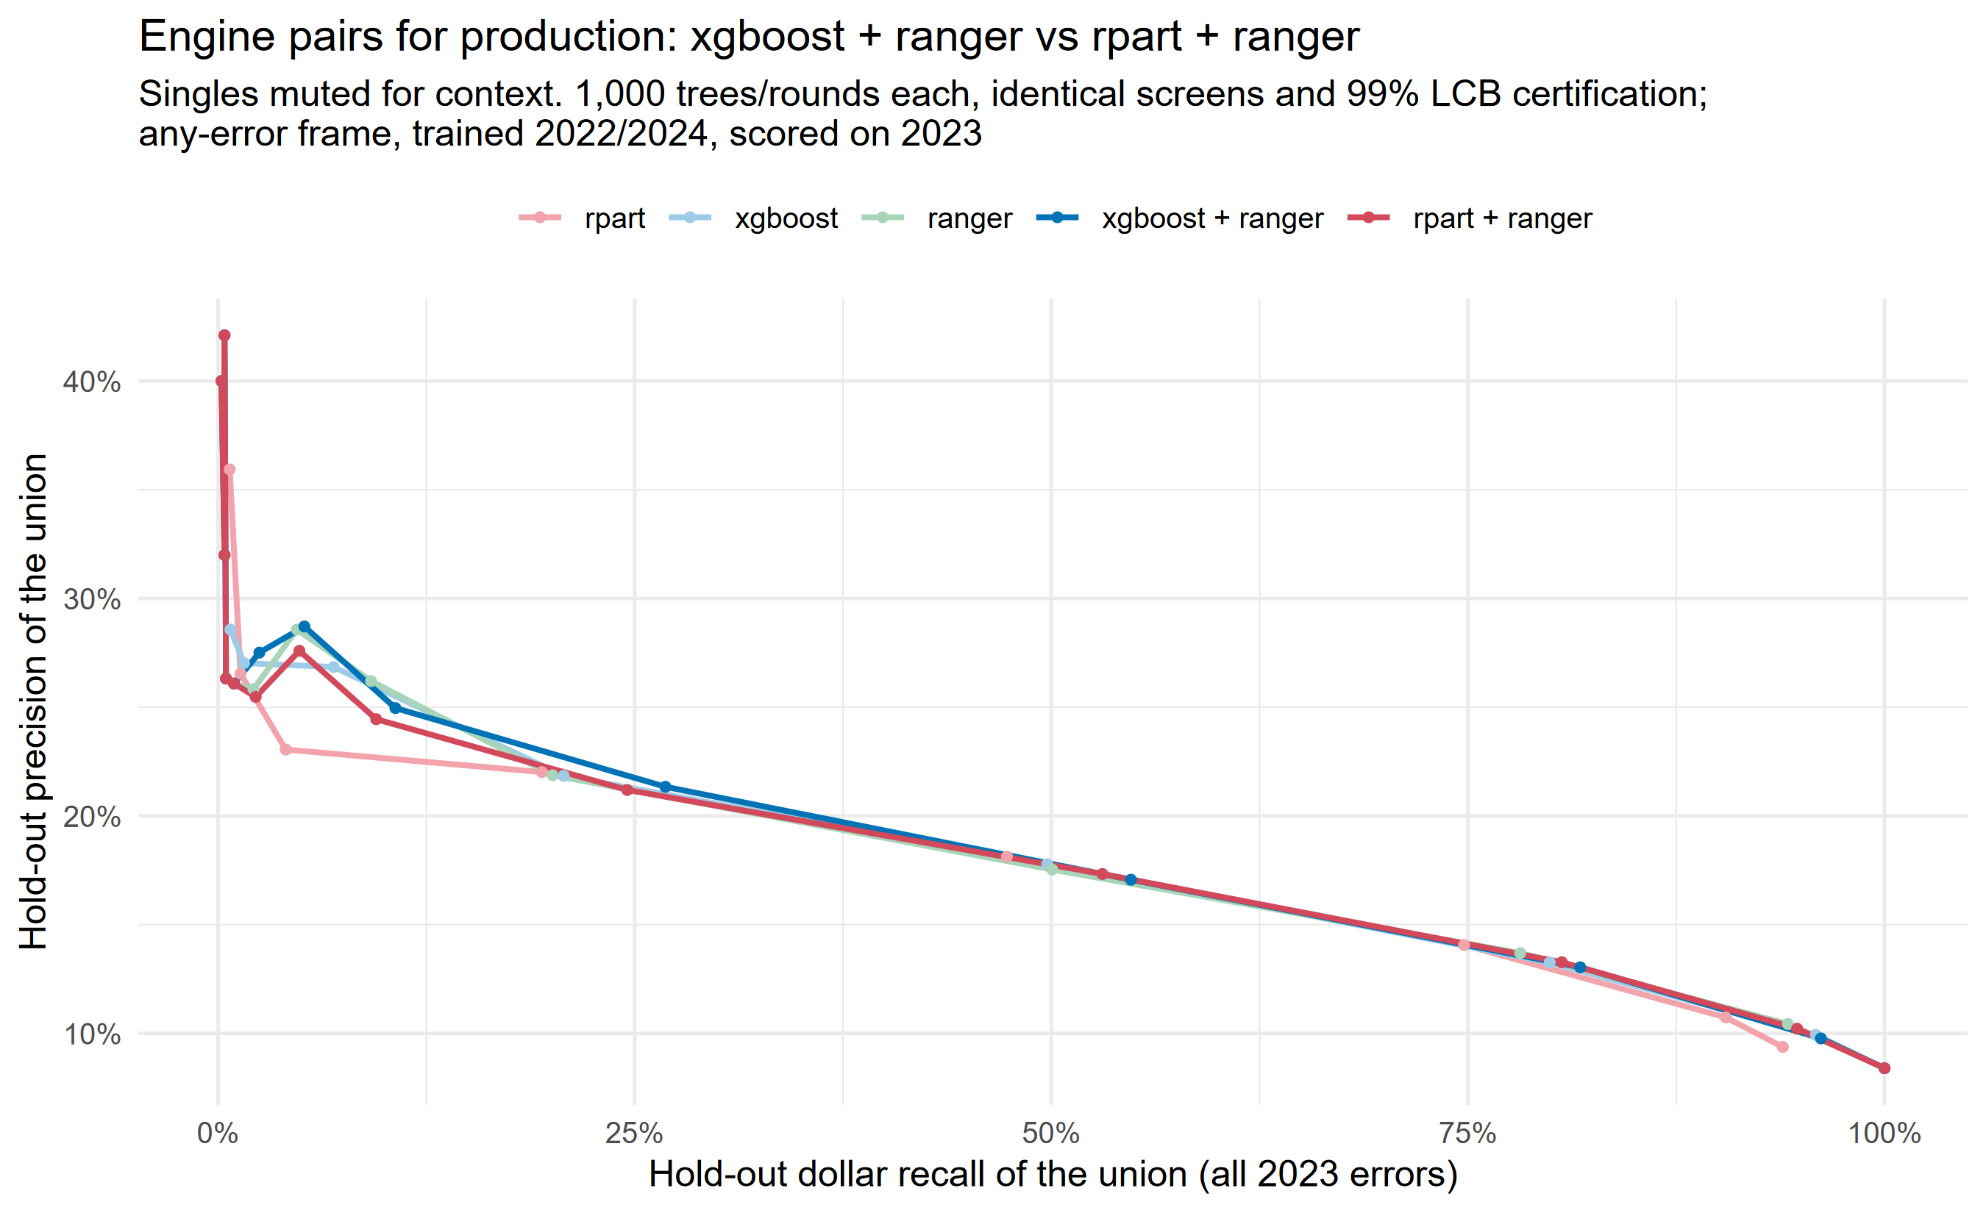
Finding rules: xgboost + constrained random forests
- Head-to-head with everything else identical (same screens, dedup, filter): xgboost + ranger catches 55% of error dollars at the 0.20 filter floor vs 47% for bagged CART ({pre}'s rule generator), at slightly better precision at matched recall (+1.2pp).
- The pair beats either engine alone; they find complementary rules (engine pairs beat singles in every test).
- Random forests can only choose between two variables in each split, forces coverage of key demographic variations such as elderly or disabled.
Notes:
- Also ~5x faster than the {pre} pipeline and runs on a 16 GB laptop (the old internal lasso needed 40+ GB at scale).

Slide 5
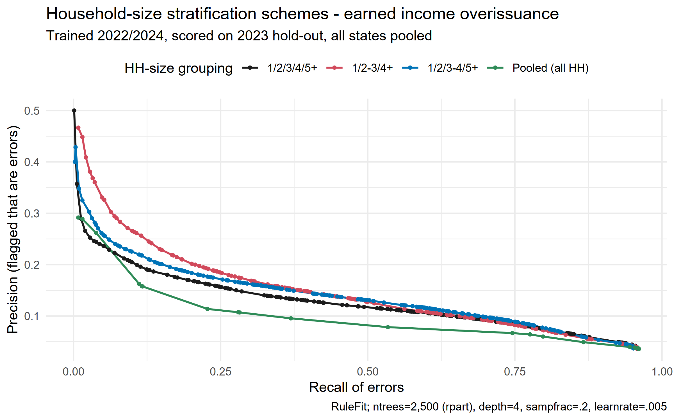
Finding rules: Modeling by household size helps
Inclusion rules · INCL_ scripts
4

Slide 6
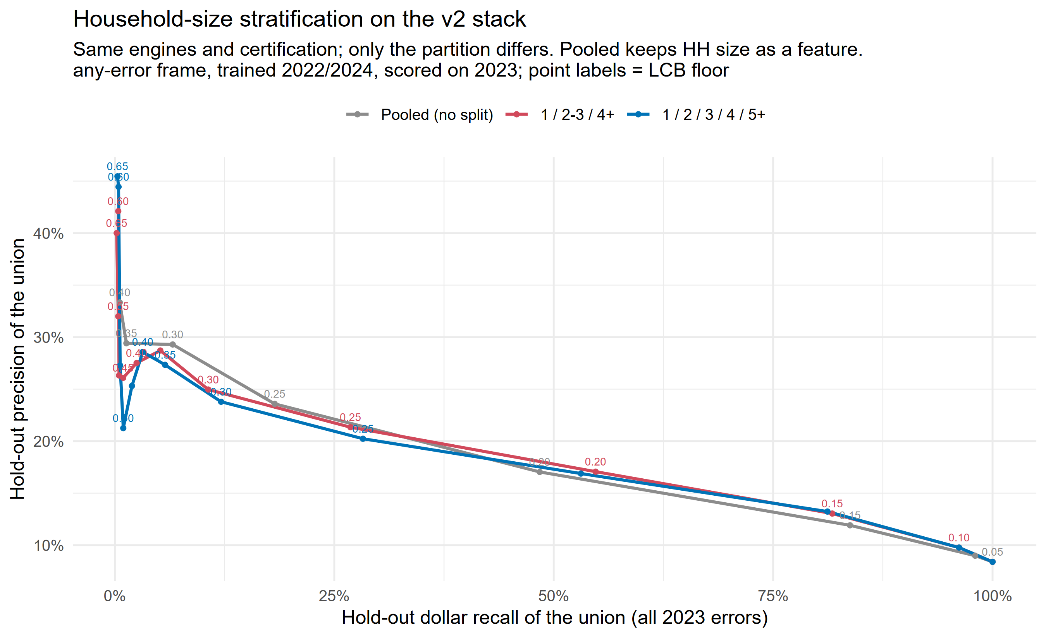
But less so after we introduce constrained random forests (mtry=2)
Inclusion rules · INCL_ scripts
4

Slide 7
How to use the scripts
Input data for finding rules
national OR
similar states OR
your state
state_threshold_ gridsearch_v2
Adjust rule cutoffs to your state's data
Add to existing curated rule set
Test on hold-out (either FY25/26 or a predefined random sample)
INPUT
Labelled cases (errors + clean)
INCL_find_inclusion_rules_by_hh_size_v2.
Find candidate rules; keep reliably accurate rules
Choose how many rules to use
Pick the precision floor that matches your review capacity
OUTPUT
State rule set for testing on FY2025 and FY2026 data
States with smaller samples and where national rules don’t perform well should use rules derived from similar states and test on their data.
Inclusion rules · INCL_ scripts
5

Slide 8
Find and combine inclusion rules:
INCL_find_inclusion_rules_by_hh_size_v2.R
Creating rules: For each error type (earned income, unearned income, underpayment, other) plus an all-errors category, and each household size, the two tree-growing methods propose rules that combine 1-4 variables.
Scoring rules: Every rule is scored three ways: on the data used to build it, on a year of data it never saw, and counting every kind of error it catches.
Selecting rules: A rule is kept only when we can be statistically confident its precision clears the bar (default: confident at the 99% level that at least 1 in 5 flagged cases has an error). Near-duplicate rules are removed.
Measure overall potential: Track, for each level of precision, what ALL the selected rules achieve together: how many cases they flag and what share of errors and error dollars they catch (a case flagged by several rules counts once).
Output tables and charts
Full rule table (scores on build data, on a new year, and against all error types)
Shortlist of high-confidence rules (near-duplicates removed)
Summary table + chart: results at each precision floor
Inclusion rules · INCL_ scripts
6

Slide 9
Example outputs from INCL_find_..._v2 output: filtered inclusion rules
file: /inclusion_rules_by_hh_size_v2/final_rules_highprecision_all_frames.csv
HH size | rule | error type targeted | precision floor met in training (lower confidence bound) | precision, new year (same error type) | precision, new year (any error)
1 | months_since_cert_n > 5.50 & unc_rawben_rel_max > 1.82 & utilities <= 340 | Earned income | 0.23 | 0.26 | 0.43
2-3 | months_since_cert_n > 1.50 & months_since_cert_n <= 15.50 & unc_rawben_rel_max > 1.69 | Unearned income | 0.21 | 0.28 | 0.46
1 | shelter_expenses_by_hh_size > 882 & total_deductions_by_hh_size > 714 & utilities <= 8 | Other (deductions, shelter, HH composition) | 0.25 | 0.24 | 0.38
7

Slide 10
Output: what the kept rules achieve together, at each precision floor
precision floor | % of error $ caught | % of caseload | cases flagged | rules kept | Precision on held-out data | % of errors caught
0.20 | 83% | 51.6% | 20,668 | 15,335 | 0.173 | 80%
0.30 | 32% | 12.5% | 5,017 | 1,832 | 0.256 | 29%
0.40 | 7% | 2.4% | 944 | 299 | 0.339 | 7%
8

Slide 11
Tuning rules for a specific state:
state_threshold_gridsearch_v2.R
state_threshold_gridsearch_v2.R
Takes the national rule list and, for one state at a time: tries a range of cutoff values for every rule on the state's training years, keeps rules that meet the quality bar on the state's own data, and picks the version of each rule that captures the most error dollars.
Built-in honesty checks
Every rule is then tested on a year of data that was never used for tuning (under both its adjusted cutoffs and the original national ones), and the whole exercise is compared against simply using the national rules unchanged. In seven-state testing, tuning helped when roughly 30+ rules met the bar (Connecticut: 43% of errors and 49% of error dollars caught, with about 1 in 5 flagged cases having an error) and hurt below that; with little data, tuning just rewards lucky cutoffs. Smaller states: use the national rules as-is.
Writes per-state rule CSVs (national + tuned thresholds side by side) to state_rules_v2/
Inclusion rules · INCL_ scripts
9

Slide 12
Appendix: why we're cautious about a rule's measured accuracy
- The trap: generate 100,000 candidate rules and keep the ones with the best measured accuracy, and you mostly keep rules that got lucky. We measured it: a list promising 20% precision delivered about 10% on a year of new data.
- The fix, by example: a rule that flagged 20 cases and was right 4 times and a rule that flagged 200 and was right 40 both measure 20%, but only the second has real evidence behind it. We adjust each rule's score for how much evidence it has, and keep a rule only when the adjusted score clears the bar.
- Result: kept rules deliver roughly what they promise on new data, and at the same delivered accuracy (about 1 in 5 flagged cases having an error), we catch 12.8% of all errors instead of 8.2%.
- Caution for single states: with only a few hundred errors to learn from, the adjustment alone is not enough; also require each rule to have flagged at least ~30 cases, or rules will still disappoint on new data.
Appendix: v2 pipeline evidence

Slide 13
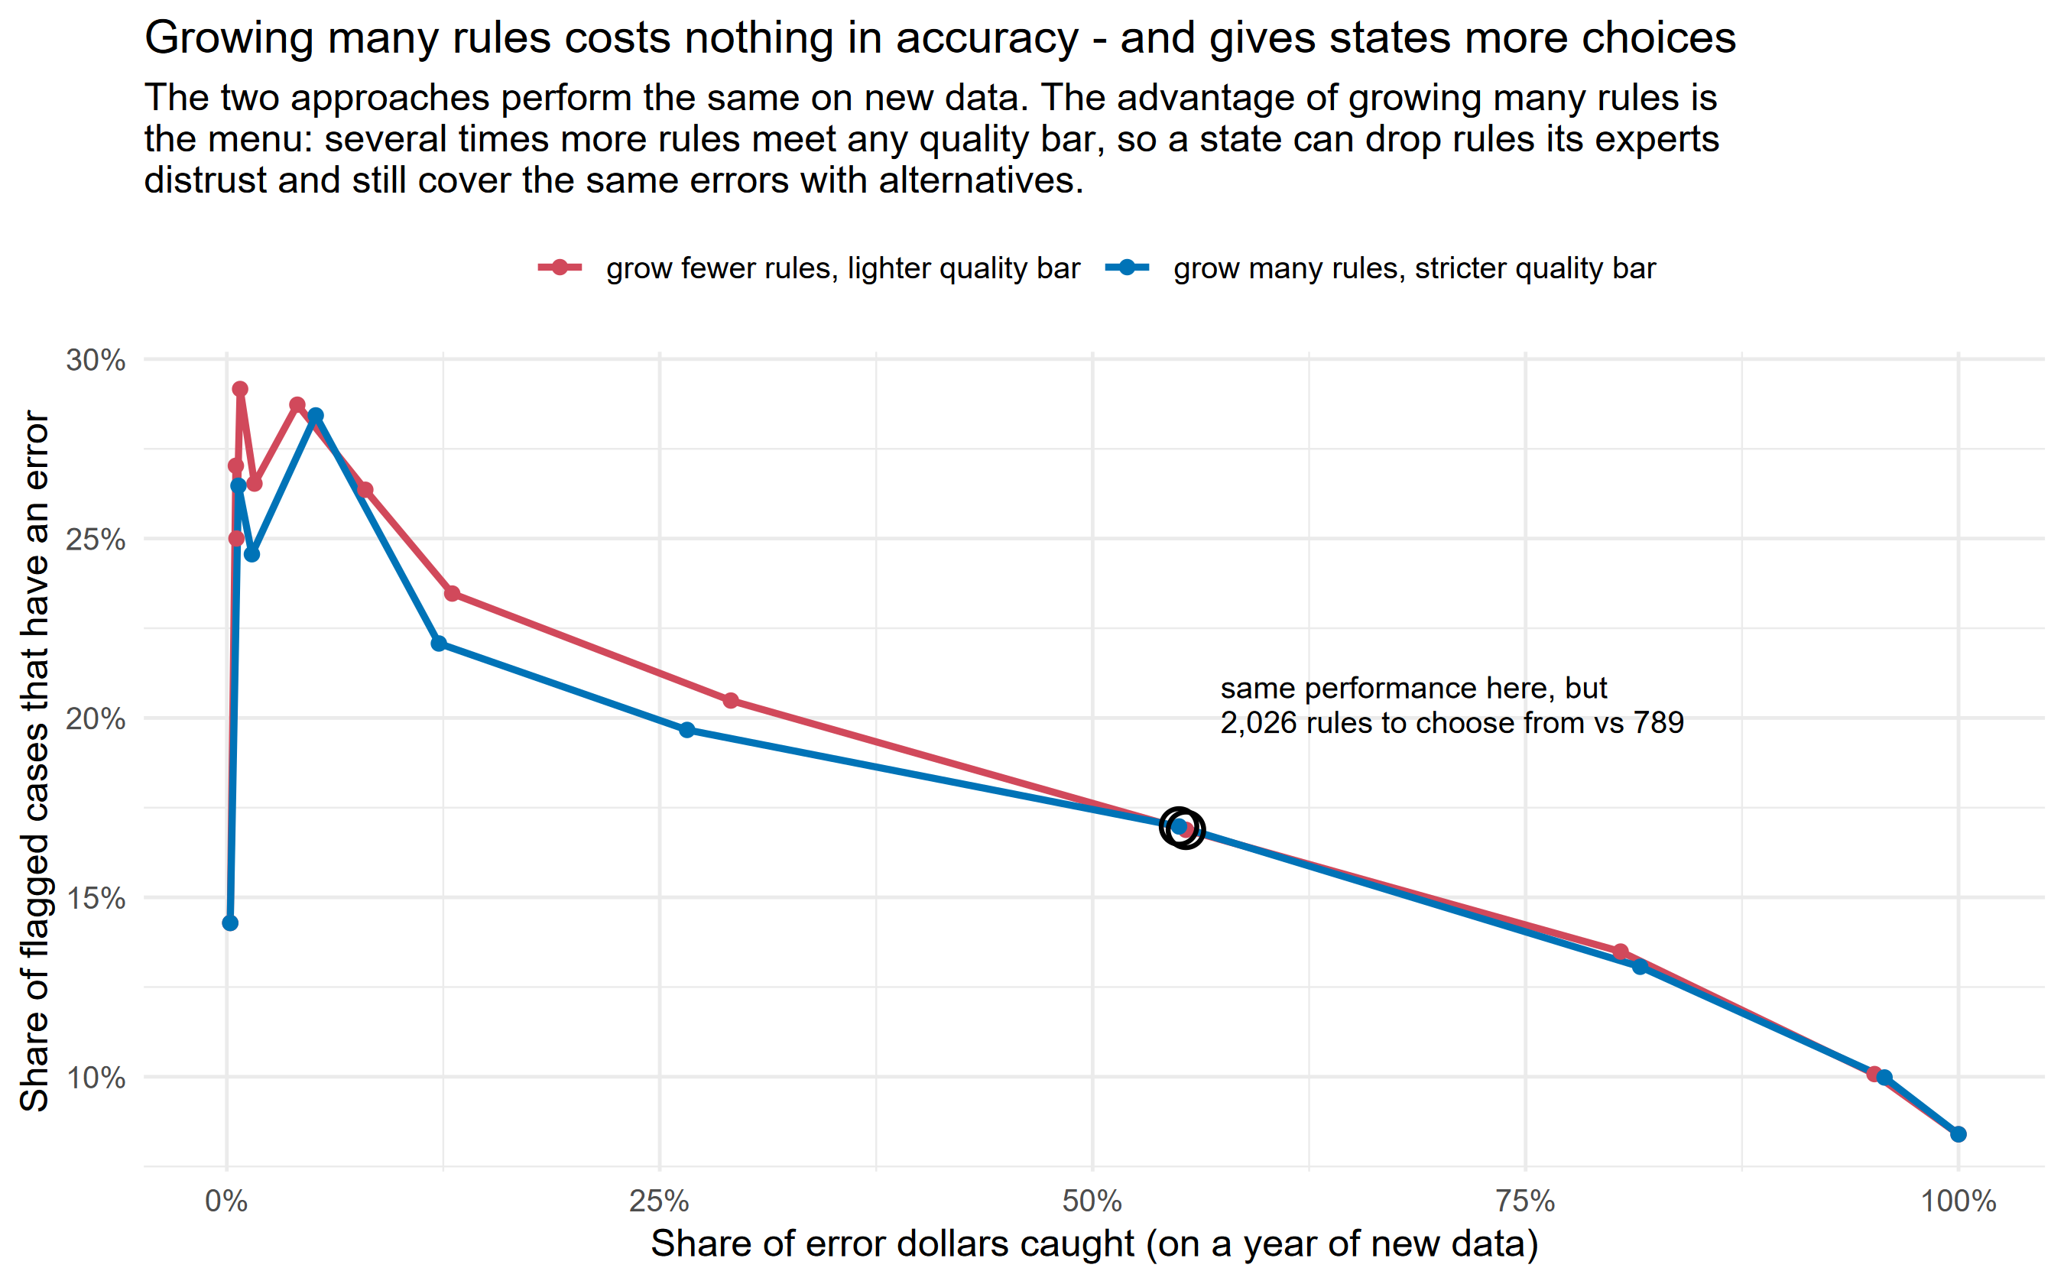
Appendix: settings that matter (and settings that don't)
- We varied one setting at a time and judged each version on a year of unseen data. What helped: letting each tree split consider two variables instead of one; learning slowly; and showing each tree a small random slice of the data (15-30%) rather than most of it.
- Growing more trees does not make the kept rules more accurate; the two curves below sit on top of each other. It makes the MENU bigger: several times more rules pass any precision floor, so states have alternatives when their experts want to drop a rule.
- Final settings: 1,000 rounds/trees for each method, with the 99%-confidence quality bar.
Appendix: v2 pipeline evidence

Slide 14
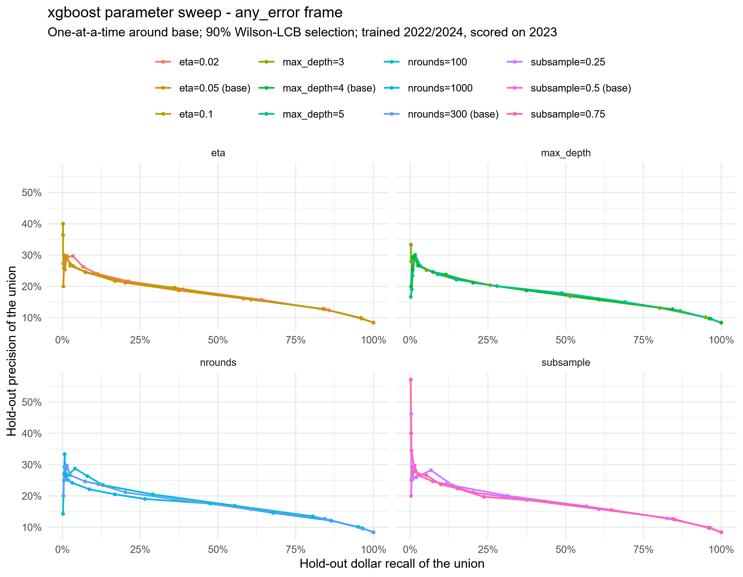
Appendix: tuning detail for the boosted-tree method (xgboost)
- Each panel varies one setting around our final choice; curves show accuracy vs share of error dollars caught, on a year of unseen data.
- Learning slowly beats learning fast; trees 4-5 questions deep beat shallower ones; more rounds mainly add rules (see previous slide).
Appendix: v2 pipeline evidence

Slide 15
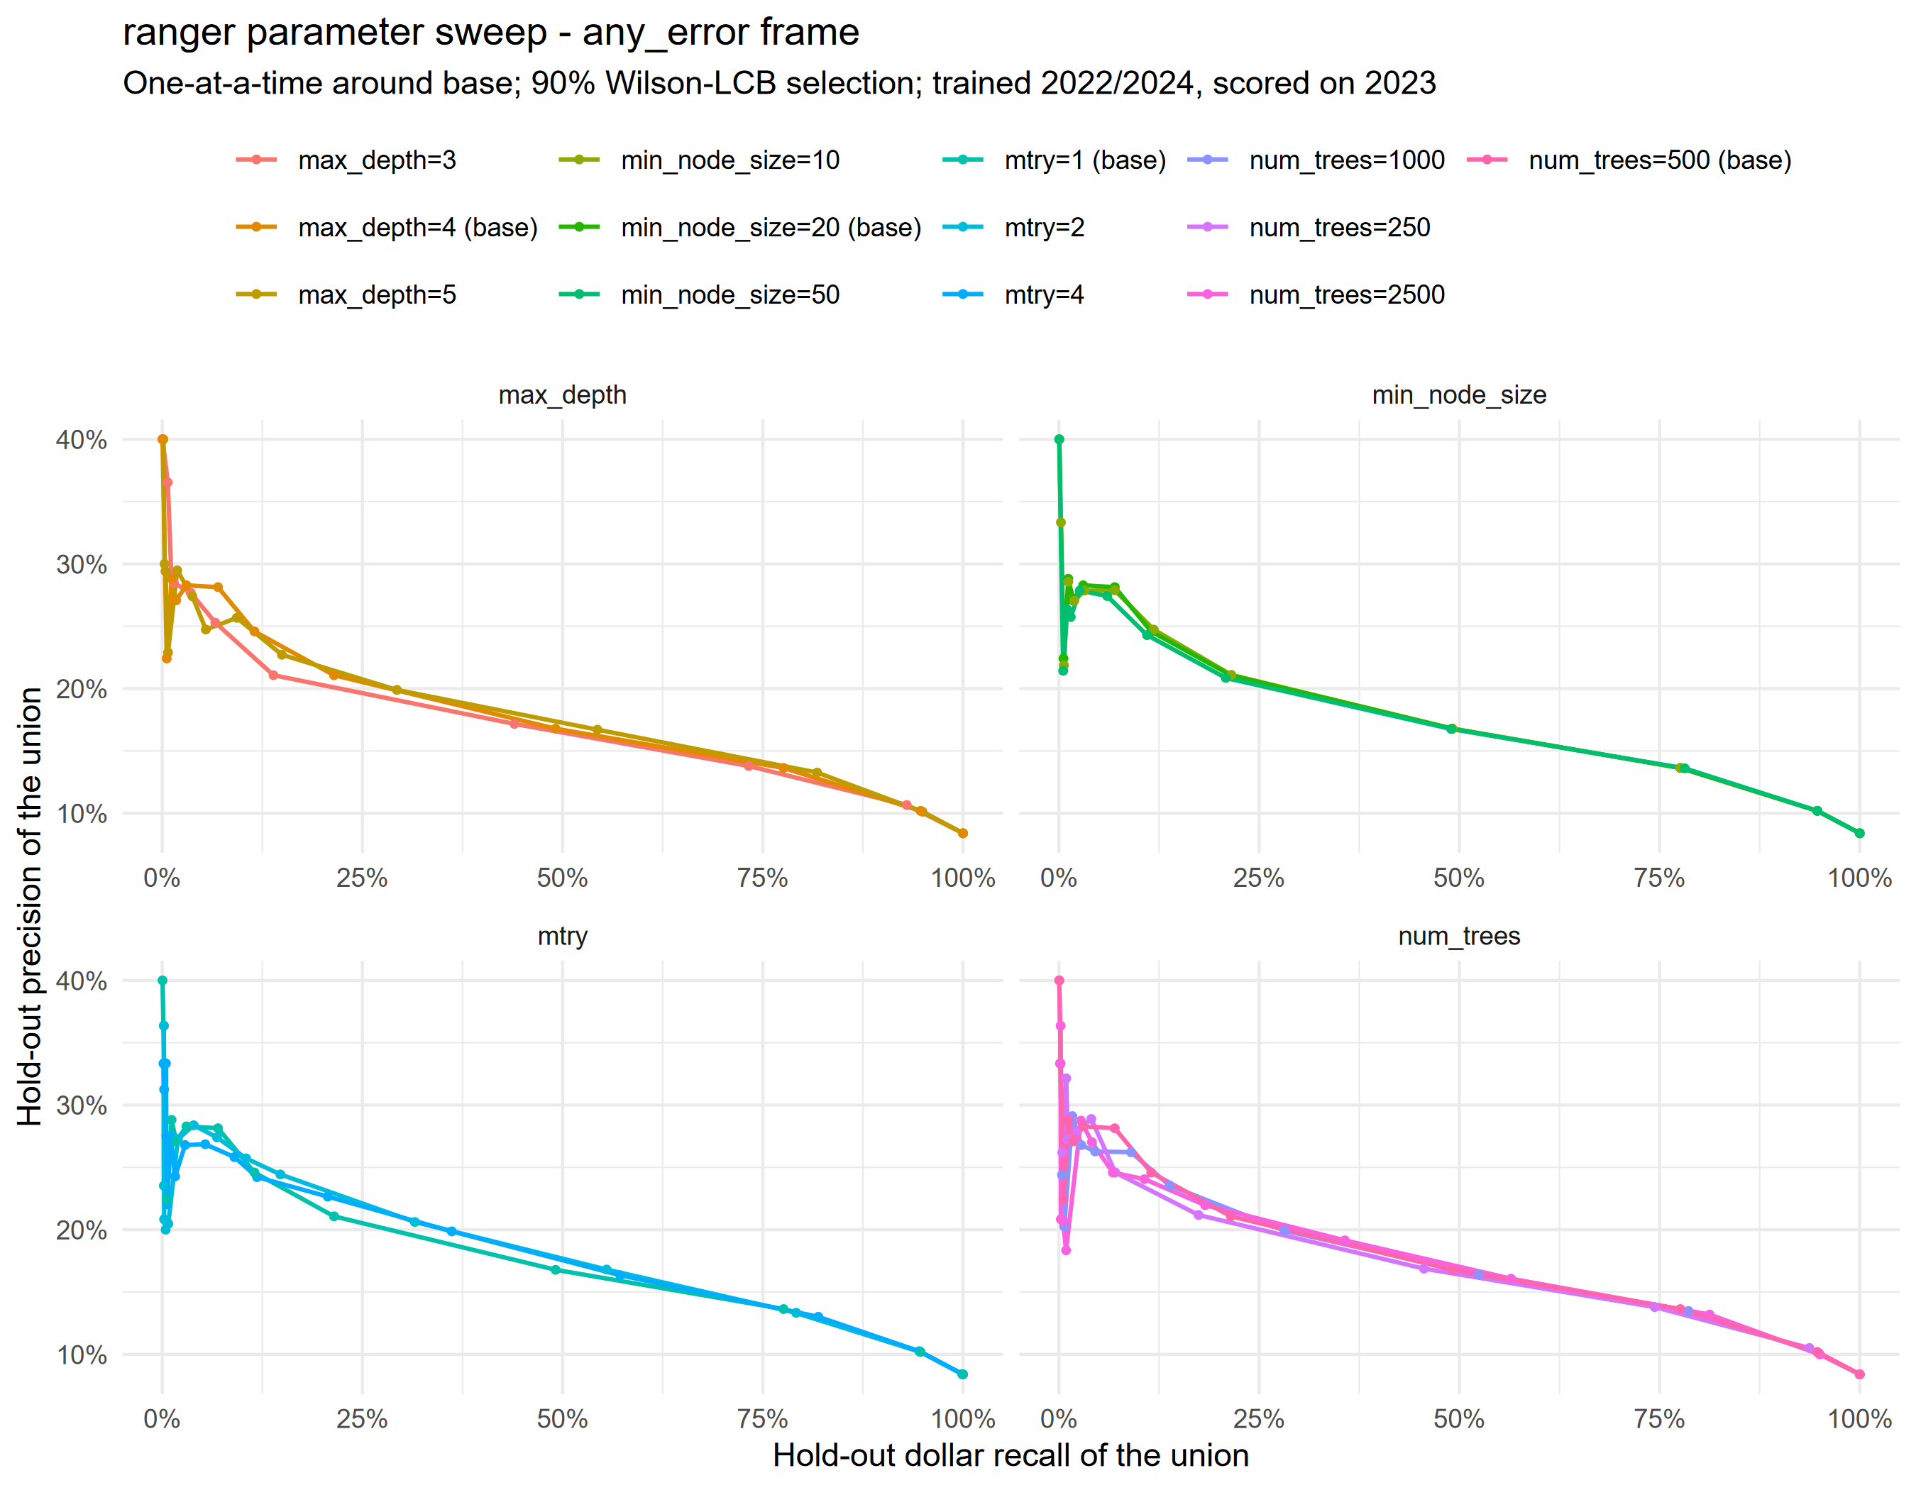
Appendix: tuning detail for the random-forest method (ranger)
- Letting each split choose between two variables beats forcing a single random variable; a little guidance beats pure randomness.
- Beyond ~500 trees, more trees neither help nor hurt accuracy; other settings barely matter.
Appendix: v2 pipeline evidence

Slide 16
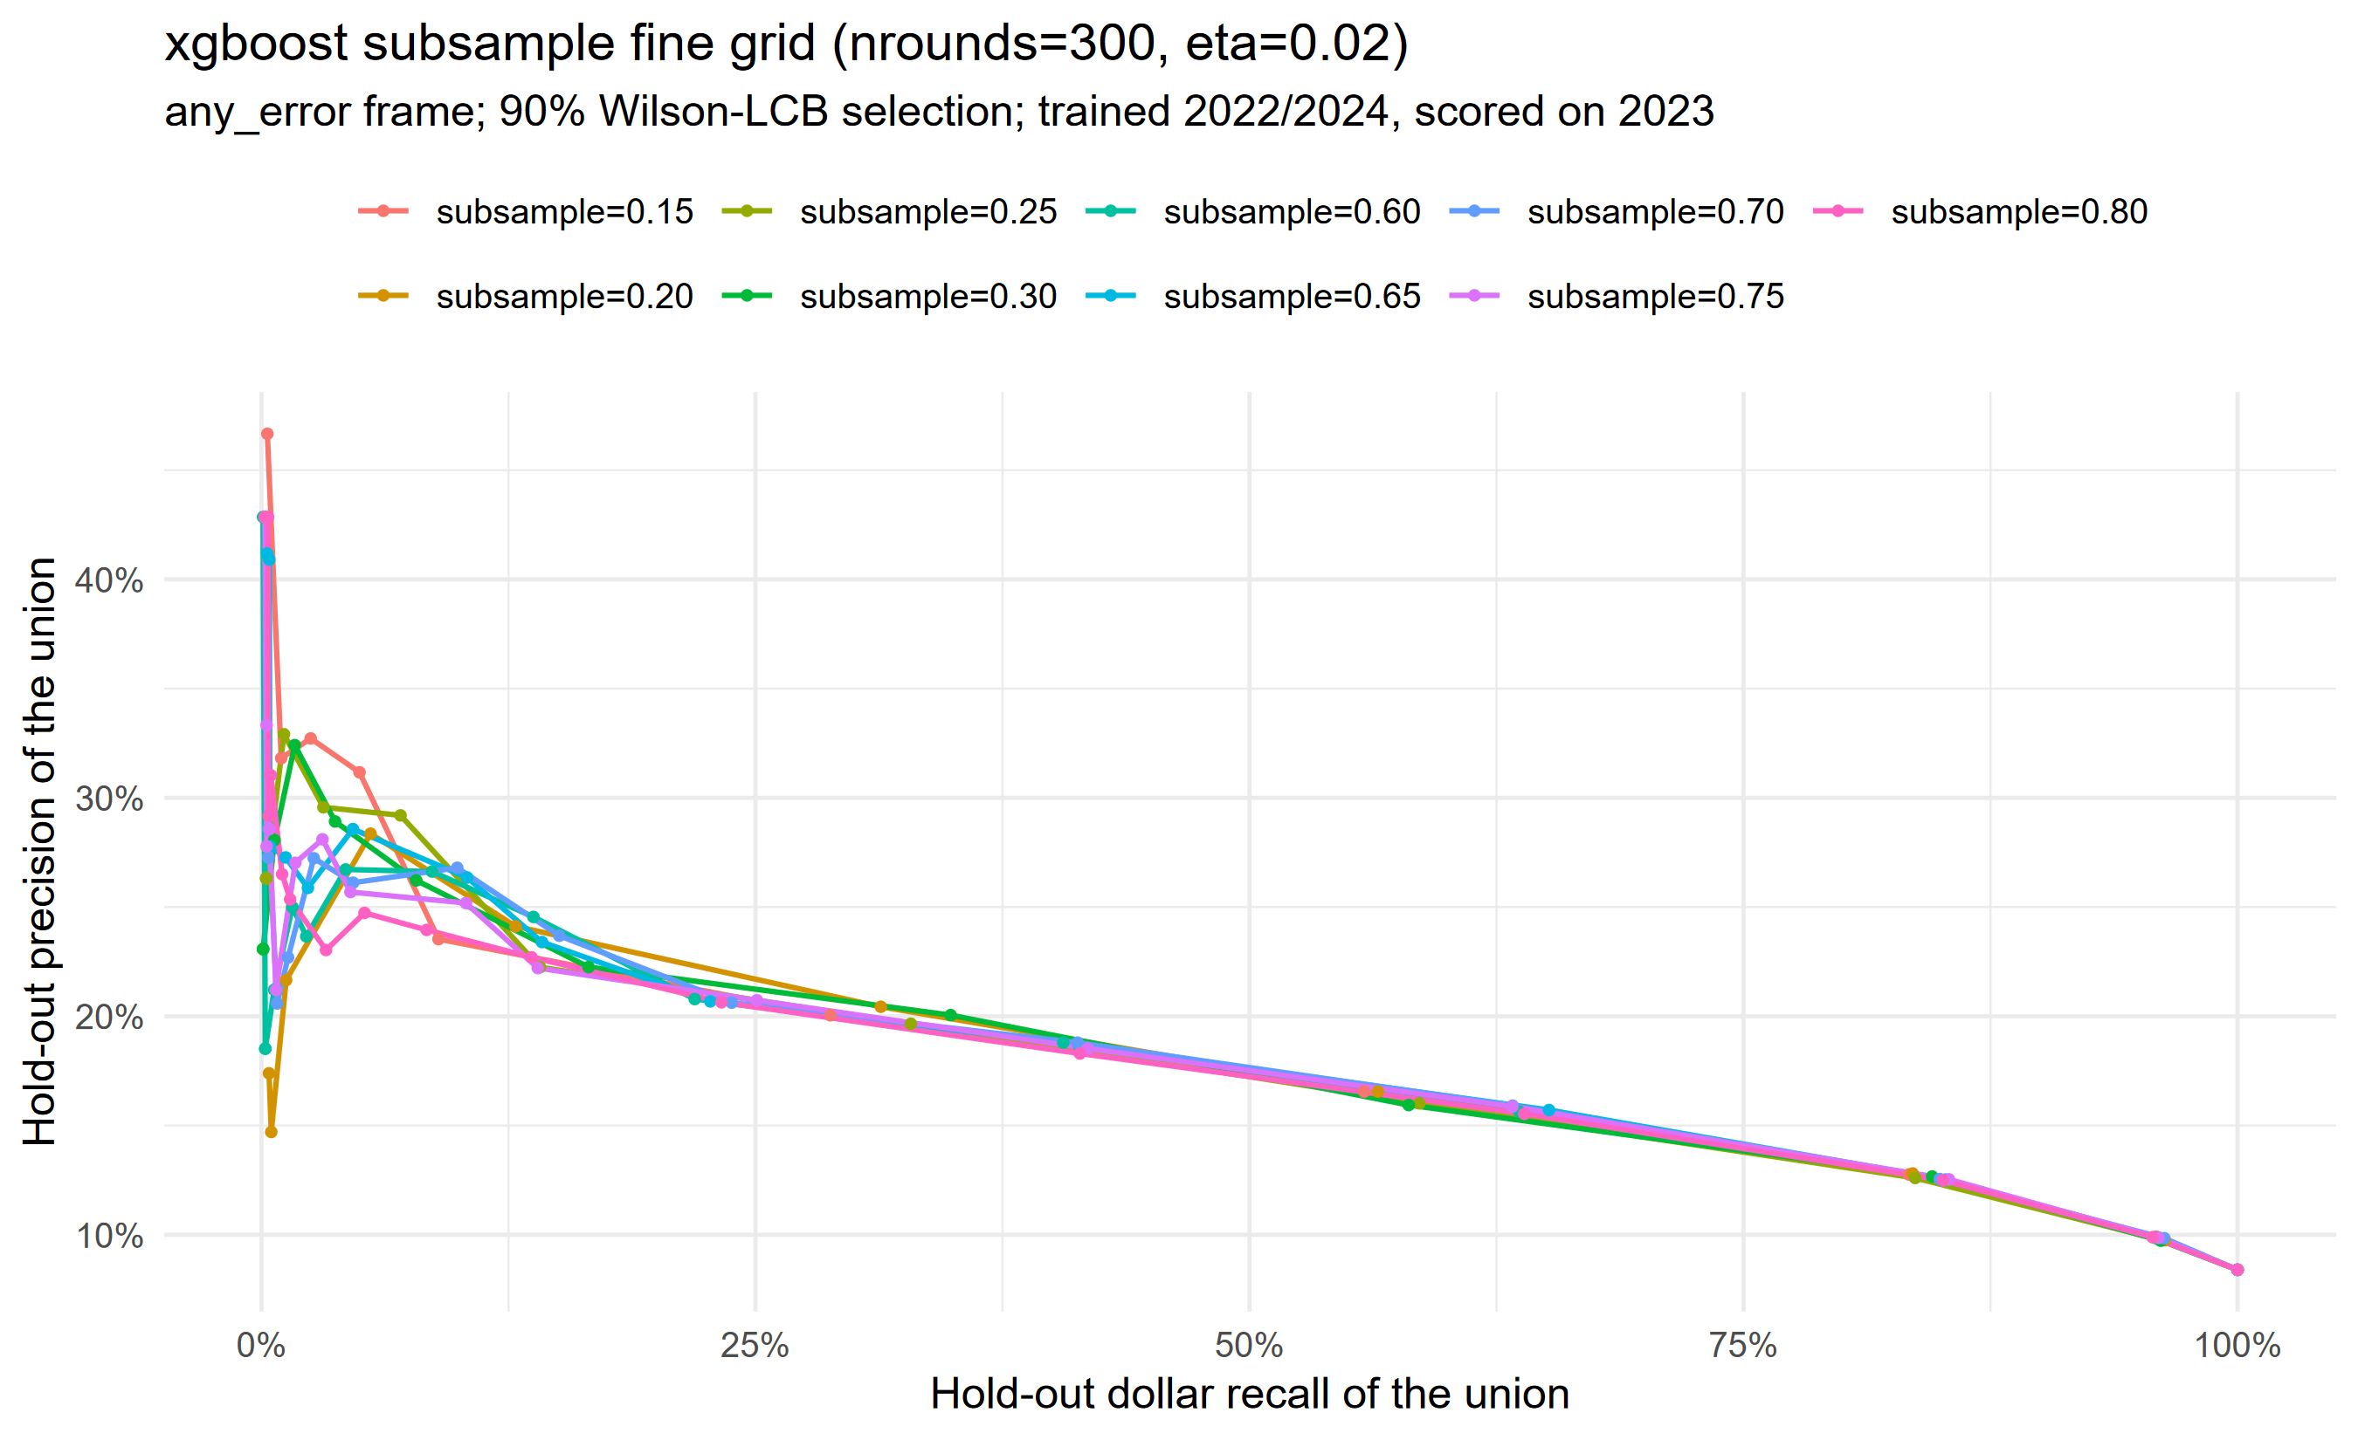
Appendix: tuning detail: how much data each tree sees
- Showing each tree a small random slice of the data (15-30%) works better than showing it most of the data (60-80%); small slices make the trees more varied, and varied trees find sharper rules.
- Anywhere in the 15-30% range performs the same; we use 20%.
Appendix: v2 pipeline evidence

Slide 17
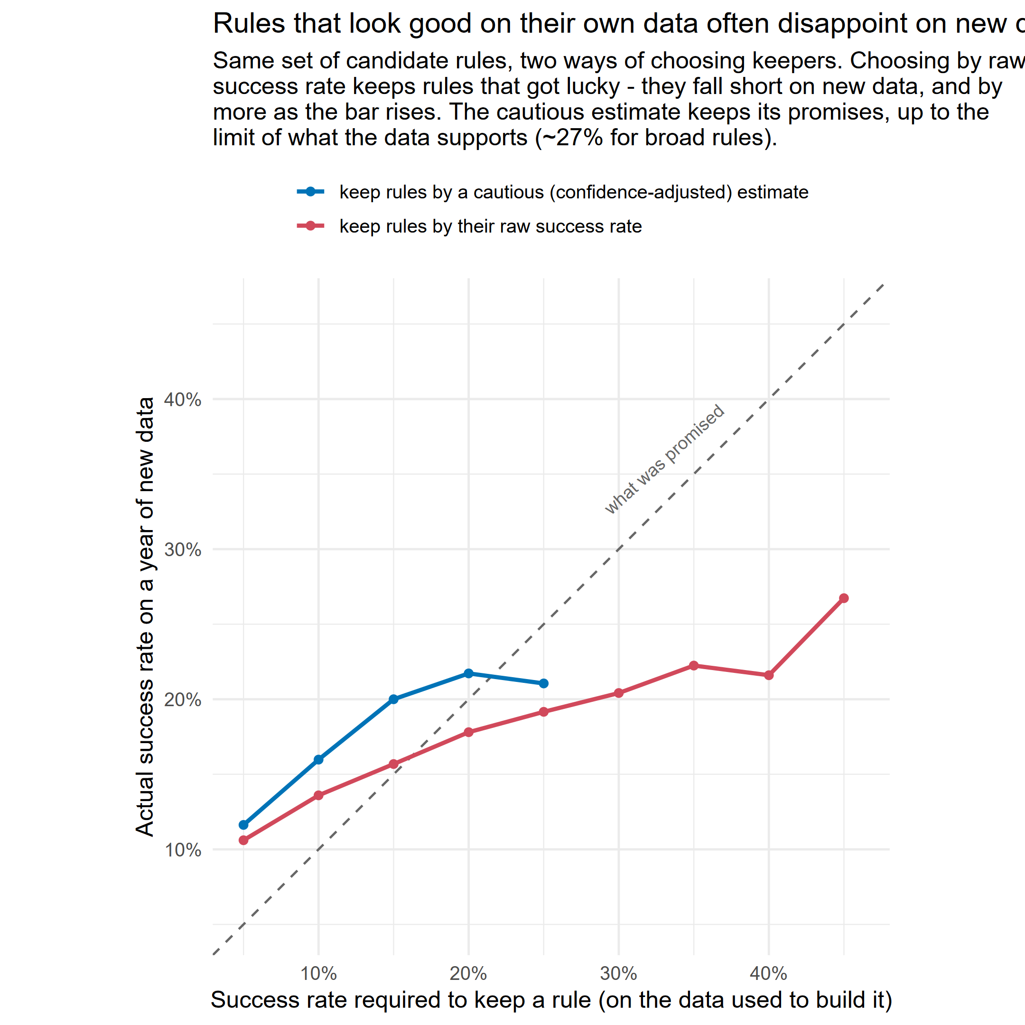
Appendix: lucky rules, measured
- Same candidate rules, chosen two ways, then scored on a year of data they never saw. Choosing by raw measured accuracy over-promises; choosing by the evidence-adjusted score keeps its promises.
Appendix: v2 pipeline evidence

Slide 18
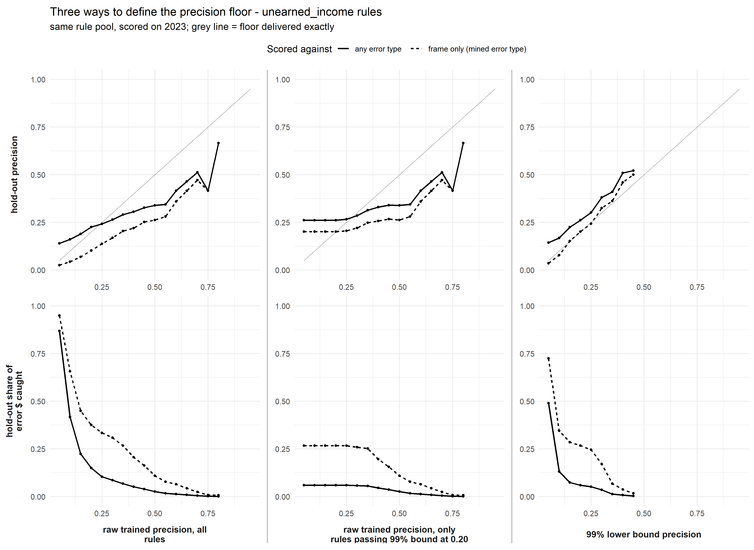
Appendix: why we use the 99% lower bound, not raw precision
Appendix: v2 pipeline evidence

Slide 19
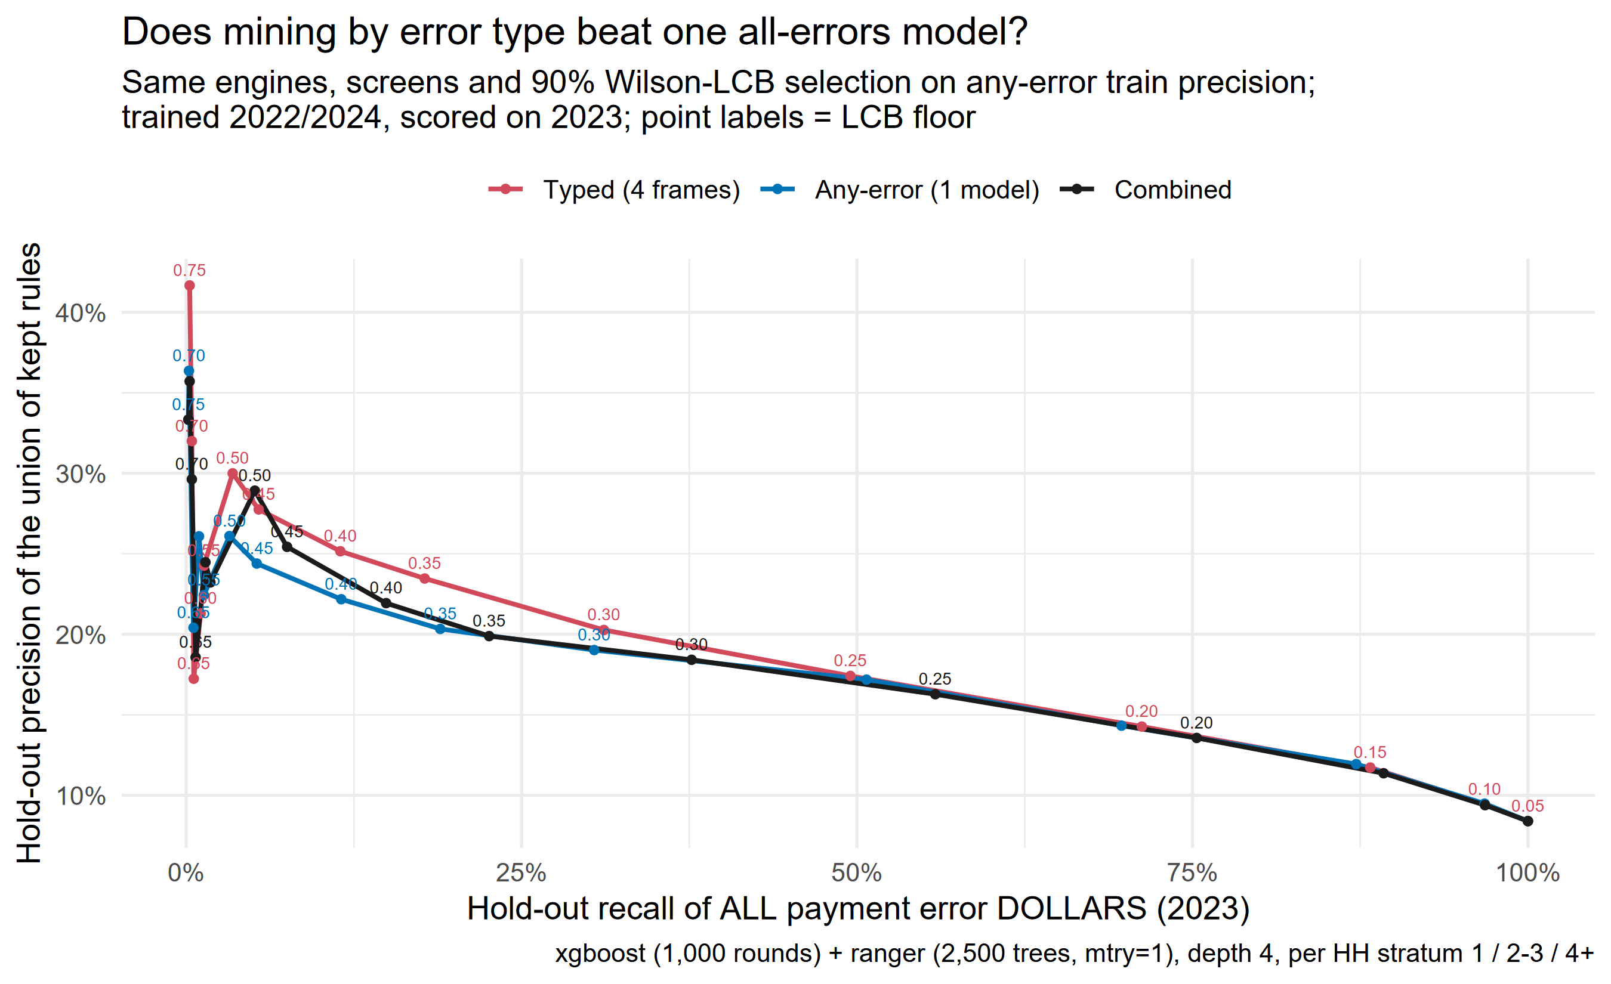
Appendix: build rules per error type AND for all errors together
- Rules built for specific error types and rules built on all errors together find different things; combining both catches 3-6 percentage points more errors at any precision floor, for a small accuracy cost. If you need just one simple model, the all-errors version gets you ~95% of the way.
Appendix: v2 pipeline evidence

Slide 20
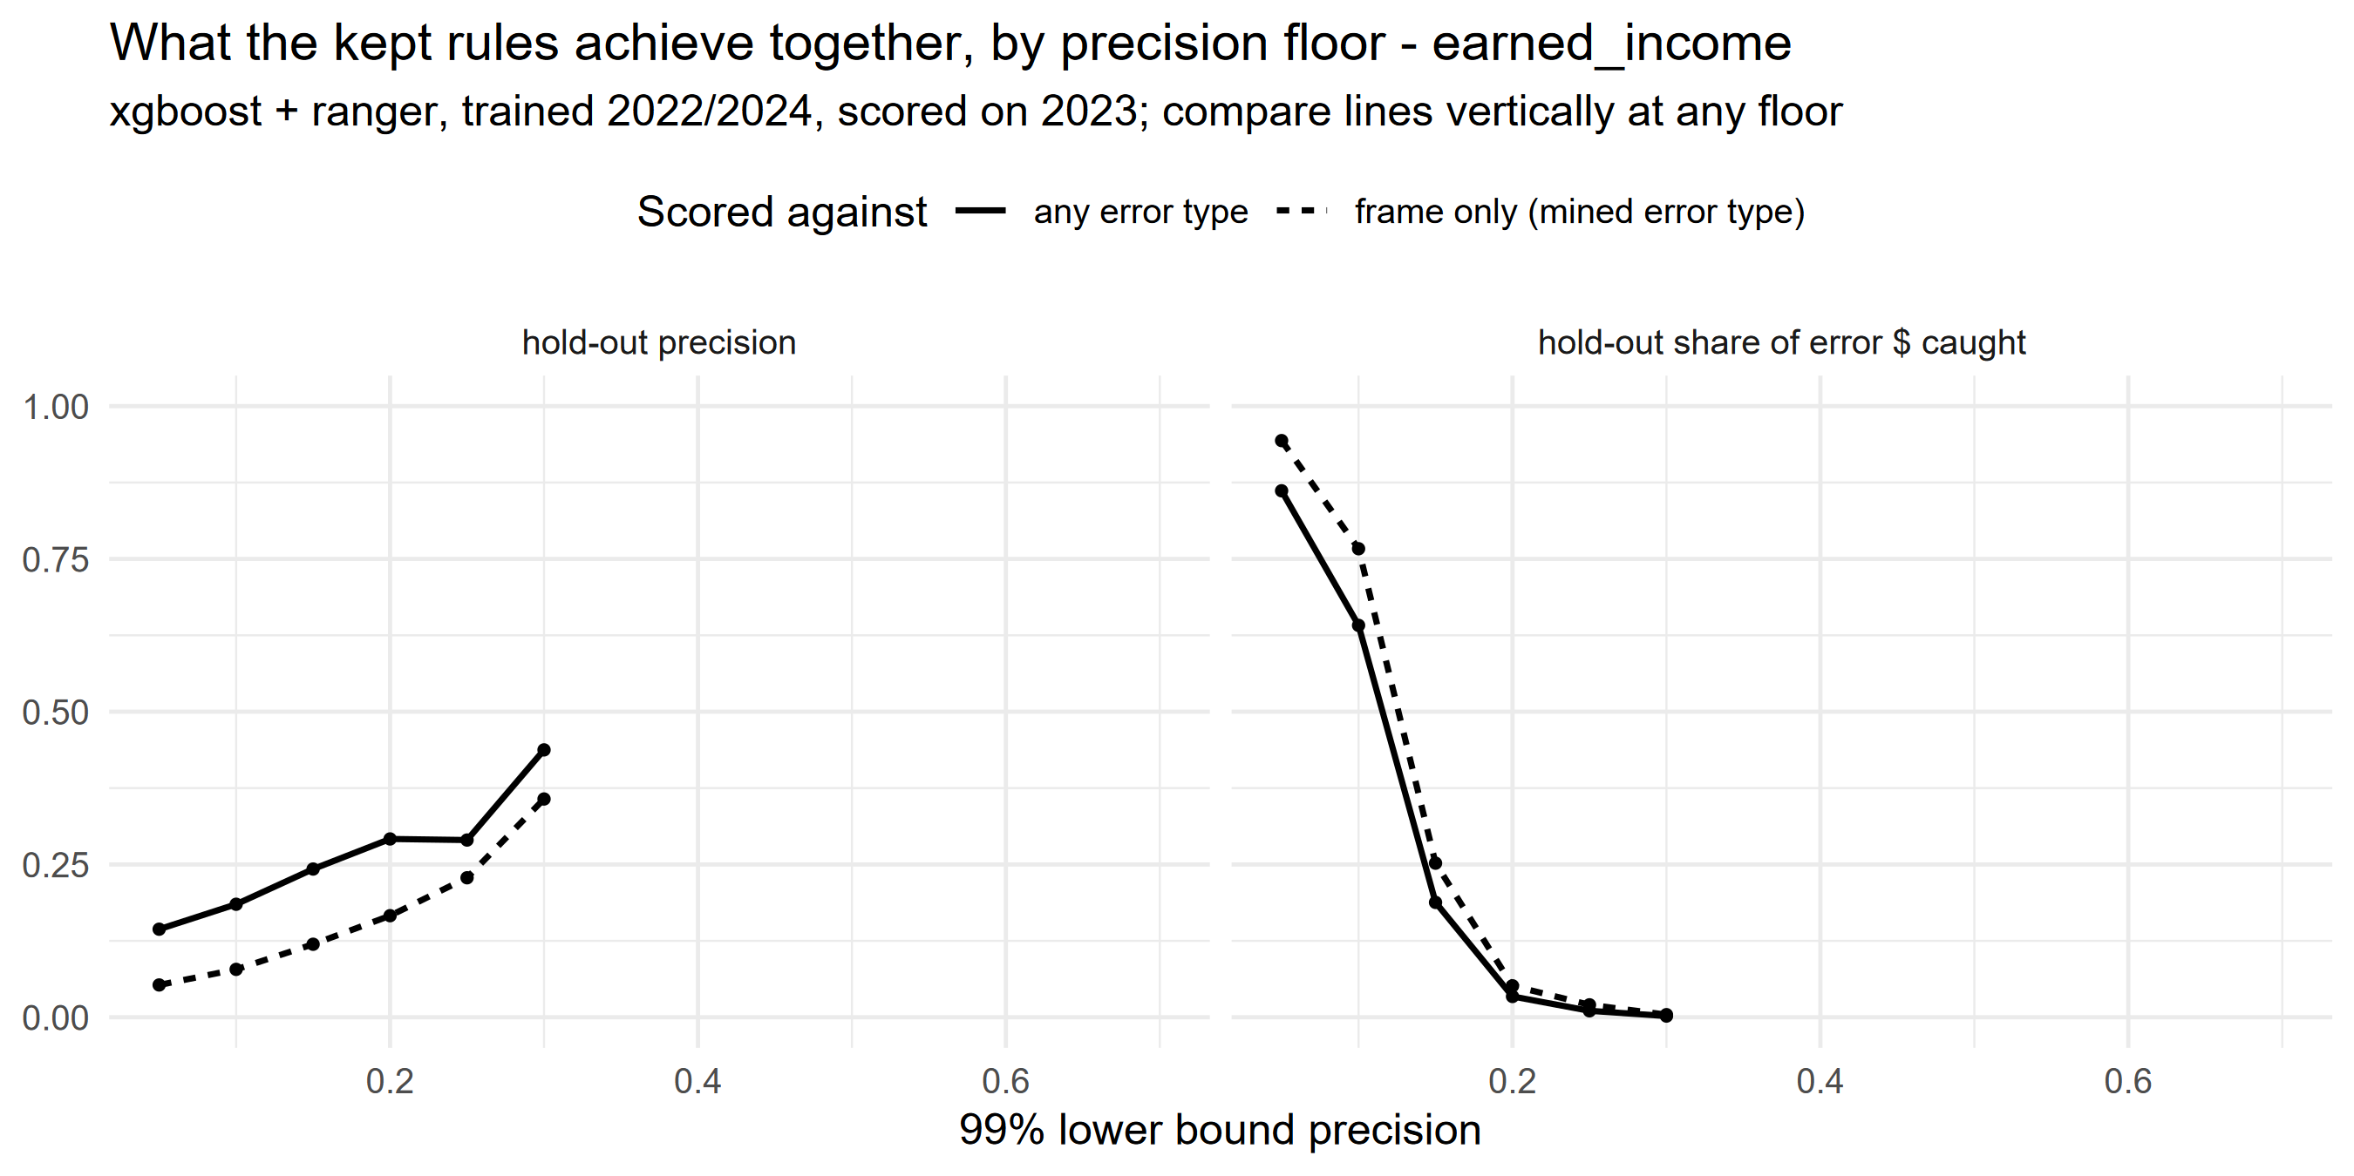
Appendix: count every error a rule catches, not just the intended kind
- A rule built to find earned-income errors also flags cases with other kinds of errors, and those reviews succeed too. Counting only the intended error type, these rules score 8%; counting every error they actually catch, 19%. Report the second number: it is what reviewers will experience (dashed vs solid lines below).
Appendix: v2 pipeline evidence

Slide 21
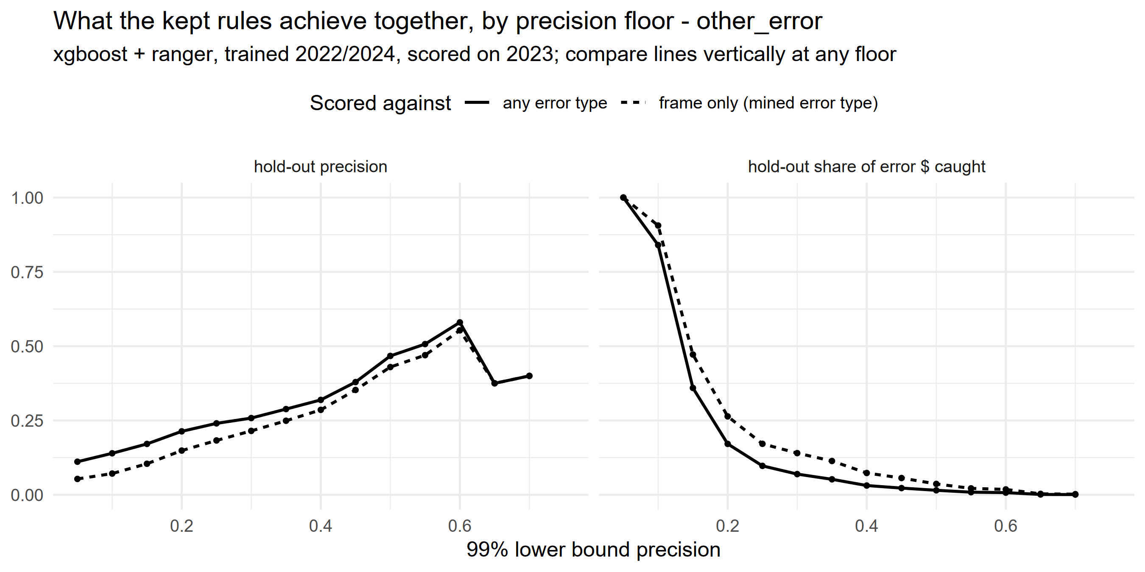
Appendix: added “other” (mostly deductions)
- Errors in deductions, shelter costs, and household composition ('other') are the LARGEST error category: 2,007 of 4,460 errors in 2023. They turn out to be somewhat learnable: this category now contributes the largest block of high-confidence rules (1,700 rules, about 1 in 5 flagged cases having an error on new data).
Appendix: v2 pipeline evidence

Slide 22
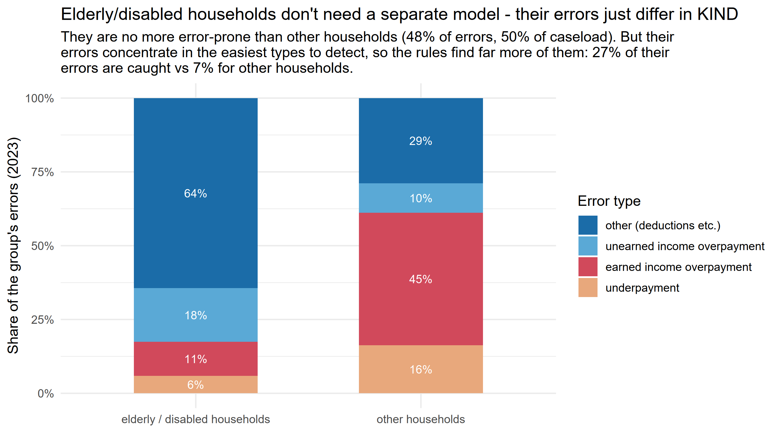
Appendix: elderly/disabled households: one model works for everyone
Appendix: v2 pipeline evidence

