Slide 1
Getting more signal out of SNAP QC data
modeling lessons · open-source code · rules each state can test on FY25/26
Eric Giannella
Georgetown Better Government Lab
July 2026

Slide 2
Two key things I want to convey
We’ve published public available rules that may help improve precision & recall. I’d love to get additional volunteers to test.
The publicly available code reflects the modeling lessons I’m going to go through today. Hopefully the lessons are helpful even if you do not use the publicly available code.
SNAP QC modeling lessons · July 2026

Slide 3
Opportunities (aka favors)
Apply a frozen, ranked rule list to your FY25/26 cases and tell us the hit rate. No modeling, no re-training. The list was mined on all states' 2022-24 public QC data.
The approach has been tested by mining rules from 2022-23 and testing on 2024:
Median precision 0.27-0.30 at 5-10% review budgets, against state base error rates of 8-17%.
Recall of 15-24% error dollars at 5-10% caseload review budgets.
All 18 states tested cleared their base rate: the rules found 1.5-3.4x the errors that unaided review of the same volume finds.
Use the code yourself! Could combine your state’s data with national qc data (also in the repo).
Code and findings: github.com/giannella/snap_qc (methods/modeling_findings.md)

Slide 4
What a rule looks like
One of the most widely shipped rules (households of 4+):
certified 10 or more months ago, AND
computed benefit at 68-82% of the household maximum, AND
deductions per household member of at least $27 -> flag the case for review
On 2022-23 training data it flagged 173 cases; 40% had a payment error (99% lower bound: at least 32%). It’s on 15 of the 18 state lists.
A typical rule combines 3-4 conditions drawn from 16 case fields.
SNAP QC modeling lessons · July 2026

Slide 5
Intuition for new modeling approach
Goal: create the best pool of rules that can be filtered and applied per state.
hopefully means the method itself is also useful
Originally: relied on decision trees with lots of 15-30% subsampling to ensure diversity. But, this approach benefited less from learning. (And, getting rules out of tree methods used to be a pain, but now it’s not.)
New approach:
- The pipeline extracts every root-to-node path in every tree as a candidate rule; xgboost's boosting makes it better at common error patterns.
- To ensure coverage for less common circumstances, we added a random forest allowed to choose between only 1 or 2 variables at each split (2 was better).

Slide 6
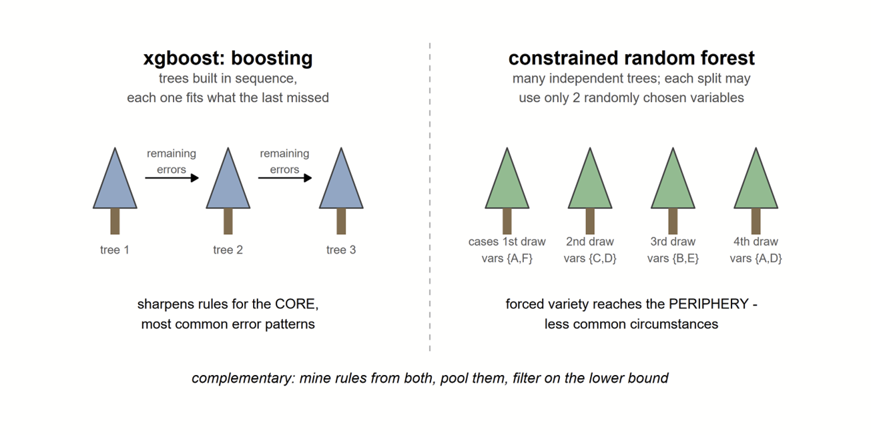
How the two engines complement each other

Slide 7
PART 1
Data improvements and limitations

Slide 8
Two data munging choices changed results more than tuning
1) Worried that second error element cases would mislead the model, probably does not matter
- 31% of error cases were being dropped (second error element); restoring them tripled the qualifying rules.
- Rule content survived the fix: 93% of the old rule set persisted.
2) Blank deduction fields dropped cases from models (e.g., ~16% of Washington's caseload); zero-fill + flag kept them. Ran search for other blanks vars.
- Both defects were invisible in model metrics. We found them only by reconciling counts against the raw files.
SNAP QC modeling lessons · July 2026
Notes:
- The fix did not rewrite the rules' content: 93% of the previous rule set survived the rebuild - 63% as the same variables and directions with shifted cutpoints, 29% matched by a new rule flagging a highly overlapping case set (Jaccard >= 0.5 on the test year), 1% exact; only 7% dropped with no counterpart. | - Nor did the restored cases add a new pattern type: brand-new rules' catches were 34% restored-case vs a 32% base.

Slide 9
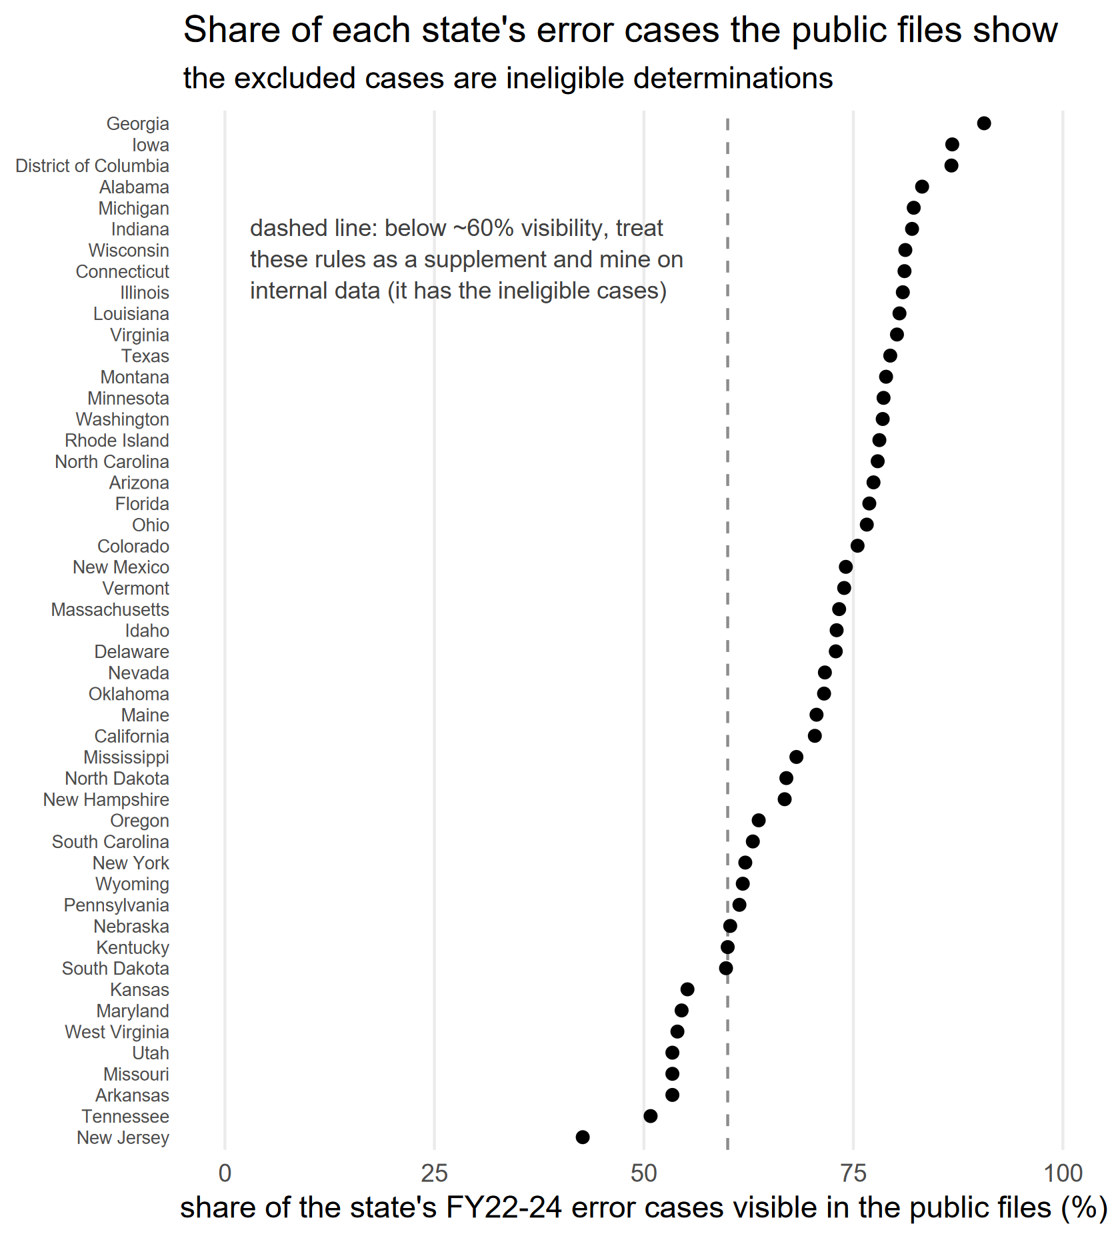
Limitations of the public QC data – esp. for certain states
We reconciled the public files against the QC technical documentation's exclusion counts, per state and year (2022-24).
The public files show 43% (New Jersey) to 91% (Georgia) of each state's error cases; national 71%. The missing cases are ineligible determinations.
This bounds what any public-data model can deliver per state; we quote it alongside every state result.
Below ~60% visibility (NJ, TN, AR, MO, UT): treat these rules as a supplement and run the mining pipeline on internal data; a full run takes about 45 minutes on a 16 GB laptop.
SNAP QC modeling lessons · July 2026

Slide 10
PART 2
Selecting rules

Slide 11
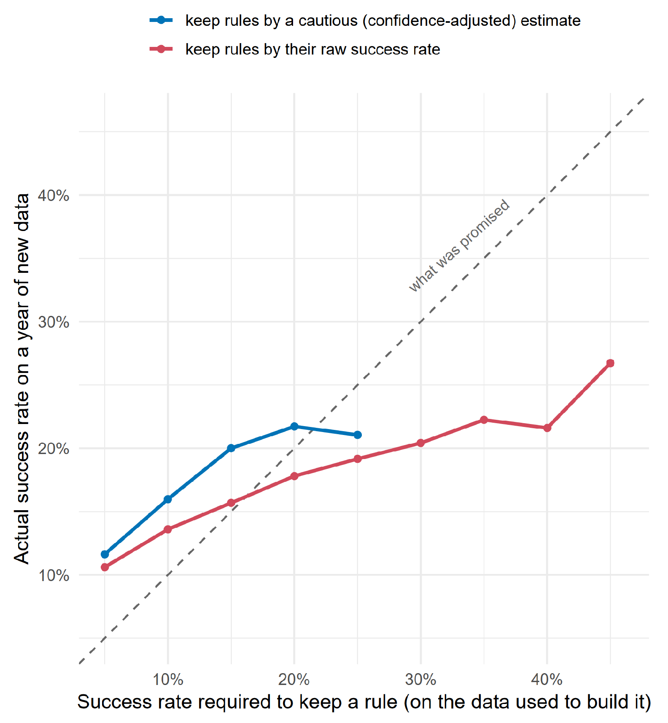
Raw training precision example: promised 0.20 and delivered 0.10
Setting rules based on training precision:
a 0.20 raw bar delivered ~0.18 combined; a 0.40 bar delivered ~0.22 (red)
Simple filter >.2 with confidence bound has expected decay (blue)
But, rules selected on the HOLDOUT >= 0.20 showed median train precision 0.116.
And, before any selection, train precision was nearly unbiased for holdout (median gap -0.003, r = 0.83)
So the decay is selection noise (regression to the mean), not overfitting or year drift
SNAP QC modeling lessons · July 2026

Slide 12
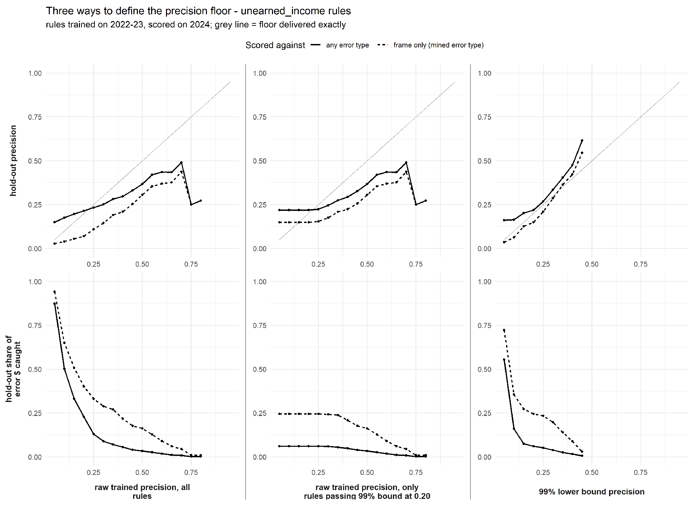
Better way to select rules: lower confidence bound
- Keep a rule only if the 99% Wilson lower bound of its training precision clears the floor: delivered precision then meets the floor, with ~50% more recall at 0.20 than raw selection.
Example:
At 10 cases flagged, aiming for 0.3 precision: need 7 of 10 hits (raw 0.70)
At 100 cases flagged, aiming for 0.3 precision: need 41 of 100 hits (raw 0.41)
(Raw selection also had a support floor: n >= 10, but curse survived it.)
- The lower bound is the only selection statistic we tested whose value survives contact with a new year.
SNAP QC modeling lessons · July 2026

Slide 13
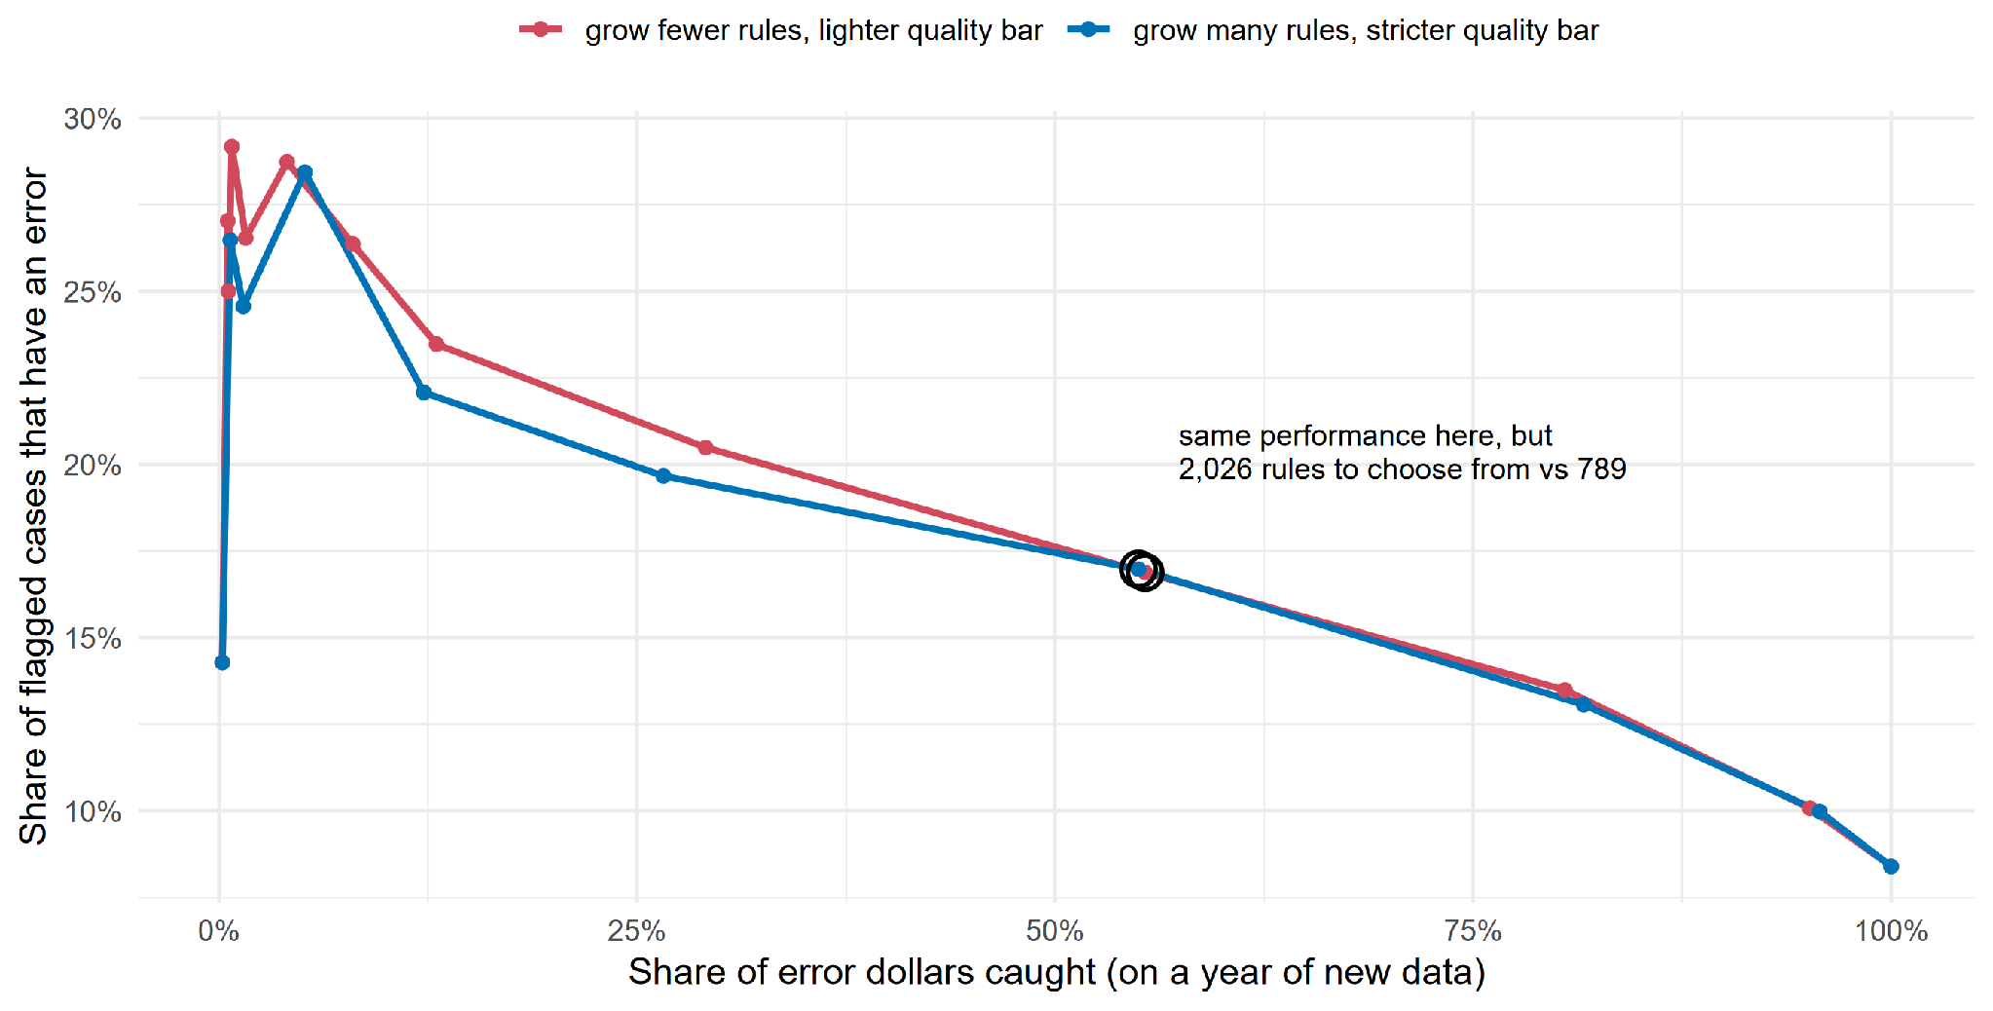
Bigger ensembles widen the menu, not the frontier
- 1000-round/1000-tree ensembles traced the roughly the same precision-recall frontier as smaller ones, but ~2.6-5x the filtered inventory.
- Why a redundant inventory? Exclude rules you know will not work.
- The 99% lower-bound filter is what keeps large pools reliable.
SNAP QC modeling lessons · July 2026

Slide 14
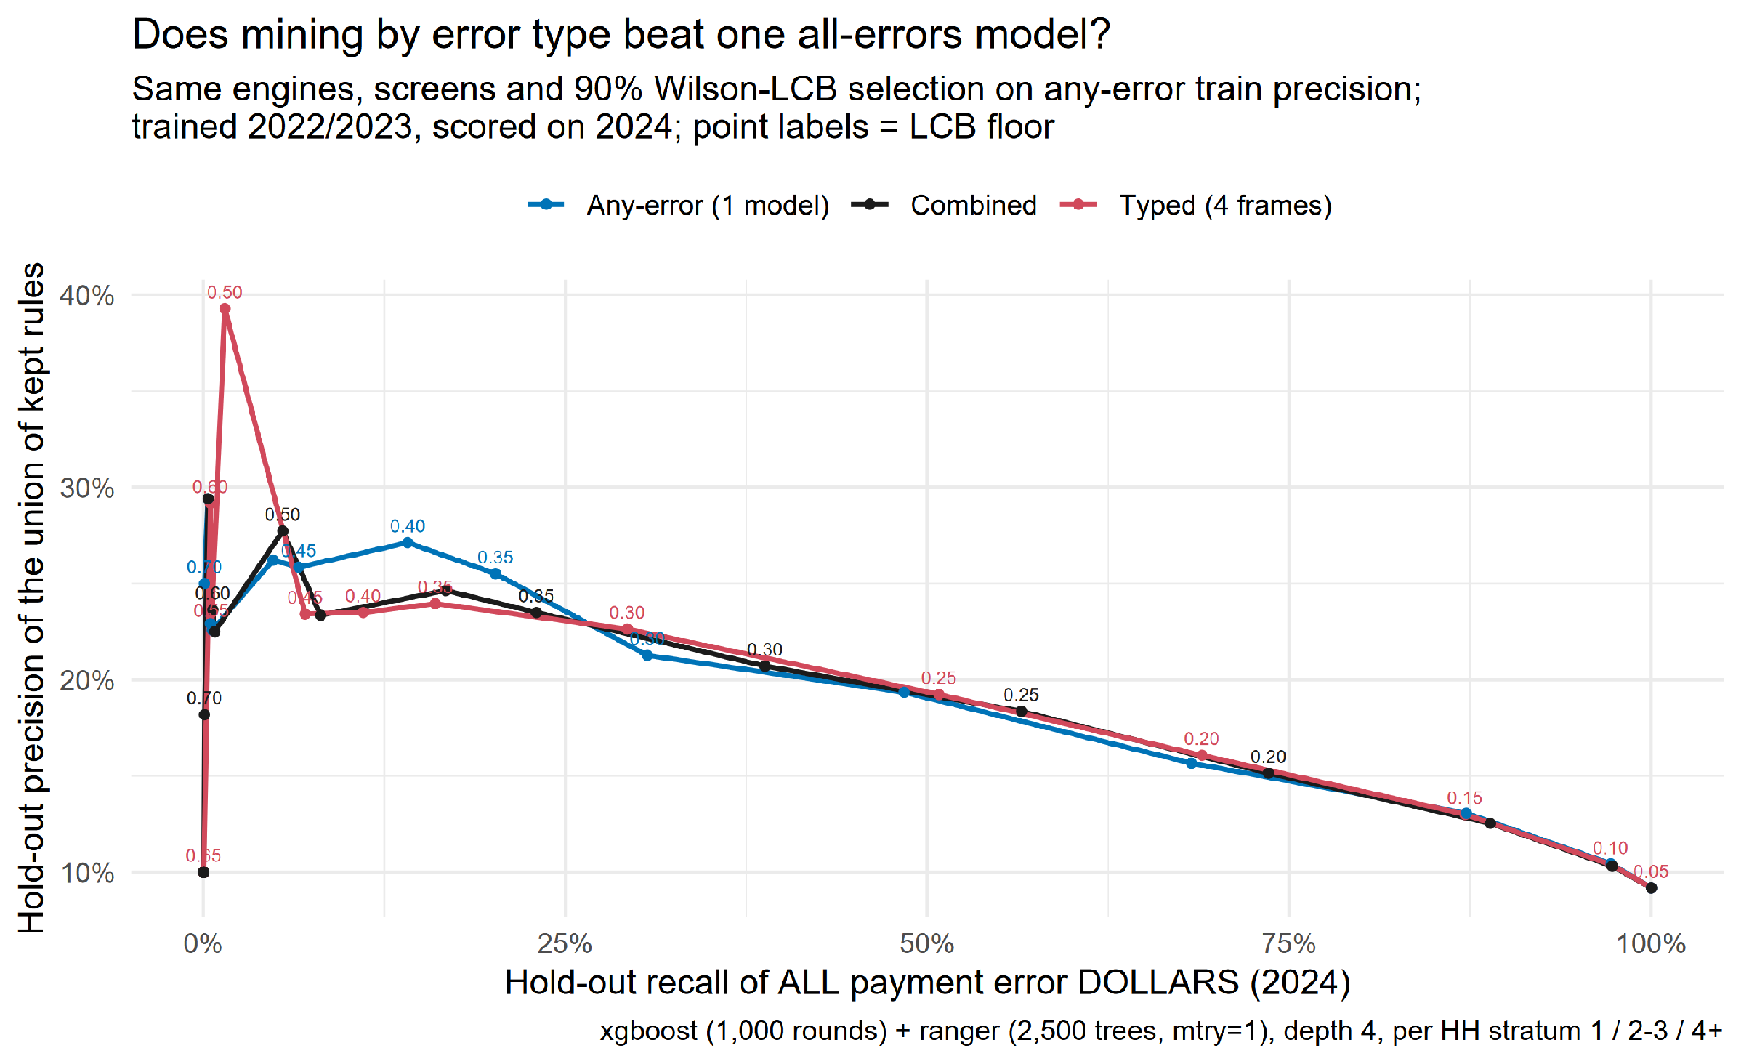
By error category vs all errors: mine both, pool them
Typed frames edge one all-errors model slightly; the UNION wins: +3-6pp recall for ~1pp precision.
Chart: the 2024 replication. The original 2023 run agreed (in repo).

Slide 15
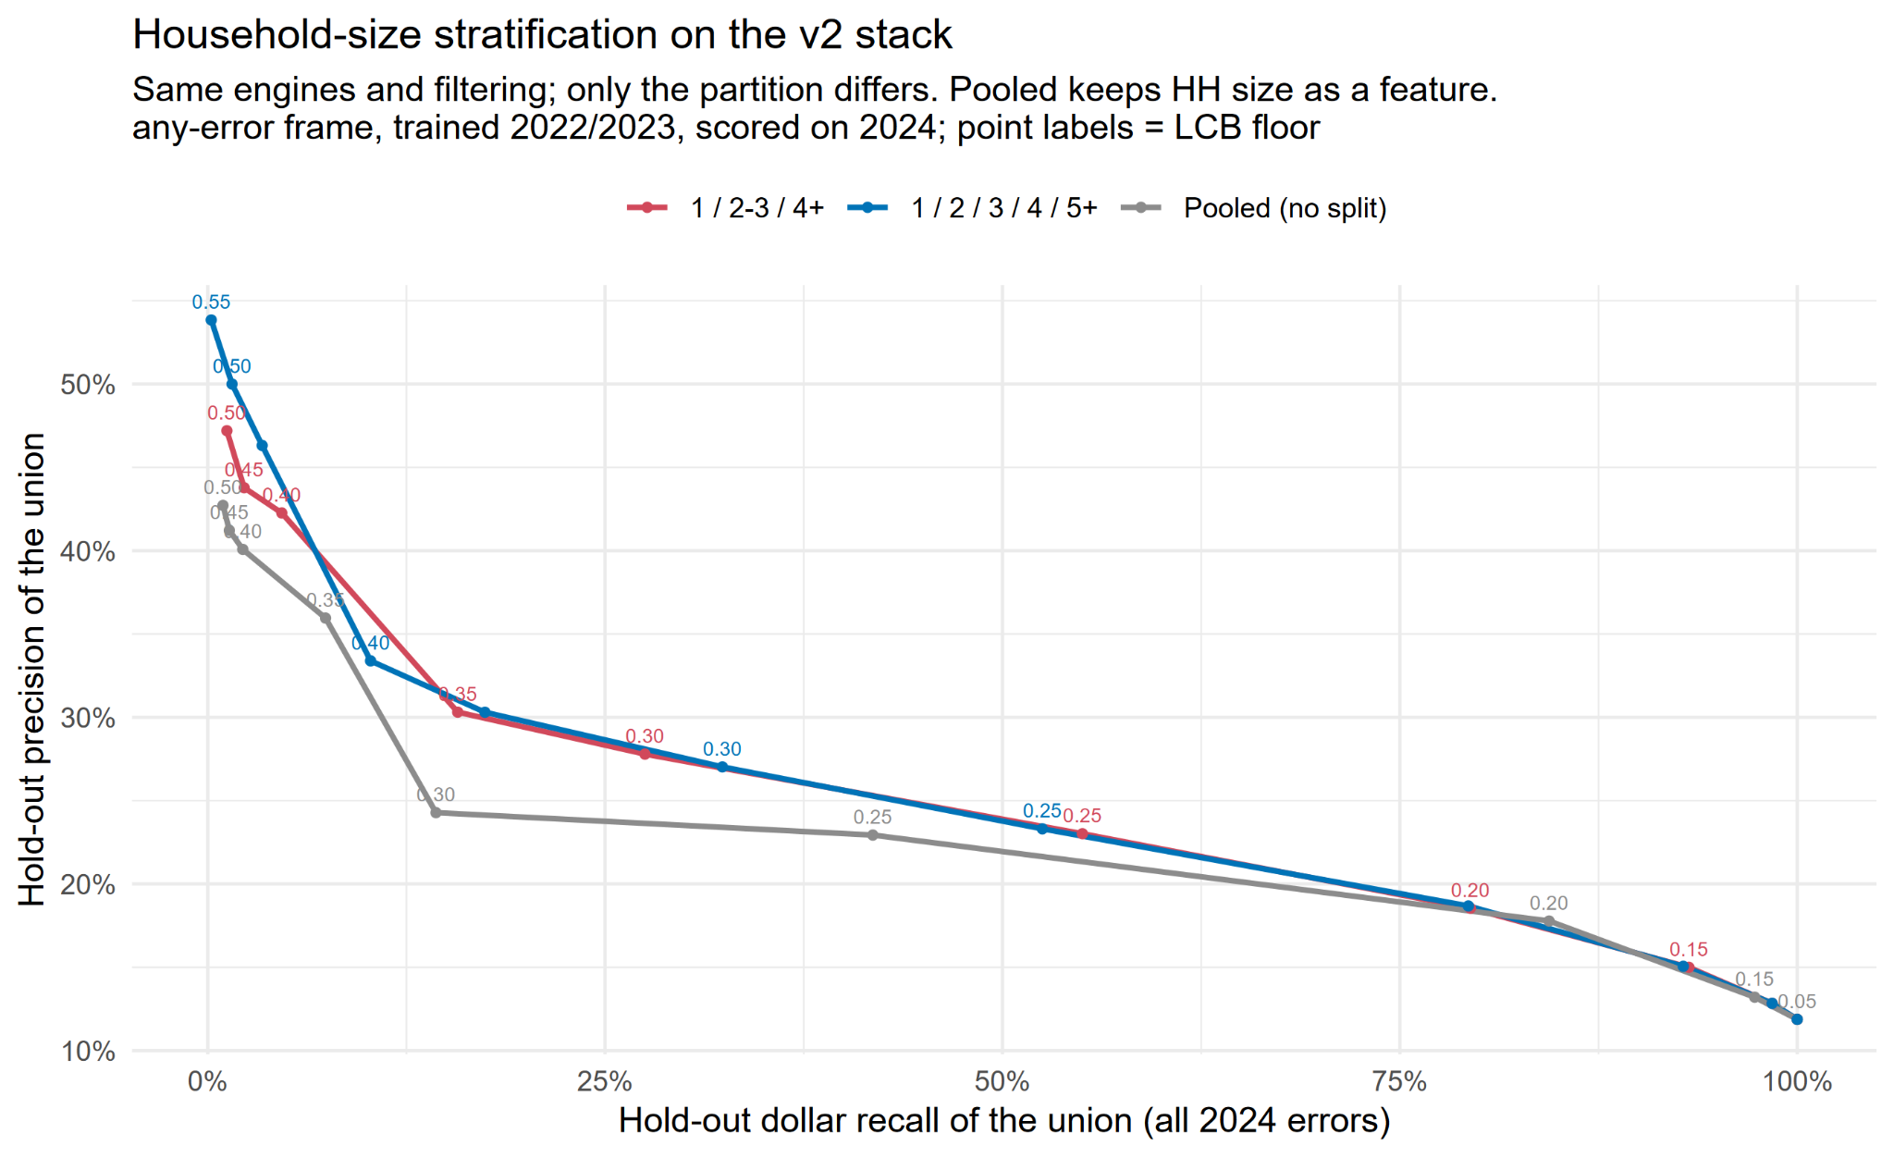
Split by coarse household-size strata (1 / 2-3 / 4+)
On CART/RuleFit, strata bought +47% precision. On v2 (RF + xgboost) the margins flip by year, but the coarse split never loses.
- 2023: pooling matched precision; split won reach.
- 2024 (chart): split wins precision (0.30 vs 0.26); pooling wins floor-reach (0.84 vs 0.79).
- Best performance: strata 1 / 2-3 / 4+.
- Elderly/disabled stratum stopped helping once mtry-2 forests arrived (parity checked).
SNAP QC modeling lessons · July 2026

Slide 16
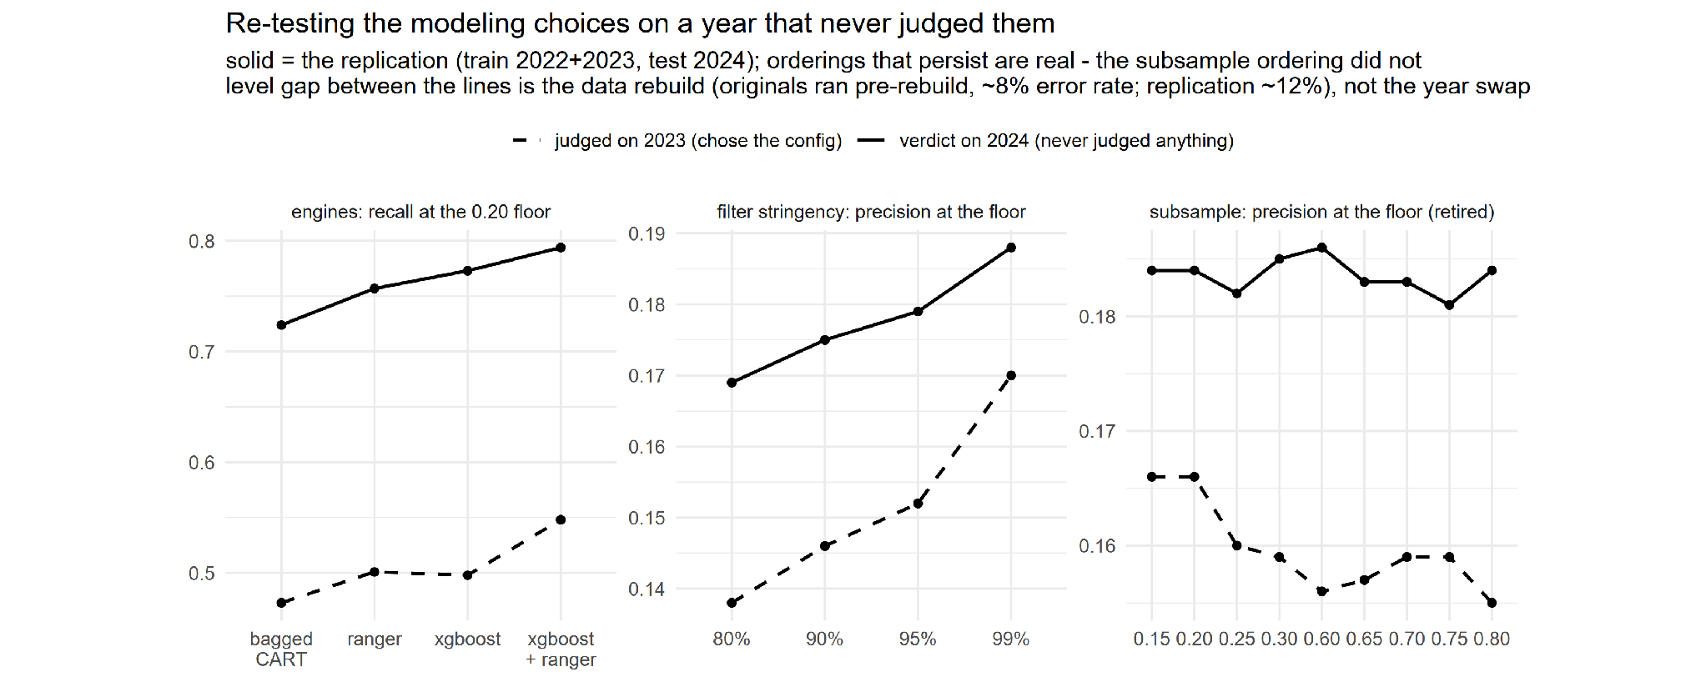
Testing the configuration
- Every configuration choice above was judged on the same held-out year (2023), so the selection PROCEDURE itself could be overfit to one year. We re-ran the decisive comparisons with the year roles swapped (train 2022+2023, test 2024).
- Three of four claims replicated: the engine pairing still leads recall (margin thinner, 2.1pp vs 3pp+), stringency still buys precision monotonically, big ensembles still widen the menu ~7x at ~0.02 precision cost.
- One claim failed and is retired: 'low subsampling beats high'. On 2024 all nine settings from 0.15 to 0.80 land within 0.005 (right panel).
SNAP QC modeling lessons · July 2026

Slide 17
PART 3 · Optimizing rule sets for states
Challenge is to not lose state-specific patterns if you set such stringent thresholds by mining much larger national data.
How do you make state-generated and nationally-generated rules comparable?
(Answer: rank every rule by its own 99% lower bound)
SNAP QC modeling lessons · July 2026

Slide 18
At state scale, confidence bounds alone were not enough
- Mining directly on one state's data (~2,000-3,000 cases/year), rules passing the same 99% lower-bound filter with small support had median HOLDOUT precision of zero at support >= 5.
- Requiring >= 30 flagged training cases (with a raw 0.30 floor) changed collapse into gentle deflation: median 0.33 train -> 0.21 held-out; ~1% of rules at zero.
- National scale hides this: with 100k+ cases the bound rarely admits tiny-support rules in the first place.
Why: at 5-10 cases the bound only passes near-perfect raw precision, exactly where luck concentrates.
SNAP QC modeling lessons · July 2026

Slide 19
Own-state, similar-state, or national? Head-to-head on 2024
Everything mined on 2022-23 only, filled to the review budget in confidence order, scored on each state's 2024 cases (12 states). Table cells: median precision / share of the state's 2024 error dollars.
The national pool is the best default: it leads median precision at both budgets and is never the disaster case.
To be sure: blended state-national worked best (in a few slides)
rules mined on | 5% budget | 10% budget
the state's own data | 0.253 / 14% | 0.240 / 25%
five similar states | 0.256 / 11% | 0.245 / 20%
all states (national) | 0.300 / 16% | 0.273 / 25%
SNAP QC modeling lessons · July 2026

Slide 20
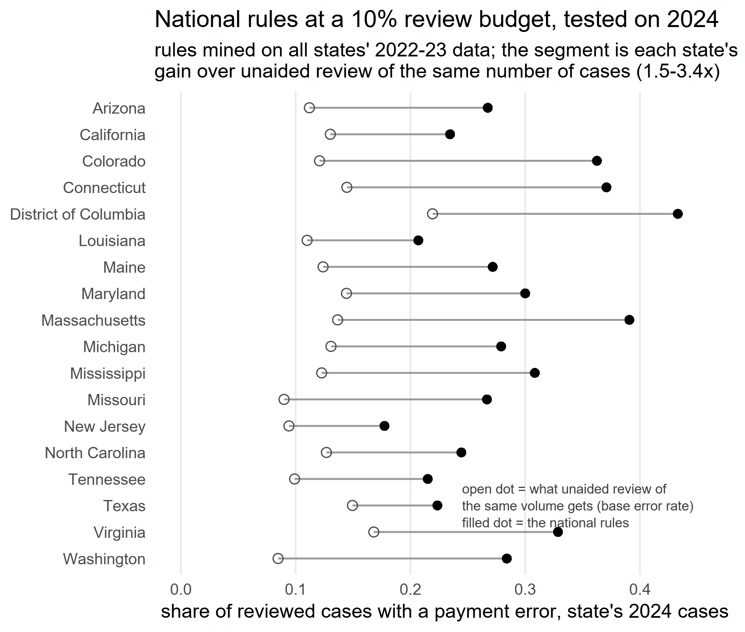
National rules, deployed a year ahead, could be a win
Mined on all states' 2022-23; applied in confidence order to 10% of caseload; scored on 2024.
Every state clears its base rate: the filled dot lands right of the open dot in all 18 states.
The gap is the gain over unaided review of the same volume: 1.5-3.4x.
SNAP QC modeling lessons · July 2026

Slide 21
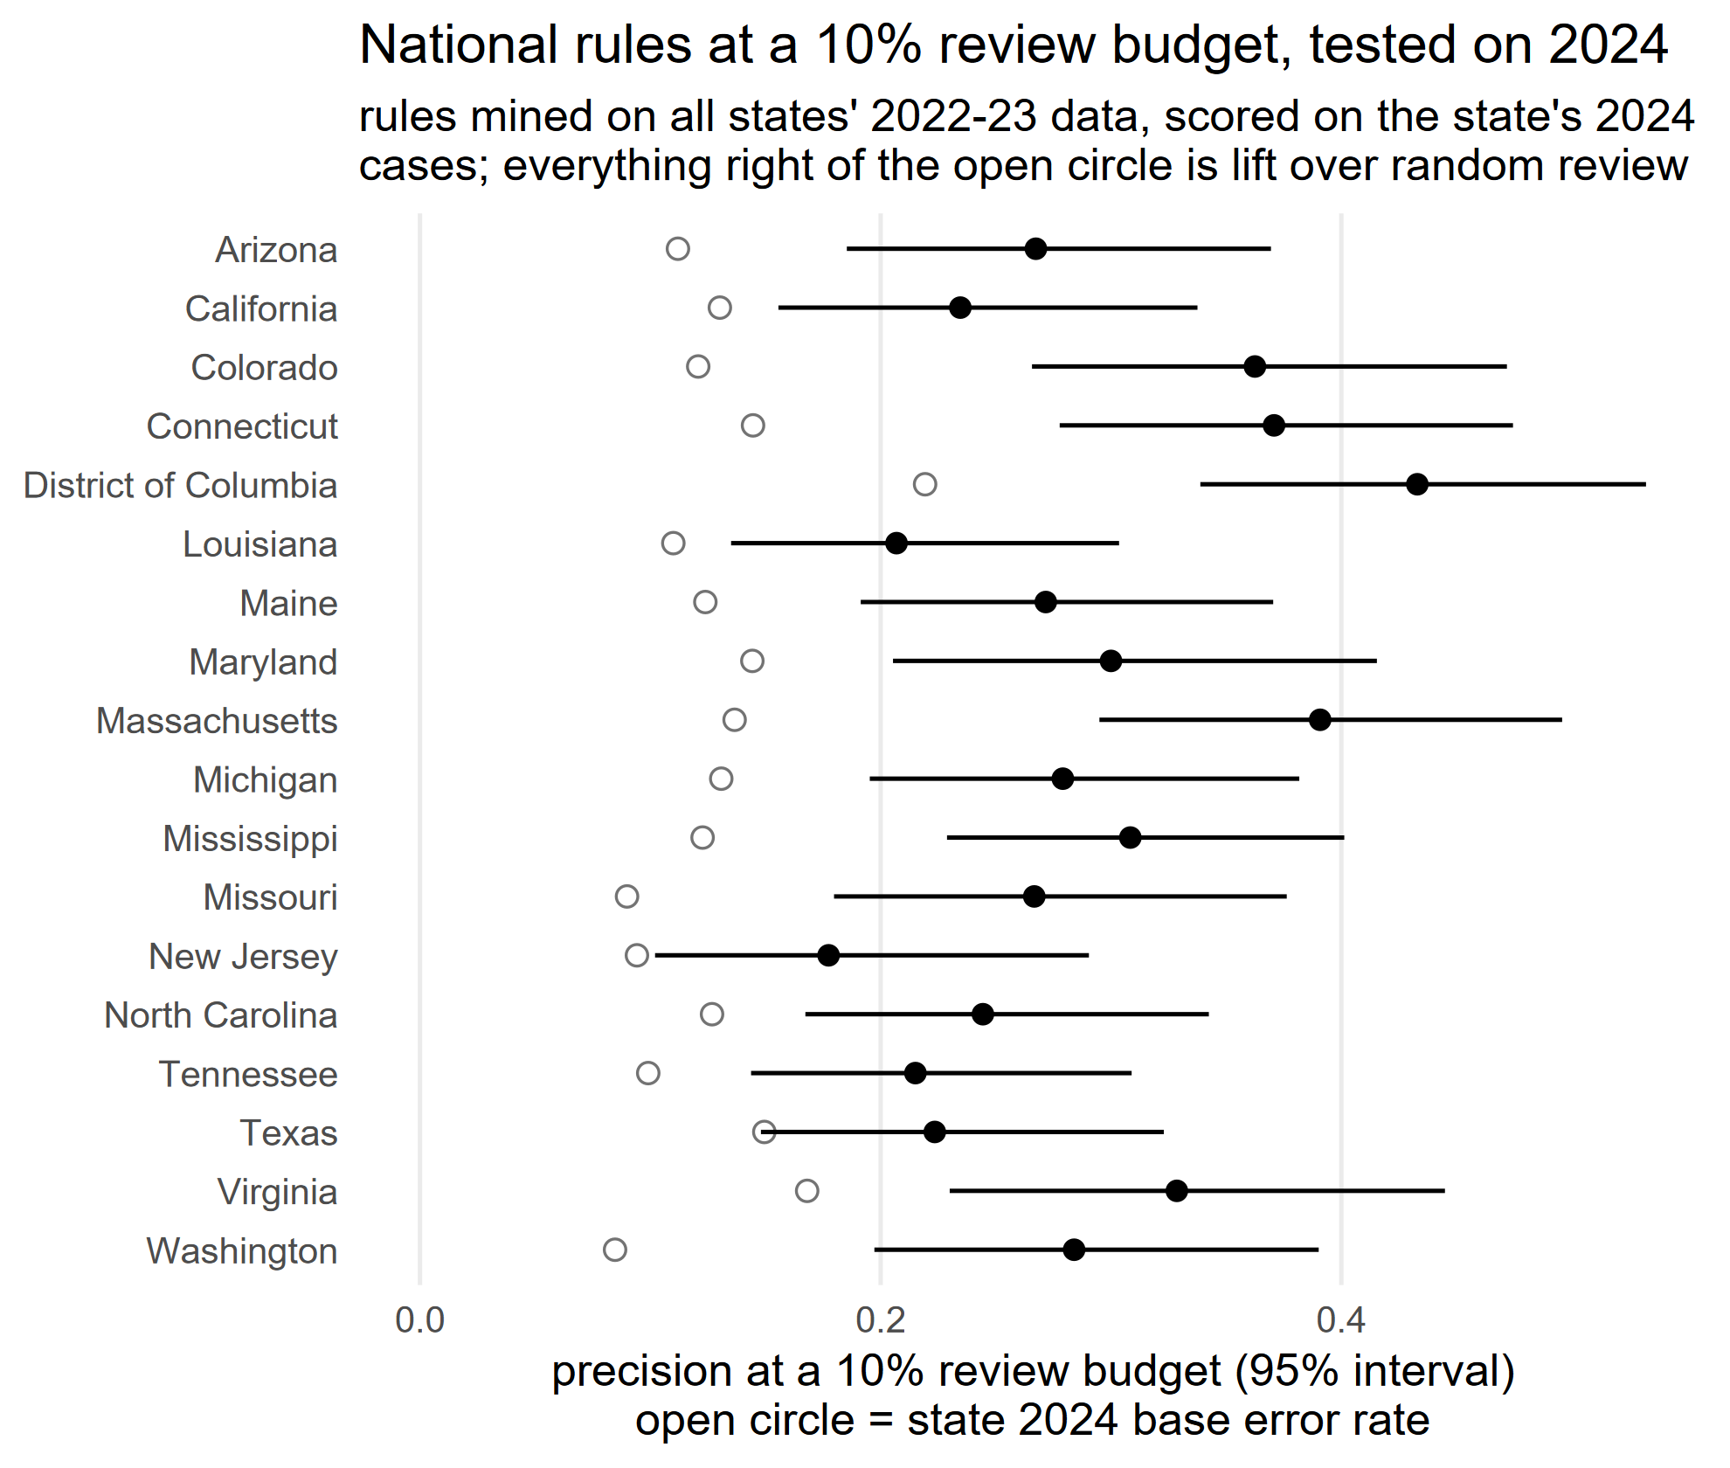
But not a big win for every state
Nearly every state's interval clears its base rate
- As expected, more missing data hurts
SNAP QC modeling lessons · July 2026

Slide 22
Blending state and national rules onto one confidence scale
- Rank EVERY rule (state or national) by its own 99% lower bound; the bound prices the certainty gap.
- As a single recipe the blend beats national-only at 5% (0.324 vs 0.294) and ties at 10%.
- Where state rules clear the bar, interleaving beats both parents (AZ, DC, MS).
- Blind spot: national bounds say nothing about transfer, so NJ's own rules never enter; the own-pool fallback exists.
option (single recipe) | 5% budget | 10% budget
national-only frozen list | 0.294 / 12% | 0.270 / 25%
blended frozen list (99% bound) | 0.324 / 15% | 0.262 / 24%
state's own pool only | 0.256 / 13% | 0.236 / 25%
SNAP QC modeling lessons · July 2026

Slide 23
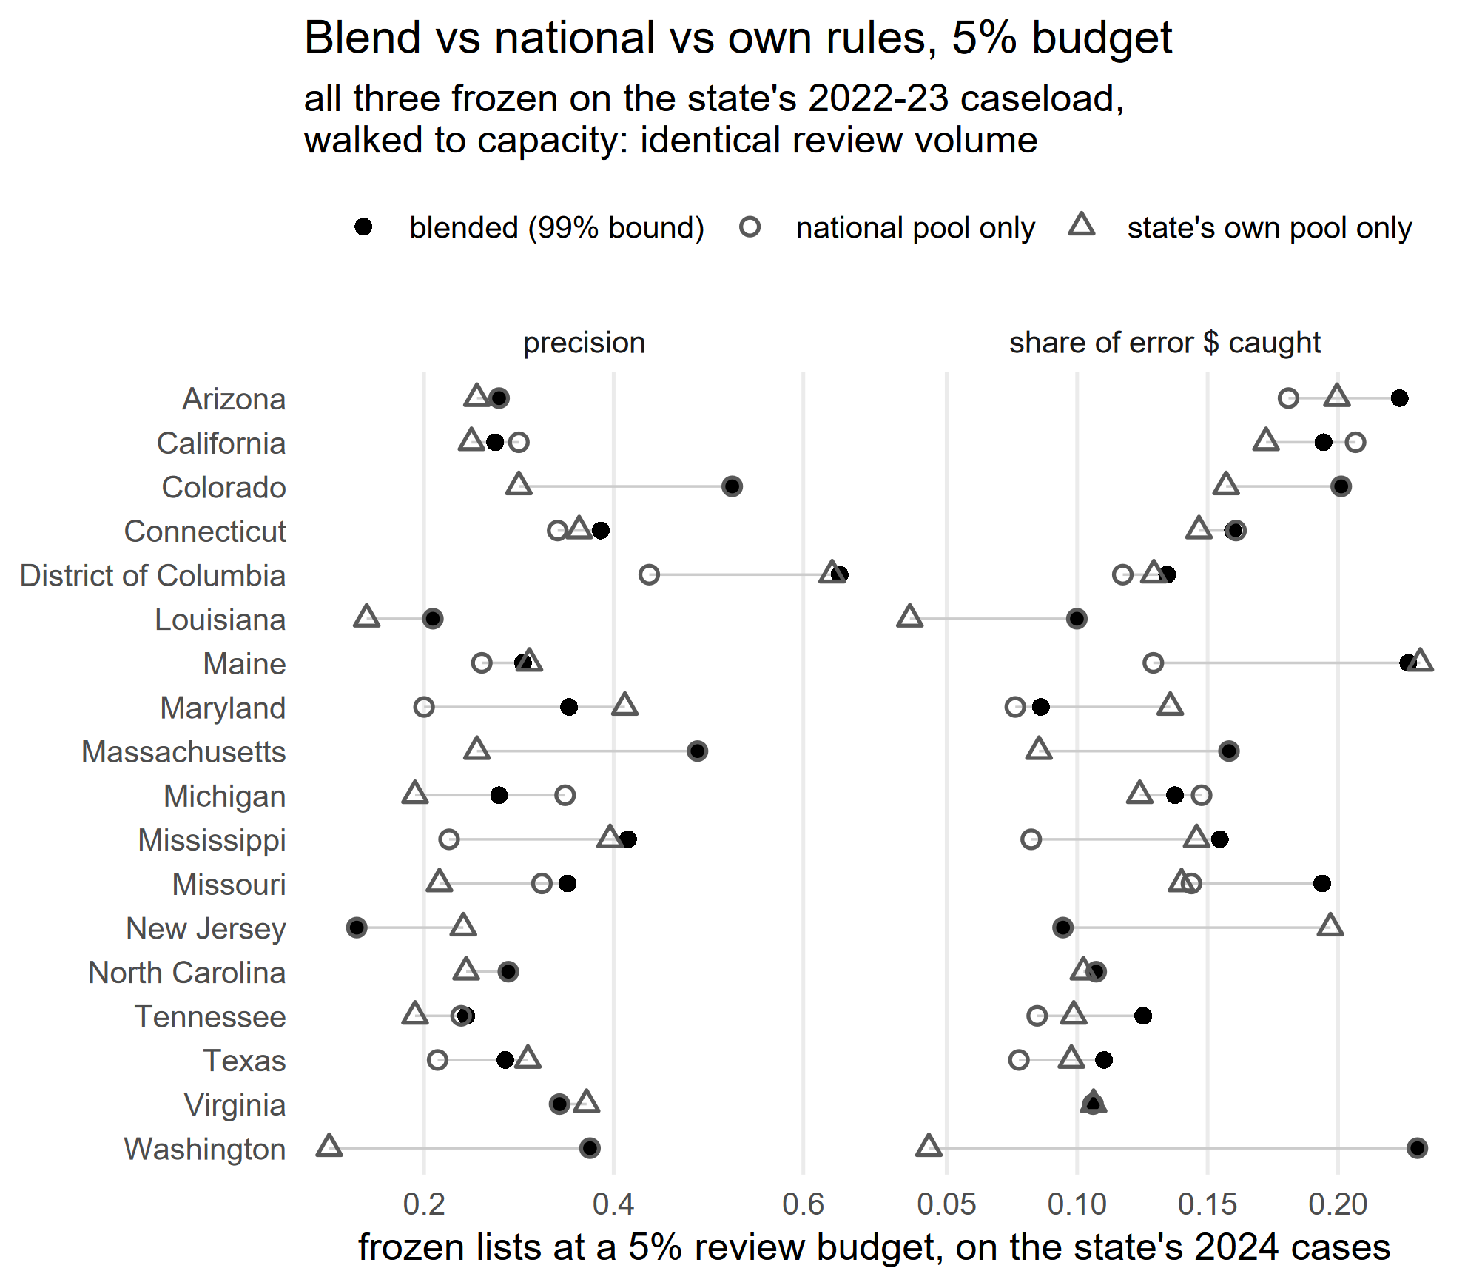
Blended state-national rules
We report budget-filled performance: add rules in confidence order until 5% or 10% of caseload is flagged (filled to review capacity).
Deployment medians:
0.30 precision / 16% of error $ at 5%;
0.27 / 25% at 10%, vs 8-17% base rates.
Precision throughout = any-error precision: a flagged case counts if it has any payment error (error type-specific precision in the repo outputs).
SNAP QC modeling lessons · July 2026

Slide 24
Blended: most widely used rules, by household size
The three most widely deployed rules per household-size stratum (10% budget lists).
Benefit-near-maximum and deduction levels are the flags, not the diagnosis: every rule is scored against ALL error types. A hit is any payment error, not a deduction error specifically.
HH size | rule | states (of 18)
1 | rawben_rel_max >= 0.236 & rawben_rel_max < 1.000 & total_deductions_by_hh_size >= 511.000 & utilities < 249.000 | 12
1 | total_deductions_by_hh_size > 336.000 & unc_rawben_rel_max > 0.891 & unc_rawben_rel_max <= 0.991 & utilities <= 29.500 | 11
1 | rawben_rel_max <= 0.998 & total_deductions_by_hh_size > 602.000 & utilities <= 272.000 | 10
2-3 | months_since_cert_n <= 25 & shelter_expenses_by_hh_size > 499 & shelter_expenses_by_hh_size <= 679 & total_deductions_by_hh_size > 644 | 9
2-3 | expedited_i >= 1.000 & months_since_cert_n < 2.000 & rawben_rel_max >= 0.649 & rawben_rel_max < 0.901 | 9
2-3 | elderly_disabled_i > 0.500 & married <= 0.500 & rawben_rel_max > 0.996 & unc_rawben_rel_max > 1.550 | 8
4+ | HH_size_n > 4.500 & rawben_rel_max > 0.478 & total_deductions_by_hh_size > 233.000 & unc_rawben_rel_max <= 0.997 | 12
4+ | months_since_cert_n > 5.500 & rawben_rel_max <= 0.997 & shelter_expenses_by_hh_size <= 494.000 & total_deductions_by_hh_size > 227.000 | 9
4+ | HH_size_n > 4.500 & months_since_cert_n > 4.500 & rawben_rel_max <= 0.988 & total_deductions_by_hh_size > 206.000 | 9
SNAP QC modeling lessons · July 2026

Slide 25
PART 4
On github: blended lists per state at 5% and 10% workload

Slide 26
The deployed list is a few dozen rules, not thousands
The state runs a few dozen rules: 16-39 build the union at a 5% budget (34-67 at 10%)
Examples:
state | budget | rules that build the union
District of Columbia | 5% | 26
District of Columbia | 10% | 53
Louisiana | 5% | 27
Louisiana | 10% | 54
California | 5% | 26
California | 10% | 43
SNAP QC modeling lessons · July 2026

Slide 27
What a state is handed under the blended approach
One ranked, blended (state + national) list per state. Below: what it delivered on the state's 2024 cases at a 5% / 10% review budget. Compare precision to the base rate; error $ = share of 2024 error dollars caught at the 10% budget.
Own rules remain the FALLBACK regime: the public files show only 43-81% of a state's error cases, so where lists disagree, only the state's internal validation can settle which is better.
state | base rate | prec (5%) | prec (10%) | error $ (10%)
Arizona | 0.11 | 0.28 | 0.33 | 38%
California | 0.13 | 0.28 | 0.25 | 29%
Colorado | 0.12 | 0.53 | 0.36 | 26%
Connecticut | 0.14 | 0.39 | 0.37 | 27%
District of Columbia | 0.22 | 0.64 | 0.49 | 23%
Louisiana | 0.11 | 0.21 | 0.21 | 23%
Maine | 0.12 | 0.30 | 0.25 | 31%
Maryland | 0.14 | 0.35 | 0.36 | 23%
Massachusetts | 0.14 | 0.49 | 0.33 | 22%
state | base rate | prec (5%) | prec (10%) | error $ (10%)
Michigan | 0.13 | 0.28 | 0.24 | 24%
Mississippi | 0.12 | 0.42 | 0.37 | 26%
Missouri | 0.09 | 0.35 | 0.25 | 29%
New Jersey | 0.09 | 0.13 | 0.16 | 16%
North Carolina | 0.13 | 0.29 | 0.23 | 15%
Tennessee | 0.10 | 0.24 | 0.19 | 24%
Texas | 0.15 | 0.29 | 0.25 | 18%
Virginia | 0.17 | 0.34 | 0.33 | 20%
Washington | 0.08 | 0.38 | 0.27 | 35%
SNAP QC modeling lessons · July 2026

Slide 28
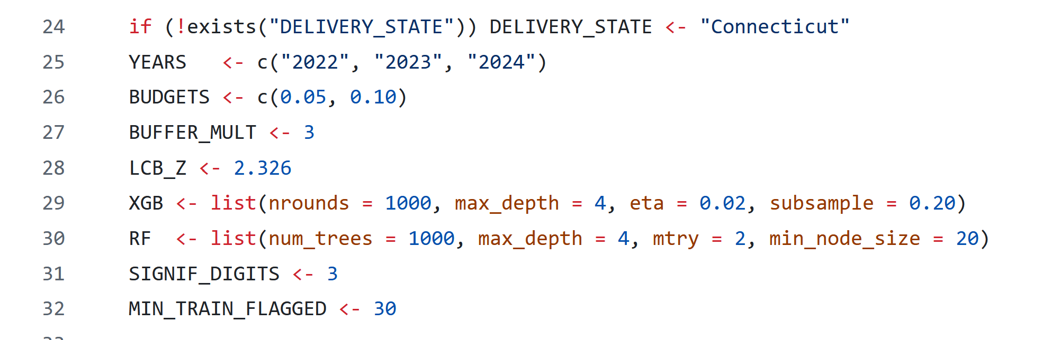
Ranked rule list per state, to % workload
One ranked list per state: fill to the budget on the state's own caseload (core), keep filling to 3x (buffer).
Can configure % workload in the INCL_blend script using BUDGETS.
SNAP QC modeling lessons · July 2026

Slide 29
What we still don't know / areas to improve
The invisible errors: 19-57% of each state's error cases (ineligible determinations) never enter the public files, so the rules have never seen them.
Uneven coverage by household type: the rule union catches 26.7% of errors in elderly/disabled households vs 7.2% elsewhere (precision inside elderly flags is slightly higher, 0.22 vs 0.19). Errors in non-elderly working households are the open gap.
States already target – we haven’t factored that in: you need to see if this is actually complementary to your existing system.
The blend's blind spot: a national rule's bound says nothing about transfer to your state (New Jersey's own rules never enter).
Engine frontier: constrained forests were the best periphery miner we tested, not the best possible one.
SNAP QC modeling lessons · July 2026

Slide 30
Validating on FY25/26: the protocol
What you need: 16 case-level fields (benefit relative to the household maximum, total deductions, shelter and utility amounts, months since certification, household size and composition, etc.) A typical rule checks 3-4 of them; mapping the fields to your eligibility system is the main effort.
Freeze: the list is built on public data FY22-FY24 (and optionally your internal data for those years).
Apply: walk the ranked list against internal FY25/26 cases up to review capacity. Workload should land near the sized budget (on 2024 the walked lists landed at 4.9-5.0% / 9.3-10.0% in all 18 states).
Also score it against your current targeting: our benchmark is unaided review; only your files can show whether the list beats the reviews you would have run anyway.
Results back to us: one CSV that contains: rule, cases flagged, errors found, error dollars, at your preferred budget.
SNAP QC modeling lessons · July 2026

Slide 31
What’s live on github
Rule lists for states in the workshop
Code for generating rules using internal state data + national QC data
Code for mining inclusion or exclusion rules
Data viz for regression trees
This presentation (shortly)
https://github.com/giannella/snap_qc/
SNAP QC modeling lessons · July 2026

Slide 32
Caveats
This may work better in a pre-auth context
Requires filtering of rules by experts. Know this does not apply / cannot be fixed in pre-auth / QA
Could be made better by linking to a model of errors fixed in pre-auth / QA (as Yale has done in CT)
Main issue with state-generated rules is lack of data.
Could try to generate synthetic data for states based on very similar households in states with similar patterns of errors (latter tended to account for policy options).
SNAP QC modeling lessons · July 2026

Slide 33
Q&A

Slide 34
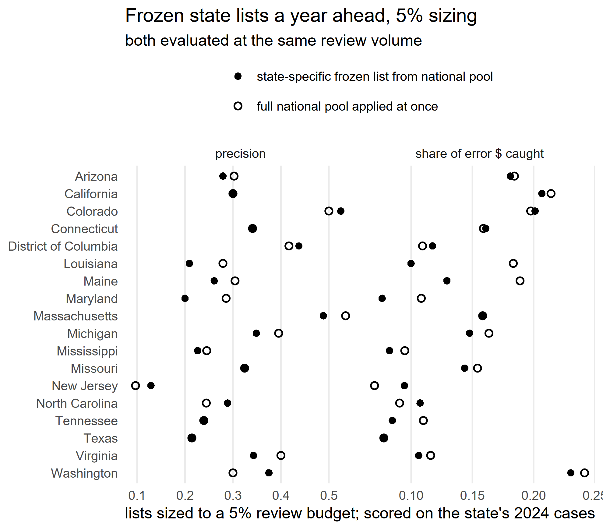
Appendix: freeze each state's list in advance: it costs almost nothing
- The frozen list (built on 2022-23, walked to capacity on 2024) against the full national pool applied at once to the realized 2024 caseload, both at identical review volume.
- Median precision 0.294 vs 0.301 (5% budget) and 0.270 vs 0.275 (10%); error dollars 12% vs 16% and 25% vs 25%. All 18 states clear their base rate.
SNAP QC modeling lessons · July 2026

Slide 35
Appendix: What a rule looks like (example 2)
Every rule is a short checklist of case facts. The top-ranked rule on Connecticut's list (one-person households):
monthly deductions above $336, AND
computed benefit at 89-99% of the one-person maximum, AND
reported utilities of $29.50 or less -> flag the case for review.
On 2022-23 training data it flagged 74 cases; 66% had a payment error (99% lower bound: at least 53%). It’s on 11 of the 18 state lists.
A typical rule combines 3-4 conditions drawn from just 16 case variables, so program staff can read and challenge every rule before it runs.
SNAP QC modeling lessons · July 2026

Slide 36
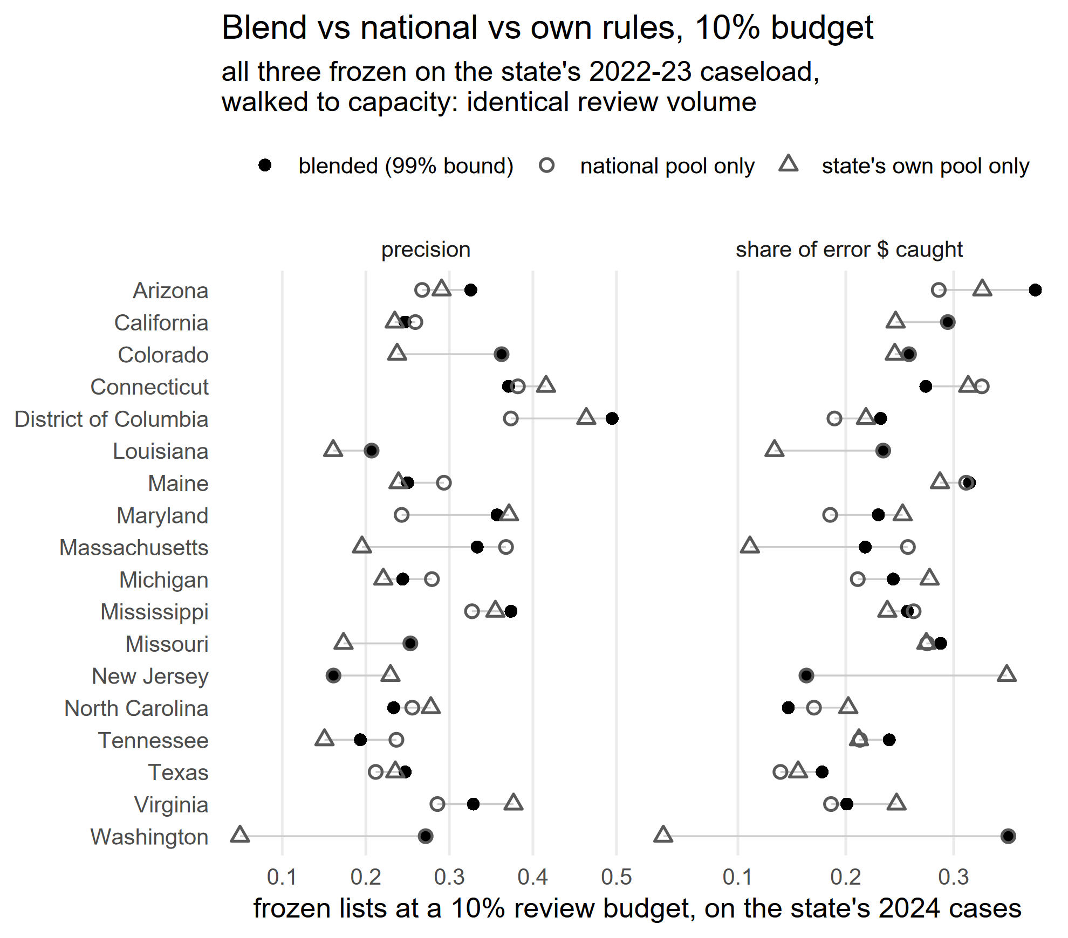
Appendix: Blend vs national vs own rules, 10% budget

Slide 37
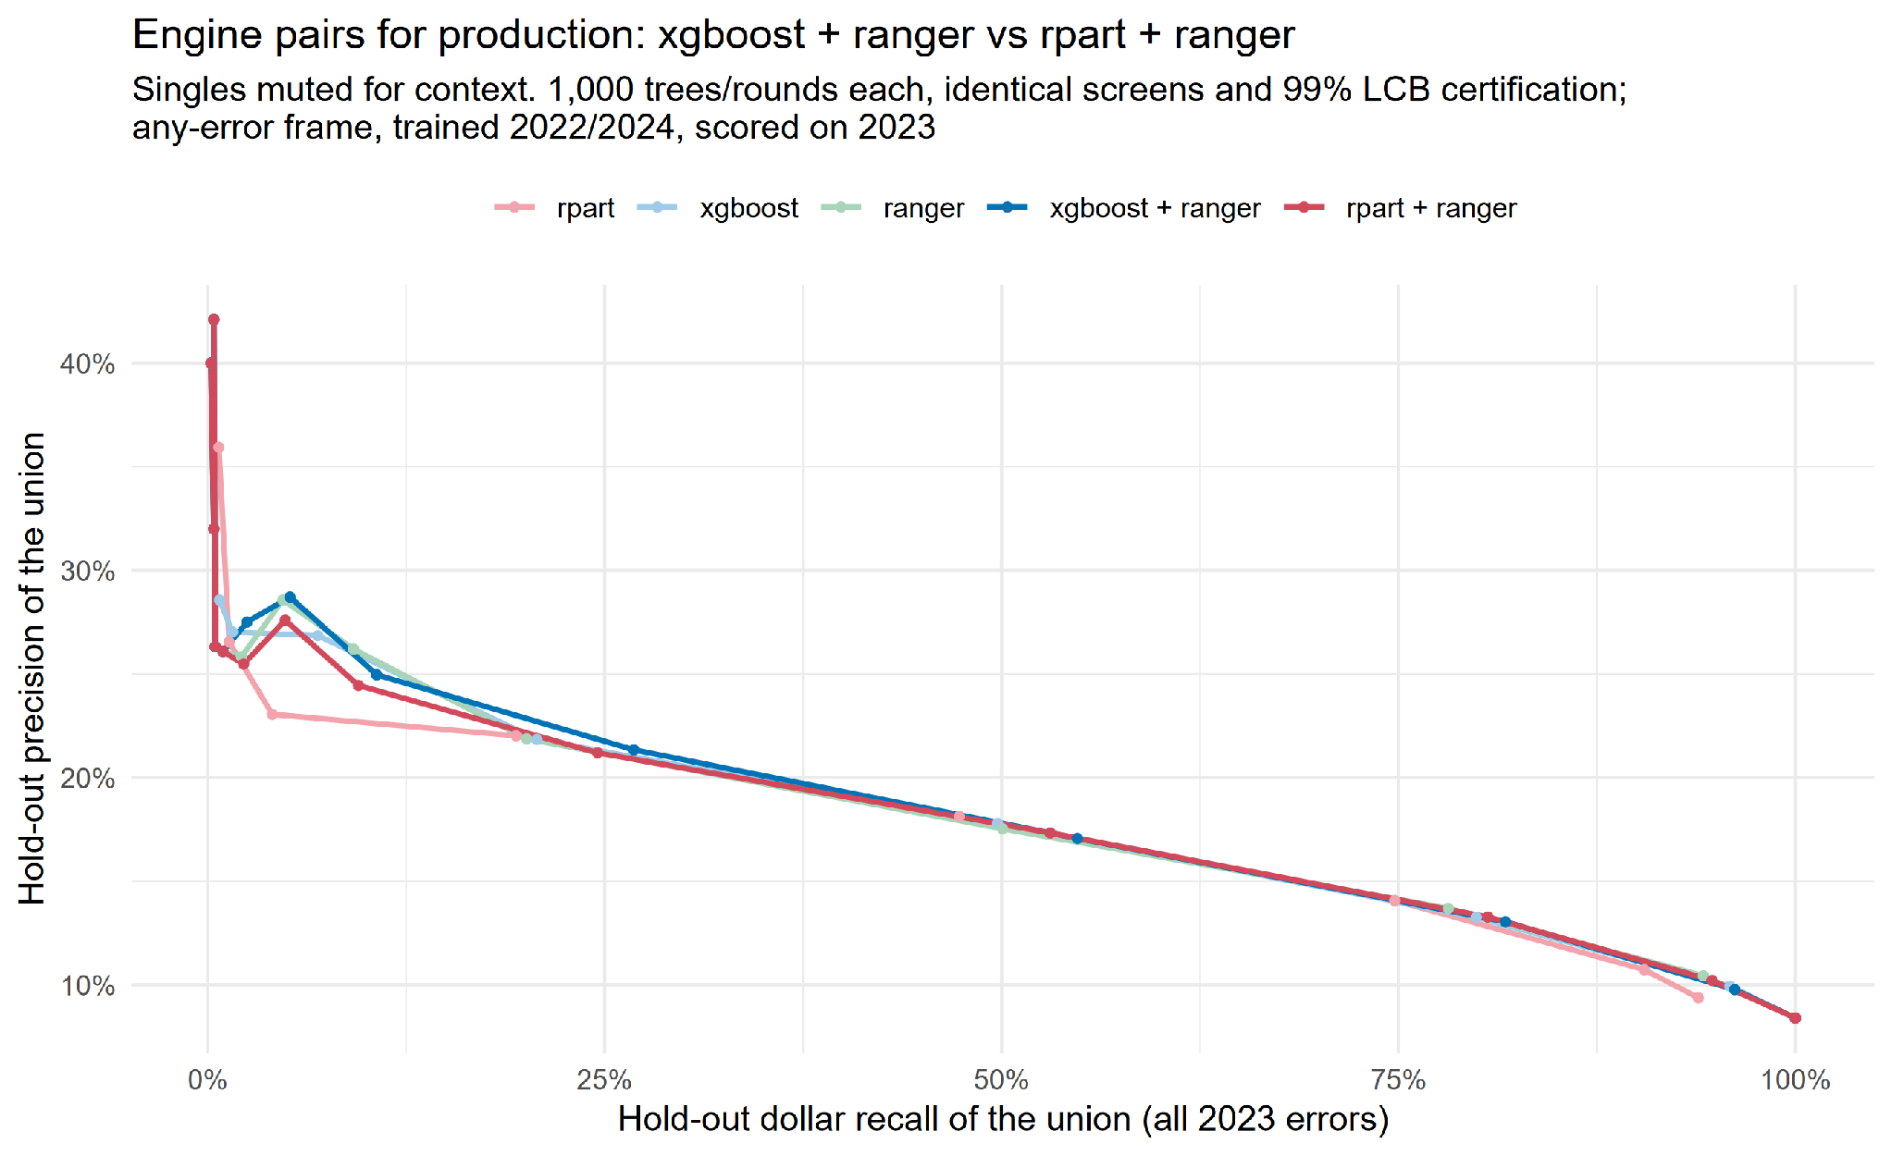
Appendix: engine tuning, what moved held-out performance
- Engine PAIRING mattered: xgboost + random forest (ranger) beat either engine alone and beat bagged-CART + ranger, everything else held equal.
- Random forests:
mtry = 2 beat mtry = 1 across the frontier;
Xgboost:
slow learning (eta 0.02, 1000 rounds) beat fast
Most other knobs did not move the frontier; we verified this by varying one setting at a time around the final configuration.
SNAP QC modeling lessons · July 2026

Slide 38
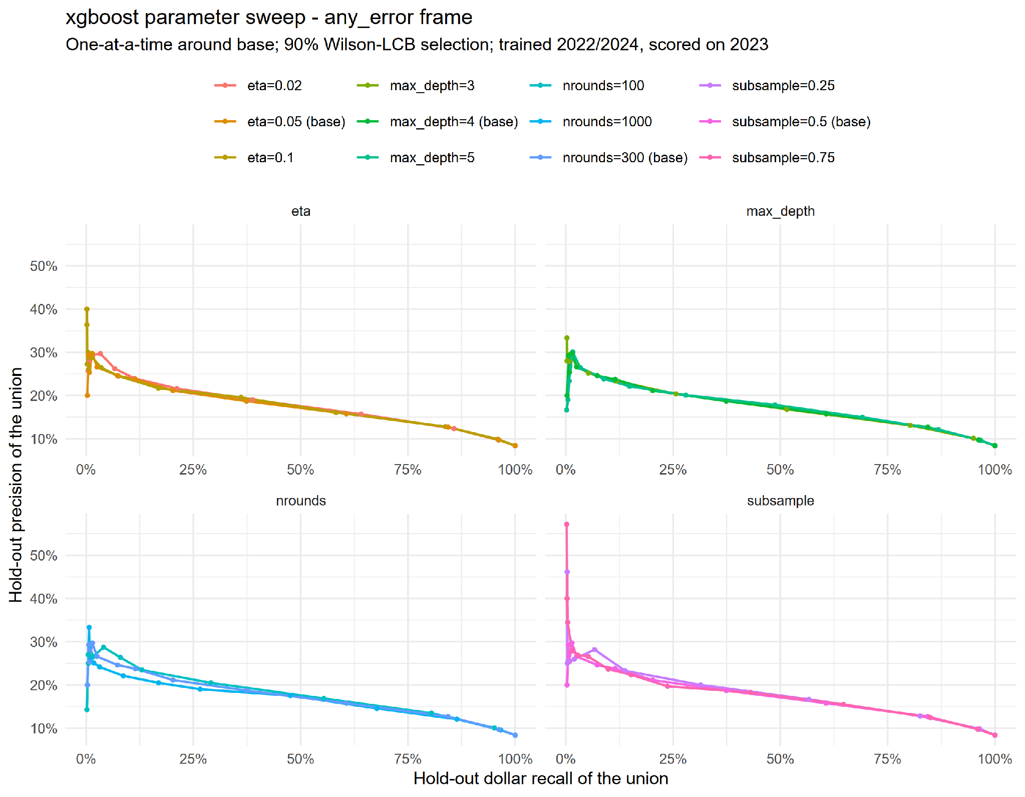
Appendix: one-at-a-time xgboost sweep

Slide 39
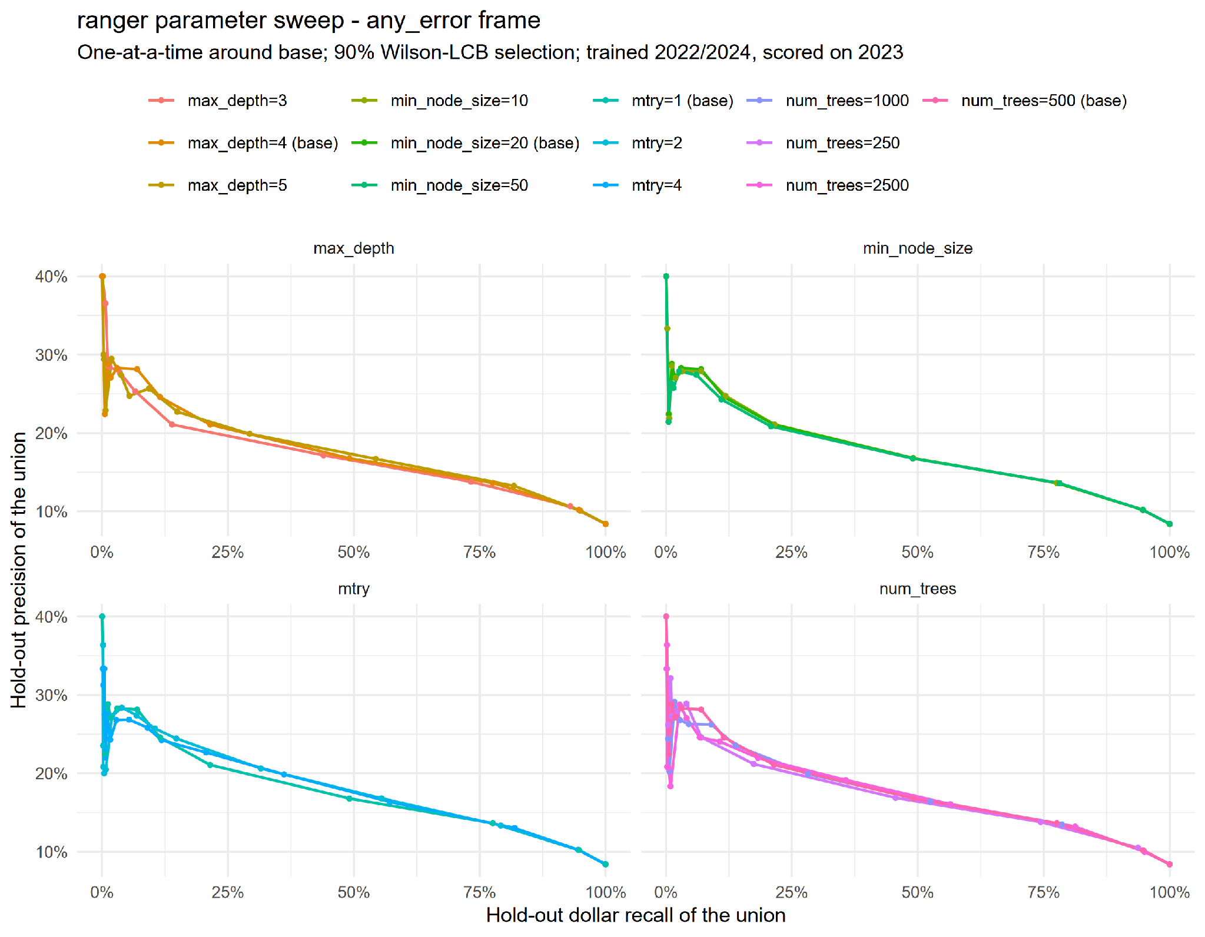
Appendix: one-at-a-time ranger sweep

Slide 40
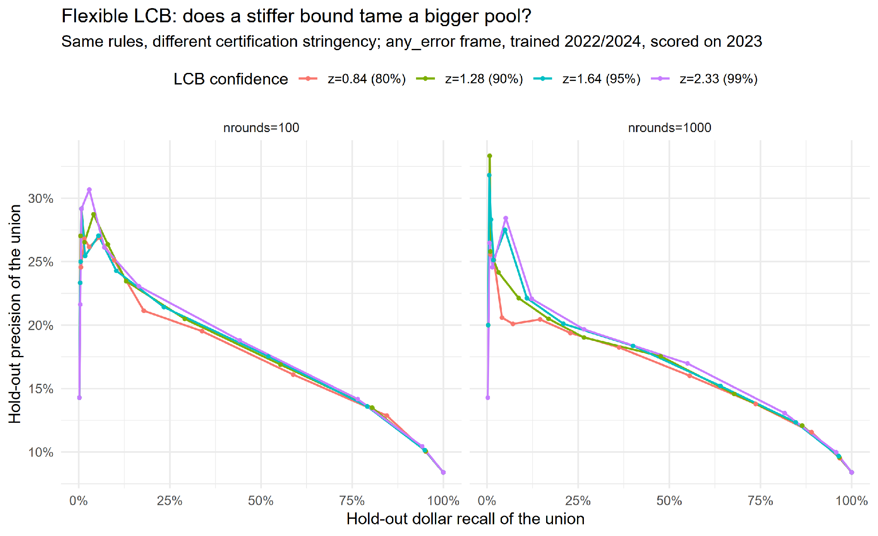
Appendix: filter stringency sweep

Slide 41
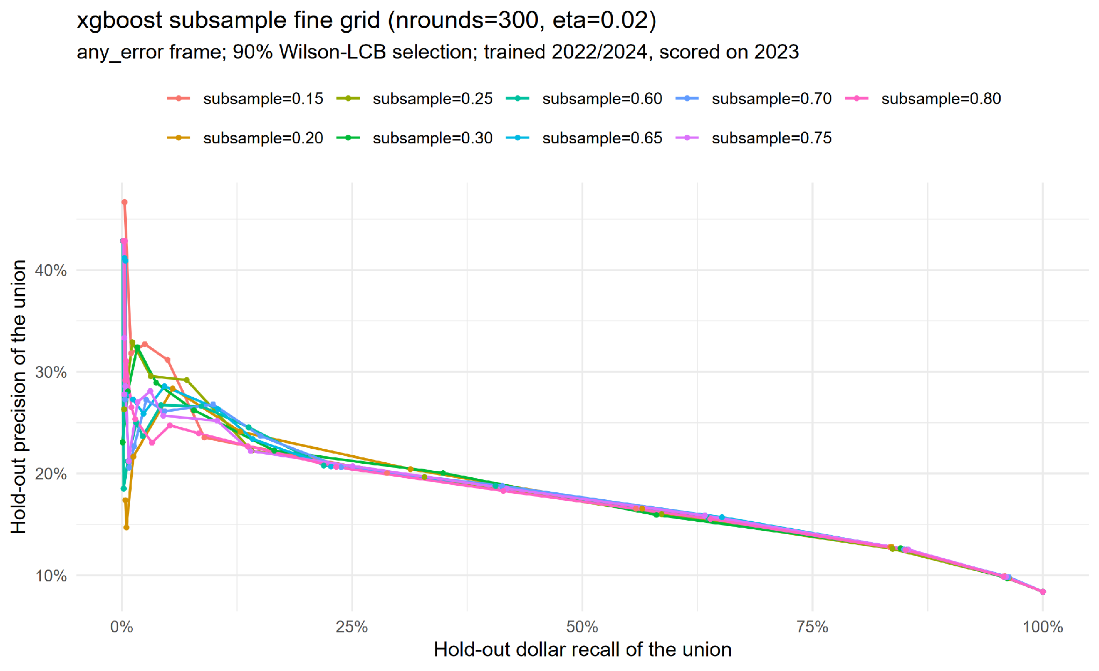
Appendix: subsampling sweep (claim retired on 2024)

Slide 42
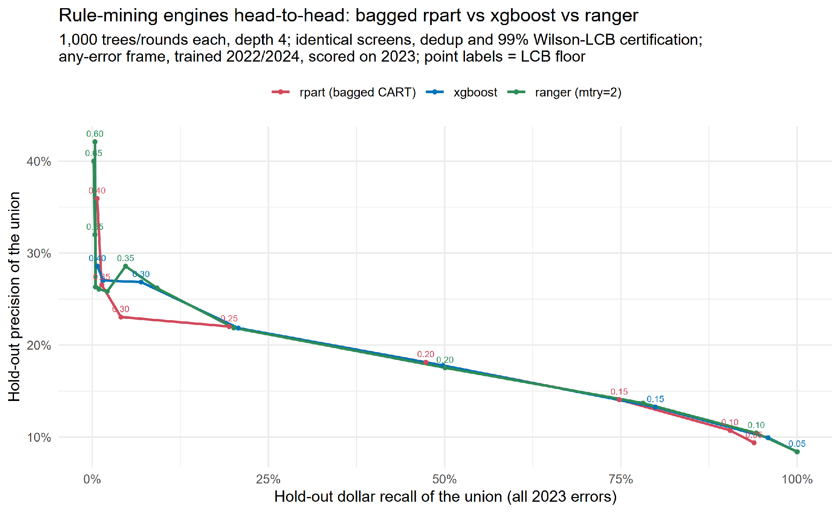
Appendix: single engines vs pairs

Slide 43
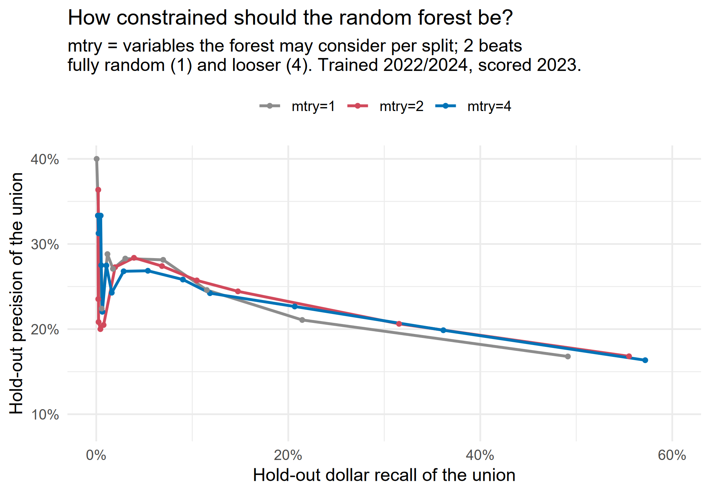
Appendix: RF contribution maximimzed at mtry=2

Slide 44
Appendix: blend vs national vs own, 5% budget

