Slide 1
Workshop: finding and tuning SNAP review-targeting rules
- Hands-on session for the two main scripts:
- INCL_find_inclusion_rules_by_hh_size_v2.R: build a rule list from labeled data
- state_threshold_gridsearch_v2.R: adjust the rules to your state and test them honestly
- github.com/giannella/snap_qc: everything today is in the public repo
Notes:
Before anyone arrives: open RStudio with the repo, load reg_model_data.rds, and have the outputs folders from a finished run ready as backup for every demo.

Slide 2
What's on offer here
- Rules mined from NATIONAL public QC data: far more error cases to learn from than any single state has, so the patterns are better established
- A pipeline that has been tested and optimized end to end: finding candidate rules, validating that they hold up on data they've never seen, and tailoring them to an individual state
- Completely open source and free (Apache 2.0): the code, the mined rules, the validation results, and these slides
- Already in use: Michigan, North Carolina, and Arizona have worked with rules from this pipeline
- What you leave with today: the ability to run both scripts yourself and a national rule list you can start evaluating immediately

Slide 3
What this has achieved on held-back state data
- Numbers below are from a year of data the tuning never saw, not the training data:
- Connecticut: about 1 in 5 flagged cases had an error; the rules caught 34% of the state's errors and 40% of its error dollars
- Arizona: about 1 in 4 flagged cases had an error; 20% of errors and 24% of error dollars caught
- North Carolina: about 1 in 6 flagged; 23% of errors, 20% of error dollars
- Smaller samples still get value without tuning: in Washington, the national rules used unchanged flagged a small set of cases of which more than a third had errors
- For scale: reviewing cases at random, roughly 1 in 10 would have an error

Slide 4
Plan for this session
- First 2 minutes: we START a small rule-mining run and let it cook (Demo 3 reads its results at the end)
- Part 1: what the finder script does, and how to read what it produces (Demo 1: explore real outputs)
- Part 2: tuning rules to one state and testing them honestly (Demo 2: live run for a state you pick)
- Part 3: the fresh results from our opening run + how to adapt everything to your own internal data
Notes:
Kick off Demo 3's run NOW, before Part 1: small config = any_error frame only, xgboost 100 rounds, ranger 100 trees, train 2022+2024, holdout 2023. ~15-25 min. Fallback for Demo 3 is the committed full outputs.

Slide 5
What you need to follow along
- R (any recent version) with five packages: dplyr, ggplot2, ranger, xgboost, rpart
- The repo: github.com/giannella/snap_qc (clone or download)
- Data: one row per case, a column saying whether the case was a true error, and whatever predictor variables you want rules to use
- to practice: the public national QC data (script 1 in the repo builds the modeling table for you)
- for real use: your internal review data works the same way; swap the variable list at the top of the script
- No special hardware: a normal laptop is fine

Slide 6
The big picture: two scripts, three decisions
- Script 1 FINDS rules: machine learning proposes ~100,000 candidate if-then rules; we keep only those we're statistically confident about. You decide: which error types and which precision floor.
- Script 2 TUNES rules to your state: tries a range of cutoffs for each rule on your data, keeps what still meets the bar, and tests everything on a year it never touched. You decide: tune locally or use national rules as-is.
- Then the third decision: HOW MANY rules to deploy: pick the precision floor whose flagged-case volume matches your review capacity.

Slide 7
The finder script: everything you change is at the top
TRAIN_YEARS <- c("2022", "2024") # years to learn from
HOLDOUT_YEARS <- c("2023") # a year kept aside for honest testing
features <- c("HH_size_n", "elderly_disabled_i", "rawben_rel_max", ...)
TARGET_IS_ERROR <- quote(!is.na(over_threshold) & over_threshold != 0)
MIN_PRECISION <- 0.20 # the precision floor for the shortlist
- features: any numeric or yes/no columns in your data: this is the main thing you customize
- TARGET_IS_ERROR: how your data says 'this case was an error'
- Everything else has sensible defaults from our testing, so you can run it unchanged

Slide 8
What you'll see while it runs
============ FRAME: earned_income ============
-- HH 1: 40437 train rows, 520 errors (1.29%)
xgboost rules: 21035 | ranger rules: 21191
screen: 43179 of 128627 rules kept (support >= 10, ...)
dedup: -1342 exact-coverage, -12435 dominated -> 29402 rules
shortlist (train LCB >= 0.20): 15 rules | median holdout precision 0.182
- It repeats this for each error type and household size; a full national run takes a couple of hours; small practice runs take minutes
- Three numbers to watch: rules proposed, rules surviving the confidence filter, and how survivors scored on the held-back year

Slide 9
What it produces (all plain CSVs)
- ..._rules_all.csv: every surviving rule with its scores: on the build data, on the held-back year, and counting any error type it catches
- ..._rules_highprecision.csv: the shortlist: rules we're confident about, near-duplicates removed. This is the file states actually review.
- ..._lcb_sweep.csv + .png: the menu: for each precision floor, how many cases all kept rules flag together and what share of errors/dollars they catch
- final_rules_highprecision_all_frames.csv: shortlists from all error types combined (one row per rule; a 'frame' column says where it came from)

Slide 10
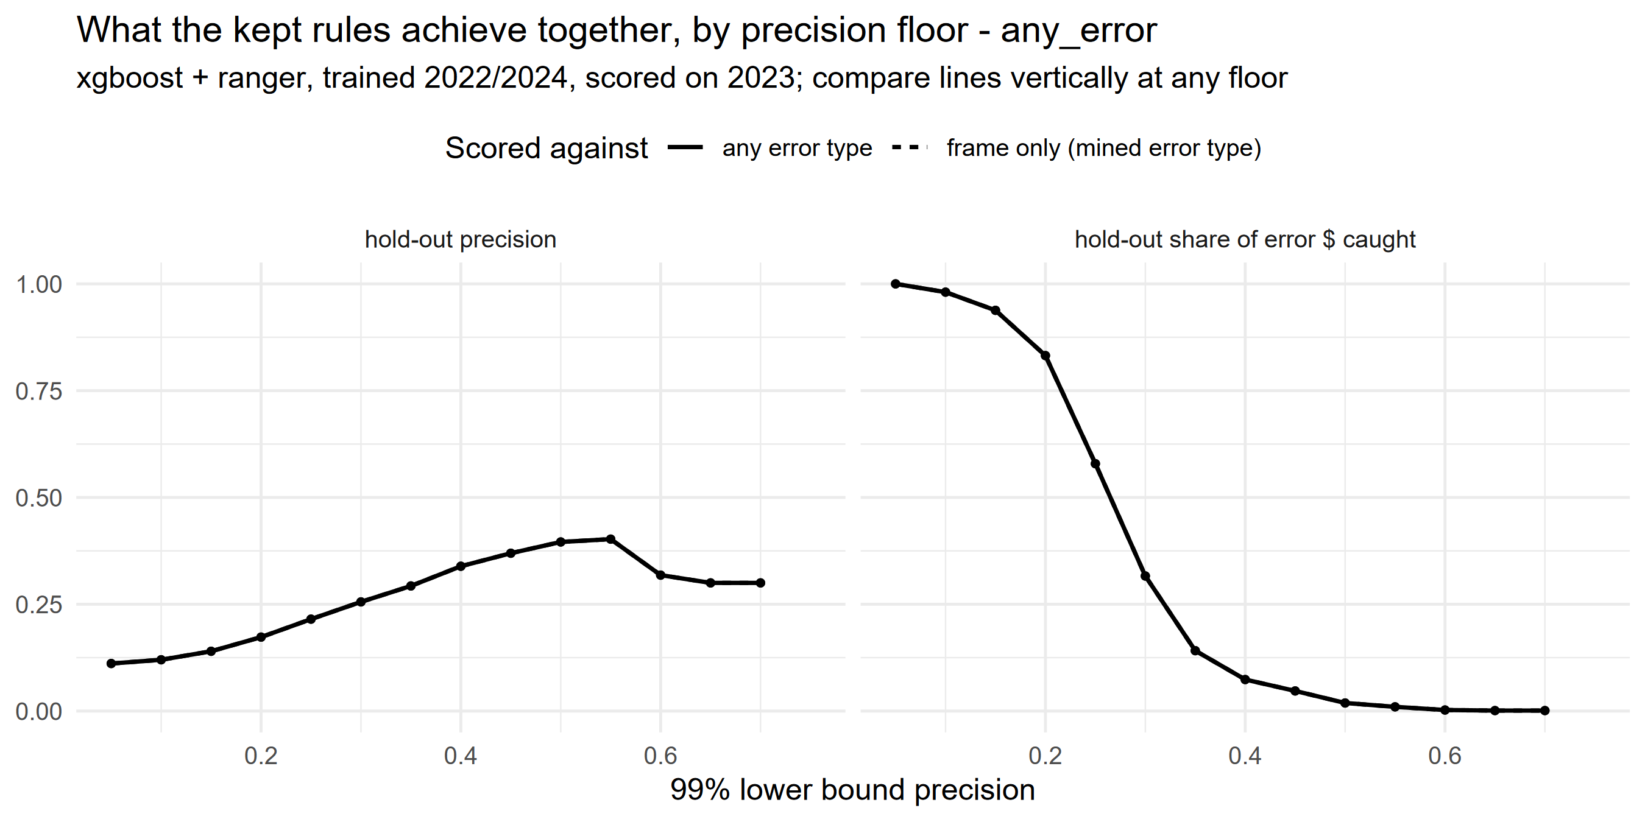
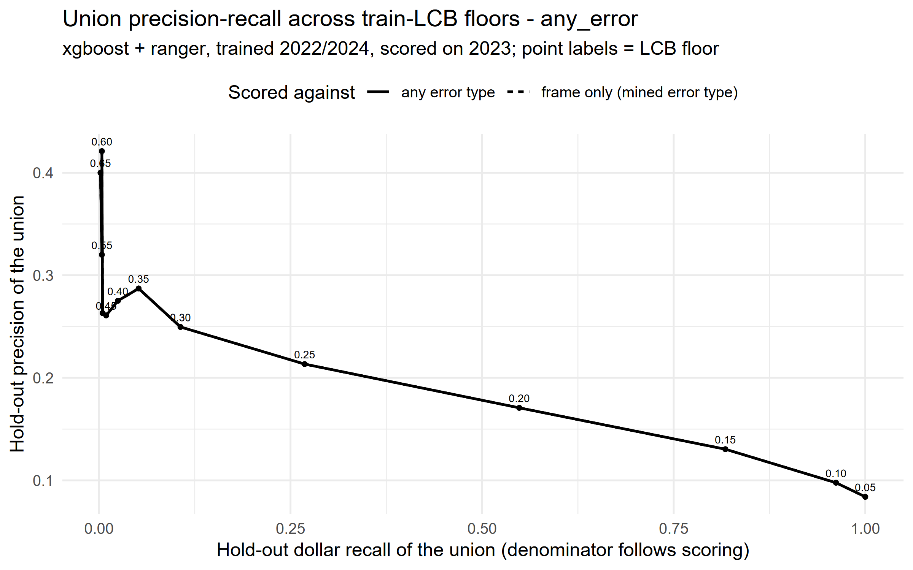
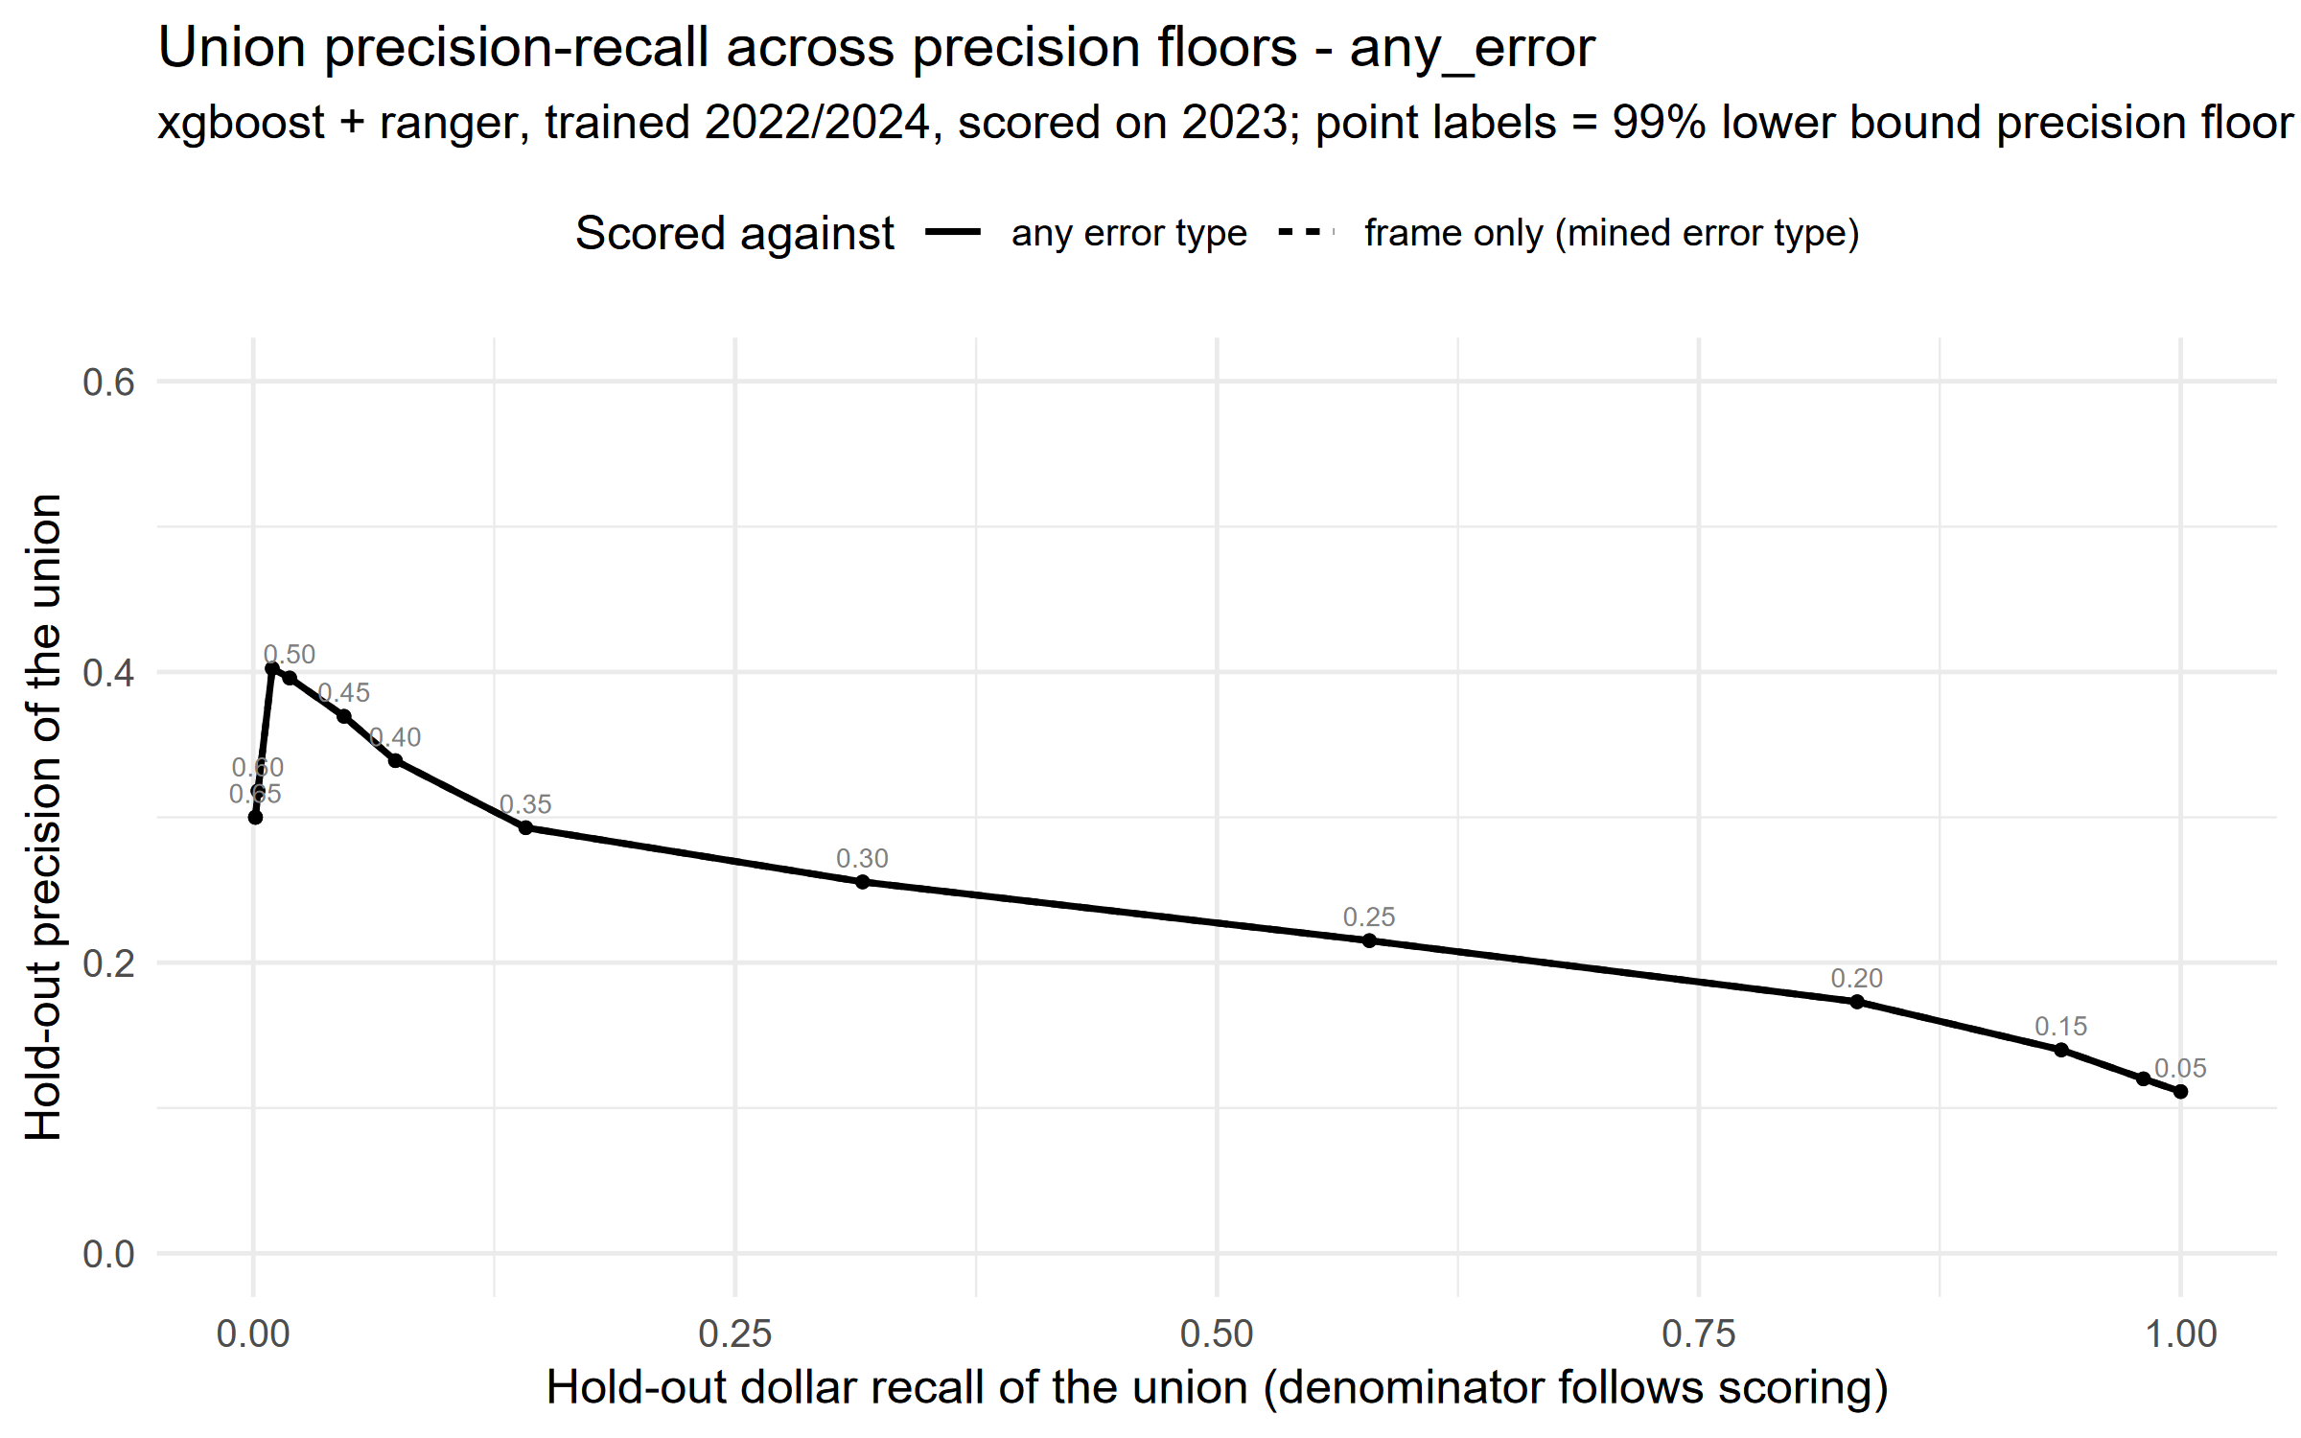
The menu, visually: accuracy vs coverage
- The x-axis is the precision floor. Move right: fewer, sharper flags; left: more coverage. Left panel = precision on a new year; right panel = share of error dollars caught.

Slide 11
LIVE DEMO
Demo 1: reading the outputs like a reviewer
- Open the shortlist CSV and sort by confident precision: what do the top rules have in common?
- Take one rule and say it in plain English (e.g. 'elderly/disabled household, benefit near the maximum, deductions under $X')
- Check it against the data live: run the rule's condition in R and look at the flagged cases; count how many were real errors
- Open the sweep chart and pick an precision floor together: 'if we can review 500 cases a year, which row are we choosing?'
Notes:
RUNBOOK (no compute, ~10 min): 1) open inclusion_rules_by_hh_size_v2/final_rules_highprecision_all_frames.csv in Excel, sort by precision_train_lcb; 2) pick a 3-condition rule with n_flagged_train > 40; 3) in R: idx <- with(reg_model_data, <paste rule>); table(reg_model_data$error_status[idx]) - narrate the counts; 4) open any_error_lcb_sweep.png and walk the floors. FALLBACK: none needed - files are static.

Slide 12
Choosing rules: you are allowed to say no
- The shortlist is a MENU, not a mandate; your program experts should drop rules that don't make operational sense
- The list intentionally keeps overlapping rules: if you drop one, another often catches the same cases a different way
- Dropping a rule never breaks the others; each rule stands on its own
- Rule of thumb from our testing: expect roughly the 'confident precision' number in practice; it was set with statistical caution so it holds up

Slide 13
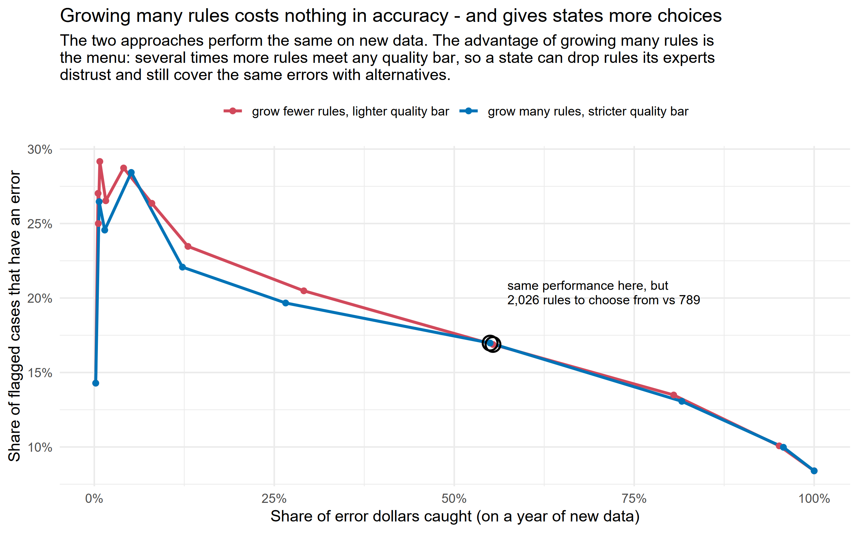
Why saying no to a rule is safe: the menu is deep
- Two ways of building the rule list perform identically on new data, but the approach we use keeps several times more rules above any precision floor. That surplus is your freedom to veto.

Slide 14
The tuner script: point it at your state
STATES <- c("Connecticut") # your state
TRAIN_YEARS <- c("2022", "2024") # years used for tuning
TEST_YEARS <- c("2023") # a year the tuning never sees
QUALIFY_MODE <- "lcb" # evidence-adjusted bar (or "support_floor")
MIN_STATE_PRECISION <- 0.20
- It tries a range of cutoff values around each national rule's numbers (e.g. income thresholds +/-25%) and keeps what qualifies on YOUR data
- Among qualifying versions it picks the one that captures the most error dollars

Slide 15
The part that keeps everyone honest
- Every tuned rule is scored on the test year (which the tuning never touched) under BOTH its tuned cutoffs and the original national ones
- The script also reports what you'd get by skipping tuning entirely and using the national rules unchanged: the fallback every state has
- Compare the three and let the test year decide. In our seven-state testing: tuning won in states where ~30+ rules qualified, and LOST to unchanged national rules in states with less data
- Why: with only a few hundred errors, tuning mostly rewards cutoffs that got lucky

Slide 16
LIVE DEMO
Demo 2: tune the rules to a state, live
- Someone name a state, and we'll change one line and run the whole thing now (takes about two minutes)
- While it runs: it is trying cutoff variants for ~190 national rules against that state's cases
- Then we read the result together: how many rules qualified, and did tuning beat the national rules on the test year?
- If few rules qualified, that IS the answer: this state should use the national rules unchanged
Notes:
RUNBOOK (~5 min incl. run): edit STATES <- c('<volunteered state>') in state_threshold_gridsearch_v2.R, save, run the runner script. ~2 min for one state. Narrate the 'rules qualified' line, then the three TEST union lines. FALLBACK: state_rules_v2/ has finished results for WA, CT, NC, LA, MI, VA, AZ - open the volunteered state's CSV if the live run misbehaves, or Connecticut's if they name a state not in the data.

Slide 17
Sizing the rule set to your review capacity
- Sort the final rules by confident precision, then take rules from the top until the projected flagged-case volume matches what your team can review
- The sweep table does this arithmetic for you at each precision floor
- Expect a trade: a small, sharp set (say 1 in 4 flags is an error, few cases) vs a broad set (1 in 6, many more errors caught overall)
- Whatever you choose, keep the unused rules; they're your replacements when experts veto something

Slide 18
LIVE DEMO
Demo 3: the run we started at the beginning
- At the start of the session we launched a small version of the finder (one error category, reduced settings). Let's read what it found
- Same console story you saw on the slides: proposed rules, survivors, shortlist
- Open its shortlist CSV: brand-new rules, found in under half an hour on a laptop
- Full-strength national runs use bigger settings and take a couple of hours; same pipeline, just smaller today
Notes:
RUNBOOK: opening run config = any_error frame only, xgboost nrounds=100, ranger num_trees=100, train 2022+2024, holdout 2023. Expect ~15-25 min and a few hundred shortlist rules. If unfinished: show the live log (tail the .log) and walk the committed full outputs instead. If it errored: same fallback - and the error is a teachable moment.

Slide 19
Adapting this to your internal data
- Your table needs: one row per case; a true/false error column; predictors
- Predictors must be numbers or yes/no; recode categories first (the script tells you which columns it can't use)
- Change three things at the top of the finder: the data frame, the features list, and TARGET_IS_ERROR
- Internal data is usually richer than the public QC files: wage records, churn history, notice dates all make good predictors
- Keep one full year aside for testing. Never let the tuning see it.

Slide 20
The three mistakes we made so you don't have to
- Trusting raw accuracy: a rule list promising 20% delivered 10% on new data. Always use the evidence-adjusted score; the scripts do this by default.
- Counting only the intended error type: reviews that find a different error still succeed. The scripts report both numbers; quote the any-error one.
- Tuning with too little data: below roughly 30 qualifying rules (or ~30 flagged cases per rule), tuned cutoffs are mostly luck. Use national rules unchanged instead.

Slide 21
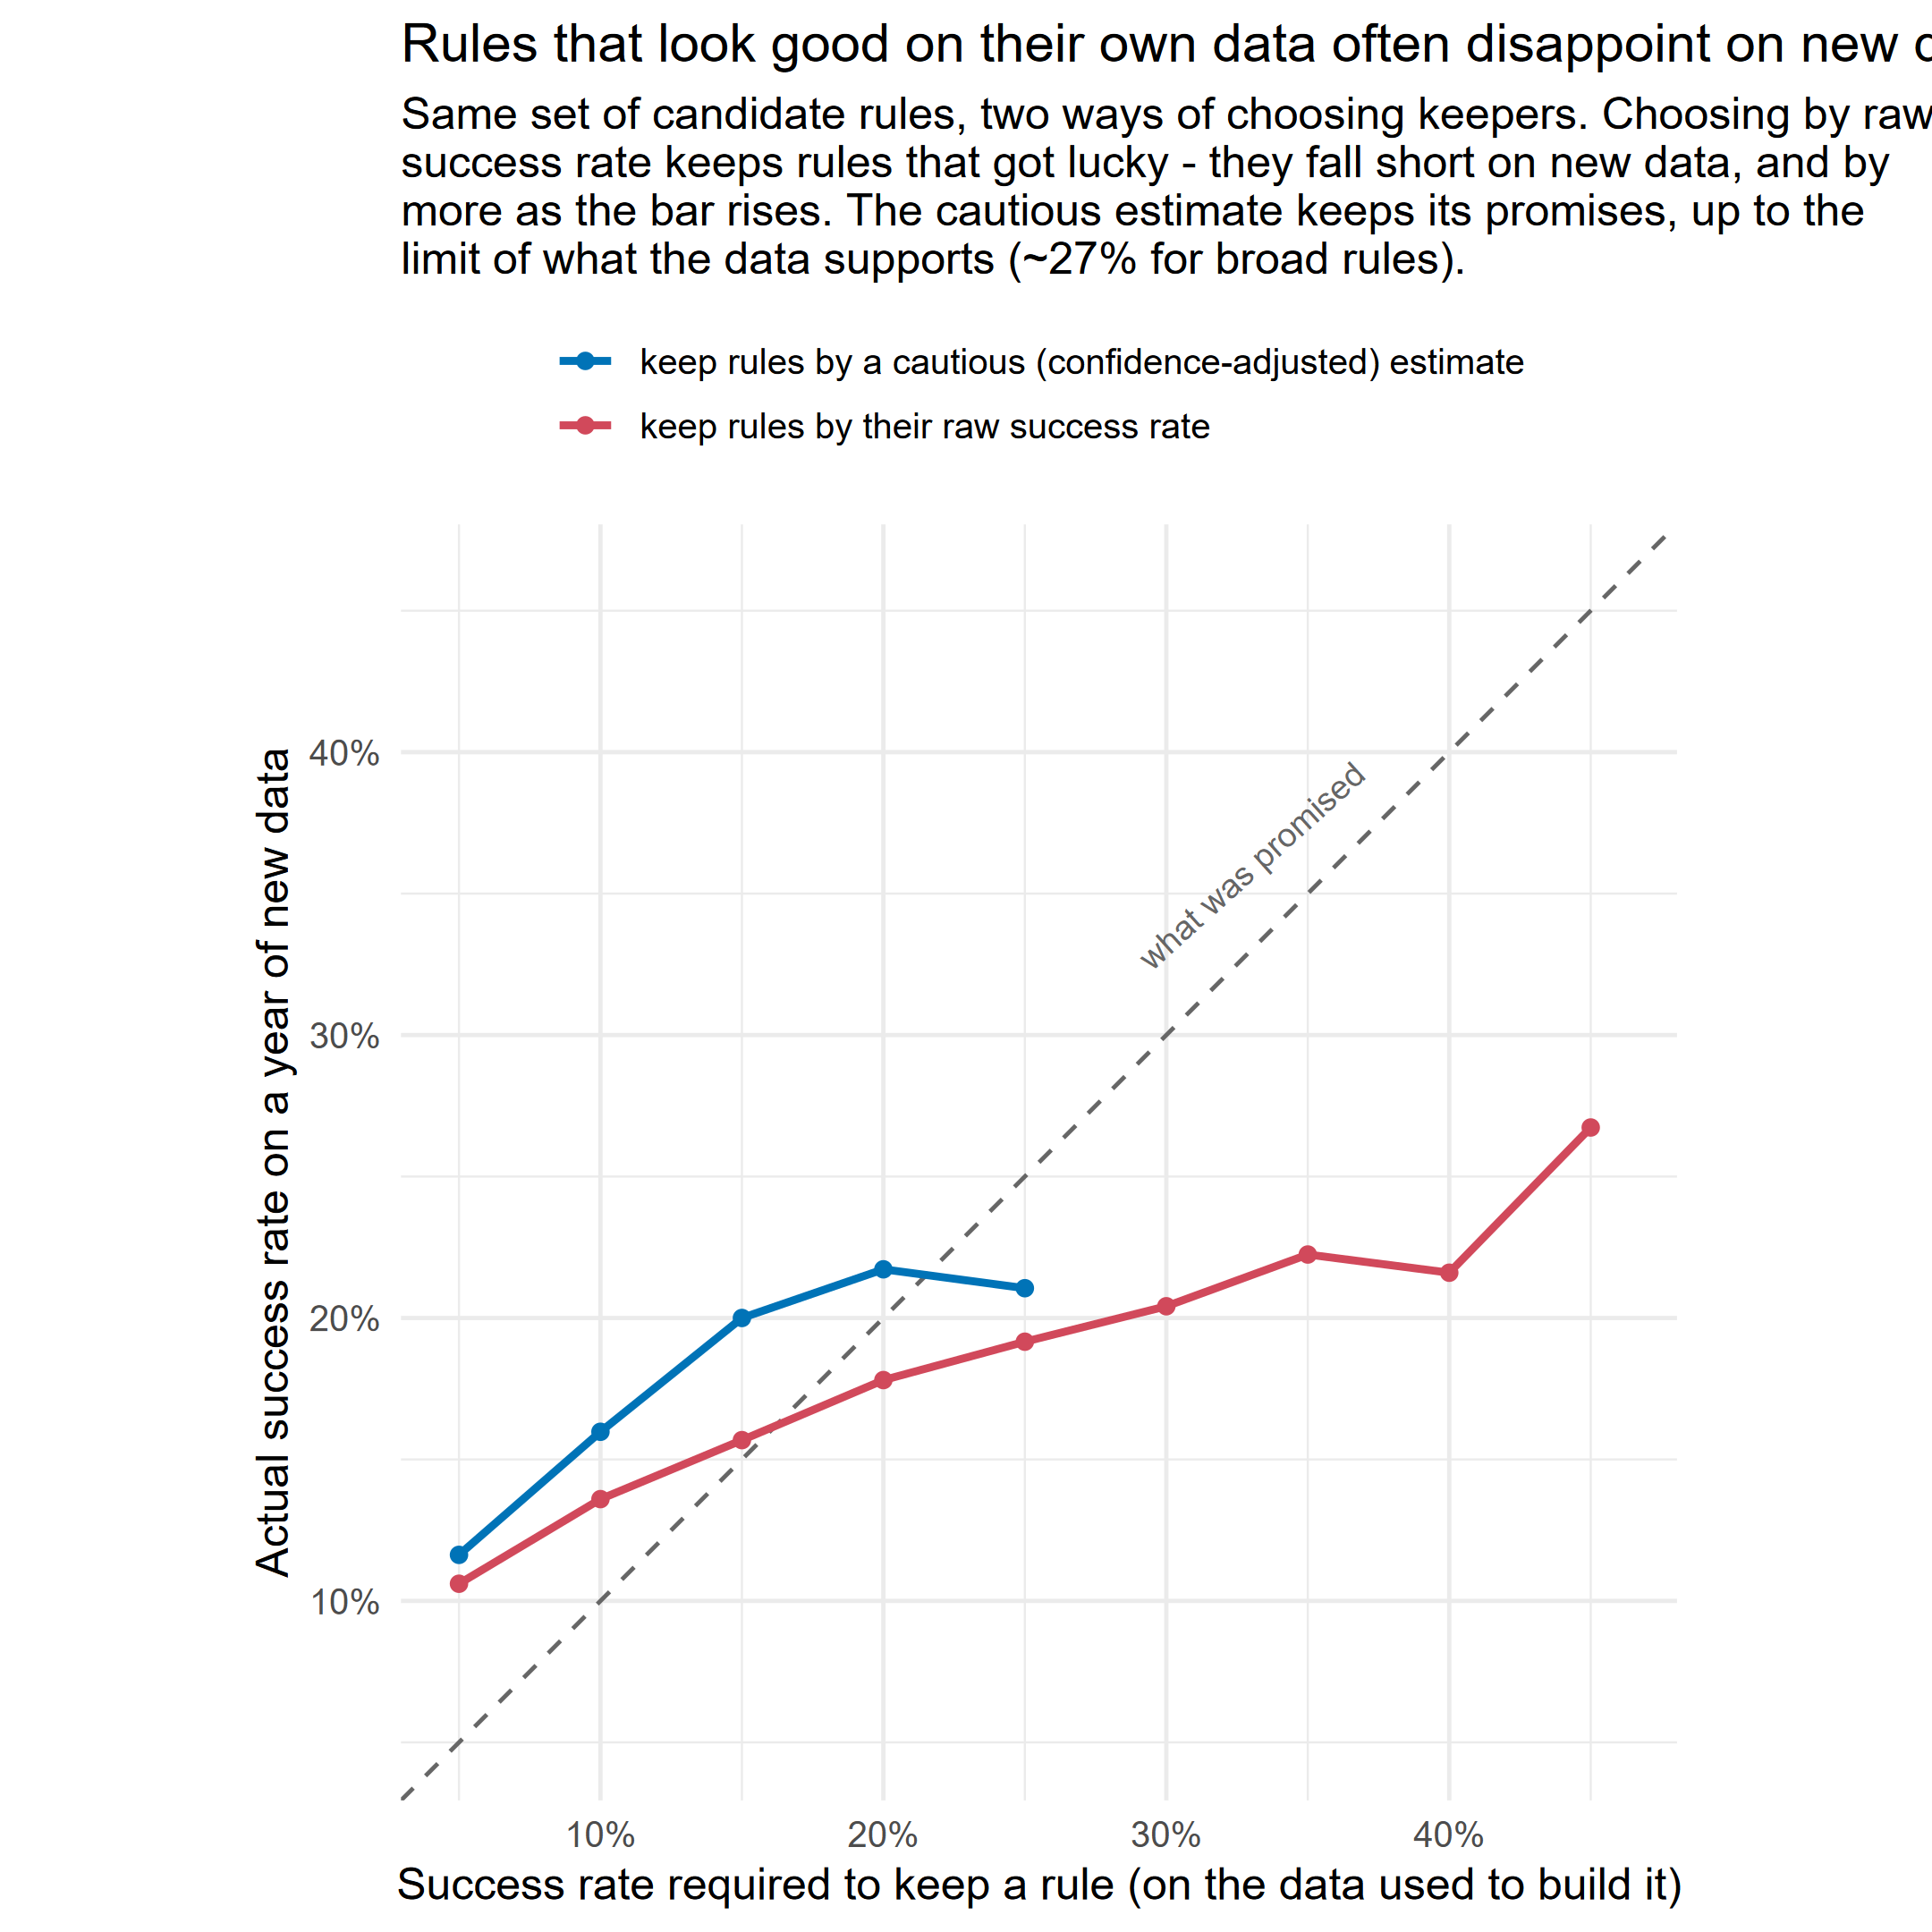
Mistake #1, visualized: rules that got lucky
- Same candidate rules, two ways of choosing keepers, scored on a year they never saw. Choosing by raw measured accuracy over-promises; the evidence-adjusted score keeps its promises. The scripts do the right thing by default.

Slide 22
Where everything lives
- Repo: github.com/giannella/snap_qc: scripts, data pipeline, this deck
- README: quick-start for both use cases + a migration guide from the old RuleFit version
- modeling_findings.md: every claim in this workshop with the numbers and charts behind it
- Example outputs are committed, so you can explore everything from Demo 1 before running anything
- Questions / your state's results: please reach out; the pipeline improves when states report back

