Slide 1
Visualizations
File created on: 14/12/2019 5:38:21 μμ

Slide 2
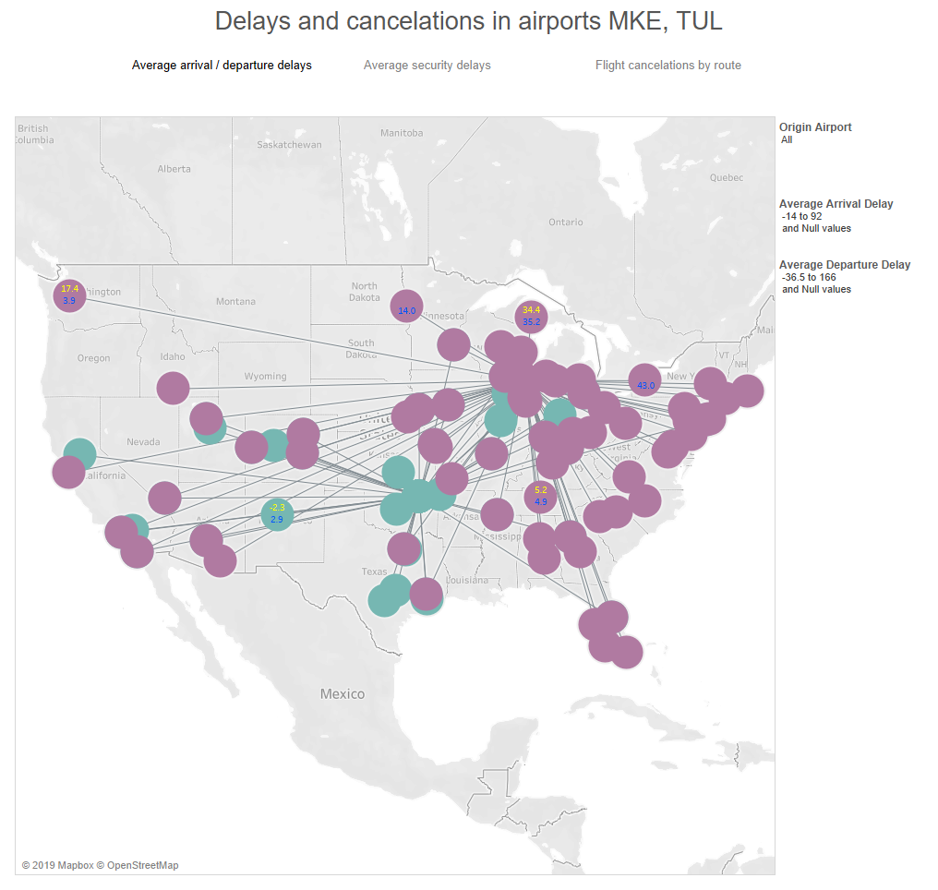

Slide 3
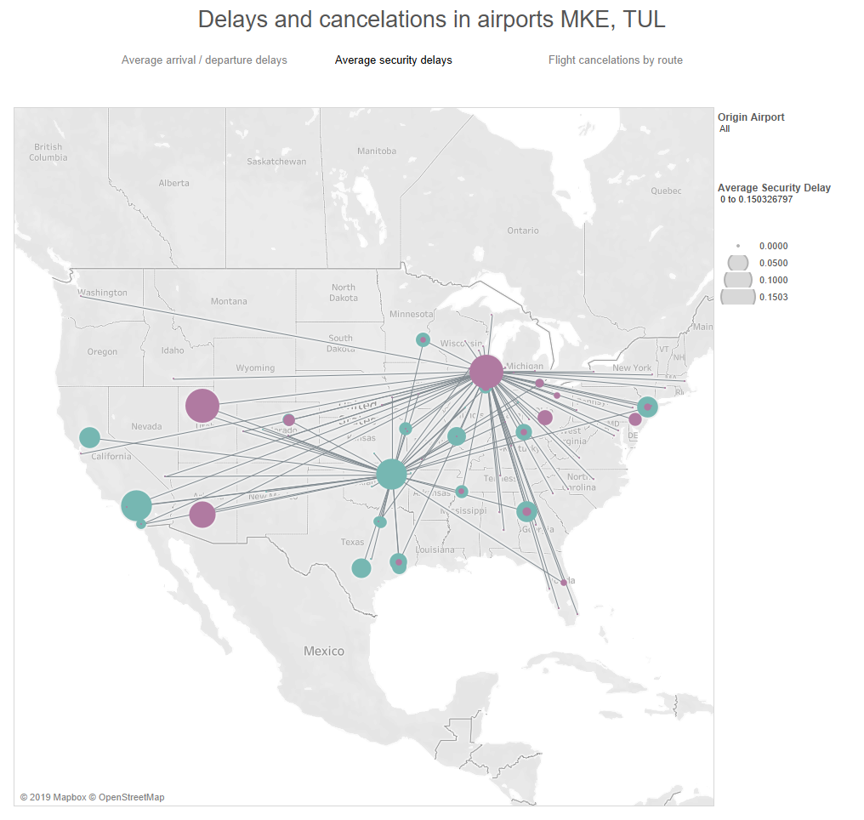

Slide 4
