Slide 1
Gr-Spider: Revealing the Power of Greek Text-to-SQL
Panagiotis Korovesis¹, Ioannis Fourfouris¹
¹National and Kapodistrian University of Athens

Slide 2
Contents
Introduction
The Greek Spider Dataset
Translation Pipeline
Challenge of Dataset Translation
Experiments Setup
Experiments Results
Conclusion and Feature work
Demo

Slide 3
Introduction
Text-to-SQL (NL2SQL):
Converts natural language queries into structured SQL queries.
Involves understanding the input text and mapping it to SQL components like SELECT, FROM, WHERE and JOIN.
Importance:
Existing datasets are primarily in English.
Limited resources for other languages, including Greek.

Slide 4
The Greek Spider Dataset
Original Spider:
Created for text-to-SQL tasks.
Annotated by 11 Yale college students.
10,181 questions and 5,693 unique complex SQL queries.
Covers 200 databases with multiple tables across 138 distinct domains.
Objective:
Introduce the first Greek dataset for Text-to-SQL applications.
Adapt the widely known Spider dataset into Greek.

Slide 5
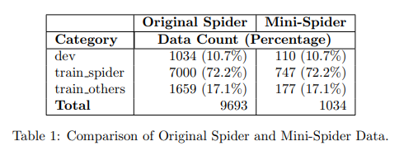
The Greek Spider Dataset
Subset for the Course:
Due to time constraints, utilized a subset of the data.
Split development data into train files to match proportions of the original dataset. → Mini-Spider and Mini-Gr-Spider
Mini-Spider Details:
20 distinct schemas, 81 tables, 441 columns.
1,034 questions.
Notes:
Due to the course’s time constraints, we used only a subset of the data. We split the development data into the required files (train_spider.json, train_others.json, dev.json) to match the proportions of the data in the original files, as shown in Table 1. On the left side of the table, we can see the number of questions in the original Spider dataset and on the right, the data in our version, as well as the corresponding proportions. We will refer to this dataset as 'Mini-Spider' and the equivalent dataset in Greek as 'Mini-Gr-Spider’. Regarding the database details, it consists of twenty distinct schemas, with eighty-one tables and four hundred forty-one columns, along with one thousand thirty-four related questions

Slide 6
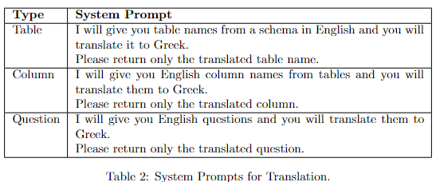
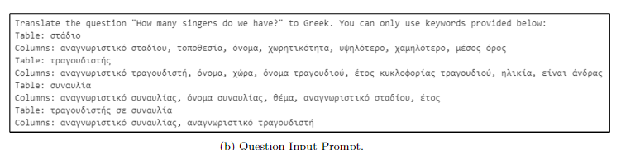
Translation Pipeline
Creation Process:
Translated the English Spider dataset using Large Language Models (LLMs).
First, translate the schema → use it as a reference to perform the question translation.
Two annotators verified and post-edited the translations.
Large Language Models (LLMs):
Chosen for their capability in handling translation tasks.
System Prompts Design.
Input Format for LLMs.
Notes:
The translation process is structured into two steps: First, we translated the schema, including table and column names. Next, the question translation was performed using the translated schema as a reference. To increase efficiency and avoid manual translation of all information, we first used Large Language Models in order to translate the Spider dataset. Then, we correct and post-edit the translations, utilizing any gathered contextual information. The final translation at each stage resultef from a cross-check between ours post-editing efforts. LLMs were selected for their translation capabilities. For the translation task, we designed specific system prompts, which are outlined in Table 2. Also, we created a structured input format to feed into the language models to obtain the translated information. An example of these inputs can be seen in the image.

Slide 7
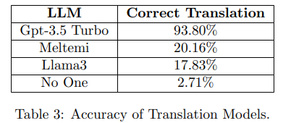
Translation Pipeline: Large Language Models Evaluation
Three models were evaluated for English-to-Greek translation:
Llama 3, Meltemi, GPT-3.5 Turbo.
3 schemas consisting of 18 tables and 89 columns were manually translated into Greek.
The 258 related questions were given to the models for translation → Accuracy validation.
*Answers containing the correct translation along with any other information, were marked as invalid
Notes:
Regarding the Large Language Models evaluation, we examined three models for their suitability for English-to-Greek translation namely Llama 3 , Meltemi and Gpt-3.5 Turbo. To identify the optimal model, we manually translated 3 schemas into Greek, comprising of 18 tables and 89 columns. Subsequently, we fed the 258 relevant questions into the models using the previously mentioned prompts and obtained the translated questions. We then validated these translations to assess their accuracy. As we can see in Table 3, Gpt-3.5 Turbo translated the most questions correctly, leading us to select it for the subsequent translation tasks. The ‘No one’ entry shows the percentage of questions that were incorrectly translated by all the language models. It is worth noting that translated questions produced by LLMs, which included additional text such as explanations for why the question was translated a certain way or definitions of tables and columns, were marked as incorrect. This is caused by the models’ ‘babbling’ behavior, especially in Llama3 and Meltemi. This is the main reason why these models have not achieved good accuracy

Slide 8
Translation Pipeline: Challenge of Dataset Translation
Ambiguity in Context and Domain Knowledge:
Schema information lacks clarity regarding its intended reference.
Some Abbreviations have unclear meanings → Validation through associated questions helps clarify the intended logic.
Non-1-1 Association:
Some English words lack exact equivalents in Greek.
Entity Polysemy:
Certain words in English have multiple meanings in Greek.
Notes:
Based on our initial investigation, we have identified the most common errors that arise when translating the spider dataset covering both schema and questions. The first one is Ambiguity in Context and Domain Knowledge: this means that some schema information lacks clarity regarding its intended reference. For instance, the term ‘Student’ may be relevant to a college attendee, a school-level student or even a doctoral candidate. Additionally, there are abbreviations, especially in column names, whose specific meaning is unclear. In such cases, we refer to the questions that use this information to validate the logic. Next, we have the Non-1-1 Association problem: Some English words do not have exact equivalents in Greek. For instance, the word ’State’ can be translated as ‘Politeia’, but in English, it typically means each of the federal states constituting the United States, whereas in Greek, it refers to the organization of a city-state or the form of government. Finally we have the Entity polysemy challenge: Certain words have multiple meanings in Greek. For example, the word ‘Transcript’ can refer to a general written or printed material, but it can also refer to a record study of a student .

Slide 9
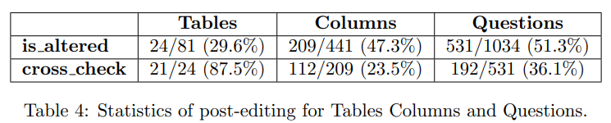
Translation Pipeline: Dataset Analysis
Sentences were reorganized, unnecessary words were eliminated.
Table and column names were corrected where needed.
GPT occasionally did not strictly follow input keywords provided in the prompt, opting instead to translate content from scratch.
*The Mini-Spider translation process required over two days in total for translation and data review.
Notes:
While Gpt-3.5 Turbo performed excellent in the translation process, we continued to refine the schema and the questions. Regarding the adjustments, we reorganized the content within sentences, eliminated unnecessary words and refined the sentence structures to sound more natural. Additionally, we corrected table and column names where needed. This was necessary because Gpt, occasionally, did not strictly follow the input keywords provided in the prompt. Instead, it translated the content from scratch.
Details of the statistics of the post-editing data can be found in Table 4. The is altered information in the table reveals the percentage of questions that were modified between the initial Gpt translation and the final translated version. As mentioned earlier, each annotator verified and post-edited the Gpt translation. The final translation resulted from a verification process of the post-edits. The cross check information indicates the percentage of disagreement between our annotations (based only on the data that were altered).

Slide 10
Experiments
Two baseline Text-to-SQL models were used to evaluate the dataset:
RAT-SQL
DAIL-SQL
A new baseline for each model was needed to make meaningful comparisons.
Notes:
For the experiment, we explored two powerful Text-to-SQL models. RAT-SQL was utilized for a traditional machine learning approach to the Text-to-SQL problem, while DAIL-SQL was chosen to assess its effectiveness, employing advanced prompt engineering to leverage large language models (LLMs). Additionally, since existing work uses the full version of the Spider Dataset while we use the Mini-Spider, we required a new baseline for each model to ensure meaningful evaluations. Therefore, we utilized the Mini-Spider dataset for training, evaluation and metric calculation, establishing the main reference for later analysis.

Slide 11
Experiments: RAT-SQL
Encodes the schema along with each question.
Performs schema linking by:
lemmatizing questions, schema info using the simplemma library
similarity search on lemmatized terms.
Incorporates multilingual language models:
mT5-large, mBart
Extensions:
Added support for mT5-base.
Added option for stanza lemmatizer
Notes:
RAT-SQL is a traditional Text-to-SQL model, which requires train and inference. The model manages to encode the database relations in an accessible way and to map columns and their mentions for a particular question. During the pre-processing phase, schema linking takes place. This is achieved by lemmatizing the questions, as well as the tables and the columns of the database, using the simplemma library. Then the columns and tables are mapped to the questions, where possible. The mRAT-SQL model, incorporates multi-language models like mT5 and mBart, facilitating the training and inference processes across different languages. Regarding our extensions,. Through experimenting we found out that simplemma lemmatizer performed worse at the schema linking process for the Greek dataset, when compared with the Stanza lemmatizer. As such, we added the support for the Stanza library.

Slide 12
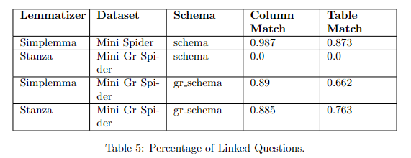
Experiments: RAT-SQL - Setup
Existing studies use the original English schema for experiments, regardless of the language of the questions, resulting in a lack of schema linking for non-English languages.
We introduce a novel approach by translating both column and table names.
Training was performed using mT5-base.
All scores shown are derived by inferencing the dev set.
Notes:
We translate table names and column names, crucial for schema linking, while leaving other fields unchanged to preserve their original values. This ensures SQL queries reference the correct tables and columns. The translated schema is referred to as gr-schema, while the original remains labeled simply as schema.
It's crucial to note that both the training and inference datasets utilize identical databases, significantly enhancing inference scores compared to scenarios where a database not used during training is employed

Slide 13

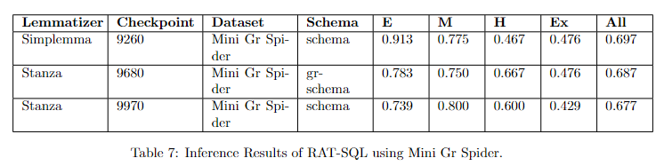
Experiments: RAT-SQL – Results (1/2)
The baseline for our comparisons resulted by training RAT-SQL on Mini Spider.
Optimal Greek
Models trained on Mini Gr Spider dataset performed worse than their English counterpart.
It appears that column/table matching had minimal impact on the accuracy.
We anticipate that the significance of accurate schema linking will become evident during inference with the translated test set
Notes:
BULLET 2: This is because both datasets utilize the same databases. Despite column/table matching not being effective with the original schema, RAT-SQL consistently encodes information from the entire database alongside each question. Given the manageable complexity of connections in the Spider dataset, the model reliably identifies links from available information. Consequently, during training, the model familiarizes itself with databases and successfully predicts questions in the dev set.
BULLET 3: uses different databases unfamiliar to the model. In this scenario, the model will heavily rely on mapping between questions and tables/columns to achieve accurate results.

Slide 14
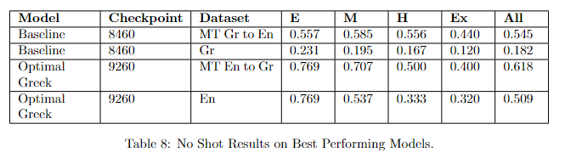
Experiments: RAT-SQL – Results (2/2)
Is manual translation of datasets and training of language-specific models still necessary?
Direct Multilingual Model Approach: Training a multilingual model solely in one language and directly inferring it in the target language.
Machine Translation Approach:
Translate questions using LLMs to the model’s train language.
Inference the model with them.
Notes:
5628.85% More English data than Greek in mt5 training
Models trained with machine-translated data also exhibited inferior performance compared to their counterparts. Despite providing additional context to the LLM for more accurate translation, it failed to produce results comparable to those from human-curated datasets.
The decline in performance can largely be attributed to the polysemy (multiple meanings) of the Greek language and the inability of Language Learning Models to fully grasp the context of questions. Despite access to database information, achieving an ideal translation that aligns perfectly with specified database tables and columns remains unsatisfactory

Slide 15
Experiments: DAIL-SQL
Leverages large open or closed source Large Language Models (LLMs) for the Text-to-SQL task.
Focuses on how to represent question, database information, relevant examples in the prompt:
Question Representation (QA): How to represent the question along with the database.
Example Selection (ES): Similarity metrics between question embeddings.
Initially performs schema linking, using Stanford Core-NLP
Extensions:
Replaced existing lemmatizer with Stanza.
Replaced existing sentence transformer with paraphrase-multilingual-MiniLM-L12-v2.
Notes:
STUDY: QA EXAMPLES
ES EXAMPLES

Slide 16
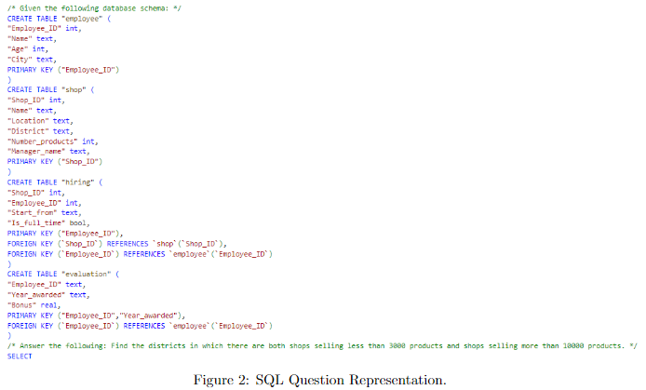

Experiments: DAIL-SQL - Setup
“SQL” question representation method for all experiments.
“Euclidian Distance of Masked Questions” example selection method for all experiments.

Slide 17
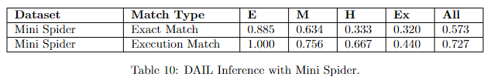
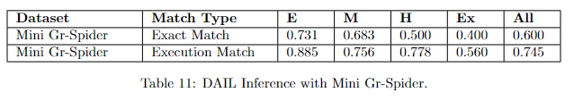
Experiments: DAIL-SQL – Results
Inferencing with Mini Gr-Spider shows marginally better results than the baseline model, contrary to the RAT-SQL experiments.
Greek language is more descriptive and it’s able to convey meanings more effectively than English, allowing the selection of more relevant examples.
This assumption needs further investigation.

Slide 18
Conclusion
Introduced the Gr-Spider dataset by translating the English Spider dataset into Greek with Large Language Models, followed by verification and post-editing for accuracy.
Evaluated the dataset using RAT-SQL and DAIL-SQL, enhanced with Greek language support.
Conducted experiments, analyzed results.
Notes:
So, what we have seen. We introduced Gr Spider, the first Greek dataset for text-to-SQL applications. To create this dataset, we translated the original dataset using Large Language Models, followed by our post-editing and verification efforts. We then used both the original and translated spider dataset to train the extended versions of RAT-SQL and DAIL-SQL models and finally, we presented and discussed the corresponding results.

Slide 19
Feature Work
Completing the entire translation for both train and test data.
Training RAT-SQL:
With the large version of selected multilingual pre-trained models.
Using other Greek stemmers.
Evaluating various DAIL-SQL configurations to find the best setup for the Greek dataset.
Notes:
Feature work will include (1) completing the entire translation for both train and test data, (2) training RAT-SQL with the large version of the selected multilingual pre-trained models while utilizing
other stemmers for Greek (like skroutz stemmer) and (3) evaluating different configurations in DAIL-SQL to determine the best ones for the Greek dataset.

Slide 20

Demo

Slide 21


