Slide 1
MultiSpider: Towards Benchmarking Multilingual Text-to-SQL Semantic Parsing
Longxu Dou¹, Yan Gao², Mingyang Pan¹, Dingzirui Wang¹, Wanxiang Che¹, Dechen Zhan¹, Jian-Guang Lou²
¹Harbin Institute of Technology
²Microsoft Research Asia
In Proceedings of the AAAI Conference on Artificial Intelligence (Vol. 37, No. 11, pp. 12745-12753)
Notes:
We are going to present the work of Multispider, an extension of the Spider dataset designed for benchmarking text-to-SQL systems. This dataset contains examples in various languages, allowing for the evaluation of text-to-SQL models with inputs in languages beyond English.

Slide 2
Contents
Introduction
MultiSpider
Translation Pipeline
Schema Augmentation: SAVe
Experiment Settings, Results & Discussion
Related Work
Conclusion
Our Approach
Notes:
So, we'll begin with the introduction where we are going to explain some of the basic concepts. Then, we’ll dive into the fundamentals of MultiSpider and we'll discuss how data is translated and how the SAVe framework is utilized to enrich data schemas. Afterward, we'll review the experiments and their corresponding results. We will also reference some existing work. Finally, we'll conclude and provide an overview of our approach.

Slide 3
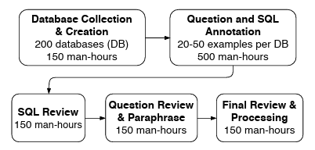
Introduction
Natural Language to SQL (NL2SQL): converting natural language queries into structured SQL queries.
Spider (NL2SQL) Dataset:
Large-scale, complex, and cross-domain semantic parsing and text-to-SQL dataset.
Developed by Yale University.
Consists of 9691 questions and 5263 SQL queries over 166 databases.
Notes:
To start with, text-to-SQL or natural language-to-SQL is a task in natural language processing where the goal is to automatically generate SQL queries from natural language text*. To assess the behavior of NL2SQL models, a benchmark dataset is needed. One such dataset is Spider, which was developed by Yale University. The dataset consist of pairs of questions and SQL queries, where the SQL queries serve as responses to the questions. Additionally, it includes the definitions of the database, such as table names and column names, which are referenced in the SQL queries. The questions are grouped into categories like ‘easy, hard, extra hard’ based on the difficulty level of generating the corresponding SQL queries.
The spider creation pipeline can be viewed on the right of the screen.
*The task involves converting the text input into a structured representation and then using this representation to generate a semantically correct SQL query that can be executed on a database.

Slide 4
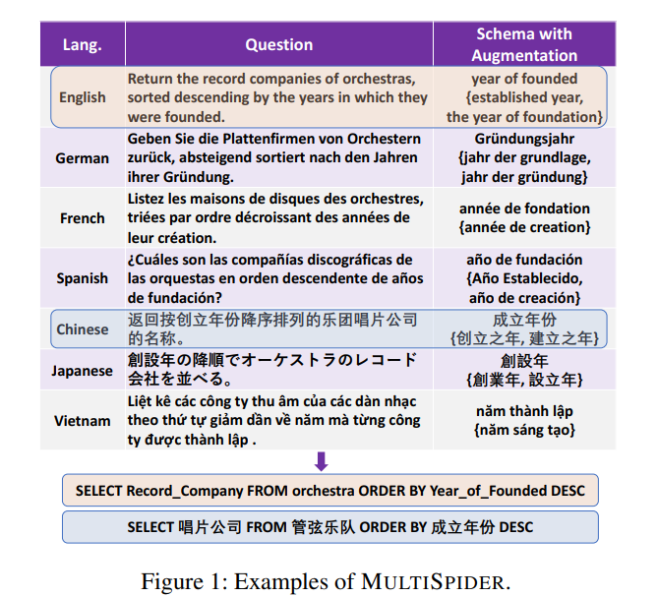
MultiSpider
Multilingual NL2SQL datasets exist* but suffer from low-quality translations and incomplete translations.
Expands the Spider dataset, covering seven main-stream languages.
Introduces a novel schema augmentation method (SAVe)
*Chinese, Vietnamese and Portuguese
Notes:
What about text-to-SQL datasets that are not in English? Generally, such datasets exist, but their translations are often described as poor and incomplete. This work aims to expand the Spider dataset to include seven mainstream languages: German, French, Spanish, Chinese, Japanese, Vietnamese. The work is also introduces a novel schema augmentation method called SAVe. This method offers variations to the schema definition to improve generalization.

Slide 5
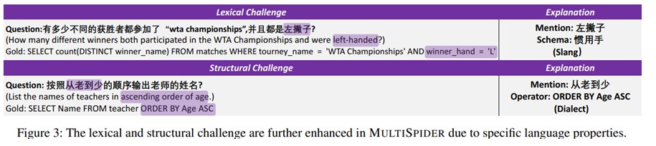
Challenges in MultiSpider
Schema Translation:
Insufficient context and domain knowledge for proper translation.
Lexical Challenges:
The context of the questions might not be enough to cope with entity polysemy.
Structural Challenges:
Complex syntax or logic cause inaccurate translations.
Left-handed
Dominant hand
From old to young
Notes:
The challenges that MultiSpider faces are grouped into three categories: schema translation, lexical and structural challenges. Schema translation poses challenges due to insufficient context and domain knowledge for accurate translation. The lexical challenges involve dealing with entity polysemy, which may not be clear from the context of the question. Structural challenges refer to the complex logic or syntactic structure that leads inaccurate translation. It is clear that the lexical and structural challenges are further enhanced due to specific language properties.

Slide 6
Up to now Work
Two well-known extensions of Spider exist:
Cspider (Chinese): Focuses on translating the schema from Chinese to English, improving existing translation quality.
Vspider (Vietnamese): Re-partitions the dataset to ensure fair comparison with other languages. It retains English values (e.g., location and name) in questions to maintain consistency with the database content.

Slide 7
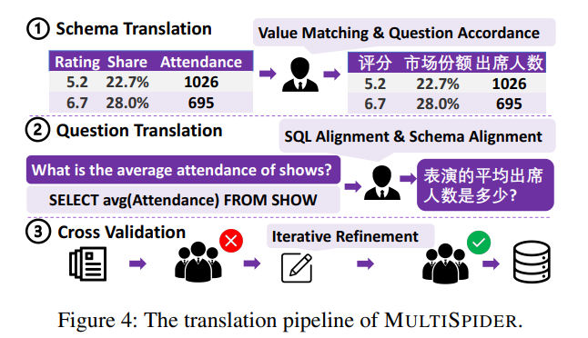
Translation Pipeline
Google Neural Machine Translation (NMT) was first used to translate the Spider.
Translation Order: Schema → Questions.
Highly qualified translators were employed to validate and post-edit the translations.
Final translation occurred with cross validation.
Notes:
To translate the original dataset, Google Neural Machine Translation was utilized. Firstly, schema translation was performed, followed by question translation to reference the translated schema. Then, highly qualified translators validated and improved the translation as needed. Finally, the best translation was chosen through voting among three annotators.

Slide 8
Schema Augmentation: SAVe
Aim: Generate more schema variations to enhance the grounding ability of the parser.
Schema Augmentation categories:
Synonyms with different lemmas.
Morphological variants (i.e. syntactic changes).
Notes:
In order to face the translation challenges, SAVe is introduced. It’s goal is to generate more schema variations to enhance the grounding ability of the parser.
Schema augmentation was chosen rather than question augmentation since it’s more efficient. The augmentation of a single table covers all the affiliated questions.
Augmentation is achieved by randomly replacing words from the translated schema with their synonyms.
Those synonyms can be classified into two categories:
Synonyms with different lemmas
(e.g. CHIEF and BRAIN are the candidates of HEAD)
Morphological Variants, which essentially means changes in the syntax
*(When we talk about Semantic parsing we are talking about mapping natural language to machine-interpretable expressions (e.g., SQL queries or logical forms))

Slide 9
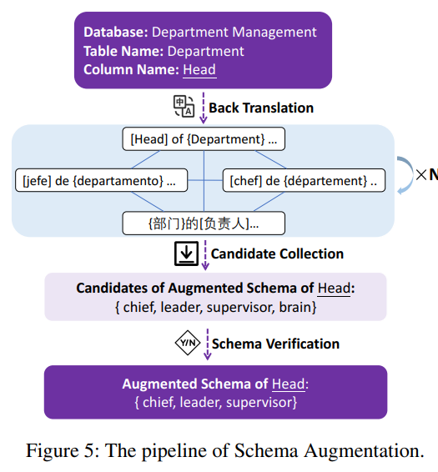
SAVe: Methodology
Back Translation: generates synonym candidates of schema, using a special template to utilize the context of the schema.
Candidate Collection: (K * N)^{[1]} synonyms are generated for each entity.
Schema Verification: Natural language inference model is employed for selecting semantic equivalency candidates.
[1]: K: Languages, N: Rounds of translation
Notes:
Okay, now lets take a look at the algorithm behind schema augmentation
The first step is Back Translation
Here, synonym candidates of the schema are generated. To ensure the synonyms are relevant, a special template is used, which utilizes the context of the schema
The second step is Candidate Collection
In total, K * N synonyms are generated for each entity, where K the Languages and N the rounds of translation.
Both variables are determined by the user.
The produced word sets can, and will most likely contain duplicates. This however is not an issue.
Why?
Because of the last step: Schema Verification
In order to select the bet fitting synonym, a natural language inference model is used. Synonyms above a defined threshold are selected.
The main challenge in schema verification is to compute the similarity of contextualized schema (head of department vs. brain of department)

Slide 10
Experiment Setup
Baseline Models:
Task-specific model: RAT-SQL
With the pre-trained multilingual encoder: mBert.
With the pre-trained multilingual encoder: XLM-Roberta-Large.
Pretrained multilingual encoder-decoder: mBart.
Evaluation Metric: exact match accuracy on all examples
Notes:
Lets take a look at the performance of the MultiSpider Dataset.
In order to evaluate the performance of the dataset, two main tools were used:
The RAT-SQL task specific model
The pretrained multilingual encoder-decoder mBart
RAT-SQL allows the use of different encoders to pre-process the dataset.
Due to the multiligual nature of the dataset mBert and XLM-Roberta-Large were used.
The evaluation metric for all the scores shown in the next slides is the exact match accuracy between the produced and the correct SQL.

Slide 11
Experiment Settings
Monolingual: The parser is trained in the human-translated dataset in the target language.
Multilingual: The parser is trained on the concatenation of train data from all languages.
Zero-Shot: The parser is trained only on the English Dataset.
Directly Predict: Predict with question and schema in the target language.
Translate-then-Predict: Translate from Target to English (NMT) → Predict.
Translate-then-Train: Translate from English to Target → Train → Predict.
Notes:
The experiments themselves can be classified into three main categories:
Monolingual: In this case the parser was trained only on the target language
Multilingual: In this case the parser was trained on all languages
Finally for the Zero-Shot examples the parser was trained on the original Spider Dataset but multiple prediction methods were applied
Directly predict: Here the schema and the query were given to the parser in the target language
Translate-then-predict: Here, the input is translated from the target into English using NMT and then fed to the parser
Translate-then-train: Here, the data were translated from the target language to English using google’s NMT. The model was trained and queried with this this data

Slide 12
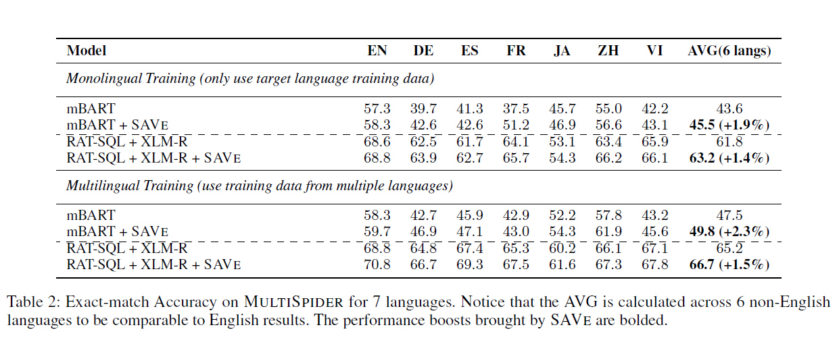
Experiment Results (1/2)
Notes:
For the experimental results, the Exact Match Accuracy metric was used. The metric measures the percentage of queries for which the generated SQL query exactly matches the ground truth SQL query. In the monolingual training (using only target language training data), we observe that Rat-SQL with XLM-R outperformed the MBART performance both with and without the SAVe framework, achieving an average exact accuracy of 63.2% across all languages with the utilization of SAVe. Similarly, in the multilingual training (using training data from multiple languages), the corresponding result was 66.7%. It is noteworthy here that train the model with the concatenation of the data in all languages enhance its performance. Also, the SAVe framework boosted performance across all examined models. Additionally, it's important to mention that the best performance was achieved in the English language in all cases, indicating the potential growth of pretrained seq2seq models in text-to-SQL.

Slide 13
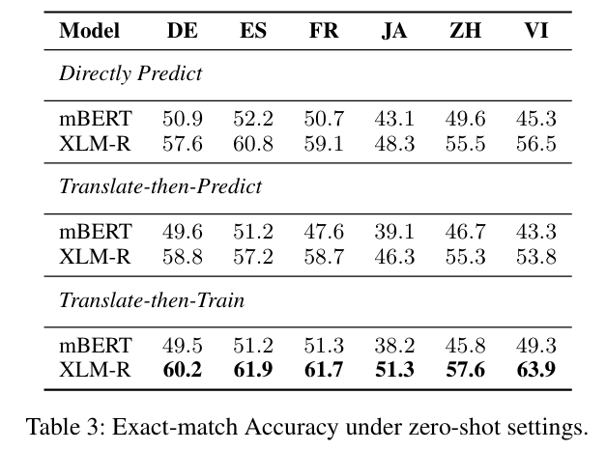
Experiment Results (2/2)
Notes:
Regarding the zero-shot setting, we can observe that performance largely depends on the choice of pre-trained encoder, where a better model enables better zero-shot transfer. It is also evident that direct prediction yields better performance than translate-then-predict, since machine translation might introduce errors, especially in schema translation. Finally, it can be seen that with a strong pretrained language model and machine translation model, the translate-then-train setting receives promising results.

Slide 14
Performance Drop in Non-English Languages
Lexical Mistakes:
Caused by the schema-linking problem (i.e. the syntactic difference between question tokens and schema).
Structural Mistakes:
The languages in MultiSpider contain more dialectal variations than English, resulting to incorrect predictions of SQL Operators.
Notes:
We mentioned earlier that there is a performance drop in non-English languages. Why is that? There are two kinds of mistakes that cause this reduction. Firstly, we have lexical mistakes, which refer to the schema not being grounded in SQL. This is usually caused by the syntactic differences between the schema and tokens, also known as the schema-linking problem. Then, we have structural mistakes, which refer to the incorrect prediction of SQL operators which caused by dialectal variations in question annotation.

Slide 15
The effect of SAVe
Performance Gain by 1.8% in all Languages:
Addressing the schema linking problem by synthesizing more schema-token pairs.
Improving the robustness of the text-to-SQL model through varies the schema input.
Notes:
Regarding the effect of SAVe, the framework increased performance by an average of around 1.8% in exact accuracy across all languages. This improvement is attributed to SAVe addressing the schema linking problem by synthesizing additional schema-token pairs and by enhancing the robustness of the text-to-SQL model by varying the schema input.

Slide 16
Related Work
Multilingual Text-to-SQL Datasets:
Vietnamese, Chinese, Portuguese – Spider.
Multilingual Text-to-SQL Systems:
NL2SQL Models:
RAT-SQL: adopts relation-aware transformer. Utilizes multilingual encoders (mBert, PhoBert, XLM-R).
Encoder-Decoders: Attempt to formulate the SQL Translation task as a seq2seq translation problem.
mBart, mT5.
Notes:
Before closing, let’s look at the general field of Text-To-SQL.
Regarding Datasets, some non-English datasets already exist. For example, the Vietnamese the Chinese Spider
Regarding Systems the two main categories are
Task specific NL2SQL models such as the RAT-SQL shown before. We would like to point out that this model uses relation aware transformers, for example mBert
Encoder-Decoder models which attempt to formulate the SQL Translation task as a seq2seq translation problem. Some examples are Bart, T5 and their multilingual counterparts mBart and mT5

Slide 17
Conclusion
MULTISPIDER Dataset:
Largest dataset covering seven mainstream languages for multilingual text-to-SQL.
Quality ensured through qualified translators and multi-round checking.
Natural, accurate and challenging for text-to-SQL tasks.
Schema Augmentation SAVe:
Expands the training data with schema variations.
Boosts model performance.
Challenges in Multilingual Text-to-SQL:
Exploration of lexical and structural challenges.
Notes:
To conclude this presentation, we would like to quickly re-iterate the main points.
MultiSpider is the largest high-quality multilingual dataset, covering 7 languages and has been proven to be challenging for text-to-SQL-tasks
The main challenges when trying to translate the Spider Dataset were lexical but also structural
To account for these problems the SAVe schema augmentation was introduced. It tripled the training data, using the same SQL Questions and different schema variations.
Models trained with the augmented dataset showed a 1.8% increase in accuracy.

Slide 18
Our Approach
GR-Spider
Greek version of the Spider Dataset, following the same translation technique (schema then questions).
Utilize Meltemi LLM in place of Google-NMT.
Benchmarking Techniques
Multilingual
Monolingual
Zero-Shot
Benchmarking Tools
mRat-SQL
Enoder options: mBert / mT5
Encoder – Decoder models
mT5 / mBart
DAIL-SQL (?)
Heavily relies on out of the box LLMs (GPT3.5 – Turbo, GPT4)
Notes:
Now for the hands-on part, for our approach we will attempt to translate the Spider Dataset Greek, introducing the GR-Spider.
For the translation process we will use:
the recently released Meltemi LLM
The open NMT translation model
In order to benchmark the dataset we will use the same techniques as Multispider. Namely:
Monolingual
Multilingual (English and Greek)
Zero-Shot
For the benchmarking tools, should our computational resources allow it we would like to use
RAT-SQL model with encoders
mBert, mT5
mT5 as an encoder – decoder model, in order to test the seq2seq SQL Translation
DAIL-SQL model which heavily relies on out of the box GPTs

Slide 19
Suggested PLAN
 | April 15 | April 22 | April 29 | May 6 | May 20 | June 4 | June 11
Machine Dataset Translation
Translation Validation
Feasibility Study of proposed models
NL2SQL Model Dev Test
Zero-Shot Benchmarking
Monolingual Benchmarking
Multilingual Benchmarking
Final Report
Project Plan
PH 1
PH 2
PH 3
PH 4
PH 5
PH 6
PH 7
PH 8
Notes:
Here is our timeline.
As you can see many tasks will have to be done in parallel.
We would like to point out the Feasibility Study.
The goal is to see what can we run with the computational resources we have available.
This will determine the final models which will be used for benchmarking.
In NL2SQL Model Dev Test phase we will run all the proposed benchmarks with the dev set, in order to make adjustments.

Slide 20


